Slide 1





Towards Global and National Indicators for Monitoring Climate Resilient WASH WHO/UNICEF JMP/GLAAS Joint Review of Indicators October 2025

Slide 2
Programme
When | What | Who
08:30-08:35 | Introduction | Rick
08:35-08:40 | Evidence reviews, developing long lists of candidate indicators | Barbara
08:40-09:00 | A draft short list for global monitoring | Rick and Barbara
09:00-09:15 | Open discussion | Everyone
09:15-09:45 | Groupwork | Everyone
09:45-10:00 | Plenary feedback | Group rapporteurs
10:00 | Close
Notes:
So the topic of climate resilience in WASH services is relevant to both the GLAAS and JMP teams, if you think about inputs, processes, outputs and outcomes.
Accordingly, we are working together to jointly conduct a review of climate resilience and WASH, with a special focus on monitoring.
The review aims to identify frameworks, indicators, data collection opportunities, and data describing links between climate resilience and WASH
To do this, we advertised for partners and selected a consortium of research partners in early 2024. The team includes the University of Leeds, Bristol, Oxford, and the University of Technology Sydney.
We also have a Technical Working Group with a lot of geographic diversity and expertise in different areas related to monitoring, climate resilience, and WASH, who help us to provide inputs and review outputs from the review. Includes representation from CCH.
The review focuses on areas where GLAAS and JMP could focus future monitoring efforts, but the review draws upon experiences from other types of monitoring, such as project or local-scale monitoring – where some concepts might have relevance to the global teams, but the level of detail is too high to be feasible for global monitoring.
We are committed to making this a very transparent process, with multiple opportunities to engage with stakeholders. This webinar is the third we’ve held so far, and we’re using it to launch a public consultation on the emerging set of candidate indicators.
And we will continue to share news about the initiative, through global events, conferences, trainings and webinars.
This is very much focused on WASH, but there’s a much wider process linked to the Global Goal on Adaptation, which set out a number of targets for climate resilience, including target 9a on water and sanitation.

Slide 3
Introduction
Notes:
Rick

Slide 4

Review process: monitoring climate resilience and WASH
GLAAS and JMP are conducting a review of monitoring climate resilience and WASH:
Identifying frameworks, indicators, data collection opportunities, and data describing links between climate resilience and WASH.
A consortium of research partners (Leeds, Bristol, Oxford, UTS) were selected to support the work.
A Technical Working Group (TWG) provides inputs and reviews outputs.
Outputs will identify areas where GLAAS and JMP could focus future monitoring efforts.
Engaging with multiple stakeholders
Feeding into work on Global Goal on Adaptation
Identification of indicators for GGA Water target 9a
Notes:
So the topic of climate resilience in WASH services is relevant to both the GLAAS and JMP teams, if you think about inputs, processes, outputs and outcomes.
Accordingly, we are working together to jointly conduct a review of climate resilience and WASH, with a special focus on monitoring.
The review aims to identify frameworks, indicators, data collection opportunities, and data describing links between climate resilience and WASH
To do this, we advertised for partners and selected a consortium of research partners in early 2024. The team includes the University of Leeds, Bristol, Oxford, and the University of Technology Sydney.
We also have a Technical Working Group with a lot of geographic diversity and expertise in different areas related to monitoring, climate resilience, and WASH, who help us to provide inputs and review outputs from the review. Includes representation from CCH.
The review focuses on areas where GLAAS and JMP could focus future monitoring efforts, but the review draws upon experiences from other types of monitoring, such as project or local-scale monitoring – where some concepts might have relevance to the global teams, but the level of detail is too high to be feasible for global monitoring.
We are committed to making this a very transparent process, with multiple opportunities to engage with stakeholders. This webinar is the third we’ve held so far, and we’re using it to launch a public consultation on the emerging set of candidate indicators.
And we will continue to share news about the initiative, through global events, conferences, trainings and webinars.
This is very much focused on WASH, but there’s a much wider process linked to the Global Goal on Adaptation, which set out a number of targets for climate resilience, including target 9a on water and sanitation.

Slide 5
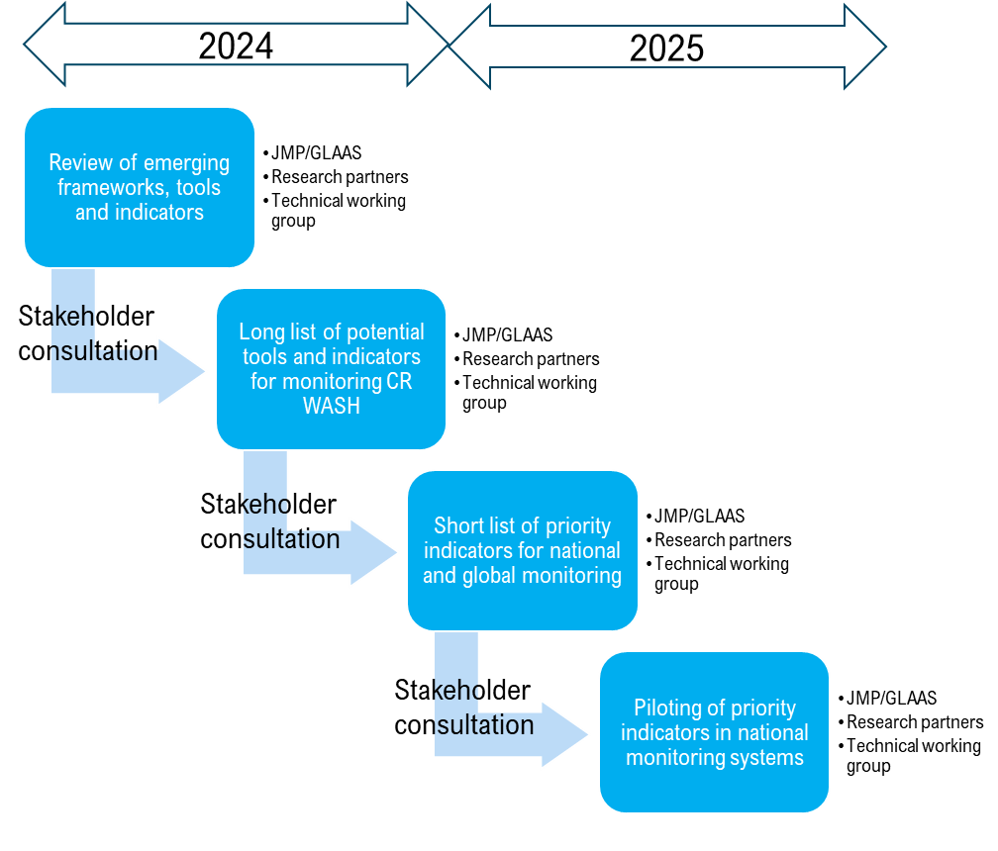
Review timeline
Consortium engaged (March 2024)
Kick-off meeting with technical working group members (22 and 23 July 2024)
Public webinar launch (29 and 30 July 2024)
1st working group meeting on the scope, evidence review and discussion paper prepared by the research partners (December 2024)
Public webinar and consultation on findings of reviews (February 2025)
2nd working group meeting to discuss the long list of indicators (2.0) prepared by the research partners (March/April 2025)
Public consultation on the long list of indicators (2.1) (April 2025)
Revision of long list based on feedback to produce refined long list (3.1, 3.2) (May-June)
Prioritization and shortlisting (June – September 2025)
3rd working group meeting to discuss the short list of proposed indicators (17-19 September 2025)
Public consultation on the short list of indicators
4th working group meeting to review the indicator pilots (May 2026)
Notes:
So, coming back to the JMP/GLAAS process, here is a summary of the steps we’ve followed so far, and what is planned for the next months.
We engaged the academic consortium in March last year, and shortly after constituted a Technical Working Group of about 20 people from around the world, with different types of expertise and experiences.
We had a kickoff meeting with the technical working group in July, followed by a first set of public webinars launching the project.
Then from July through the end of the year the research partners conducted a series of reviews, both of peer-reviewed literature and grey literature, which were also informed by public calls. These findings were reviewed by our Technical Working Group in December and shared in a public webinar in February this year.
Several weeks ago, we had a second Technical Working Group meeting to review the long list of indicators which resulted from the reviews, and today we are launching a public consultation on that long list of indicators.
We will spend the next several months reviewing the long list and working to develop a short list of proposed indicators that could be used by the JMP and GLAAS teams for global monitoring. And today we are asking you for your feedback on that long list to help us in this process.
We should have a third working group meeting to finalize the short list of proposed indicators by September, which will be followed by a third public consultation.
And then, we expect to pilot the shortlisted indicators with interested countries, and about a year from now, hopefully, we will have some practical experiences in hand that we can use to further refine the shortlisted indicators, if needed.
As you can see it’s an iterative process, where the JMP and GLAAS teams work with the research partners to develop something, which is reviewed by the Technical Working Group, and put out for public consultation, before moving on to the next step. And we’re about halfway through the process of developing and piloting these indicators.

Slide 6



Public consultation
Objectives
Share list of proposed global indicators for development and potential eventual monitoring by JMP and GLAAS teams
Feedback from diverse stakeholders on scope, spread, potential (not: wordsmithing)
Pave the way for piloting in 2026
🕙 Session 1
Wednesday, 5 November
09:00–10:00 CST
🕙 Session 2
Wednesday, 5 November
16:00–17:00 CST
Project website

Slide 7
Reviews and long list
Notes:
Barbara

Slide 8
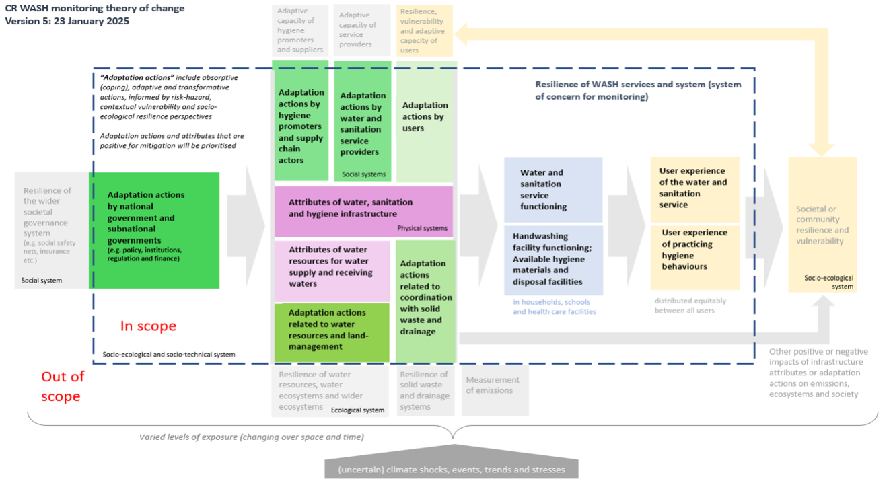

Slide 10
Where did the list of candidate indicators come from?
We carried out 3 systematic reviews looking for adaptation actions or attributes that have been linked to climate-resilient WASH outcomes in the academic literature:
Sanitation
Hygiene
WASH in general
We carried out 2 further reviews looking for adaptation actions or attributes that have been linked to climate resilience:
An umbrella (review of reviews) for water supply
A scoping review on how resilience is conceptualised in WASH and adjacent sectors
We identified key objectives which could be achieved in each component of the framework which are likely to lead to or be an outcome of climate resilient WASH
We then mapped more than 600 candidate indicators that had been identified from our research to each objective (list 1.0)

Slide 11
Towards a short(er) list
Notes:
Rick

Slide 12
Towards a short(er) list
February 2025 (1.0)
~600 indicators resulting from formal reviews
March 2025 (2.0)
Consolidating redundant/similar indicators
Establishing ‘indicator objectives’, gap filling
Available on website, public consultation
23 April to 9 May 2025
May 2025 (3.0)
Incorporating feedback from the public consultation, further consolidation/refinement
Available on website
June 2025 (4.0)
Prioritizing within indicator objectives

Slide 13
Towards a short(er) list
September 2025 (5.0)
Most derived from 4.0 list, some synthesized
All worthy of further development
Some too context-specific for global monitoring
October 2025 (5.1)
Feedback from 3rd Technical Working Group meeting
Further review and refinement of 5.0 list
Balancing
Across framework components, parallel structures
Slow and rapid onset events
Next steps
JMP and GLAAS will work on indicator development
Engage with pilot countries
Develop metadata, specific metrics used to collect data for the indicators
Notes:
Explain we will show the 42, but the tables show the 100

Slide 14
Policy: 1 and 2 (of 5)
Objective | All WASH
WASH policy and planning incorporates current and future climate risk | 101: WASH sector policy and plans which integrate climate adaptation measures for households and institutions *: (a) are in place; (b) align with national adaptation plans; and (c) are regularly revised using updated climate projections
Management is appropriate to ensure and advance climate resilience | 102: WASH Sector policy mandates the use of risk-based management plans that take into account current and future climate
* And which (i) identify current and future climate risks to WASH, (ii) identify at risk populations, (iii) include costed climate adaptation measures and (iv) mandate 'build-back-better' principles for post climate-event recovery
Notes:
Rick
I’m going to start with the enabling environment indicators, related to policies, institutions, regulation and finance, and then pass over to Barbara.
Indicator objectives on the left, candidate indicators on the right.
None of these candidate indicators are ready to go – they would all need metadata, clear definitions, etc., and that would be the aim of the next phase, in country pilots. But we need reasonable candidates to take forward for the country piloting.
101 is a ‘stacked indicator’ – looks like three separate indicators, but we expect to be able to condense these into a single index, perhaps with three levels.
102 is a more conventional dichotomous indicator, about the use of risk-based manage plans, like WSPs or SSPs, but that take into account current and future climate.

Slide 15
Policy: 3 and 4 (of 5)
Objective | All WASH
National climate resilience planning incorporates climate resilient WASH | 103: National adaptation plans are in place and include: (a) targeted WASH objectives for households and institutions; (b) and a strategy for WASH adaptation for households and institutions; (c) or a costed strategy for WASH adaptation for households and institutions
 | 106: National mitigation plans are in place and include: (a) a national protocol for measuring and reporting emissions from WASH; (b) and an estimate of the contribution of WASH to NDCs; (c) and a strategy for mitigating emissions from WASH; (d) or a costed strategy for mitigating emissions from WASH
Notes:
Climate resilience planning: two proposed indicators, around national adaptation plans and national mitigation plans. Both are stacked indicators, that reference different benchmarks that we think could be consolidated into a single indicator.
Note 106 is the only nod to emissions – the framework is much more about adaptation than mitigation. Measuring carbon emissions is really important, but is beyond the scope of our review. But as a policy measure, having plans for quantifying and mitigating emissions, we consider within scope, especially because some of the adaptation actions could have their own impacts on emissions.

Slide 16
Policy: 5 (of 5)
Objective | All WASH
Climate resilient WASH strategy is equitable | 105: Sector strategies include measures to ensure climate resilient WASH investments are focused on populations vulnerable to and disproportionately affected by climate change
Not shortlisted (an example):
Objective | Water supply
Access to a minimum service level is maintained | 104: Regulation mandates that sufficient quantities of domestic water supply be provided as a priority before allocations to other water uses are made
Notes:
Last policy indicator is about equity: recognizing that climate hazards won’t impact everyone equally, this one calls for having strategies to ensure that CRWASH investments are focused on the most vulnerable populations.
Remember, we have a list of about 100 indicators that we think have promise, but we don’t have the resources to develop them all, so we’ve shortlisted a set of 42. I’m showing here one example of an indicator that we didn’t shortlist, about prioritizing domestic water over other water uses in resource allocations. It does have promise, but we are trying to keep to a manageable number and this one isn’t currently on our shortlist. Though if we hear from a lot of people that it really should be, we will take note. And in the groupwork in a little while, you will see the full set of 100 recommended indicators.

Slide 17
Institutions: 1 (of 3)
Objective | All WASH
Data are available for CR WASH planning | 201: Climate data and seasonal forecasts for WASH service delivery are: (a) downscaled to a scale relevant for WASH service delivery; (b) accessible to WASH sector stakeholders; (c) include content directly relevant to the delivery of WASH services; (d) reviewed and updated regularly; and (e) used to inform updates to WASH policies and plans
Notes:
We’ve recommended three indicators around institutions, and this first one is about use of climate data and seasonal forecasts for WASH service delivery. Are these data downscaled and accessible for use by WASH sector stakeholders? Are the data relevant to WASH service delivery? And are they reviewed and updated regularly, and used to inform updates to WASH policies and plans?
Again, that looks like five separate indicators, but we believe we will be able to consolidate them into an index – it will be another stacked, or composite, indicator.

Slide 18
Institutions: 2 and 3 (of 3)
Objective | All WASH
Early warning systems in place that support actions to reduce impact of climate events | 202: Multi-hazard early warning systems are: (a) accessible to WASH sector stakeholders; (b) and include information directly relevant to the delivery of WASH services; (c) and are reviewed and updated regularly; (d) and are used to inform updates to WASH policies and plans
National WASH monitoring systems collect information on impacts of climate on WASH services | 203: WASH monitoring systems collect data on the impact of climate on WASH services in households/ schools/ health care facilities disaggregated by service levels, geography, and population subgroups
Notes:
The other two indicators related to institutions have to do with early warning systems, and national WASH monitoring systems.
202
203. Doesn’t specify what types of impacts, just that the monitoring systems do track climate impacts. And this one calls for monitoring in households, schools, and health care facilities, ideally disaggregated by service levels, geography, and population subgroups.

Slide 19
Regulation: (3)
Objective | All WASH
Design and construction standards and guidance exist for CR WASH | 301: Standards and regulations that take into account current and future climate are available to support the design and construction of resilient infrastructure
Operation and maintenance standards and guidance exist for CR WASH | 302: Standards and regulations that take into account current and future climate are available to support the operation and maintenance of resilient infrastructure
 | 303: Standards and guidance exist for restoration of services during and following a climate event
Notes:
For regulation, we have three related proposed indicators – they are all about having standards and regulations available, that take into account current and future climate.
301 is about standards and regulations for design and construction of resilient architecture, while 302 is about operation and maintenance, and 303 is about restoration of services following a climate event. But they are clearly very related to each other, and you will see that they also relate to some of the downstream indicators.

Slide 20
Finance: (2)
Objective | All WASH
Sufficient budget allocation for WASH climate adaptation | 401: Ratio of total annual budget available (all sources) to total annual costs identified for WASH climate adaption
Funds for WASH climate adaptation are utilized | 403: Ratio of total annual expenditure (all sources) to total annual costs identified for WASH climate adaption
Notes:
Finally, we have a pair of indicators related to finance: the first is about budget allocation – how does the budget allocation compare to the total annual costs identified for WASH climate adaptation? And we know that budgeted funds are not always fully utilized, so the second indicator is about the ratio of actual expenditure to total annual costs identified.

Slide 21
Adaptation actions by hygiene promoters & supply chain actors (1)
Objective | Water supply | Sanitation | Hygiene
Support to households provided to undertake actions for climate resilience/ recovery | - | - | 503: Proportion of population covered by well-defined, event-specific preparedness plans which include: education/ messaging on hygiene behaviour; and stockpiling, storing, and distribution of hygiene products
Notes:
Barbara
The next area in the conceptual framework is about the kinds of adaptation actions that service providers can take. Let’s start with hygiene promoters, and supply chain actors.

Slide 22
Adaptation actions by service providers: 1 and 2 (of 4)
Objective | Water supply | Sanitation | Hygiene
Management is appropriate to ensure and advance climate resilience | 602: Proportion of population/ schools/ healthcare facilities served by water service providers that implement risk management plans which consider current and future climate (for example climate-resilient water safety plans) | 702: Proportion of population/ schools/ healthcare facilities served by sanitation service providers that implement risk management plans which consider climate variability and climate projections (for example flood and drought preparedness plans) | -
Notes:
Here we can see a paired indicator – with similar requirements for water supply and sanitation – and this is a point that came up in the climate resilience and hygiene session on Tuesday – the need for anticipatory risk-based planning. This also links to policy indicator 102, about mandating the use of risk management plans for water and sanitation service provision.

Slide 23
Adaptation actions by service providers 3 and 4 (of 4)
Objective | Water supply | Sanitation | Hygiene
Operation and maintenance standards for climate resilient WASH are implemented | 604: Proportion of population/ schools/ healthcare facilities served by water supply services that conform to national regulations and standards for operations and maintenance that take into account current and future climate | 703: Proportion of population / schools/ healthcare facilities served by sanitation services that conform to national regulations and standards for operations and maintenance that take into account current and future climate | -
Notes:
Links to 302

Slide 24
Coordination with Water Resources Management (2)
Objective | Water supply and Sanitation | Hygiene
Coherence and cooperation between agencies to deliver climate resilient WASH | 1101: Investment and operational plans for WRM are referenced in investment and operational plans for (a) Water supply (b) Sanitation and wastewater | -
 | 1102: Proportion of population in catchments where water resource management plans address climate risks to (a) Water supply (b) Sanitation and wastewater | -
Notes:
Coordination with water resources is clearly important – but the whole ‘scope’ of managing water resources in a sustainable way is out of scope

Slide 25
Coordination with Drainage and Solid Waste Mgt (1)
Objective | Water supply and Sanitation | Hygiene
Coherence and cooperation between agencies to deliver climate resilient WASH | 1202: Investment and operational plans for (a) Water supply (b) Sanitation and wastewater reference drainage investment and operational plans. | -
Notes:
Similarly we were very aware of the need to link in to solid waste management and drainage – and here we see essentially a policy and planning indicator that might be a good predictor of the existence of that type of coordination.

Slide 26
Attributes of water resources for WS and receiving waters (1)
Objective | Water supply and Sanitation | Hygiene
Water quality is maintained | 1302: Number of incidents of water quality non-compliance downstream of a wastewater treatment plant before, during, and following a climate event | -
Notes:
Water quality is clearly important – this is the indicator that rose the top of the pile but we can note that there is some anxiety about the fact that this focuses on surface water and there is probably scope for something that addresses groundwater.

Slide 27
Attributes of infrastructure: 1 and 2 (of 4)
Objective | Water supply | Sanitation | Hygiene
Construction and design standards for climate resilient WASH are implemented | 1401: Proportion of population/ schools/ healthcare facilities served by water supplies that conform to national regulations and standards for design and construction that take into account current and future climate* | 1501: Proportion of population/ schools/ healthcare facilities served by sanitation services that conform to national regulations and standards for design and construction that take into account current and future climate** | See next
* water supply source, water treatment, water storage and distribution
** capture and containment, conveyance, treatment
Notes:
We shied away from calling for specific infrastructure adaptations because there is limited evidence that any specific adaptation drives resilience – but clearly in any given context IF there are climate-relevant norms and standards we can ask questions about whether these are implemented.
Again, reference to national standards and regulation for design and construction, indicator 301.

Slide 28
Attributes of infrastructure: 3 and 4 (of 4)
Objective | Water supply | Sanitation | Hygiene
Construction and design standards for climate resilient WASH are implemented (cont.) | See previous | See previous | 1601: Proportion of schools where hygiene services conform to national regulations and standards for design and construction that take into account current and future climate*
 |  |  | 1602: Proportion of healthcare facilities where hygiene services conform to national regulations and standards for design and construction that take into account current and future climate*
* Hand hygiene and menstrual hygiene
Notes:
The same question can be asked about hygiene facilities – but these indicators focus on schools and healthcare facilities not household services.

Slide 29
Service functioning: 1 and 2 (of 8)
Objective | Water supply | Sanitation | Hygiene
Access to safely managed services is maintained | 1704: Proportion of population / schools/ healthcare facilities within nationally determined climate hazard zones using basic/safely managed drinking water services | 1805: Proportion of population/ schools/ healthcare facilities within nationally determined climate hazard zones using basic/safely managed sanitation services | -
Notes:
Rick
8 proposed indicators related to service functioning, all have parallel structures.
First set: takes the existing global SDG indicators, of safely managed drinking water and sanitation services in households, or basic services in schools and health care facilities, and calls for layering those onto nationally determined climate hazard zones. So, for instance, what proportion of households living in flood-prone areas, or drought-prone areas, have safely managed drinking water services? This does presume that countries have determined climate hazard zones, but that again links back to some of the policy indicators, like #105 on identifying priority vulnerable populations.
There are some real technical challenges in doing this – right now most countries can’t map safely managed services at a subnational level, but we think it is a reasonable ambition to set.

Slide 30
Service functioning: 3 (of 8)
Objective | Water supply | Sanitation | Hygiene
Access to basic hygiene facilities is maintained | - | - | 1905: - Proportion of population/ schools/ healthcare facilities with access to soap and water at a handwashing facility within nationally determined climate hazard zones
Notes:
Here’s the corresponding hygiene indicator

Slide 31
Service functioning: 4 and 5 (of 8)
Objective | Water supply | Sanitation | Hygiene
Access to a minimum service is maintained | 1701: Proportion of population/ schools/ healthcare facilities whose domestic water supply infrastructure is damaged due to a climate event. | 1801: Proportion of population/ schools/ healthcare facilities whose domestic sanitation infrastructure is damaged due to a climate event | -
Notes:
Next, we have a pair of proposed indicators around damage. These are related to indicators drawn from the Sendai Framework for Disaster Risk Reduction. By the way, that global framework has 38 indicators, so 42 is very much in the same league.
One of the Sendai indicators is about damage to critical infrastructure, including schools and health care facilities, attributed to disasters. These are made a bit more specific, to refer to domestic water supply supply and sanitation infrastructure. Will be very relevant to the whole discourse on loss and damage

Slide 32
Service functioning: 6, 7 and 8 (of 8)
Objective | Water supply | Sanitation | Hygiene
Access to a minimum service is maintained (cont.) | 1703: Proportion of population/ schools/ healthcare facilities reporting at least 1 period of disruption to water supply at home in the last Y due to a climate event | 1803: Proportion of population / schools/ healthcare facilities reporting at least 1 period of disruption to sanitation at home in the last Y due to a climate event | 1902: Proportion of population/schools/healthcare facilities reporting at least 1 period of disruption to access to a soap and water for hygiene practices at home in the last Y due to a climate event
Notes:
Finally, a set of three indicators around disruptions to services. These are related to but distinct from the damage indicators, and again echo Sendai indicators around disruptions to basic services attributed to disasters.
We propose a hygiene indicator around disruptions to access to soap and water, but we didn’t propose one on the last slide about damage to infrastructure. Not that hygiene infrastructure can’t be damaged due to climate events, but hygiene infrastructure is completely at the household, or school or fealth care facility, while water and sanitation infrastructure includes larger engineered systems like treatment plants and distribution lines that are more salient for damage.

Slide 33
User experiences: 1 and 2 (of 8)
Objective | Water supply | Sanitation | Hygiene
Access to a minimum service level is maintained | 2005: Proportion of population/ schools/ healthcare facilities who report easy access to alternative water supply facilities that meet minimum national/local standards of service when needed during a period of disruption due to a climate event | 2104: Proportion of population/ schools/ healthcare facilities who report easy access to alternative sanitation facilities that meet minimum national/local standards of service when needed during a period of disruption due to a climate event. | -
Notes:
Barbara
User experiences really matter and are a good composite indicator of both the extent to which services are maintained AND the confidence that households have in coping during a crisis. This first pair are focused on the availability of alternative services when primary facilities are rendered unusable during a climate event.

Slide 34
User experiences: 3 and 4 (of 8)
Objective | Water supply | Sanitation | Hygiene
Access to hygiene materials is maintained | - | - | 2203: Proportion of women, girls, and menstruators that report having enough MHM materials to change as often as they wanted before, during, and following climate events
 |  |  | 2205: Proportion of population that report having enough soap and water to practice hand hygiene behaviours as often as they wanted before, during, and following climate events
Notes:
For hygiene we have two indicators that are about the ease with which people can access critical hygiene materials.

Slide 35
User experiences: 5 and 6 (of 8)
Objective | Water supply | Sanitation | Hygiene
Users are protected from distress related to service disruptions | 2001: Proportion of population reporting that they worried about not having enough water for all household needs due to a climate event | 2101: Proportion of population who felt safe at the sanitation locations they used most before, during, and following a climate event in the [last Y] | -
Notes:
This pair of indicators are about the experience of distress – and they are built out from the HWISE/ IWISE work.

Slide 36
User experiences: 7 and 8 (of 8)
Objective | Water supply | Sanitation | Hygiene
User complaints/ requests for assistance are dealt with in a timely manner | 2004: Total complaints per 1000 customers before, during, and following a climate event (a) received by drinking water service providers or regulators (b) received and analysed by drinking water service providers or regulators (c) received, analysed and acted upon by drinking water service providers or regulators | 2103: Total complaints per 1000 customers before, during, and following a climate event (a) received by sanitation service providers or regulators (b) received and analysed by sanitation service providers or regulators (c) received, analysed and acted upon by sanitation service providers or regulators | -
Notes:
Thinking about data sources
This is the type of information that would come from regulators/ service providers
This pair are promising for relatively easy roll out.

Slide 37
Shorter list 5.1 (42 indicators)
503
602
702
1701
1801
2005
2104
1703
1803
2001
2101
1704
1805
2004
2103
604
703
101
102
103
105
106
201
202
1401
1501
1601
1602
203
301
302
303
401
403
1202
1905
1902
2203
2205
1101
1102
1302

Slide 38
Q&A
15 min

Slide 39
Groupwork
30 min

Slide 40
Breakout groups
What information would be appropriate for the upcoming global consultation?
List of 600, 300, 100, 42?
Could/should the set of 42 be reduced? What should be cut? What should be prioritized?
Apart from potential for combination (not a true reduction)
Is anything obviously missing?
How is the balance?
Across the conceptual framework
Rapid vs slow onset events
SWA definition: Anticipate, Respond to, Cope with, Recover, Adapt, Transform
Opportunities for piloting?

Slide 41
Plenary feedback
15 min

Slide 42
Public consultation
Objectives
Share list of proposed global indicators for development and eventual monitoring (JMP/GLAAS)
Feedback from diverse stakeholders on scope, spread, potential (not: wordsmithing)
Pave the way for piloting in 2026
🕙 Session 1
Wednesday, 5 November
09:00–10:00 CST
🕙 Session 2
Wednesday, 5 November
16:00–17:00 CST

Slide 43


Thank you!
UNICEF and WHO gratefully acknowledge the financial support provided by the Directorate-General for International Cooperation (Kingdom of the Netherlands) and the Foreign, Commonwealth & Development Office (United Kingdom).
Project website
Sign up here to receive updates!
washmonitoring@who.int

Slide 44
Towards a short list of indicators
Refined long list of indicators (version 3.2): Academic consortium has updated the long list based on feedback from the technical working group and the public consultation
Reduced from 422 indicators to 317 indicators by cleaning up duplicates, merging indicators, etc.
Indicators organized into 22 framework components
Based on inputs from the Technical Working Group, priority indicators are being selected for a draft short list
Online platform (XLeap) has been set up to rate individual indicators using five criteria (Relevance, Measurability, Sensitivity, Comparability, Usefulness)
TWG, JMP, GLAAS, and academic consortium members have rated a subset of indicators from the long list (3.2) using the online platform
Based on rating data and comments from the online platform, GLAAS/JMP team and consortium members are selecting approx. 5 priority indicators per framework component
Draft short list will consolidate priority indicators across the 22 framework components

Slide 45
Next steps and opportunities for engagement
Draft shortlist to be discussed at the Technical Working Group meeting in September
Some challenges encountered in the short-listing process include:
What to do about indicators monitoring good WASH practices but not necessarily climate-specific?
E.g. NL095 [Percentage by length of] water supply network (storage and distribution) new or refurbished within the last X (25-30?) years
Appropriate level of specificity (global monitoring vs. sub-national or project level monitoring)
Refining/adapting existing indicators from the longlist
Balancing indicators with existing data vs. theoretical indicators
Revised short list following TWG meeting will be published online for public consultation (October 2025)
Piloting of the short list of indicators in countries starting early 2026
Notes:
maybe add a challenge about established vs theoretical indicators (which could tie back to a GLAAS example), and the related point about a preference for building on existing data collection instruments as opposed to building whole new ones.

