Slide 1

Five years to go: latest JMP trends and inequalities data
When | What | Who
14:00 | Welcome | Bruce Gordon, WHO
14:10 | Opening remarks | Eva Schreuder (Netherlands)
14:15 | Launch of the JMP report | Rick Johnston (WHO) Tom Slaymaker (UNICEF) Ayça Dönmez (UNICEF, online)
14:45 | Panel discussion | Jess MacArthur (Eawag) Julia Schalk (WaterAid Sweden) Leonard Tedd (UK FCDO, online) Muyatwa Sitali (SWA)
15:15 | Open discussion | All (in person and online)
15:25 | Closing comments | Cecilia Scharp (UNICEF)

Slide 2
Welcome and opening comments
Bruce Gordon, Head of Water, Sanitation, Hygiene and Health (WHO)
Eva Schreuder, Head of Water Team, Ministry of Foreign Affairs, Kingdom of the Netherlands

Slide 3
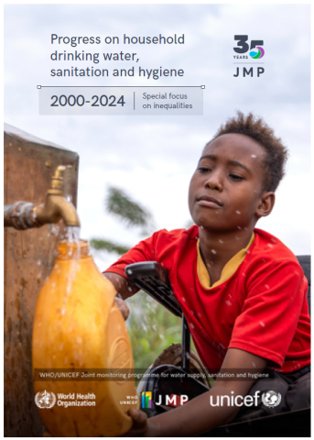
JMP report launch
Rick Johnston (WHO)
Tom Slaymaker (UNICEF)
Ayça Dönmez (UNICEF, online)

Slide 4
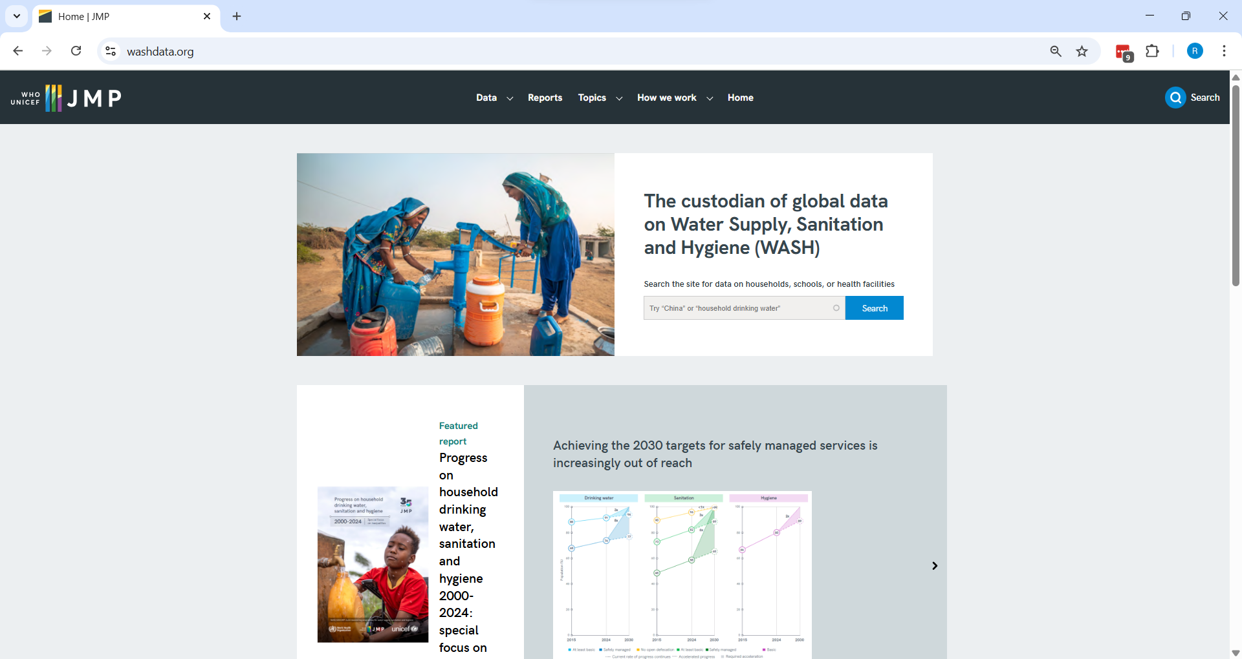
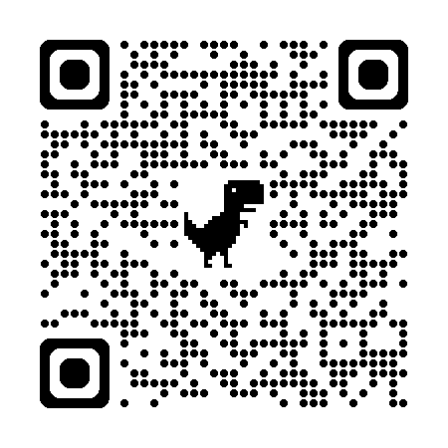

Slide 5
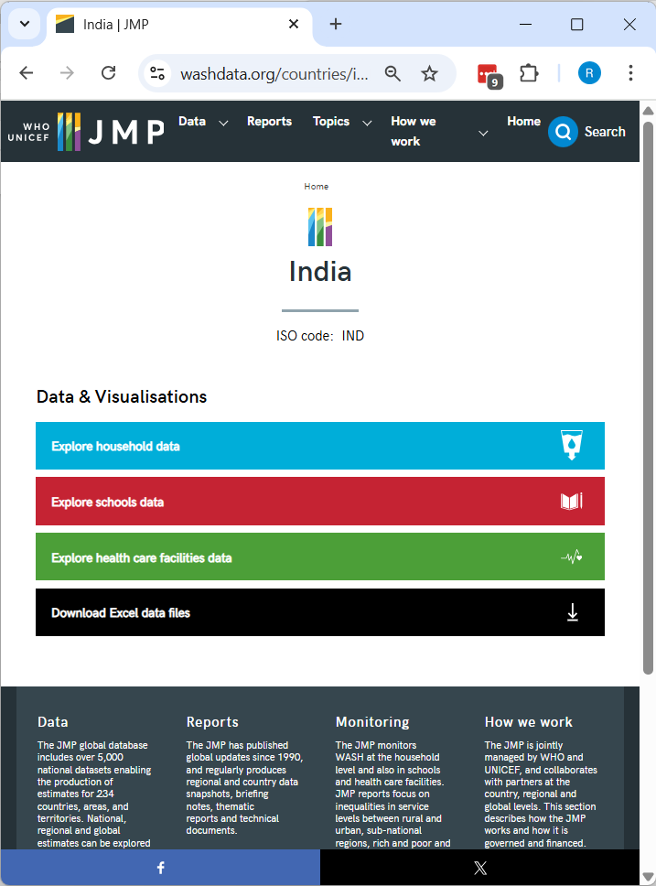
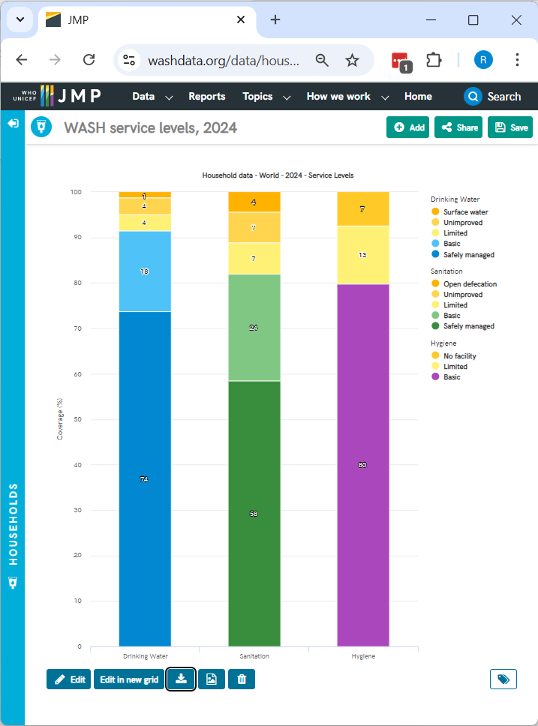

Slide 6
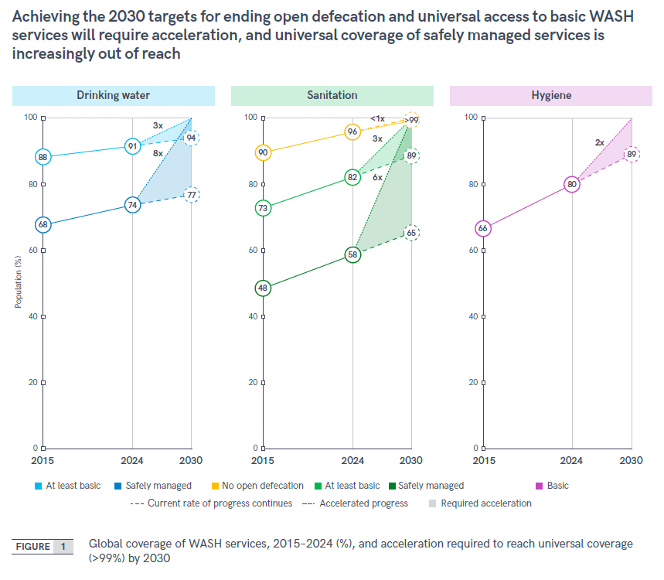

Slide 7
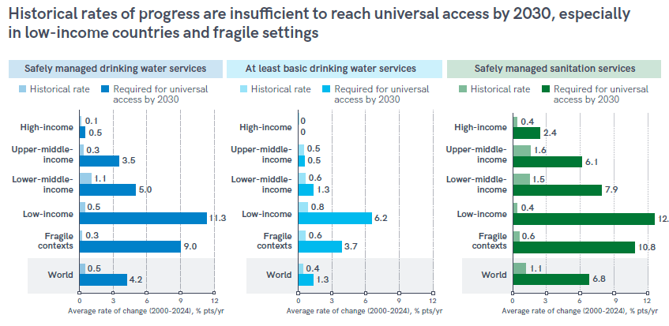
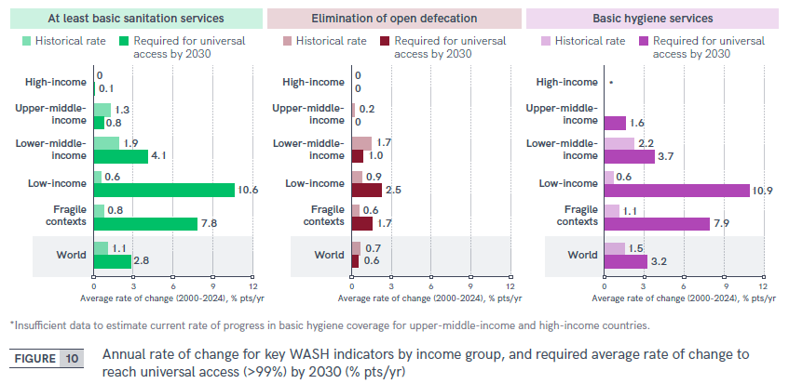

Slide 8
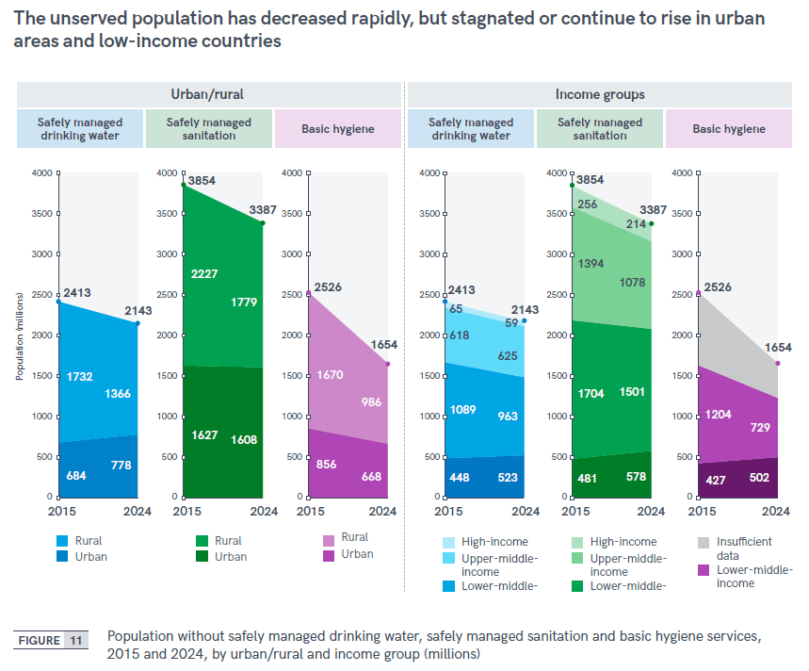
Inequalities in unserved populations

Slide 9
Focus on inequalities
Geographic
Laos People’s Democratic Republic
Socio-economic
Paraguay
Individual
Mongolia

Slide 10
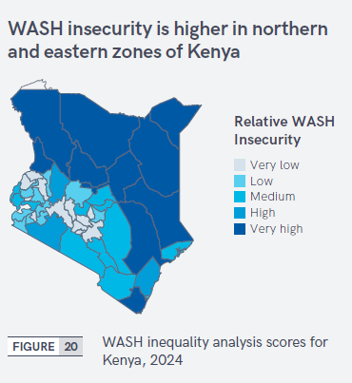
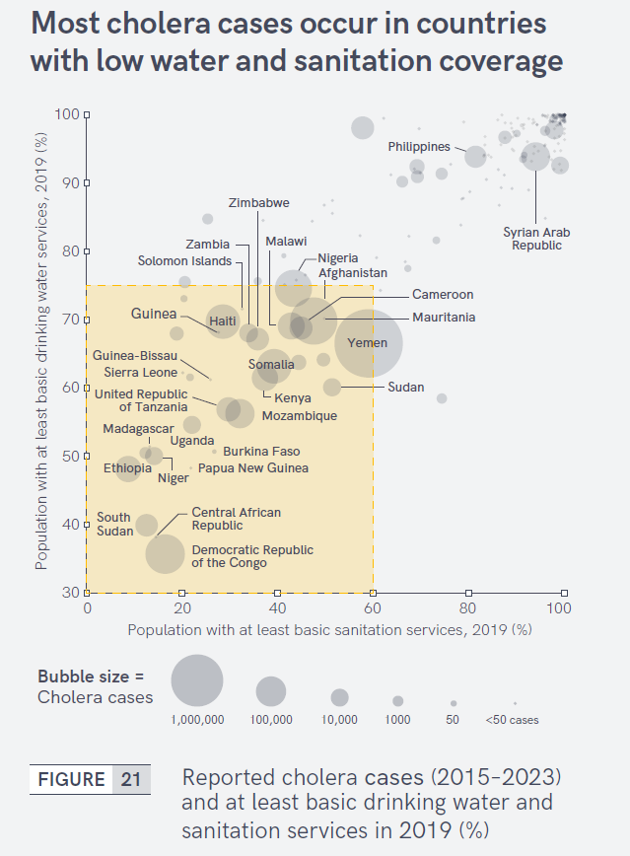
Overlapping inequalities

Slide 11
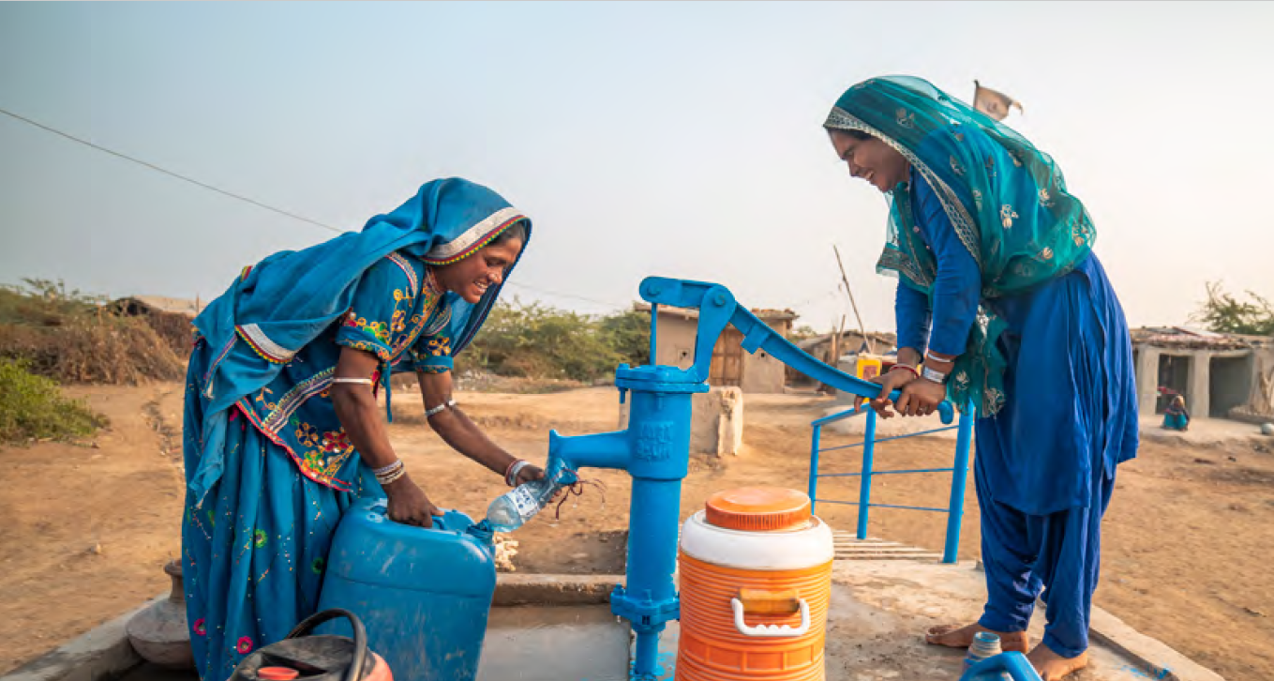
Target 6.1: By 2030, achieve universal and equitable access to safe and affordable drinking water for all

Slide 12
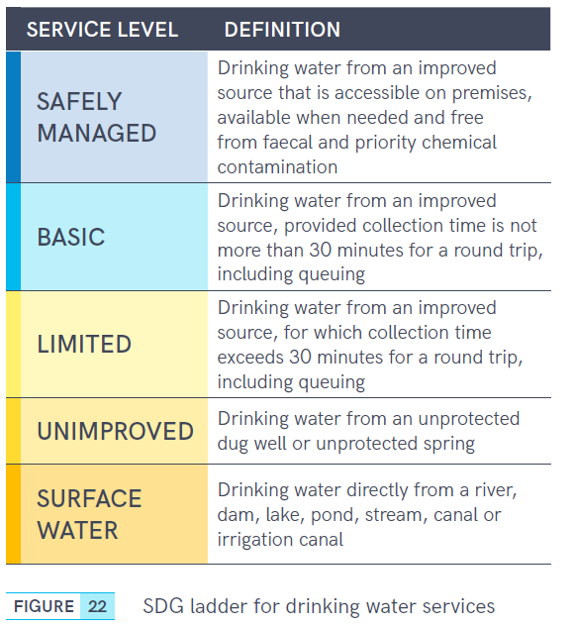
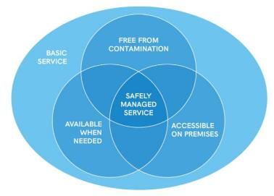
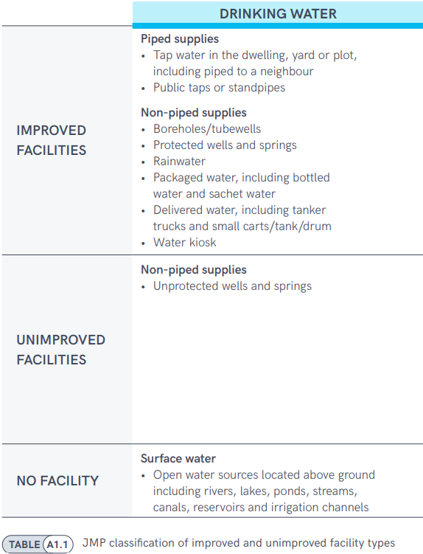
6.1.1 Safely managed drinking water
At least basic
Improved

Slide 13
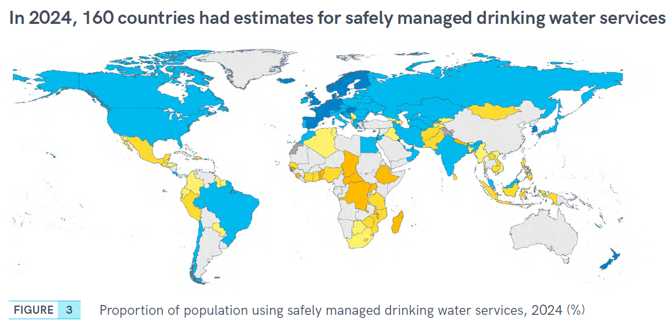
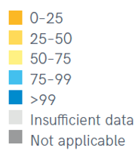

Slide 14
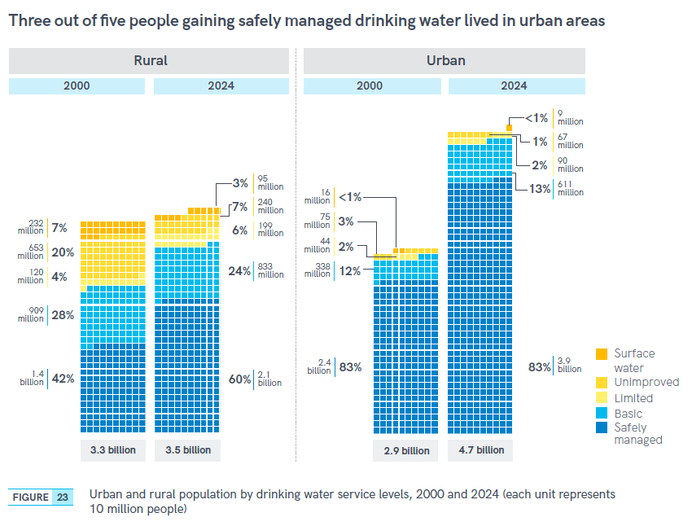

Slide 15
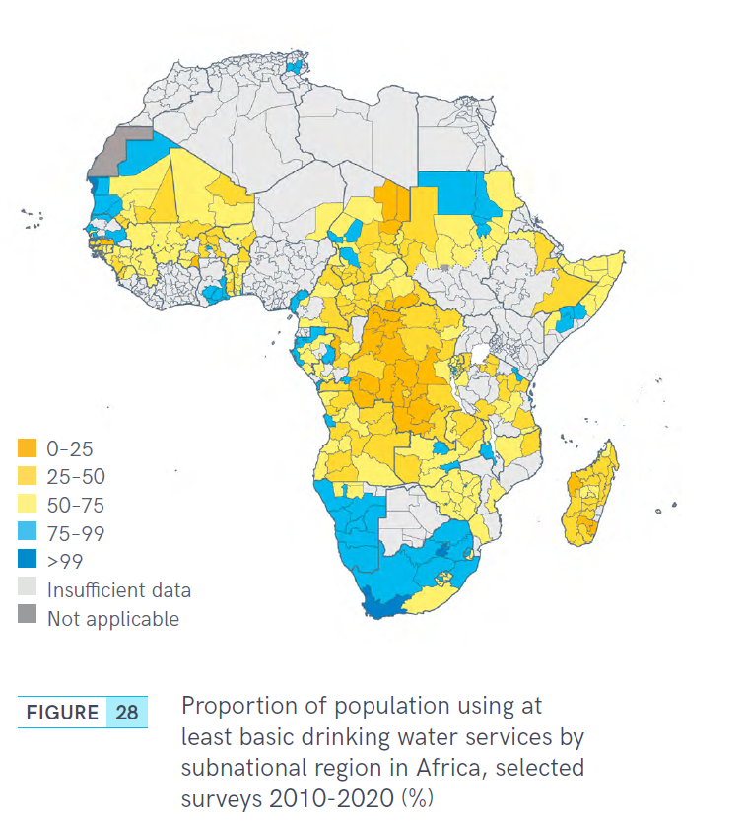
Inequalities in basic drinking water services

Slide 16
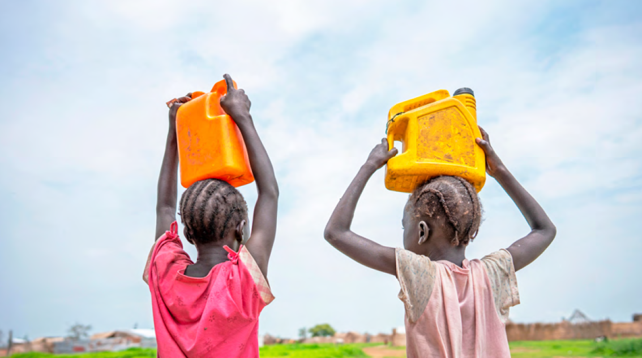
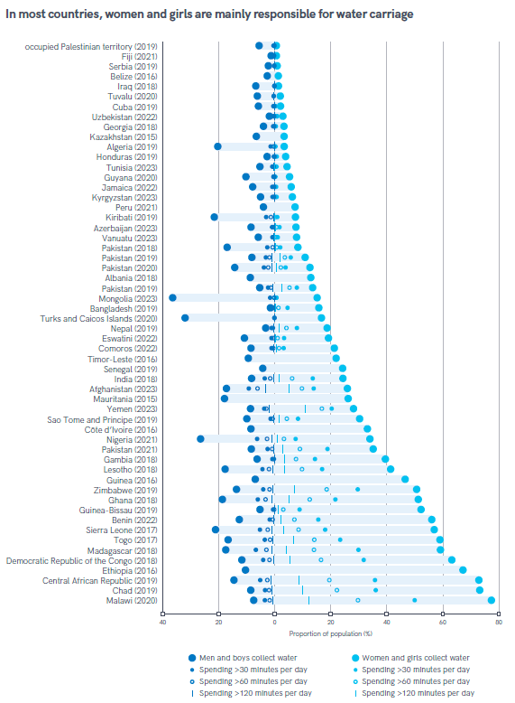
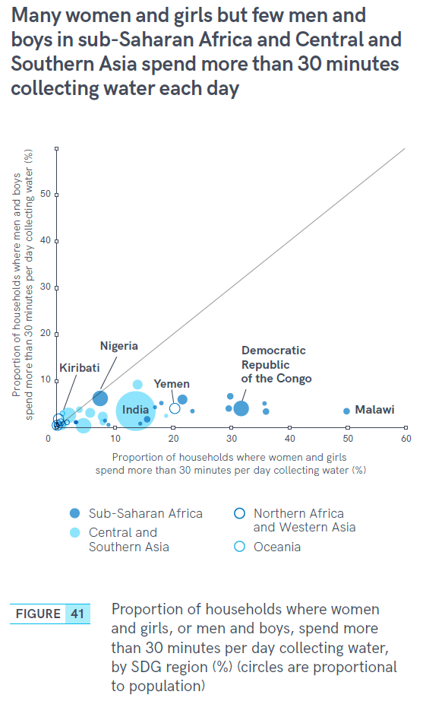
Gender inequalities in water collection

Slide 17
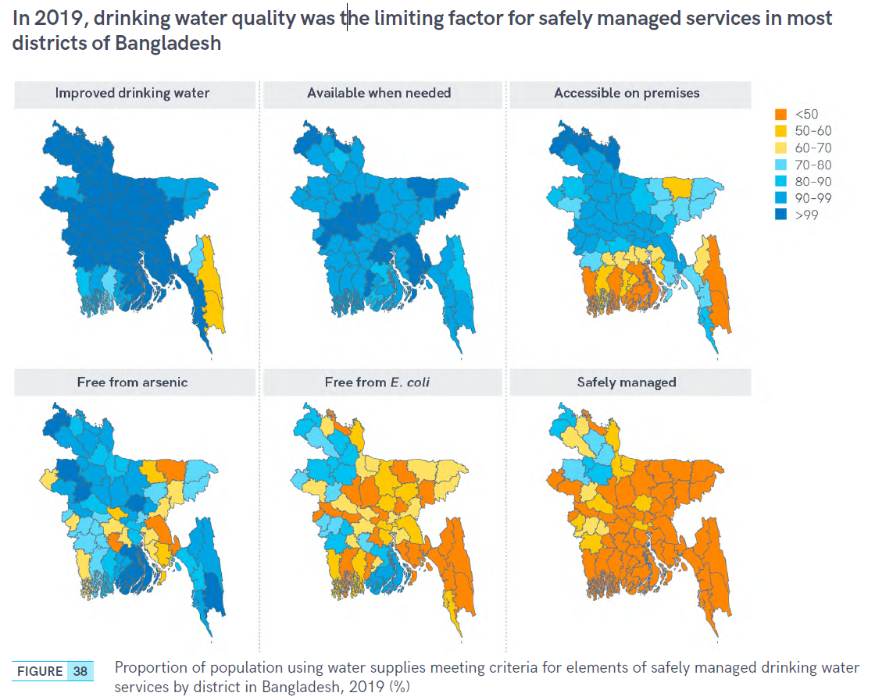

Inequalities in safely managed services

Slide 18
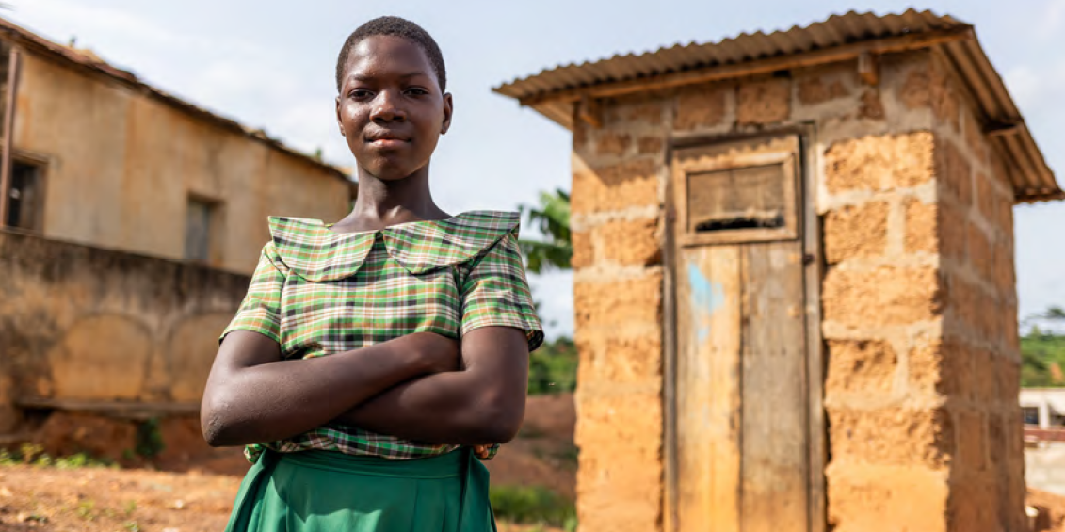
Target 6.2: By 2030, achieve access to adequate and equitable sanitation and hygiene for all, and end open defecation, paying special attention to the needs of women and girls and those in vulnerable situations

Slide 19
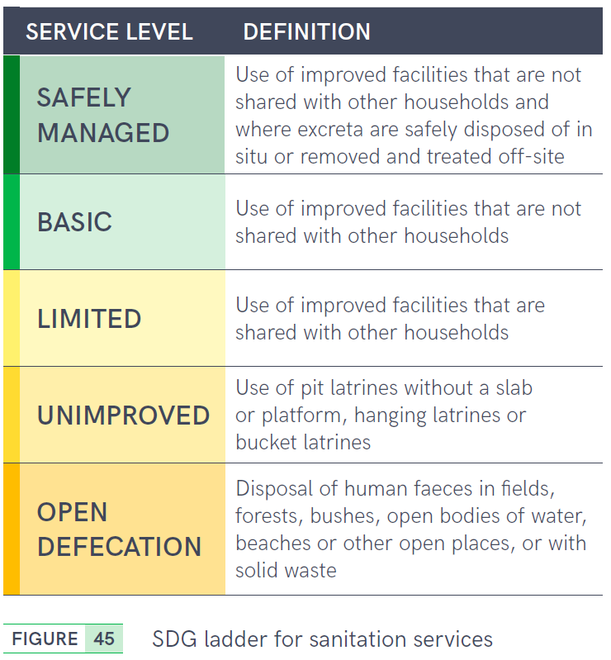
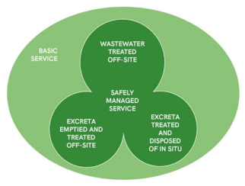
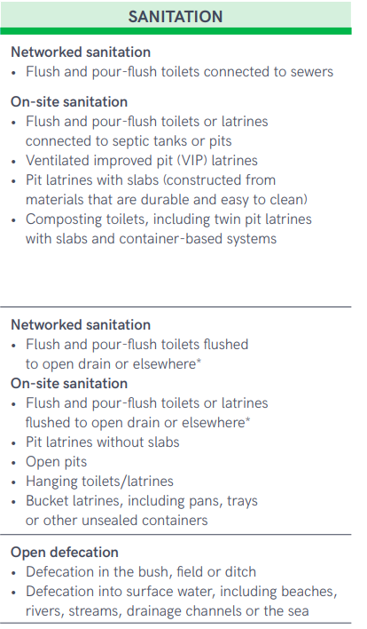
6.2.1a Safely managed sanitation
At least basic
Improved

Slide 20
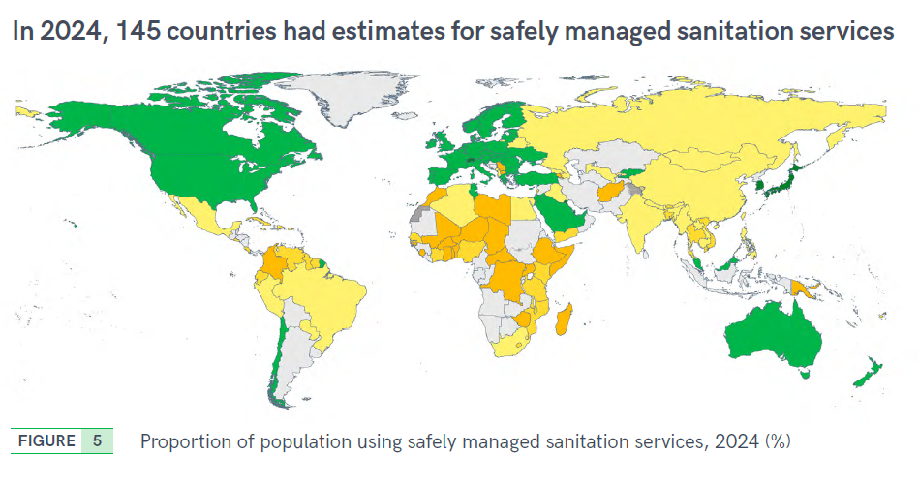
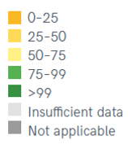

Slide 21
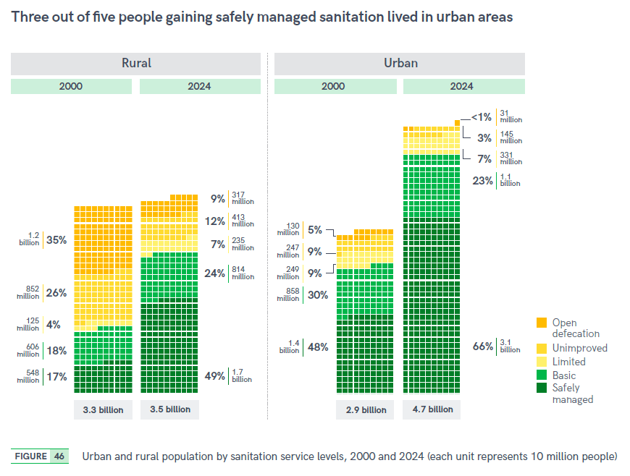

Slide 22
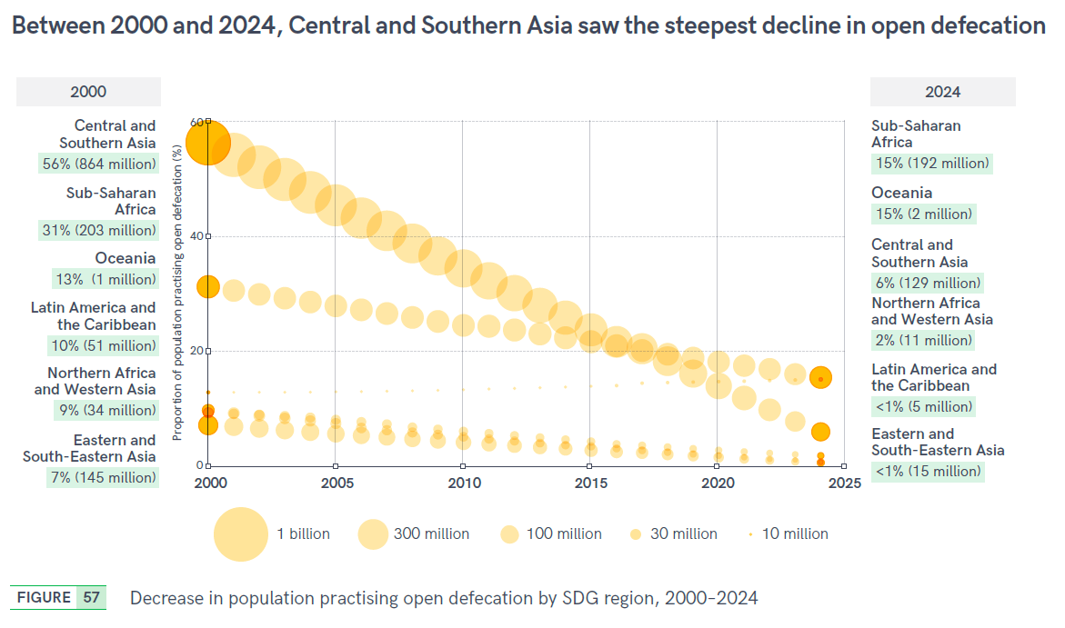

Slide 23

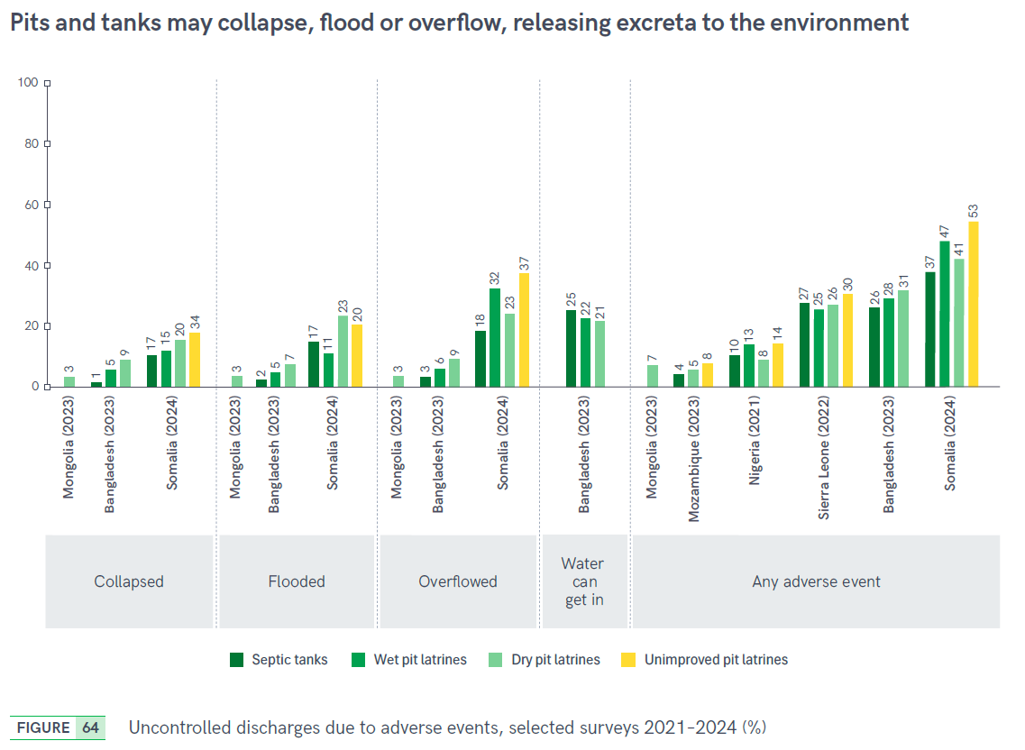


Slide 24
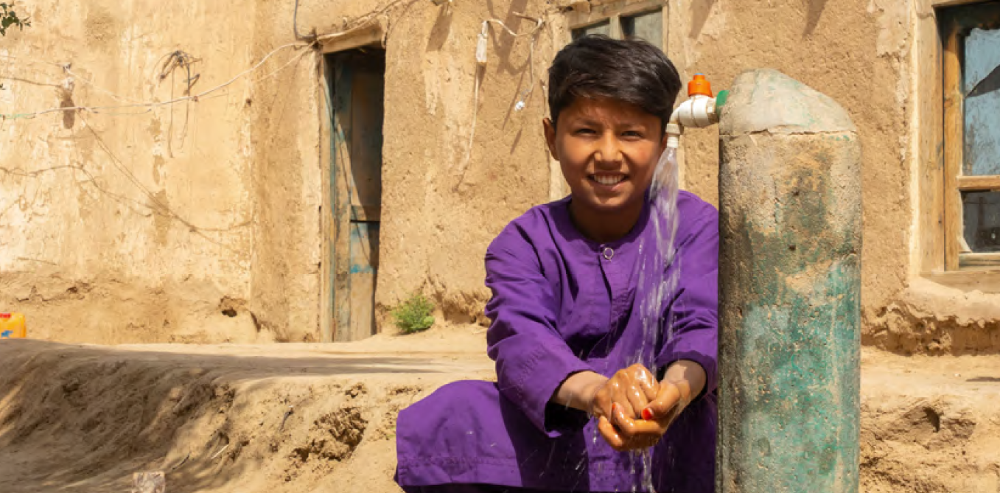
Target 6.2: By 2030, achieve access to adequate and equitable sanitation and hygiene for all, and end open defecation, paying special attention to the needs of women and girls and those in vulnerable situations

Slide 25
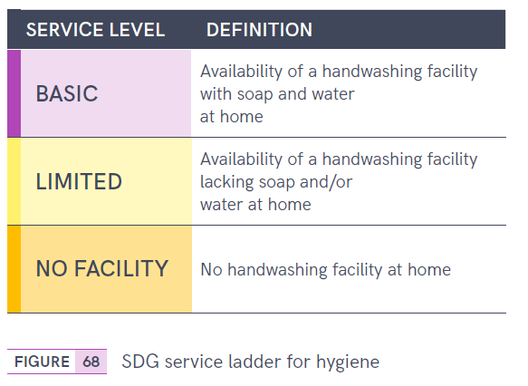
6.2.1b Hygiene

Slide 26
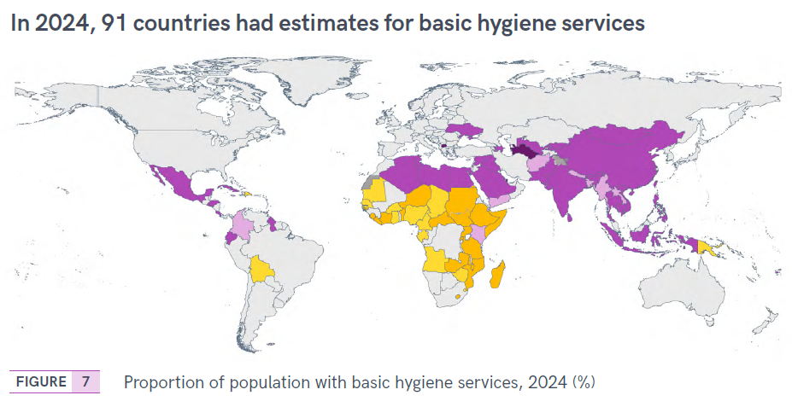
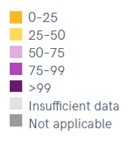

Slide 27
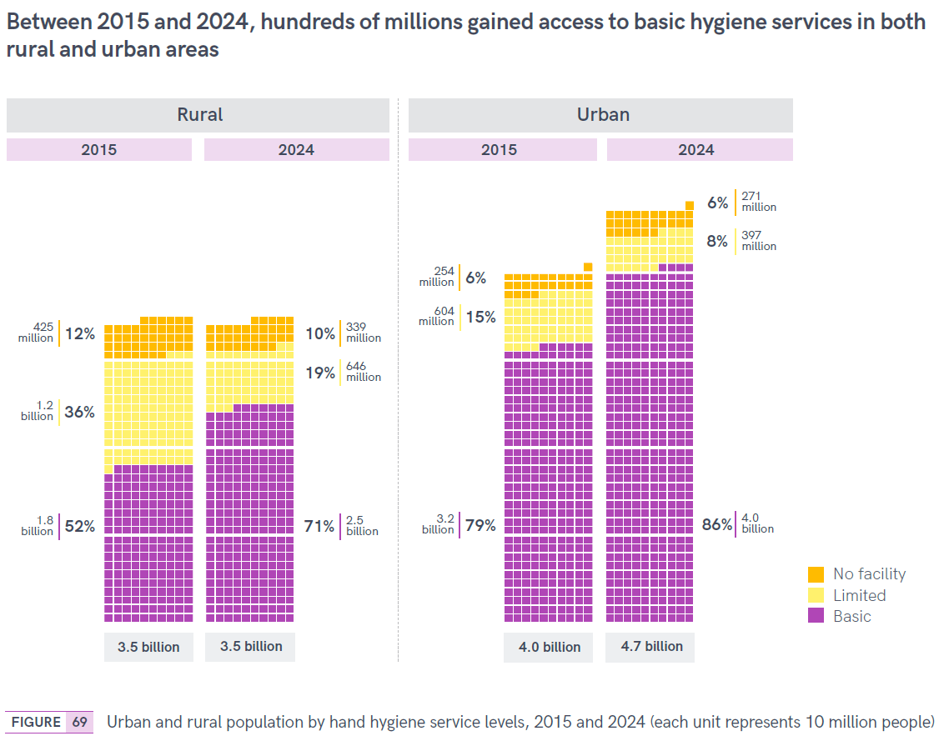

Slide 28
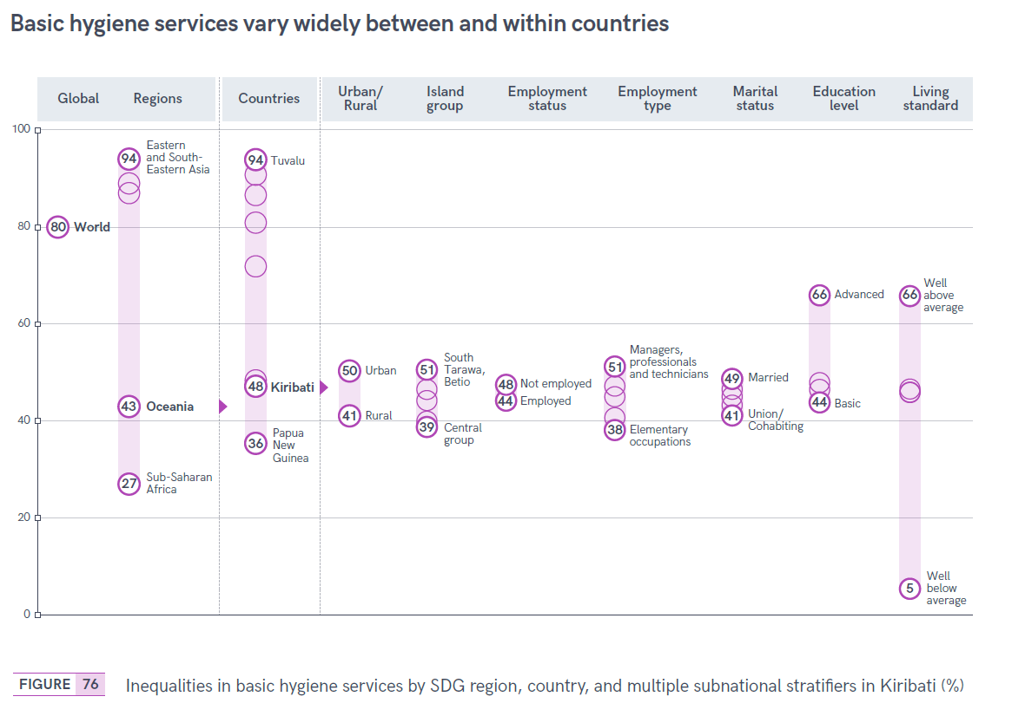
Inequalities in basic hygiene services

Slide 29
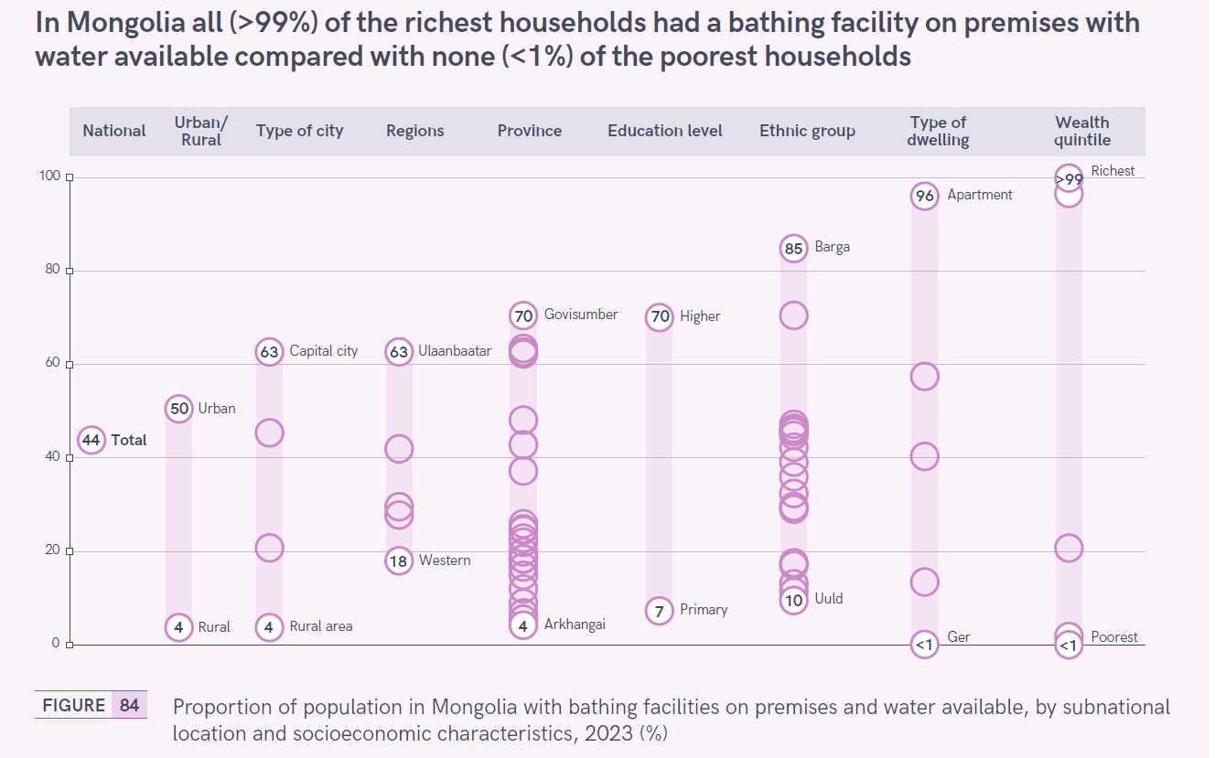
Bathing facilities on premises with water

Slide 30
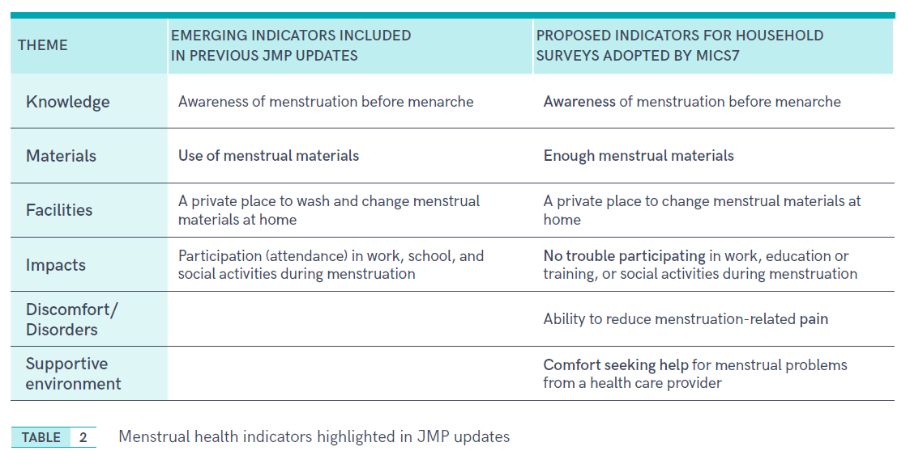
Menstrual health (new indicators)

Slide 31
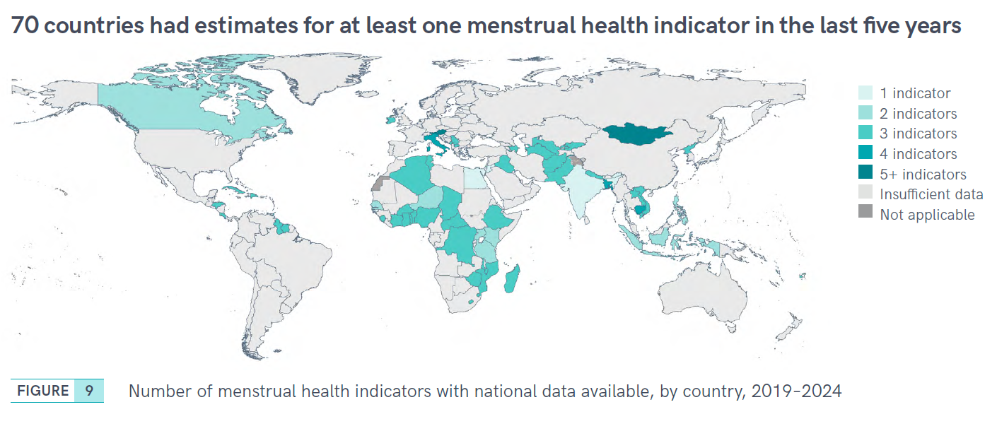

Slide 32
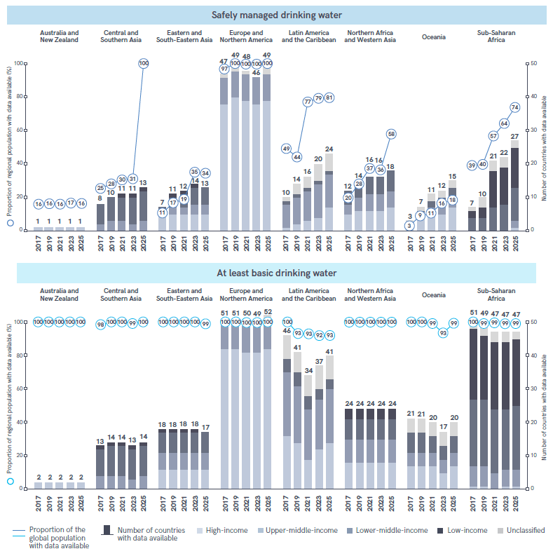
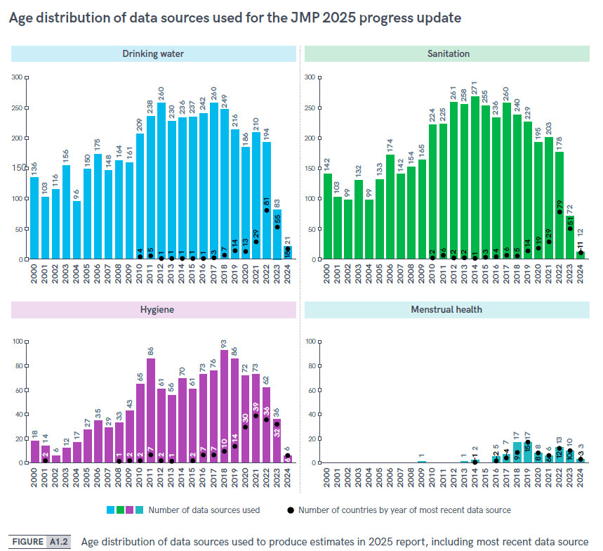
Data progression and gaps

Slide 33
Thank you!
info@washdata.org
UNICEF and WHO gratefully acknowledge the financial support provided by the Department for Foreign Aid and Trade (Australia), the Austrian Development Agency (Austria), the Bill and Melinda Gates Foundation, the Agence Française de Développement (France), the Federal Ministry for Economic Cooperation and Development (Germany), the Directorate-General for International Cooperation (Kingdom of the Netherlands), the European Commission (EU), the Swiss Agency for Development and Cooperation (Switzerland), the Foreign, Commonwealth & Development Office (United Kingdom), the United States Agency for International Development (United States of America), and UN-Water.

