Slide 1
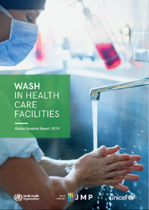
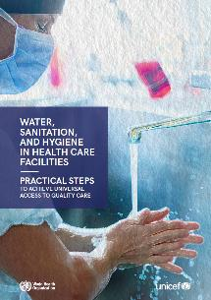
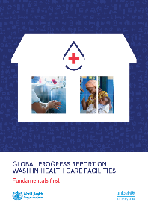
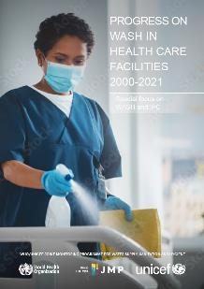
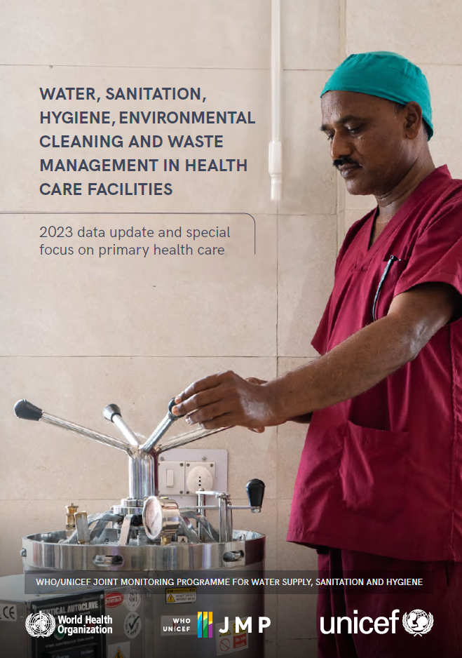
WASH in health care facilities: 2023 data update and special focus on primary health care
2019
2020
2022
2024
12 December 2024
Rick Johnston (johnstonr@who.int)
washdata.org
Notes:
Presenting on behalf of the WHO/UNICEF JMP
Fourth global update since a baseline in 2019, now on a two year cycle

Slide 2
JMP 2024 report
Updates and supersedes data in 2022 report
Data update (2023)
2022 report: ~80 figures
2024 report: 53 figures
Draws on data from almost 700 sources
Facility surveys, MIS, published reports
Representing at least 1.2 million health care facilities (double that of the 2019 baseline)
Notes:
It’s called a ‘2023 data update’ because it includes data through 2023.
And also because we use ‘data update’ to indicate a shorter report, that focuses on the basic WASH indicators at the national scale. In comparison, a full progress report will go into more detail about inequalities, and highlight examples of monitoring that go beyond the basic indicators.
Our 2022 report was a full progress report, and it was significantly longer.
We do this because we produce reports on WASH in schools and WASH in HCF in the same year, so it reduces a bit the burden of producing two full reports at almost the same time.
This report included data from almost 700 sources, which can be … and represent at least 1.2 million HCF. (More, because some data sources don’t specify the number of facilities assessed).

Slide 3
 | SERVICE LEVEL | WATER | SANITATION | HYGIENE | WASTE MANAGEMENT | ENVIRONMENTAL CLEANING
 | BASIC SERVICE | Water is available from an improved source on the premises. | Improved sanitation facilities are usable, with at least one toilet dedicated for staff, at least one sex-separated toilet with menstrual hygiene facilities, and at least one toilet accessible for people with limited mobility. | Functional hand hygiene facilities (with water and soap and/or alcohol-based hand rub) are available at points of care, and within five metres of toilets. | Waste is safely segregated into at least three bins, and sharps and infectious waste are treated and disposed of safely. | Protocols for cleaning are available, and staff with cleaning responsibilities have all received training.
 | LIMITED SERVICE | An improved water source is available within 500 metres of the premises, but not all requirements for a basic service are met. | At least one improved sanitation facility is available, but not all requirements for a basic service are met. | Functional hand hygiene facilities are available either at points of care or toilets but not both. | There is limited separation and/or treatment and disposal of sharps and infectious waste, but not all requirements for a basic service are met. | There are cleaning protocols and/or at least some staff have received training on cleaning.
 | NO SERVICE | Water is taken from unprotected dug wells, springs, or surface water sources, an improved source that is more than 500 metres from the premises, or there is no water source. | Toilet facilities are unimproved (e.g. pit latrines without a slab or platform, hanging latrines, bucket latrines) or there are no toilets. | No functional hand hygiene facilities are available either at points of care or toilets. | There are no separate bins for sharps or infectious waste, and sharps and/or infectious waste are not treated/disposed of. | No cleaning protocols are available, and no staff have received training on cleaning.
Notes:
Five service areas, three service levels each.
Basic service levels are all composite indicators, which are built up from two or more sub-indicators.
But they are still very basic, and don’t cover a lot of important aspects of WASH services, for instance water quality, or hand hygiene compliance. Those higher levels of service are even more data-poor, but we do highlight good examples of them in full progress reports.

Slide 4
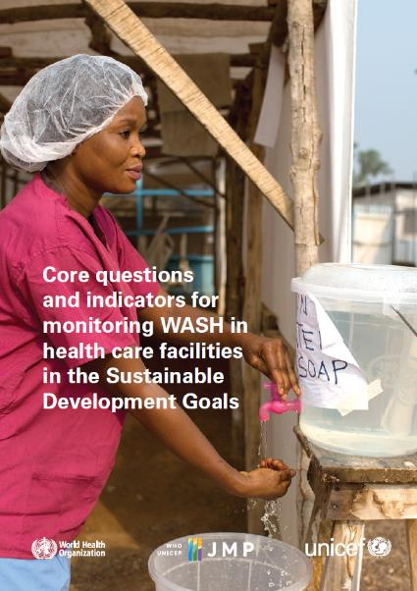
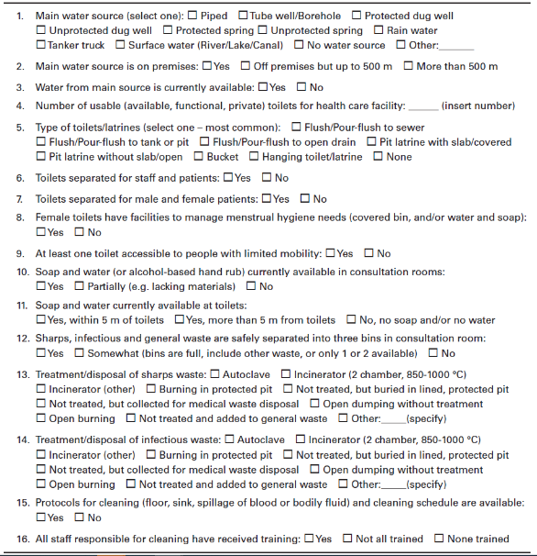
Notes:
Core questions document, published in 2018, gives recommended questions that could be included in a facility assessment or MIS, to collect all of the information needed for the five service ladders. 16 questions in all, ranging from 2 for hygiene or environmental cleaning, to 6 for sanitation.

Slide 5
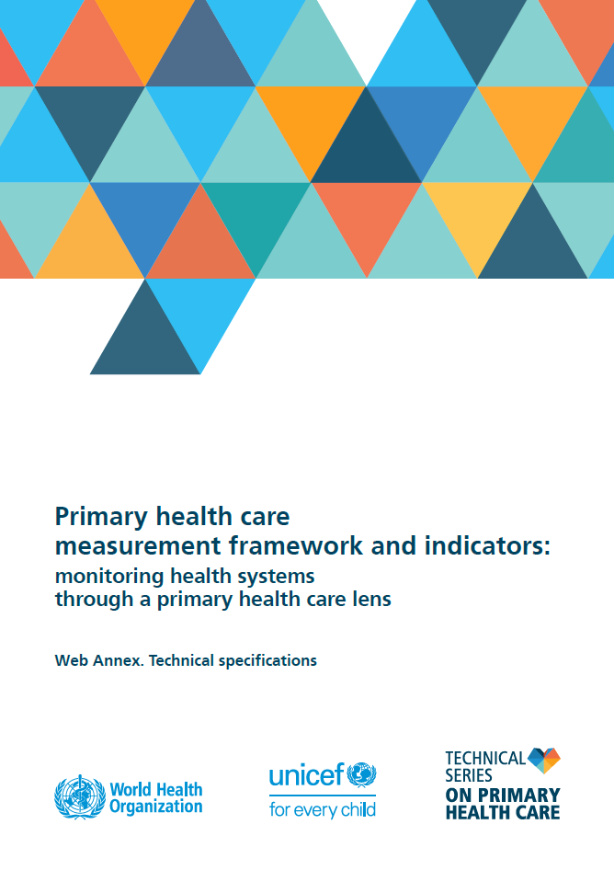
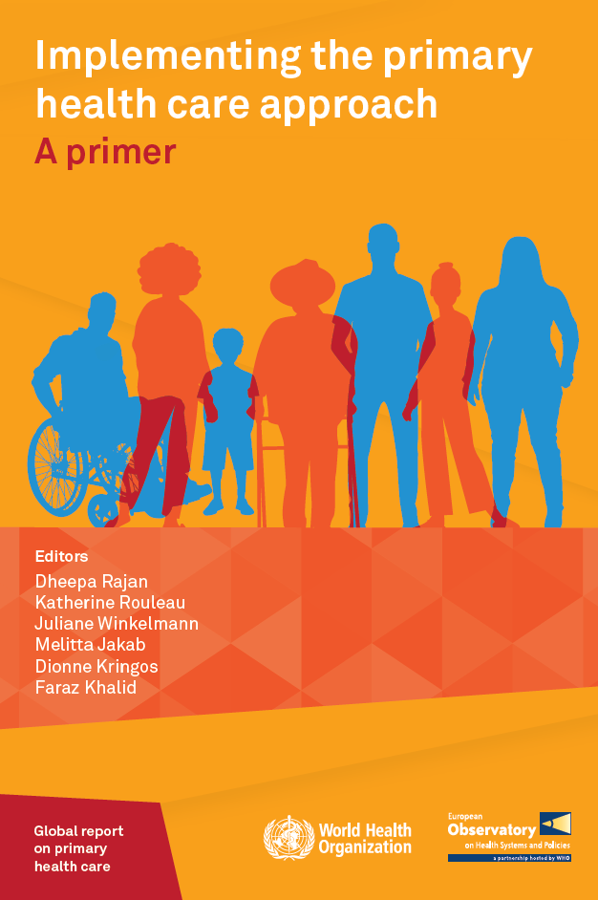
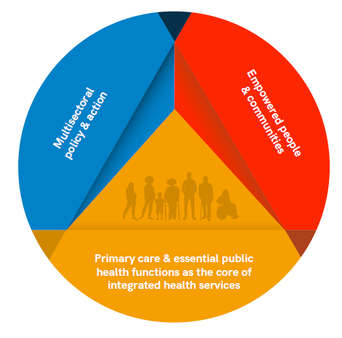
Special focus on WASH and primary health care (PHC)
Explore linkages between WASH and PHC, why WASH is important for PHC
Direct WASH audiences towards PHC resources, frameworks
Notes:
Fundamental framework is illustrated in the circle diagram on the right, which describes three interrelated and synergistic core components of PHC:
a. primary care and essential public health functions as the core of integrated health services; (in yellow)
b. addressing the broader determinants of health through multisectoral policy and action; (in blue) and
c. empowering individuals, families and communities to take charge of their own health. (in red)
Often the focus is put on primary care (in yellow), which is the bit that takes place in health care settings, but to really adopt the PHC approach means to be working intersectorally, including at the community and individual level.
Think it helps when engaging with the health care sector to be able to speak a bit of their language, and to say for instance that WASH is essential to advancing PHC, but also that adopting a PHC approach is critical to improving WASH services, both in health care facilities and more broadly.

Slide 6
4 core strategic levers for PHC
Political commitment and leadership
Governance and policy frameworks
Funding and allocation of resources
Engagement of community and other stakeholders
WASH corollaries
SDG6 Global Accelerator Framework
Sanitation and Water for All building blocks, collaborative behaviours
Notes:
We wanted to highlight similarities between the PHC and WASH worlds in terms of frameworks.
PHC has what they call…
The report shows that these all have WASH corollaries, especially in the …

Slide 7
10 operational levers for PHC
Models of care
Primary health care workforce
Physical infrastructure
Medicines and other health products
Engagement with private sector providers
Purchasing and payment systems
Digital technologies for health
Systems for improving the quality of care
Primary health care-oriented research
Monitoring and evaluation
Core PHC indicator: Availability of basic water, sanitation and hygiene (WASH) amenities
Notes:
PHC also has 10 operational levers, and in the report we show how each of them has some degree of linkage with WASH.
Most obviously in physical infrastructure, which is where the health sector tends to situate WASH in HCF. But for instance, all models of care rely on patients and caregivers having access to safe WASH in health care facilities, and WASH is crucial for the primary health care workforce to delivery quality care, both in health facilities and in communities.
[CLICK]
Finally, PHC has a small set of 13 core indicators that are important for national, regional and global monitoring, and that includes a WASH indicator (where WASH also includes environmental cleaning and health care waste management).

Slide 8
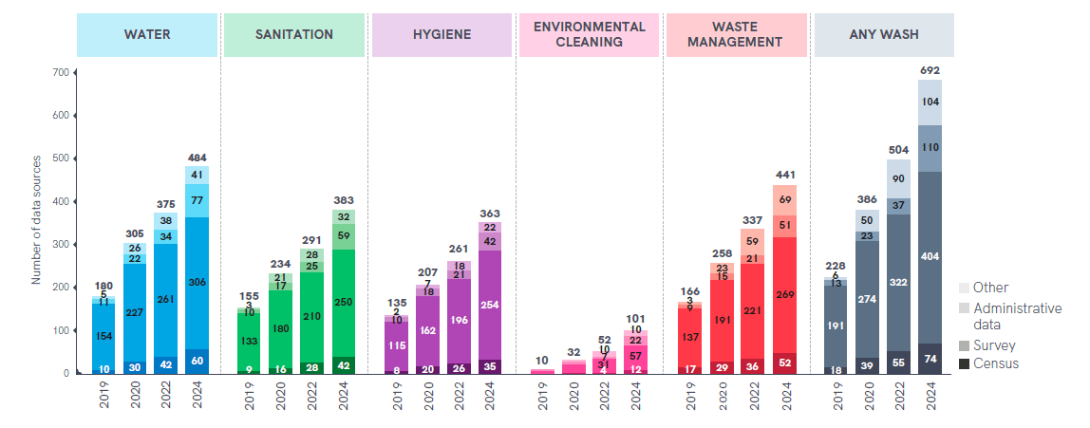
Growth in numbers of data sources
Notes:
Turning to our report, I mentioned that we drew on almost 700 sources
Relatively few for EC, but growing fast
Mainly surveys, but definitely seeing strong growth in availability of administrative data such as HMIS.

Slide 9
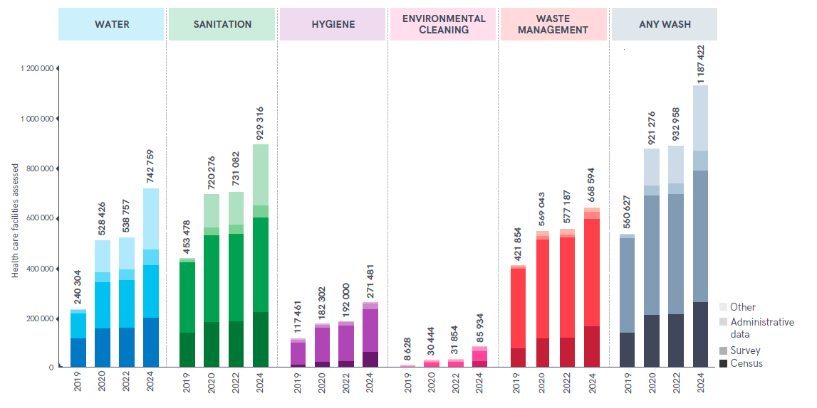
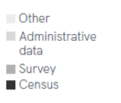
Growth in numbers of facilities represented
Notes:
Representing over 1.2 million HCF, a steady increase over the different report cycles.
Actually, we found a new data series for rural Indian Health Services that covers an average of 175,000 HCF per year for 15 years. We excluded that from this graph, since they would add another 3 million HCF to the 2024 figures.

Slide 10
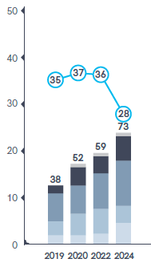
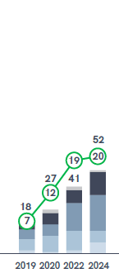
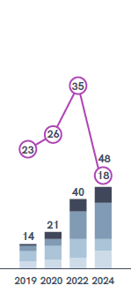
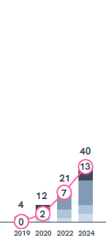
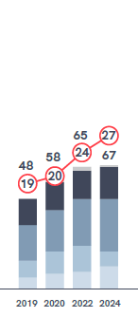
30%
30%
Notes:
We can move from the numbers of data sources, and HCF assessed, to the number of countries and proportion of the global population represented.
Number of countries steadily increasing, mainly in LMICs.
Big drop in population coverage since the last report – due to ageing data from China. A nice survey from 2018, hasn’t been repeated.

Slide 11
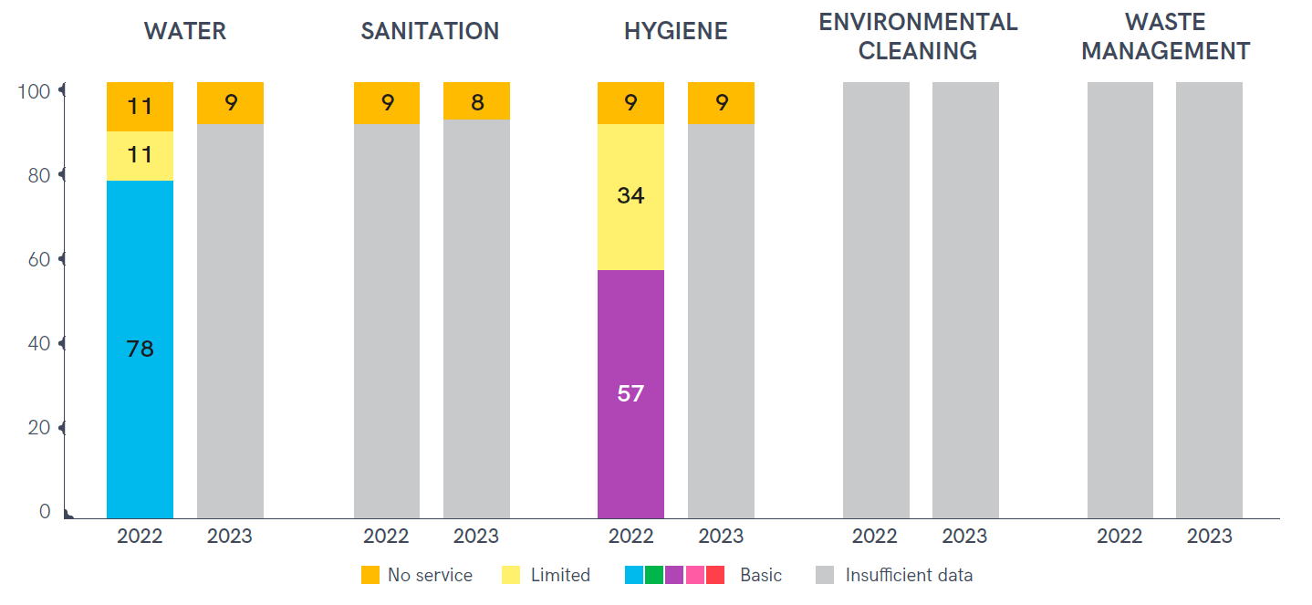

Slide 12
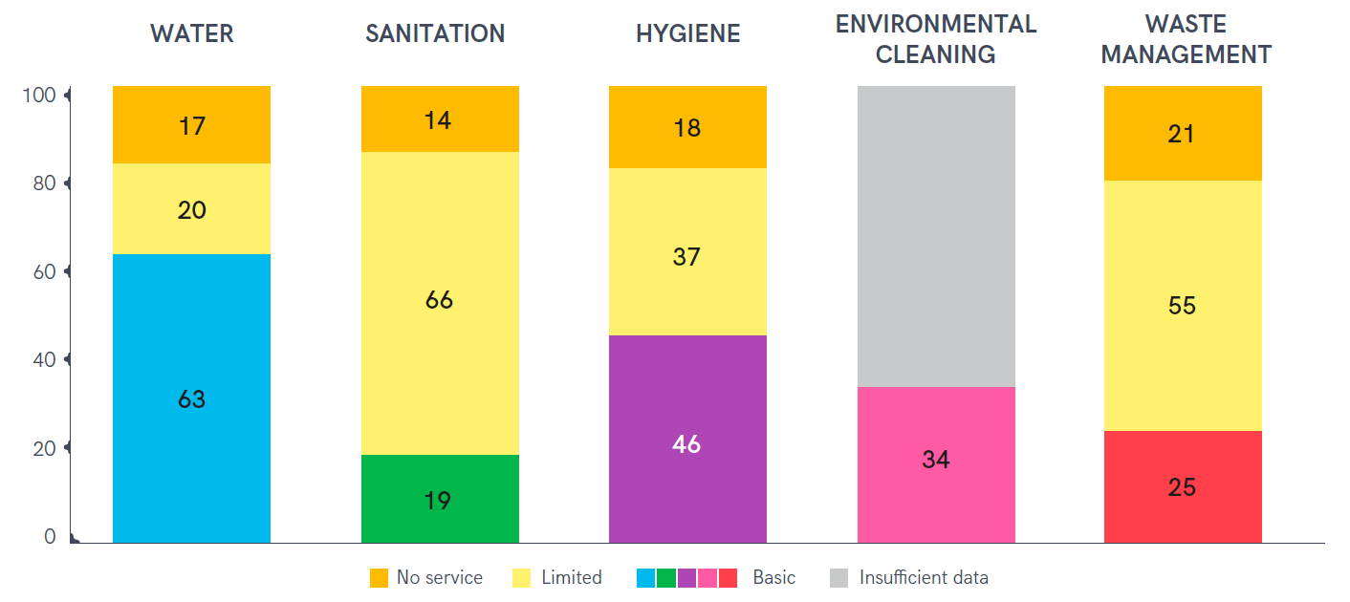
WASH services in HCF in fragile contexts

Slide 13
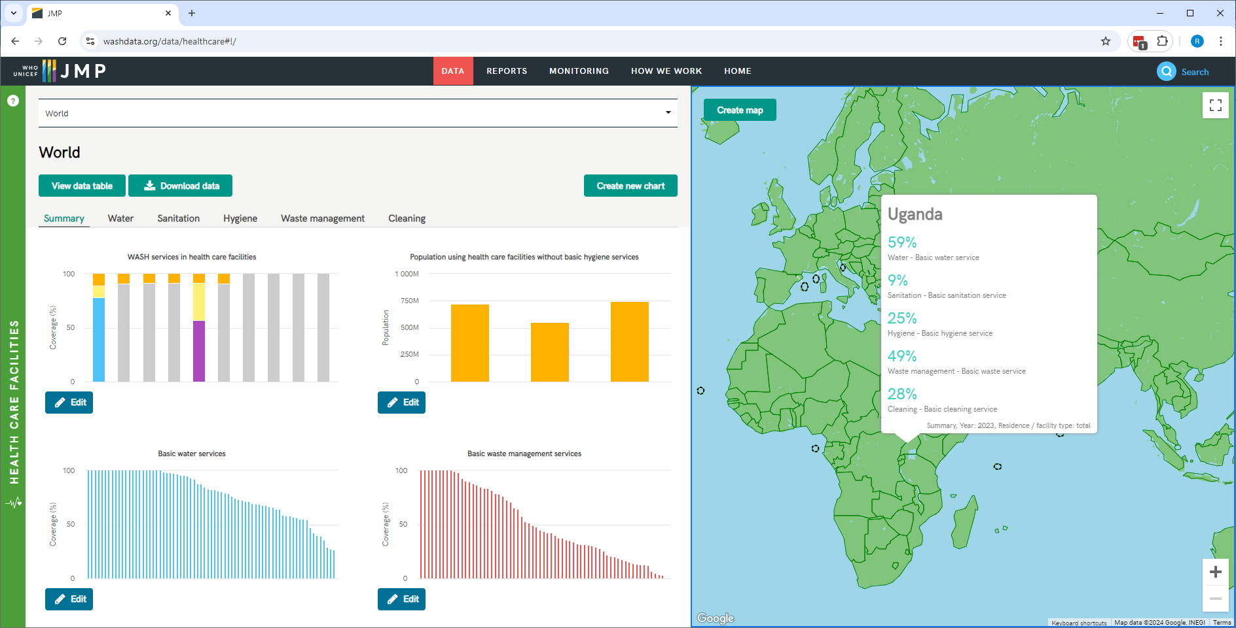
Notes:
Wanted to point people to the JMP website, washdata.org, in case you haven’t explored it. It includes an interactive data portal where you can explore the database and create your own figures, tables, or maps.
Here you can see one of the default graphs in the upper left, showing the basic WASH ladders for 2023 and 2024, like I showed a few slides ago.
You can also see on the map that Uganda is one of the countries that has estimates for all five WASH indicators. There were 29 such countries, up from 16 in the 2022 report.

Slide 14
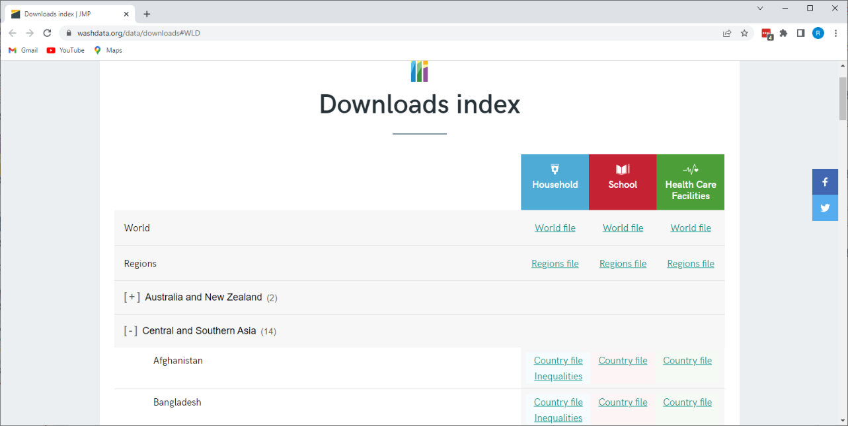
Notes:
Also on the website you can download the Excel country files, which include all of the data sources used as well as the resulting estimates. If you are mainly interested in an individual country, or want to see where the estimates have come from, this is the place you should go.

Slide 15
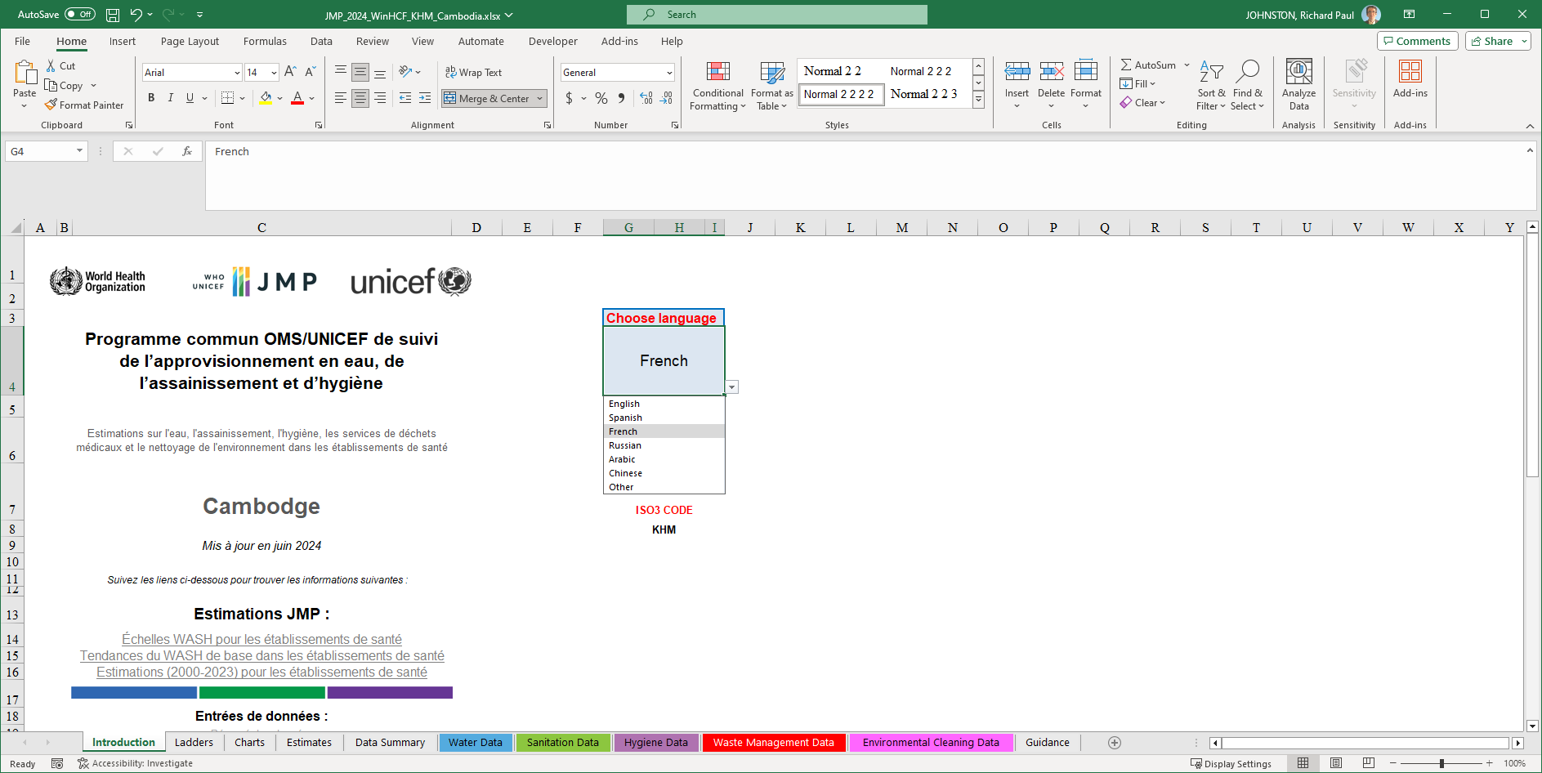
Notes:
Here’s an example of Cambodia.
Multiple tabs, about ten or so. Will show you just a few.
This is the Introduction tab, which allows you to select a language. Right now available for the UN languages, but if anyone really wanted to translate the glossary of terms, there are about 200 phrases used in the file and if you translate that list you could convert the file into whatever language you like.

Slide 16
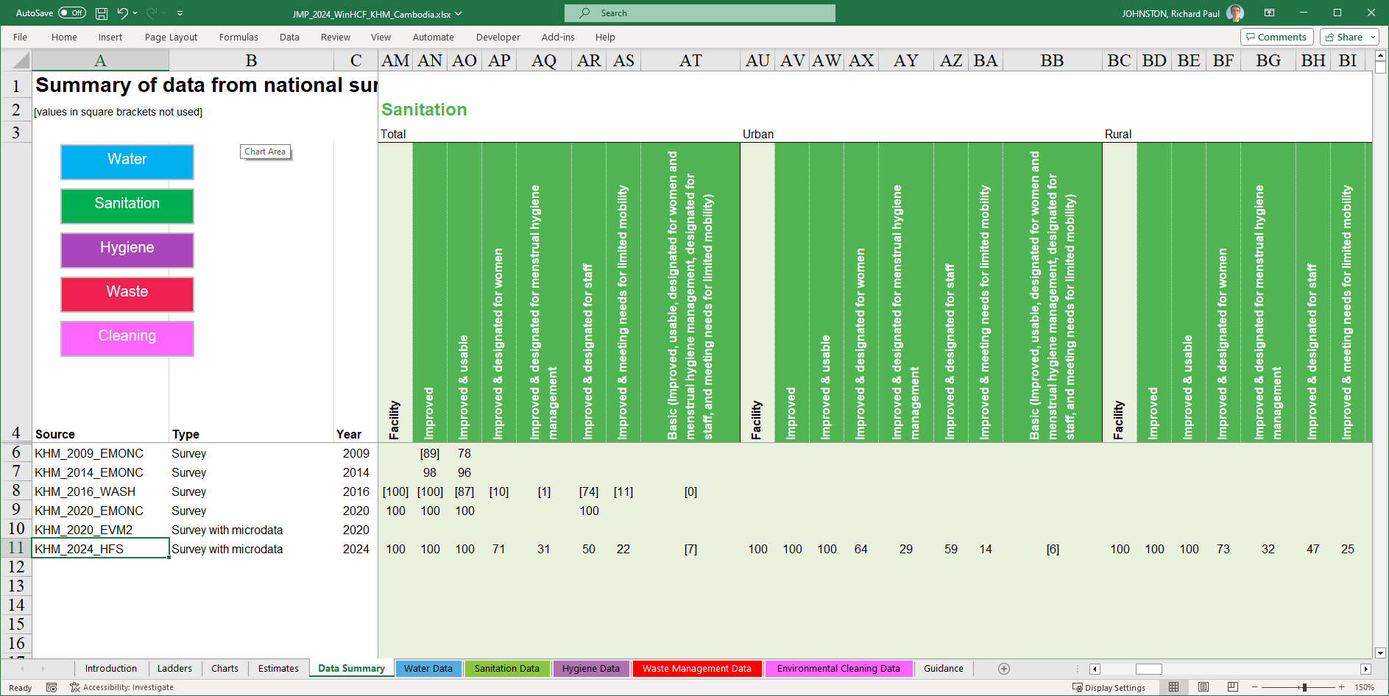
Notes:
The data summary tab (back into English)…
For Cambodia, six data sources, including a recent 2024 Health Facility Survey which was well aligned with the global indicators. You can see that the earlier surveys like the three EMONCs had some information about sanitation, but only on improved, or improved and usable sanitation. So this new more comprehensive assessment allowed the establishment of a national baseline for Cambodia in this report.
The earlier data sources also didn’t distinguish between urban and rural health care facilities, so again the new health facility assessment filled a data gap there.
You can also see that while nearly all HCF in Cambodia have improved and usable sanitation – and maybe this was a bit worse 10-15 years ago, the coverage with other indicators like menstrual hygiene, or accessibility to those with limited mobility, is much lower. We’ll come back to that point.

Slide 17
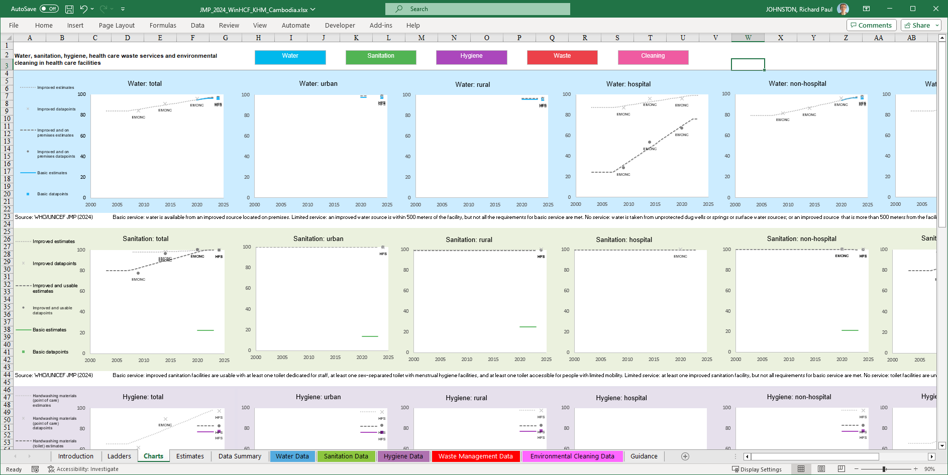
Notes:
Another interesting tab in the country file is the Charts tab, where you can see the different data points used over time, and the resulting linear regression estimtaes.
Nice progression for example on improved water on premises for hospitals.
You can see that for urban and rural, we only have that new 2024 data point so we can’t say anything about the historical trends.

Slide 18
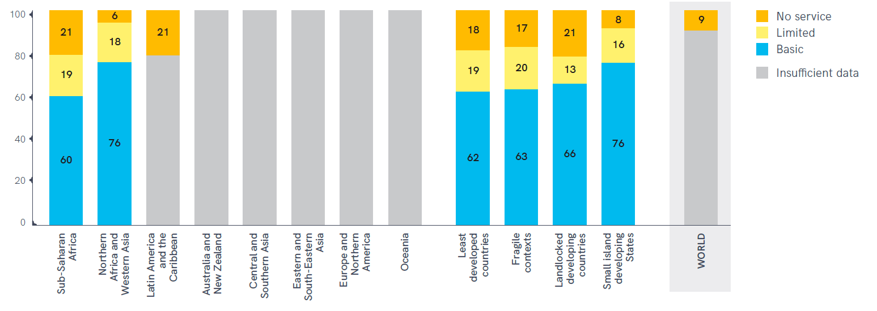
Notes:
Definition: improved, on premises, and available.
Two SDG regions, no global estimate.

Slide 19
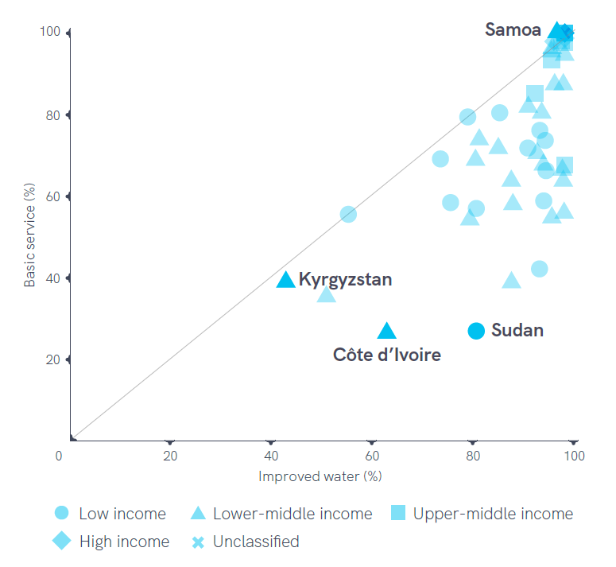
Improved vs basic
Not always on premises
Water not always actually available
Notes:
Sudan: about 80% improved, but only a bit more than 20% basic. Some of those improved supplies are either not on premises, or water isn’t actually available from them. In the case of Sudan, the challenge is more to have water available on premises, while in Kyrgyzstan the limiting factor is more having water available from the improved source.

Slide 20
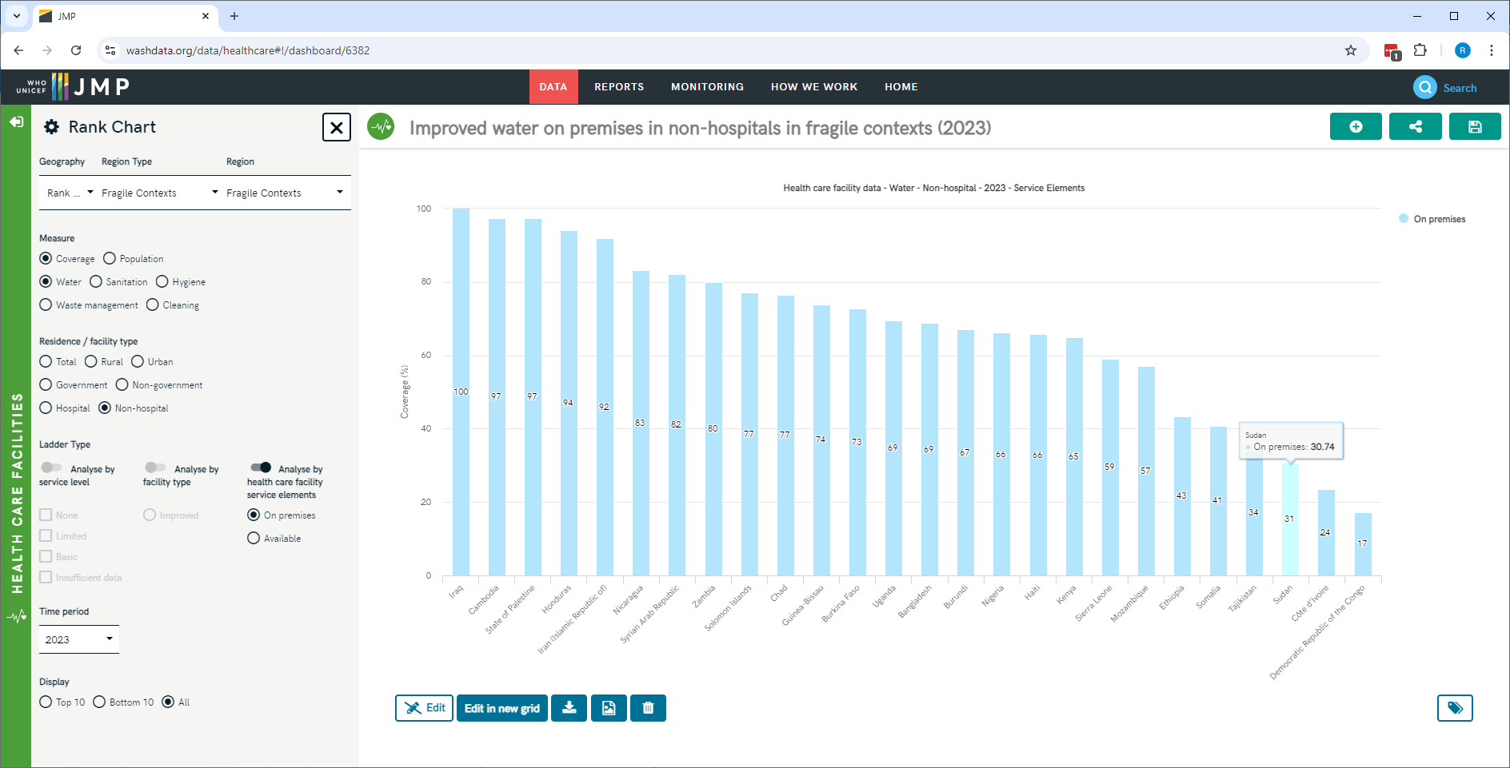
https://washdata.org/data/healthcare#!/dashboard/6382
Notes:
Rank chart, showing improved water on premises in non-hospitals (restricted to Fragile Contexts)
26 out of 60 fragile contexts with data, ranging from 100% to 1&% in DRC.
Sudan (non-hospitals): only 31% have improved on premises
Can also save dashboards, so this one for example is number 6382.

Slide 21
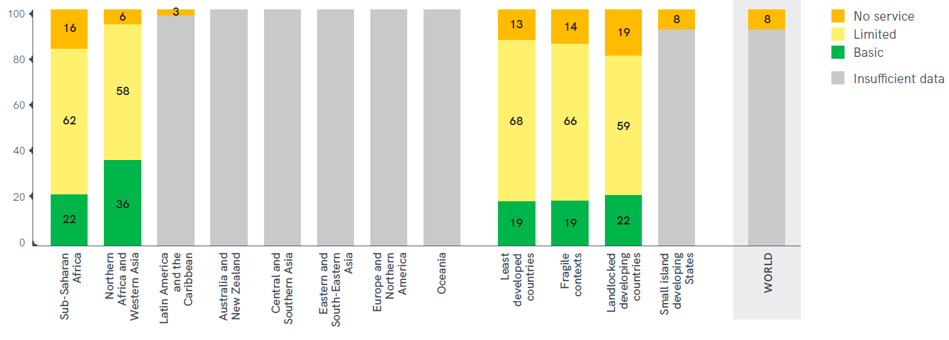
Notes:
Definition: more elements.
Still two SDG regions.

Slide 22
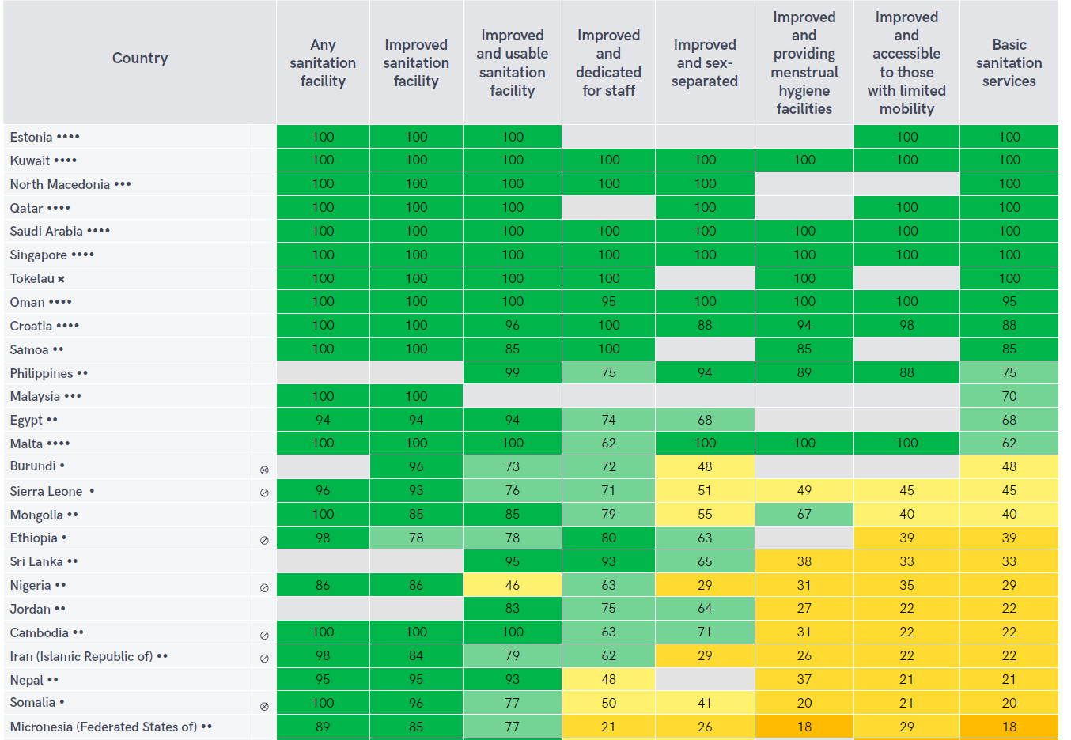
Notes:
Multiple sub-indicators for basic sanitation.
Grey indicate some cases where not all of the indicators are available. JMP will make an estimate if we have ‘improved and usable’, and at least two of the other four: staff, sex-separate, menstrual hygiene and limited mobility.
Because different sub-indicators may come from different data sources, can’t always be combined at the level of the health facility. So we just take the minimum of all of the sub-indicators.
For example Burundi: 48%, driven by sex-separated, but no data on MH or limited mobility. Leads to 48% basic sanitation.
Note Somalia, limiting factors of MHM and limited mobility. Both around 20%, limited mobility is a shade higher.

Slide 23
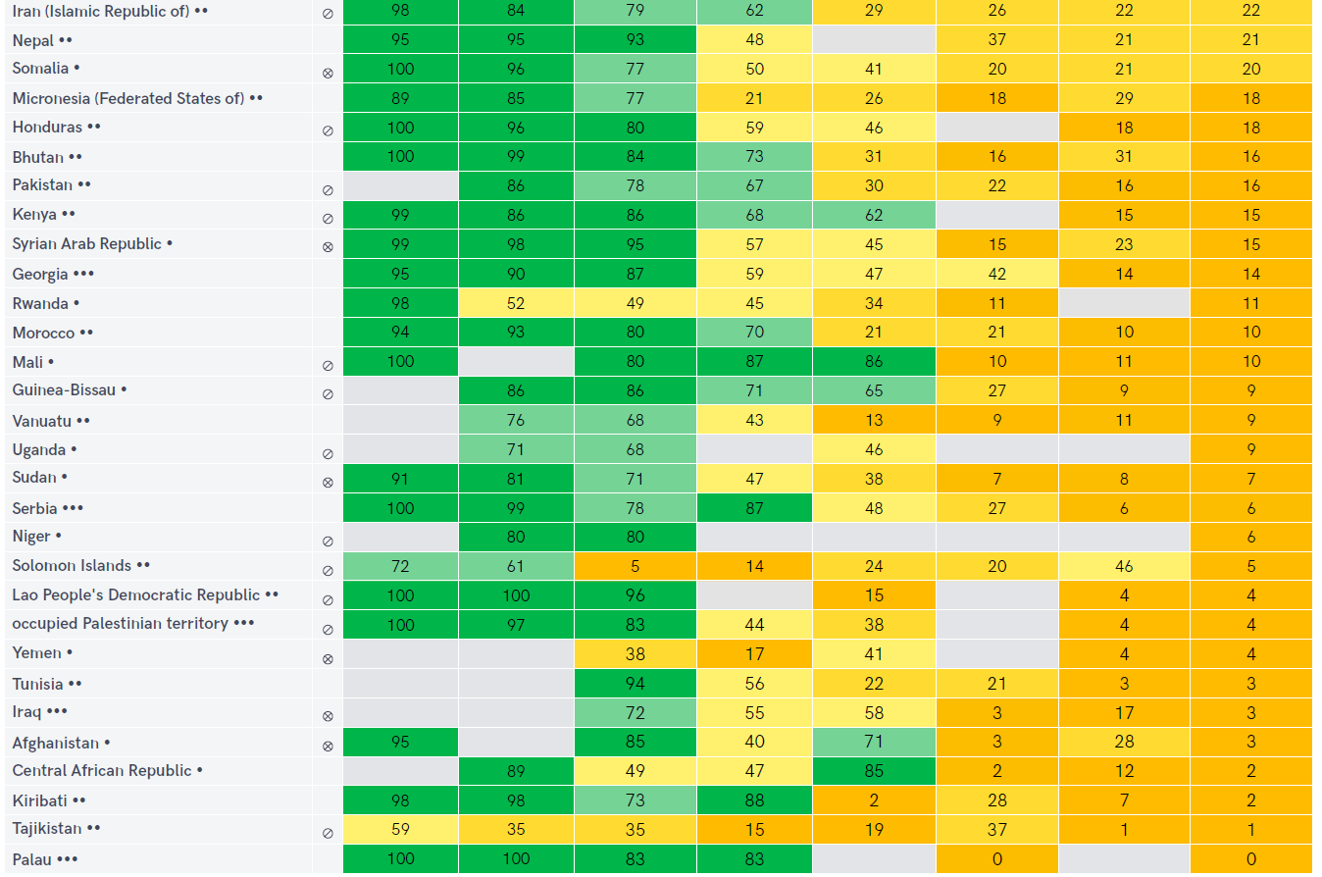
Notes:
Extreme examples: Kiribati where sex-separated is the limiting factor.
Also see a lot of fragile contexts, that’s the round icon right before the matrix. The dots by the name indicate the income group: one dot for low income, four dots for high-income.

Slide 24
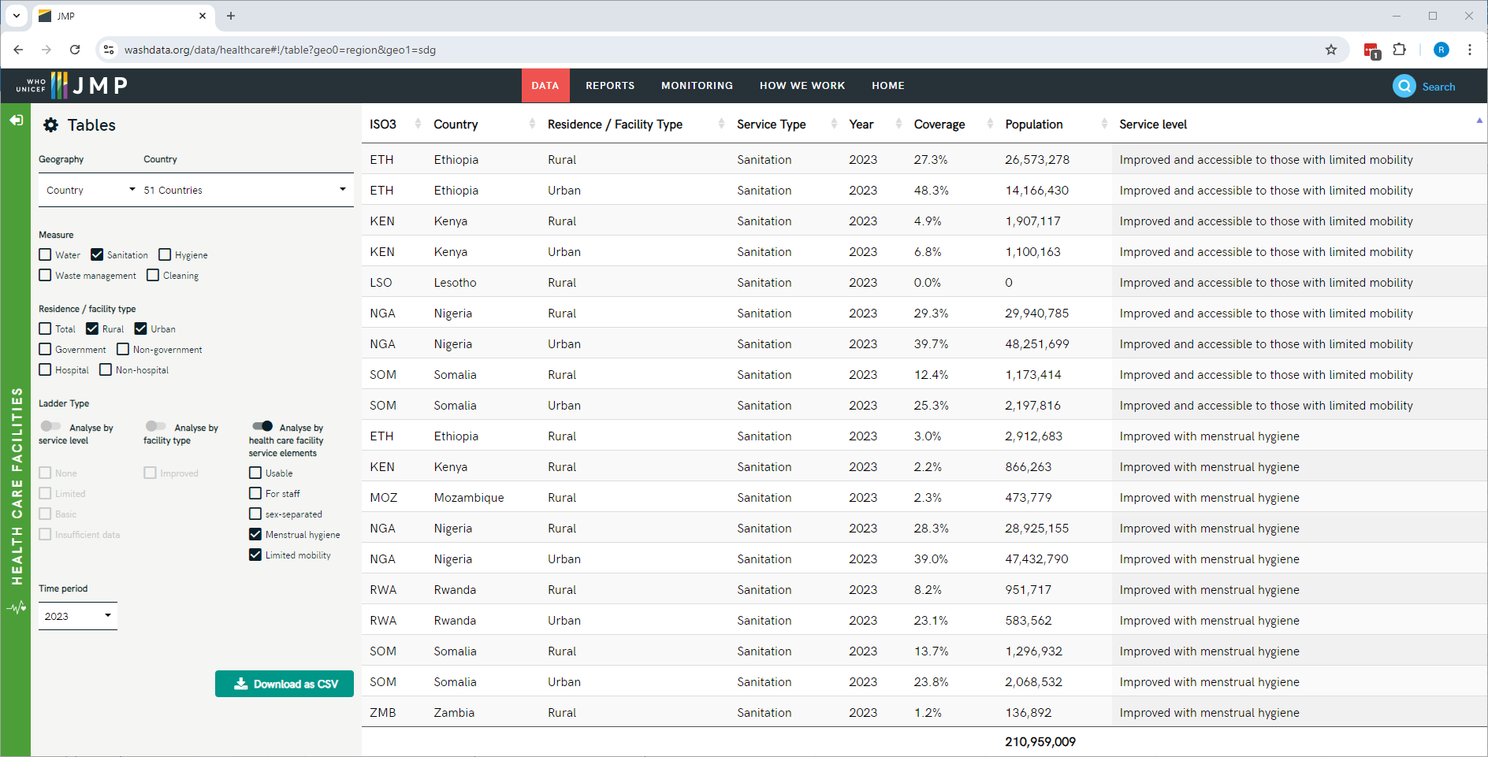
Notes:
Tables
Somalia: limited mobility and MH, both around 20%, here we see the urban/rural breakdown. Also note that in some countries data are available only for rural areas, for instance MH in Zambia.

Slide 25
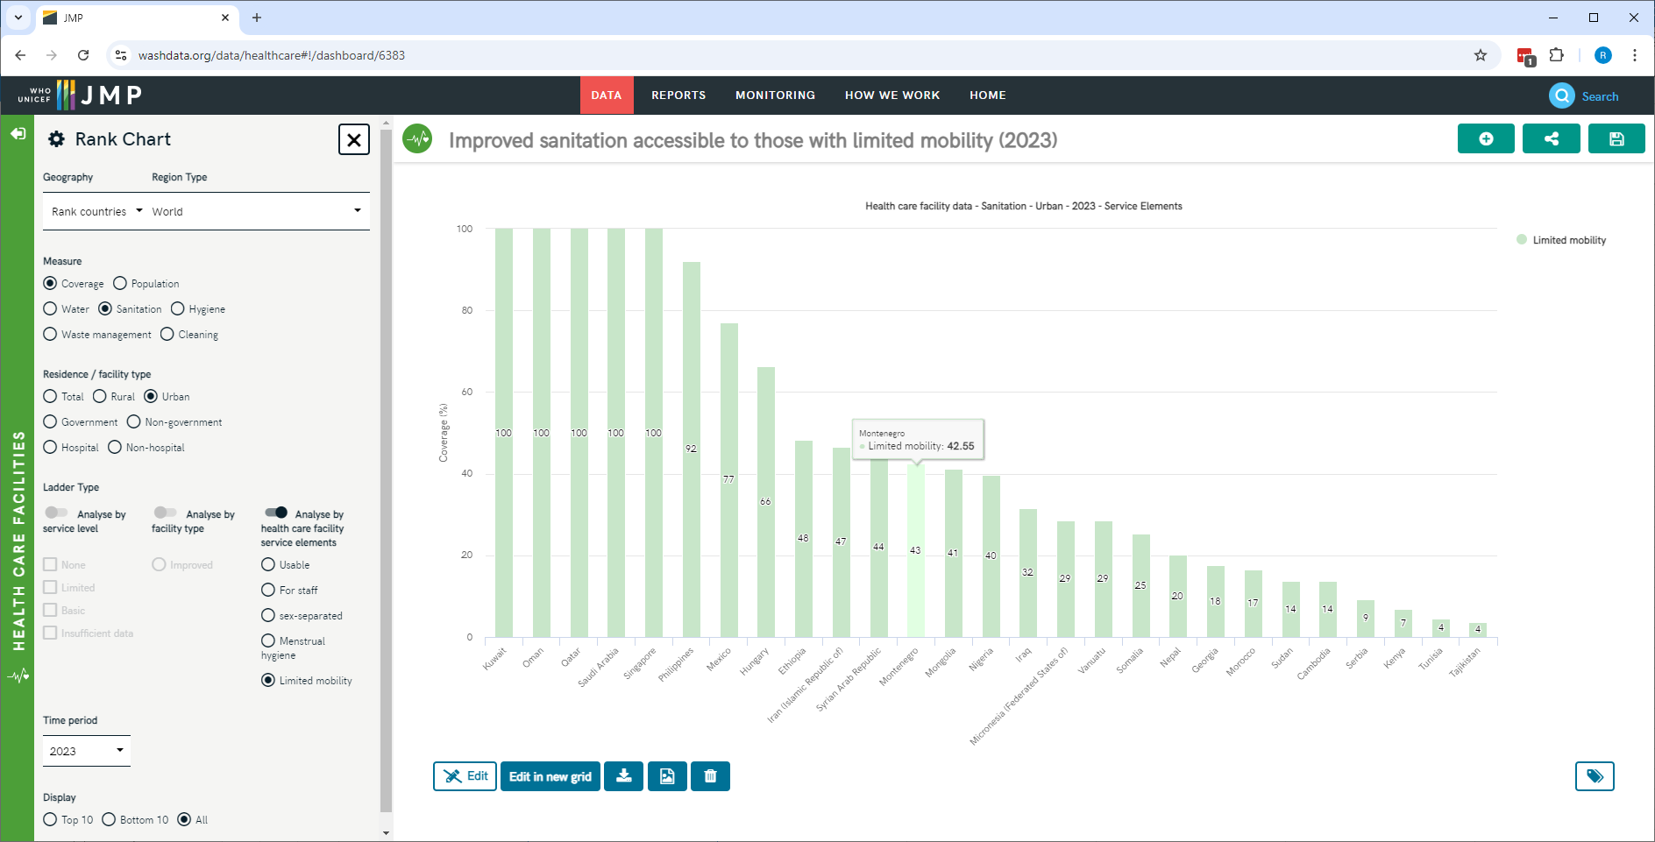
https://washdata.org/data/healthcare#!/dashboard/6383
Notes:
26 out of 60 fragile contexts with data

Slide 26
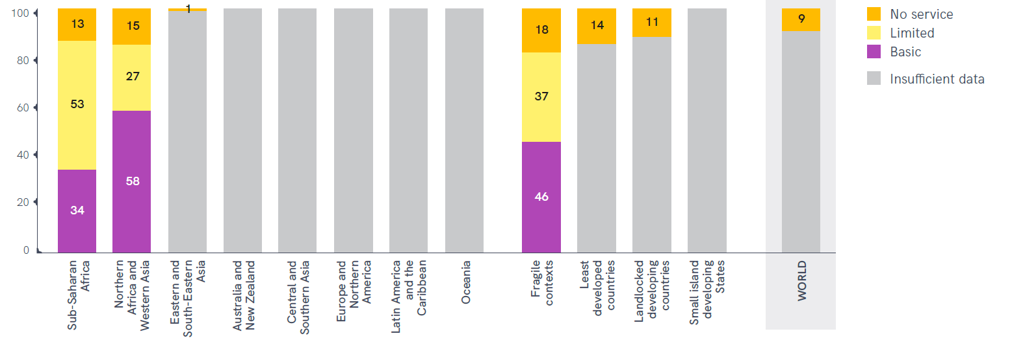
Notes:
Simpler definition: two elements

Slide 27
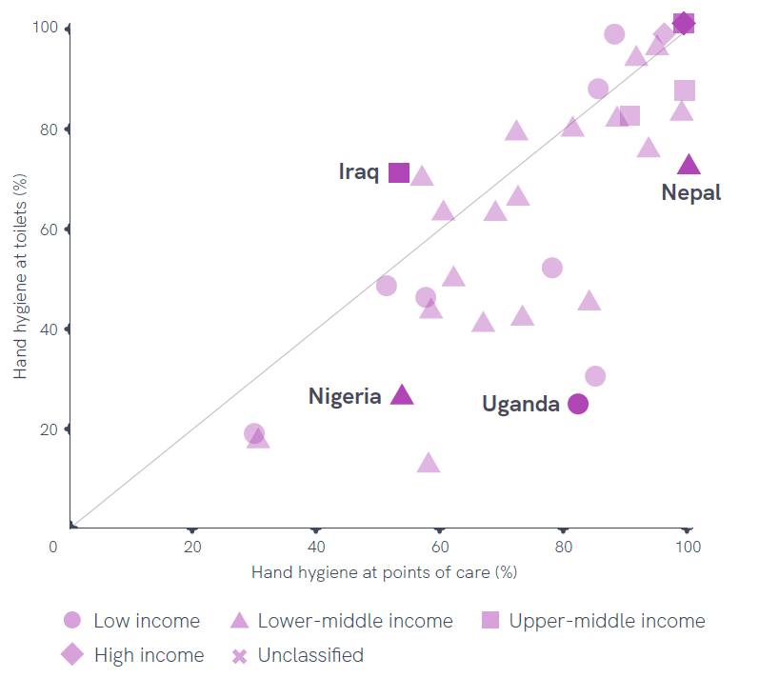
Limiting factor
Usually availability of water and soap at toilets, rather than hand hygiene at points of care
(Often data unavailable for toilets)

Slide 28
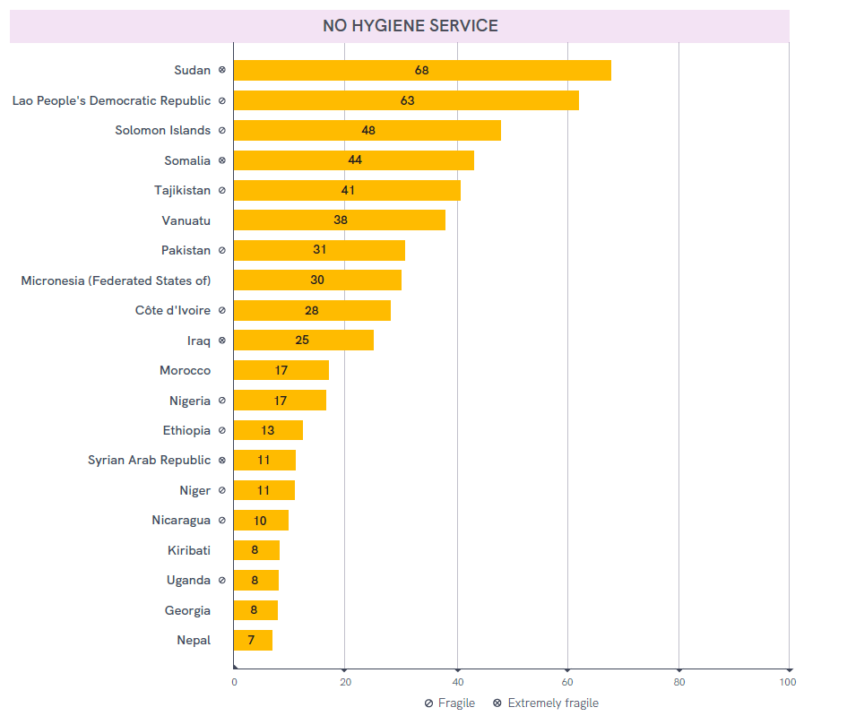

Slide 29
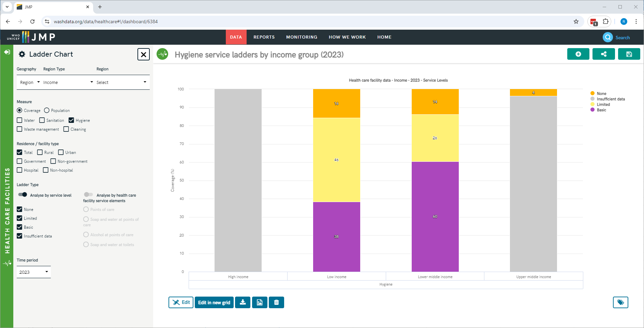
https://washdata.org/data/healthcare#!/dashboard/6384
Notes:
Ladder chart

Slide 30
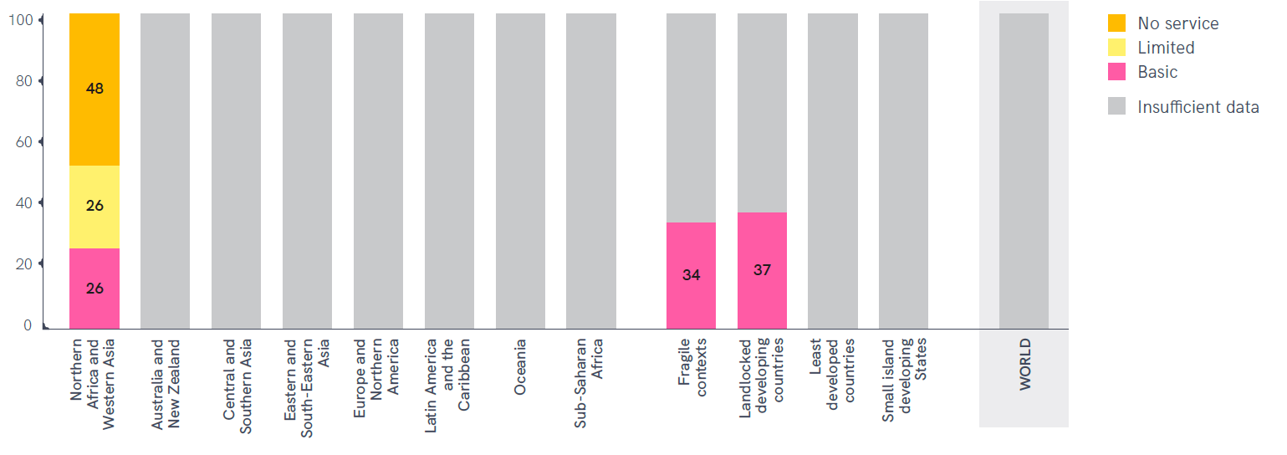
Notes:
Still only 11% data coverage for SSA, only 7 of the 51 countries in the region. NAWA has data from 12 countries representing nearly half of the regional population

Slide 31
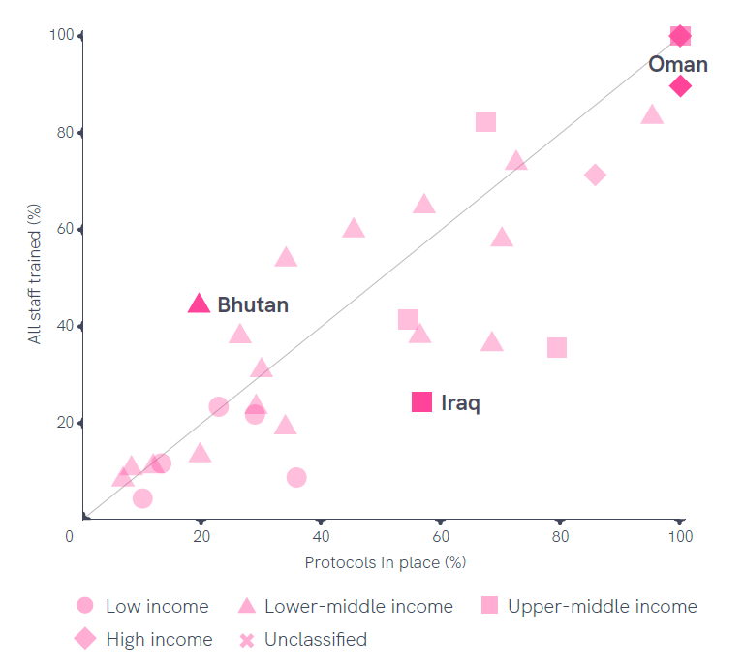
Limiting factor
Sometimes availability of protocols (e.g. Bhutan)
More often, incomplete training of staff responsible for cleaning (e.g. Iraq)

Slide 32
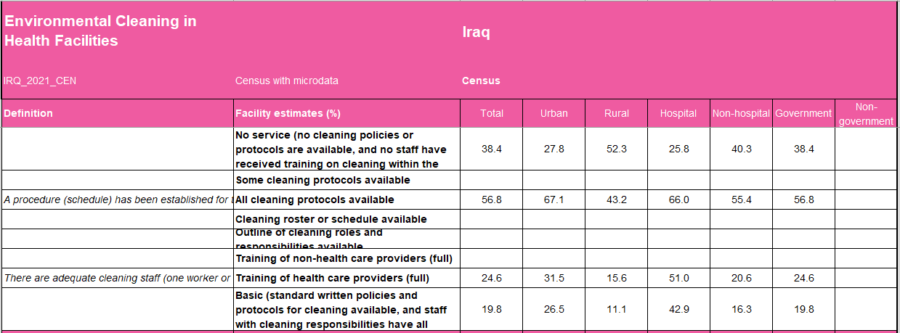
Notes:
Environmental Cleaning Data tab in country file
57% for all cleaning protocols available
25% for all health care providers are trained
Combine them at 20%, but JMP rule is to take the minimum, in each of the different domains. So 25% for total, 31% for urban, 16% for rural, etc.
Really good data disaggregation in this Census, everything except non-government facilities.

Slide 33
30. A procedure (schedule) has been established for the cleaning of each room / setting regularly and when needed
31. There are adequate cleaning staff (one worker or many workers) trained and can demonstrate correct procedures for cleaning and disinfection and self-monitoring to be in place as required for clean and safe rooms.
a. Yes | b. There are cleaning staff, but not adequate/ trained | c. Not available
51.04 |  | 48.96
25.25 | 53.68 | 21.08
28.26 | 47.83 | 23.91
18.55 | 42.45 | 39
23.08 | 30.77 | 46.15
12.61 | 26.62 | 60.77
11.11 | 22.22 | 66.67
27.27 | 22.73 | 50
24.61 | 38.25 | 37.14
Healthcare Facility Type | b. Procedure is known but not applied.
Hospital
Major Primary Health Care Center (Family Health) | 25.63
Primary Health Care Center (Family Health) | 19.57
Subprimary Health Care Center | 21.09
Mobile clinic | 7.69
Healthy home | 14.36
Medical detachment | 7.41
Other | 9.09
Total | 18.63
a. Yes | b. Procedure is known but not applied. | c. Not available
66.04 |  | 33.96
41.7 | 25.63 | 32.68
38.04 | 19.57 | 42.39
31.09 | 21.09 | 47.82
30.77 | 7.69 | 61.54
21.37 | 14.36 | 64.27
11.11 | 7.41 | 81.48
45.45 | 9.09 | 45.45
38.16 | 18.63 | 43.21
Notes:
Called a Census, because it covered all HCF, but it was really a WASH-IPC focused assessment, conducted by the MoH with support from WHO and UNICEF.
73 indicators, in most cases three response levels: Yes, partial, no.
Results tabulated by different types of HCF; for JMP estimates we take the first one as hospital and group all of the other ones together as non-hospitals.
Indicator 30: close to “protocols for cleaning are available”. Take yes or “known but not applied”. So about 57%.
Indicator 31: close to “all staff with cleaning responsibilities have received training”. In this case, don’t consider the ‘partial’ category as meeting the basic service requirement. So that‘s your 25%.

Slide 34
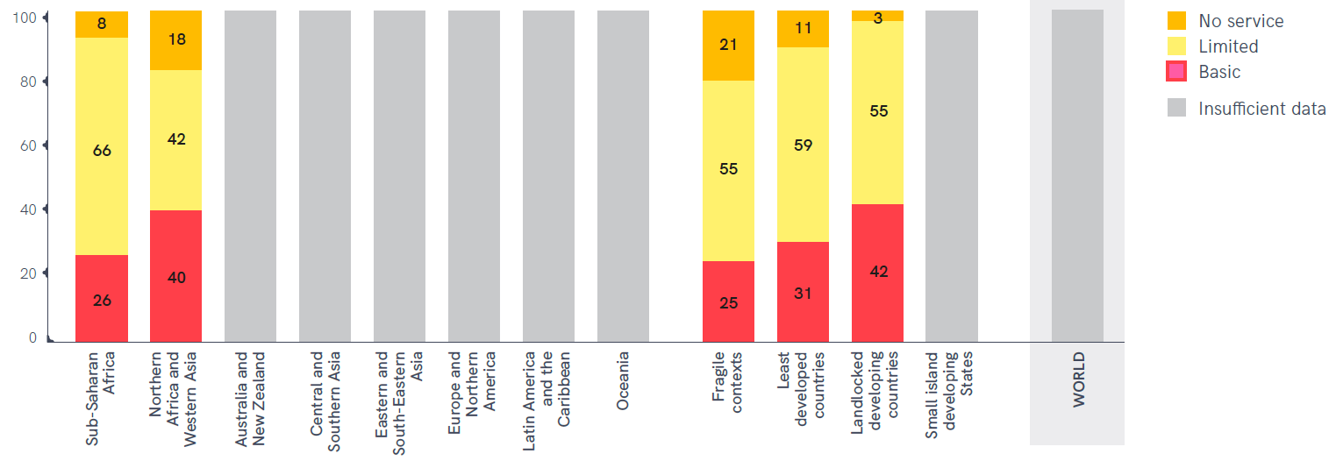
Notes:
Last one: definition
Same two SDG regions. Here, SSA had 80% data coverage: waste management is more commonly reported in the health literature. Getting close in some other regions: Central and Southern Asia were at 28% data coverage.

Slide 35
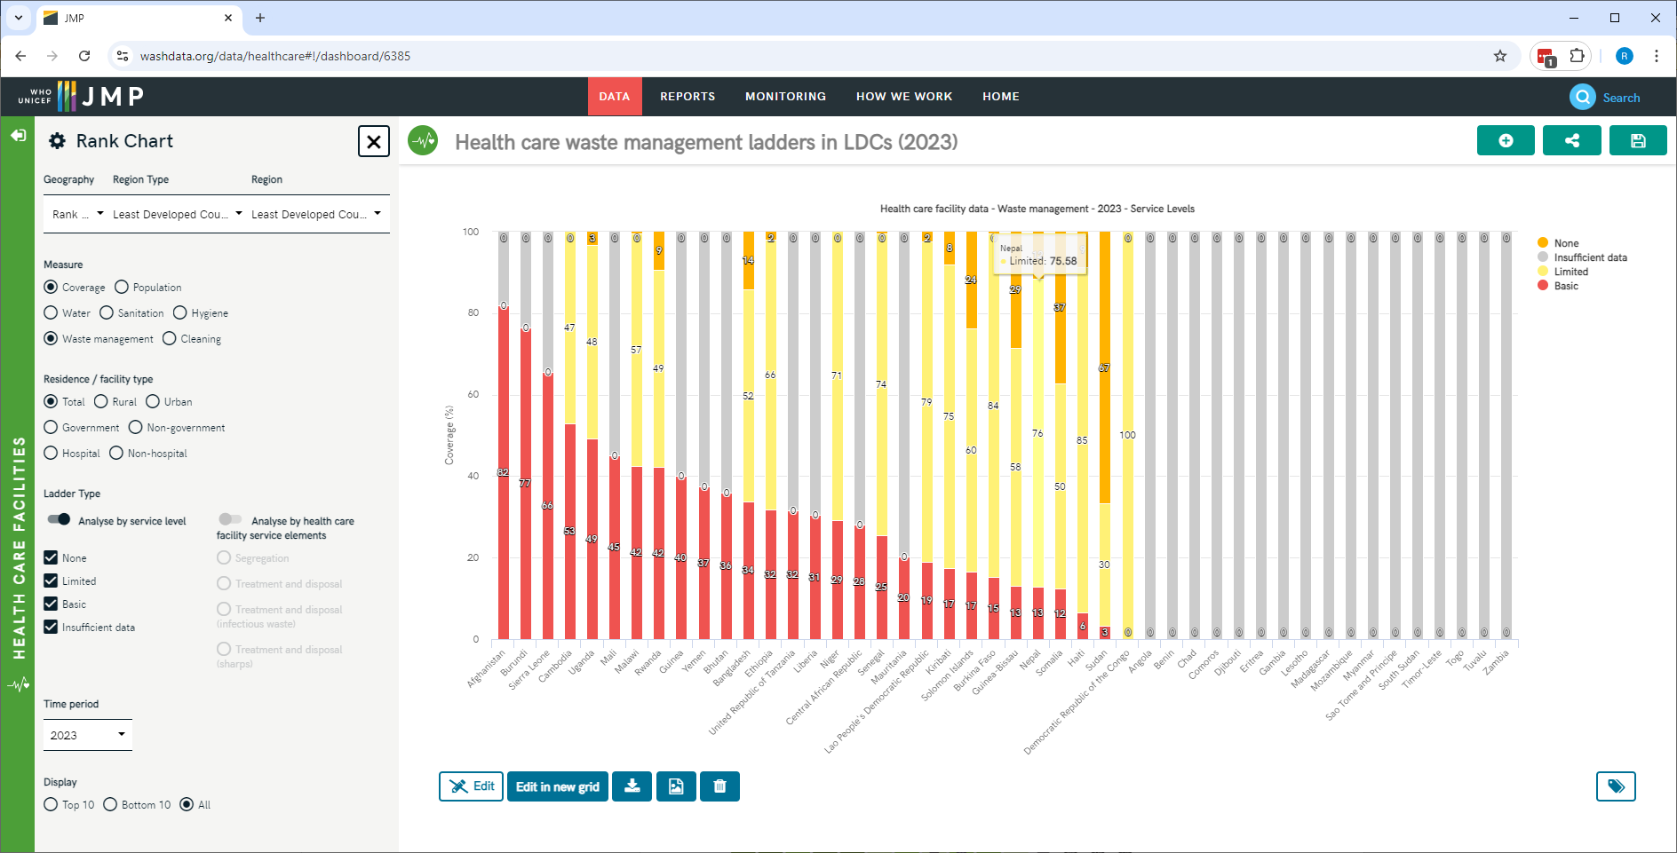
https://washdata.org/data/healthcare#!/dashboard/6385
Notes:
Another Rank chart, this time for full ladders.
Lots of yellow: limited service. That means some level of segregation or treatment, but not meeting the basic service level. Nepal: 13% basic but 76% limited.

Slide 36
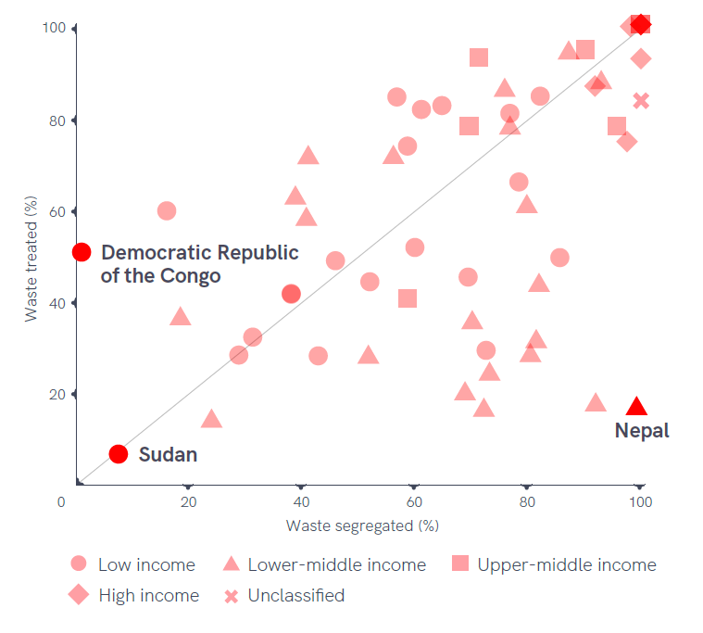
Limiting factor
Often segregation
Treatment without segregation, e.g. DRC
Often treatment
Segregation without treatment, e.g. Nepal (burning)
Notes:
In Nepal, while almost all facilities reported safe segregation (>99%), less than a fifth (17%) reported safe treatment and disposal. By contrast, in the Democratic Republic of the Congo, half of health care facilities (50%) reported safe treatment
and disposal but hardly any (<1%) reported safe segregation.
Many countries to the right of the line do practice some treatment, but doesn’t meet the basic service requirement.

Slide 37
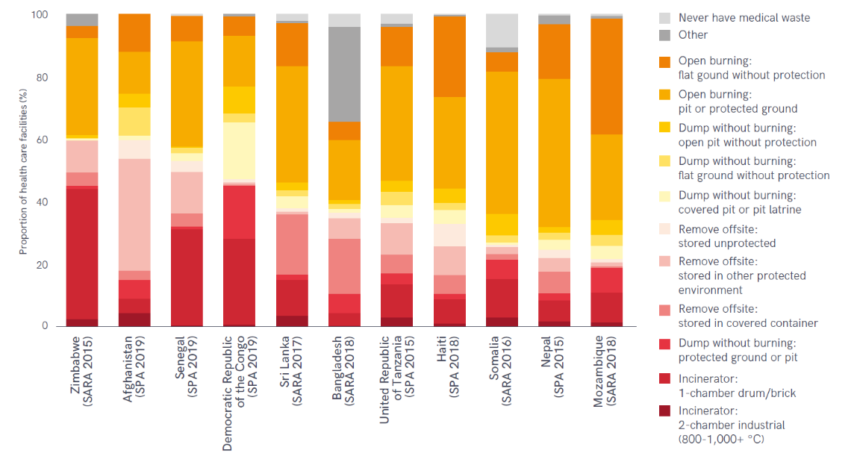
Notes:
Nepal SPA 2015: lots of burning. Whether it’s on flat ground without protection (dark organe), or in a pit or protected ground (light orange, very common in Nepal), it doesn’t meet the basic service level.
Best practice is to not incinerate at all, or if burning to use a 2-chamber industrial incinerator that gets hot enough to prevent the formation of toxic compounds when plastic is burnt. But that’s the dark red, which is very rare in all of these LMICs.

Slide 38
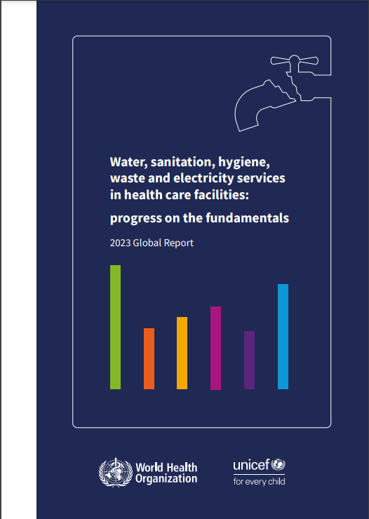
Next steps
2019
2019
2022
2020
2024
2023
2026
2025
Full report
Report, UNGA input
Notes:
JMP reports give statistics, they don’t talk at all about why things are the way they are, or what actions are being taken by countries and individual HCF.
WHO and UNICEF produce a parallel series of reports that do describe these actions, starting from the ‘practical steps’ document that came out in 2019, through updates in 2020 and 2023.
Next of these is planned for May or June, it will focus on the ‘country tracker’ which is a self-reported assessment that countries take at the national level, not the facility level. There’s a round of data collection underway right now.
Both of these will feed into a formal report to the UNGA in response to the 2023 resolution.
And then in 2026 we’ll have the next JMP full report on WASH in HCF, so we have already started looking for new data sources to get ready for that.

Slide 39
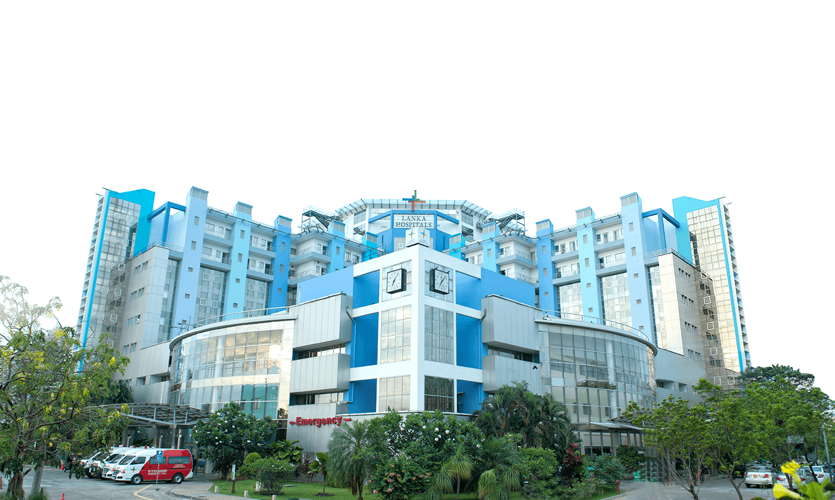
Thank you!
info@washdata.org

