Slide 1
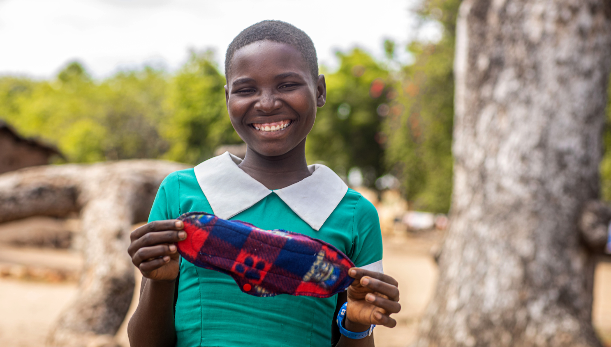
Global progress update on WASH in schools
UNC Water and Health 2024
WHO/UNICEF Joint Monitoring Programme (JMP)
www.washdata.org
7th WASH in Schools ILE, Manila 11 November 2019
Notes:
WHO/UNICEF JMP serves as custodian of global data for targets 6.1 and 6.2
The WHO/UNICEF Joint Monitoring Programme for Water Supply, Sanitation and Hygiene (JMP) has reported country, regional and global estimates of progress on drinking water, sanitation and hygiene (WASH) since 1990.
The JMP maintains an extensive global database and has become the leading source of comparable estimates of progress at national, regional and global levels.

Slide 2
OUTLINE
1
2
3
What proportion of schools have basic WASH services?
Are countries on track to meet the SDGs for WinS by 2030?
Which countries are making rapid progress?
Notes:
We will try to provide answers to these questions today.

Slide 3
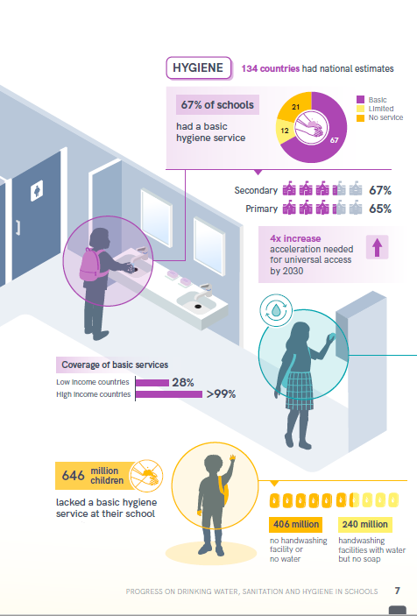
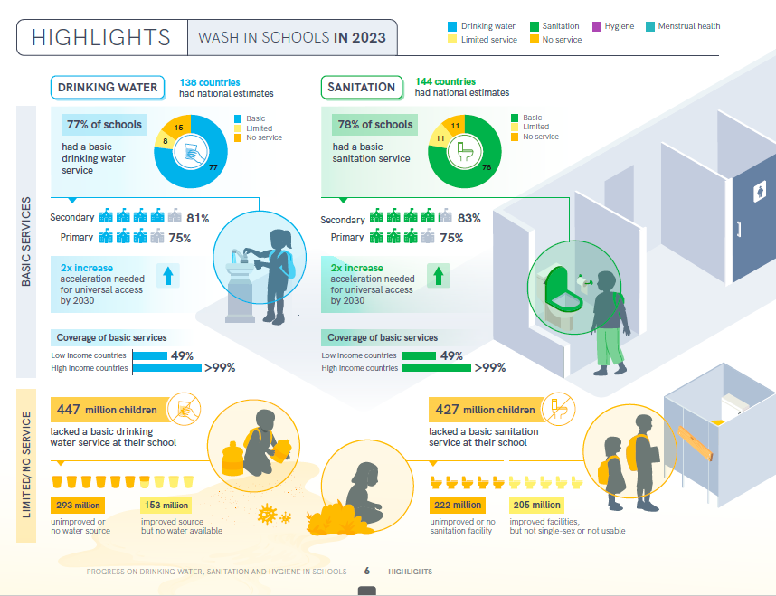
INFOGRAPHIC HIGHLIGHTS FROM JMP 2024 REPORT
Notes:
Our latest report included an infographic summarizing headline statistics and key messages from the report for non-specialist audiences
We would love to have your feedback and suggestions for improving the visualization and communication of JMP estimates for WASH in schools

Slide 4
4.a Build and upgrade education facilities that are child, disability and gender sensitive and provide safe, nonviolent, inclusive and effective learning environments for all
4.a.1 Proportion of schools with: …(e) basic drinking water; (f) single-sex basic sanitation facilities; and (g) basic handwashing facilities (as per WASH indicator definitions)
Notes:
The JMP ladders focus on progress towards a basic level of drinking water, sanitation and hygiene service in schools which is the indicator used for SDG monitoring
Agreed upon by Expert Group representing multiple regions and organizations, including UNESCO-UIS.
“usable” refers to toilets or latrines that are (1) available to students (doors are unlocked or a key is available at all times), (2) functional (the toilet is not broken, the toilet hole is not blocked, and water is available for flush/pourflush toilets), and (3) private (there are closable doors that lock from the inside and no large gaps in the external structure) at the time of the questionnaire or survey.

Slide 5
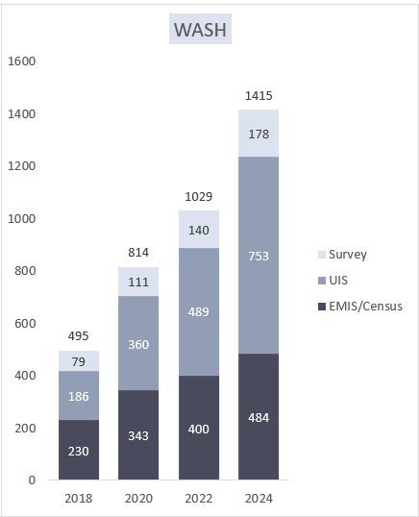
NATIONAL DATA SOURCES USED IN THE JMP 2024 REPORT
The JMP produces updated estimates on WASH in schools every 2 years
A total of 1,415 national data sources were used in the 2024 progress update
Many data are from national Education Management Information Systems (EMIS)
Notes:
A total of 1,029 national data sources were used for the 2022 update report
Average of 5.6 datasets per country (182 countries)
Data sources include EMIS, periodic censuses, UNESCO Institute for Statistics data, and surveys
Data were mapped to the indicator elements to standardize results between surveys and countries to the extent possible

Slide 6
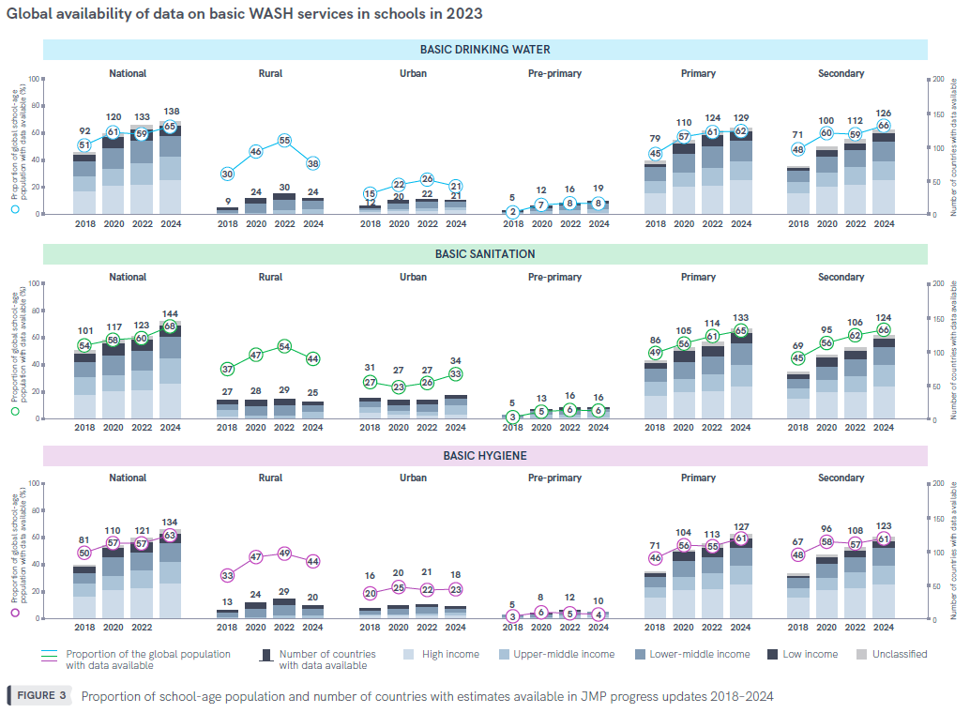
Global availability of data on basic WASH services in schools in 2023
Data available for 63-68% of global school-age pop for 2024 report
Data gaps persist for urban/rural disaggregation and pre-primary schools

Slide 7
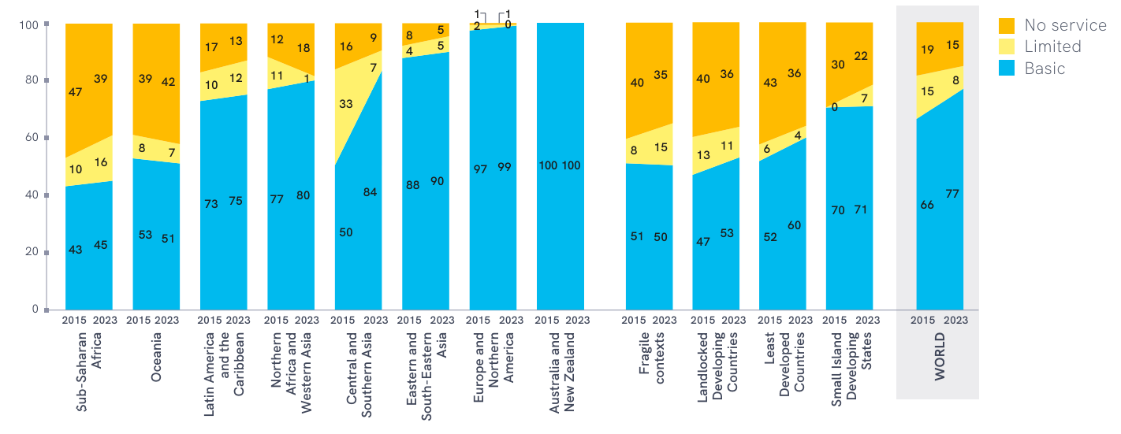
BASIC DRINKING WATER IN SCHOOLS (2023)
Estimates from 138 countries
77% of schools globally had basic service
447 million children lacked basic service
Notes:
Globally: increase from 66% in 2015 to 77% in 2022, 1.3 % pt/yr
447 million lacking, down from 620 in 2015.
Tremendous growth in CASA, relatively flat in other regions

Slide 8
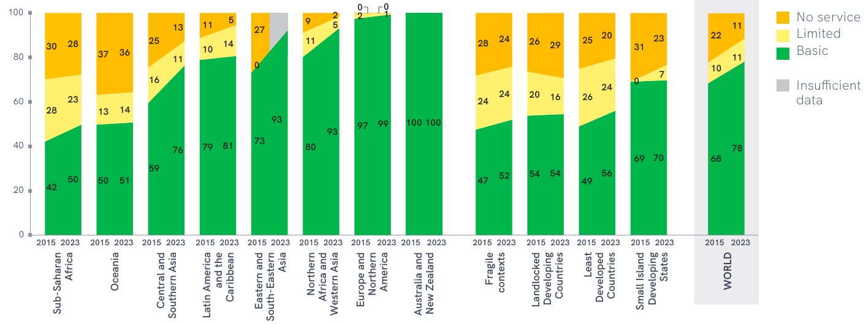
BASIC SANITATION IN SCHOOLS (2023)
Estimates from 144 countries
78% of schools globally had basic service
427 million children lacked basic service
Notes:
Globally: increase from 68% in 2015 to 78% in 2022, 1.2 % pt/yr
427 million lacking, down from 586 in 2015.
Tremendous growth in CASA, also strong in SSA an ESEA

Slide 9
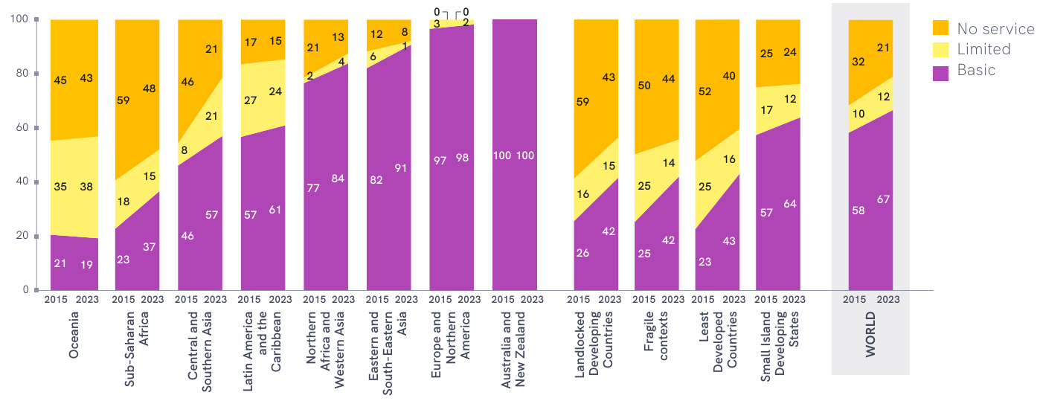
BASIC HYGIENE IN SCHOOLS (2023)
Estimates from 134 countries
67% of schools globally had basic service
646 million children lacked basic service
Notes:
Globally: increase from 58% in 2015 to 67% in 2022, 1.1 % pt/yr
646 million lacking, down from 770 in 2015.
Strongest growth in SSA, also notable in CASA, LAC, NAWA and ESEA. Decreasing in Oceania

Slide 10
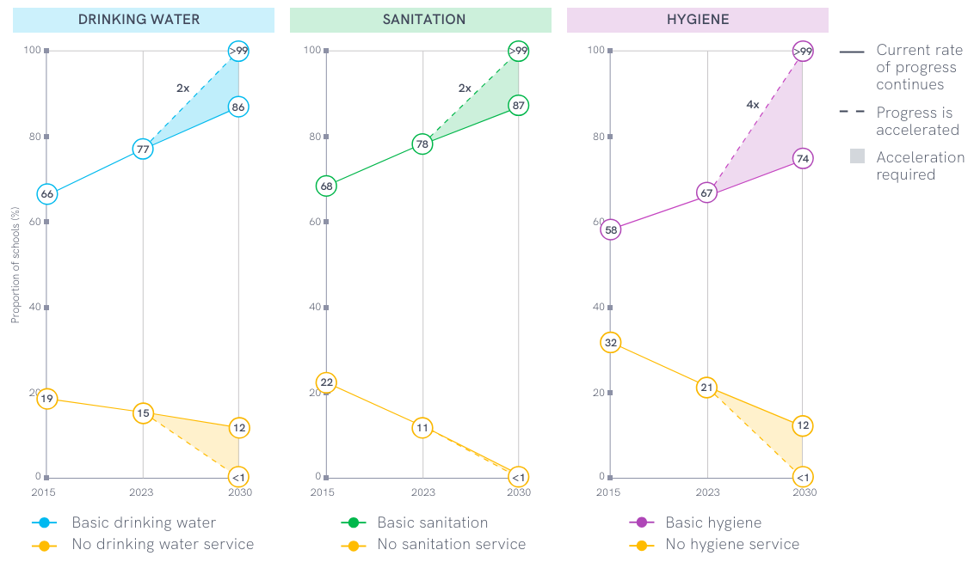
TRENDS IN BASIC WASH IN SCHOOLS (%), 2015 → 2023 → 2030
We are not on track to meet the SDGs…
We need to increase rates of progress 2- to 4-fold to reach global targets by 2030!
Notes:
While some progress on WASH in schools has been made since the start of the SDGs it is much too slow to meet the SDGs by 2030 and is some cases is stagnant or decreasing.
Some regions are on track
Already universal: ANZ, ENA
Water: CASA
Sanitation: ESEA, NAWA
Hygiene: no other regions

Slide 11
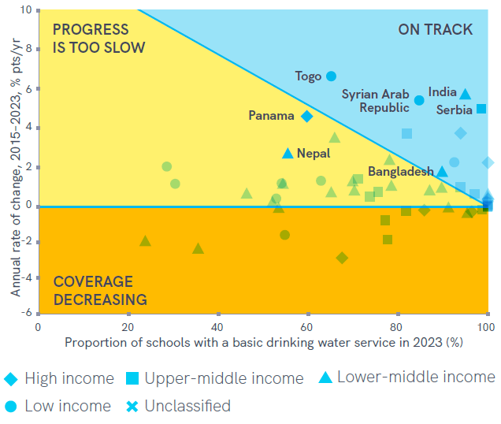
PROGRESS ON BASIC DRINKING WATER IN SCHOOLS (2023)
19 of 53 countries with trend data are on track
Rapid progress is possible!
E.g. India, Panama, Serbia, Syria, Togo increased coverage by >5 % pts/ yr
Some countries are close!
E.g. Benin (LMIC) has increased 3-fold from 35% in 2015 to 66% in 2023, on track to reach 93% by 2030.
Benin
Notes:
Explain axes
But progress is still too slow in many.
E.g. Panama (a HIC) has increased 5-fold (19% in 2015 - 60% in 2023), but this rate is still insufficient.

Slide 12
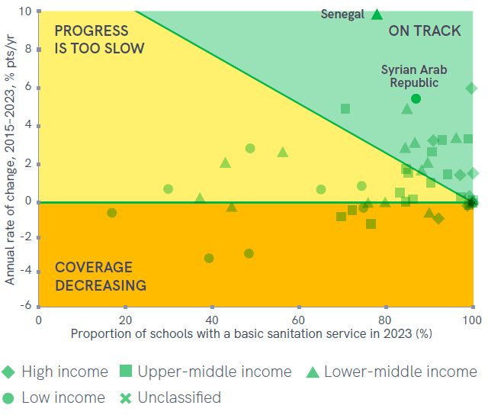
PROGRESS ON BASIC SANITATION IN SCHOOLS (2023)
24 of 51 countries with trend data are on track
5 countries with progress over 5 % pts/yr: Croatia, Indonesia, Philippines, Syrian Arab Republic, and Senegal
Syria is the only LIC on track for universal coverage
Croatia
Indonesia
Philippines

Slide 13
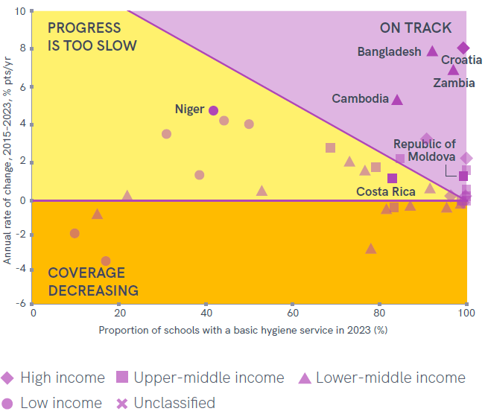
PROGRESS ON BASIC HYGIENE IN SCHOOLS (2023)
13 of 38 countries with trend data are on track
Croatia, Bangladesh, Cambodia, Niger, Zambia achieved increases of >5 % pts/yr
Ethiopia has made impressive strides with nearly 4 % pts/yr improving from <1% in 2015 to over 30% in 2023 but faster progress is needed.
Ethiopia
Notes:
Cambodia and Zambia were also some of the first countries to align national monitoring systems with the SDG indicators for WinS.
Niger (5.2 % pts/yr) and Cambodia (5.8% pts/yr) recorded similarly fast progress, but by 2023, Niger (low income) had only reached 42% coverage compared with 84% coverage in Cambodia (lowermiddle income).

Slide 14
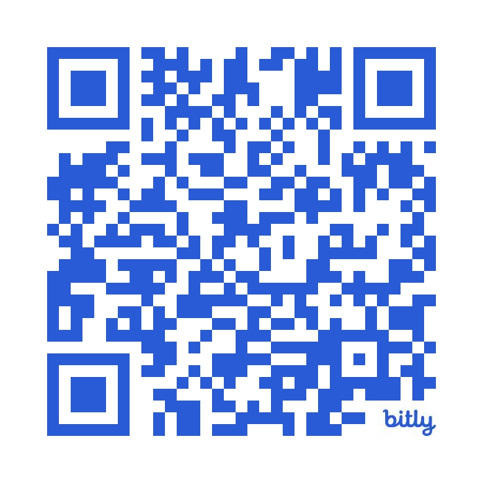
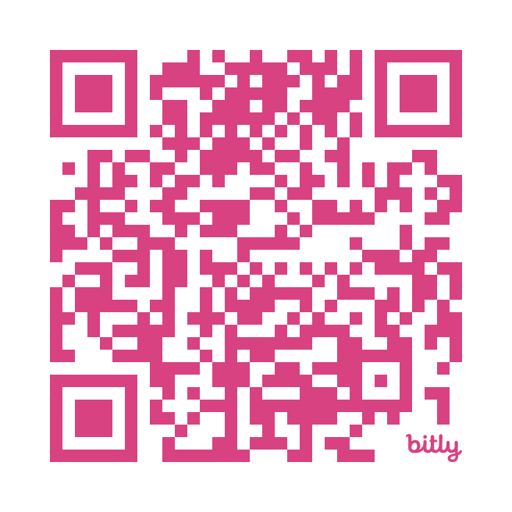
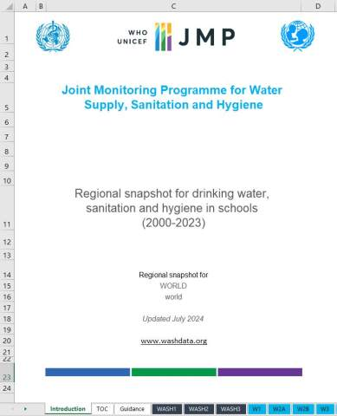
See the national estimates and data used for generating them in JMP WinS Country Files (in multiple languages): washdata.org/data/downloads washdata.org/reports/statistical-snapshots-jmp-2024-progress-update-wash-schools
Notes:
Country files are available online for over 180 countries including detailed data and sources that were used and assumptions made
Detailed data files are available on washdata.org.

Slide 15
JMP SERVICE LADDERS FOR WASH IN SCHOOLS
DRINKING WATER |  | SANITATION |  | HYGIENE
Advanced service: Additional criteria may include quality, quantity, continuity, and accessibility to all users |  | Advanced service: Additional criteria may include student per toilet ratios, menstrual hygiene facilities, cleanliness, accessibility to all users, and excreta management systems |  | Advanced service: Additional criteria may include hygiene education, group handwashing, menstrual hygiene materials, and accessibility to all users
Basic service: Drinking water from an improved source and water is available at the school at the time of the survey |  | Basic service: Improved sanitation facilities at the school that are single-sex and usable (available, functional and private) at the time of the survey |  | Basic service: Handwashing facilities with water and soap available at the school at the time of the survey
Limited service: Drinking water from an improved source but water is unavailable at the school at the time of the survey |  | Limited service: Improved sanitation facilities at the school that are either not single-sex or not usable at the time of the survey |  | Limited service: Handwashing facilities with water but no soap available at the school at the time of the survey
No service: Drinking water from an unimproved source or no water source at the school |  | No service: Unimproved sanitation facilities or no sanitation facilities at the school |  | No service: No handwashing facilities available or no water available at the school
Notes:
It is recognised that this basic minimum level of service is not sufficient for full realization of the human rights to education, safe water and sanitation and that additional rungs may be needed in future to monitor advanced service levels.
We try to focus on a specific area each report. MH was the special focus last report.
For more on MH in schools, please come to the Tuesday 8:30-10am session on monitoring MH.

Slide 16
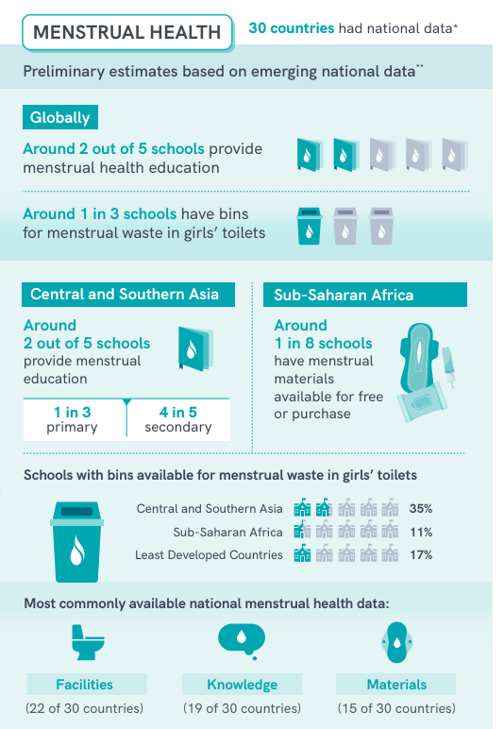
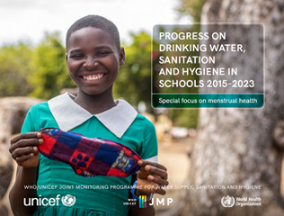
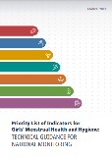
Topics covered:
Domains based on the globally recommended priority indicators:
30 countries have nationally representative data on at least one of the priority indicators for schools or schoolgirls
Few countries have national data related to MH impacts (9), discomfort/disorders (5), a supportive social environment (2)
Definitions vary widely between countries and data sources – indicator harmonization is needed, including adoption of globally recommended priority indicators
Data availability
Materials
Facilities
Knowledge
Discomfort/disorders
Supportive social environment
MH impact
Policy
Priority Indicators for girls’ MHH, Global MHH Monitoring Group (2022): https://tinyurl.com/ytyxd2e9
Notes:
The JMP 2024 progress update on WinS had a special focus on menstrual health (Section 5 – lots of detail)
The report reviewed the availability of nationally representative data corresponding to each of the domains in the list of priority indicators for girls
We found that 30 countries had nationally representative data for at least one of the priority indicators for schools or school girls (7 out of 8 regions and all income groups)
22 had data for facilities, 19 for knowledge, 15 for materials
But relatively few had national data for MH impacts (9), discomfort/disorders (5) and supportive social environment (2)
Because these countries represent more than 30% of the school age population we included some preliminary regional and global estimates
Globally around 2 out of 5 schools provide MH education and around 1 in 3 have bins for menstrual waste in girls' toilets
Central and Southern Asia 2 out of 5 schools provide MH education
Sub-Saharan Africa 1 in 8 schools have menstrual mateirals available for free or purchase
But report also highlights that definitions vary widely between countries and data sources which makes comparison difficult so much more effort needed to harmonize and standardise these indicators in national monitoring sytems

Slide 17
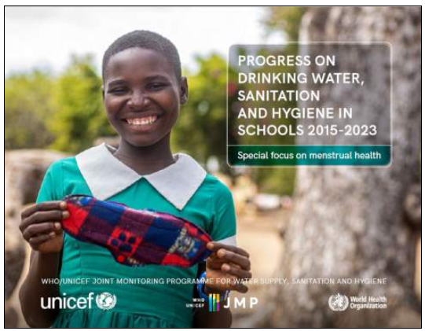
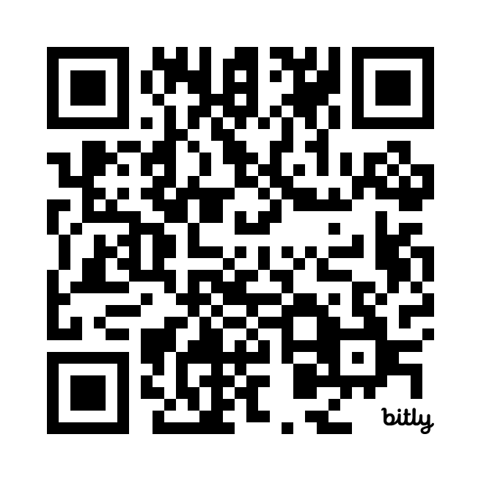
SUMMARY
Many countries now have national data on basic WASH services in schools and a growing number have sufficient data to estimate trends
Globally, we are not on track to meet the SDGs, with a 2- to 4-fold rate increase needed.
→ We need to accelerate progress on WASH in Schools!
Some countries are achieving impressive rates of progress and on-track to meet the SDGs
→ What can other countries learn from these strong performers?
The full report is available here:
https://washdata.org/reports/jmp-2024-wash-schools
Notes:
Challenges and way forward
My presentation (20 min). Engage audience at end – hear their views. Q&A/group discussion.
End with - What support structures do countries need (2-3 things)?

Slide 18
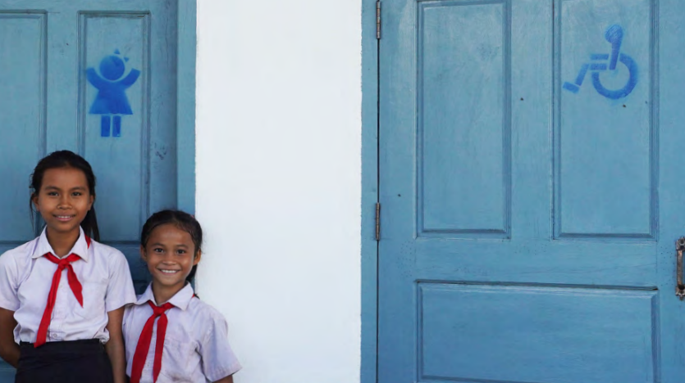
Thank you!
info@washdata.org
washdata.org/monitoring/schools

