Slide 1

Safely treated wastewater
Target 6.3 seeks to “by 2030, improve water quality by reducing pollution, eliminating dumping and minimizing release of hazardous chemicals and materials, halving the proportion of untreated wastewater and substantially increasing recycling and safe reuse globally”
SDG Indicator 6.3.1 is “the proportion of domestic and industrial wastewater flows safely treated”
Notes:
Greetings everyone, my name is Andrew Shantz and I am a consultant with WHO. We will turn now to SDG Indicator 6.3.1 on safely treated wastewater, which is associated with a target to improve water quality by reducing pollution and halving the proportion of untreated wastewater that is discharged globally.
The indicator is represented as the proportion of domestic and industrial wastewater flows that are safely treated.

Slide 2



Custodian agencies for global monitoring
Total wastewater
Industrial wastewater
Domestic wastewater
Notes:
- There are three custodian agencies responsible for global monitoring. Our colleagues at UN-Habitat are responsible for the total and industrial wastewater components. WHO is responsible for domestic wastewater – in part due to linkages to the JMP and monitoring of safely managed sanitation under Indicator 6.2.1a. And finally, UNSD is a custodian due to their important Environmental Statistics questionnaire which is an important source of harmonized wastewater data.

Slide 3
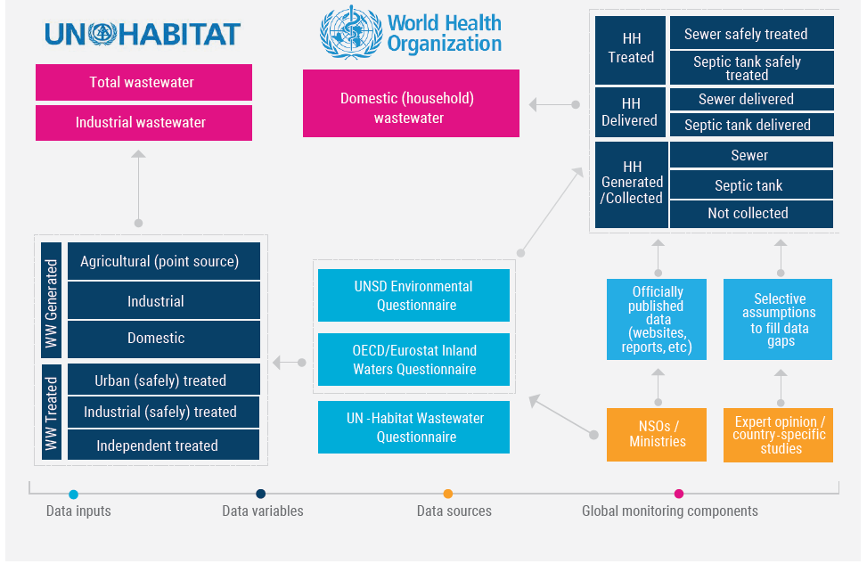
Indicator 6.3.1: Domestic wastewater
Different methodology and approach than for total and industrial wastewater
Notes:
The approaches that UN-Habitat and WHO use for the monitoring of the indicator are distinct and not comparable. UN-Habitat compiles data directly from UNSD and other large databases, ignores any data gaps, and publishes data on total and industrial wastewater that is representative only of the data published by countries, whether complete or incomplete. WHO’s methodology fills data gaps in some cases using assumptions. UN-Habitat updates their database and estimates every 3-years while WHO updates theirs every 2-years in coordination with the JMP. However, we publish a combined report for Indicator 6.3.1 every 3-years.

Slide 4
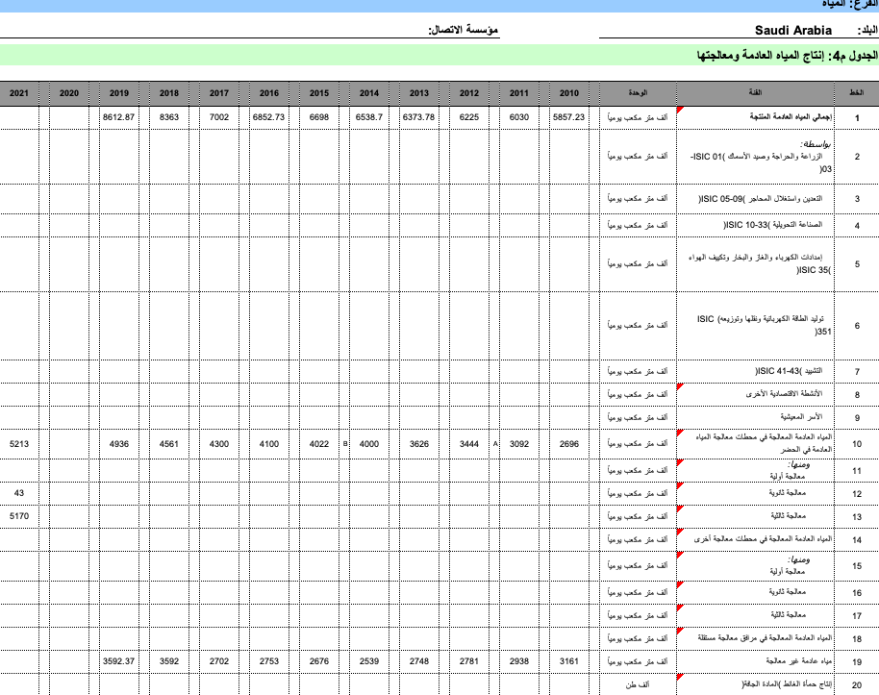
UNSD / UNEP Environmental Questionnaire
Table W4 – Volumetric wastewater data
Generated by households
Treated in urban WWTP
Primary
Secondary
Tertiary
https://unstats.un.org/unsd/envstats/country_files
Notes:
This slide shows an example of the important UNSD / UNEP environmental questionnaire that many National Statisticsal Offices (NSOs) would already be familiar with. Here we have Table W4 which presents volumetric wastewater data. The highlighted cells may be used by WHO for 6.3.1 monitoring.

Slide 5
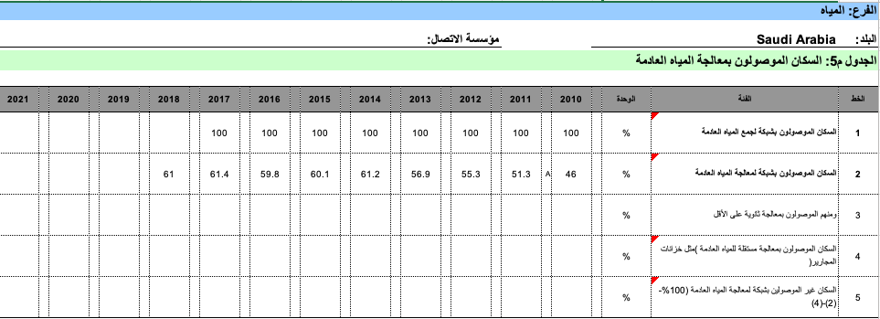
UNSD / UNEP Environmental Questionnaire
Table W5 – Population-based wastewater data
https://unstats.un.org/unsd/envstats/country_files
% connected to sewers
% connected to sewers with treatment
plants
% connected to sewers with secondary
Or higher treatment
Notes:
This slide shows Table W5, which presents population-based wastewater data and again the highlighted cells are those used by WHO. The UNSD questionnaire does not include all the data used to compute a country’s country estimate for domestic wastewater, but it is a very important source of data worth highlighting.

Slide 6
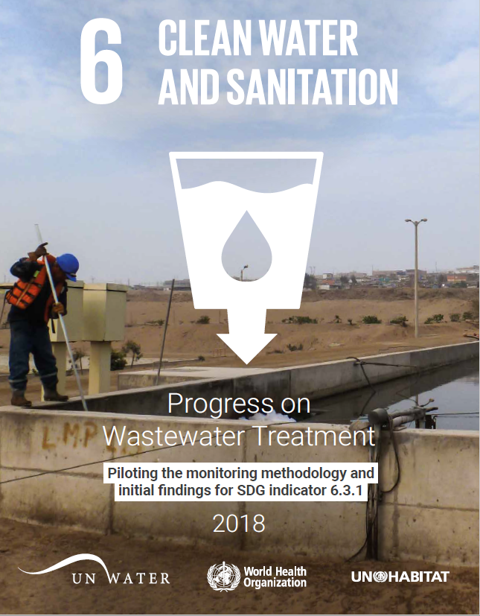
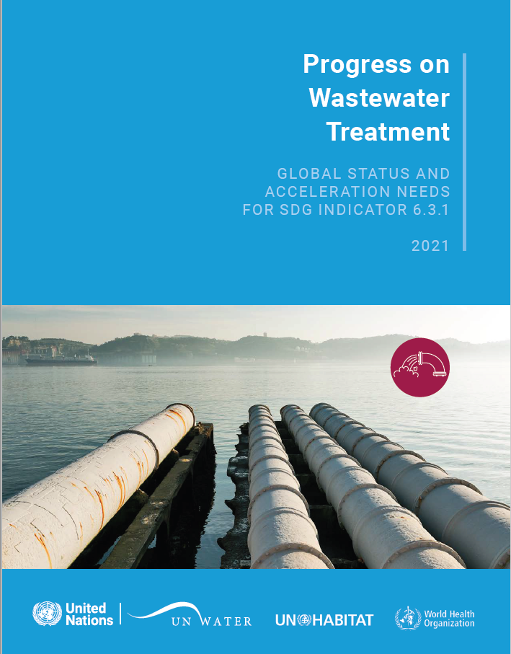
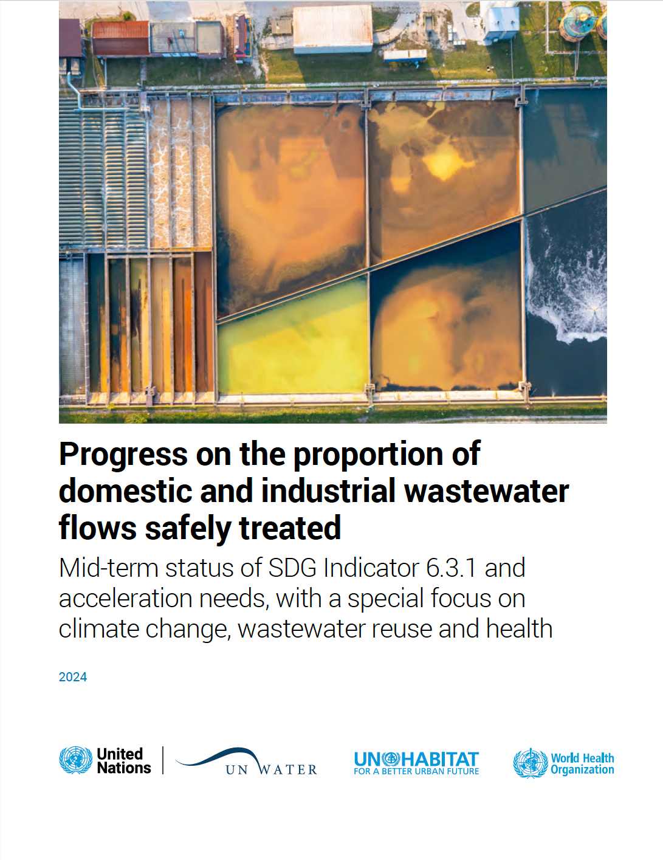
Global progress reports on SDG 6.3.1
First report was published in 2018.
Subsequent reports every 3 years
https://www.unwater.org/publications/progress-wastewater-treatment-2024-update
2018
2021
2024
Notes:
Indicator 6.3.1 is a relatively new indicator with the first report being published in 2018 using a preliminary beta methodology, and subsequent reports in 2021 and 2024 using a full methodology. Data and reports may be found on the UN-Water website.

Slide 7
Domestic wastewater (WHO)
Domestic wastewater
  Households
  Services
Notes:
Domestic wastewater, according to its formal definition, is comprised of flows generated by household and services – such as non-industrial businesses, institutions, and facilities. Although WHO aims to monitor domestic wastewater, due to limited data reporting of wastewater from services, we currently focus our methodology on households only.

Slide 8
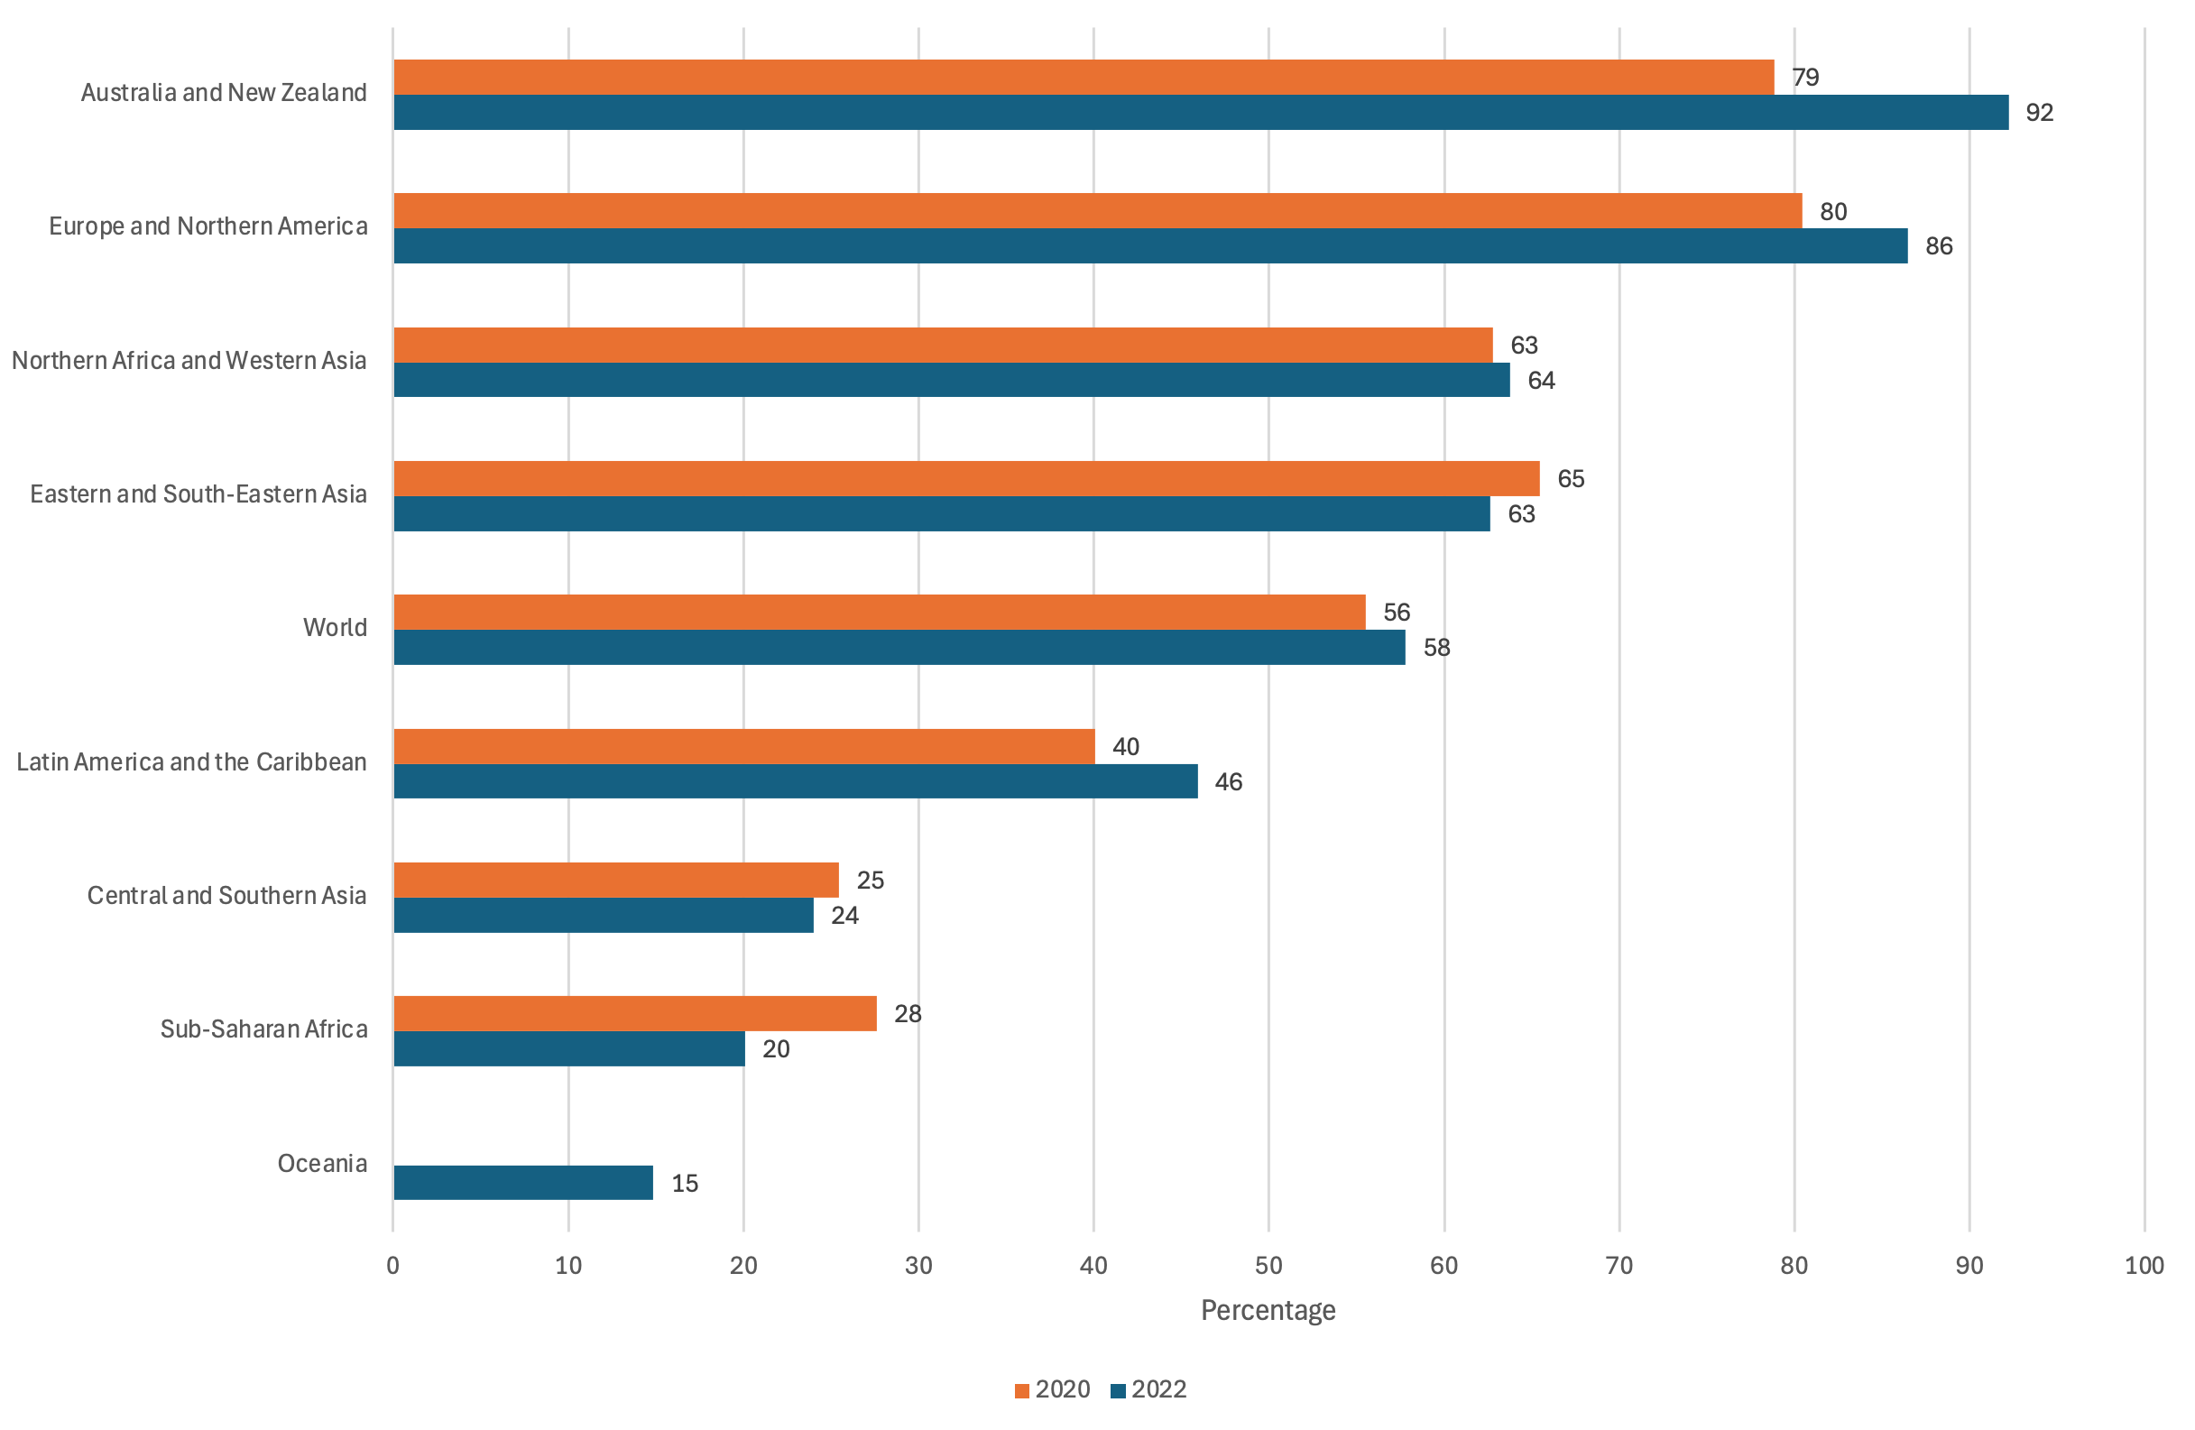
Progress on household wastewater
Globally, 58% of household wastewater was safely treated in 2022
64% in Northern Africa and Western Asia SDG region
Notes:
Here we can see the latest data on the indicator globally and by region. As highlighted, our latest estimates suggest that approximately 58% of global household wastewater flows are safely treated. The figure in the Northern Africa and Western Asia SDG region is slightly higher at 64%.

Slide 9
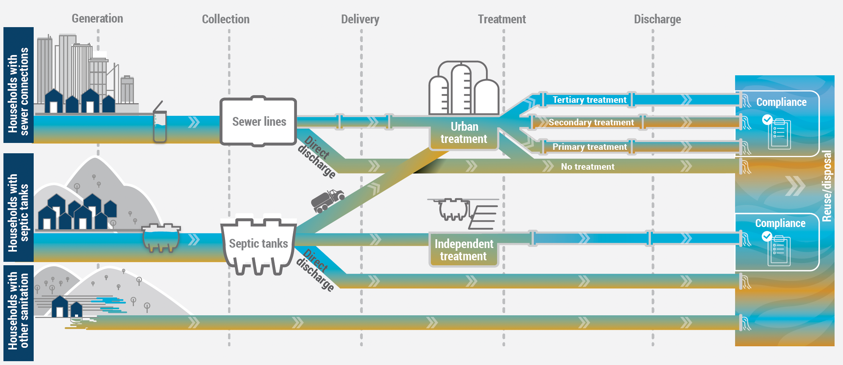
Conceptual framework for estimating safely treated household wastewater
ALL HOUSEHOLDS
Notes:
So, how do we compute these estimates at country level. The methodology is best conveyed using this conceptual framework that we have developed and which I will briefly walk you through now.

Slide 10
Conceptual framework for estimating safely treated household wastewater
Total household wastewater generated (m3/year), all households not just urban or sewer-connected (reported directly or internally estimated by WHO)
ALL HOUSEHOLDS
Notes:
We look for data from countries on the total volume of wastewater generated by households (this is a variable in the UNSD questionnaire), but if unavailable we compute this ourselves based on the total population and household water use.

Slide 11
Conceptual framework for estimating safely treated household wastewater
% of wastewater collected in 1) sewers, 2) septic tanks, 3) all other sanitation facilities (estimates from the JMP, Indicator 6.2.1a)
1.
2.
3.
Notes:
As you can see on the left side, we have classified households into three categories using estimates from the JMP – those with sewer connections, septic tank connections, and all other types of sanitation.

Slide 12
Conceptual framework for estimating safely treated household wastewater
Note: Only flows from households with sewer & septic tank connections have potential to be classified as ‘safely treated’
Notes:
Only households with sewer or septic tank connections have the possibility of contributing to safely treated flows.

Slide 13
Conceptual framework for estimating safely treated household wastewater
% safely treated sewer wastewater flows depend on:
1. % collected in sewers and delivered to wastewater treatment plants (administrative data)
Notes:
Looking at sewer wastewater flows, we are interested in the proportion of flows that are delivered to wastewater treatment plants and the proportion that is directly discharged to the environment

Slide 14
Conceptual framework for estimating safely treated household wastewater
2. % safely treated at wastewater treatment plants
Notes:
Subsequently, we are interested in what happens at the wastewater treatment plant. Safely treated flows are associated with levels of treatment that are employ technological processes categorised as secondary or higher. This is Option 1. Safely treated flows can also be classified by the proportion that are discharged in compliance with standards. If data are available for both options, we use Option 2 over Option 1.

Slide 15
Conceptual framework for estimating safely treated household wastewater
% safely treated at wastewater treatment plants:
Option 1 - % treated by secondary or higher technologies (administrative data)
Notes:
Correspondingly, we look for published data that separates flows into primary, secondary, tertiary treatment levels.

Slide 16
Conceptual framework for estimating safely treated household wastewater
Option 2 - % discharged in compliance with national/local standards (administrative data)
Notes:
And for the proportion of flows that are discharged in compliance with standards

Slide 17
Conceptual framework for estimating safely treated household wastewater
% of safely treated septic tank flows depends on:
1) containment in a properly installed, functioning, maintained tank – no contamination to the surface environment! (sanitary inspections)
Notes:
Now moving to septic tanks, the methodology is very similar to that employed by the JMP for Indicator 6.2.1a. We use the same data for containment.

Slide 18
Conceptual framework for estimating safely treated household wastewater
2) how fecal sludge is managed: a) not yet emptied; b) emptied, buried onsite; c) taken away by a service provider (inspections, HH surveys); d) emptied, disposed locally; e) off-site treatment
Off-site
On-site
Not safely treated
Notes:
And the same data on septic tank emptying, delivery to faecal sludge treatment facilities, and safe treatment therein.

Slide 19
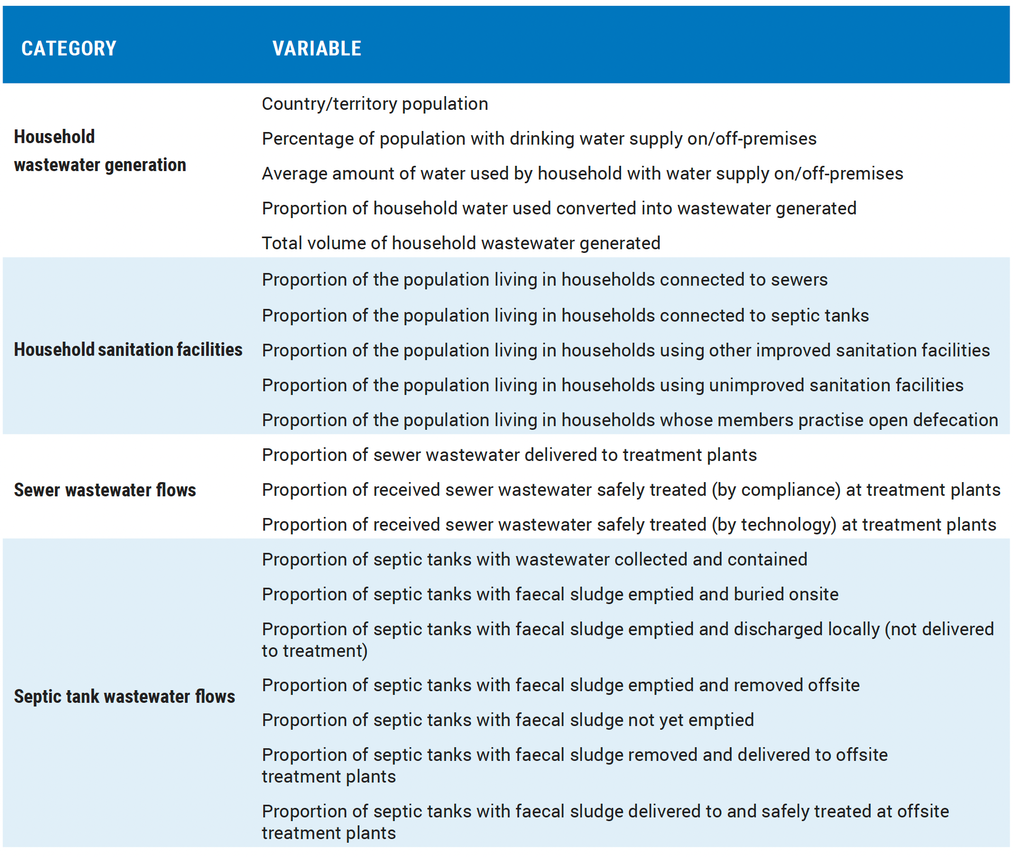
Variables for which we are looking for country data…
Notes:
All of the different variables for which we are looking for data covering the conceptual framework which I’ve just described are listed here in this table for your reference.

Slide 20
A few methodological remarks…
Snapshot approach
  Most recent data point for each variable is used to compute estimate
Data must be nationally-representative & <10 years old
Volumetric-based data preferred
  But population-based data used as a proxy
Standard assumptions can be employed for input variables if data are missing…but, some rules to reduce their influence…
  Depending on whether sewer or septic tank connections are more common
Notes:
I will add a few additional remarks on our methodology. At present we use a snapshot approach where we use only the most recent data point that you publish for each of the variables. The data must be nationally representative and less than ten years old. We prefer to use volumetric data, but will also use population data as a proxy for volumes. We use assumptions to fill-in data gaps, but have generated some rules that prevent these assumptions from dominating the estimates.

Slide 21
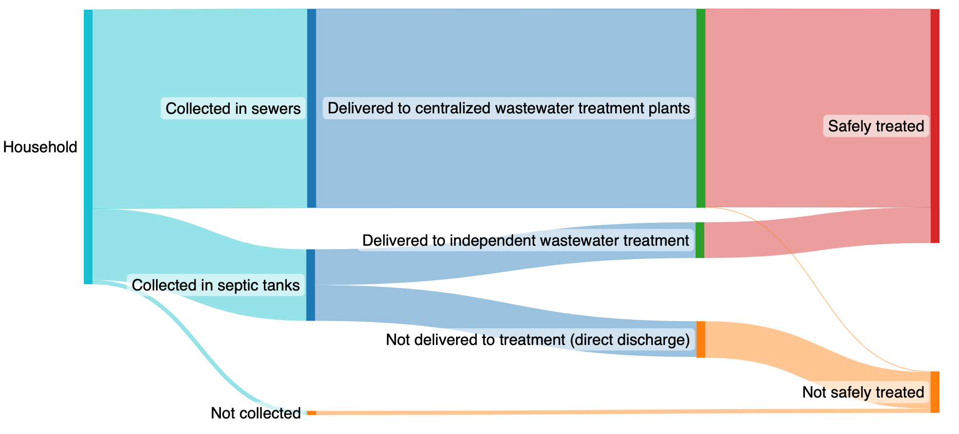
Example: Saudi Arabia
Generation
Collection
Delivery to Treatment
Treatment / Discharge
88%
12%
Notes:
We will now turn to a country example for Saudi Arabia. Here is a flow diagram representing the proportion of estimated household wastewater flow that is collected in sewers and septic tanks, delivered to treatment and subsequently safely treated. For Saudi Arabia in 2024, the draft estimate which is pending review during the current consultation is 88%.

Slide 22
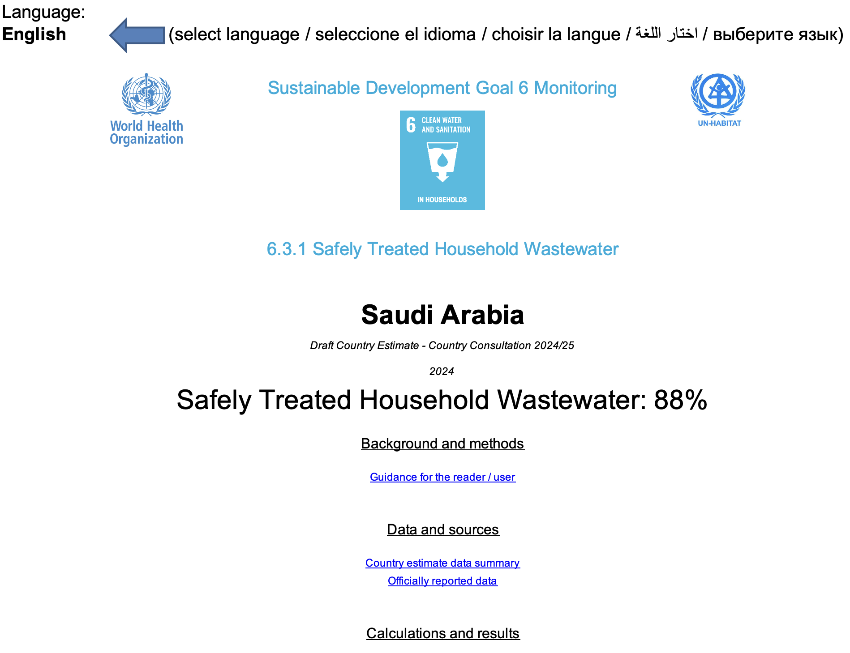
Notes:
Here we have the Introduction worksheet of the Excel country file which we have shared, which shows the overall estimate and allows users to select from among the UN languages.

Slide 23
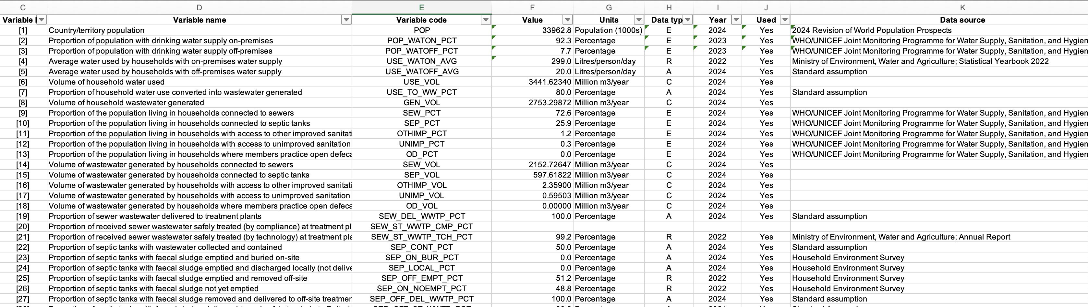
Worksheet: “Data inputs (all)”
List of all 40 variables ([1] to [40]) used for the computation of the country estimate
Data type:
C – calculation
R – official reported data
A – default assumption
E – estimation (based on statistical techniques)
Notes:
The next worksheet I want to highlight is ‘Data inputs (all)’ This worksheet presents all the different variables used in the calculation of the country estimate. These can be estimations, assumptions, official reported data which we have compiled from countries, or calculations.

Slide 24
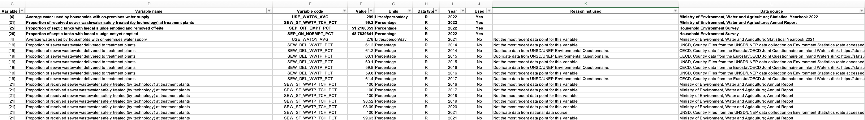
Worksheet: “Data inputs (reported)”
List of all official reported data compiled for the country
‘Used’ data at the top (in bold)
Explanation of reason not used
Notes:
The most important worksheet for your review during the consultation is ‘Data inputs (reported)’. This worksheet summarizes all of the data that we have compiled for your country so far. The most recent data points for each variable are in bold at the top, with the field ‘Used’ set to ’Yes’. You may find information on the units, year, data source, and other notes corresponding to each data point.

Slide 25
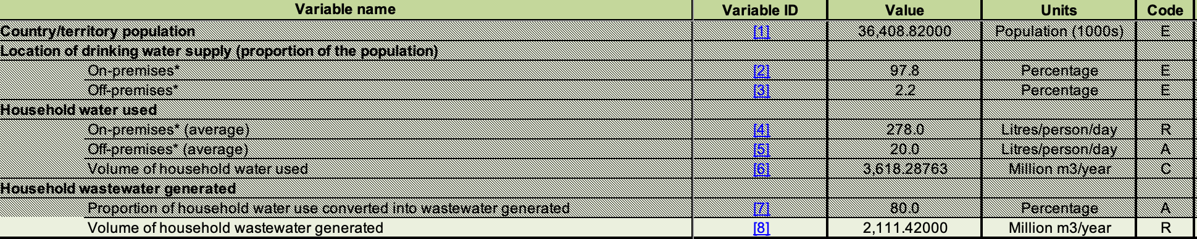
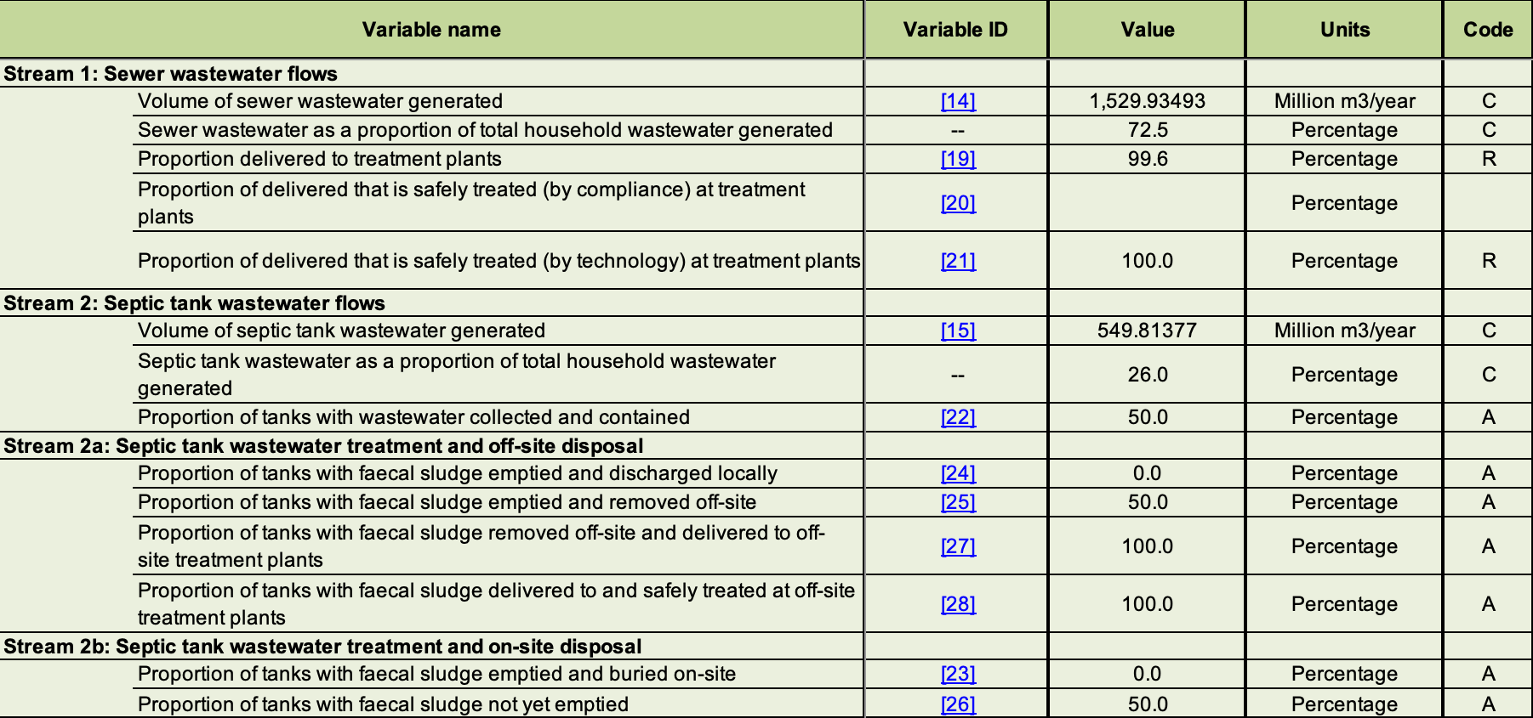
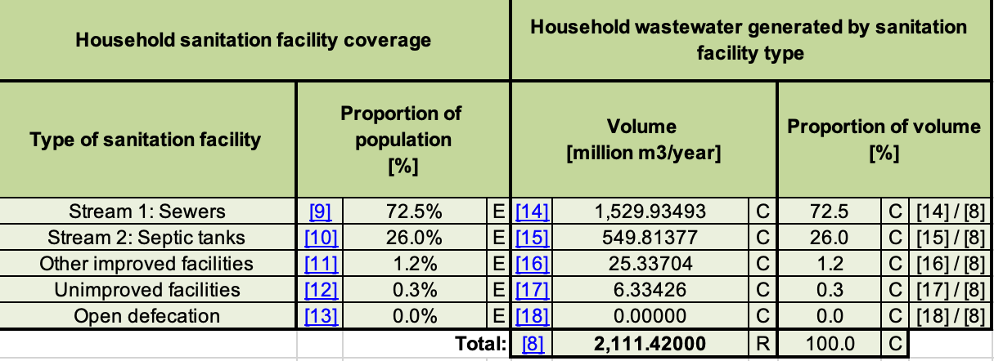
Other tabs for wastewater generation (total), generation (by wastewater stream), delivery to treatment, and safely treated
Notes:
There are other worksheets that you may also explore, and these present the data calculations for the different stages of the conceptual framework

Slide 26
Country | Estimate 2024? | Estimate |  | Dominance | WHO region | UNICEF region | Income level (WB)
 |  | 2024 | 2022
Bahrain | Yes | 94 | 93 | Sewer | EMR | Middle East and North Africa | High income
Kuwait | Yes | 100 | 100 | Sewer | EMR | Middle East and North Africa | High income
Oman | No |  |  | Septic tank | EMR | Middle East and North Africa | High income
Qatar | Yes | 100 | 100 | Sewer | EMR | Middle East and North Africa | High income
Saudi Arabia | Yes | 88 | 85 | Sewer | EMR | Middle East and North Africa | High income
United Arab Emirates | Yes | 95 | 95 | Sewer | EMR | Middle East and North Africa | High income
Iraq | Yes | 42 | 42 | Septic tank | EMR | Middle East and North Africa | Upper middle income
Libya | No |  | 14 | Sewer | EMR | Middle East and North Africa | Upper middle income
State of Palestine | Yes | 71 |  | Sewer | EMR | Middle East and North Africa | Upper middle income
Algeria | Yes | 76 | 76 | Sewer | AFR | Middle East and North Africa | Lower middle income
Djibouti | Yes | 11 | 11 | Septic tank | EMR | Middle East and North Africa | Lower middle income
Egypt | Yes | 63 | 74 | Sewer | EMR | Middle East and North Africa | Lower middle income
Iran (Islamic Republic of) | Yes | 26 | 25 | Sewer | EMR | Middle East and North Africa | Lower middle income
Jordan | Yes | 77 | 77 | Sewer | EMR | Middle East and North Africa | Lower middle income
Lebanon | No |  |  | Sewer | EMR | Middle East and North Africa | Lower middle income
Morocco | Yes | 75 | 45 | Sewer | EMR | Middle East and North Africa | Lower middle income
Pakistan | No |  | 38 | Sewer | EMR | South Asia | Lower middle income
Tunisia | Yes | 76 | 73 | Sewer | EMR | Middle East and North Africa | Lower middle income
Afghanistan | Yes | 6 |  | Septic tank | EMR | South Asia | Low income
Somalia | No |  |  | Sewer | EMR | Eastern and Southern Africa | Low income
Sudan | No |  |  | Septic tank | EMR | Middle East and North Africa | Low income
Syrian Arab Republic | No |  |  | Sewer | EMR | Middle East and North Africa | Low income
Yemen | No |  | 28 | Sewer | EMR | Middle East and North Africa | Low income
Notes:
This table summarises the situation with respect to the indicator across the UNICEF MENA region and WHO EMR region. Countries have been grouped by World Bank income levels. Those without a country estimate are highlighted in bold – namely Oman, Libya, Lebanon, Pakistan, Somalia, Sudan, Syria, and Yemen. I have included the latest draft 2024 estimates along side the official 2022 estimates and also indicated which countries are sewer dominant vs. septic tank dominant. For those that are sewer dominant, we require sewer wastewater treatment data to publish an estimate. For those that are septic tank dominant we require tank emptying data.

Slide 27
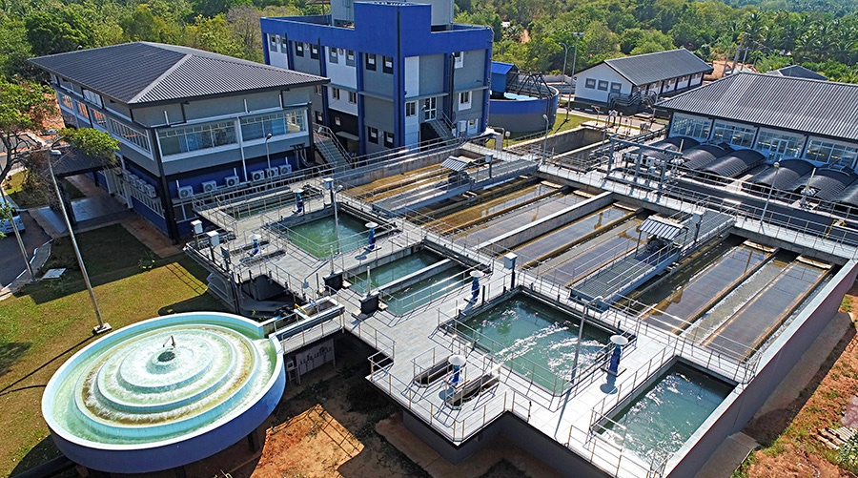
Additional resources
  UNSD/UNEP Environmental questionnaire
    https://unstats.un.org/unsd/envstats/questionnaire
  Methodological note on domestic wastewater for Indicator 6.3.1
    https://www.unwater.org/publications/domestic-wastewater-treatment-methodology-2024
Notes:
And to close the presentation, here are a few links to the UNSD questionnaire and our methodological note. Thank you very much for your attention and we look forward to your feedback during the consultation.

