Slide 1
#3 Estimating 6.2.1 and addressing data gaps
6.2.1a: sanitation
6.2.1b: hygiene (handwashing with soap)
Related to 6.2.1:
Bathing (new)
Menstrual health (new)
Notes:
Hi, it’s Rick Johnston from WHO again. Let’s turn now to SDG 6.2 on sanitation and hygiene.
I’m going to discuss indicator 6.2.1a on sanitation, and then pass over to my colleague Francesco Mitis to discuss indicator 6.2.1b on handwashing with soap. Francesco will also discuss some emerging indicators related to hygiene, on bathing and menstrual health.

Slide 2
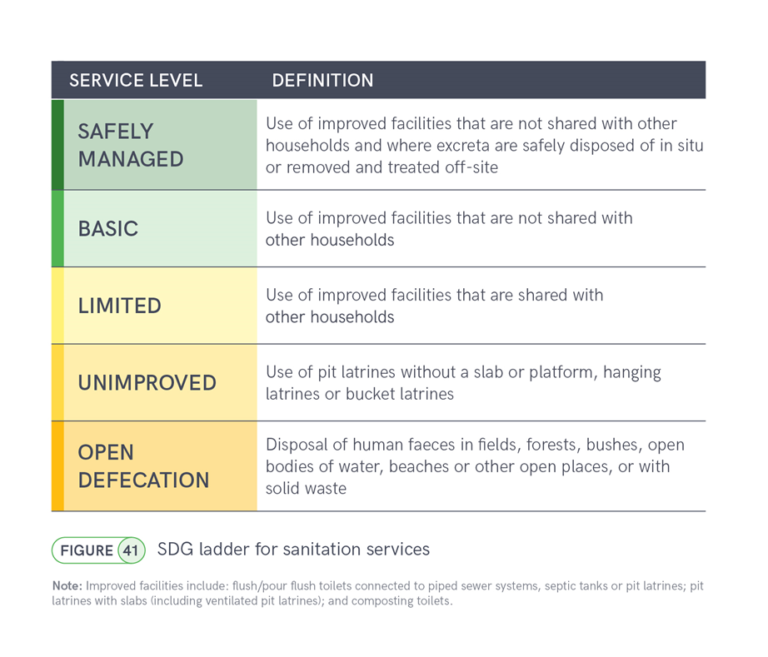
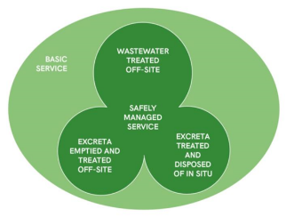
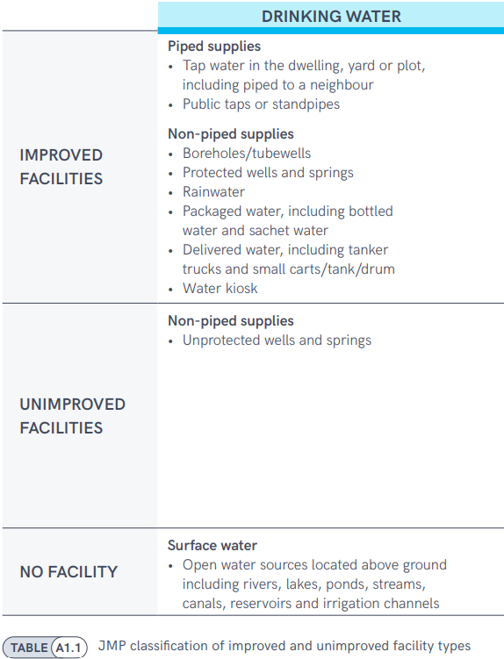
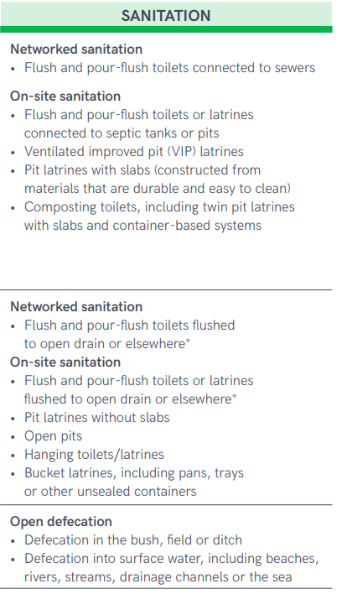
6.2.1a Safely managed sanitation
At least basic
Improved
Notes:
For sanitation, we use a ladder to describe difference levels of service. This is based on the technology classification that was used in the MDG period, of improved and unimproved facilities.
The sanitation ladder ranges from open defecation at the bottom to safely managed sanitation at the top.
The top three rungs (limited, basic, and safely managed) all represent people who are using improved sanitation facilities, such as sewer connections, septic tanks, or improved pit latrines.
Households using improved sanitation facilities that are shared with other households are counted as having limited service. On the other hand, if they are using improved facilities that are not shared then they count as a basic sanitation service.
But additional criteria are applied to meet the SDG indicator 6.2.1a, of ‘safely managed services’. To meet this standard, excreta must either be safely disposed of in-situ, or removed and treated offsite. We will explore those definitions in more detail.
Since households with safely managed drinking sanitation services also meet the requirements for basic services, the two levels can also be grouped together as ‘at least basic service’, which is part of the indicator used for monitoring SDG target 1.4 ‘universal access to basic services’.

Slide 3
6.2.1a Safely managed sanitation
The population using an improved sanitation facility which is
Not shared, and where
Excreta are safely disposed in situ or
Transported and treated off site
Notes:
Let’s look in more detail at the safely managed sanitation definition.
This is the population that is using an improved sanitation facility, which is not shared, and where excreta are either safely disposed of in situ, or transported and treated off site.
The diagram on the right shows that there are three pathways to safely managed sanitation: you can have wastewater that is transported through sewers and treated offsite at a centralized wastewater treatment plant (the top circle), or you can have wastewater, or excreta, that is stored on site, for instance in a septic tank or pit latrine, but then emptied and treated off-site – this is sometimes called faecal sludge management. That’s the bottom left circle. Finally, you have excreta that are stored on site, and never emptied, or emptied and buried onsite: these are considered treated and disposed of in situ.

Slide 4
Not shared
Transported and treated offsite
Concerns about health, privacy, safety, access at all times
Onsite storage that is effectively contained, and
Emptied and delivered to treatment offsite
Sewered systems with at least secondary treatment, or
Excludes public and community toilets
Safely disposed of in situ
Onsite storage that is effectively contained, and
Never emptied, or
Emptied and buried onsite
Notes:
Here are a few more clarifications about those elements of safely managed sanitation.
We are often asked why shared sanitation facilities can’t be considered safely managed. In part it’s because there is epidemiological evidence that people are at higher risk of diarrhoeal disease when they use shared sanitation, even when the facilities are shared among a small number of households. But an even more important consideration is that it’s difficult to ensure privacy and safety at all times for all users – especially for women and girls, and the elderly – when people don’t have private sanitation facilities at the household level. So for those reasons, public and community toilets, as well as toilets shared by two or more households, are not counted towards safely managed sanitation (or towards basic sanitation).
Next; wastewater and excreta can be transported and treated offsite, and this can mean either sewered systems, where wastewater is delivered to a treatment plant that provides secondary or higher treatment; it can also mean onsite storage like a septic tank or pit latrine, that effectively contains the excreta – preventing it from re-entering the surface environment – and then is emptied and delivered to treatment offsite
Finally, if excreta are stored onsite in a tank or pit that effectively contains the waste, isolating it from the surface environment, it can be considered safely managed if the storage tank hasn’t been emptied – so the excreta is all still in the tank – or if has been emptied and the contents are buried onsite, for instance in a covered pit.
So there are a lot of different ways for households to have safely managed sanitation, it’s not only possible through sewer connections.

Slide 5
22
19
21
16
13
10
ISO3 | Country | Most recent data source (survey or census) | Most recent data source (admin) | Open defecation (total) | Basic sanitation services (total) | Safely managed sanitation services (total) | Safely managed sanitation services (urban) | Safely managed sanitation services (rural)
AFG | Afghanistan | AFG_2023_MICS | - | Yes | Yes | Yes | Yes | Yes
BHR | Bahrain | BHR_2018_NHS | BHR_2021_MWMAUP | Yes | Yes | Yes | No | No
DJI | Djibouti | DJI_2023_DEM | - | No | No | No | No | No
EGY | Egypt | EGY_2022_EFHS | EGY_2023_PWSS | Yes | Yes | Yes | Yes | Yes
IRN | Iran (Islamic Republic of) | IRN_2021_HIES | IRN_2021_CC | No | Yes | No | Yes | No
IRQ | Iraq | IRQ_2018_MICS | IRQ_2023_ES | Yes | Yes | Yes | Yes | Yes
JOR | Jordan | JOR_2023_JPFHS | JOR_2023_MOH | Yes | Yes | Yes | Yes | Yes
KWT | Kuwait | - | KWT_2021_ASBE | Yes | Yes | Yes | Yes | No
LBN | Lebanon | LBN_2023_MSNA | LBN_2013_MDG+ | Yes | Yes | Yes | No | No
LBY | Libya | LBY_2022_MSNA | - | Yes | Yes | Yes | No | No
MAR | Morocco | MAR_2022_AFB | MAR_2019_UNSD | Yes | Yes | Yes | Yes | No
OMN | Oman | OMN_2019_HIES | OMN_2022_NAMA | Yes | Yes | No | No | No
PAK | Pakistan | PAK_2023_CEN | PAK_2021_PCRWR | Yes | Yes | No | No | Yes
QAT | Qatar | QAT_2020_CEN | QAT_2022_ES | Yes | Yes | Yes | No | No
SAU | Saudi Arabia | SAU_2022_CEN | SAU_2022_MEWA | Yes | Yes | Yes | Yes | No
SOM | Somalia | SOM_2024_MSNA | - | Yes | Yes | Yes | Yes | Yes
SDN | Sudan | SDN_2022_AFB | SDN_2013_MDG+ | Yes | Yes | No | No | No
SYR | Syrian Arab Republic | SYR_2022_HNO | - | No | Yes | No | No | No
TUN | Tunisia | TUN_2023_MICS | TUN_2023_ONAS | Yes | Yes | Yes | Yes | Yes
ARE | United Arab Emirates | ARE_2018_HS | ARE_2022_WW | Yes | Yes | Yes | Yes | Yes
YEM | Yemen | YEM_2023_MICS | YEM_2013_MDG+ | Yes | Yes | Yes | Yes | Yes
PSE | occupied Palestinian territory | PSE_2021_SECS | PSE_2021_WSRC | Yes | Yes | Yes | Yes | Yes
Notes:
Here’s a summary of the 22 countries in the WHO EMR region, it’s very similar to the UNICEF MENA set of countries.
All of these countries except Djibouti have estimates for basic sanitation services – I will come back to that. Also, all countries except for Djibouti, Iran and Syria have data on open defecation.
There are estimates for safely managed sanitation at the national level, in all but six countries: Djibouti, Iran, Oman, Pakistan, Sudan and Syria. That’s a bit higher coverage than for safely managed drinking water.
There are a number of countries that have safely managed at the national level, but can’t disaggregate into urban and rural areas. For example, Bahrain and Qatar. So only 13 countries have estimates for urban areas, and only 10 for rural areas.

Slide 6
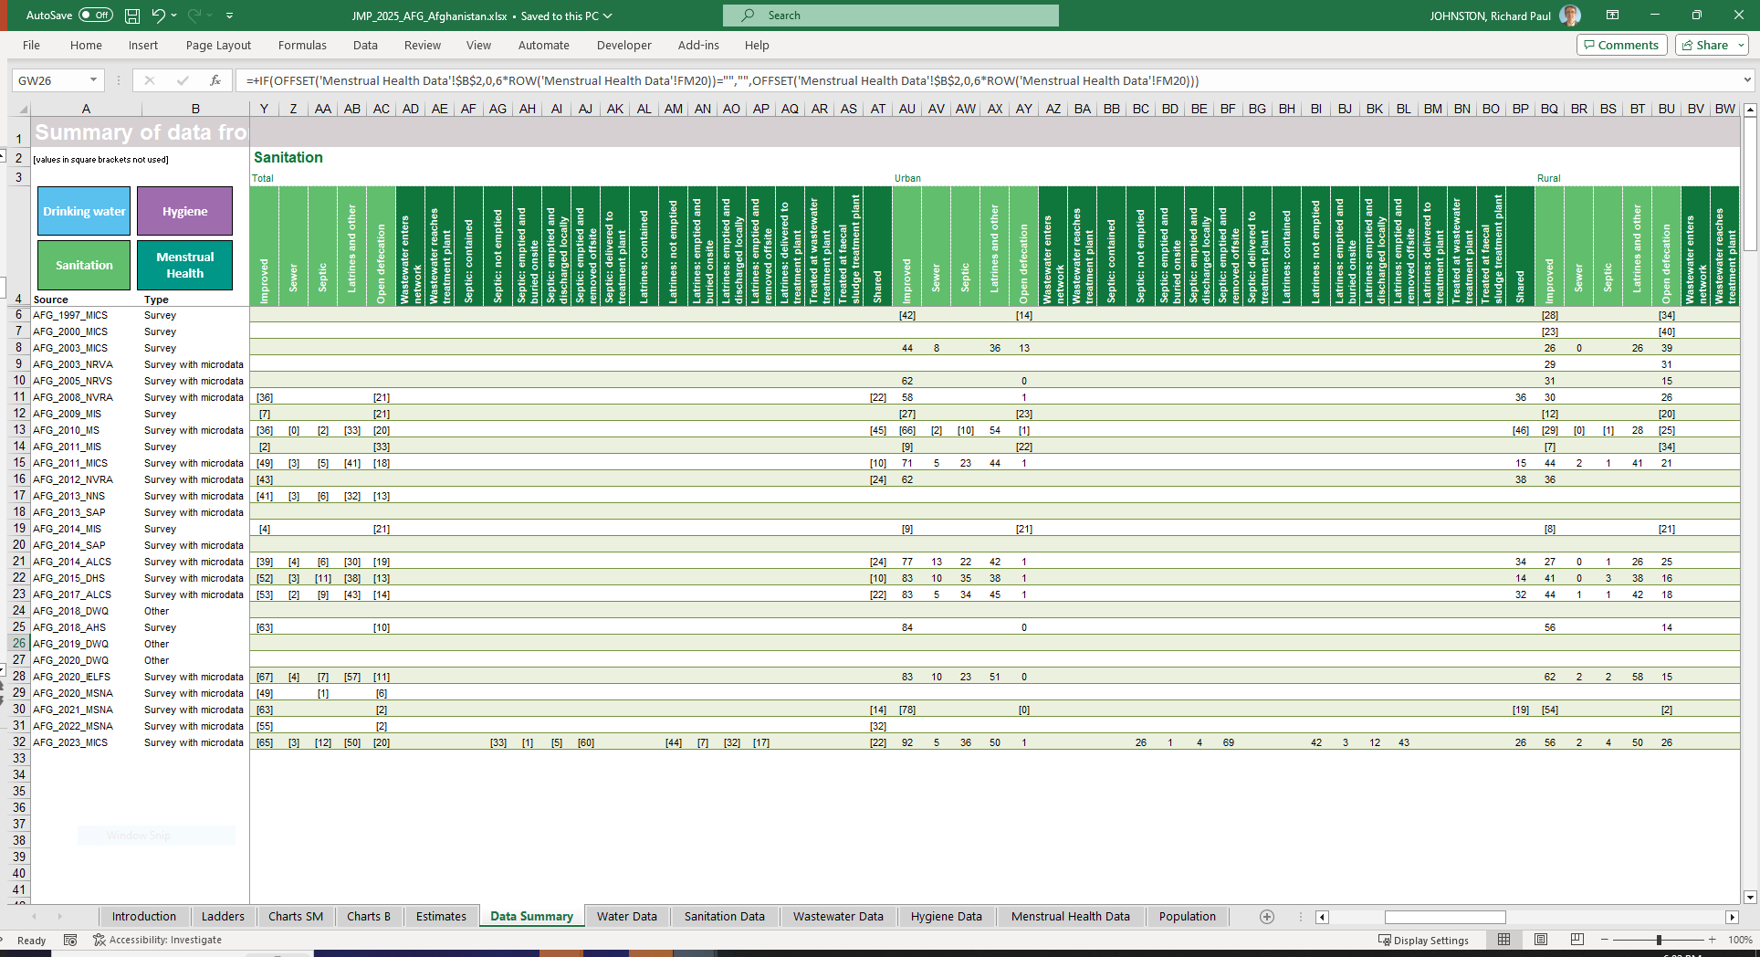
Notes:
Here’s an example of a country file, this is from Afghanistan, where on the Data Summary tab you can see that we have 27 data sources, going back to 1997, with the 2023 MICS being the most recent.
Not all of these have information on sanitation, for instance there are sources from 2018, 2019 and 2020 about drinking water quality. So those rows are blank for the sanitation columns.
Now for all of these data sources, the different columns are showing the sanitation variables, and there are columns for total, urban and rural populations.
The JMP method is to produce linear regressions for the urban and rural areas, and to combine them to produce total, or national estimates. Which means that we don’t actually use the national-level data, we just use the urban and rural data. And that’s shown in the country file by using square brackets around the variables that are not used. So you can see that all of the Total variables have square brackets around them, and aren’t used. Also, the 1997 MICS is not used because we restrict data to sources from 2000 and later. So that first row is showing data in square brackets as well. And there are a few cases where data for urban and rural areas are shown in the file, but not used for some reason or another – maybe they are not representative, or the variables don’t match the global definitions well, or they may simply be outliers. For example, there are three Malaria Information Surveys thar found more than 20% open defecation in urban areas. But actually all of these surveys allowed multiple responses, and the totals were well over 100%, so we couldn’t use the sanitation data from these surveys. Still, we include them in the country file for completeness, and explain in the notes why they haven’t been used to produce estimates.

Slide 7
Improved and improved not shared (AFG)
Notes:
The country file has a tab showing Basic Charts, which is a useful place to see the data on improved sanitation, and also on basic sanitation, which excludes shared facilities.
Here in this example from Afghanistan you see that there are a lot of data points for improved sanitation, about a dozen, and that there is a general positive trend in both urban and rural areas, but also that there is a fair amount of scatter. This is just due to the differences in survey methodology, it doesn’t really mean that improved sanitation is going up and down from year to year. And that’s why we use linear regression to produce estimates for all years, rather than relying on a single survey.
The light green line is showing the estimates for improved sanitation, and the dark green line is the estimates for basic sanitation, excluding shared facilities. And you can see that shared sanitation is more of an issue in urban than in rural areas, which is often the case.
As I mentioned earlier, we combine the urban and rural estimates to produce total or national estimates.

Slide 8
Improved and improved not shared (DJI)
Notes:
Remember I said that we don’t have estimates for basic sanitation in Djibouti? We do have some data sources from Djibouti, but the most recent is from 2017. And with our regression rules, we can extend the regression line forward through 2019, and then hold that estimate constant until 2023, but not further. And since the next JMP report will have a reporting year of 2024, we will show Djibouti as not having estimates, unless through the country consultation some more recent data are shared.

Slide 9
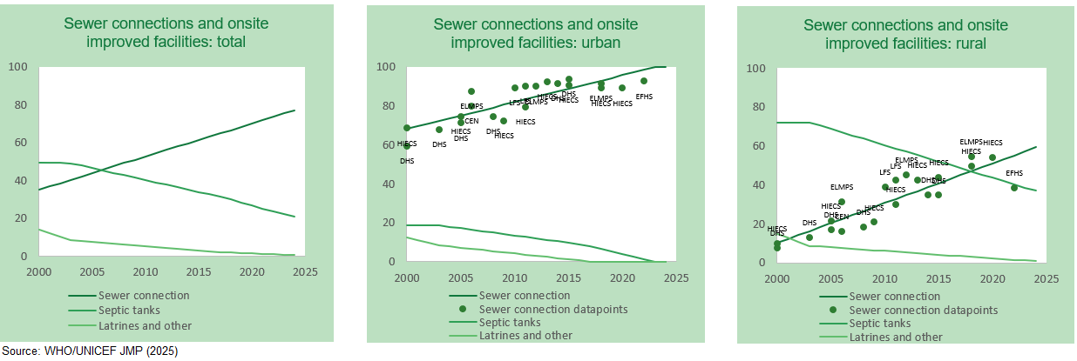
Improved facility type (Egypt)
Notes:
The country files have another tab with charts related to safely managed services, which show the trends in different types of improved sanitation facility (sewer connection, septic tanks, latrines and other).
Here you can see that in Egypt there has been a strong growth in sewer coverage in both urban and rural areas (that’s the dark green line, and the data points). The regression line shows that sewer coverage is nearly universal now in urban areas, though the most recent data point the 2022 EFHS found only 93% coverage. The linear regression doesn’t capture tailing very well. You can also see that in rural areas there is a significant but declining population using septic tanks, that’s the medium green line.

Slide 10
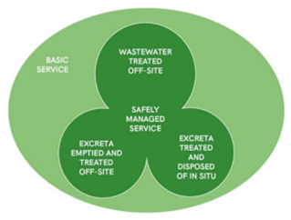
Wastewater treated
Safe management of sewered sanitation
Need sectoral data, not only household surveys
Proportion of sewered wastewater that reaches treatment plants
Often available from UNSD Environment Statistics
Wastewater treated
“At least secondary or higher levels of treatment” = safely managed
Or primary treatment with a long ocean outfall
If no data available JMP assumes 50% of wastewater from sewers is treated
But only uses this estimate in countries where onsite sanitation > sewered sanitation
Notes:
So the first pathway towards safely managed sanitation is to have sewered wastewater that is safely managed. And for that it’s essential to have data from the wastewater sector, not only from household surveys. Household surveys are still the JMP’s preferred source of data on how many people are using sewered sanitation, but households don’t know anything about what happens once they flush the toilet.
Here we’re looking for two kinds of information from the sector. First, the proportion of sewered wastewater that actually reaches treatment plants. Often this is available from the UN Statistics Division’s Environment Statistics programme, they regularly circulate a questionnaire about wastewater. Second, among the wastewater that reaches treatment plants, how much is treated to secondary or higher levels of treatment. Primary treatment alone isn’t considered sufficient for safely managed sanitation, with an exception for coastal treatment plants that discharge primary effluent through long ocean outfalls.
If countries don’t have nationally representative data about treatment of sewage, the JMP can assume that 50% of wastewater from sewers is treated, but we’ll only use this to produce estimates where the majority of the population is using non-sewered or onsite sanitation.

Slide 11
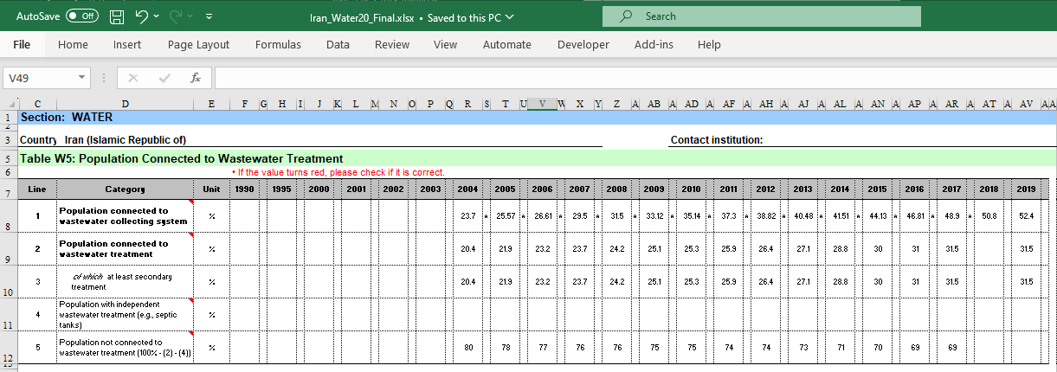
52.4% of population connected to wastewater collecting systems
31.5% of population connected to wastewater treatment
31.5/52.4 = 60.1% sewer wastewater reaches treatment plant
31.5/31.5 =100% of treated wastewater treated with secondary or higher processes
Notes:
Here’s an example of that UNSD Environment Statistics questionnaire, from the 2020 round where Iran provided data from 2004 through 2019. UNSD has recently circulated their 2024 questionnaire, so if Iran has completed this and could share it through the consultation, we would update the country file and estimates. For now, the 2020 file is the most recent one available.
You can see in the table data on the proportion of the population connected to wastewater collecting systems (that means sewers), which was 52.4% in 2019.
The table also shows the proportion of the population connected to wastewater treatment – not all of the sewers deliver all of their wastewater to treatment plants. So that is 31.5% of the population in 2019.
We then just take the ratio of those two, to calculate that 60.1% of sewer wastewater is reaching a treatment plant.
We can also see from this table that the population connected to at least secondary treatment was also 31.5% in 2019, so we take that to mean that 100% of wastewater that reaches treatment plants receives at least secondary treatment.

Slide 12
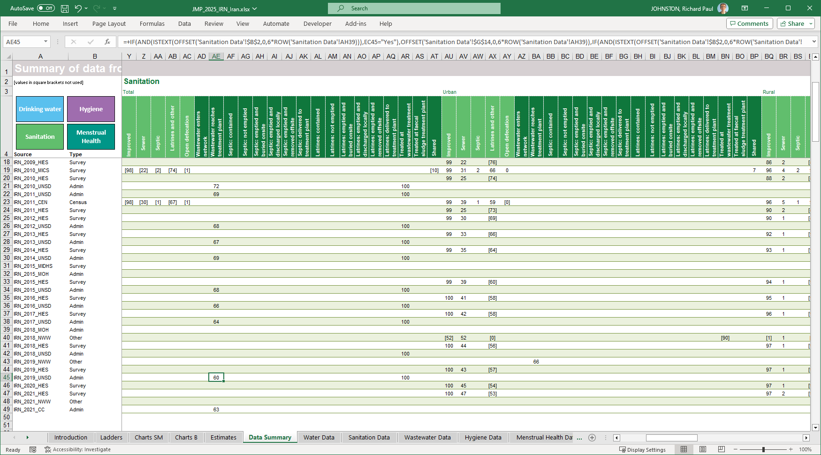
Notes:
Here, in the JMP country file for Iran, you can see on the Data Summary tab that figure of 60%. It’s similar to, maybe a bit lower than, the figures reported to UNSD for earlier years, from 2010 through 2017. That then gets combined with data from more sources about how many people are using sewer connections

Slide 13
Safely managed onsite sanitation
Effective containment
Emptied and removed offsite
Safely disposed of in situ
Either never emptied, or emptied and buried onsite
Notes:
So that’s sewered wastewater. But non-sewered, or onsite sanitation can also be safely managed, if it is effectively contained, and is either emptied and removed offsite, or safely disposed of in situ.
Let’s look at examples of these from the region.

Slide 14
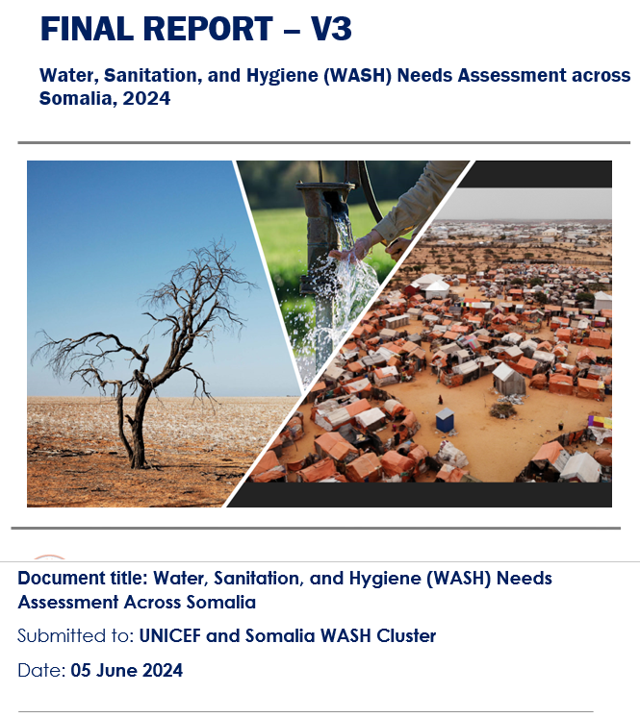
Containment
D11. Does your septic tank or pit latrine have an outlet pipe for liquid effluent? Yes/No
D12. If it has an outlet pipe for liquid effluent, where does this pipe discharge?
To a leach field, soak pit
To a sewer/closed drain that leads
To a wastewater treatment plant
To a waterbody (not connected to WWTP)
To don’t know where
To an open drain
To a water body/surface
Notes:
Data on effective containment usually comes from household surveys, through questions that have been recently developed. Here’s an example from Somalia, where a 2024 WASH Needs Assessment survey included these two questions: does your septic tank or pit latrine have an outlet pipe for liquid effluent? And if so, where does this discharge?

Slide 15
Containment
D13. In the last year, have excreta from your (pit latrine or septic tank) been
Overflowed
Flooded
Containment collapsed
Notes:
The Needs Assessment also asked if excreta from the septic tank or pit latrine had been released to the surface, because the pit had overflowed, or flooded, or collapsed. Any of those would count as ineffective containment.

Slide 16
Containment
Use of sanitation facilities |  | Somalia
SOM_2024_NAAS |  | UNICEF and Somalia WASH Cluster
Survey |  | Water, Sanitation, and Hygiene (WASH) Needs Assessment across Somalia, 2024
Extracted 2024 |  | Last modified 2024
Definitions | Facility type estimates |  | Urban | Rural | Total
 |  | Improved | 78.2 | 50.9 | 59.0
 |  | Sewer | 8.9 | 5.8 | 7.8
 |  | Septic | 4.1 | 1.0 | 2.9
 |  | Other | 65.2 | 44.1 | 48.3
 |  | Open defecation | 6.9 | 30.4 | 15.6
 | Service level estimates
 |  | Sewer | 8.9 | 5.8 | 7.8
Default assumption: 100% |  | Wastewater enters network
Default assumption: 100% |  | Wastewater reaches treatment plant
 |  | Septic | 4.1 | 1.0 | 2.9
 |  | Contained/stored and treated | 50.8 | 20.8 | 47.1
Default assumption: 100% |  | Not emptied/treated and disposed in situ | 68.9 | 91.8 | 71.8
Default assumption: 0% |  | Emptied and buried on site | 20.3 | 5.8 | 18.4
Default assumption: 0% |  | Emptied and discharged locally | 4.4 | 0.0 | 3.9
Default assumption: 0% |  | Emptied and removed offsite | 6.4 | 2.3 | 5.9
Default assumption: 100% |  | Delivered to treatment plant
 |  | Latrines and other improved | 65.2 | 44.1 | 48.3
 |  | Contained/stored and treated | 32.5 | 44.9 | 36.6
Default assumption: 50% |  | Not emptied/treated and disposed in situ | 74.9 | 88.5 | 79.0
Default assumption: 0% |  | Emptied and buried on site | 12.9 | 8.5 | 11.6
Default assumption: 0% |  | Emptied and discharged locally | 4.6 | 0.6 | 3.4
Default assumption: 50% |  | Emptied and removed offsite | 7.7 | 2.4 | 6.1
Default assumption: 100% |  | Delivered to treatment plant
 |  | Treated
Default assumption: 50% |  | At wastewater treatment plant
Default assumption: 0% or based on wastewater treatment if offsite is dominant |  | At faecal sludge treatment plant
 |  | Shared | 34.8 | 30.7 | 33.8
 |  | Safely managed
Default: 50%
Default: 100%
Notes:
So with these questions, the survey found that about 47% of septic tanks were ‘contained’ using this definition – that’s very close to the default assumption of 50% that the JMP uses for septic tanks when there aren’t data available.
But effective containment was worse for pit latrines – only about 37% were classified as effectively containing wastes, mainly because of overflowing or flooding.

Slide 17
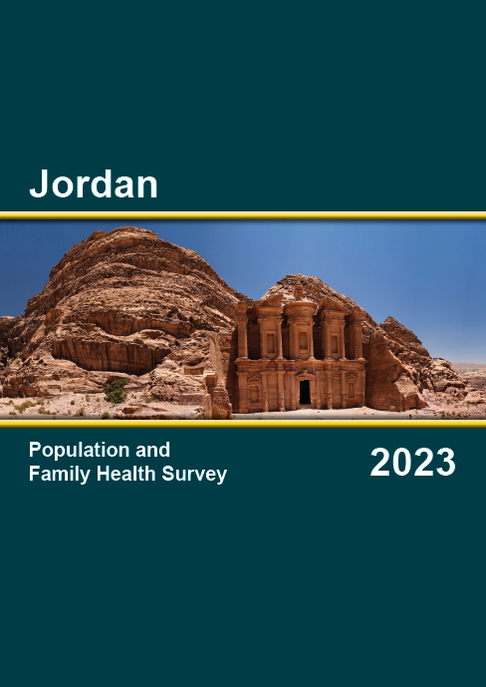
Emptied and removed offsite
Notes:
So that’s containment.
Household surveys are also a good way to get information on emptying of pit latrines and septic tanks.
If a tank or pit has been emptied, and the household respondents say that it was taken away offsite, or to a treatment plant, it is potentially safely managed. But we would need to match this with data from the sector, about how much faecal sludge is actually transported to treatment, and what kind of treatment it receives. This kind of data is very scarce.
Of course, if the household reports that their tank has been emptied, and the waste was dumped into surface water, or left uncovered, that would count as NOT safely managed sanitation.
This is an example from Jordan, from the 2023 Population and Family Health Survey. These kinds of questions are now standard in DHS and MICS surveys.

Slide 18
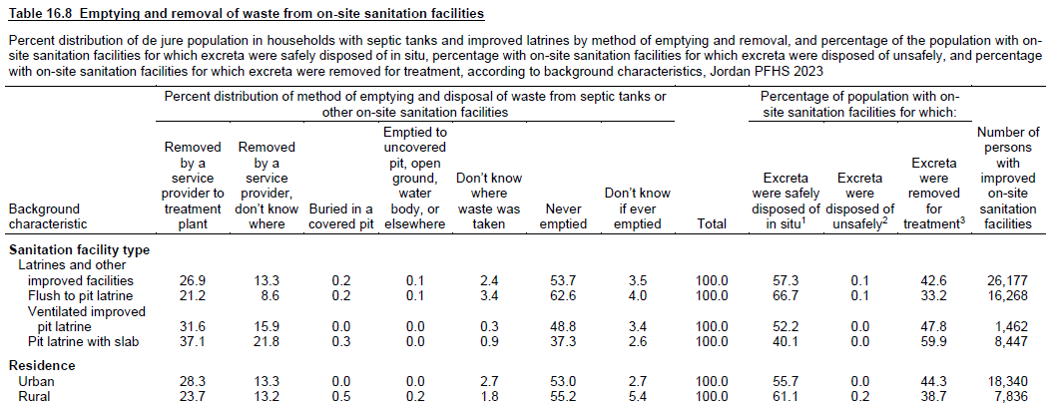
Potentially safely managed – need more data on faecal sludge management
Notes:
The report shows that in about 40% of households, excreta were removed for treatment, and are potentially safely managed. This was a bit higher in urban than in rural areas, 44% compared to 39%.

Slide 19
Safely disposed of in situ
Notes:
Those same questions can be used to measure safe disposal in situ. If a household says that they have never emptied their tank, or don’t know, that is interpreted as the waste remaining underground. And as long as it is effectively contained, and not shared, it would be counted as safely managed sanitation.
Also, if the tank is emptied, and reportedly buried onsite, for instance in a covered pit, that would also count as safely disposed of in situ.

Slide 20
Safely managed (if not shared): safely disposed of in situ
Notes:
And in Jordan we see that this is the most common outcome – more than half of onsite sanitation systems had reportedly never been emptied. Not emptying is a bit higher in rural areas, but also quite high in urban areas. So as long as those facilities are not shared they would count as safely managed through in situ disposal.

Slide 21
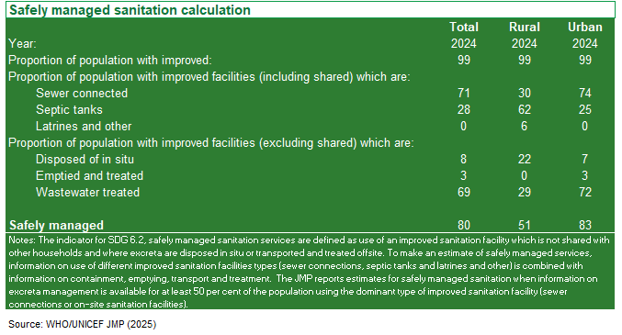
Calculation of safely managed sanitation (JOR)
Notes:
Jordan: has over 50 data sources, very data rich. But the 2023 Population and Family Health Survey is the only one with data on management of onsite sanitation.
Here you can see a table in the country file that summarizes the calculation of safely managed sanitation.
First: improved sanitation is nearly universal, in both urban and rural areas.
But sewer coverage is dominant in urban areas, and for the country as a whole, while septic tanks are the main technology in rural areas. Now in the last JMP update, we didn’t have data on management of onsite sanitation, so there were no estimates for safely managed sanitation in rural areas. With this report, Jordan has filled that gap, and we can see that in rural areas 22% of the population used on-site sanitation that was safely disposed of in situ. We still don’t have data on what happens with the on-site sanitation that is emptied and taken offsite, it would be great to fill that data gap on faecal sludge management. But for now, we take that 22% of the rural population with sanitation safely disposed of in situ, and add it to another 29% with sewered wastewater treatment, to get 51% safely managed sanitation in rural areas. Which is lower than the 83% in urban areas – this is to be expected since sewer coverage is so much higher in urban areas, and in Jordan almost all sewer wastewater receives secondary treatment or better.

Slide 22
Data gaps
Ageing data, losing estimates
Djibouti: last data from 2017, has SMS through 2023
High proportion of on-site sanitation, without sufficient data
Oman
Iran (SMS in urban only)
Sudan
High proportion of sewered sanitation, without sufficient data
Pakistan (SMS in rural only)
Syria
Notes:
Six countries without data on safely managed sanitation at the national level for 2024. There are more that have national data, but can’t disaggregate into urban and rural areas, for example Bahrain and Qatar.
With that, let me pass over to Francesco Mitis, who will discuss the other part of indicator 6.2, on hygiene. Thanks for your attention.

