Slide 1
6.2.1b Hygiene
Notes:
Good morning, I am Francesco Mitis and I will present the part on hygiene (both handwashing and bathing) and menstrual health
As for water and sanitation I will try to illustrate data gaps and some results, based on country examples
Let’s start with hygiene (handwashing part)
The hygiene ladder only has 3 rungs. Basic hygiene service means households have a handwashing facility with soap and water available at home. If facility is available but either soap or water are missing it counts as limited service and at the bottom of the ladder we have no handwashing facility at all.

Slide 2
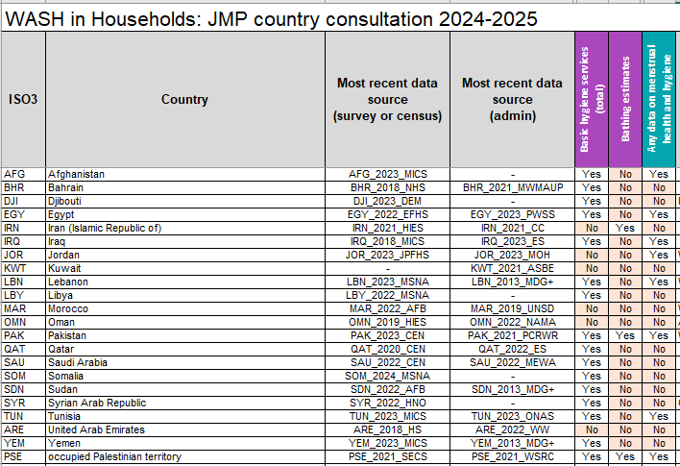
Handwashing - data gaps
Handwashing
22 countries
16 with estimates
Notes:
As you can notice there are some data gaps in the region. We will describe handwashing data situation now, and later we will describe two new estimates type which are reported for the first time in the country files: bathing facilities and menstrual health, already reported in this table.
For handwashing we have 6 countries without estimates: Iran, Jordan, Kuwait, Lybia, Morocco and United Arab Emirates. For some of the countries with estimates we only have estimates at national level, without urban/rural disaggregation. Not having estimates does not mean the country is without data. Sometimes these are too old to produce estimates.. We will see some of these cases in the next few minutes.

Slide 3
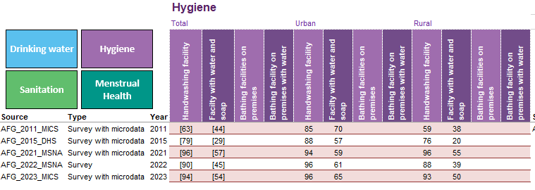
Notes:
Here you can find, from data summary tab, a description of hygiene data sources in Afghanistan. Data on handwashing facilities and on handwashing facilities with water and soap were available, disaggregated at urban/rural level, from 5 data sources: two MICS survey (including the recent 2023 one), one DHS and two MSNAs. The empty columns are dedicated to bathing facilities variables, not available for Afghanistan.

Slide 4
Handwashing facility with soap and water
Handwashing facility observed in dwelling, yard or plot
MICS 2011, 2023; MSNA 2021, 2022; DHS 2015
Proportion of facilities which are
Fixed
Mobile
Proportion of facilities with
Water and soap/detergent available
Water only
Soap only
Notes:
This is the detail of the available data sources and the disaggregation which is needed to calculate the estimates. We are collecting observations on the following categories: whether a handwashing facility is fixed or mobile; if there are water and soap, only water, only soap, none of them. Only for one of the 5 data sources listed above (MICS23) the detailed situation on fixed /mobile handwashing facilities was available but results are highly comparable with the ones coming from the other data sources

Slide 5
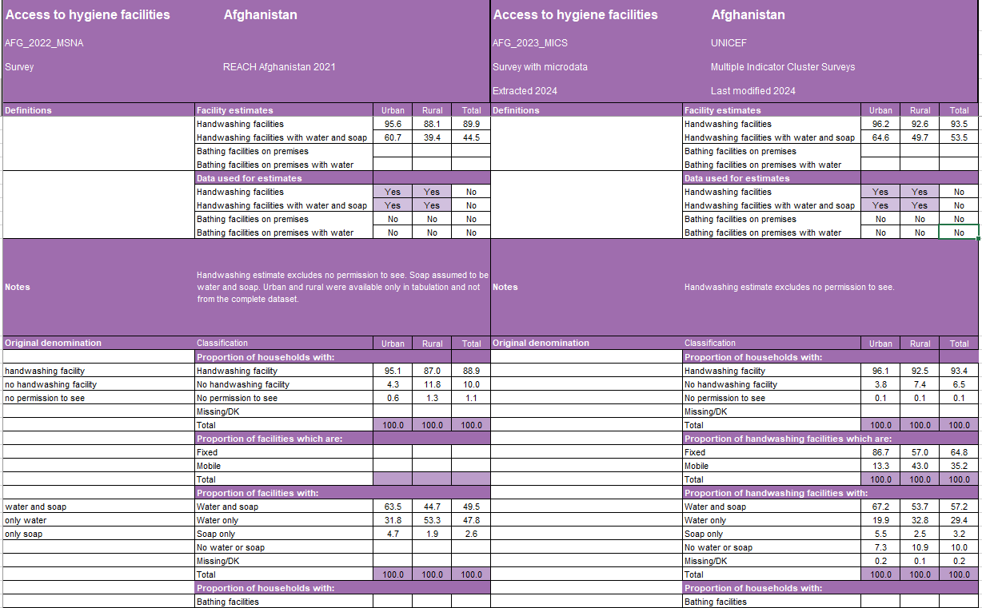
Notes:
This is how the last two of these data sources appear in the hygiene tab. As you can see there is space for notes, to write down the original definitions (if given) and it is specified whether the specific data source is used to create estimates or no (yes/no section). The bottom part of the tab is now dedicated to bathing facilities, as well as the bottom part of the “facility estimates” part and of the “data used for estimates” part

Slide 6
Basic hygiene
Notes:
Five data points. Few compared to water and sanitation, but many compared to most countries
The JMP regression gives values for any given year, also for those ones without datapoints – extension and extrapolation rules are applied as in water and sanitation regressions. You can see this for years before 2011.
Estimates are slowly decreasing in urban areas while increasing in rural areas
Compare DHS 2015 with MSNA and MICS23: DHS15 seems an outlies but does not affect too much the regression line

Slide 7
Data gaps & high income countries
Usually hygiene data are collected only in low and middle income countries through household surveys
However, we have some notable exceptions, coming from this region
Bahrain (admin data from 2010 to 2020 only at national level)
Saudi Arabia (data from the household environment survey 2022, only national level)
Qatar (admin data from 2014 to 2022, only national level)
Oman (household survey, in 2017, only at national level – estimate lost)
Notes:
Usually hygiene data are collected only in low and middle income countries through household surveys
For years we had only one high income country in the world with a handwashing estimates – Oman. This was thank to a Nutrition survey conducted n 2017 only at national level. Now that data source is too old to produce estimates
But we still have notable exceptions from high income countries if this region
A survey in Saudi Arabia, conducted in 2022 only at national level and with data for regions too but not for urban/rural, is giving estimates to the country; the same happens for admin data from Bahrain and Qatar. All these countries have now handwashing estimates.

Slide 8
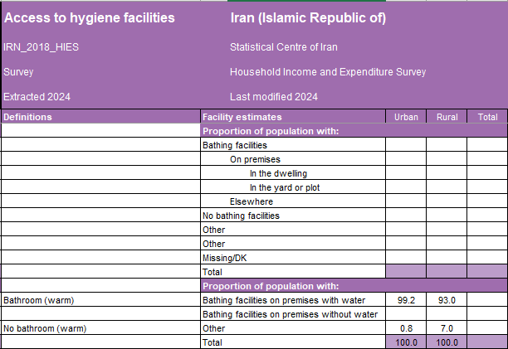
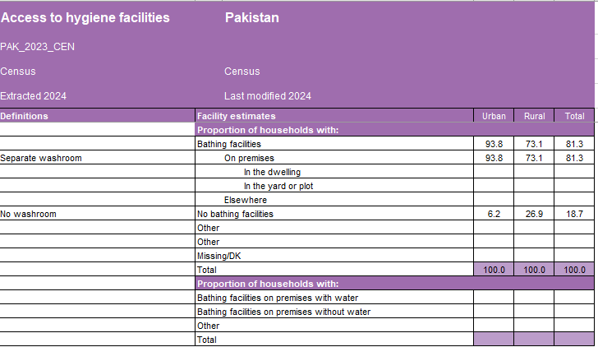
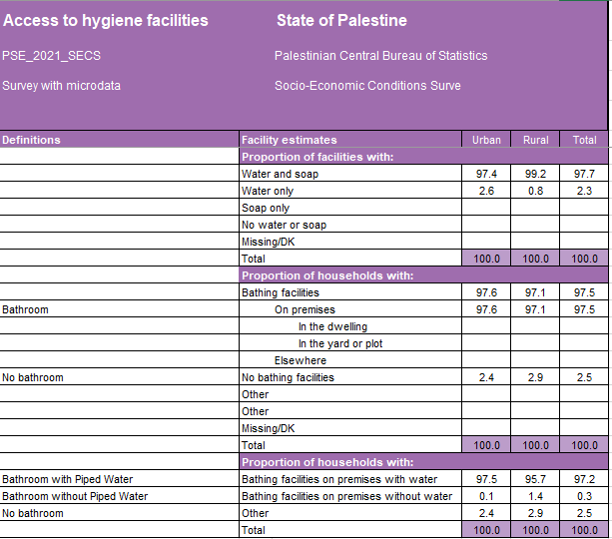
Bathing facilities (new)
Notes:
As I told you we are also collecting data on bathing facilities. If they are on premises (in the dwelling/yard/plot/elsewhere) and if they have water. New questions on this are available in the latest MICS questionnaire and can be used if needed.
We have recent data only from Iran, Pakistan and Palestine. Definitions are variable and sometimes difficult to harmonise (as you can see from the slide we have the following definitions: bathroom (warm water) in Iran, bathroom with piped water in Palestine and separate washroom in Pakistan). The use of MICS question can help in harmonizing definitions and help comparing the results across countries

Slide 9
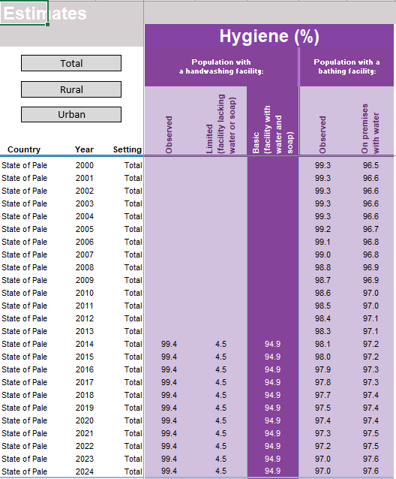
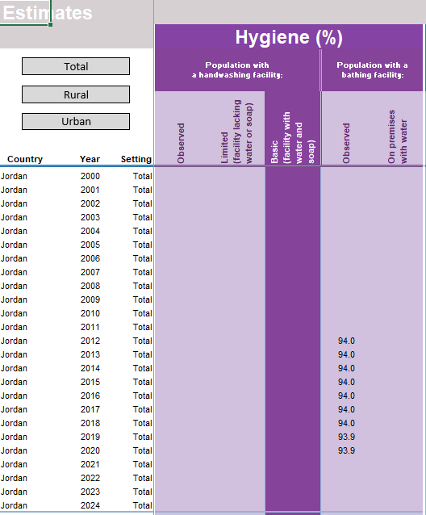
Bathing - estimates
Notes:
We have new features added to the country files. In the estimates tab you will find for the first time estimates for bathing facilities (observed on premises and with water) and for menstrual health for total/urban/rural, if data allows.
Estimates are calculated through the JMP regression and they are shown in the last two columns of this table. No trend charts are available in the country files yet- these are two examples
On the left, Palestine: recent data and estimates available
On the right, Jordan: old data (survey from 2016) , extrapolation of the estimates for 4 years due to JMP rules, and no estimate for 2024

Slide 10
Bathing and menstrual health- data gaps
Bathing
22 countries
3 with estimates
3 (Jordan, Iraq, Egypt) with old data and no estimates
Menstrual health
22 countries
- 6 with estimates
- 2 (Iraq and Egypt) with old data and no estimates
Notes:
This is the overall picture of data gaps on bathing and menstrual health. Bathing facilities gaps are in the second pink column, while the menstrual health one in the last column (we are only reporting “any data on MH here”). Regarding bathing, for some countries (Jordan, Iraq, Egypt) we have data sources, but too old, so no estimates
For menstrual health, you will see we restructured the tab in the country file. We have data from Afghanistan, Egypt, Iraq, Jordan, Lebanon, Pakistan, Syria and Palestine

Slide 11
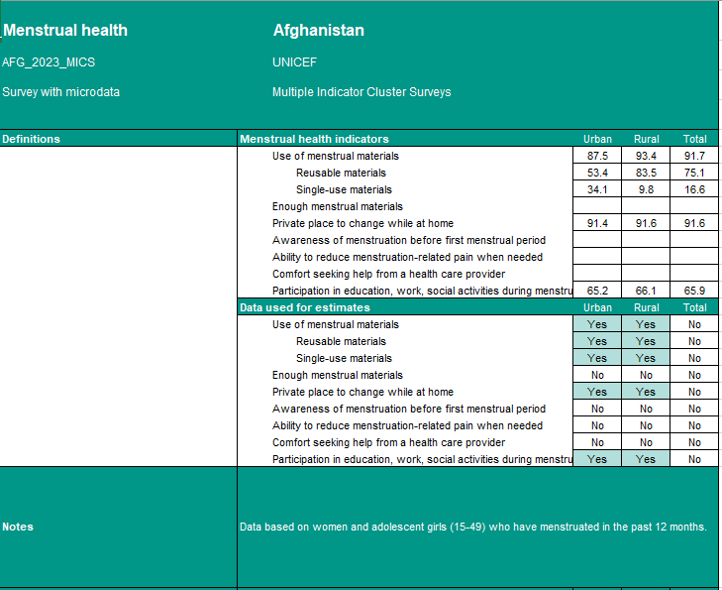
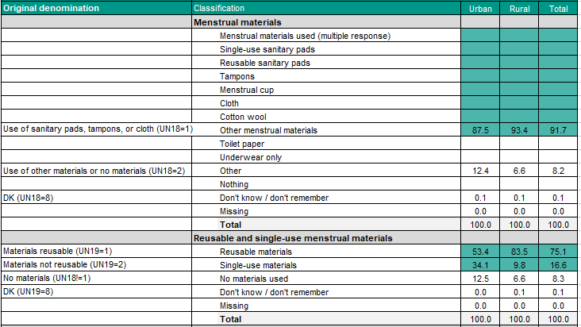
Menstrual health (new)
Notes:
In the new tab (here the example from Afghanistan) we can see we have also space for data also on “Comfort seeking help from a health care provider” and on “Ability to reduce menstruation-related pain when needed). The other changes are just some additional lines giving more details - .only part of the tab is shown here.

Slide 12
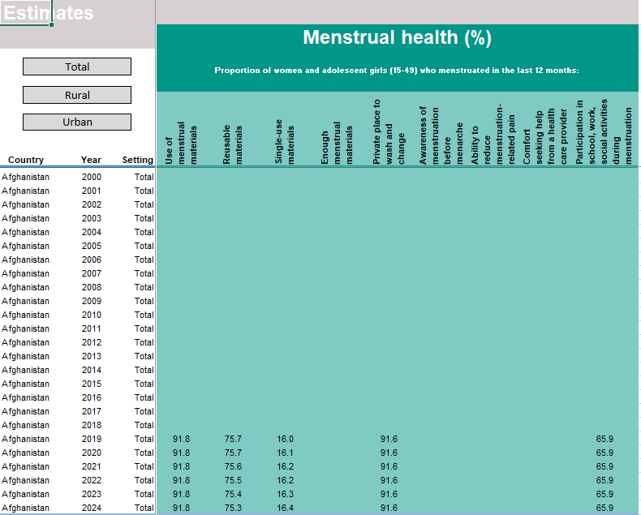
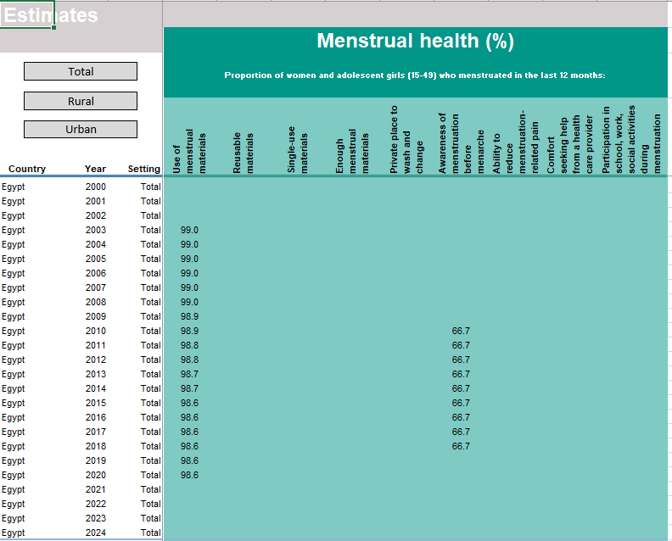
Menstrual health estimates
Notes:
As for bathing we have menstrual health estimates in the country file – here the Afghanistan and the Egypt examples for total population. As you can see for Egypt we have data but they are too old (2009 and 2014) to give an estimate in 2024. in fact JMP rules allow an extrapolation of 6 years (since we have two data sources), so until 2020. as for bathing, we have estimates in the country file but no trend charts yet

