Slide 1
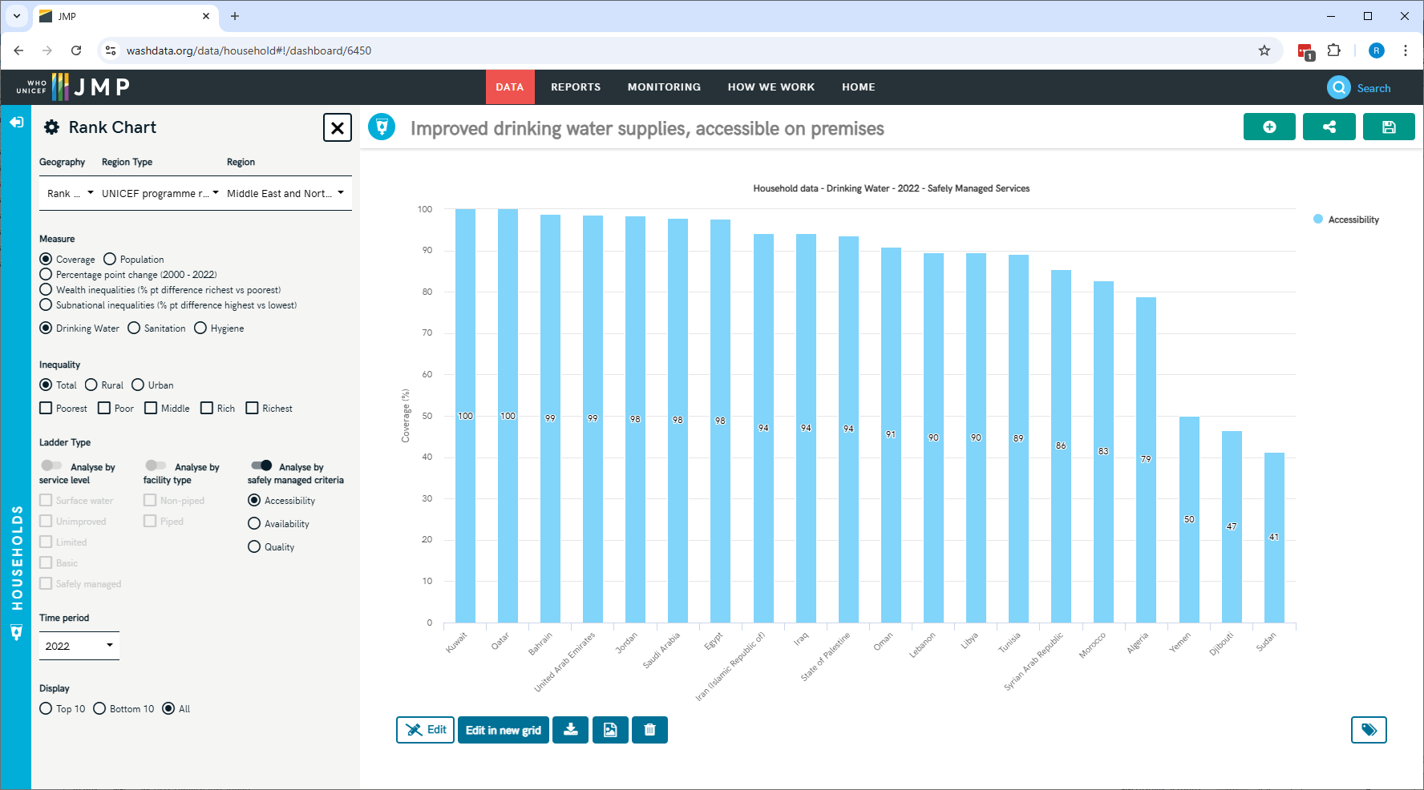
20
(losing SAU)
https://washdata.org/data/household#!/dashboard/6450
Notes:
From our website, you can see the elements of safely managed drinking water by country, here I’m showing the 20 countries in the UNICEF programme region of Middle East and Northern Africa. Of course, the website is showing data from the 2023 report, which shows coverage in 2022.
In this last report, data on “improved water supplies, accessible on premises” were available from all 20 countries in the region. As discussed, we will be losing data from Saudi Arabia for the new report.

Slide 2
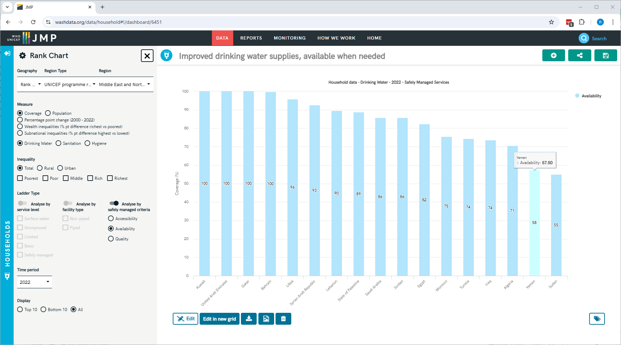
17
No SAU, IRN, OMN
https://washdata.org/data/household#!/dashboard/6451

Slide 3
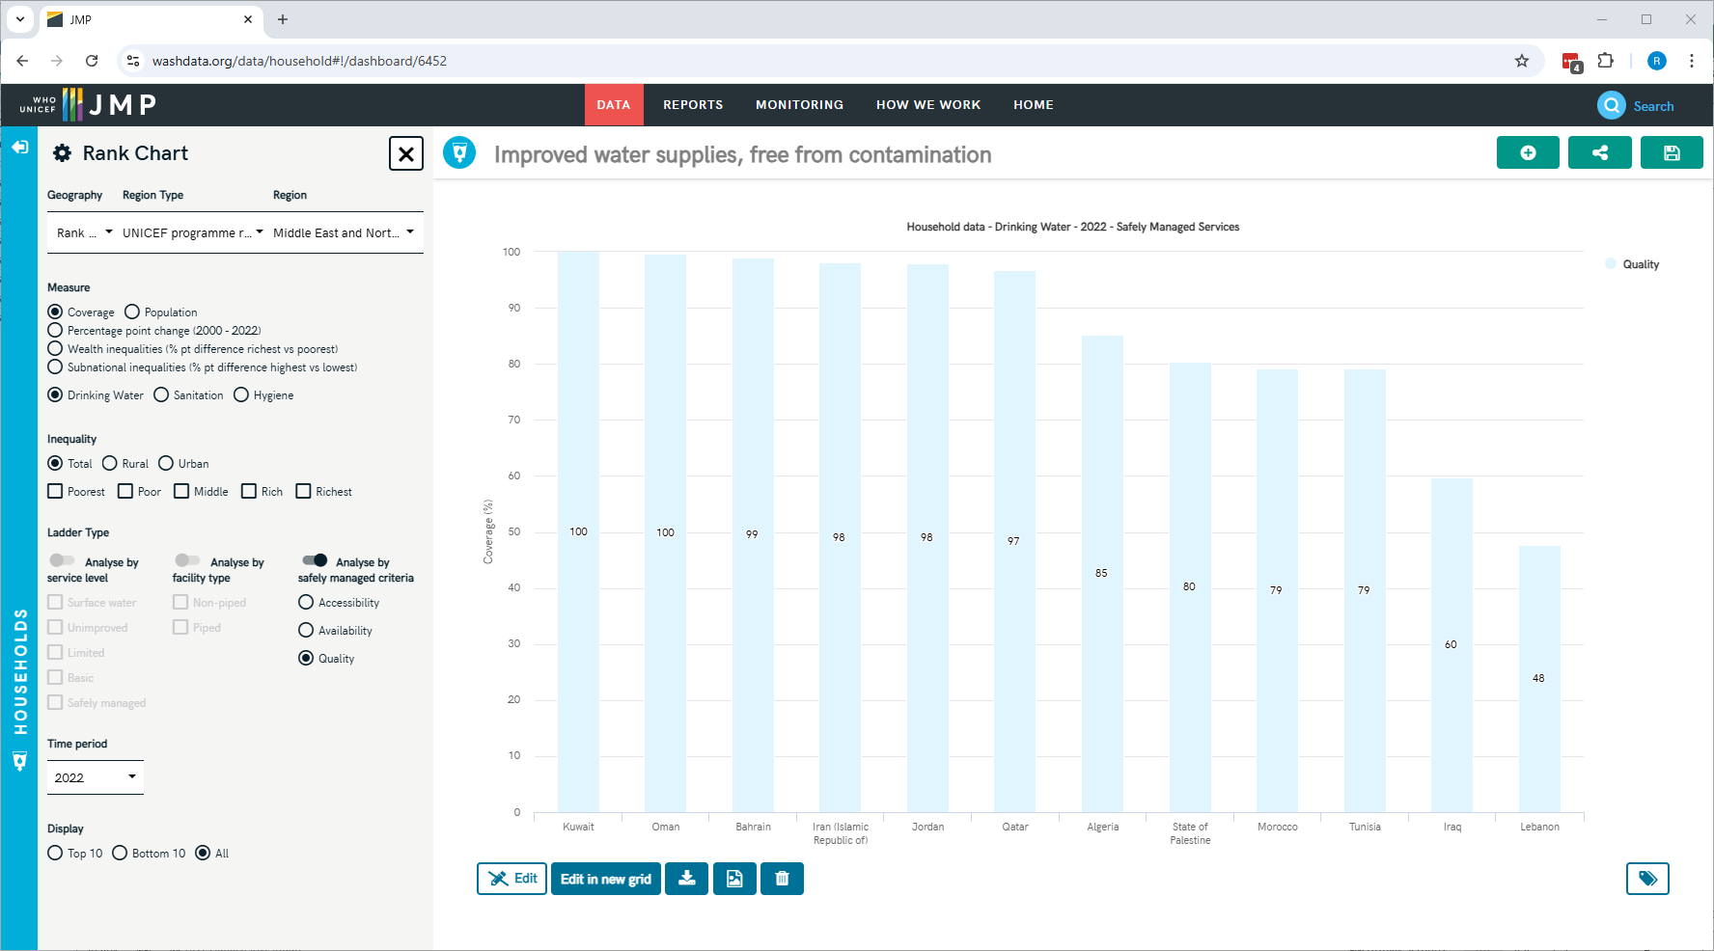
13
No ARE, DJI, LBY, SAU, SDN, SYR, YEM
https://washdata.org/data/household#!/dashboard/6452

Slide 4
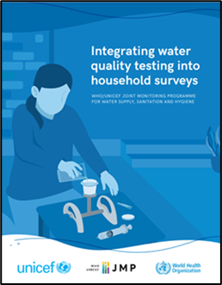
Integrating water quality testing in hh surveys
2014-15
2016-17
Congo MICS
Nepal MICS
2018-2019
Ethiopia ESS
2020-2021
Pakistan MICS (Sindh)
Afghanistan ALCS
Belize MICS6 Pilot
Ecuador ENEDMU
Nigeria MICS
Paraguay MICS
Chad MICS
DPRK MICS
Philippines APIS
Togo MICS
Lao PDR SIS
Sierra Leone MICS
Suriname MICS
Lebanon National Survey
Ghana MICS
Algeria MICS
Georgia MICS
Tunisia MICS
Jamaica MICS
CAR MICS
Iraq MICS
Kiribati MICS
Mongolia MICS
Gambia MICS
Lesotho MICS
Madagascar MICS
Guinea-Bissau MICS
Côte d’Ivoire MICS
DRC MICS
Viet Nam MICS
Benin MICS
Guyana MICS
Kosovo MICS
Malawi MICS
Tanzania LSMS
Turks and Caicos MICS
2022-23
Mozambique DHS
Trinidad and Tobago MICS
Dominican Republic MICS
Eswatini MICS
Uganda DHS
Laos PDR MICS
Somalia/Somaliland MICS
Azerbaijan MICS
Belize MICS
Burkina Faso National Survey
Sri Lanka National Survey
Sudan MICS
Tunisia MICS
Lebanon MICS
Nauru MICS
Turkmenistan MICS
Vanuatu MICS
Fiji MICS
Ecuador ENEMDU
Cote d’Ivoire DHS
Sao Tome and Principe MICS
Tonga MICS
Tuvalu MICS
Ethiopia EDHS
Nicaragua MICS
State of Palestine MICS
2012-2013
Bangladesh MICS
Ghana LSS
Notes:
More than 50 countries supported to-date

Slide 5
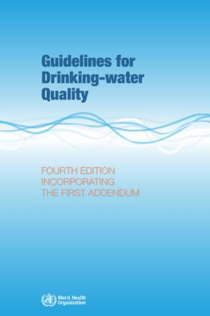
WHO risk levels for faecal contamination of drinking water

Slide 6
Elements of safely managed drinking water (Tunisia)
Notes:
Note that ‘available when needed’ is the lowest of the three SMDW elements, and so is the limiting factor. While ‘accessible on premises’ is coming from three rounds of MICS surveys (2012, 2018 and 2023), ‘available when needed’ is coming from the two recent MICS but also from the Afrobarometer surveys (2013, 2015, 2018, and 2022). ‘Free from contamination’ is coming only from the two most recent MICS surveys.

Slide 7
Calculation of safely managed drinking water
Safely managed drinking water calculation (Tunisia)
 | Total | Rural | Urban
Year: | 2024 | 2024 | 2024
Proportion of population with improved: | 99 | 97 | 99
Proportion of population with improved sources which are:
Accessible on premises | 88 | 79 | 91
Available when needed | 65 | 58 | 68
Free from contamination | 68 | 66 | 69
Safely managed | 65 | 58 | 68
Notes: The indicator for SDG 6.1, safely managed drinking water services are defined as use of an improved drinking water source which is accessible on premises, available when needed and free from contamination. To make an estimate of safely managed services, information on the use of improved drinking water sources is combined with information on the accessibility, availability and quality of drinking water. Estimates are based on the minimum value of these criteria or, where estimates are available for both rural and urban, a population weighted average of the two. The JMP reports estimates for safely managed drinking water provided information is available for at least 50 per cent of the population on quality of drinking water and either accessibility or availability.
Source: WHO/UNICEF JMP (2025)
Notes:
Safely managed is calculated based on the minimum of accessible, available and free from contamination
Availability when needed is the limiting factor for safely managed drinking water in both rural and urban areas

Slide 8
Reflections and clarifying questions on estimating 6.1.1
https://washdata.org/how-we-work/jmp-country-consultation
Results of the consultation should be shared with the WHO and UNICEF country and regional offices, and copied to info@washdata.org.
The consultation deadline is 31 January 2025.

