Slide 1
#2 Estimating 6.1.1 and addressing data gaps

Slide 2
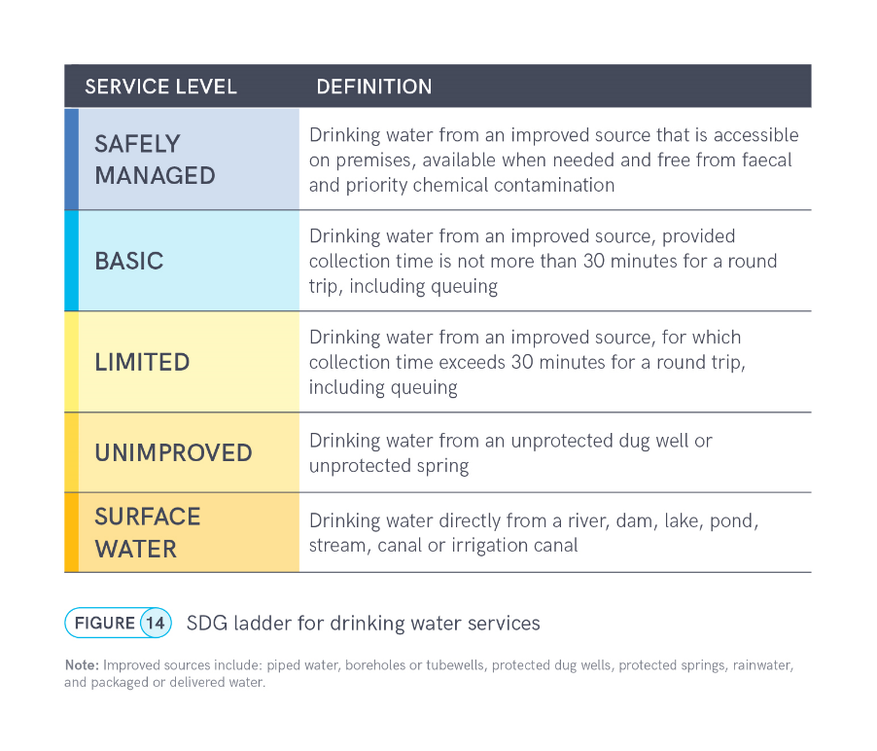
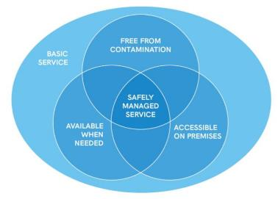
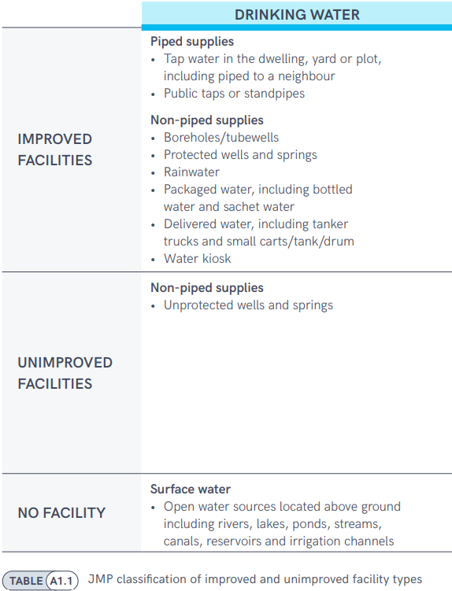
6.1.1 Safely managed drinking water
At least basic
Improved
Notes:
The JMP uses ‘service ladders’ to benchmark and compare progress across countries, and these have been updated and expanded for SDG monitoring. The drinking water ladder defines five service levels, ranging from surface water to safely managed drinking water services, which is the global indicator for SDG target 6.1. The ladder builds on the improved/unimproved source type classification used for Millennium Development Goal (MDG) monitoring and introduces additional criteria related to the level of service provided. For SDG monitoring, households using improved sources are divided into three categories. If a round trip to collect water, including queuing, exceeds 30 minutes, it counts as a ‘limited service’, and if it takes no more than 30 minutes, it counts as a ‘basic service’.
But to meet the SDG standard for ‘safely managed services’, improved sources must be accessible on premises, available when needed, and free from contamination. Since households with safely managed services also meet the requirements for basic services, the two levels can also be grouped together as ‘at least basic service’, which is the indicator used for monitoring SDG target 1.4

Slide 3
6.1.1 Safely managed drinking water
The population using an improved drinking water source that is
Accessible on premises,
Available when needed, and
Free from contamination
Notes:
The JMP uses ‘service ladders’ to benchmark and compare progress across countries, and these have been updated and expanded for SDG monitoring. The drinking water ladder defines five service levels, ranging from surface water to safely managed drinking water services, which is the global indicator for SDG target 6.1. The ladder builds on the improved/unimproved source type classification used for Millennium Development Goal (MDG) monitoring and introduces additional criteria related to the level of service provided. For SDG monitoring, households using improved sources are divided into three categories. If a round trip to collect water, including queuing, exceeds 30 minutes, it counts as a ‘limited service’, and if it takes no more than 30 minutes, it counts as a ‘basic service’.
But to meet the SDG standard for ‘safely managed services’, improved sources must be accessible on premises, available when needed, and free from contamination. Since households with safely managed services also meet the requirements for basic services, the two levels can also be grouped together as ‘at least basic service’, which is the indicator used for monitoring SDG target 1.4

Slide 4
Accessible on premises
Available when needed
Free from contamination
Household connections, or
National household surveys and censuses
E. coli or thermotolerant coliforms (all countries)
Sufficient (subjective)
Administrative data from service providers or regulators
Continuous: 24/7
Most of the time: at least 12 hrs/day or 4 days/week
Arsenic and fluoride (where relevant)
At point of collection
In the yard or plot
Can be piped or non-piped sources

Slide 5
22
21
14
8
7
ISO3 | Country | Most recent data source (survey or census) | Most recent data source (admin) | Basic drinking water services (total) | Safely managed drinking water services (total) | Safely managed drinking water services (urban) | Safely managed drinking water services (rural)
AFG | Afghanistan | AFG_2023_MICS | - | Yes | Yes | Yes | Yes
BHR | Bahrain | BHR_2018_NHS | BHR_2021_MWMAUP | Yes | Yes | No | No
DJI | Djibouti | DJI_2023_DEM | - | Yes | No | No | No
EGY | Egypt | EGY_2022_EFHS | EGY_2023_PWSS | Yes | Yes | No | No
IRN | Iran (Islamic Republic of) | IRN_2021_HIES | IRN_2021_CC | Yes | Yes | Yes | Yes
IRQ | Iraq | IRQ_2018_MICS | IRQ_2023_ES | Yes | Yes | Yes | Yes
JOR | Jordan | JOR_2023_JPFHS | JOR_2023_MOH | Yes | Yes | No | No
KWT | Kuwait | - | KWT_2021_ASBE | Yes | Yes | Yes | No
LBN | Lebanon | LBN_2023_MSNA | LBN_2013_MDG+ | Yes | Yes | No | No
LBY | Libya | LBY_2022_MSNA | - | Yes | No | No | No
MAR | Morocco | MAR_2022_AFB | MAR_2019_UNSD | Yes | Yes | Yes | Yes
OMN | Oman | OMN_2019_HIES | OMN_2022_NAMA | Yes | Yes | No | No
PAK | Pakistan | PAK_2023_CEN | PAK_2021_PCRWR | Yes | Yes | Yes | Yes
QAT | Qatar | QAT_2020_CEN | QAT_2022_ES | Yes | Yes | No | No
SAU | Saudi Arabia | SAU_2022_CEN | SAU_2022_MEWA | No | No | No | No
SOM | Somalia | SOM_2024_MSNA | - | Yes | No | No | No
SDN | Sudan | SDN_2022_AFB | SDN_2013_MDG+ | Yes | No | No | No
SYR | Syrian Arab Republic | SYR_2022_HNO | - | Yes | No | No | No
TUN | Tunisia | TUN_2023_MICS | TUN_2023_ONAS | Yes | Yes | Yes | Yes
ARE | United Arab Emirates | ARE_2018_HS | ARE_2022_WW | Yes | No | No | No
YEM | Yemen | YEM_2023_MICS | YEM_2013_MDG+ | Yes | No | No | No
PSE | occupied Palestinian territory | PSE_2021_SECS | PSE_2021_WSRC | Yes | Yes | Yes | Yes
Notes:
21 of the 22 countries in the WHO EMR region have estimates for basic drinking water services. All but Saudi Arabia – will come back to that.
14 countries, about 2/3, have estimates for safely managed drinking water at the national, or total, level.
Only 8 countries have estimates for safely managed drinking water in urban settings, and 7 for safely managed drinking water in rural areas.
When countries don’t have estimates for safely managed drinking water, it is usually because data on drinking water quality (if it is “free from contamination”) are not available, or are not representative of the entire population.

Slide 6
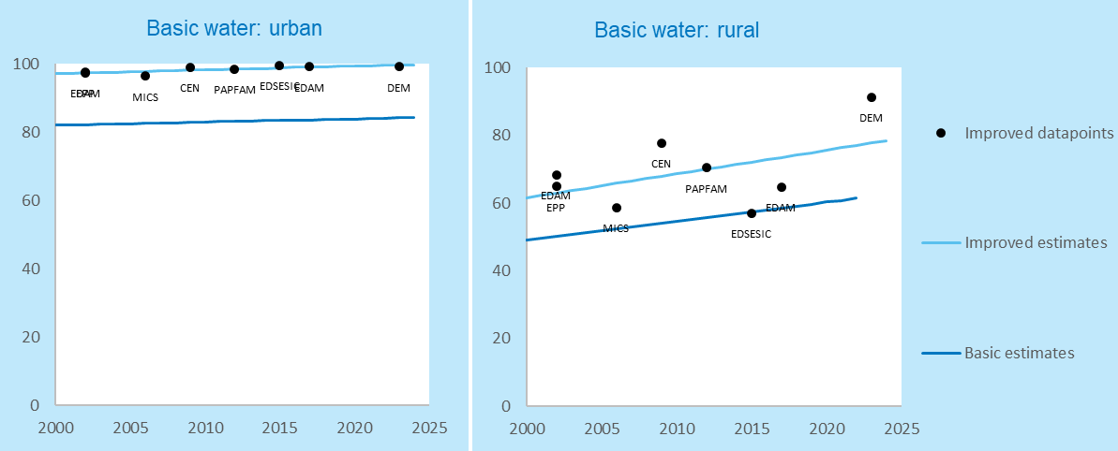
Improved and improved ≤30 mins (Djibouti)
Notes:
Large number of data sources for calculating use of improved sources and collection time

Slide 7
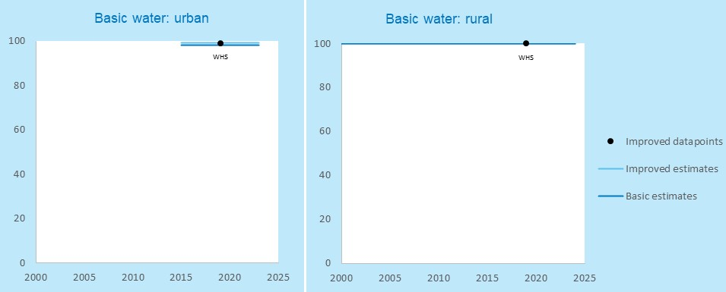
Improved and improved ≤30 mins (Saudi Arabia)
Notes:
Only one data source available, from 2019. Can extrapolate to 2023, but not to 2024. So losing estimates this round.

Slide 8
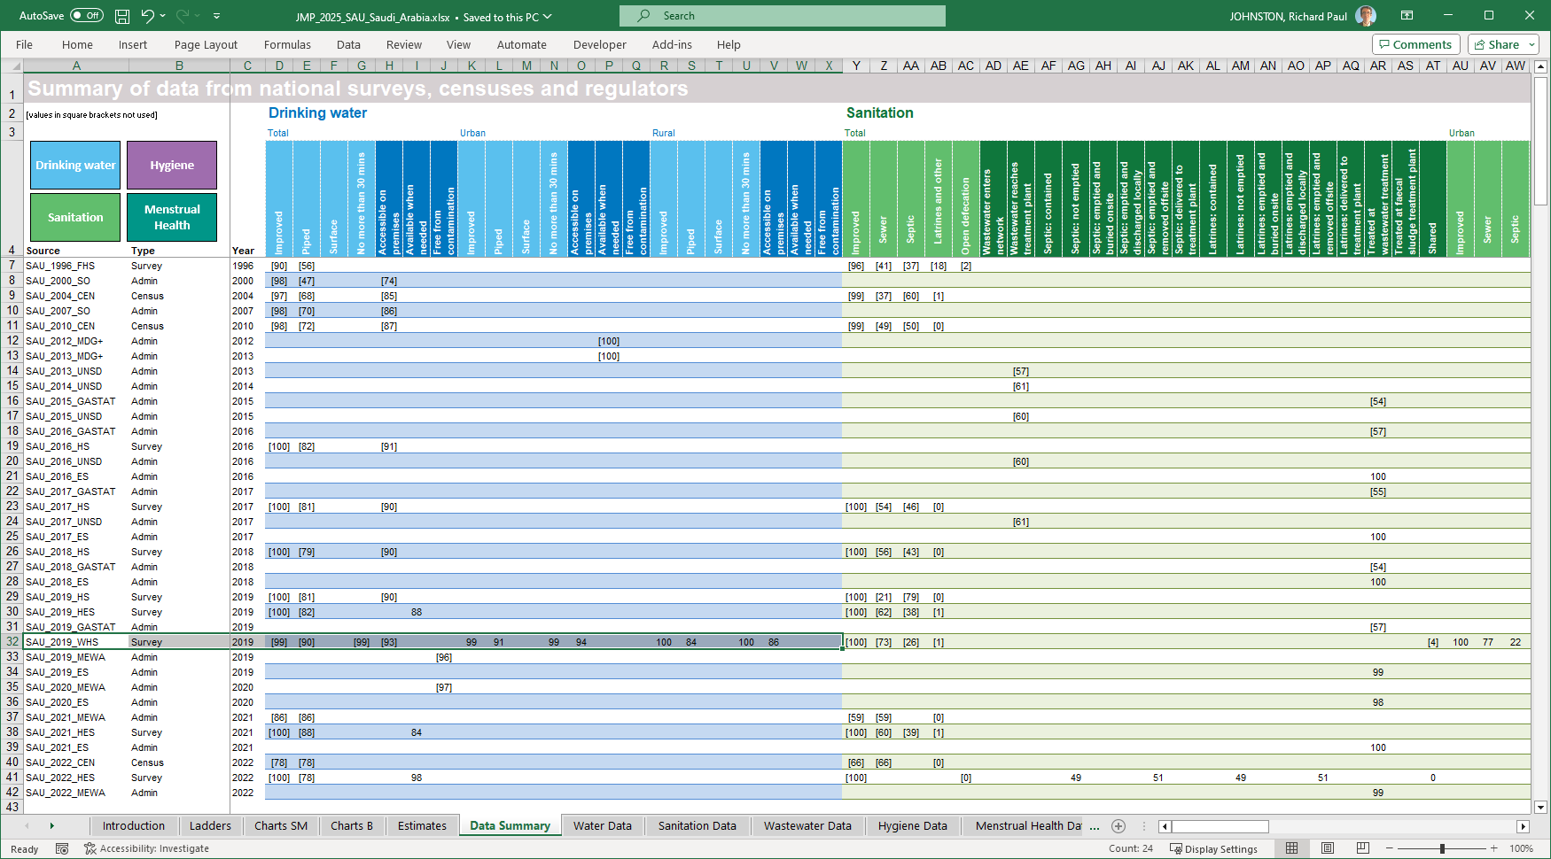
Notes:
Saudi Arabia does have data on ‘improved water’ from recent data sources, like the 2022 Household Environment Survey, or the 2022 Census.
But these data are only available at the national level. We’ve had discussions with the statistical office, GASTAT, and they have confirmed that these data can’t be disaggregated into urban and rural areas. They do have plans to fill this gap in future data collection, but for the time being, we have to rely on the 2019 World Health Survey, which I mentioned can only be extrapolated through 2023.
About 15% of the population lives in rural areas (2024). Only the 2019 WHS provides data broken down into urban and rural.

