Slide 1
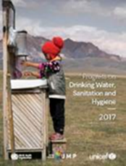
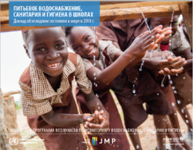
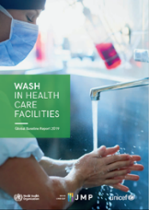
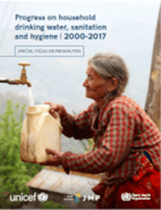
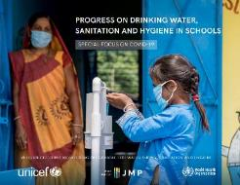
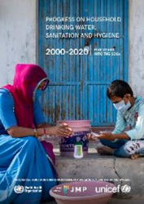
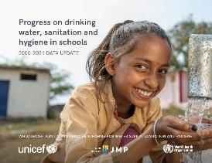
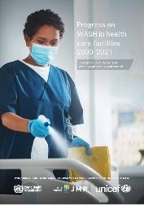
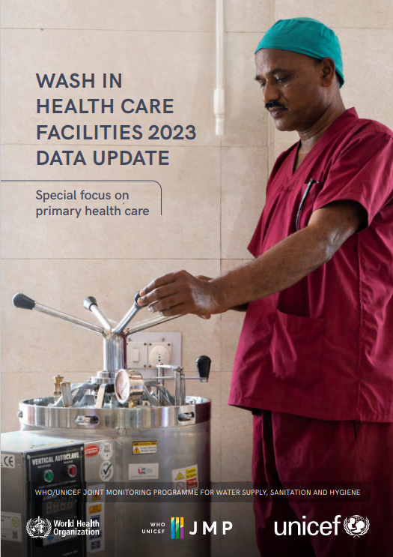
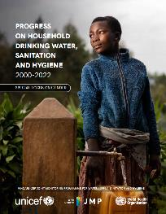
WHO/UNICEF JMP global monitoring of drinking water, sanitation and hygiene
WASH in Households in odd years
WASH in Schools and Health Care Facilities in even years
2017
2018
2019
2019
2020
2020
2021
2022
2022
2024
2023
2024
Tom Slaymaker (tslaymaker@unicef.org)
Rick Johnston (johnstonr@who.int )
2025 update
washdata.org
Notes:
Hello and welcome to an orientation on global monitoring of drinking water, sanitation, and hygiene, to inform the 2025 country consultation process.
The WHO/UNICEF joint programme has been monitoring WASH since 1990
We previously reported on MDGs and now responsible for global monitoring of SDG targets related to WASH
JMP reporting previously focused on households and has now been expanded to cover schools and health care facilities
We now produce updates for each setting every 2 years. Households in odd years. Schools and Health Care Facilities in even years.
We published updates for schools and health care facilities in 2024 and will be launching a 2025 household update in 2025
At the end of each year we circulate draft estimates to country offices for a 2 month period of country consultation with national authorities
WHO and UNICEF regional and country offices play a critical role in making sure that the latest available national data are included in JMP estimates
The JMP team also works closely with regional and country offices to help governments address data gaps and strengthen national systems for monitoring SDG WASH targets (key part of our mandate)

Slide 2
Outline: country consultations in EMR/MENA
Introduction (Rick Johnston, WHO/JMP)
6.1.1 Drinking water (Tom Slaymaker, UNICEF/JMP)
6.2.1a Sanitation (Rick Johnston, WHO/JMP)
6.2.1b Hygiene (Francesco Mitis, WHO/JMP)
6.3.1 Wastewater (Andrew Shantz, WHO)
Joint consultation: deadline 31 January 2025
Notes:
This presentation is the first in a set of presentations designed to support the country consultations in the WHO Eastern Mediterranean region as well as the UNICEF Middle East and Northern Africa region.
I’m Rick Johnston I lead the WHO side of the WHO/UNICEF Joint Monitoring Programme, and I’m going to start with an overview of global monitoring of water, sanitation, hygiene and wastewater, and how the country consultation fits into this.
After this presentation, we have a set of four presentations that go into detail about specific indicators that are under consultation.
Tom Slaymaker, the UNICEF lead for the JMP, will review estimates of drinking water, under SDG indicator 6.1.1. Then I’ll come back to talk about sanitation, including SDG indicator 6.2.1a, before passing on to my colleague Francesco Mitis to discuss hygiene and SDG indicator 6.2.1b. Finally, Andrew Shantz from WHO will present the estimates for SDG indicator 6.3.1 on domestic wastewater, which is closely aligned with the sanitation indicator 6.2.1a, but does have some key differences.
In all cases, draft estimates have been shared with countries at the beginning of December last year, and feedback is welcome before the deadline of 31 January.

Slide 3
#1 Introduction to global monitoring of WASH (WHO/UNICEF JMP; WHO)

Slide 4
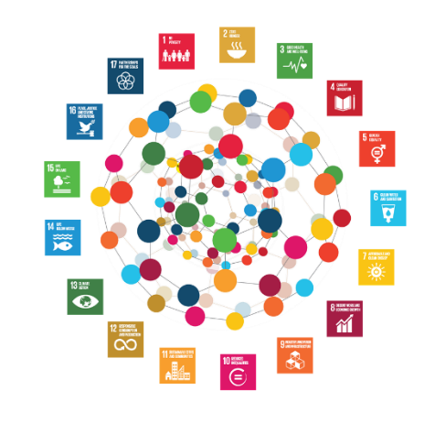
Inter-Agency and Expert Group on SDG Indicators
https://unstats.un.org/sdgs/iaeg-sdgs/
Notes:
IAEG-SDG developed the current list of SDG global indicators (231 unique indicators)
IAEG members drawn from national statistical offices (NSOs)
Rotating list of 27 member states representing each SDG region, you can see that currently we have Egypt, Tunisia, and Jordan from the EMR/MENA region as members.
IAEG nominated custodian agencies for each SDG global indicator

Slide 5
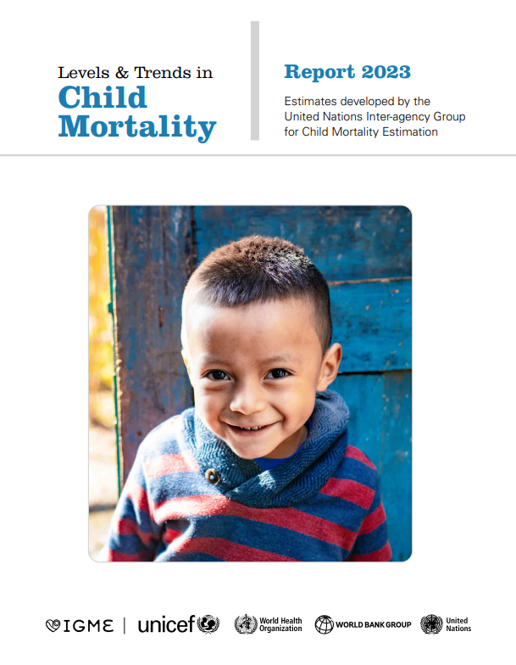
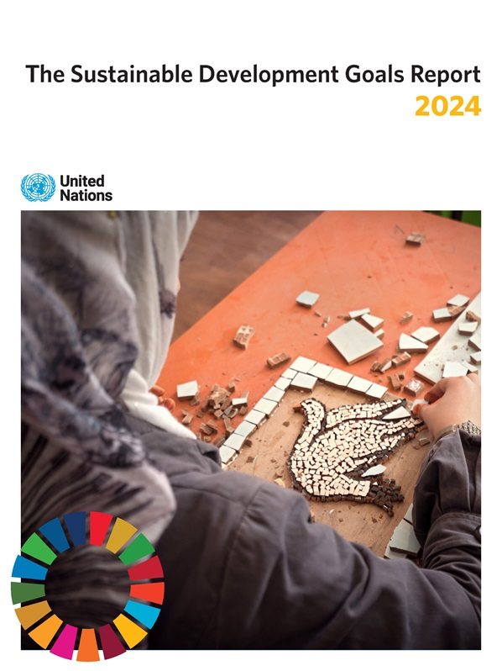
Custodian agencies for SDG global indicators
Custodian agencies are expected to:
Maintain global databases
Lead methodological work and develop standards
Contribute to statistical capacity building
Establish mechanisms for compilation and verification of national data
Provide internationally comparable data and narrative to UNSD for global SDG database and annual SDG progress report
Global SDG database https://unstats.un.org/sdgs/indicators/database/

Slide 6
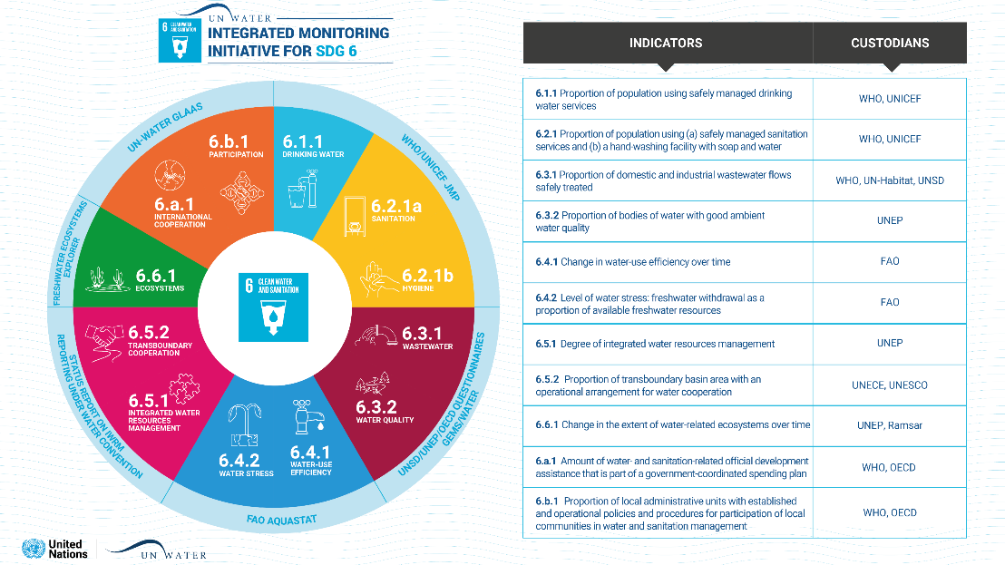
UN Water Integrated Monitoring Initiative for SDG 6
Notes:
SDG 6 includes 8 targets and 12 global indicators
WHO/UNICEF JMP serves as custodian of global data for targets 6.1 and 6.2
WHO and UN-Habitat are the custodians for the wastewater target under 6.3, in collaboration with the UN Statistics Division.
And we work with the other agencies responsible for global monitoring of other targets under the UN Water IMI-SDG6
We also try to coordinate support for SDG 6 monitoring at regional and country level
We also collaborate with agencies responsible for reporting on other SDG goals for Poverty, Education, Health, Gender

Slide 7
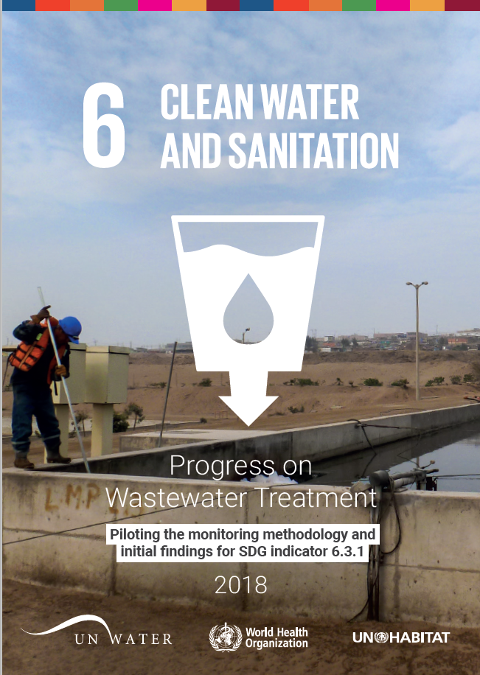
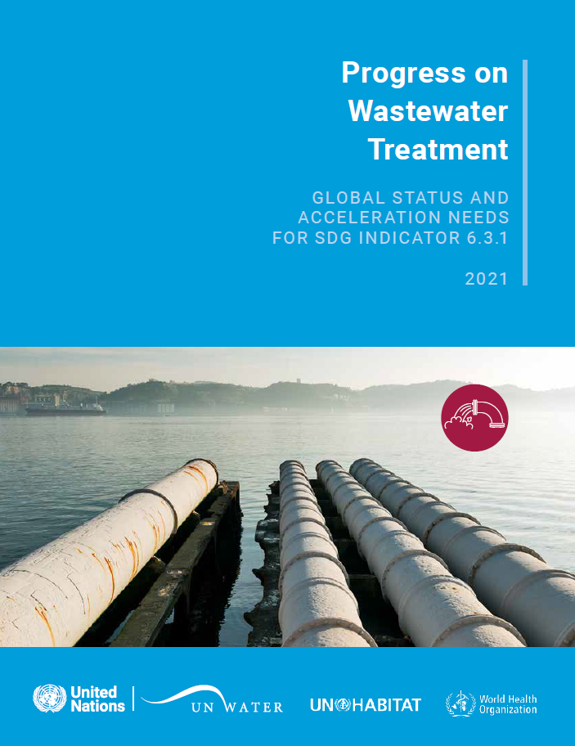
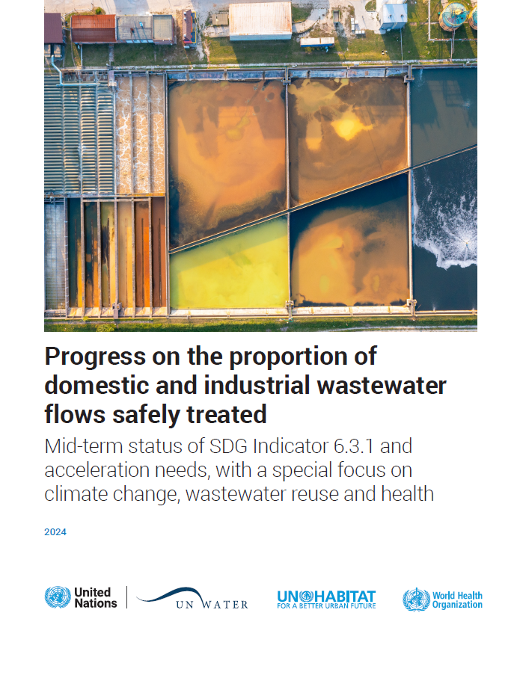
Global reports on wastewater treatment (WHO/UN Habitat)
Notes:
Last year, WHO and UN-Habitat released the third global report on wastewater treatment, following reports in 2018 and 2021. These reports are on a three-year cycle, so the next narrative report will come in 2027.

Slide 8
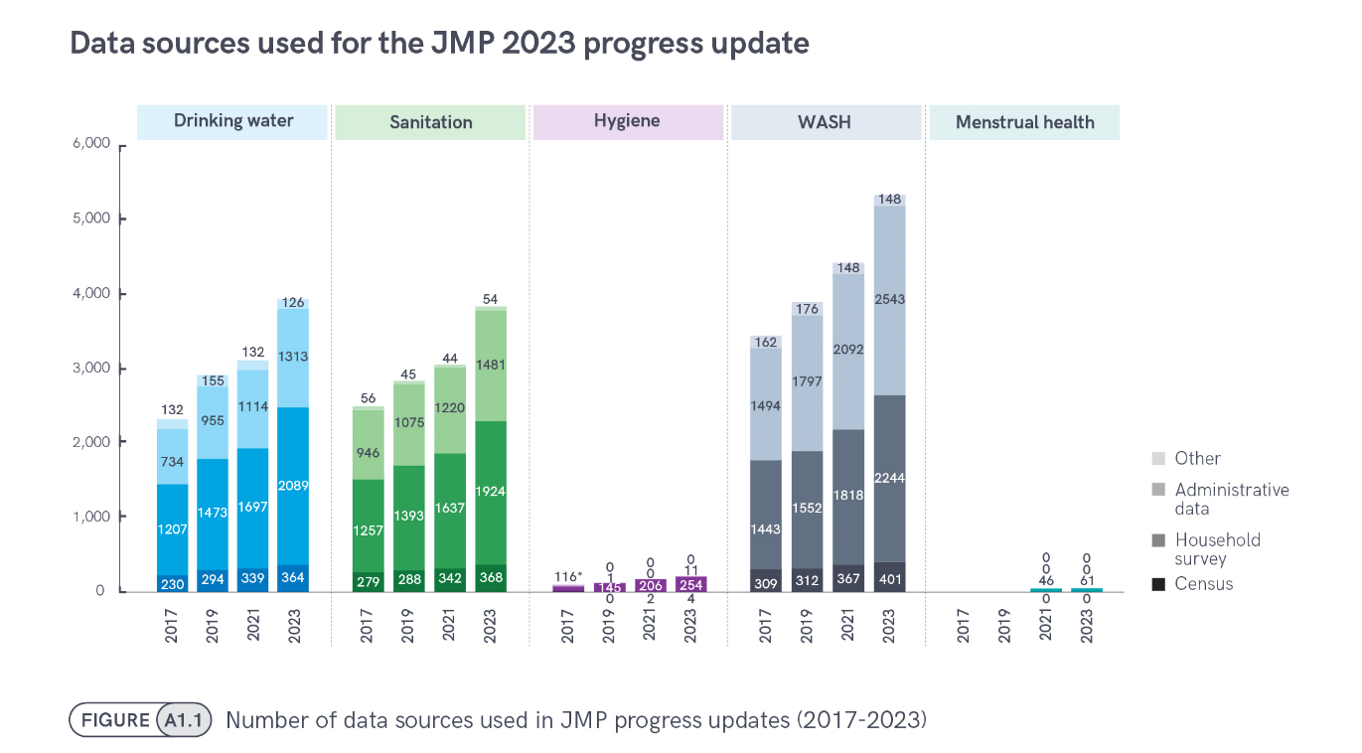
JMP 2023 progress update: special focus on gender
Notes:
In contrast, the JMP reports are on a two-year cycle, and our last report came out in 2023. It had a special focus on gender.
All of our reports aim to produce internationally comparable estimates based on national data sources
The household database now contains nearly 8000 national datasets of which 5340 were used for the 2023 report.
About half from censuses and hh surveys and half from administrative data including regulators.
This chart shows how the database has grown with each JMP update
Nearly 4000 datasets on drinking water (3894) and sanitation (3831) but only 269 on hygiene (almost all hh surveys)
In 2021 the JMP established a new database on menstrual health which now includes 61 datasets (all hh surveys)

Slide 9
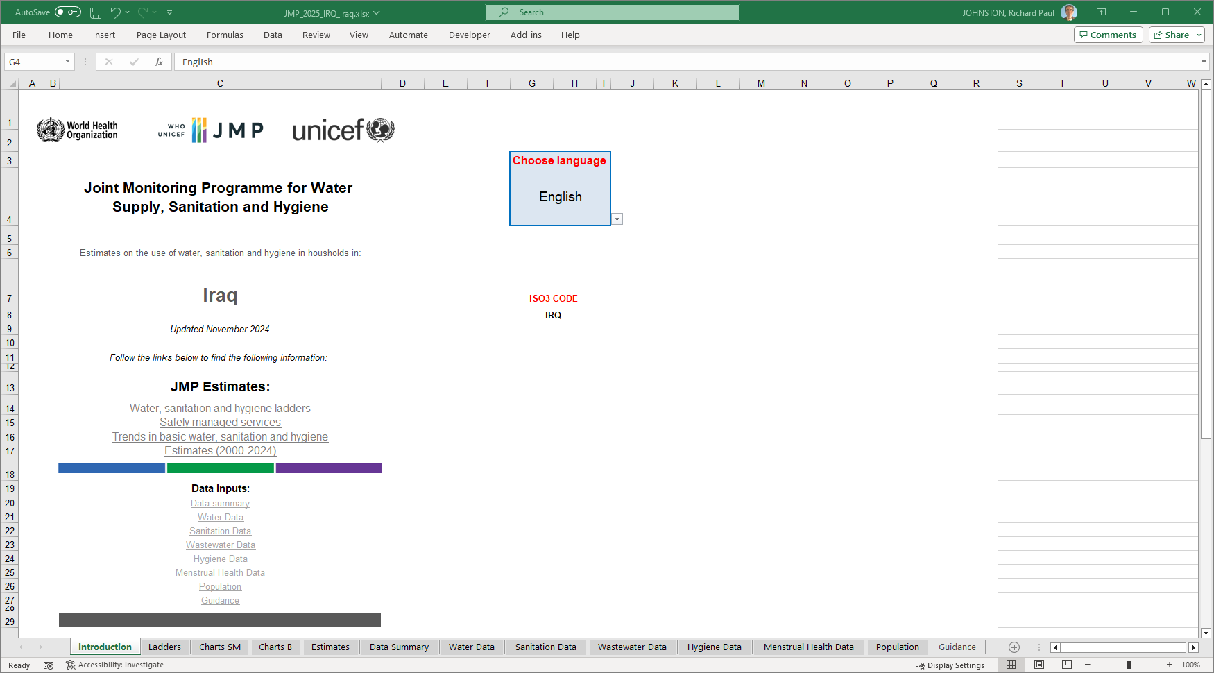
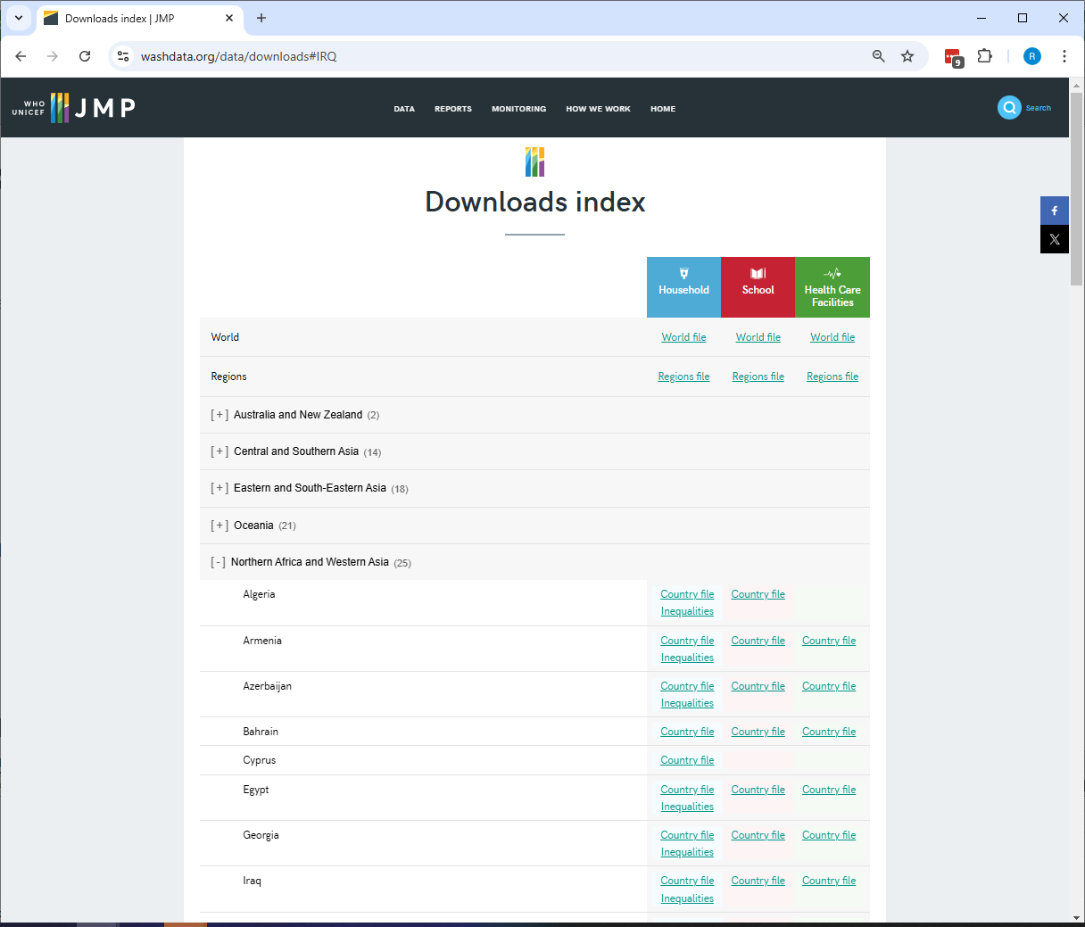
https://washdata.org/data/downloads#IRQ
Notes:
So those national datasets are recorded in what we call Country Files.
These are Excel spreadsheets which contain a complete list of available national data sources and they show how these data sources have used by JMP to produce internationally comparable estimates
Finalized country files for households, schools and health care facilities can be downloaded from the JMP website, you see the link on the right.
Here is an example of the new draft country file for Iraq, which hasn’t yet been finalized, so it’s not available online.
The Introduction tab includes links to tabs containing the JMP estimates and data inputs used to produce them
It also has a language selection box, and…

Slide 10
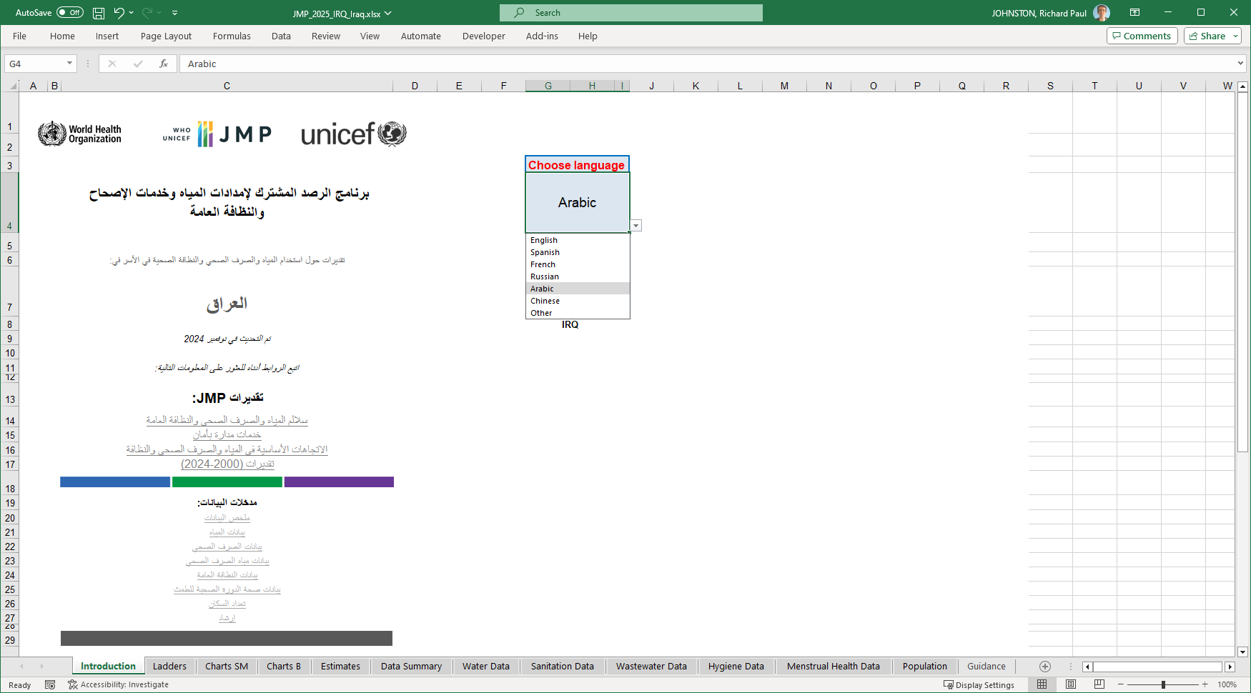
https://washdata.org/data/downloads#IRQ
Notes:
You can select between English, Spanish, French, Russian, and Arabic. It’s also possible to create custom translations for other languages. So here you see what the introduction tab looks like in Arabic.

Slide 11
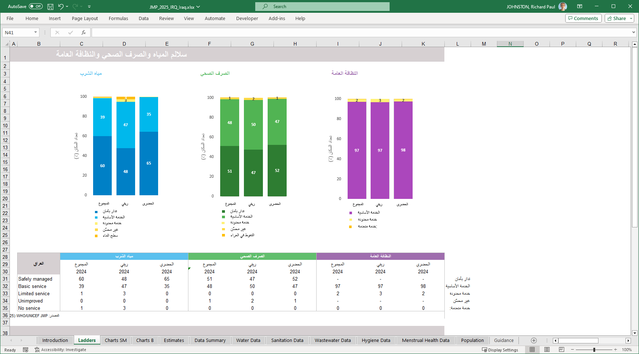
Notes:
Another useful tab is the “Ladders” tab, which shows for total, urban and rural populations, what estimates are available for the water, sanitation and hygiene service ladders.
You can see here that for Iraq, we have estimates for 2024 for all three ladders, and for all of the service levels. Some countries don’t have sufficient data to calculate all of the service levels, so for instance you might not see the dark blue bars for SMDW, or the dark green for SMS.

Slide 12
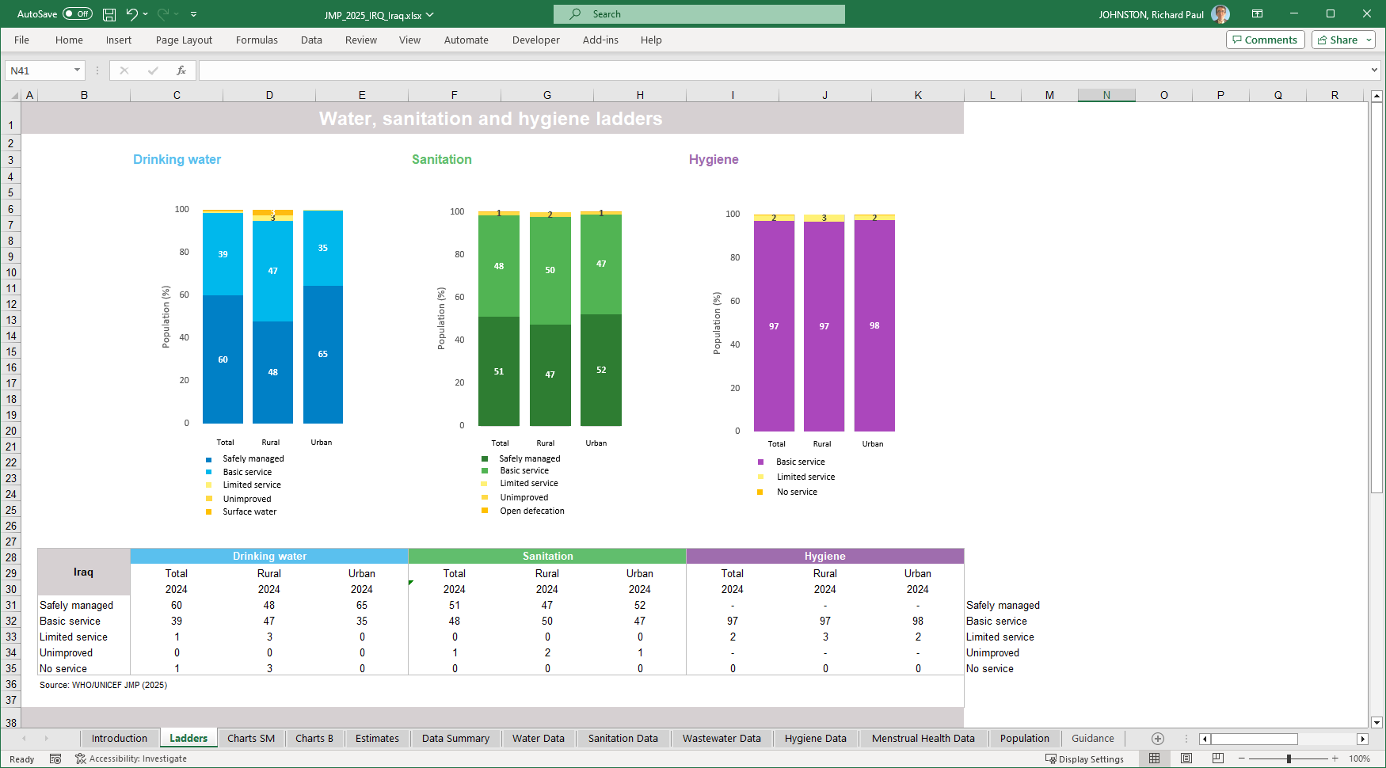
Notes:
Let me switch back to English so I can read the slides as well.

Slide 13
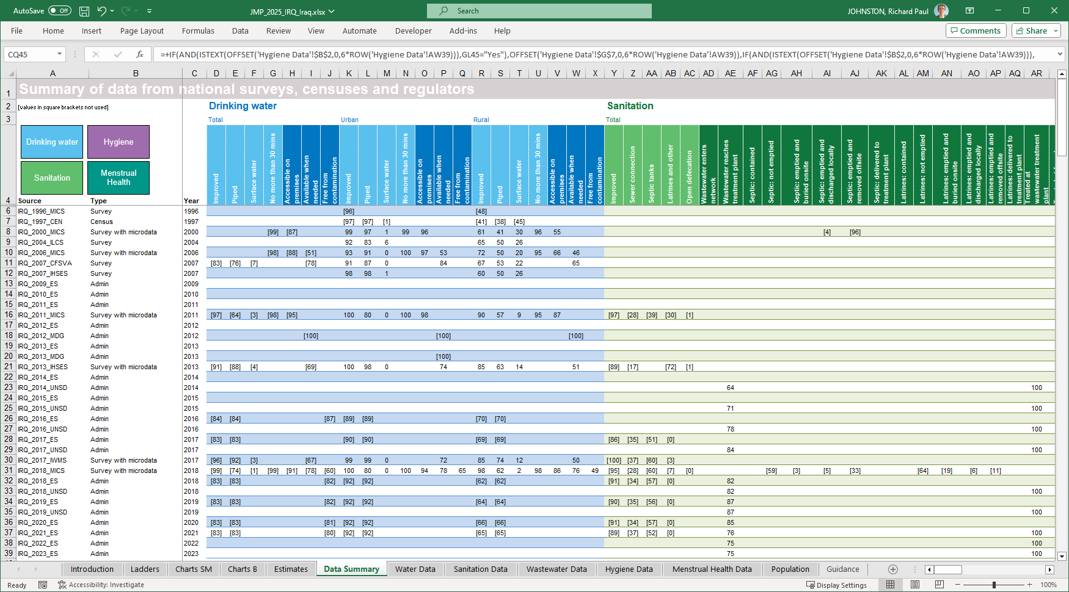
Notes:
An important tab is the Data Summary tab, this lists all of the national data sources that the JMP has found and extracted data from. We have 34 national data sources, going back to the 1996 MICS survey. Some of these are household surveys, but there is also one census, and a good number of administrative or sectoral data sources. This is probably the first tab to start with during the consultation, to confirm that we have all of the most recent and correct national data sources.
In some cases we extract data but can’t use these to produce estimates; in that case the data are shown on this tab in square brackets. Sometimes we can’t use data because they are incomplete, or not representative, or don’t match the global indicators. For example, we have data on drinking water quality from a number of administrative reports called “Environmental Statistics of Iraq”, we abbreviate those with _ES. These provide data on bacteriological compliance, but only of water in public distribution networks. And since a significant part of the population uses other drinking water sources, including bottled water, we don’t use these Environmental Statistics data. We do have comprehensive data on water quality from a household survey that measured E. coli from all household drinking water sources, the 2018 MICS.

Slide 14
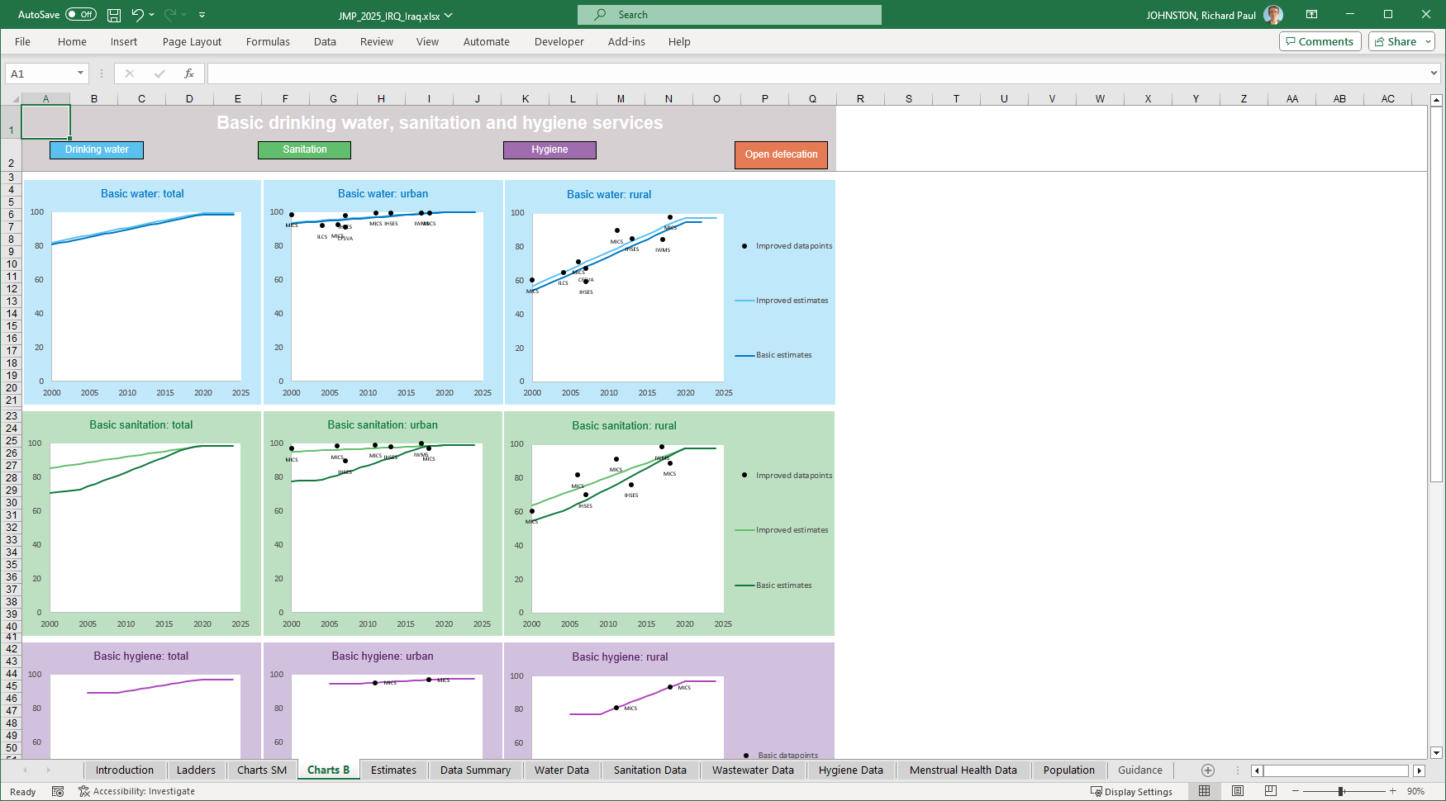
Notes:
The Charts B tab shows how we use these data sources for the basic services indicators. Here you see the data points on improved water and sanitation, and also on basic hygiene, which is just the availability of water and soap in the home for handwashing. We take those individual data points, and make a simple linear regression on them. We do this separately for urban and rural areas, and then combine them to produce national or total estimates.
You can see we have a lot of data points for improved water and sanitation, but only two for basic hygiene. Still, that’s enough information to show a clear positive trend for all these indicators.
You can also see that sometimes individual data points can be different from each other – look for instance at the rural sanitation points. Here it seems that the MICS usually – but not always - finds higher coverage than the IHSES survey. And that’s why we use linear regression instead of just relying on the most recent data point.

Slide 15
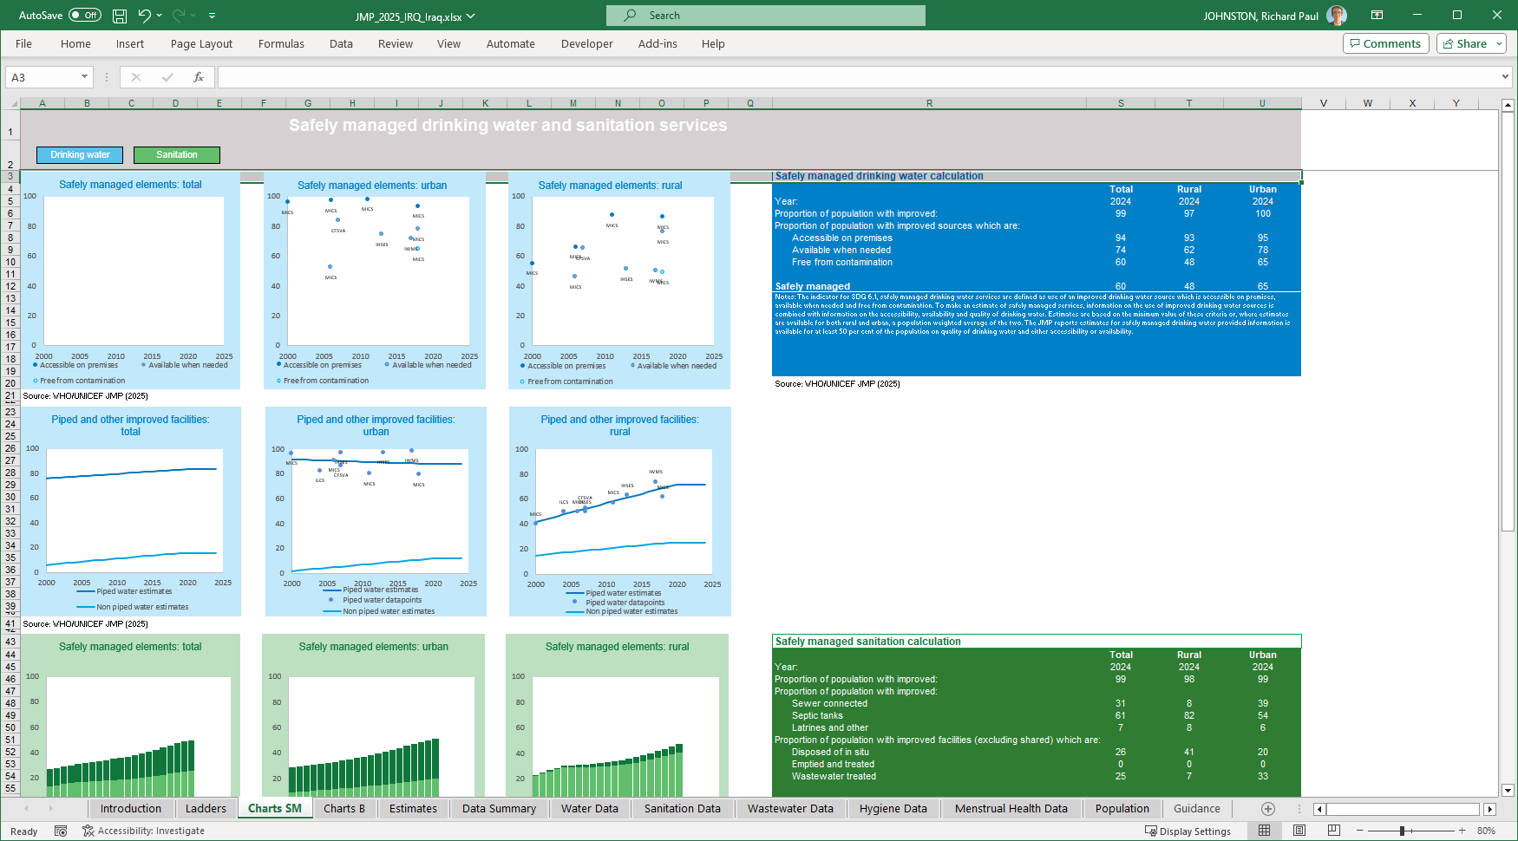
Notes:
Another useful tab is the Charts SM tab, which shows some of the variables more related to Safely Managed services, including a summary of the calculations for safely managed drinking water and sanitation.

Slide 16
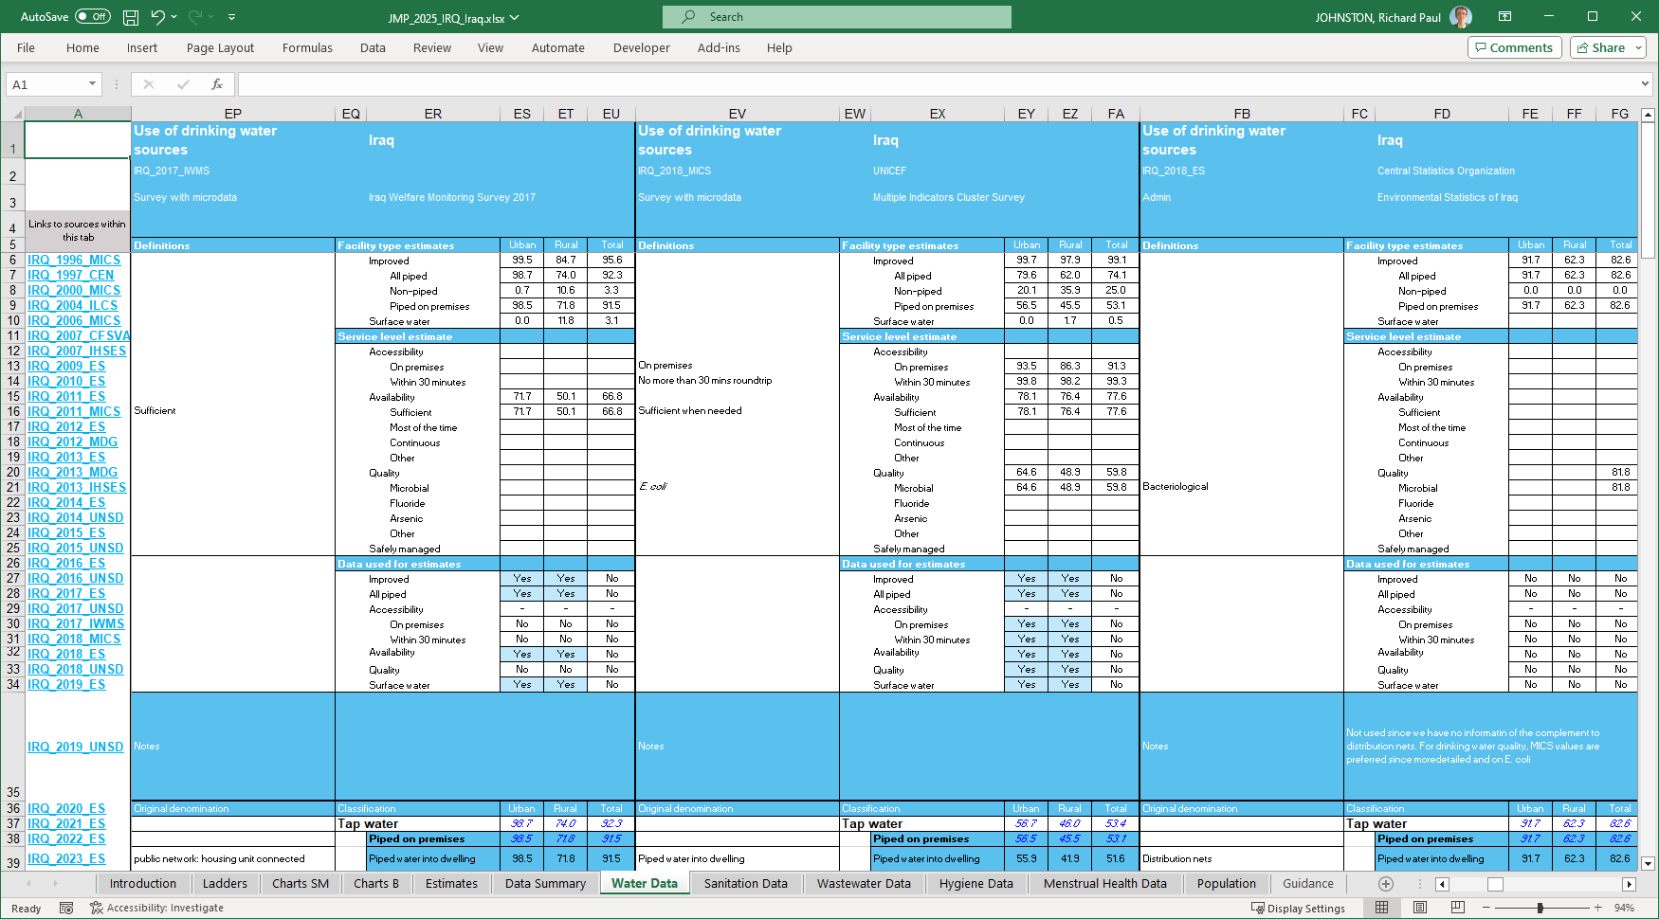
Notes:
Then, for each data source, there are tabs that show in detail what information we have extracted, regarding water, sanitation, wastewater, hygiene, and menstrual health.
Here for example two household surveys, from 2017 and 2018, as well as the 2018 Environmental Statistics report. This is a good place to check to see that we have correctly extracted all of the relevant information from individual data sourecs.

Slide 17
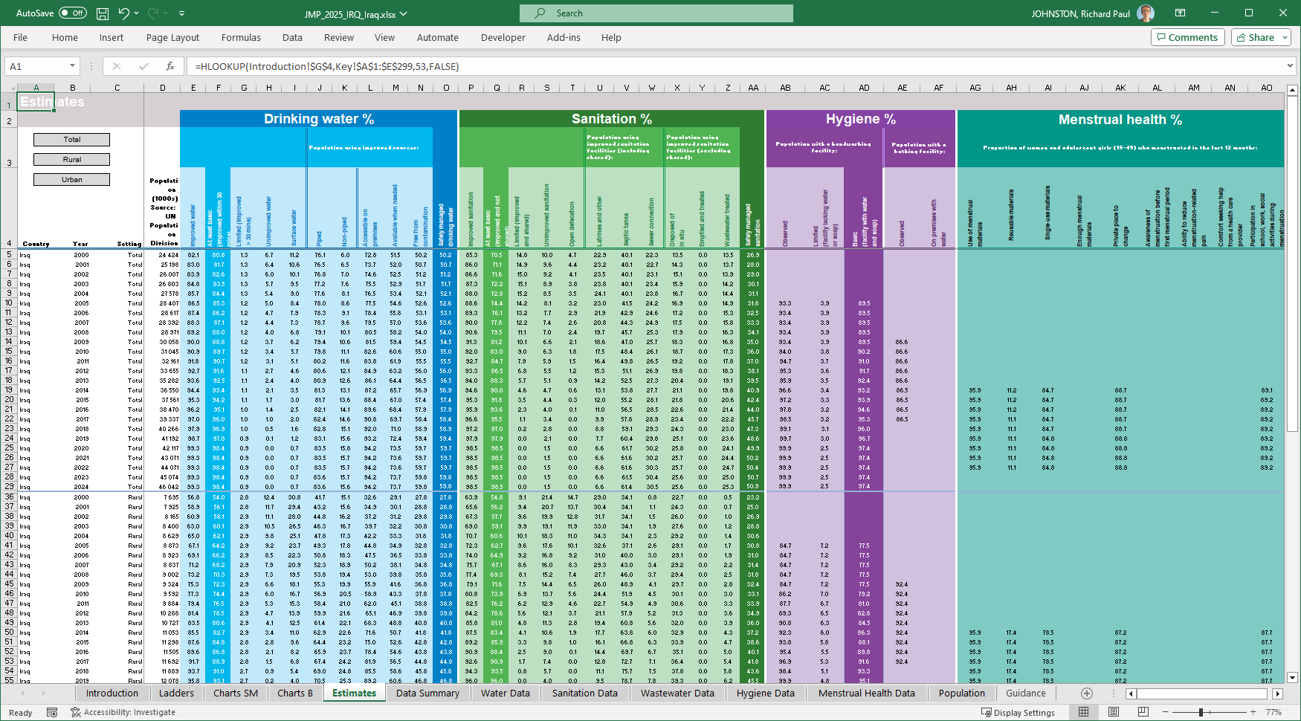
Notes:
So, on the basis of the linear regressions, we produce estimates for all years, and show them on the Estimates tab. Note that since these are coming from linear regressions, they won’t be identical to any single data point, but they do show the trends over time. The tab shows data for total populations for the years 2000-2024, and lower down you can find the rural and urban estimates.
You can see that in Iraq there has been strong progress on safely managed sanitation, rising from 26.9% in 2000 to 50.9% in 2024, so nearly doubling.

Slide 18
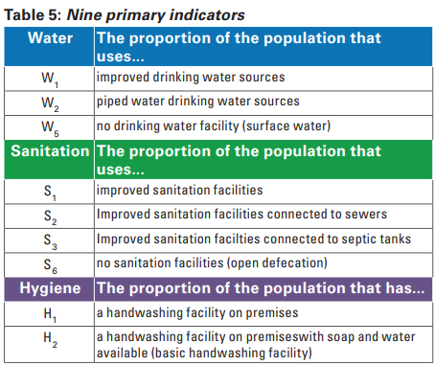
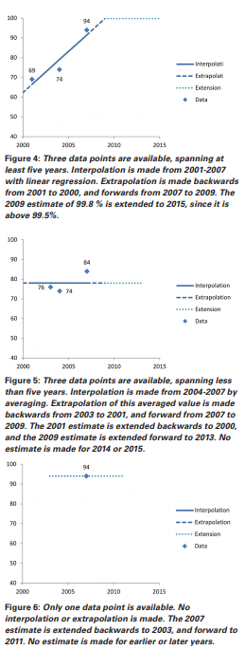
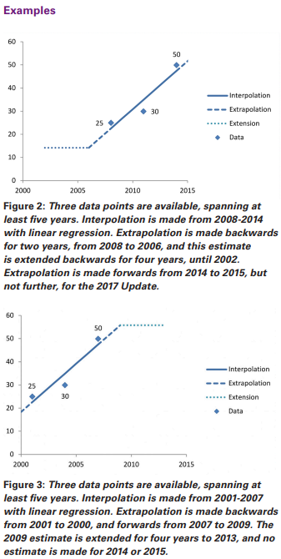
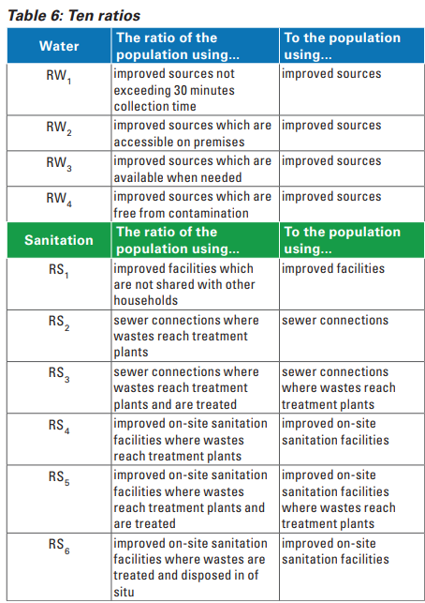
JMP methodology
https://washdata.org/reports/jmp-2017-methodology
Notes:
If you’d like more detail about the JMP methodology, we have a report that provides a detailed description of the different steps in the JMP methodology
Small refinements to JMP methods are recorded in Methods Annex of each JMP report
JMP estimates for WASH in households are based on 9 primary indicators which come directly from data inputs and ten ratios which are then combined with primary indicators to produce secondary indicators
JMP uses a linear regression of all available data inputs and has established a set of rules for interpolation, extrapolation, and extension of estimates
We also have rules about how fare we can extrapolate those regressions, because if a country doesn’t have recent data sources, we may not be able to produce estimates.
Clearly, if the only data available are from, say, 2012, it doesn’t make sense to say that that reflects the situation in 2024.

Slide 19
Country consultations for 2025 updates
Is the country file missing any relevant national sources of data that would allow for better estimates?
Are the data sources listed considered reliable and suitable for use as official national statistics?
Is the interpretation and classification of the data extracted from national sources accurate and appropriate?
 | 1 | 2 | 3 | 4 | 5 | 6 | 7 | 8 | 9 | 10 | 11 | 12
2024 |  | Prepare reports Health care facilities, schools |  |  |  |  | Compile new data Households, 631 |  |  |  | Consultation Households, 631
2025 |  | Prepare reports Households (631) |  |  |  |  | Compile new data Health care facilities, schools |  |  |  | Consultation HCF, schools
Publish progress updates
Notes:
So, we come to the country consultation, the task at hand.
The JMP produces updates every two years for the databases on households, and also for the databases on schools and health care facilities. We usually publish these around May or June, and then start to work compiling new data sources for the next report. In 2024 we published updates on schools and HCF, and then compiled new data on households (also WHO compiled new data on wastewater for 6.3.1). These were then shared with WHO and UNICEF regional and country offices in December, to engage with countries and share feedback by the end of January 2025. And that will give us a few months to write the reports, and make sure that the latest data go into the global SDG report which comes out each year.
During the consultation, we have three key questions:

Slide 20
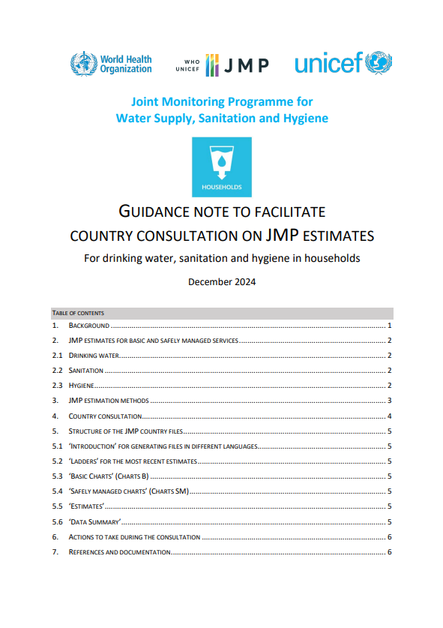
JMP country consultations
Guidance note to facilitate country consultation
English, French, Spanish, Russian & Arabic
WHO/UNICEF country offices contact national authorities
Always the NSO, additionally relevant ministries and agencies
Seek technical feedback on JMP country file
Three questions
WHO and UNICEF division of labour
JMP estimates: WHO and UNICEF co-lead
631 estimates: WHO lead (keep UNICEF informed)
Provide feedback to JMP team via info@washdata.org
Deadline January 31, 2025
https://washdata.org/how-we-work/jmp-country-consultation
Notes:
We do have guidance notes to facilitate the country consultation, they are available in multiple languages
We rely on the WHO and UNICEF regional and country offices to contact the relevant national authorities.
The JMP team also works closely with regional and country offices to help governments address data gaps and strengthen national systems for monitoring SDG WASH targets (key part of our mandate)
The current consultation for WASH in households was launched on 2nd December 2024 and ends on 31 January 2025

Slide 21
What the country consultation is not
The purpose of the consultation is not to compare JMP or 631 estimates with national estimates of WASH coverage but rather to review the completeness or correctness of the datasets in the country files and to verify the interpretation of national data in the JMP or 631 estimates.
The consultation is not expected to involve complex analysis, or to review the estimation methodology, but simply to identify any missing data sets and to provide feedback on the interpretation and classification of existing national data.

Slide 22
Please don’t edit the Excel files directly!
The country files contain many formulas and links.
Due to the statistical modelling approach used, we kindly ask you to not work directly in the MS Excel worksheets but rather provide data for consideration (including its source) in an additional document to the JMP team.

Slide 23
Reflections and clarifying questions on JMP global monitoring of WASH
https://washdata.org/how-we-work/jmp-country-consultation
Results of the consultation should be shared with the WHO and UNICEF country and regional offices, and copied to info@washdata.org.
The consultation deadline is 31 January 2025.

