Slide 1
2nd International Learning Exchange on WinS - Africa
8 May 2024
Christie Chatterley, WHO/UNICEF Joint Monitoring Programme (JMP)
Monitoring progress on menstrual health services in schools

Slide 2
Why should we monitor MH in schools?
Monitoring data are needed to inform advocacy, policies, costing (and more!) to support improvement
If we don’t monitor it, we can’t improve it
What do you mean?
Why is it so important to improve MH services in schools?
Basic WASH services are necessary but not sufficient for students who menstruate.
What are we waiting for!? Let’s go monitor MH in schools!!
There are roughly 900 million adolescent schoolgirls in the world counting on us.
Notes:
so they can fully participate, meet learning outcomes, reach their goals and potential

Slide 3
What exactly should we be monitoring??

Slide 4
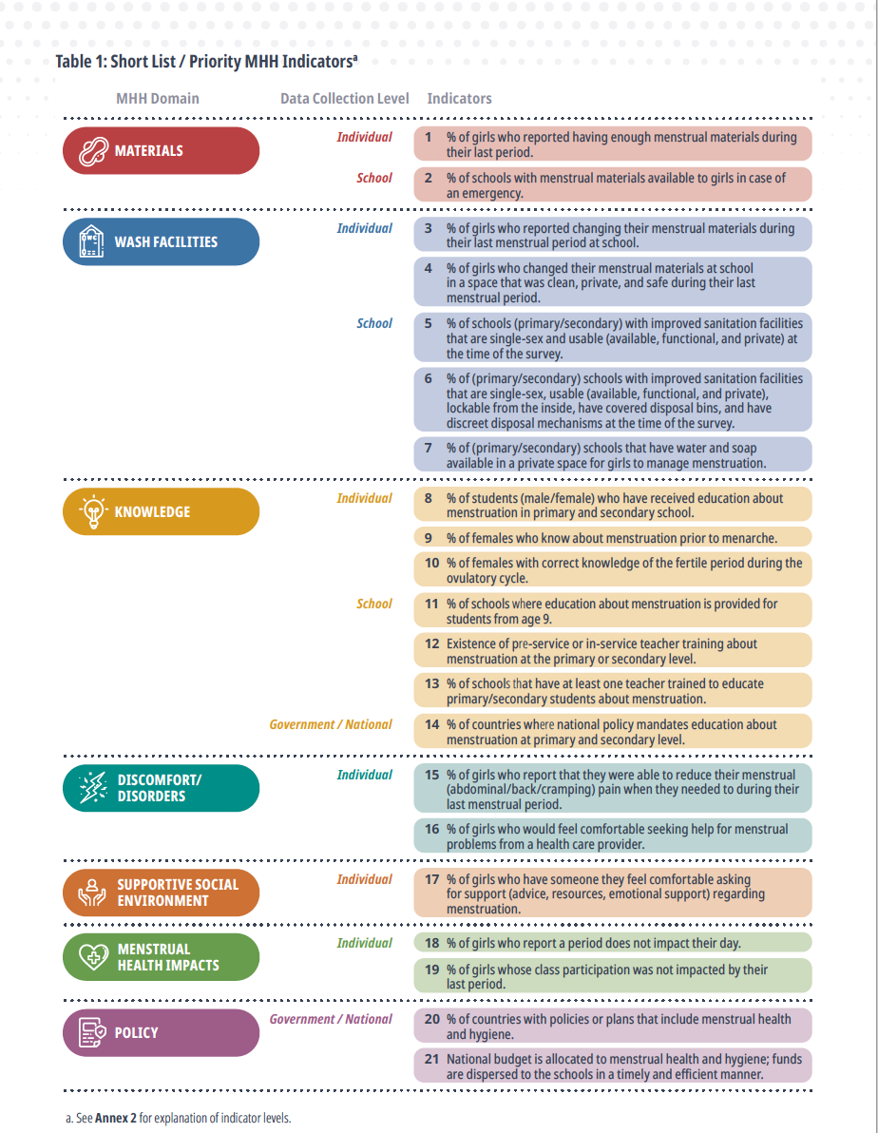
It is not expected to include all 21
7 are at the school-level and would be appropriate in an EMIS
11 are at individual level and could be included in a survey of schoolgirls
3 are at the country-level from review of national documents
Select based on national priorities and type of data source

Slide 5
Some countries already have data related to some of the priority indicators for girls’ menstrual health and hygiene!

Slide 6
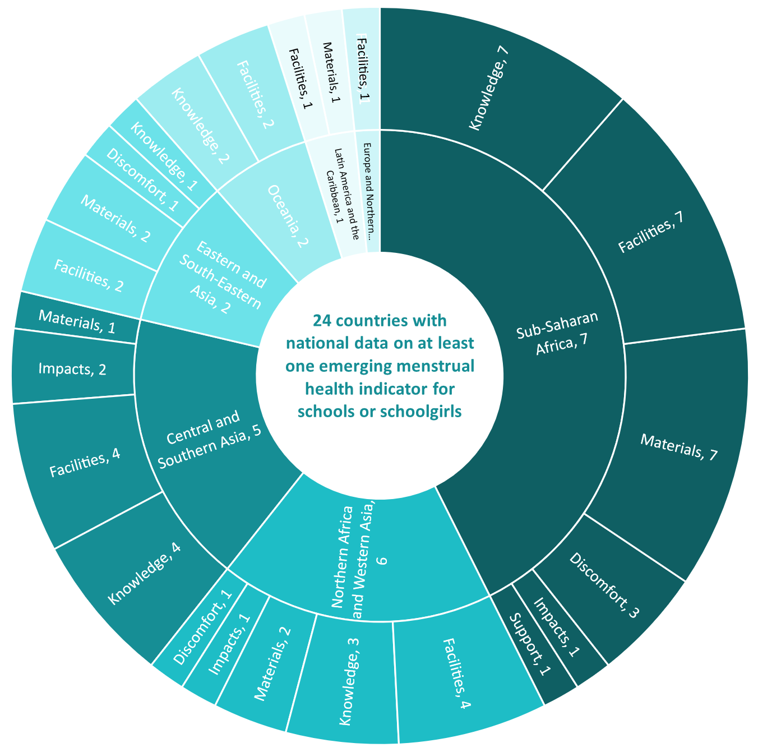
Most of the emerging national data are from African countries!
10 African countries have national data related to the priority indicators for schools and schoolgirls
Ethiopia, Sierra Leone, and Zambia have included at least one question in their EMIS for at least one year.
Most data are related to Materials, Facilities, and Knowledge
Fewer countries monitor impacts, social support, and discomfort/ disorders

Slide 7
A Sneak Peak at Emerging Data (EMBARGOED – will be officially released 28 May)

Slide 8
Highlights
Sufficient data (>30% of the school age population) were available to report global and regional aggregates for a few indicators:
Materials
In sub-Saharan Africa, around 1 in 10 schools (12%) have menstrual materials available
Facilities
Globally, around 1 in 3 schools (31%) have bins for menstrual waste in girls’ toilets
In sub-Saharan Africa, 1 in 10 schools (11%) have bins for menstrual waste in girls’ toilets
Knowledge
Globally, around 2 out of 5 schools (39%) provide menstrual health education.
These are emerging data however and indicator definitions are often unclear and/or not harmonized between countries

Slide 9
Several countries have data on the availability of menstrual materials at school
Definition – Proportion of schools with…
sanitary pads in school canteen, school clinic, guidance office, or laboratories
provision of sanitary pads for emergency cases
% girls who do not say they rarely or never find free period products in bathrooms
sanitation towels for girls in 'emergency' situations
availability of supplies for the management of menstrual hygiene in the school
menstrual hygiene materials (e.g. pads) provided by the school for free or purchase
sanitary pads available for emergencies
% girls who reported sanitary pads for emergency MHM are available in their school
sanitary napkins for girls available for emergencies
menstrual pads available at the school
pads and MHM materials available
menstrual hygiene materials (e.g. pads) provided by the school (for free or purchase)
any kind of sanitary towel distribution programme (for emergency use)
sanitary napkins available at the school
*Proportion of individuals

Slide 10
The proportion of schools with bins for menstrual waste in girls’ toilets varies widely by country and specific indicator
Definition – Proportion of schools with…
% of girls who don't report there are no trash cans in the toilet cabins
wrapping materials and trash bins for used sanitary pads in all exclusively female toilets
with sanitary bins in toilets
a special bin for female needs in female toilets (girls’ schools)
separate dustbins with lid for disposal of sanitary waste
presence of facilities for disposal of used sanitary towels
facilities to dispose of sanitary pads
waste bin in each toilet block
waste baskets with lids (in toilets)
disposal bins in the girls’ toilets
waste bins with lid in compartments intended for girls for maintaining menstrual hygiene
provision of covered bins for disposal
toilet for girls used for menstrual management had sanitary pad disposal bins available
waste bins in at least one female latrine for MHM
covered bins for menstrual hygiene management in girls' toilet/latrine
garbage bins inside girls' latrines
a trash can in each latrine cubicle for girls or in the common areas of the toilets
menstruation pad bin
covered bins for disposal of menstrual hygiene materials in girls' toilet compartments
covered bins for disposal of menstrual hygiene materials in the girls' toilets (reported)
trash can in each latrine cubicle for girls
*Proportion of individuals

Slide 11
The provision of MH education in school varies widely between countries
Definition – Proportion of schools where…
menstrual hygiene taught at school
curriculum includes adolescent health topics that mentions girls’ periods
IEC materials on menstrual health are available for students
they offer menstrual hygiene management education
% of teachers who reported lessons were provided on the menstrual cycle
there are school lessons on menstrual hygiene for girls
education on maintaining menstrual hygiene provided for older girl pupils
% of girls who said they have access to menstrual hygiene education at school
menstrual hygiene education is provided to all or some students
there are menstrual hygiene education sessions for girls
they provide training to girls on safe disposal of sanitary pads
menstrual health management is discussed with girl students
menstrual hygiene education sessions are provided for girls
menstrual hygiene education is provided for girls
menstrual health and hygiene are in lessons
% of girls exposed to messages about menstruation from school
menstrual hygiene education is provided to all or some students
there are IEC/CCC tools on menstrual hygiene (posters, leaflets, etc.) at the school
*Proportion of individuals

Slide 12
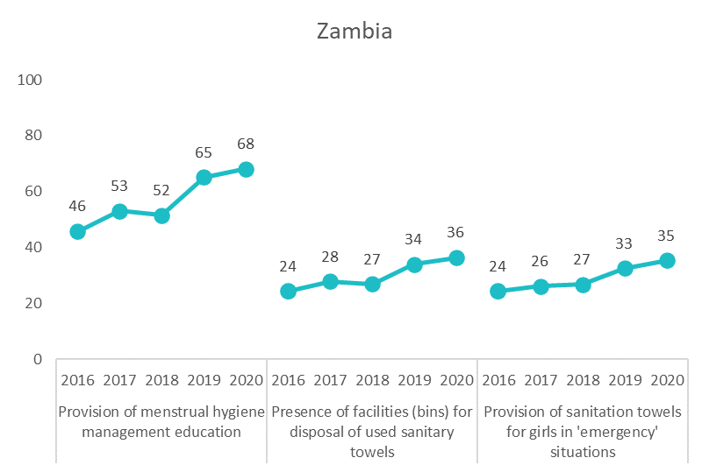
THE POWER OF MONITORING! Schools in Zambia increasingly provide MH services to students
You may have noticed that Zambia had the highest coverage of the African countries in the previous charts
Zambia has included 3 questions on MH in their EMIS since 2016!!!
Notes:
Later data – challenges moving to electronic EMIS

Slide 13
What can we do next?
Read the special focus on MH in the upcoming JMP global report on WinS
Join us to learn more at the global MH day webinar in early June
Harmonize MH indicators across countries
Include MH in the EMIS
Use a few of the priority indicators for girls’ MHH
The new MH module in the UNICEF MICS7 household survey provides an example (but only age 15-49)
Gather harmonized data so we can push for MH to be included in post-SDG global monitoring to track global and regional progress and encourage national monitoring

Slide 14
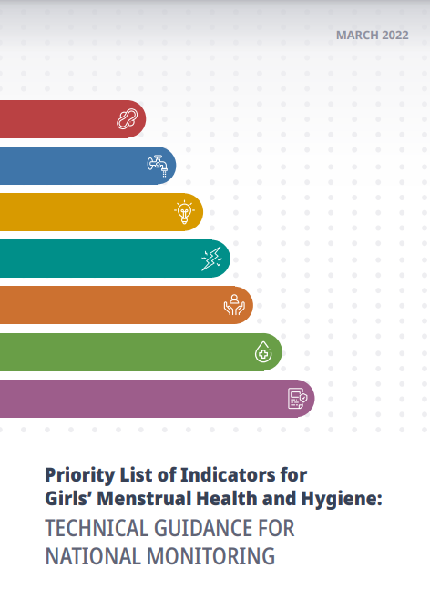
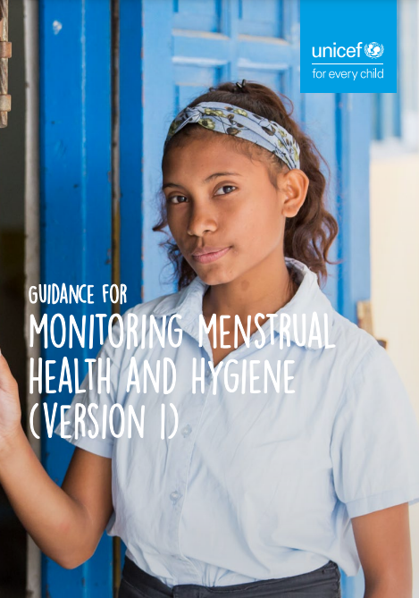
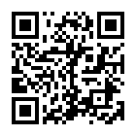
Resources
Plus the JMP progress report will have a special focus on MH (to be released 28 May)
Resources can be downloaded here:
Notes:
Add snapshots, side events, add to ILE page. QR code on screen?
Pretty URLs?
https://washdata.org/report/jmp-core-questions-monitoring-wash-schools-2018
https://washdata.org/report/unicef-2020-guidance-monitoring-mhh-v1

Slide 15
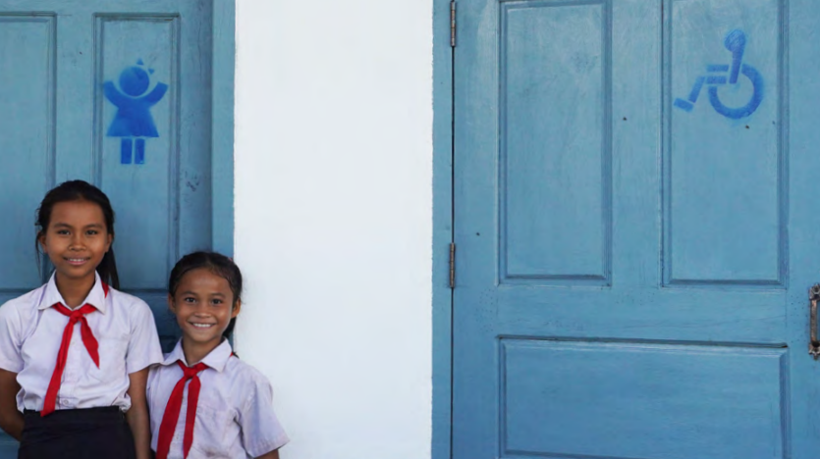
Thank you!
info@washdata.org

