Slide 1



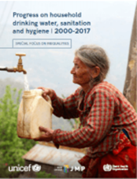


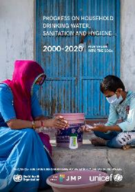


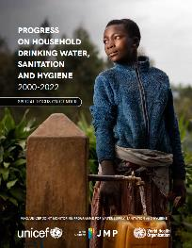
WHO/UNICEF JMP Country Consultation on
WASH in schools and WASH in health care facilities
13th November 2023
WASH in Households in odd years
WASH in Schools and Health Care Facilities in even years
2017
2018
2019
2019
2020
2020
2021
2022
2022
2023
2024
2024
Schools update
HCF update
washdata.org
Tom Slaymaker (tslaymaker@unicef.org)
Rick Johnston (johnstonr@who.int)

Slide 2
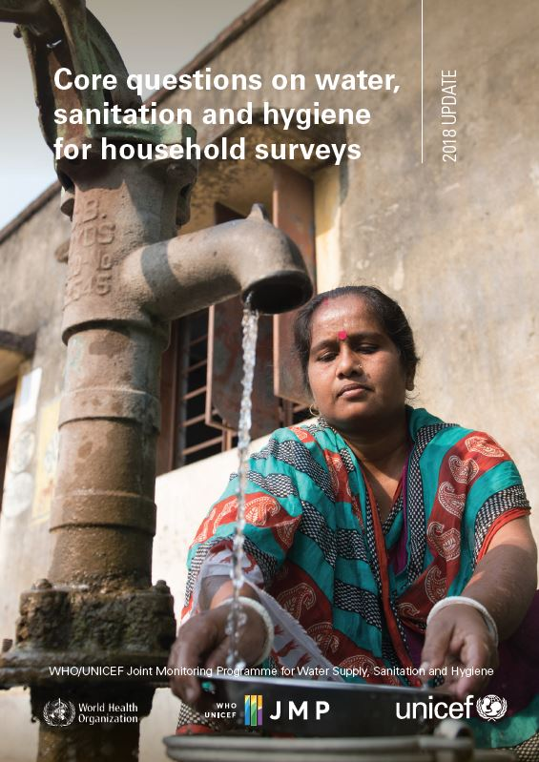

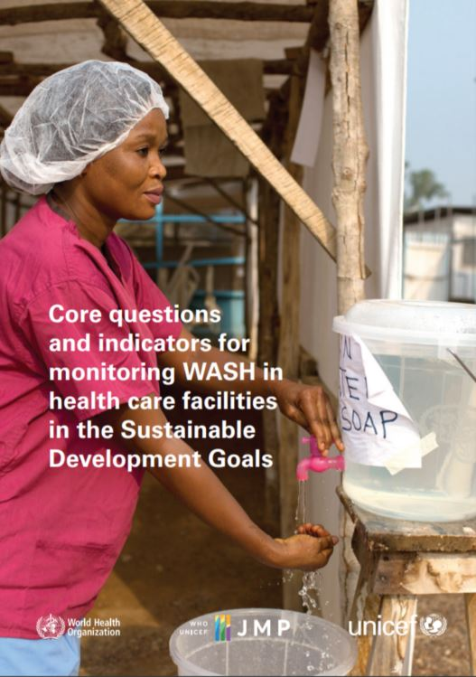
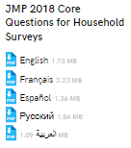
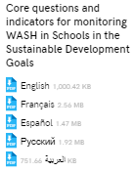
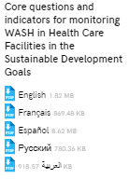
JMP core questions and indicators
https://washdata.org/reports

Slide 3
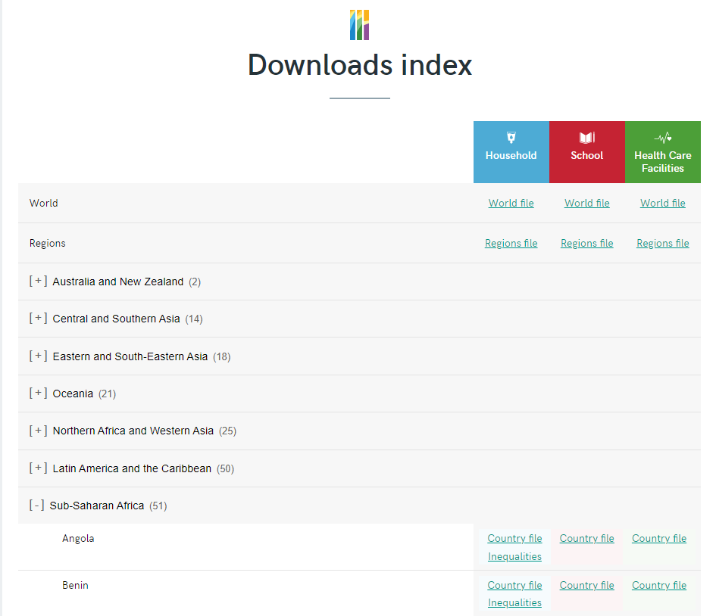
JMP country files
https://washdata.org/data/downloads

Slide 4
Country consultations for 2024 updates
  Is the country file missing any relevant national sources of data that would allow for better estimates?
  Are the data sources listed considered reliable and suitable for use as official national statistics?
  Is the JMP interpretation and classification of the data extracted from national sources accurate and appropriate?
 | 1 | 2 | 3 | 4 | 5 | 6 | 7 | 8 | 9 | 10 | 11 | 12
2023 |  | Prepare reports Households |  |  |  |  | Compile new data Health care facilities, schools |  |  |  | Consultation Health care facilities, schools
2024 |  | Prepare reports Health care facilities, schools |  |  |  |  | Compile new data Households |  |  |  | Consultation Households, 631
Publish progress updates

Slide 5
JMP country consultation purpose
The purpose of the consultation is not to compare JMP and national estimates of WASH coverage but rather to review the completeness or correctness of the datasets in the JMP country file and to verify the interpretation of national data in the JMP estimates.
The consultation is not expected to involve complex analysis, or to review the estimation methodology, but simply to identify any missing data sets and to provide feedback on the interpretation and classification of existing national data.

Slide 6
JMP country consultation process
In different countries, different sectoral ministries should be consulted (education, health, water, environment) but in all cases we encourage you to engage with the National Statistics Office which is primarily responsible for SDG reporting at the national level.
WHO and UNICEF regional and country offices are requested to coordinate and ensure effective division of labour.
  Health care facilities: WHO lead
  Schools: UNICEF lead

Slide 7


Slide 8
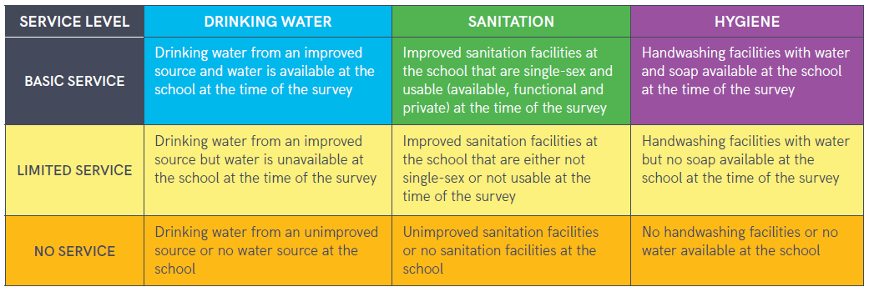
JMP service ladders for WASH in schools
“Schools” includes pre-primary, primary and secondary schools

Slide 9

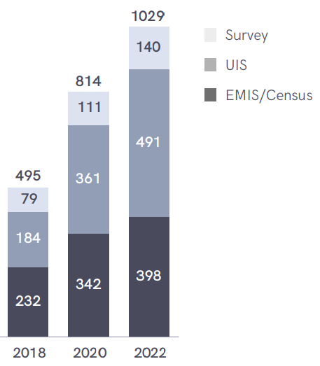
National data sources used in 2022 report
A total of 1029 national data sources were used (compared to 495 in 2018)
Basic service level estimates available for 147 countries
Average of 6.2 datasets per country
From EMIS/Census, UIS & surveys

Slide 10
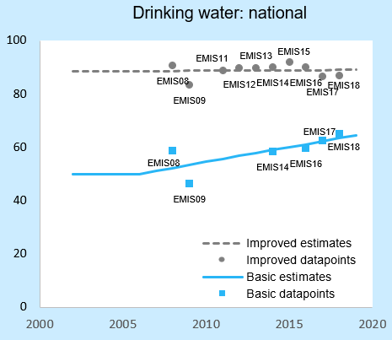
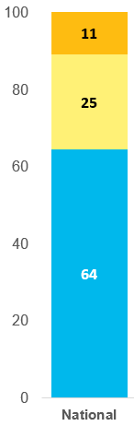
Harmonizing national data with SDG indicators
Example: Bhutan 2015/16 annual education statistics (EMIS) microdata
Main water source: ◻ Piped water supply ◻ Protected dug well ◻ Protected spring ◻ Unprotected spring
◻ Rainwater collection ◻ Drilled water ◻ Store
Source functionality: ◻ Fewer than 2 days per week
◻ 2-4 days per week ◻ 5-7 days per week
Facility type | Proportion improved
No drinking water facility | 0 | 0.0
No response | 0 | 0.0
Piped water supply | 1 | 69.8
Protected dug well | 1 | 0.2
Protected spring | 1 | 20.0
Unprotected spring | 0 | 10.0
Rainwater collection | 1 | 0.0
Drilled water | 1 | 0.0
Store | 0 | 0.0
Definition | Estimates (%) | National
 | No water source | 0.0
 | Unimproved | 10.0
 | Improved | 90.0
Functional 5-7 days / week | Available | 65.1
Improved & functional 5-7 days/wk | Basic (improved & available) | 59.8
10

Slide 11
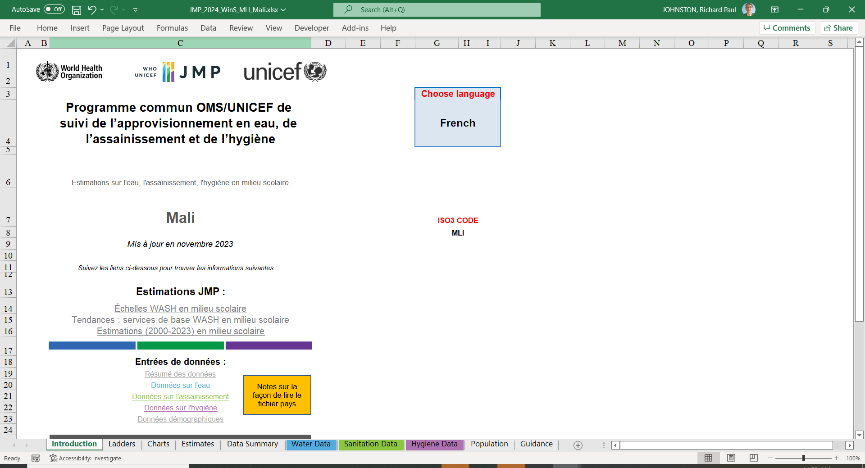
Country file

Slide 12
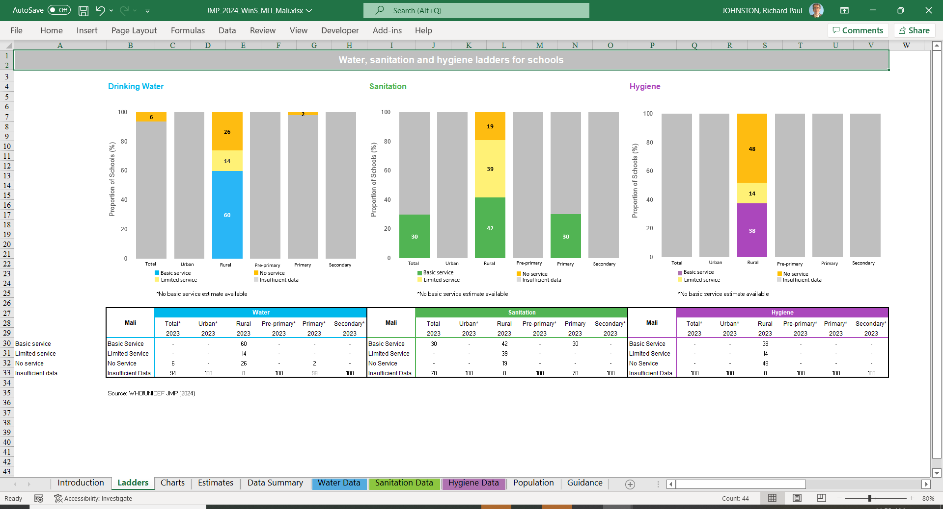
Ladders

Slide 13
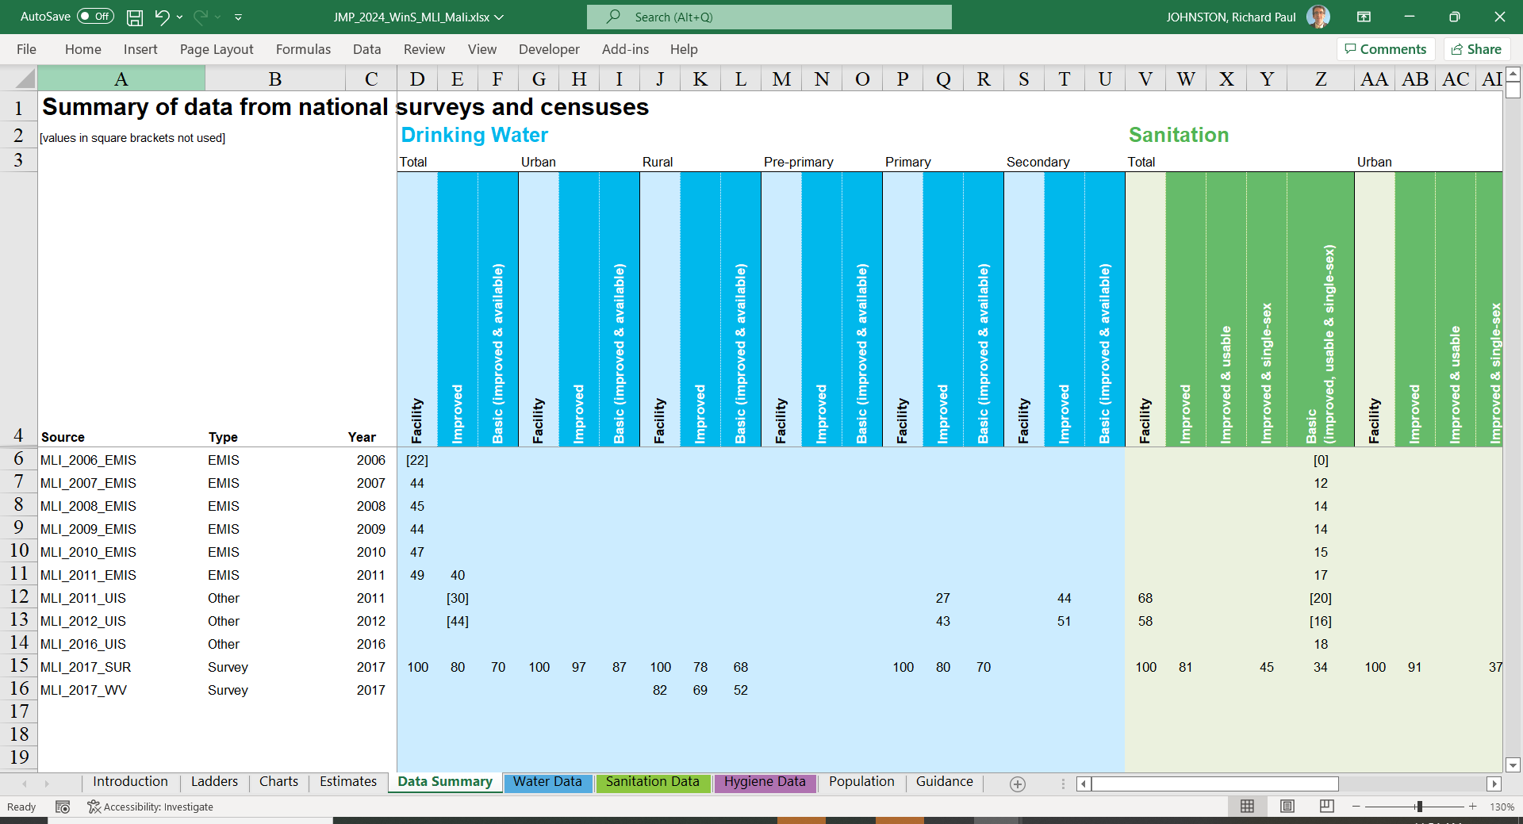
Data summary

Slide 14
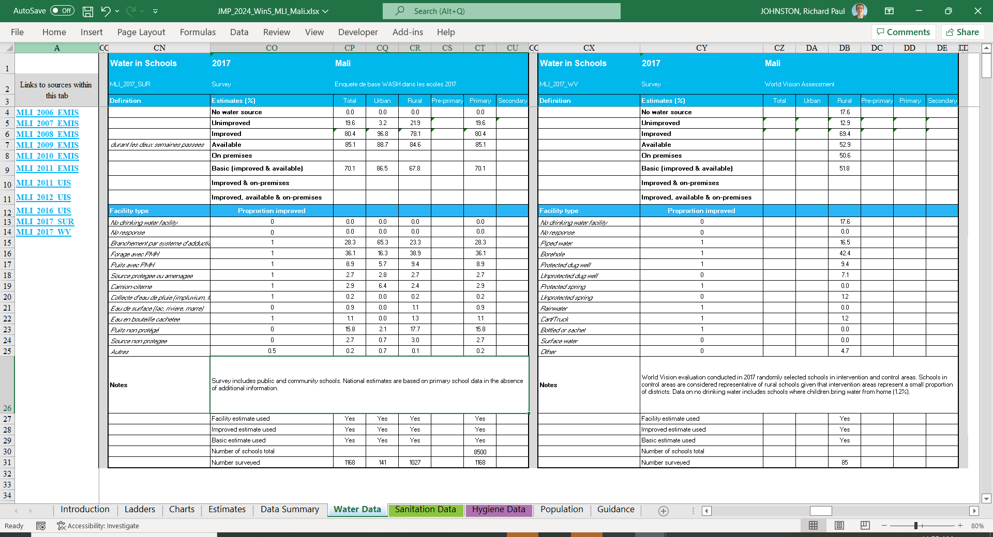
Water Data

Slide 15
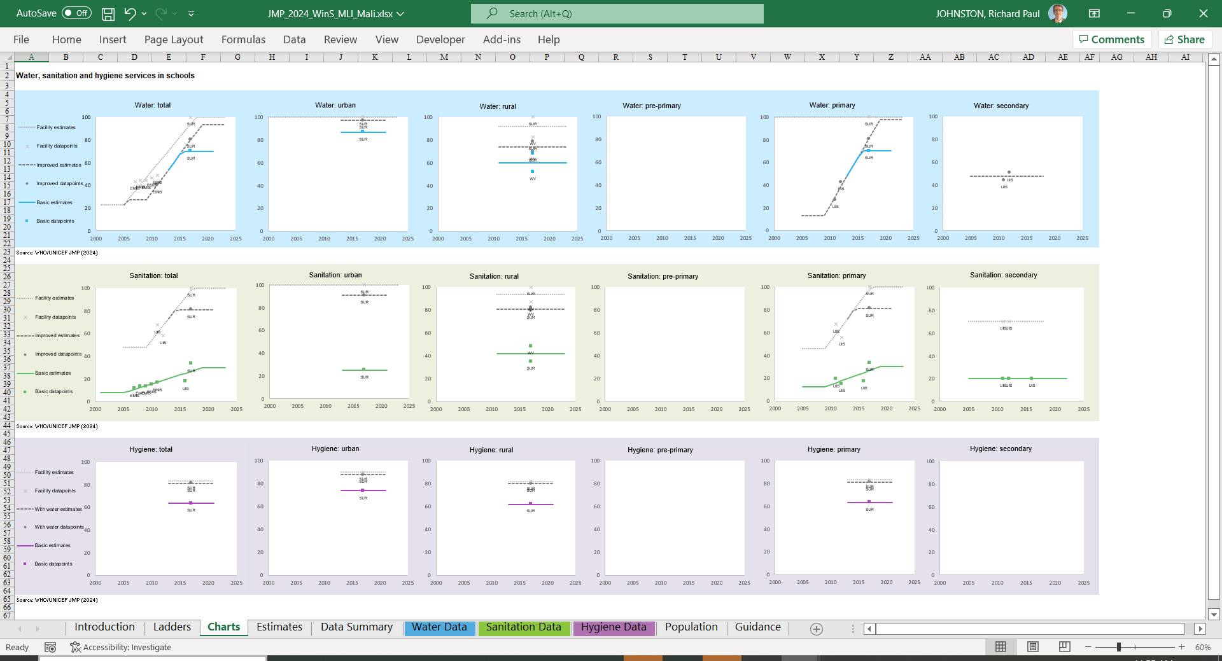
Charts

Slide 16
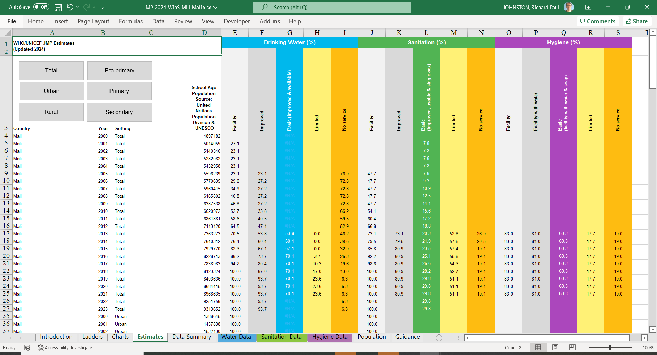
Estimates

Slide 17
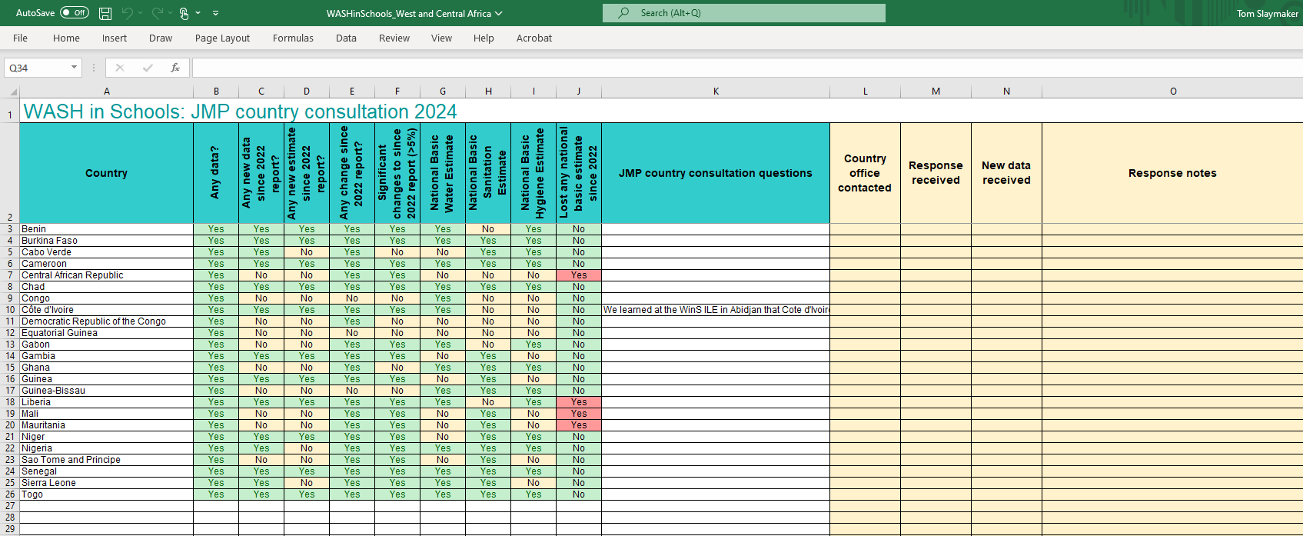
Regional tracker file (schools)

Slide 18
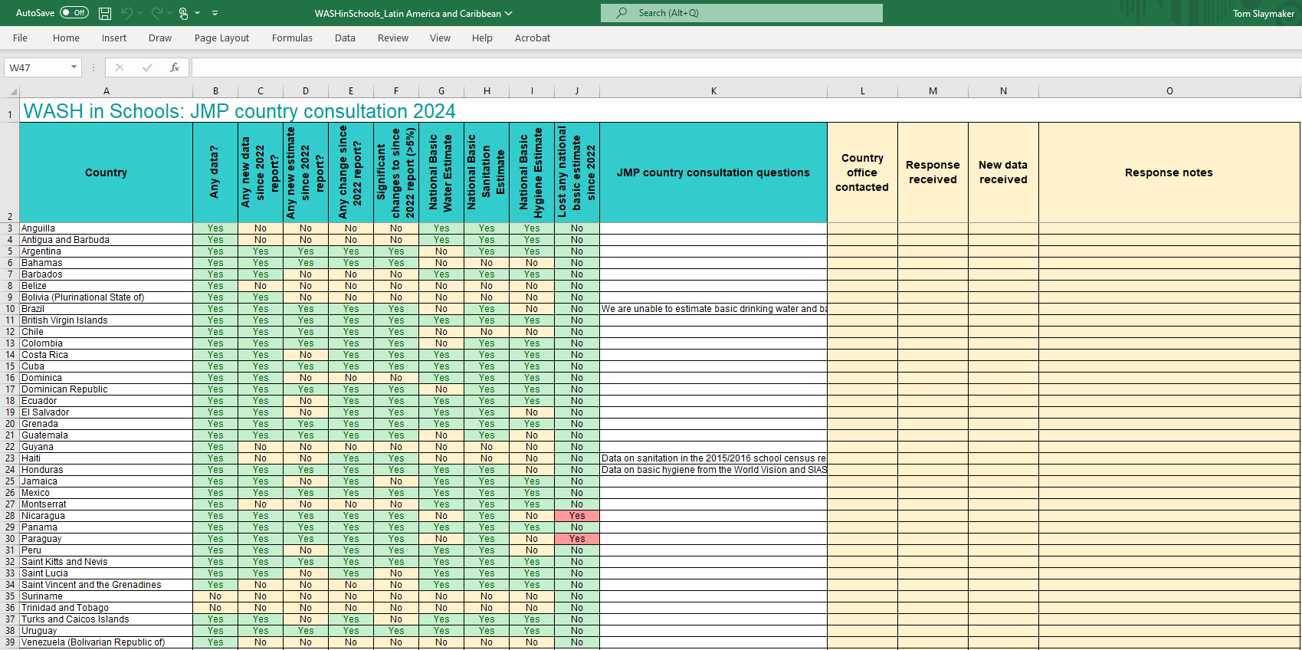

Slide 19


Slide 20
Service ladders for WASH in health care facilities
SERVICE LEVEL | WATER | SANITATION | HYGIENE | WASTE MANAGEMENT | ENVIRONMENTAL CLEANING
BASIC SERVICE | Water is available from an improved source on the premises. | Improved sanitation facilities are usable, with at least one toilet dedicated for staff, at least one sex-separated toilet with menstrual hygiene facilities, and at least one toilet accessible for people with limited mobility. | Functional hand hygiene facilities (with water and soap and/or alcohol-based hand rub) are available at points of care, and within five metres of toilets. | Waste is safely segregated into at least three bins, and sharps and infectious waste are treated and disposed of safely. | Protocols for cleaning are available, and staff with cleaning responsibilities have all received training.
LIMITED SERVICE | An improved water source is available within 500 metres of the premises, but not all requirements for a basic service are met. | At least one improved sanitation facility is available, but not all requirements for a basic service are met. | Functional hand hygiene facilities are available either at points of care or toilets but not both. | There is limited separation and/or treatment and disposal of sharps and infectious waste, but not all requirements for a basic service are met. | There are cleaning protocols and/or at least some staff have received training on cleaning.
NO SERVICE | Water is taken from unprotected dug wells or springs, or surface water sources; or an improved source that is more than 500 metres from the premises; or there is no water source. | Toilet facilities are unimproved (e.g. pit latrines without a slab or platform, hanging latrines, bucket latrines) or there are no toilets. | No functional hand hygiene facilities are available either at points of care or toilets. | There are no separate bins for sharps or infectious waste, and sharps and/or infectious waste are not treated/disposed of. | No cleaning protocols are available, and no staff have received training on cleaning.

Slide 21
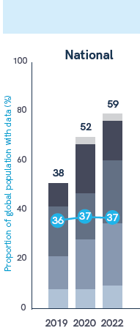
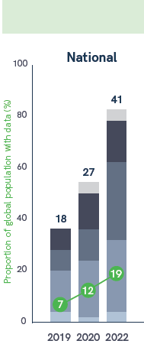
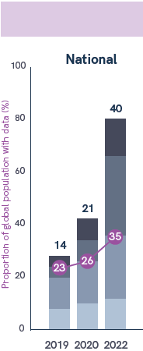
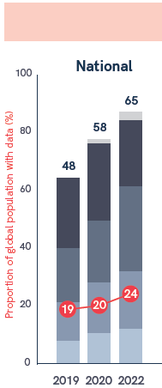
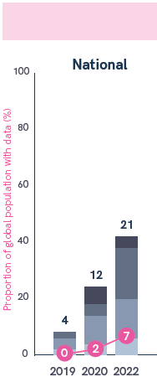
WASH in health care facilities data coverage
BASIC WATER
BASIC SANITATION
BASIC HYGIENE
BASIC WASTE
BASIC CLEANING
30%

Slide 22
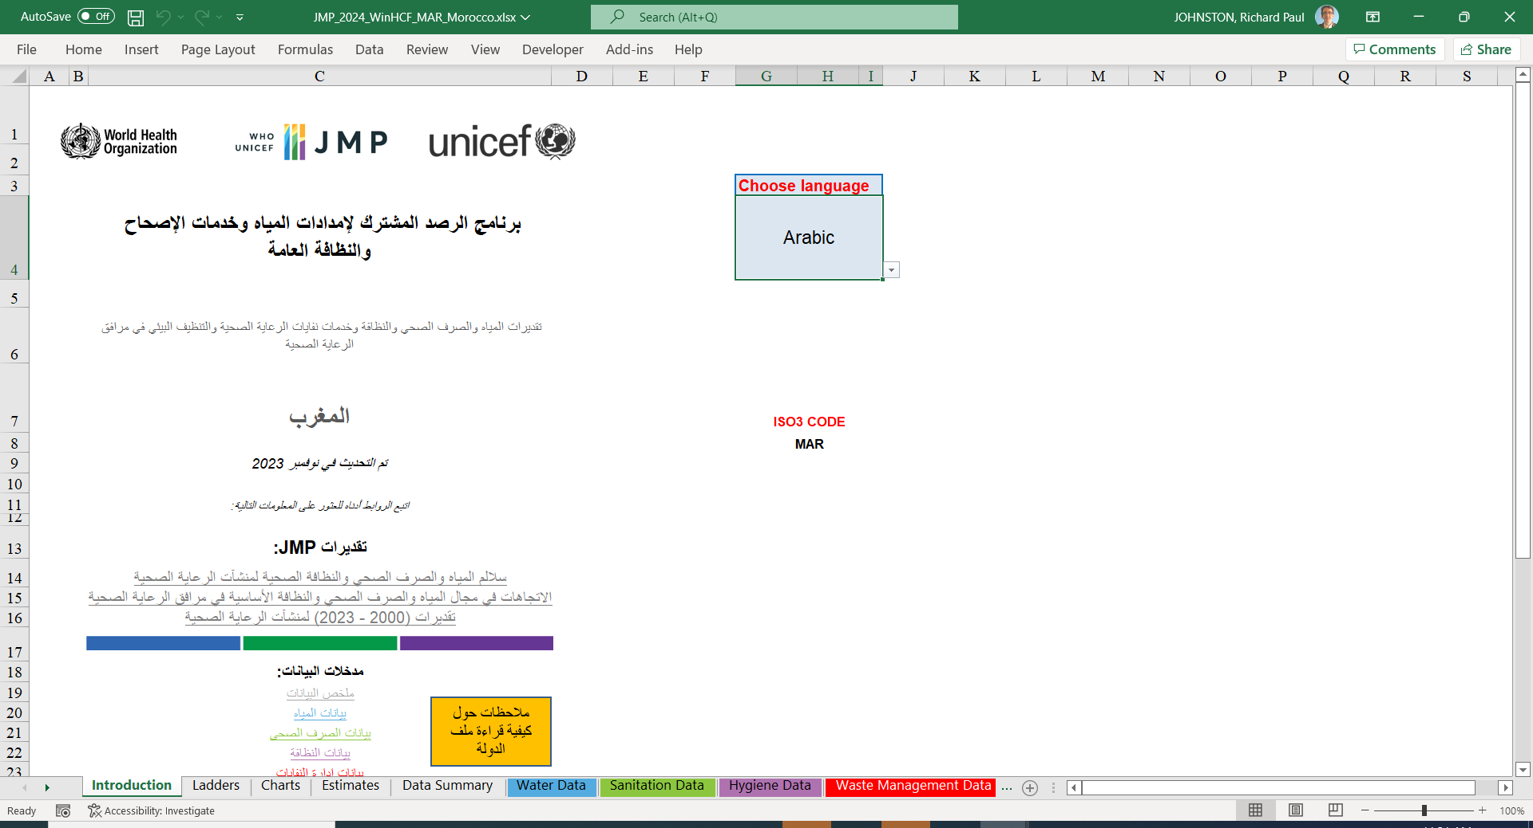

Slide 23
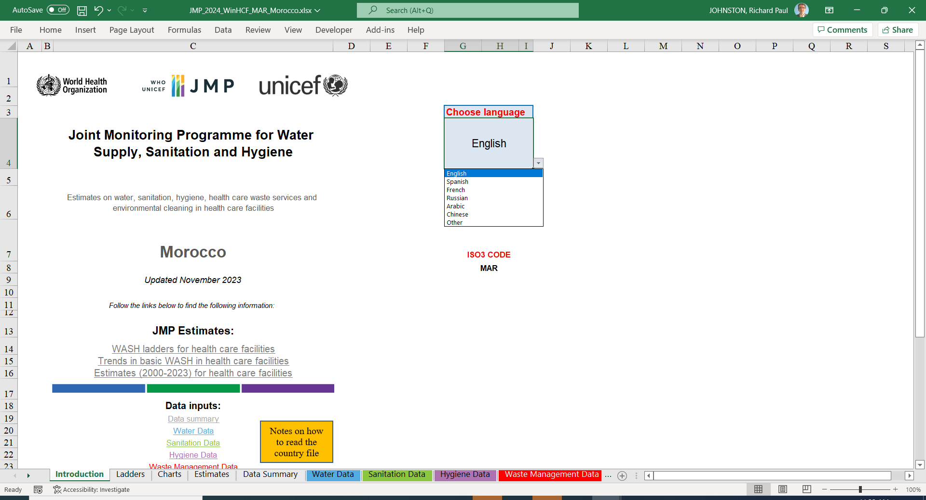

Slide 24
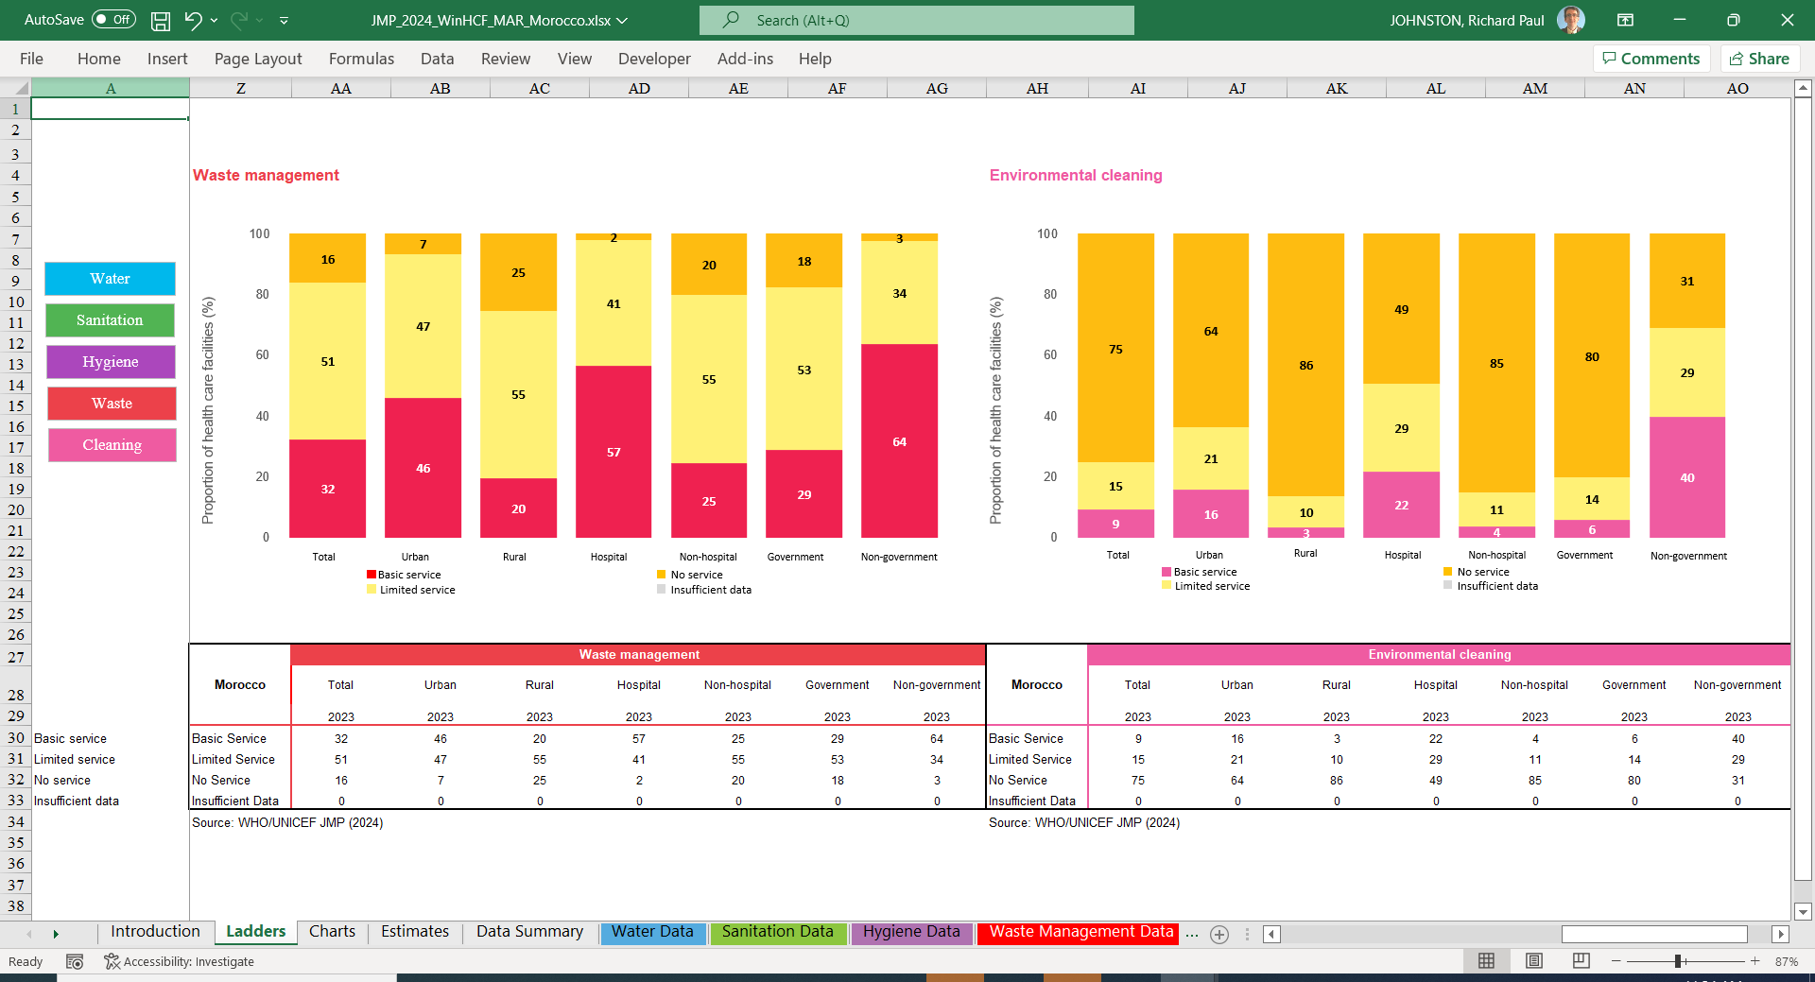
Ladders

Slide 25
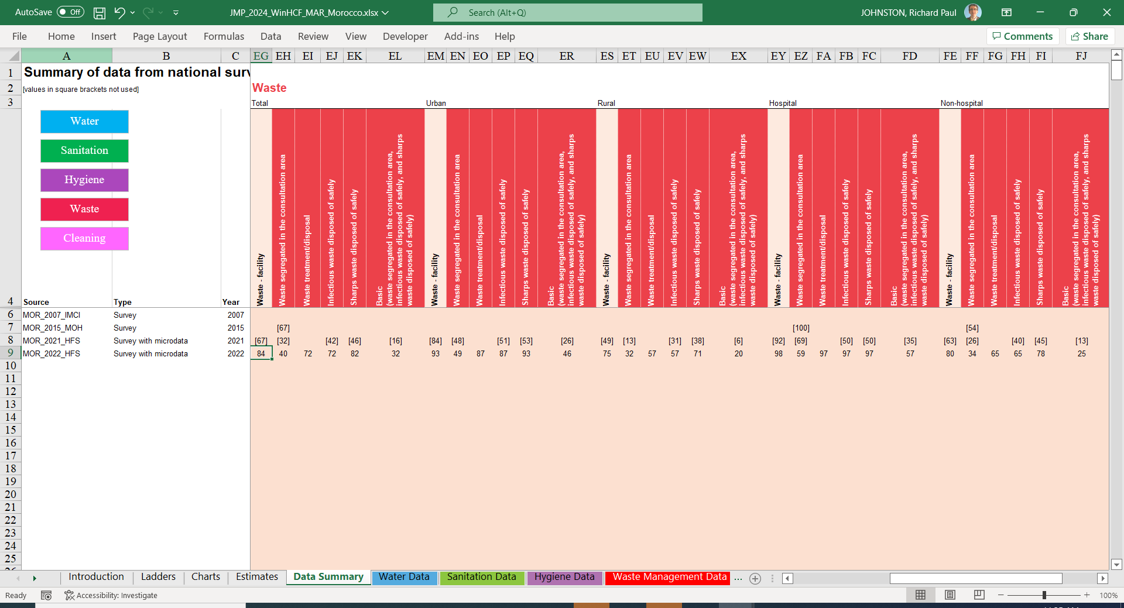
Data summary

Slide 26
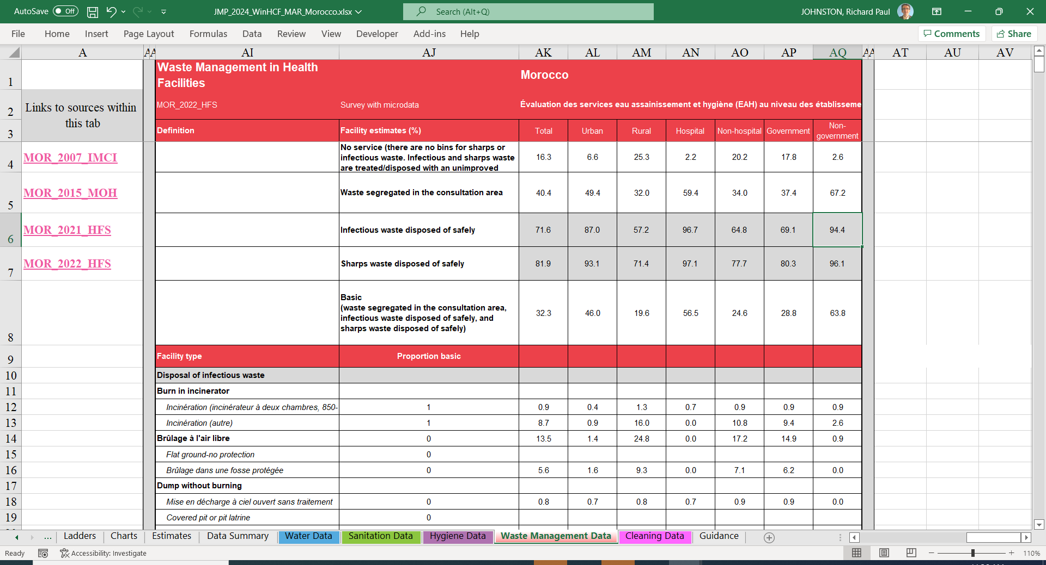
Waste Management Data

Slide 27
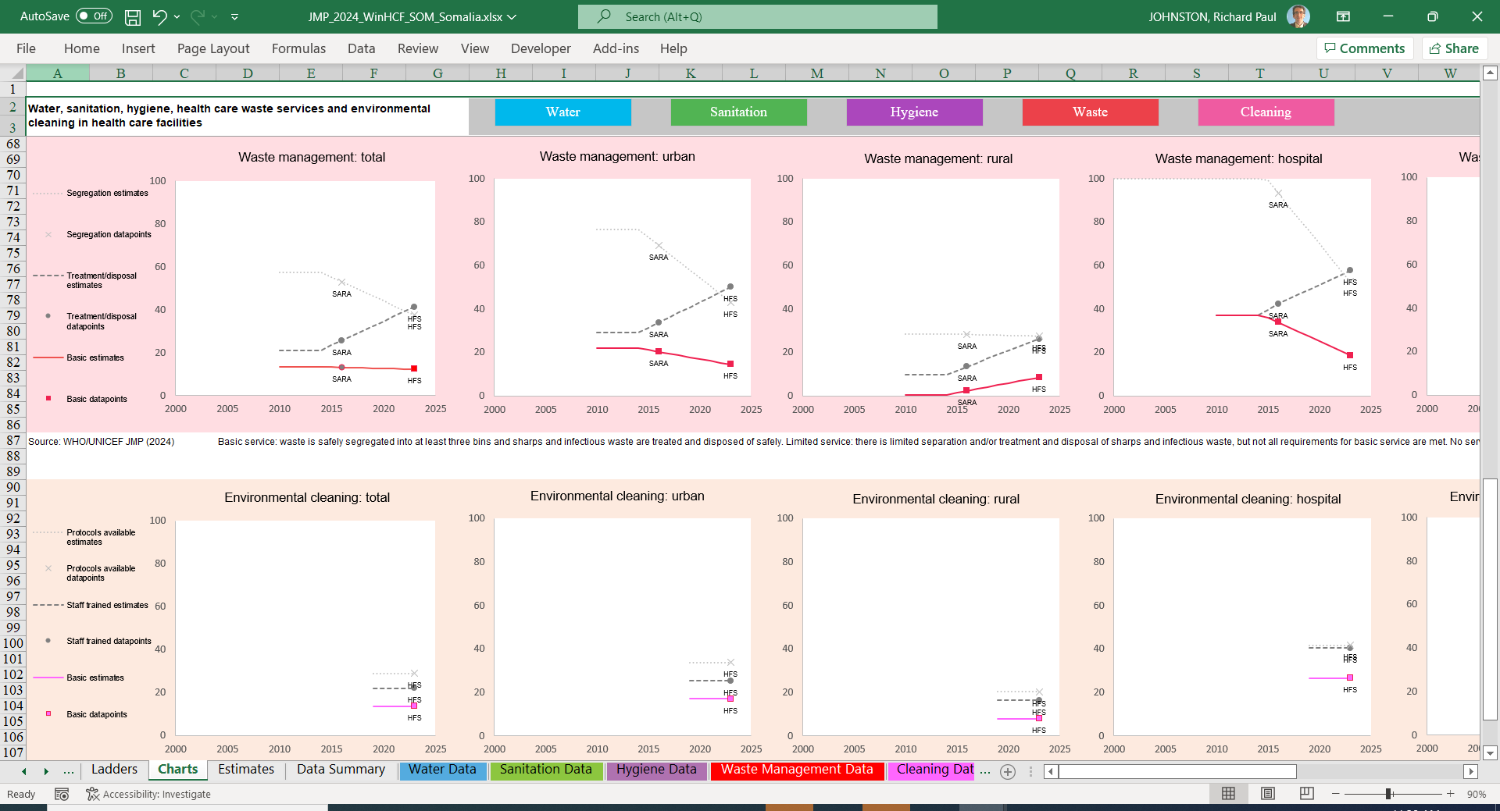
Charts

Slide 28
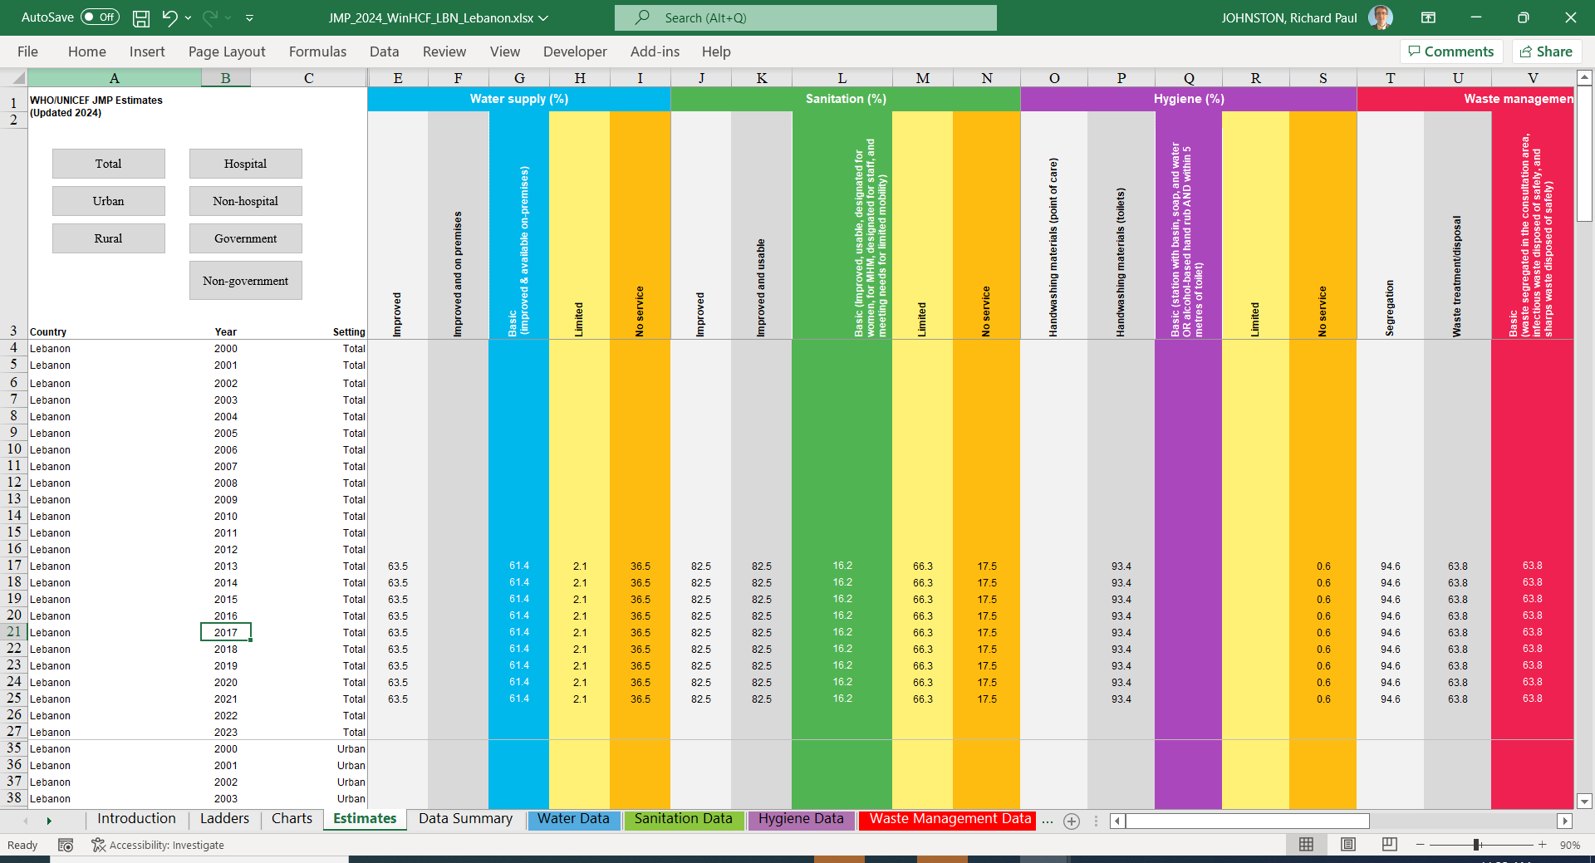
Estimates

Slide 29
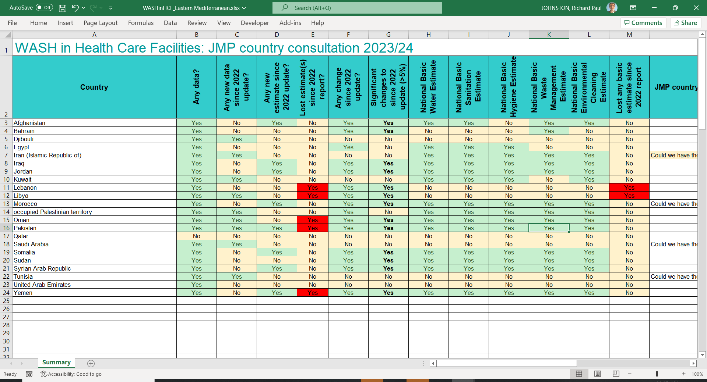
Regional tracker file (health care facilities)

Slide 30
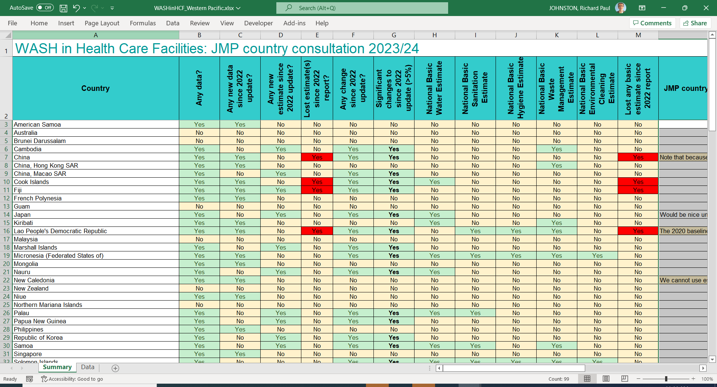
Regional tracker file (health care facilities)

Slide 31

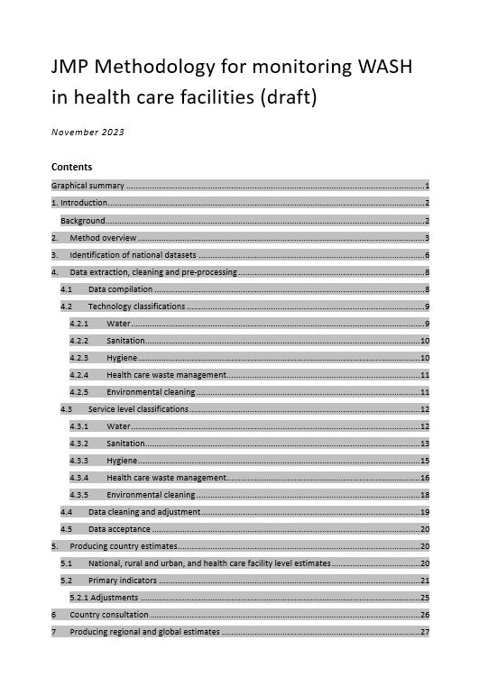
JMP methodological notes
Identification of national datasets
Data extraction and cleaning
  Data compilation
  Technology classifications
  Service level classifications
  Data cleaning and adjustment
  Data acceptance
Producing country estimates
Country consultation
Producing regional and global estimates
https://washdata.org/reports/jmp-2021-methodology-wash-in-schools
https://washdata.org/reports/jmp-2023-winhcf-methodology-draft

Slide 32
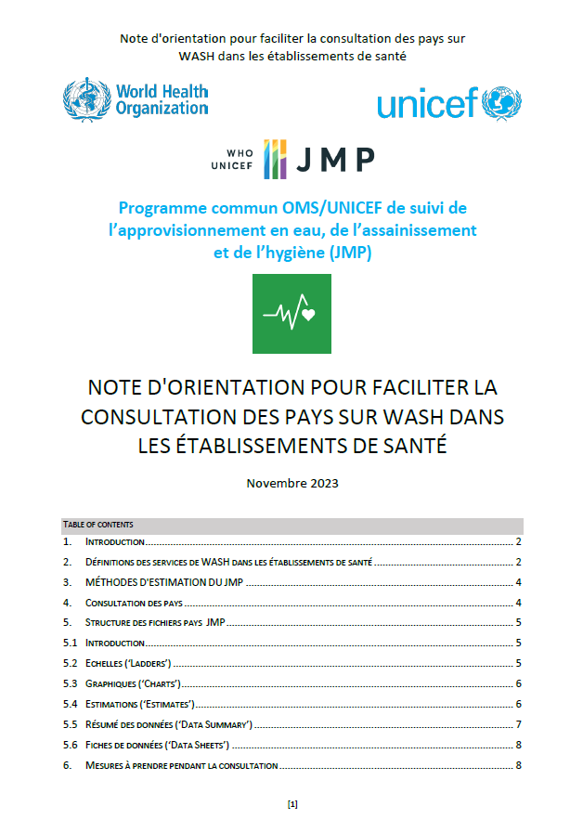
JMP country consultation guidance
Guidance note to facilitate country consultation
  English, French, Spanish, Russian & Arabic
Identify relevant national authorities
  NSOs, MoE, MoH, MoW, regulator, other
Seek technical feedback on JMP country file
  Is it missing any relevant national data sources?
  Are the data sources used considered reliable?
  Is the interpretation/classification of national data correct?
Provide feedback via info@washdata.org by 31st Jan 2024
  Finalisation of estimates in Feb/March
  Publication of JMP progress updates in June/July 2024
https://washdata.org/how-we-work/jmp-country-consultation

Slide 33

Please don’t edit the Excel files directly!
The country files contain many formulas and links.
Due to the statistical modelling approach used, we kindly ask you to not work directly in the MS Excel worksheets but rather provide data for consideration (including its source) in an additional document to the JMP team

Slide 34
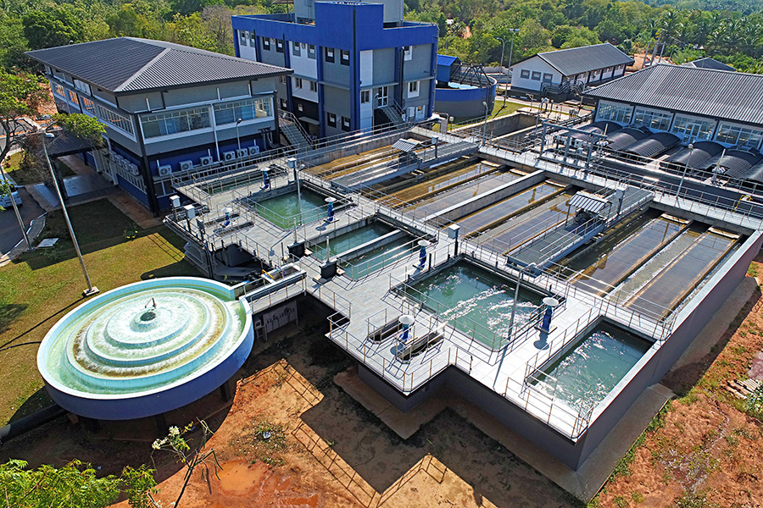
Thank you!
info@washdata.org

