Slide 1
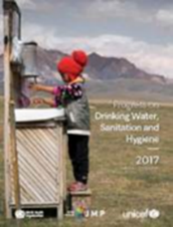
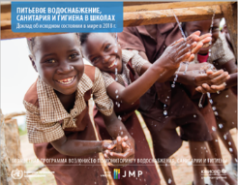
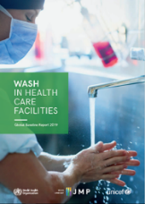
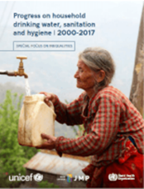
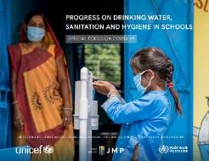
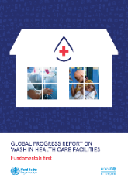
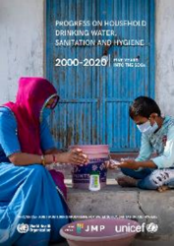
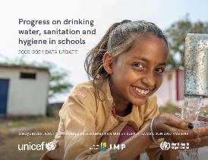
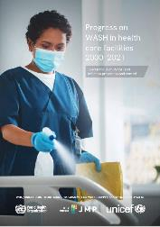
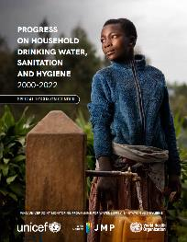
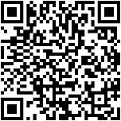
WHO/UNICEF JMP global monitoring of drinking water, sanitation and hygiene
WASH in Households in odd years
WASH in Schools and Health Care Facilities in even years
2017
2018
2019
2019
2020
2020
2021
2022
2022
2023
UNC Water and Health, 23 October 2023
Rick Johnston (johnstonr@who.int)
Tom Slaymaker (tslaymaker@unicef.org)
https://washdata.org/
Notes:
WHO/UNICEF joint programme since 1990
We previously reported on MDGs and now responsible for global monitoring of SDG targets related to WASH
JMP reporting previously focused on households and has now been expanded to cover schools and health care facilities
We now produce updates for each setting every 2 years. Households in odd years. Schools and Health Care Facilities in even years.
Our last household update came out in July 2023 and we will publish updates for schools and health care facilities in 2024
At the end of each year we circulate draft estimates to country offices for a 2 month period of country consultation with national authorities
WHO and UNICEF regional and country offices play a critical role in making sure that the latest available national data are included in JMP estimates
The JMP team also works closely with regional and country offices to help governments address data gaps and strengthen national systems for monitoring SDG WASH targets (key part of our mandate)

Slide 2

JMP 2023 progress update: exploring the underlying data
08:30 Introduction
08:40 – 09:10 Drinking water
  Exercise: JMP Country files
09:10 – 09:40 Sanitation
  Exercise: JMP Website
09:40 – 10:00 Hygiene, menstrual health
  Exercise: JMP Inequalities files
Notes:
Today will cover highlights from our 2023 report, but will also have some participatory exercises to demonstrate how the JMP data systems work, and how you can explore them in different ways.
We have Excel Country files, we have a data portal on our website, and we have more detailed inequalities files, that are less well known that the standard country files.

Slide 3
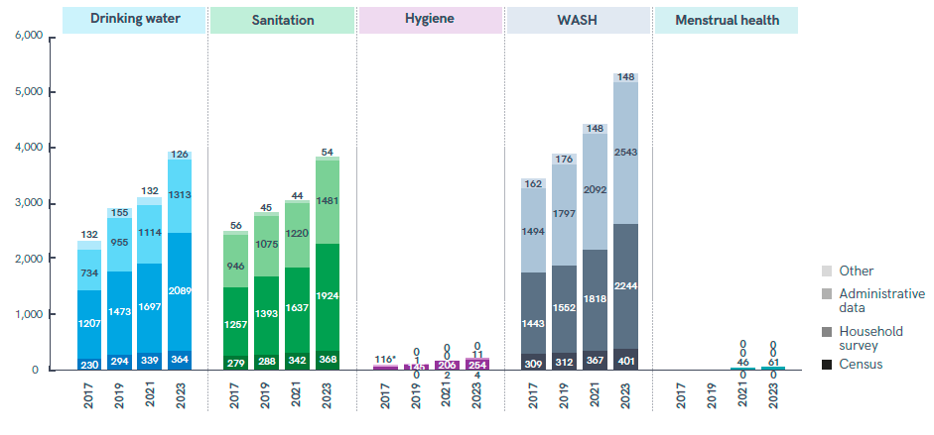
JMP 2023 progress update: special focus on gender
Data sources used for the JMP 2023 progress update
https://washdata.org/reports/jmp-2023-wash-households
Notes:
This presentation will give highlights from the JMP 2023 progress update on WASH in households which has special focus on gender
The JMP produces internationally comparable estimates based on national data sources
The household database contains nearly 8000 national datasets of which 5340 were used for last report. About half from censuses and hh surveys and half from administrative data including regulators.
This chart shows how the database has grown with each JMP update
Nearly 4000 datasets on drinking water (3894) and sanitation (3831) but only 269 on hygiene (almost all hh surveys)
In 2021 the JMP established a new database on menstrual health which now includes 61 datasets (all hh surveys)

Slide 4
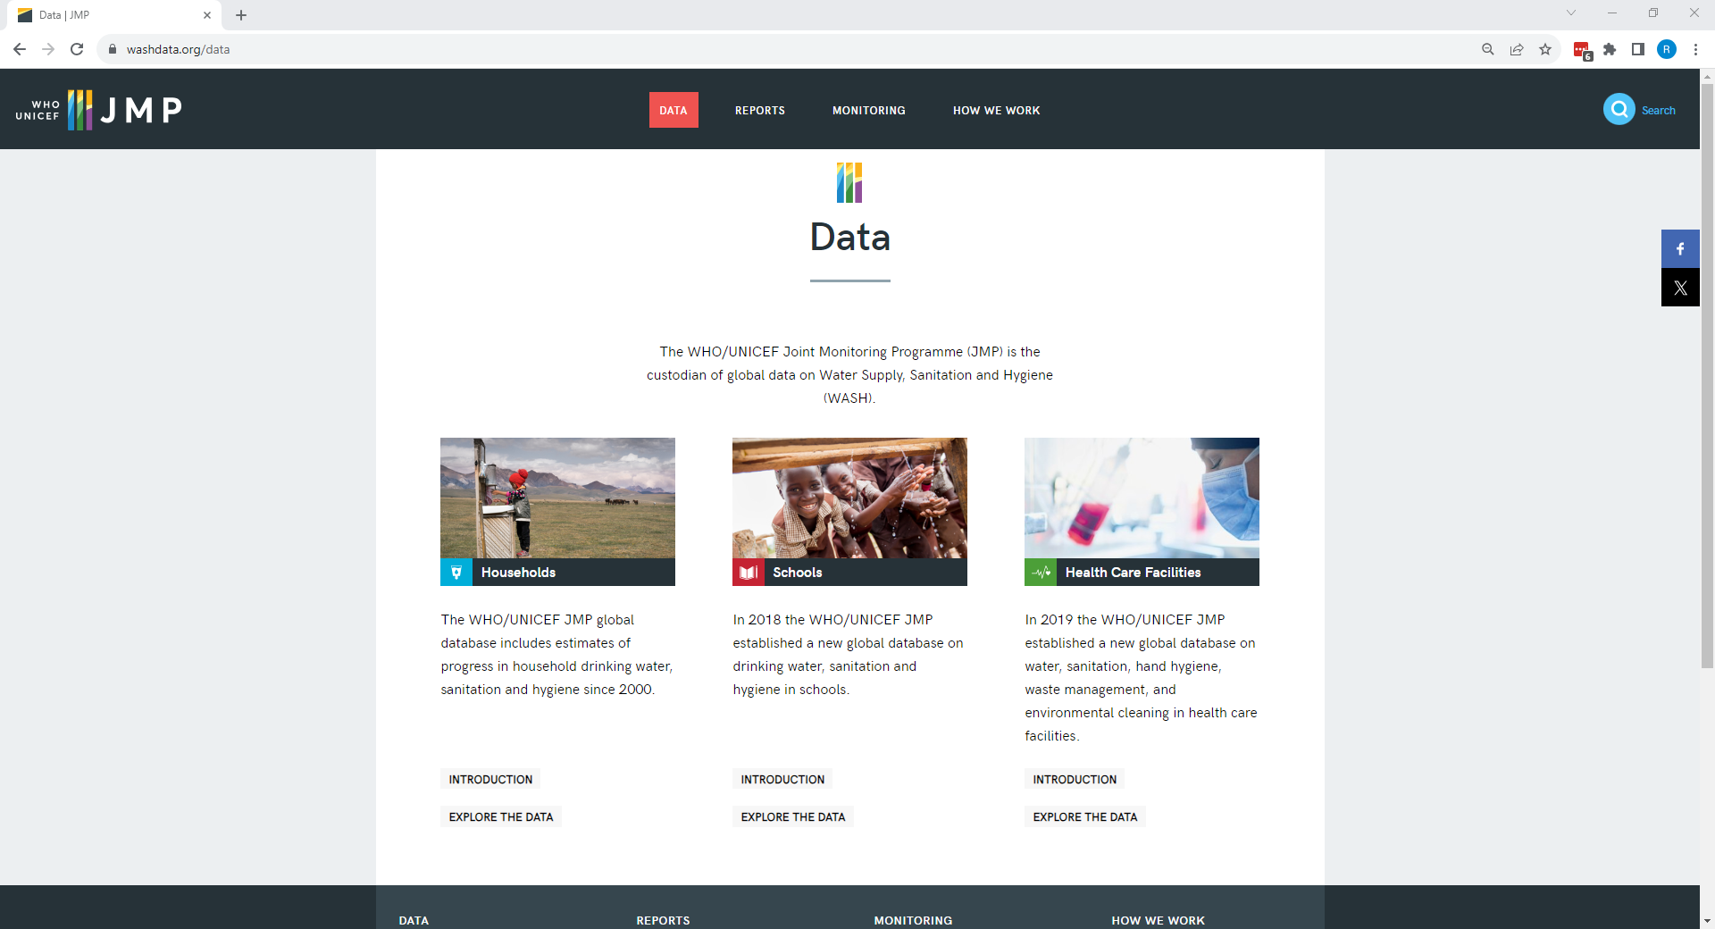
https://washdata.org/data/
Notes:
Our website includes a data portal, where you can download JMP country files, and can also make your own charts and tables. We’re going to demonstrate both of those today.
The starting point is washdata.org/data, from there you can explore the databases on households, schools, or health care facilities. Today we will focus on households.

Slide 5
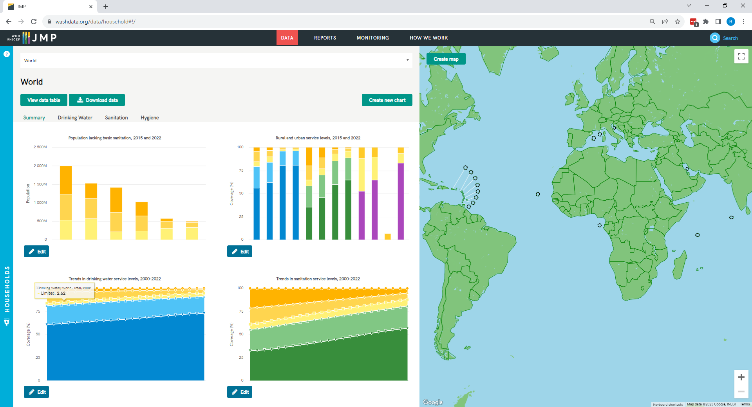
https://washdata.org/data/household#!/
Notes:
How to get to the downloads page

Slide 6
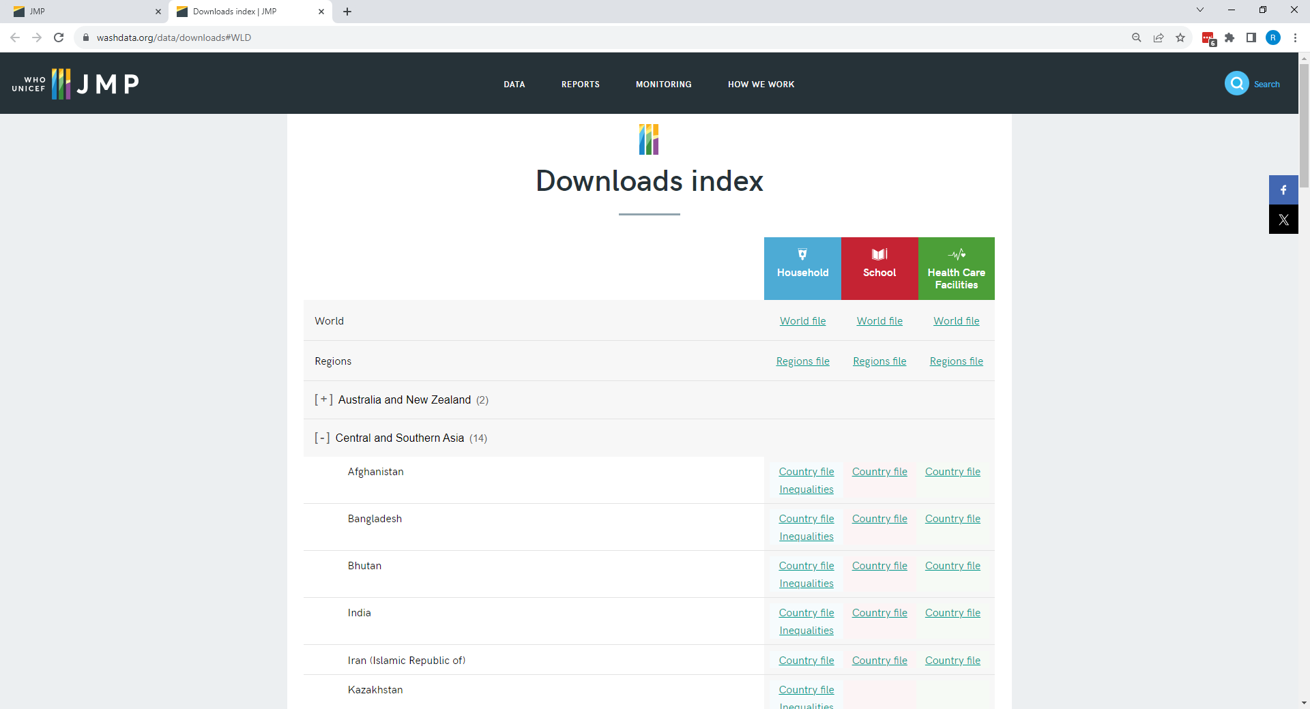
Notes:
The downloads page. Encourage people to download the India country file, we will use that as an example.

Slide 7
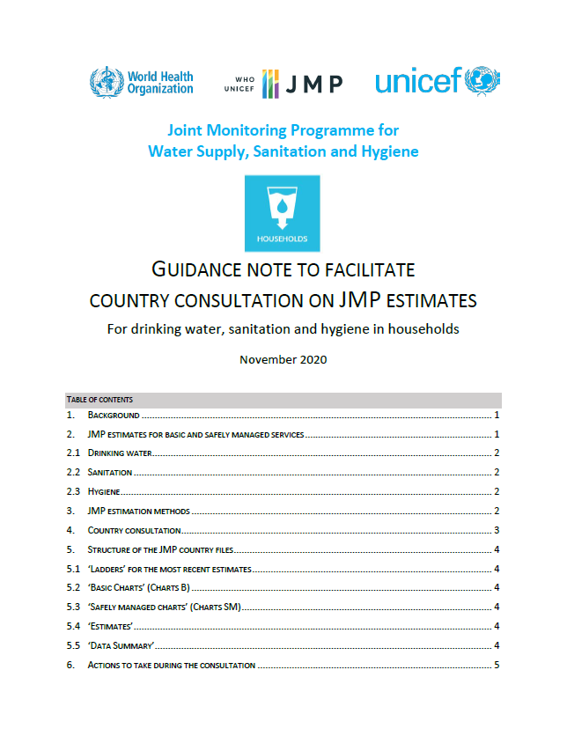
JMP country consultations
Guidance note to facilitate country consultation
  English, French, Spanish, Russian & Arabic
WHO/UNICEF country offices contact national authorities
  NSOs, MoE, MoH, MoW, regulator, other
Seek technical feedback on JMP country file
  Is it missing any relevant national data sources?
  Are the data sources used considered reliable?
  Is the interpretation/classification of national data correct?
Provide feedback to JMP team via info@washdata.org
  Country consultation in Q4 (November-January)
  Publication of JMP progress updates in Q2 (June-July)
https://washdata.org/how-we-work/jmp-country-consultation

Slide 8
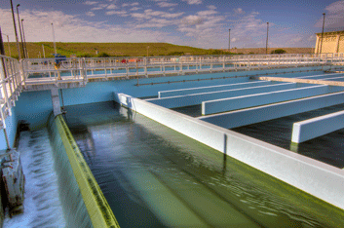
Target 6.1: By 2030, achieve universal and equitable access to safe and affordable drinking water for all

Slide 9
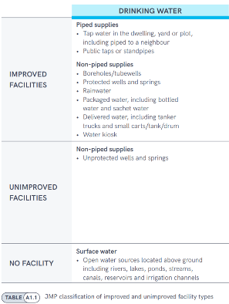
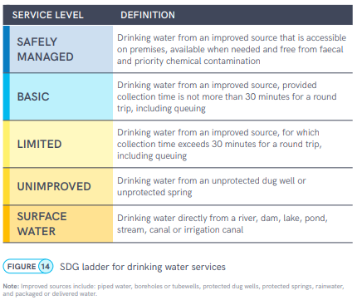
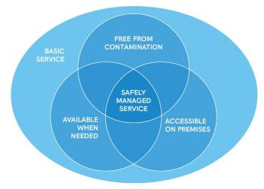
Indicator 6.1.1 : Safely managed drinking water
Notes:
The JMP uses ‘service ladders’ to benchmark and compare progress across countries, and these have been updated and expanded for SDG monitoring. The drinking water ladder defines five service levels, ranging from surface water to safely managed drinking water services, which is the global indicator for SDG target 6.1. The ladder builds on the improved/unimproved source type classification used for Millennium Development Goal (MDG) monitoring and introduces additional criteria related to the level of service provided. For SDG monitoring, households using improved sources are divided into three categories. If a round trip to collect water, including queuing, exceeds 30 minutes, it counts as a ‘limited service’, and if it takes no more than 30 minutes, it counts as a ‘basic service’.
But to meet the SDG standard for ‘safely managed services’, improved sources must be accessible on premises, available when needed, and free from contamination. Since households with safely managed services also meet the requirements for basic services, the two levels can also be grouped together as ‘at least basic service’, which is the indicator used for monitoring SDG target 1.4

Slide 10
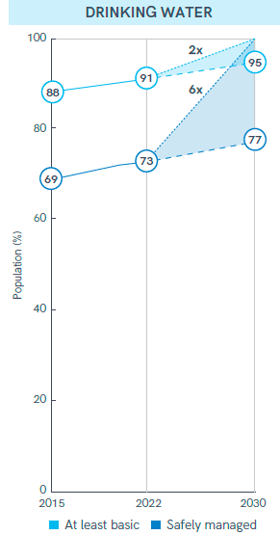
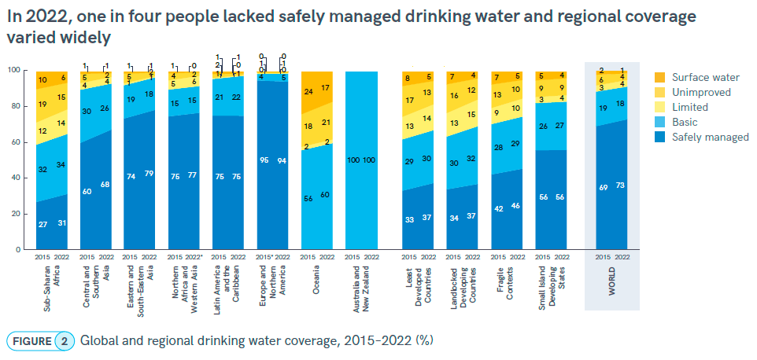
Notes:
The ladders show trends between 2015 and 2022 for the world (on the right-hand side) and for different regional groupings
Estimates for safely managed services are available for 6 out of 8 SDG regions and coverage ranges from 31% in SSA to 94% in Europe and Northern America
Between 2015 and 2022 coverage of safely managed services has increased from 69% to 73%. This means that 1 in 4 people (2.2 billion) still lacked safely managed drinking water in 2022.
Globally 703 million people still lacked even a basic drinking water services in 2022. 8 out of 10 lived in rural areas and over half lived in Least Developed Countries.

Slide 11
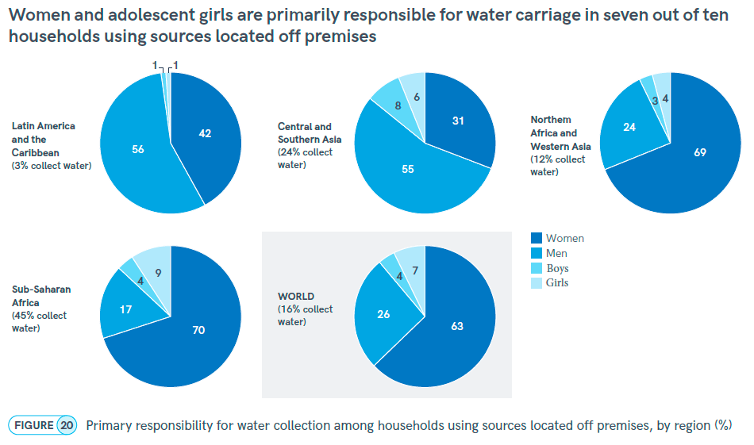
Gender and drinking water
Notes:
The burden and responsibility for water carriage also varies between regions (Figure 20). Globally, 16% of the population (1.8 billion people) live in households where water is collected from sources located off premises (both improved and unimproved). In two out of three of these households (63%), women are primarily responsible for water carriage, compared with one in four households (26%), where men are responsible. Nearly half (45%) of the 1.2 billion people in sub-Saharan Africa and a quarter (24%) of the 2.1 billion people in Central and Southern Asia rely on water collection, compared with only 12% of the population in Northern Africa and Western Asia (554 million), and just 3% in Latin America and the Caribbean (660 million). Women are four times as likely as men to fetch water in sub-Saharan Africa and nearly three times as likely in Central and Southern Asia. However, in Northern Africa and Western Asia, and in Latin America and the Caribbean, men are more likely to be responsible. Globally, girls (7%) are more likely than boys (4%) to fetch water and this is true for all regions except Northern Africa and Western Asia.

Slide 12
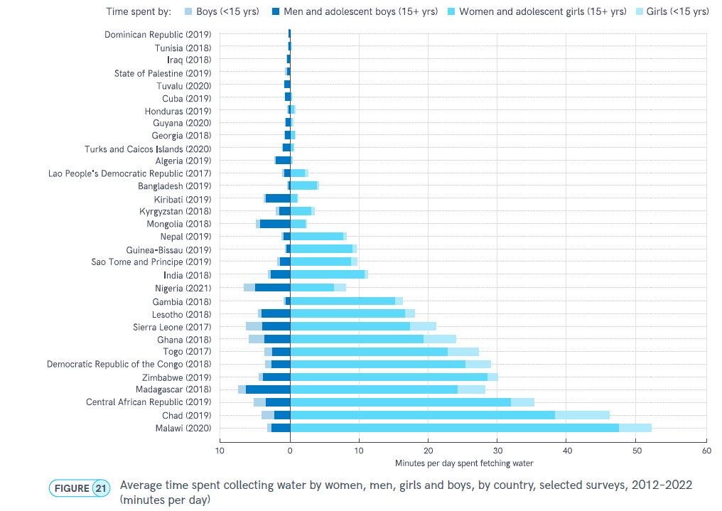
Gender and drinking water
Notes:
Figure 21 shows the average amount of time spent each day collecting water in countries with disaggregated data available for women, men, girls and boys. The average time spent per household per day on water collection ranges from 55 minutes in Malawi to less than one minute in Dominican Republic. In 20 out of 31 countries, women and girls spent more time collecting water than men and boys.
In countries where men and boys are primarily responsible for water collection, the burden of water carriage was relatively light: men and boys spent four minutes per day fetching water in Kiribati and Mongolia, two minutes per day in Algeria, and one minute or less per day in the remaining eight countries. In all 12 countries where household members spent at least 10 minutes per day collecting water, women were primarily responsible for water fetching; all but one of these countries are located in sub-Saharan Africa. In 11 countries, women and girls spend more than five times as much time collecting water per day as men and boys, and in five countries (Bangladesh, Chad, Gambia, Guinea-Bissau and Malawi), women and girls spent more than ten times as much time. The biggest gender disparity was observed in Malawi, where women and girls spent 52 minutes per day collecting water while men and boys spent three minutes. In Chad, girls spent five times as much time per day (eight minutes) collecting water than boys (1.7 minutes).

Slide 13
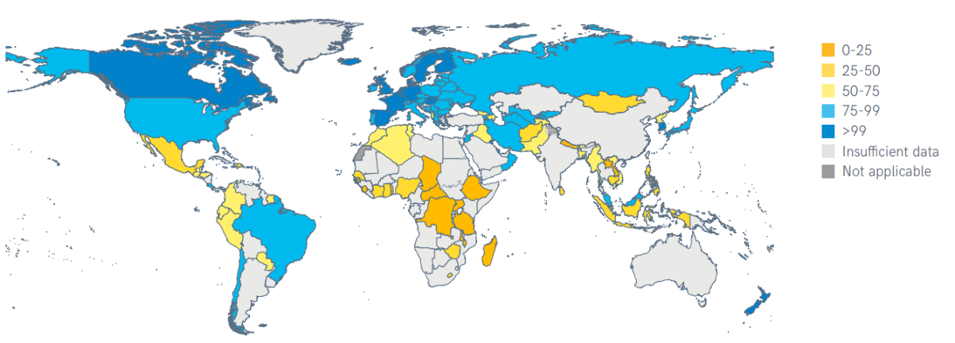
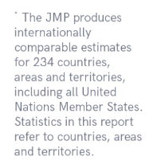
142 countries had estimates for safely managed services in 2022
Proportion of population using safely managed drinking water services, 2022 (%)
Notes:
142 countries, areas and territories representing 51% of global population - six out of eight SDG regions
Missing national estimates for large countries including India (only rural), China (only urban), Indonesia
Many LMICS still lack nationally representative data on drinking water service levels

Slide 14
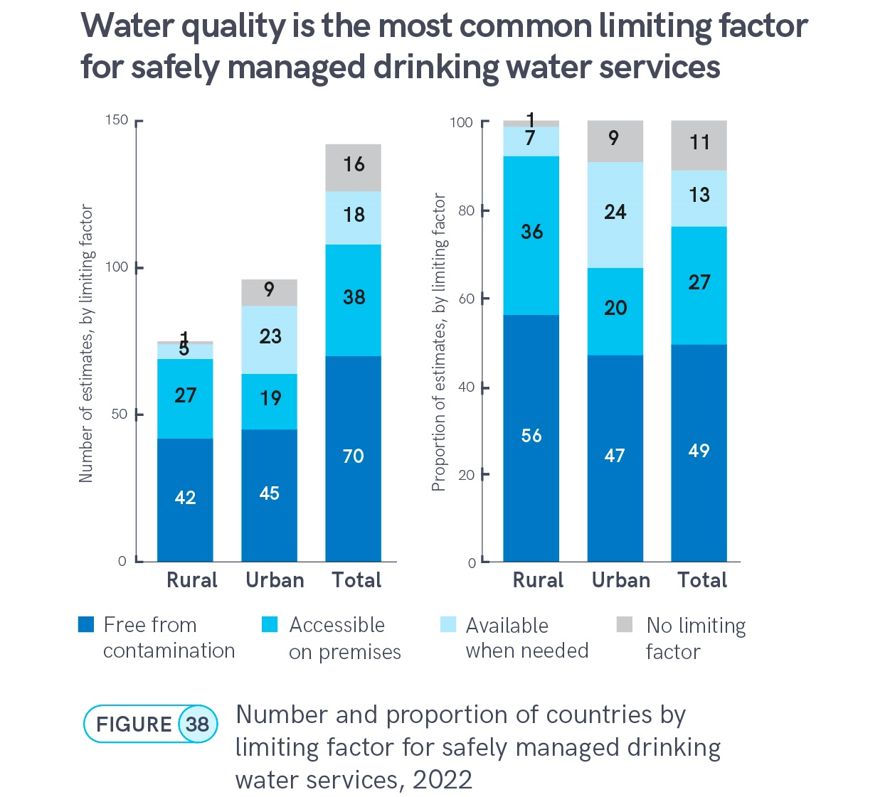
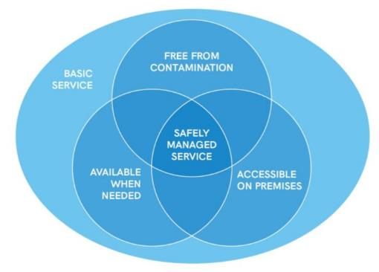

Slide 15
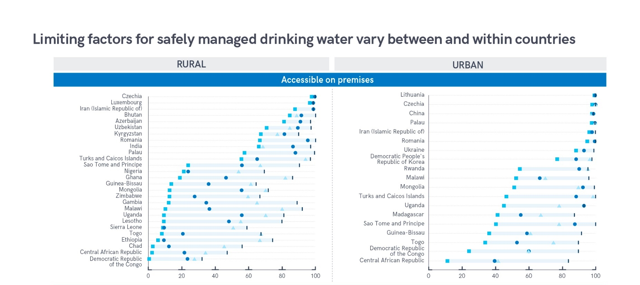

Slide 16
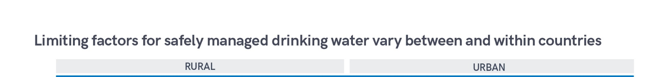
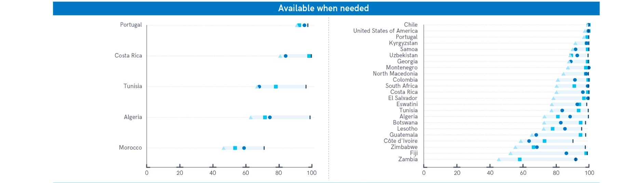

Slide 17
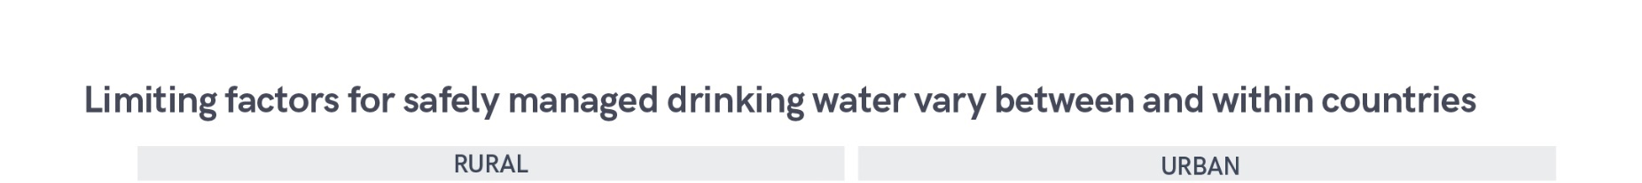
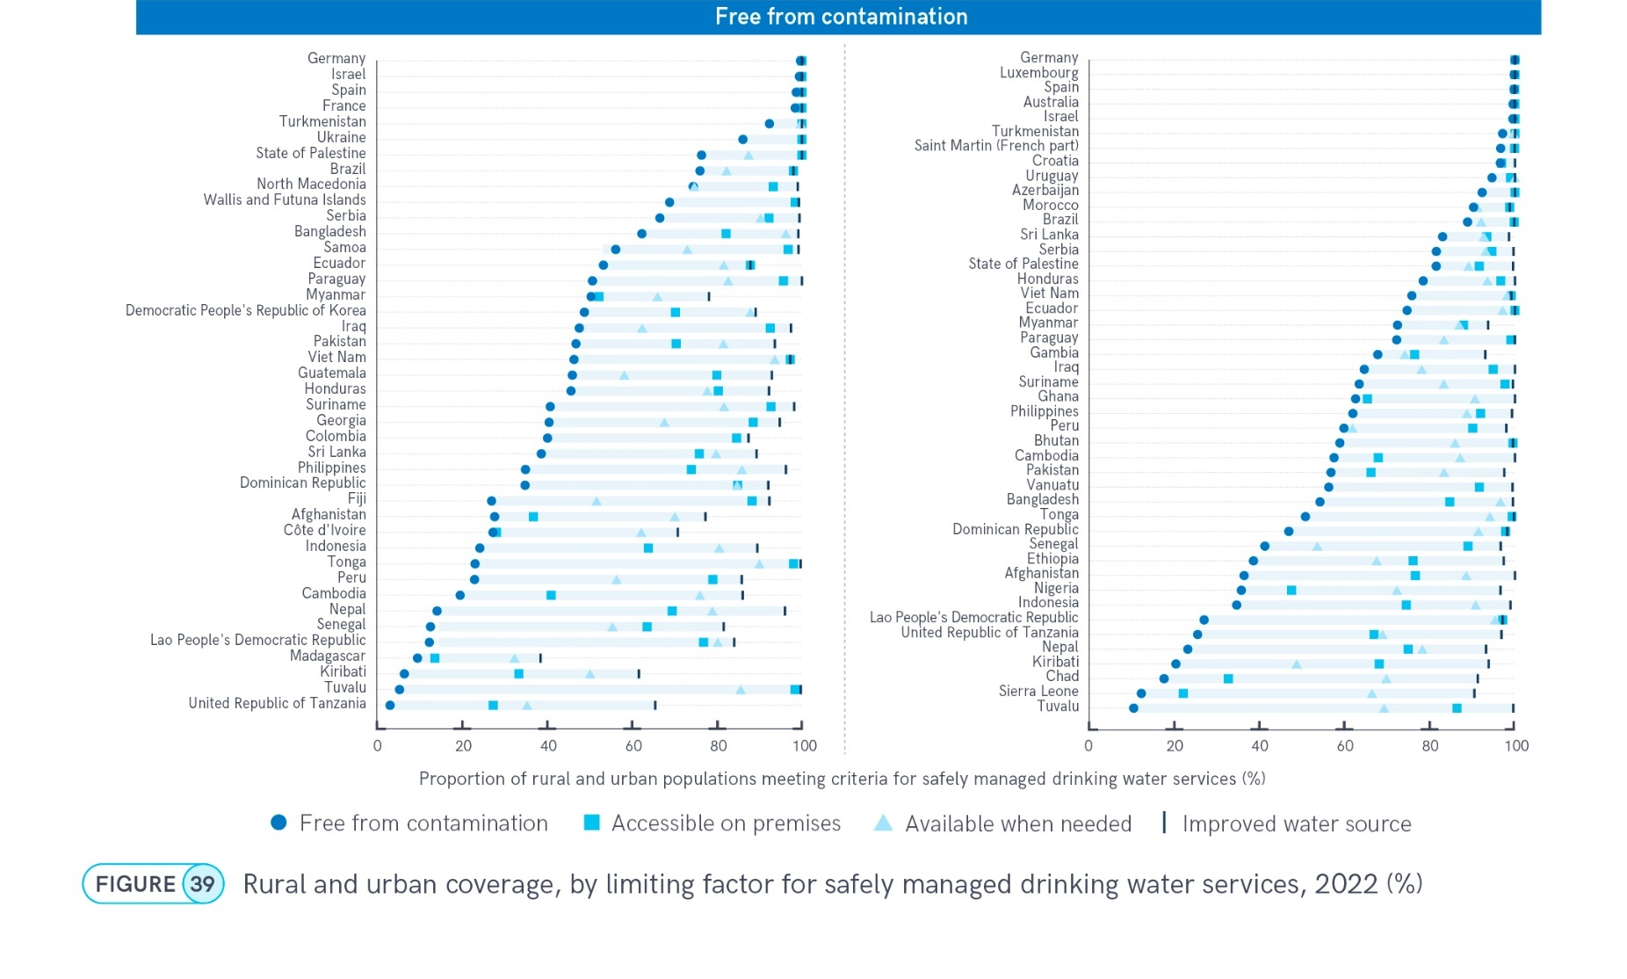

Slide 18
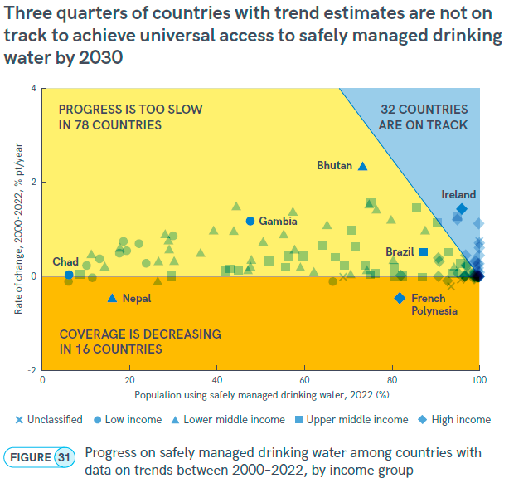
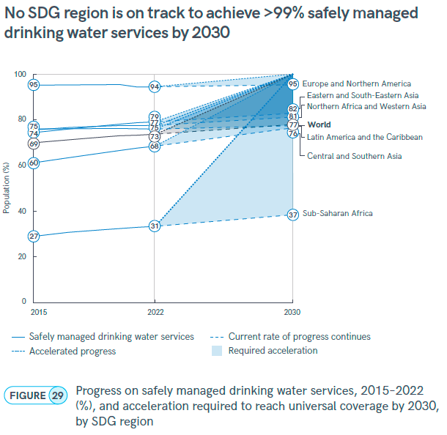
Notes:
Between 2015 and 2022, global coverage of safely managed drinking water increased by 4 % pts (from 69% to 73%). At current rates of progress, the world will only reach 77% coverage by 2030, leaving 2 billion people without safely managed services (Figure 29). While coverage has increased in most SDG regions, it has stagnated in Latin America and the Caribbean (at 75%) and decreased slightly in Europe and Northern America (from 95% to 94%). Central and Southern Asia has achieved the fastest rate of progress, rising 8 % pts from 60% in 2015 to 68% in 2022.
However, no SDG region is on track to achieve universal coverage by 2030. Achieving universal access to safely managed drinking water will require a sixfold increase in current rates of progress (20-fold in least developed countries, 19-fold in fragile contexts).
Bhutan has recorded the fastest annual rate of progress since 2000 (2.32 % pts/yr), but current coverage is 73% so this rate of change will still not be sufficient to reach >99% by 2030. Ireland is progressing more slowly (1.44 % pts/yr) but had already achieved 96% coverage by 2022 so is on track to achieve universal access by 2030.

Slide 19
Exercise 1 (JMP country files)
What proportion of improved drinking water sources in Malawi are free from E. coli?
Which national data source does this information come from?

Slide 20
https://washdata.org/data/household#!/
Notes:
How to get to the downloads page

Slide 21
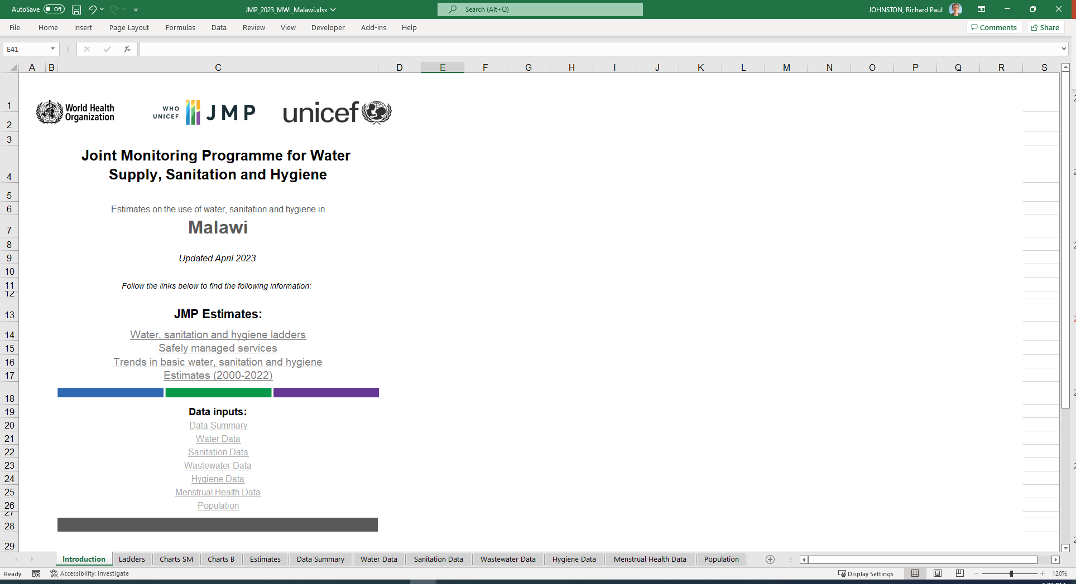
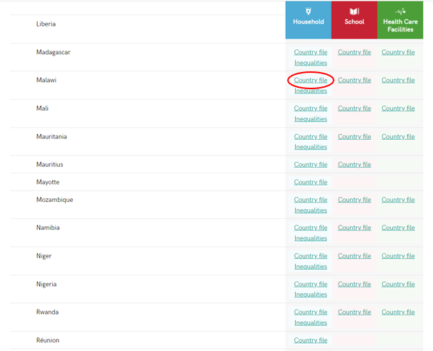
https://washdata.org/data/country/MWI/household/download
Notes:
Download the Malawi country file

Slide 22
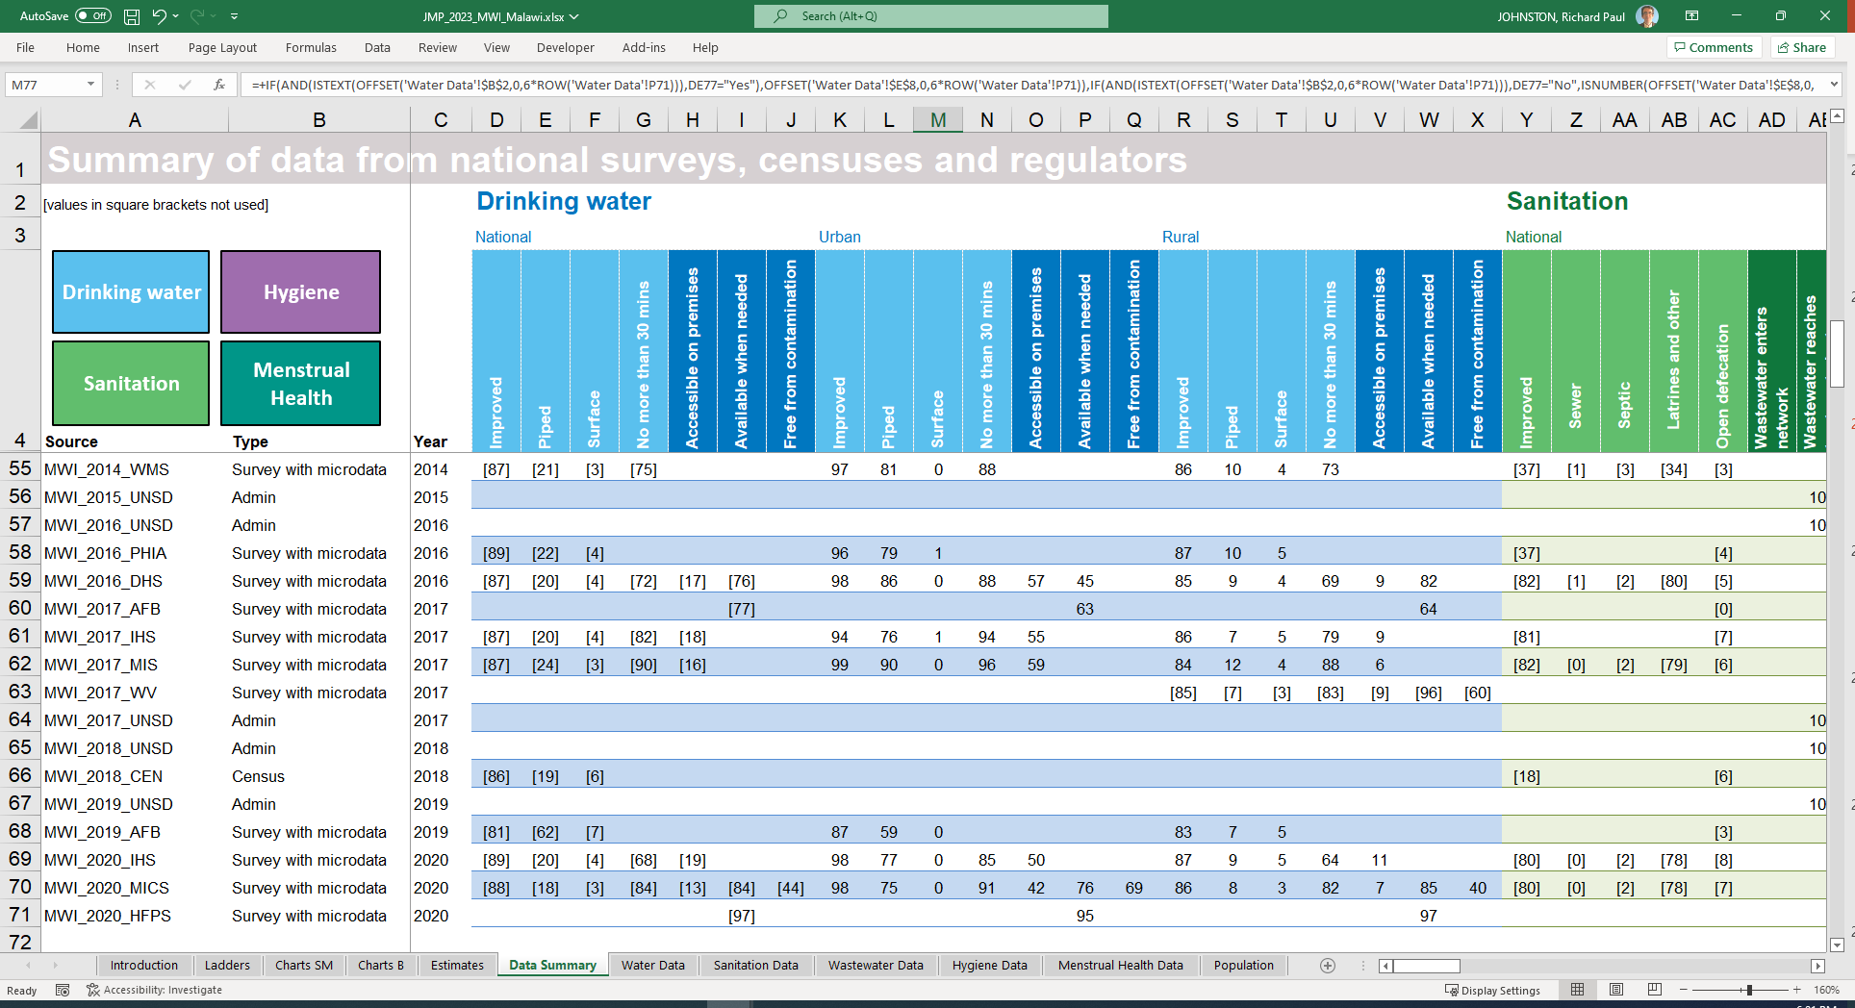
Notes:
The Data Summary tab shows only one source that has water quality for both urban and rural areas.
(World Vision 2017 in rural areas was not used, following request from the government during the consultation process)

Slide 23
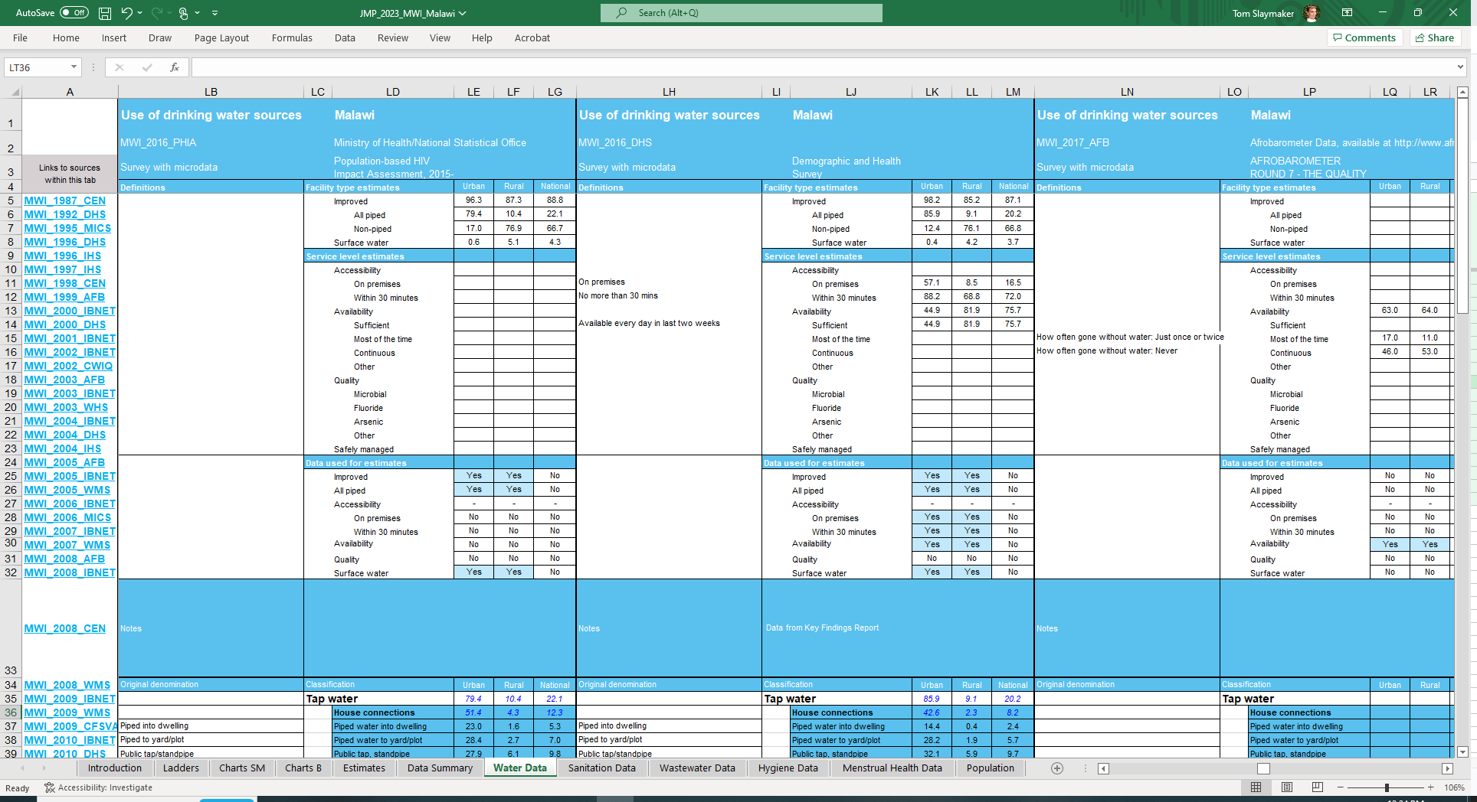
Notes:
The MICS found that only 45% of improved sources were free from contamination at the source. Better quality in urban than in rural areas.

Slide 24
Exercise 1 (JMP country files)
What proportion of improved drinking water sources in Malawi are free from E. coli?
Which national data source does this information come from?

Slide 25
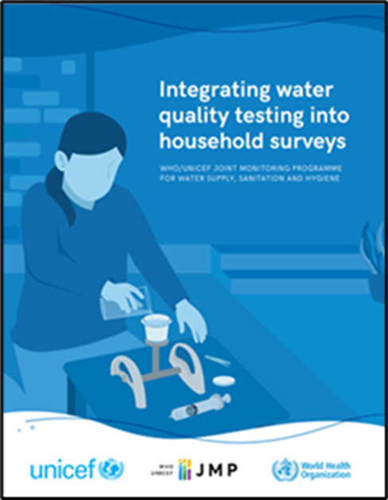
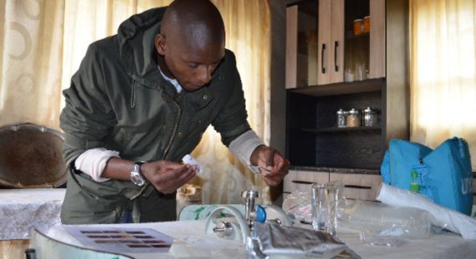
Water quality testing in household surveys
2023
2012-2015
2012-13
Ghana LSS
Congo MICS
Nepal MICS
2018
Ethiopia ESS
2020
(Pakistan MICS)
(Afghanistan ALCS)
(Belize MICS6 Pilot)
Ecuador ENEDMU
(Mongolia MICS)
Nigeria MICS
Paraguay MICS
Côte d’Ivoire MICS
Philippines APIS
Senegal EEAH
Sierra Leone MICS
Suriname MICS
Lao PDR SIS
Georgia MICS
Tunisia MICS
Iraq MICS
Kiribati MICS
Mongolia MICS
DRC MICS
Lesotho MICS
Madagascar MICS
Ghana MICS
Côte d’Ivoire DHS
2021
2022
Benin MICS
2019
Algeria MICS
Bangladesh MICS
CAR MICS
Chad MICS
Gambia MICS
Dominican Republic MICS
Guinea-Bissau MICS
Honduras MICS
Lebanon National
Indonesia SKAM-RT
Sao Tome and Principe MICS
Samoa MICS
State of Palestine MICS
Malawi MICS
Bangladesh MICS
2014-15
2016-17
Ecuador ENEMDU
Trinidad and Tobago MICS
Togo MICS
Tonga MICS
Turks and Caicos MICS
Tuvalu MICS
Viet Nam MICS
Eswatini MICS
Fiji MICS
Sri Lanka HIES
Zimbabwe MICS
Kosovo MICS
Mozambique DHS
Nigeria NORM
Tanzania NPS
DPRK MICS
Nepal MICS
Nigeria NORM
Guyana MICS
Afghanistan MICS
Argentina MICS
Azerbaijan MICS
Belize MICS
Burkina Faso NS Ethiopia DHS
FSM Micronesia MICS
Guatemala DHS
Laos SIS
Lebanon MICS
Nauru MICS
Nicaragua MICS
Somalia MICS
Sudan MICS
Tunisia MICS
Turkmenistan MICS
Uganda DHS
Vanuatu MICS
* Italic: Surveys not published as of August 2023
(.) : Not nationally representative
https://washdata.org/monitoring/drinking-water/water-quality-monitoring
25
Notes:
>50 countries supported to date

Slide 26
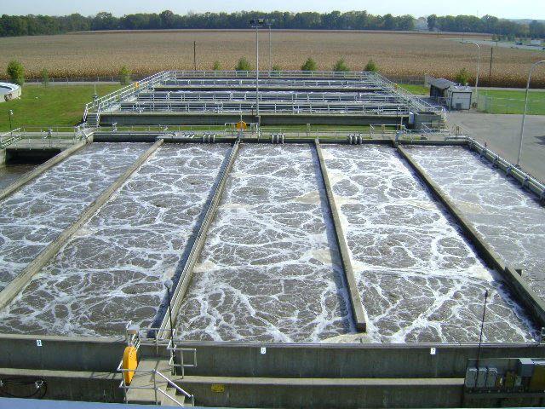
Target 6.2: By 2030, achieve access to adequate and equitable sanitation and hygiene for all, and end open defecation, paying special attention to the needs of women and girls and those in vulnerable situations

Slide 27
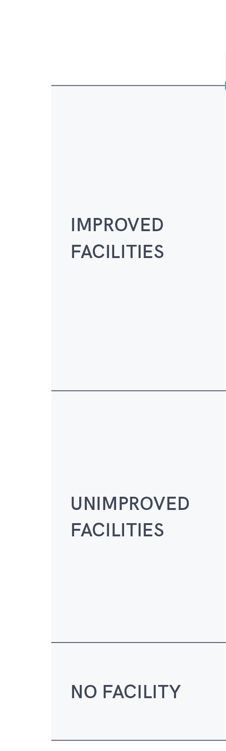
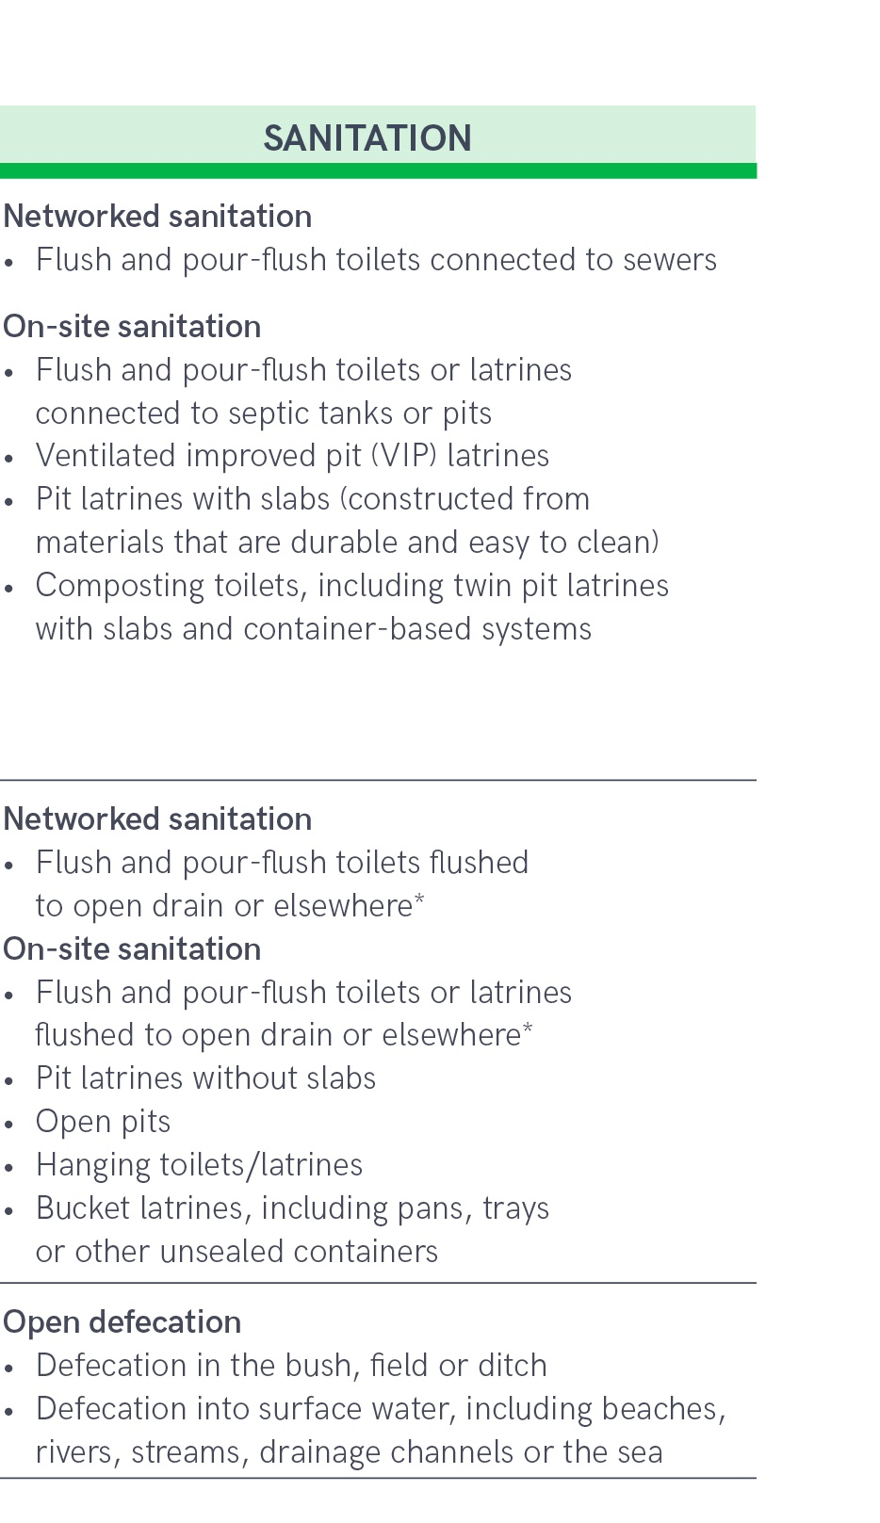
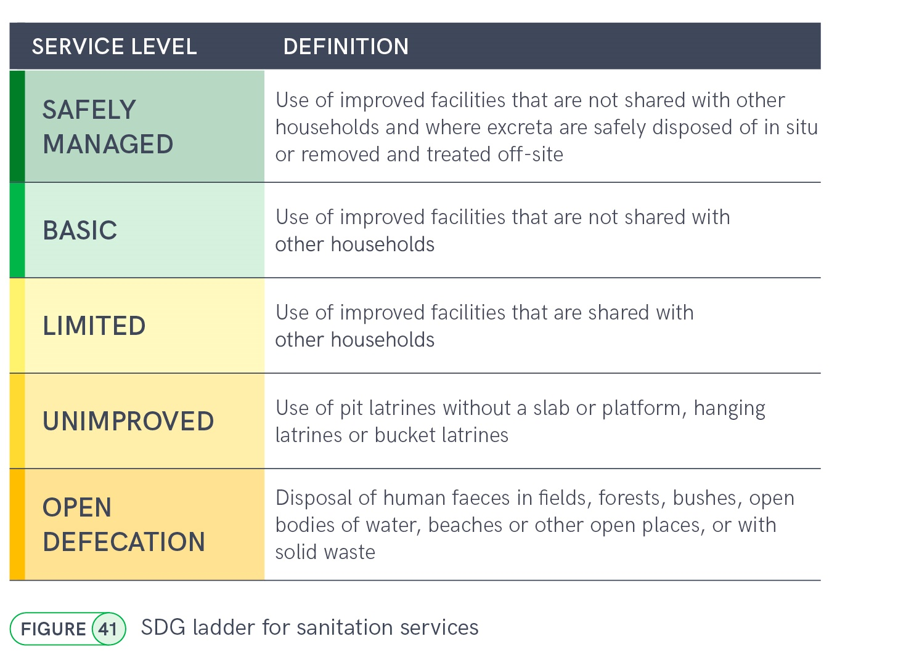
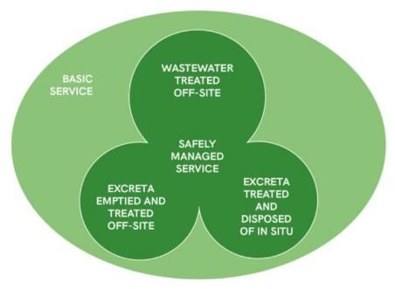
Indicator 6.2.1a: Safely managed sanitation
Notes:
The sanitation ladder ranges from open defecation at the bottom to safely managed sanitation at the top. Ladder builds on the improved/unimproved facility type classification used for MDG monitoring. For SDG monitoring households using improved sanitation facilities divided into three categories
Improved sanitation facilities that are shared with other households count as limited service and if they are not shared then they count as a basic sanitation service. But additional criteria are applied to meet the SDG standard for ‘safely managed services’, excreta must either be safely disposd of in-situ, or removed and treated offsite
Cartoon on the right hand side illustrates the 3 possible routes to safely managed sanitation.

Slide 28
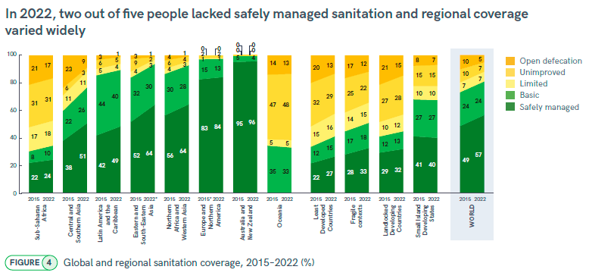
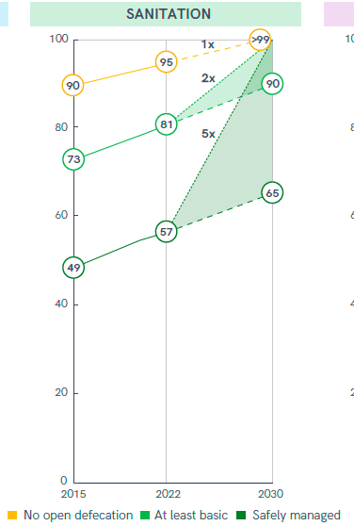
Notes:
These ladders show trends between 2015 and 2022 for the world (on the right-hand side) and for different regional groupings
Estimates for safely managed services (dark green) are available for 7 out of 8 SDG regions and coverage ranges from 24% in SSA to 96% in Australia and New Zealand
Between 2015 and 2022 coverage of safely managed services has increased from 49% to 57%.
This means that nearly half the global population still lacked safely managed sanitation in 2020 (3.5 billion people).
Among these 1.5 billion people still lacked even a basic sanitation service in 2022, including 419 million who still practised open defecation.
Chart on the right shows current rates of progress and acceleration required to reach universal coverage by 2030 (1x, 2x, 5x)

Slide 29
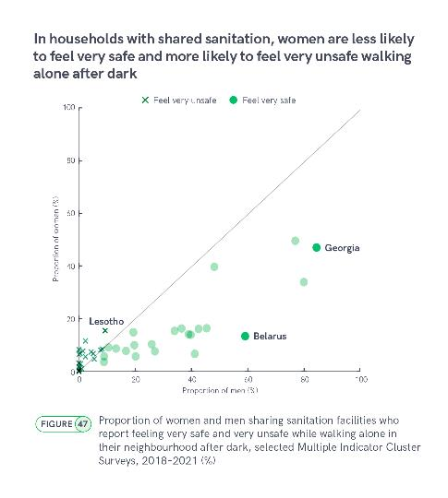
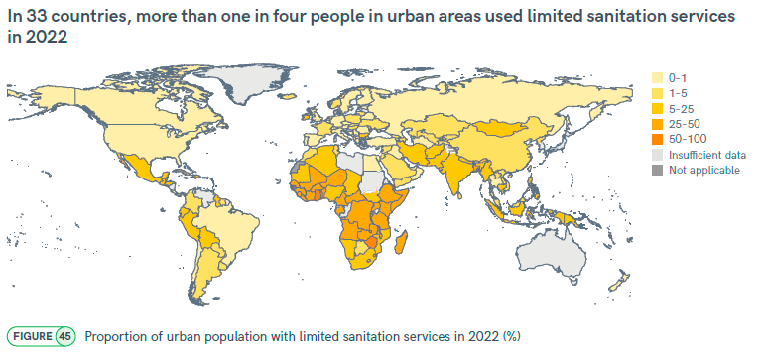
Gender and sanitation
Notes:
2023 report included a section looking at gender and sanitation
Shared sanitation facilities are an important interim solution when individual household facilties are not feasible, but they frequently do not meet the needs of women and girls due to concerns about accessibility when needed, cleanliness, privacy and personal safety.
In 2022, 570 million people used improved facilties that were shared with other households and count as a ‘limited’ service. Three out of five (335 million) lived in urban areas. Gender inequalities related to shared sanitation are likely to be greatest in the 33 countries where more than a quarter of the urban population used limited services in 2022, of which 30 were located in sub-Saharan Africa (Figure 45). In 2022, one in five people used limited services in sub-Saharan Africa (18%), compared with one in ten in Central and Southern Asia (11%), and one in twenty in Oceania (5%).
The Multiple Indicator Cluster Surveys (MICS) ask women and men separately how safe they feel walking alone in their neighborhood after dark. In 22 recent surveys among households that use shared sanitation facilities, men were much more likely than women to report feeling ‘very safe’ (Figure 47). For example, in Georgia, 85% of men but only 47% of women said that they felt very safe, while in Belarus, men (59%) were more than four times as likely to report feeling very safe than women (13%). Far fewer respondents reported feeling ‘very unsafe’, but this was much more common among women than men.

Slide 30

In 13 countries, more than 1 in 4 people practised open defecation in 2022
Notes:
In 2022, 419 million people worldwide did not use a toilet and practised open defecation. Women and girls who practise open defecation are less likely to be able to maintain privacy and dignity, and more likely to face physical, sexual or verbal assault than men and boys.18 While there were still 36 countries with open defecation rates between 5% and 25%, gender inequalities were likely to be greatest in the 13 countries where at least one in four people practise open defecation. These were mostly in sub-Saharan Africa and include Chad (63%), Niger (65%) and South Sudan (60%), where more than half of the population still practised open defecation in 2022 (Figure 44).

Slide 31

135 countries had estimates for safely managed services in 2022
Notes:
The JMP progress update shows that many countries still do not have sufficient national data to report on the SDG global indicator
In 2022, national estimates were available for 135 countries, areas and territories, representing 86% of the global population (including India and China)
While most countries have data on treatment of wastewater from hhs connected to sewers, very few countries have data on treatment and disposal of waste from septic tanks and pit latrines which remains a major data gap

Slide 32


The distribution of on-site and sewered sanitation varies widely by region
Notes:
Globally there are now roughly equal numbers of people using sewer connections (dark green) and on-site sanitation such as septic tanks and pit latrines (light green) – 43%
Globally, two thirds of the urban population have sewer connections but on-site systems dominate in rural areas
But patterns vary widely between regions
In Least Developed Countries nearly half the population (49%) use on-site systems and just 4% have sewer connections
Even in urban areas of SSA 62% of the population have on-site systems and just 16% have sewer connections
This has really important implications when it comes to provision of safely managed sanitation services

Slide 33

Never emptied, but contained
Notes:
On-site sanitation systems that are not shared, and that provide effective containment, can be considered safely managed if they are not emptied and excreta remain contained in the pit/tank. When the pit/ tank is emptied, it can also be counted as safely managed if the excreta are buried on-site, or are removed off-premises and treated.
In recent years, new questions in household surveys have allowed many countries to collect nationally representative data on pit and tank emptying practices. Many survey respondents indicate that their pit latrine or septic tank has never been emptied; this is particularly common in rural areas (Figure 58A).
Emptying and removal for off-site treatment is much more common for septic tanks and for urban areas (Figure 58B). Household survey respondents can’t reliably indicate if faecal sludge is treated once it leaves the property; additional information is needed from administrative sources about the amount of faecal sludge that is collected and delivered to plants designed to treat faecal waste. While such information may be available at the scale of individual municipalities, it is typically not aggregated at the national scale.

Slide 34

Wastewater, faecal sludge (emptied)
Notes:
Wastewater from households with sewer connections is considered safely managed if it is delivered to a treatment plant designed to provide secondary or higher levels of treatment. Primary treatment also meets the standard for safely managed sanitation if the primary effluent is discharged in a way that precludes further human contact (for example, through a long ocean outfall). In 2022, 152 countries had total estimates for both the proportion of the population using sewer connections and the proportion using sewer connections from which wastewater is treated and therefore safely managed. Figure 65 shows that in many countries coverage of wastewater treatment was not keeping up with coverage of sewer connections.
In 2022, the Kingdom of the Netherlands had universal coverage (>99%) of sewer connections and nearly all of these (97%) were safely managed. Puerto Rico also had universal coverage of sewer connections but only a third (33%) of sewered wastewater
received secondary or higher treatment. Among upper-middle-income countries, Brazil (71%) and Armenia (72%) had similarly high coverage of sewer connections but 39% of wastewater was safely managed in the former compared to <1% in the latter.

Slide 35

Wastewater, faecal sludge (emptied)
Notes:
Once tanks and pits are emptied, faecal sludge may be buried or discharged locally, or removed off-site. On-site burial is considered safely managed, and in some countries (Bangladesh, Guyana and Zimbabwe) this practice was particularly widespread for latrines (Figure 64). Faecal sludge emptied from septic tanks was much more likely to be removed off-site than sludge removed from latrines. In Thailand, 95% of households where septic tanks had been emptied reported that the faecal sludge was removed off-site, only 1% was buried on-site. In countries that fall far from the diagonal line in Figure 64, survey respondents reported that the faecal sludge was neither removed off-site nor buried on-site. For example, in Serbia and Viet Nam, 44% and 45% of respondents with latrines, respectively, reported that these had been emptied by household members, with the contents deposited in uncovered pits, open ground, water bodies or elsewhere. None of these methods of disposal are considered safely managed.

Slide 36

Safely management of on-site and sewered sanitation in rural and urban areas varies widely by region
Notes:
Figure 62 shows large variations by region and residence. In rural areas, safely managed sanitation was dominated by on-site systems, except in Europe and North America, and Northern Africa and Western Asia. In urban areas, safely managed sanitation was mainly through sewer connections in four SDG regions (Eastern and South- Eastern Asia, Europe and Northern America, Latin America and the Caribbean, and Northern Africa and Western Asia), but was mostly via on-site sanitation in three regions (Central and Southern Asia, Oceania and sub-Saharan Africa). In least developed countries, landlocked developing countries and fragile contexts, on-site sanitation was the main contributor to safely managed sanitation in both urban and rural areas.

Slide 37


Notes:
For example, China has recorded the fastest annual rate of progress among upper-middle-income countries (2.45 % pts/yr), rising from 13% in 2000 to 67% in 2022, but this will not be sufficient to reach >99% by 2030. South Africa has achieved similar coverage (72%) but is progressing more slowly (0.78 % pts/yr). Among low-income countries, Malawi (1.75 % pts/yr) has shown the fastest rate of progress but had only reached 46% coverage by 2022, so is not on track to achieve universal access by 2030.
Between 2015 and 2022, global coverage of safely managed sanitation increased by 8 % pts (from 49% to 57%). At current rates of progress, the world will only reach 65% coverage by 2030, leaving 3 billion people without safely managed services (Figure 56). Since 2015, all SDG regions have increased coverage but rates of progress differ. Central and Southern Asia increased coverage by 13 % pts (from 38% to 51%), and Eastern and Southern Asia increased coverage by 12 % pts (from 52% to 64%), while all other regions increased coverage by less than 10 % pts. By contrast, sub-Saharan Africa only managed to increase coverage by 2 % pts (from 22% to 24%). Despite progress, no SDG region is on track to achieve universal coverage by 2030. Achieving universal access to safely managed sanitation will require a fivefold increase in current rates of progress (16-fold in least developed countries, 15-fold in fragile contexts).

Slide 38
Exercise 2 (washdata.org)
Which of the low-income countries had the highest national coverage of safely managed sanitation services in 2022?
How much of this comes from wastewater treated offsite, faecal sludge treated offsite, and onsite sanitation treated in situ?

Slide 39
https://washdata.org/data/household#!/
Notes:
For this exercise we are going to use the data portal on the JMP website
Splashpage displays default charts but you can use the data tool to create your own
Select create chart

Slide 40

Notes:
For this exercise we are going to create a rank chart

Slide 41

Notes:
Default is rank chart showing all countries of the world
But you can use the menu on the left hand side to filter the different variables
For this exercise we want to rank low income countries (region type = LIC)
Select measure (coverage), inequality (total), ladder type (service level = safely managed) and year (2022)
So first create a rank chart for safely managed and then analyse by safely managed criteria

Slide 42
Exercise 2 (washdata.org)
Which of the low-income countries had the highest national coverage of safely managed sanitation services in 2022?
How much of this comes from wastewater treated offsite, faecal sludge treated offsite, and onsite sanitation treated in situ?

Slide 43

https://washdata.org/data/household#!/dashboard/5482

Slide 44

https://washdata.org/data/household#!/dashboard/5483

Slide 45




Monitoring safely managed onsite sanitation (SMOSS)
Scaling up SMOSS monitoring to address SDG data gaps
Developing guidance and tools for monitoring SMOSS
Phase 1 (2020-2022)
Phase 2 (2023-2024)
Bangladesh
Ecuador
Indonesia
Oman
Nepal
Moldova
Malawi
Costa Rica
Kenya
Zambia
Serbia
https://washdata.org/monitoring/sanitation/safely-managed-on-site-sanitation
Notes:
6 pilots in Phase 1 (Bangladesh, Ecuador, Kenya, Indonesia, Serbia and Zambia)
Combines household surveys, technical inspections and compilation of data from service providers and local and municipal government
Data collection ongoing and results expected in March/April
Expert group meeting to review findings and refine tools in June/July
5 more pilots in Phase 2 beginning second half of 2023
Scaling up data collection to address SDG data gaps

Slide 46
Target 6.2: By 2030, achieve access to adequate and equitable sanitation and hygiene for all, and end open defecation, paying special attention to the needs of women and girls and those in vulnerable situations

Slide 47

6.2.1b Hygiene
Notes:
The hygiene ladder was added for SDG monitoring and only has 3 rungs. Basic hygiene service means households have a handwashing facility with soap and water available at home. If facility is available but either soap or water are missing it counts as limited service and at the bottom of the ladder we have no handwashing facility at all.

Slide 48

84 countries had estimates for basic hygiene services in 2022
Notes:
Most of the data on handwashing come from household surveys in low- and middle-income countries. High-income countries don’t have as many household surveys, and when they do they typically don’t ask about water, sanitation and hygiene, as universal coverage is presumed.
In the JMP report published a few months ago, national estimates were available for 84 countries, areas and territories, representing 69% of the global population (including India and China).
You can see from the map that data were most commonly available in sub-Saharan Africa, where coverage rates tend to be lower.

Slide 49


Progress on household hygiene services 2015-2022
Notes:
The hygiene service ladder includes basic hygiene services, which we show in purple, but also includes those with a handwashing facility lacking soap or water, which we call limited hygiene services – that’s in yellow – and those with no handwashing facilities at all, shown in orange.
Estimates for basic hygiene services were available for four of the eight SDG regions, including Northern Africa and Western Asia which is currently the only region on track to achieve universal access before 2030.
Access to hygiene services is lowest in sub-Saharan Africa, but is also quite low in Oceania – in both of these regions about a third of the population has no handwashing facility at all at home.

Slide 50

Gender and hygiene
Notes:
For our 2023 update it was difficult to find data on gender and hygiene. While the burden associated with not having handwashing facilities is likely to disproportionately impact women and girls who remain primarily responsible for child care and domestic chores, very few countries have data disaggregated by sex or gender
A small number of studies in high-income countries have either asked people about their reported handwashing practices, or observed actual handwashing behaviour in public settings, such as bathrooms in universities, transport hubs or museums.26 These studies are often small-scale, not nationally representative and not fully comparable due to methodological differences. However, they consistently show that, while people do not always wash their hands after using public bathrooms, women are more likely to do so than men (Figure 72).
In one study of motorway rest stop bathrooms in England, women were more than twice as likely as men to be observed washing their hands with soap and water after using the toilet. However, in most other studies, gender gaps were smaller, at around 10–25 % pts. Women were also more likely to self-report handwashing than men, but this gap was smaller. In 2010, a Harris Interactive study found that 99% of women and 93% of men in the United States of America reported ‘always’ washing their hands after using public toilets, but structured observation in four major cities showed that only 93% of women and 77% of men actually did so. A similar study in shopping malls in New Zealand found that males (81%) not only washed their hands less frequently than females (92%), but also washed their hands for a shorter period of time and were less likely to use soap (66% vs. 77%).
Existing data suggest that the availability of a bath or shower within a dwelling, yard or plot varies across countries and could be a useful additional indicator of hygiene inequalities. Access to bathing facilities has also been identified as an important dimension of gender-related inequalities in the ability of women and girls to meet their hygiene needs.

Slide 51

Four core indicators on Menstrual Health
Domain | Proportion of women and girls age 15-49 years who have menstruated in the past year who…
Materials | used menstrual materials during their last period
Facilities | had a private place to wash and change at home during their last menstrual period
Knowledge | Knew about menstruation before their first period
MH impacts | Participated in school, work or social activities during their last menstrual period
Notes:
Menstrual health indicators are sex-specific and highly gender-relevant, and therefore provide a useful measure of gender-related inequalities in WASH. They address both the specific sanitation and hygiene-related needs of women and girls, and other persons who menstruate, and also wider gender norms, taboos and stigma that surround menstruation in many parts of the world.
By 2022, nationally representative data on menstrual health were available for 53 countries, representing seven out of eight SDG regions, of which 44 countries had data for at least three of the four harmonized indicators (Figure 82). Fifty-one countries had data for use of materials, 50 countries had data for a private place to wash and change, and 46 countries had data on participation in activities during menstruation. Only two countries had national data on awareness of menstruation before menarche, Egypt and Bangladesh, the latter of which was the only country with data for all four indicators.
(includes reusable and single-use pads, tampons, menstrual cups, cloth, cotton wool, but not underwear only or toilet paper)

Slide 52

Notes:
Figure 98 shows that in most countries, coverage of use of materials and a private place to wash and change was higher than participation, and in some countries the proportion of adolescent girls and women meeting all three criteria was significantly lower still. For example, in Madagascar, 94% used materials, 91% had a private place to wash and change, and 92% participated in activities during menstruation, but only 79% satisfied all three needs.

Slide 53
Exercise 3
In Bangladesh, what is the % pt gap in basic hygiene coverage between richest and poorest wealth quintiles?
What type of menstrual materials did women and girls use during their last period?
  Mainly reusable or mainly single-use?
  How does this vary by wealth?
Notes:
Can use either the country file or the inequalities file.

Slide 54

Notes:
Go to the downloads page and select inequalities file

Slide 55

Notes:
Inequalities files have a separate tab for each data source which contains data disaggregated by subnational region and wealth quintile
For this exercise select the most recent (MICS19)

Slide 56

Notes:
Buttons at the top allow you to display data on water, sanitation, hygiene and menstrual health
Buttons also allow you to chose between data by wealth quintile or by subnational region
So for the first question select hygiene

Slide 57


Slide 58


Slide 59


Slide 60






Progress on global monitoring of Menstrual Health
Highlighted as emerging thematic area in global household report
Dedicated chapter in JMP global report (42 countries with data)
Dedicated chapter in global report (53 countries and examples on new indicators)
2018
2020
2022
2019
2021
2023
Globally recommended core questions on menstrual health for household surveys
Published global guidance on monitoring Menstrual Health
New indicators and questions agreed on by expert group
MH also included in global monitoring of health care facilities and schools
Notes:
Definition of ‘Menstrual Health’ published in 2021 (reference in slide on new indicators too)
…on at least one MH indicator
…to better capture experiences of those who menstruate
Add slide with new indicators and reference girls indicators doc

Slide 61




Updated indicators on Menstrual Health
Updated to better capture the experiences of those who menstruate.
Based on new literature (definition of menstrual health, priority indicators for monitoring girls’ MHH, USAID workplace study…) and expert review
Notes:
Add references (girls indicators)

Slide 62

Thank you!
info@washdata.org

Slide 63


Notes:
Global availability of data on SDG WASH indicators is improving but some big gaps remain
This table shows the number of countries and % of population for which data are available on different aspects of WASH services and those with data for less than 50% of population are highlighted in yellow
It shows that while almost all countries have data on basic drinking water and basic sanitation, many countries still lack data on basic hygiene (data are missing for urban areas and for middle and high income countries which are less likely to include questions on handwashing in household surveys)
Data for safely managed drinking water are now available for more than half the worlds population (51%). Most countries have data on accessibility and availability of drinking water but data on drinking water quality are only available for 51% of the global population (just 16% of the population in Oceania).
Data coverage for safely managed sanitation has improved (86%) as we now have data for both China and India but many countries still lack data on treatment and disposal of wastes. While many countries have data on treatment of wastewater from households connected to sewers data on emptying and treatment of wastes from onsite facilities such as septic tanks and pit latrines are only available for 5 countries representing just 1% of the relevant population.
Safe management of wastes from onsite sanitation systems remains the single biggest data gap for national and global monitoring of SDG WASH targets.

