Slide 1

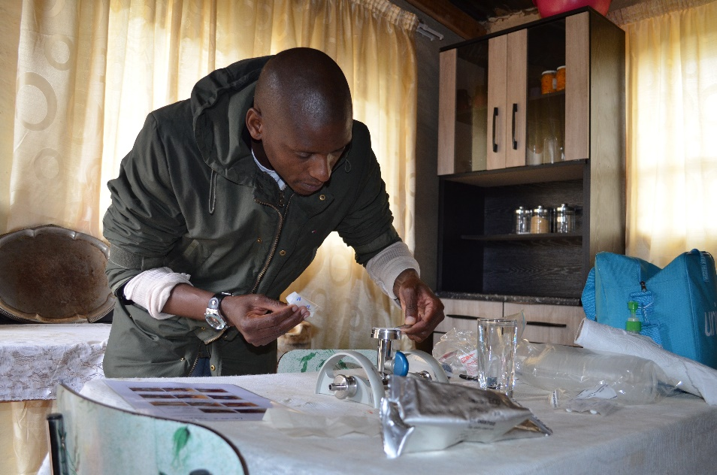
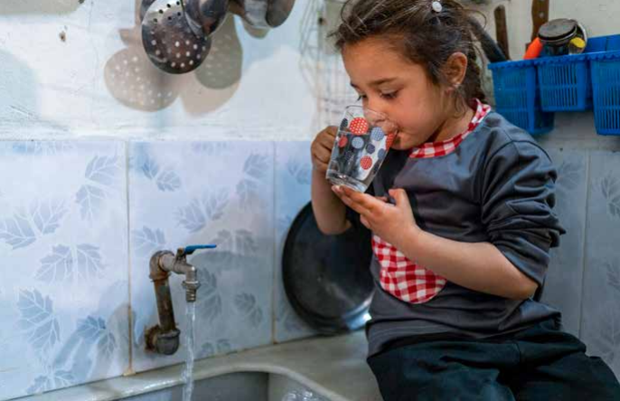
Progress and challenges in monitoring safely managed drinking water services
20 August 2023
World Water Week 2023
Time: 11:00 - 12:30 - Location: C2 - Session ID 11203
Rick Johnston (johnstonr@who.int) Tom Slaymaker (tslaymaker@unicef.org) Ayca Donmez (adonmez@unicef.org)
washdata.org
Notes:
Joint programme
Global monitoring and support to national monitoring
2021 report 4500 national data sources (50% census and surveys, 50% admin)
3283 national sources for drinking water (2/3 census and surveys)
2023 update will be released in July

Slide 2
Progress and challenges in monitoring safely managed drinking water services
Time: 11:00 - 12:30 - Location: C2 - Session ID 11203
Introduction (5 mins)
JMP estimates for safely managed drinking water services (30 mins)
  Definitions, data sources, estimates (15 mins)
  Interactive exercise based on JMP country file (15 mins) – download country files from JMP website
Integrating water quality testing into household surveys (30 mins)
  Methods, cost, lessons learned (15 mins)
  Interactive exercise based on JMP website (15 mins) – use data visualization tools available in JMP website
Progress on safely managed drinking water services (10 mins)
  JMP progress update on WASH in households 2000-2022: special focus on gender
  Limiting factors for safely managed drinking water
5. Discussion (15 mins)

Slide 3



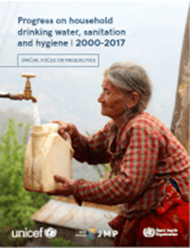
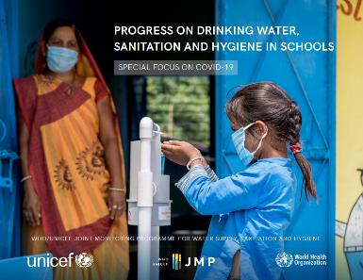

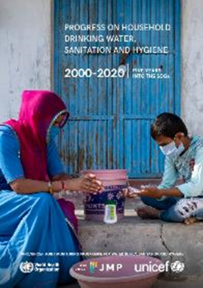


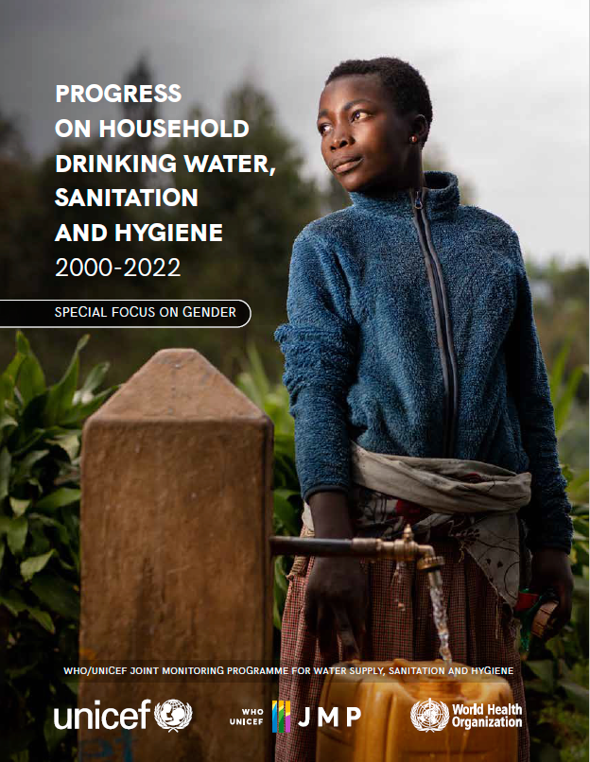
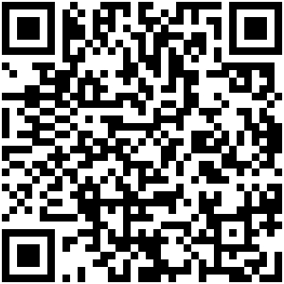
1. JMP estimates for safely managed drinking water services
JMP monitors drinking water services in different settings:
WASH in Households in odd years
WASH in Schools and Health Care Facilities in even years
2017
2018
2019
2019
2020
2020
2021
2022
2022
2023
washdata.org
Notes:
JMP measures progress in drinking water services for various settings: in this session the focus is on households
JMP reporting previously focused on households and has now been expanded to cover schools and health care facilities
WHO/UNICEF joint programme since 1990
We previously reported on MDGs and now responsible for global monitoring of SDG targets related to WASH
We now produce updates for each setting every 2 years. Households in odd years. Schools and Health Care Facilities in even years.
We published updates for schools and health care facilities in 2022 and will be launching our 2023 household update on 6th of July 2023
At the end of each year we circulate draft estimates to country offices for a 2 month period of country consultation with national authorities
WHO and UNICEF regional and country offices play a critical role in making sure that the latest available national data are included in JMP estimates
The JMP team also works closely with regional and country offices to help governments address data gaps and strengthen national systems for monitoring SDG WASH targets (key part of our mandate)

Slide 4
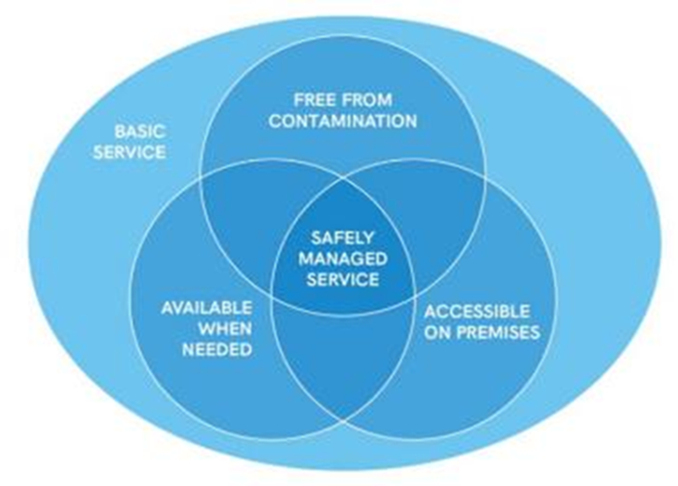
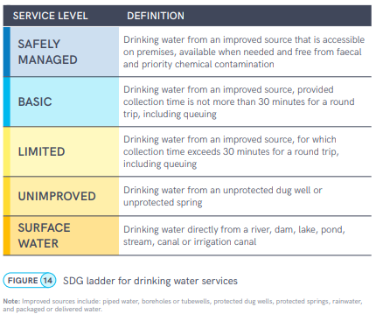
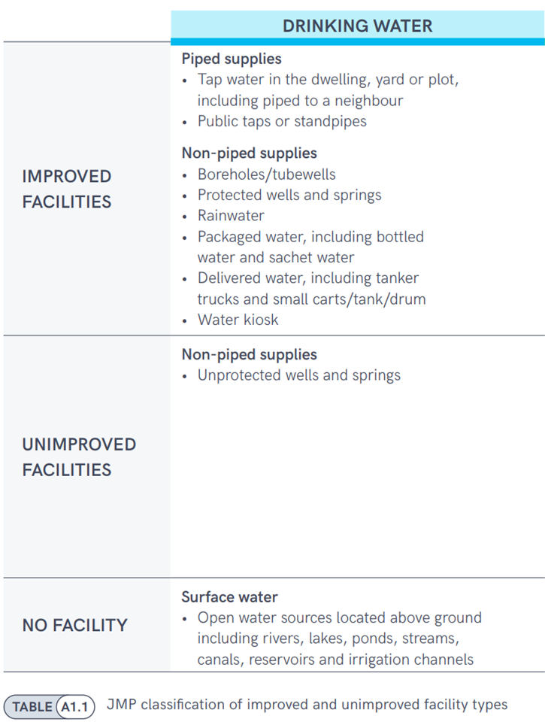
SDG 6.1.1 Proportion of population using safely managed drinking water services
Minimum of accessibility, availability and quality
in rural and urban areas - to produce national estimates.
For drinking water improved source which meet the human rights criteria of:
Accessibility – the location and time to collect drinking water, measured in most countries,
Availability – water is available when needed
Quality – direct measurement in household surveys or administrative sources
Notes:
The Joint Monitoring Programme (JMP) under UNICEF and WHO is responsible for monitoring WASH relevant SDG indicators, one of them being SDG 6.1.1 which is the proportion of population having access to safely managed DW.
For drinking water improved source which meet the human rights criteria of:
Accessibility
Availability
Quality
Accessibility is already measured in most countries, the location and time to collect drinking water
Availability can be captured with a question on whether water is available when needed
Quality – direct measurement in household surveys
To calculate safely managed drinking water services, the JMP takes the minimum value for accessibility, availability and quality in rural and urban areas and combines these to produce national estimates.

Slide 5
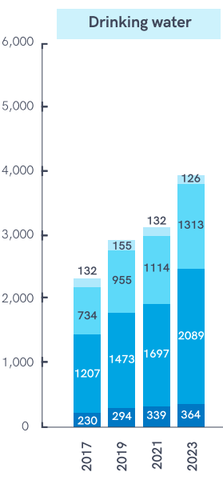
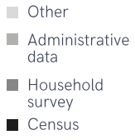
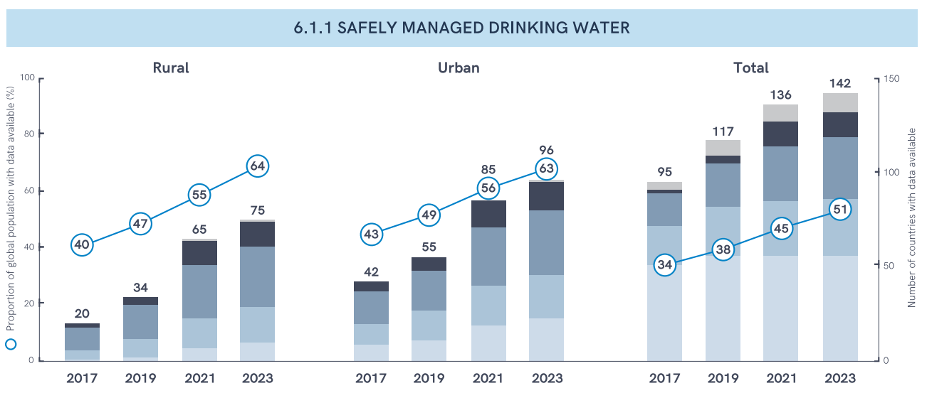
Data Sources
Information can come from multiple sources such as
censuses,
household surveys
administrative data
secondary datasets compiled by international or regional initiatives
studies conducted by research institutes
technical information received during country consultations.
→ Household surveys critical, especially to enable tracking inequalities
Global data availability for SDG WASH indicators has increased steadily since 2017
Notes:
censuses, household surveys and administrative data; secondary datasets compiled by international or regional initiatives (for example, European Protocol on Water and Health, Statistical Office of the European Union and the International Benchmarking Network); studies conducted by research institutes; and technical information received during country consultations.
Information can come from multiple sources and household surveys critical, especially to enable tracking inequalities
To calculate safely managed drinking water services, the JMP takes the minimum value for accessibility, availability and quality in rural and urban areas and combines these to produce national estimates.

Slide 6
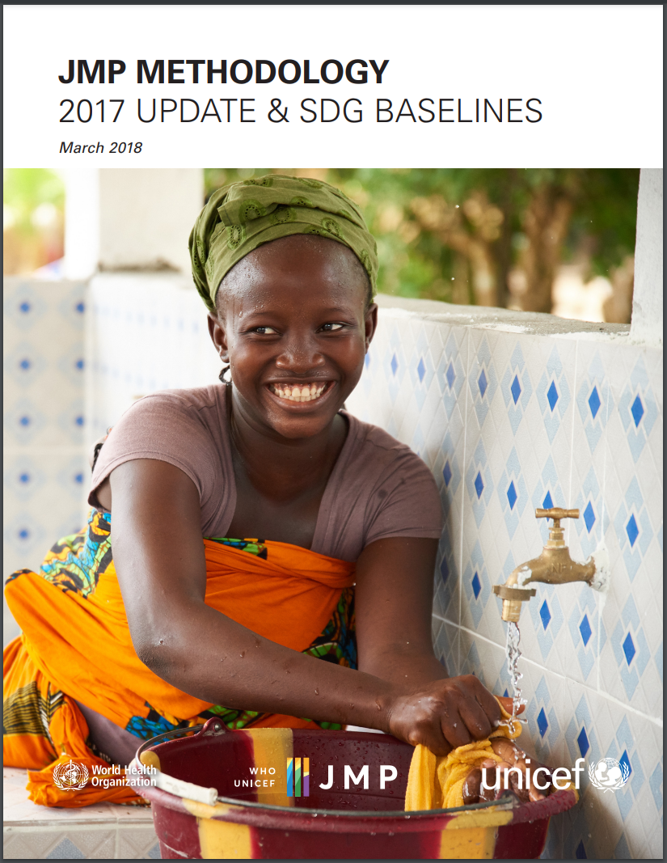
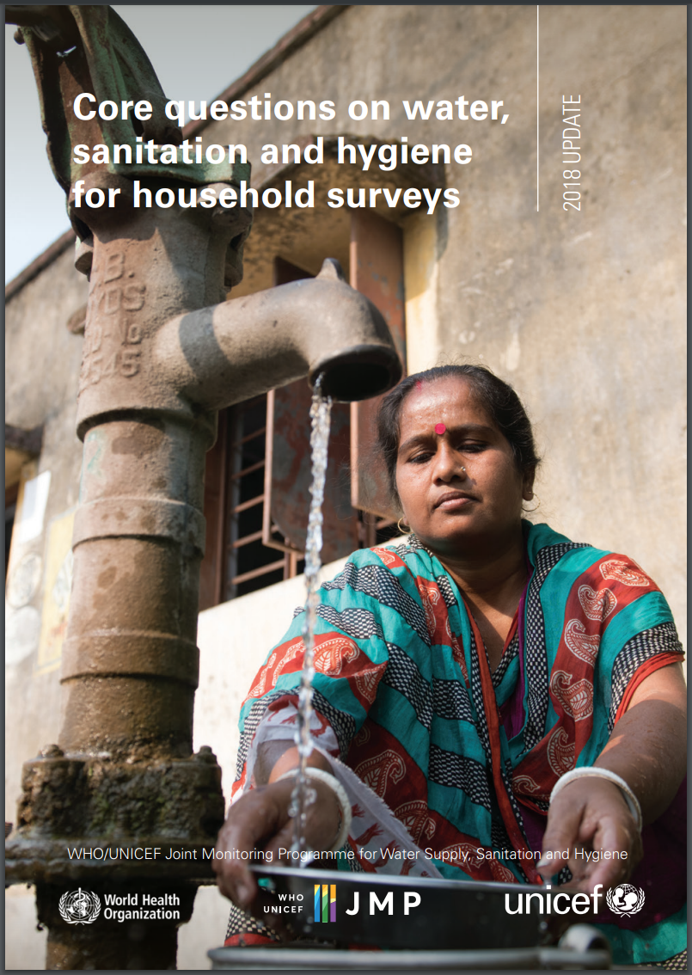
JMP Guidelines and Methods
https://washdata.org/reports/jmp-methodology-2017-update
https://washdata.org/reports/jmp-2018-core-questions-household-surveys
Available in AR, EN, ES, FR, RU

Slide 7
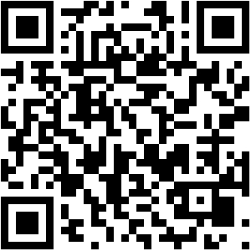
Questions in household surveys: Multiple Indicator Cluster Survey (MICS7)
MICS7 Tools – Survey Design: https://mics.unicef.org/tools#survey-design
MICS7 Base Questionnaires
Household Questionnaire + Water Quality Testing Form

Slide 8
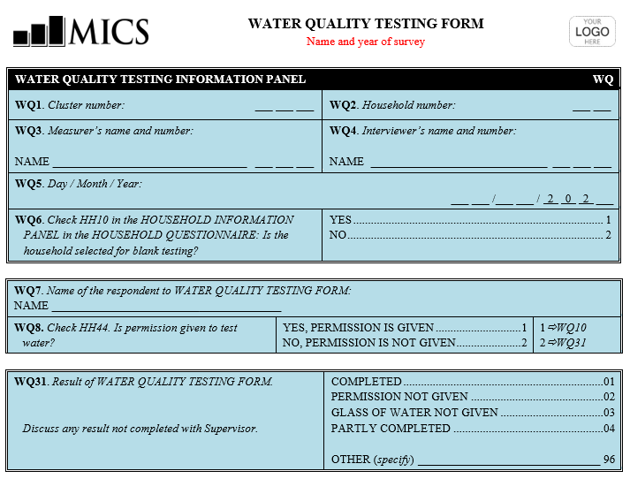
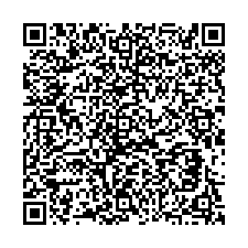
Questions in household surveys
MICS7 WQ Testing Form:

Slide 9
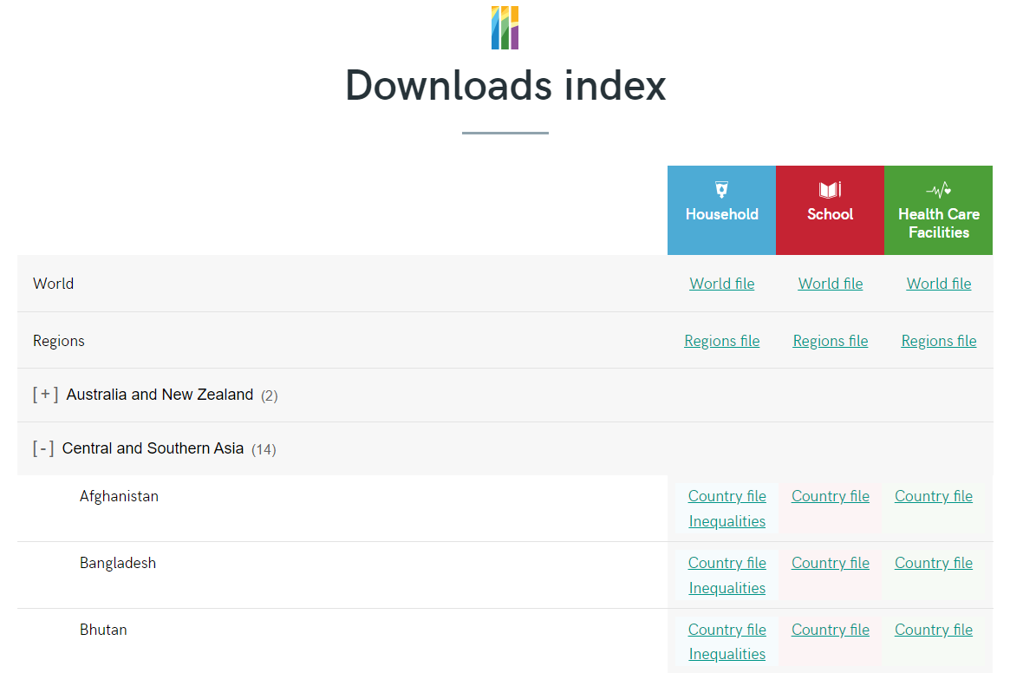
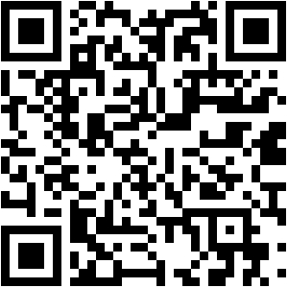
Interactive exercise on JMP country file
https://washdata.org/data/downloads#WLD

Slide 10
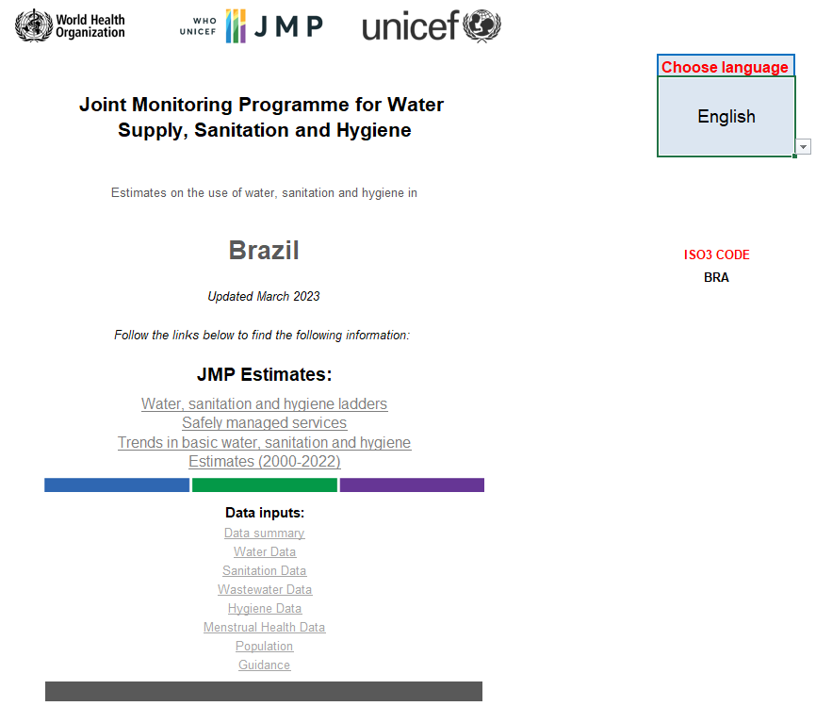
JMP country file: Brazil
Available in different languages
(Introduction tab with options)
Notes:
Language could be selected in introduction tab

Slide 11
Interactive exercise on JMP country file
Questions: In Brazil…
Q1. How many data sources are listed in the country file?
Q2. What is the most recent data source with water quality data?
Q3. What proportion of the population has access to safely managed drinking water services?
https://washdata.org/data/downloads#WLD

Slide 12
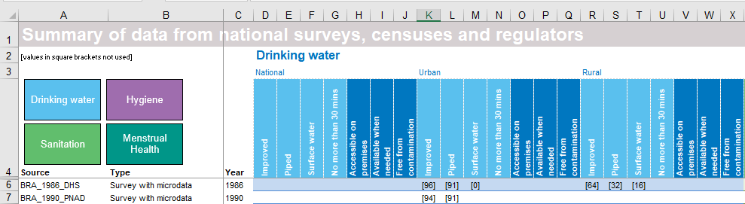
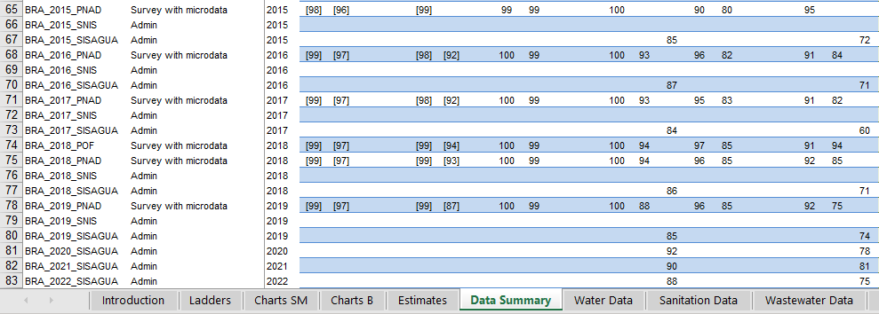
Q1 & Q2. JMP country file: Data Summary
Data Summary tab:
Contains a complete list of national data sources and shows how these have been used to produce internationally comparable estimates.
Q1. Brazil CF lists 78 data sources between 1986 and 2022.
Q2. The most recent data source with rural and urban WQ estimates is SISAGUA.
.
.
.

Slide 13
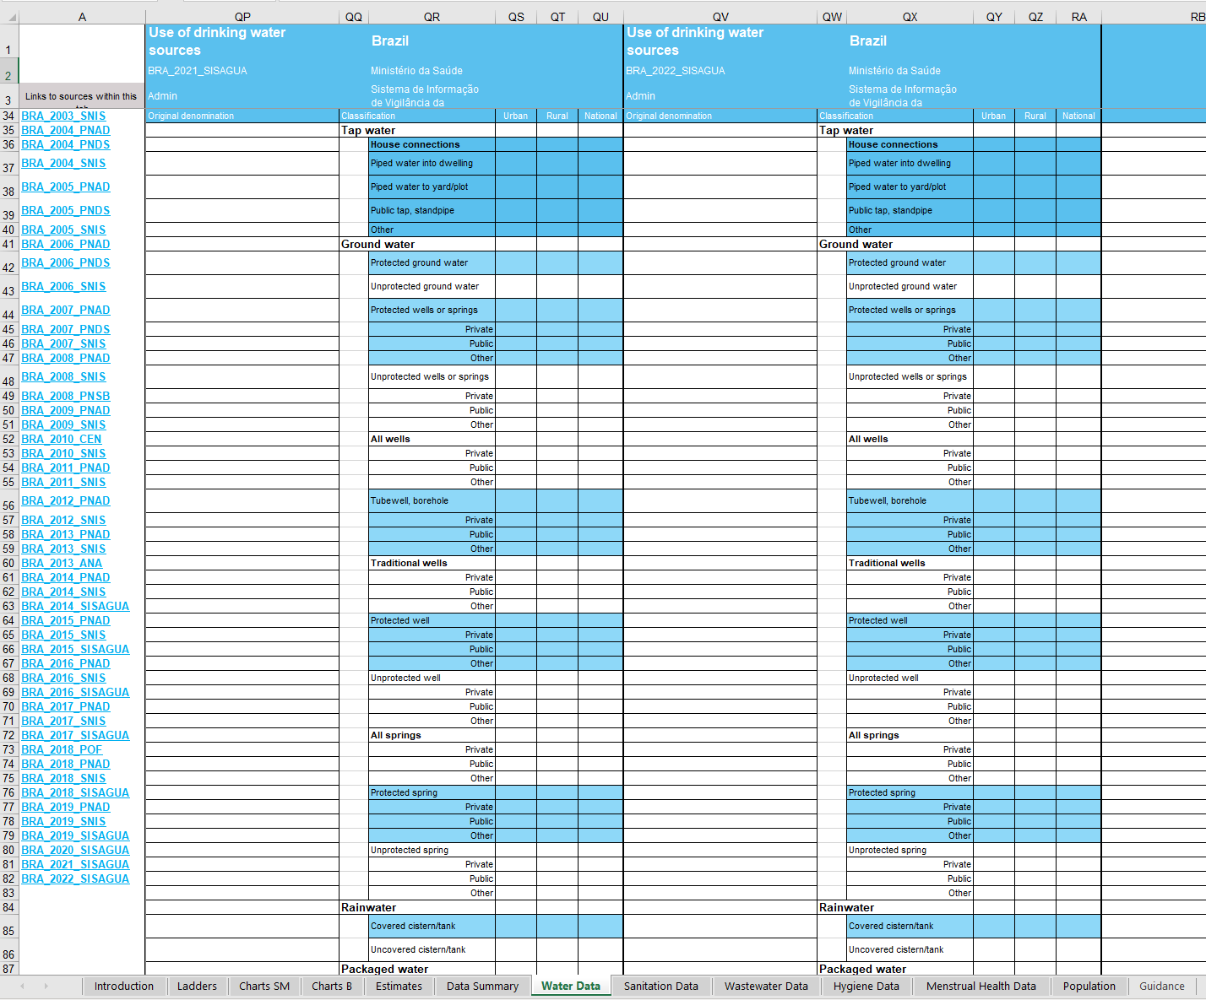
Q1 & Q2. JMP country file: Water Data
Water Data tab:
Contains a complete list of national data sources on file for that country
Column A lists all available data sources
Links to relevant columns with disaggregated data from that data source

Slide 14
Interactive exercise on JMP country file
Questions:
Q1. Number of data sources listed in the country file
Q2. The most recent data source with water quality data
Q3. Proportion of population who has access to safely managed drinking water services
→ Example: Brazil

Slide 15
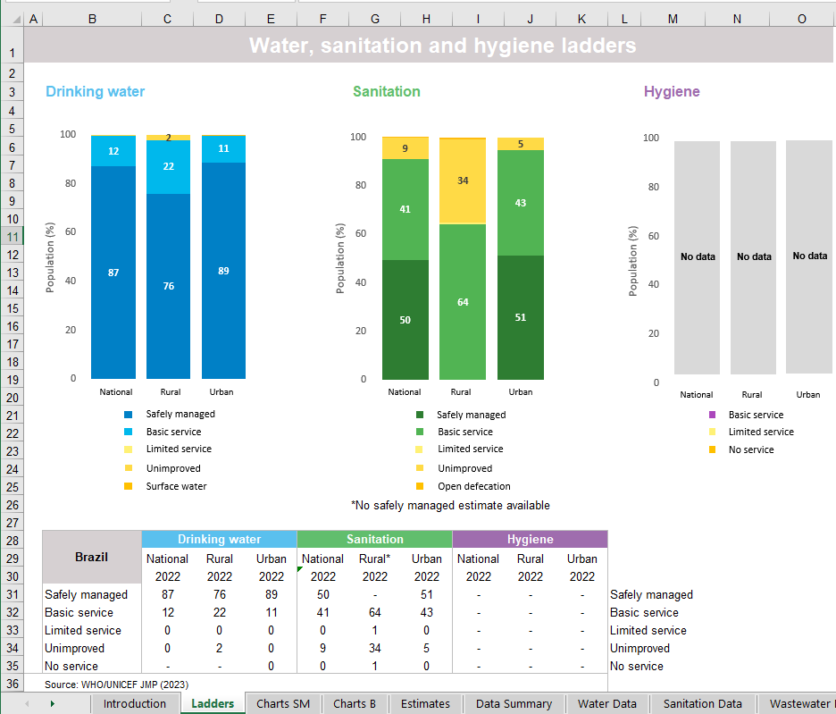
Q3. JMP country file: Ladders
Ladders tab:
A summary tab for JMP ladder estimates for all domains.
In Brazil, 87% of the population had access to safely managed drinking water services in 2022.
Notes:
Other useful tabs

Slide 16
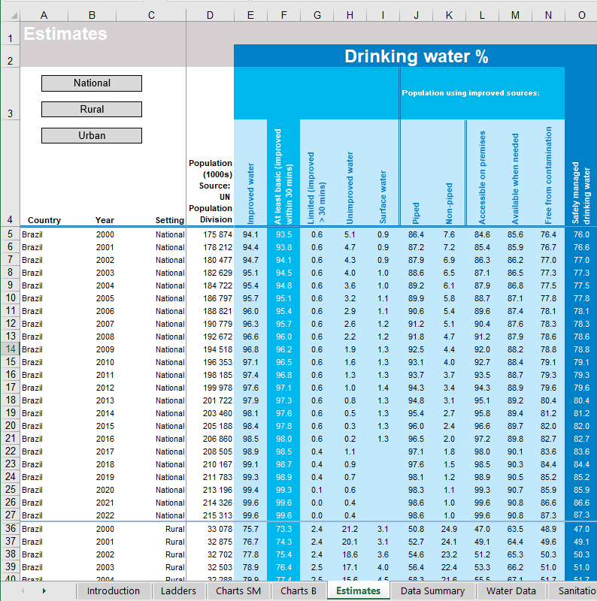
Q3. JMP country file: Estimates
Estimates tab:
JMP estimates for different JMP service ladders and their components for all domains, at total, rural and urban levels.
Notes:
Other useful tabs

Slide 17
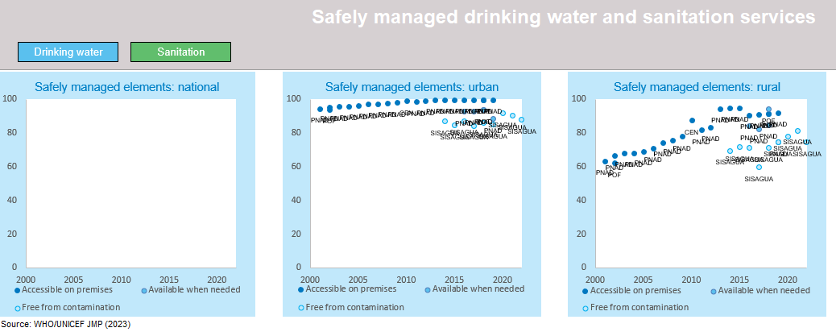
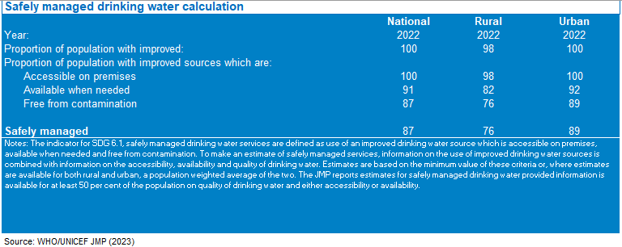
Q3. JMP country file: Charts SM
Notes:
Other useful tabs

Slide 18
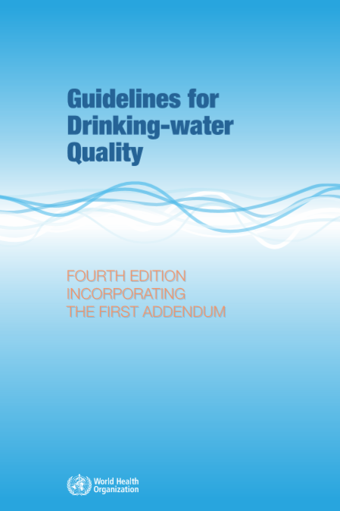
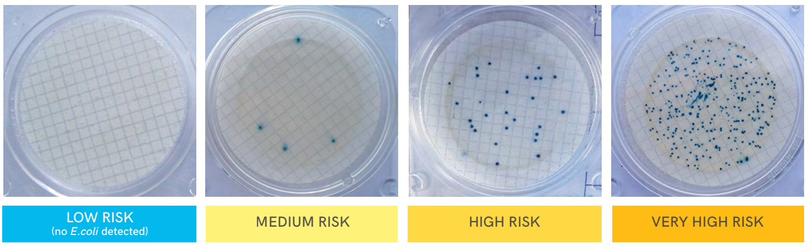
2. Integrating water quality testing into household surveys
What to measure? → “Free from contamination”
Faecal contamination: Top priority
  E. coli testing (priority for all countries)
  Source (PoC) and household (PoU)
  Risk levels – no of Colony Forming Unit (CFU) per 100ml:
  Low:- <1, Moderate: 1-10,
  High: 11- 100, Very High: >100
High priority chemicals
  Fluoride and Arsenic (where relevant)
  WHO guideline values:
  Arsenic: <10 μg/L (10 micrograms per litre)
  Fluoride: <1.5 mg/L (1,500 micrograms per
  litre)
<1
1-10
11-100
>100
Notes:
There are too many pathogens to measure directly! Instead we use an indicator of fecal contamination, the WHO’s preferred indicator E. coli
MICS module to directly test drinking water used by households for faecal contamination
* Free from contamination (Ecoli at source - subsample with different weights)
recode WQ27 (0 = 1 "No E.coli")(1/101 = 0 "E.coli detected")(991 992 = .), gen(wat_quality)
* Free from contamination (arsenic - subsample with different weights)
recode WQ19C (0/10 = 0 "<=10 ppb arsenic")(11/995 = 1 "> 10 ppb arsenic")(991 992 = .), gen(wat_quality_arsenic)
1 gram of faeces has almost 100 billion bacteria, over a billion E. coli. The test used in MICS can detect a single bacterium in 100 mL. Teams have to be careful to not contaminate the samples.
Other national priorities:
Arsenic and fluoride are important in some countries, where relevant samples can be collected for teams for testing in a laboratory. This is possible for chemicals but very hard for bacteria. We have supported arsenic testing in Bangladesh, fluoride in Ethiopia.
WHO guidelines:
No E. coli (or alternatively thermotolerant coliforms) detected in a 100 mL sample
Arsenic: a concentration of arsenic not exceeding the WHO provisional guideline value of 10 μg/L (10 micrograms per litre)
Fluoride: a concentration of fluoride not exceeding the WHO guideline value of 1.5 mg/L (1,500 micrograms per litre)
There are lots of contaminants but feacal contamination is the top priority and in line with WHO Guideline for DWQ, E.Coli is the principal measure of feacal contamination.
In addition to faecal contamination, there are also hundreds of chemicals that have guideline values. JMP considers Arsenic and Fluoride which affect very large populations and have severe health impact
In addition to faecal contamination, high-priority chemical parameters at a global level are arsenic and fluoride, because these can occur naturally, affect large populations, and have serious health impacts. Arsenic and fluoride contamination of groundwater is widespread and there are several regions where the levels of contamination in drinking water exceed the WHO guideline values8 . High levels of contamination often occur in sub-national regions of specific countries and testing can be informed by groundwater risk maps9 .
Bangladesh with Arsenic – others could also be added but by not overburdening the field team and the survey itself. Samples could be collected ot be tested later though.

Slide 19
“Faecal and priority chemical contamination”
Data on faecal (E. coli or thermotolerant coliforms) from 172 countries/territories
  Data coming primarily from administrative sources and household surveys
  Point of collection/delivery, not point of use/consumption
Less data on arsenic (77 countries), fluoride (73 countries)
Minimum approach: few countries can integrate datasets at household level
  Take the minimum value, at the level of urban, rural, or total population
  64 countries with all three parameters: E. coli limiting factor in 75% (n=48)
  Arsenic (n=7): Andorra, Austria, Croatia, Greece, Hungary, Portugal, Slovakia
  Fluoride (n=9): Cyprus, Estonia, Finland, Italy, Lithuania, Malta, Moldova, Norway, UK
Other parameters
Notes:
So missing out on some arsenic and fluoride contamination. Example of Bangladesh – worst arsenic contamination in the world but higher levels of faecal contamination.
Arsenic is the limiting factor in 7 countries, most have very high compliance with E. coli
Andorra 99.76 90.64 100
Austria 98.6 92.9 100
Greece 98.03773 97.93 100
Croatia 70.5 66.31 100
Hungary 89.8 54.1 97.1
Portugal 97.2 97.17 98.86
Slovakia 97.38 96.8 99.86
Fluoride is the limiting factor in 9 countries, again where microbiological compliance is very high:
Cyprus 96.3 100 94
Estonia 98.5 100 77.03
Finland 99.8 99.9499 88.6
United Kingdom of Great Britain and Northern Ireland 99.83904 99.93136 99.67848
Italy 93.9 92.62 91.25
Lithuania 99 100 76
Republic of Moldova 84.9 100 83.5
Malta 100 100 98.23009
Norway 98.3 99.8 96.6
Other parameters are also important at the national and local levels, but don’t occur at the same scale as arsenic and fluoride, or have the same egregious health impacts, so they aren’t aggregated for global monitoring.

Slide 20
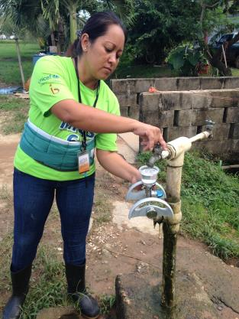
Water quality testing module for household surveys
Test water from point of collection and the point of use
→ Quantification of E. coli in 100 mL samples (risk levels)
Test takes ~5-10 mins followed by 24 hour incubation
Sub-sample: 3-5 households per cluster, n~800-5000
Test by existing team member (often the “measurer” - anthropometry)
Quality Assurance/Control: expert training, blank tests, field supervision
Notes:
Testing drinking water from a glass provided by households/within home (point of use) and also from the source(point of collection) – we ask HH to take us to the source of water where the glass of water comes from
These can be very different (contamination, treatment e.g. boiling)
Usually there are 500 clusters nationally selected by stratification and random sampling. There are 20-25 HHs selected in a cluster and there are 100-150 clusters. We reduce the number of HH as there are a lot of additional work for the teams (approx. 20 field teams with 1 supervisor and 3-5 interviewers and a measurer, working for 3-5 months), 25 HHs are selected to estimate indivual level information, within a cluster the WQ could be reasonably closer.
Typically, the sample size will be 3-5 households per cluster. This is cost-effective and means it is not too much of a burden on the team. This is based on a combination of logistics and marginal gains in precision (+ simulation study by sampling expert).
Test by the existing member of the team, not recruiting for a new person – mostly the interviewer responsible for anthropometry test, who is measuring children weights/height
We want to be able to tell “how much” contamination there is and can use risk classes based on the number of E. coli – per 100 ml.
We use modified membrane filtration method
Quality Assurance/Quality Control: We work with national laboratories or line ministries to support the training of field teams.
JMP maintains a pool of consultants to support that
We focus very strongly on blank tests – in every cluster
Obviously field supervision is part of the survey management

Slide 21
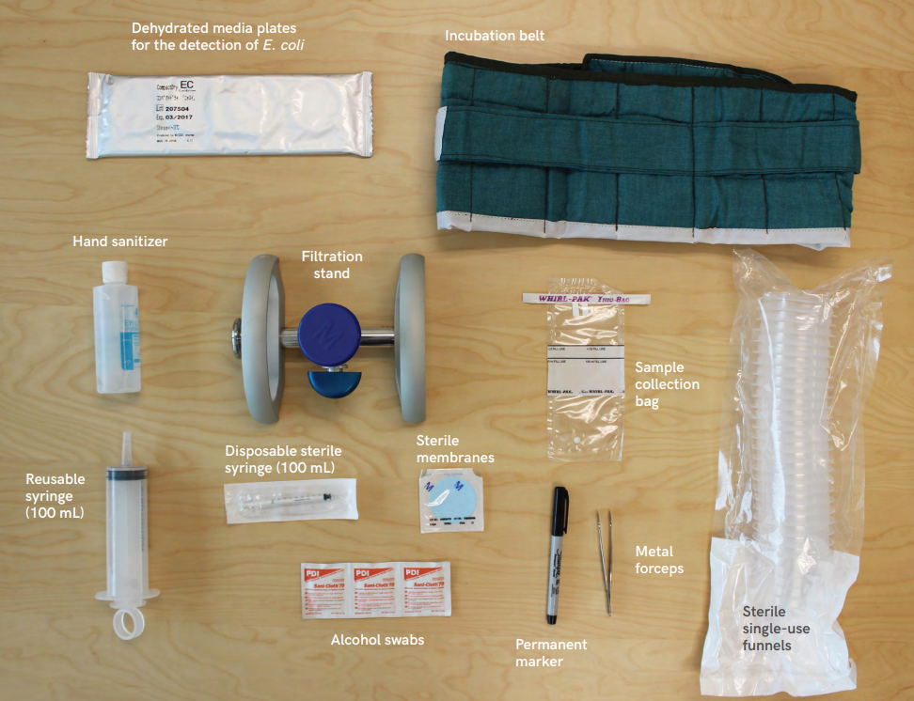
Portable testing equipment
Adapted membrane filtration approach used in most surveys
UNICEF Supply Division supports countries with procurement
Body belt incubation or optional electric incubator
Notes:
Including the Millipore filtration stand, the cost is about 1500 dollars per team for the equipment (to be lowered to ~$100)
Consumables are $2.5 per test (usually 3 hh per cluster)
The JMP can support purchase of equipment for water testing in MICS surveys
Together with UNICEF Supply Division, JMP & MICS are exploring innovative ways to lower the costs in future
We are trying to allow people who donot have experience with the WQ testing to do it reliably in the field.
Incubation belt to allow body temperature to incubate compact dry plates for 24 hrs – there is also electric incubators but depending on the country it could be more complex than the use of body temperature incubators.

Slide 22
Water Quality Testing
Timeline and Costs
Integration in household surveys is highly cost-effective
Additional USD 50-75,000 per survey
JMP has a budget to support surveys until 2030
Most items are available from UNICEF Supply Division:
Allow 2-3 months for delivery
Local procurement needed including for
Hand sanitizer
Marker pen
Technical support and Resources
Manual for water quality testing
Water quality testing form
Training materials
International consultants
Tabulation plan/syntax
Further analysis
https://mics.unicef.org/tools?round=mics6
New materials for MICS7 will be available:
https://mics.unicef.org/tools#data-collection
22
Notes:
Integration of water testing in household surveys is a very cost-effective way of collecting nationally representative information on water quality. It is much more expensive to run a dedicated survey with dedicated teams.
The costs are around $50-$75k per survey but expected to reduce over time as new innovations lower the cost of supplies
The WHO/UNICEF JMP has budget to support integration of water testing in household surveys through end of 2030, first come first served basis. Let us know if you are considering inclusion in an upcoming survey.
Including the Millipore filtration stand, the cost is about 1500 dollars per team for the equipment (to be lowered to ~$100)
Consumables are $2.5 per test (usually 3 hh per cluster)
The JMP can support purchase of equipment for water testing in MICS surveys
Together with UNICEF Supply Division, JMP & MICS are exploring innovative ways to lower the costs in future

Slide 23
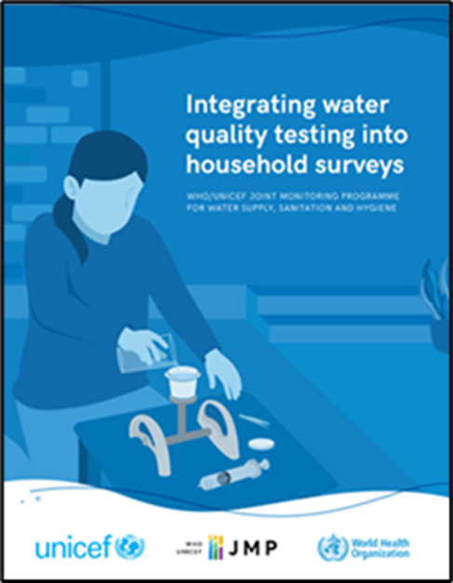
>50 countries supported to date
2023
2012-2015
2012-13
Ghana LSS
Congo MICS
Nepal MICS
2018
Ethiopia ESS
2020
(Pakistan MICS)
(Afghanistan ALCS)
(Belize MICS6 Pilot)
Ecuador ENEDMU
(Mongolia MICS)
Nigeria MICS
Paraguay MICS
Côte d’Ivoire MICS
Philippines APIS
Senegal EEAH
Sierra Leone MICS
Suriname MICS
Lao PDR SIS
Georgia MICS
Tunisia MICS
Iraq MICS
Kiribati MICS
Mongolia MICS
DRC MICS
Lesotho MICS
Madagascar MICS
Ghana MICS
Côte d’Ivoire DHS
2021
2022
Benin MICS
2019
Algeria MICS
Bangladesh MICS
CAR MICS
Chad MICS
Gambia MICS
Dominican Republic MICS
Guinea-Bissau MICS
Honduras MICS
Lebanon National
Indonesia SKAM-RT
Sao Tome and Principe MICS
Samoa MICS
State of Palestine MICS
Malawi MICS
Bangladesh MICS
2014-15
2016-17
Ecuador ENEMDU
Trinidad and Tobago MICS
Togo MICS
Tonga MICS
Turks and Caicos MICS
Tuvalu MICS
Viet Nam MICS
Eswatini MICS
Fiji MICS
Sri Lanka HIES
Zimbabwe MICS
Kosovo MICS
Mozambique DHS
Nigeria NORM
Tanzania NPS
DPRK MICS
Nepal MICS
Nigeria NORM
Guyana MICS
Afghanistan MICS
Argentina MICS
Azerbaijan MICS
Belize MICS
Burkina Faso NS Ethiopia DHS
FSM Micronesia MICS
Guatemala DHS
Laos SIS
Lebanon MICS
Nauru MICS
Nicaragua MICS
Somalia MICS
Sudan MICS
Tunisia MICS
Turkmenistan MICS
Uganda DHS
Vanuatu MICS
* Italic: Surveys not published as of August 2023
(.) : Not nationally representative
https://washdata.org/reports/integrating-water-quality-testing-household-surveys
23
Notes:
Slum surveys in Indonesia, Philippines?
() is for pilot or not national?
Undeline is for?
2023: Burkina Faso National Survey
2023 FSM?
From earlier presentation: MICS LAC ??
2016-17:
Afghanistan ALCS
2022-23:
Laos PDR MICS
Somalia Somaliland MICS
Mozambique DHS
202-2021:
Dominican Republic MICS
Sao Tome and Principe MICS – not in 2019?

Slide 24
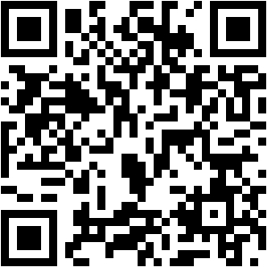
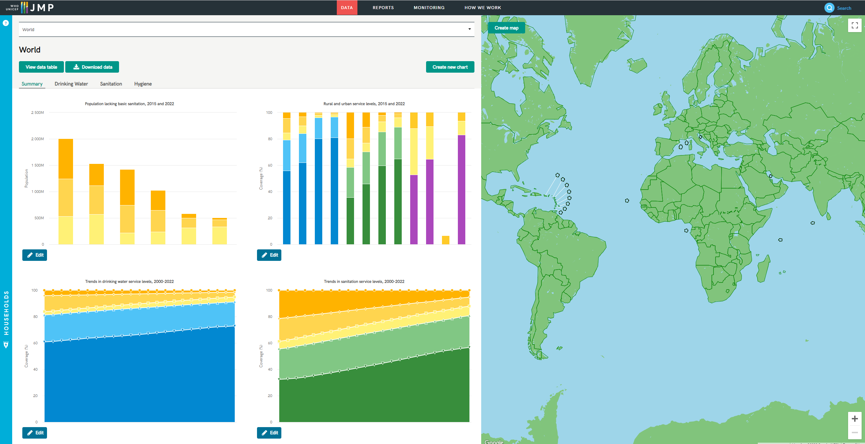
Interactive exercise on JMP website
https://washdata.org/data/household#!/

Slide 25
Interactive exercise on JMP website
Questions:
What rank does Brazil hold among LAC countries for accessibility of drinking water on premises?
  Rank chart in a region by proportion of people with drinking water accessibility, availability and quality in 2022
Has water quality in Brazil improved more rapidly in urban or in rural areas?
  Bar chart: water quality between years 2015 and 2022

Slide 26
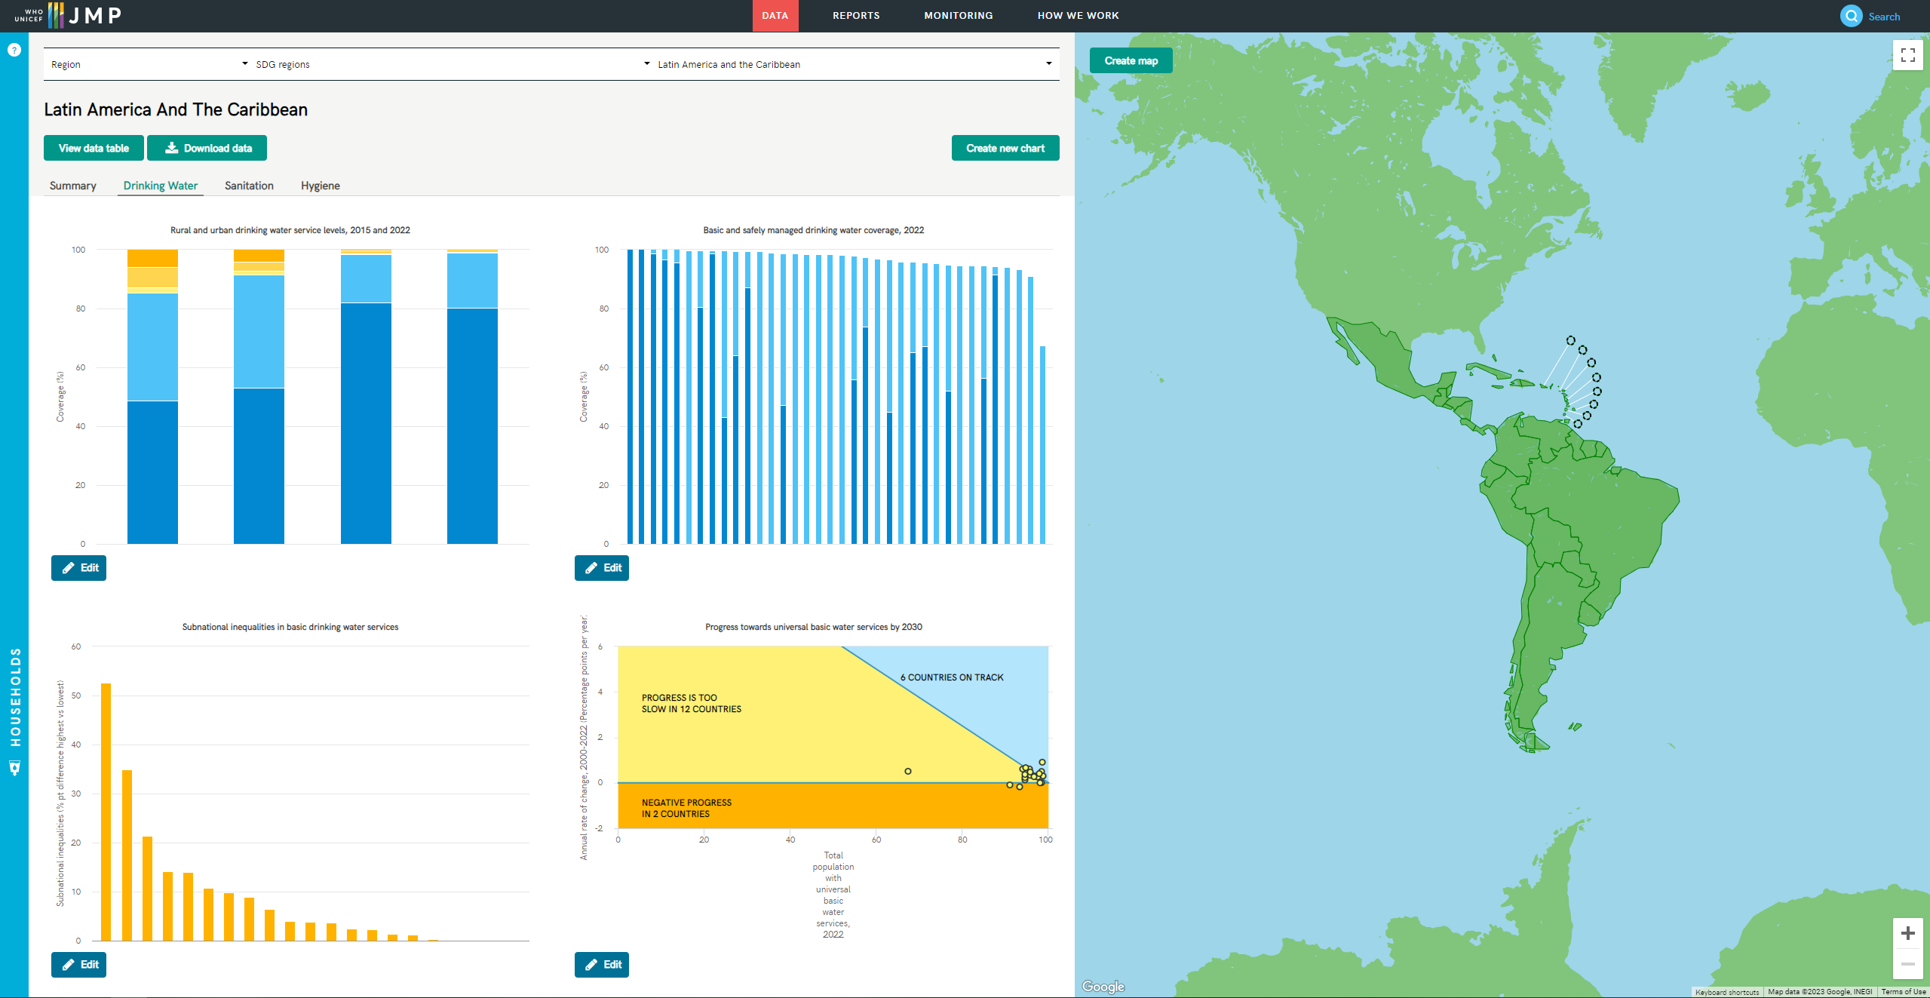
JMP website: Standard figures for drinking water
Notes:
To generate figures: By editing existing figures with a relevant template (rank or ladder) or create new

Slide 27
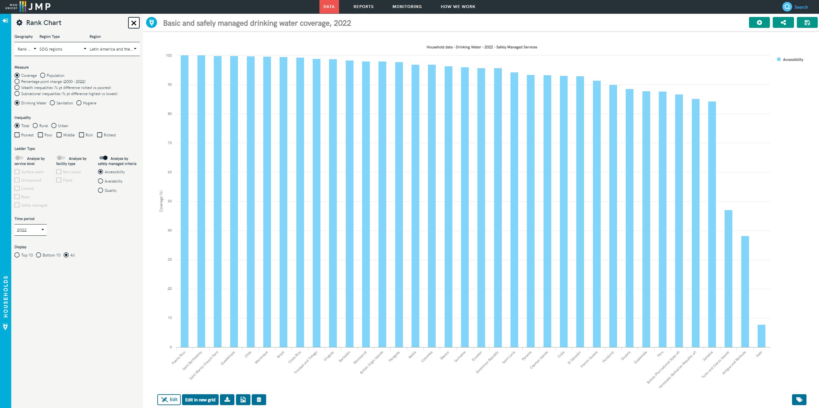
JMP website: Rank countries based on accessibility, availability and quality
Notes:
It is a rank chart
Top 10 or bottom 10

Slide 28
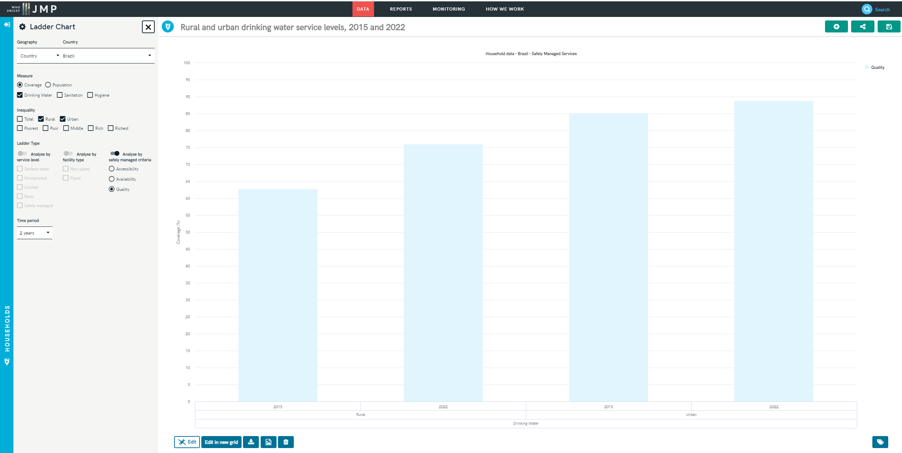
JMP website: Rank countries based on accessibility, availability and quality
Notes:
By creating a new chart and selecting Ladder Chart or revising the existing ladder chart

Slide 29
3. Progress on safely managed drinking water services
2017
2019
WASH in Households (in odd years)
2021
Most recent update in 2023 (6th of July):
  JMP progress update on WASH in households 2000-2022: special focus on gender
2023

Slide 30
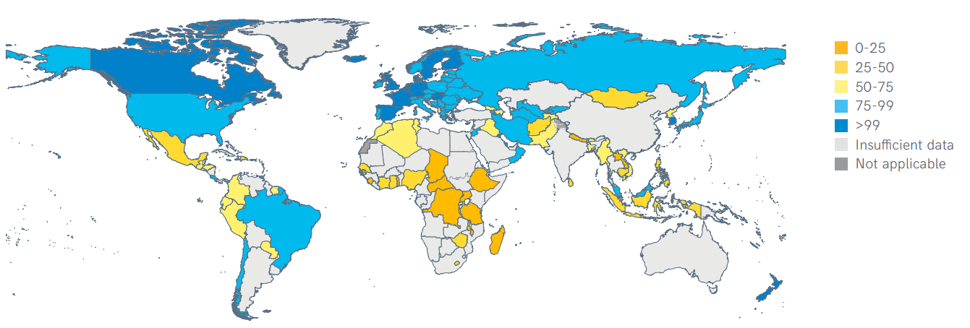
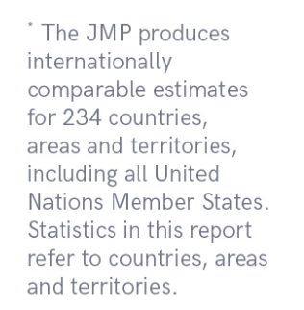
142 countries had estimates for safely managed services in 2022
Proportion of population using safely managed drinking water services, 2022 (%)
Notes:
142 countries, areas and territories representing 51% of global population - six out of eight SDG regions
Missing national estimates for large countries including India (only rural), China (only urban), Indonesia
Many LMICS still lack nationally representative data on drinking water service levels

Slide 31
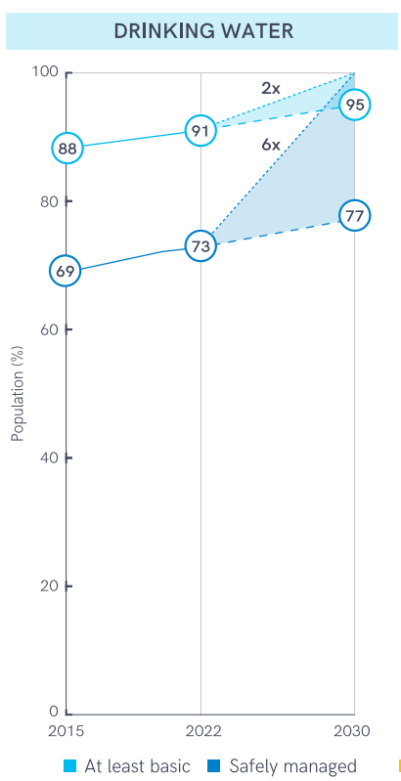
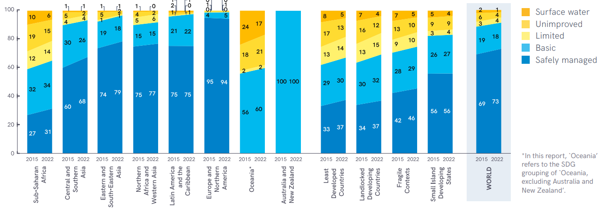
The world is off track to meet the SDG target
Global and regional drinking water coverage, 2015–2022 (%)
Global coverage of WASH services, 2015–2022 (%), and acceleration required to reach universal coverage (>99%) by 2030
Notes:
Estimates for 6 out of 8 SDG regions (30%)
Insufficient national data to generate regional estimates for Oceania and ANZ
No SDG region is on track to achieve universal access by 2030
On this basis estimated that 1 in 4 still lacked SMDW in 2022 (as in 2020)
Extrapolated current rates of progress and showed acceleration required to achieve universal access by 2030
overall rate of progress will need to increase sixfold to meet the SDG global target.
‘world is off track’ and ‘6x acceleration required’

Slide 32
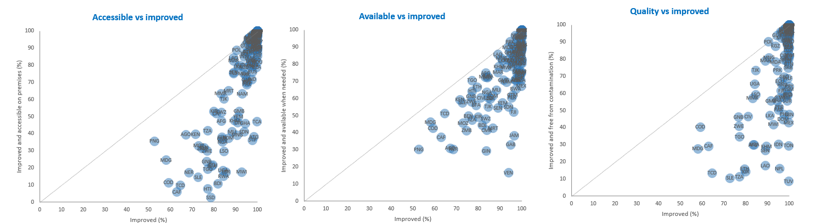
Improved is not always accessible, available, or free from contamination
Regional snapshots: https://washdata.org/how-we-work/country-and-regional-engagement
Notes:
To calculate safely managed drinking water services, the JMP takes the minimum value for accessibility, availability and quality in rural and urban areas and combines these to produce national estimates.
2023 report highlighted the challenge of meeting these new criteria and that the limiting factor varies between and within countries

Slide 33
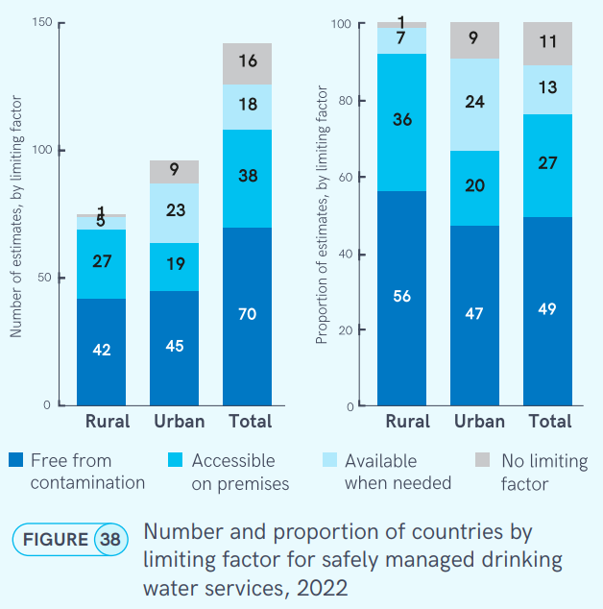
Water quality is the most common limiting factor for safely managed drinking water services
The lowest (min) of availability, accessibility, quality is therefore the ‘limiting factor’.
142 estimates at national level, only 75 in rural areas and 96 in urban areas.
Water quality is limiting factor in about half of cases (49%).
Accessibility on premises is second most common (27% and is particularly an issue in rural areas (36%).
Availability when needed is less common (13%), but especially in urban areas is an issue in certain countries (24%).
Notes:
Analysis based on 2023 update
Chart shows number of estimates (left) and proportion of estimates (right) by limiting factor
142 estimates at national level, only 75 in rural areas and 96 in urban areas.
Can’t always combine the three elements at the household level, because they may come from different data sources – so we take the minimum of the three for rural, urban and national. The lowest of the three is therefore the ‘limiting factor’.
Quality is limiting factor in about half of cases (49%).
Accessibility on premises is second most common (27%), and is particularly an issue in rural areas (36%).
Availability when needed is less common (13%), but especially in urban areas is an issue in certain countries (24%).

Slide 34
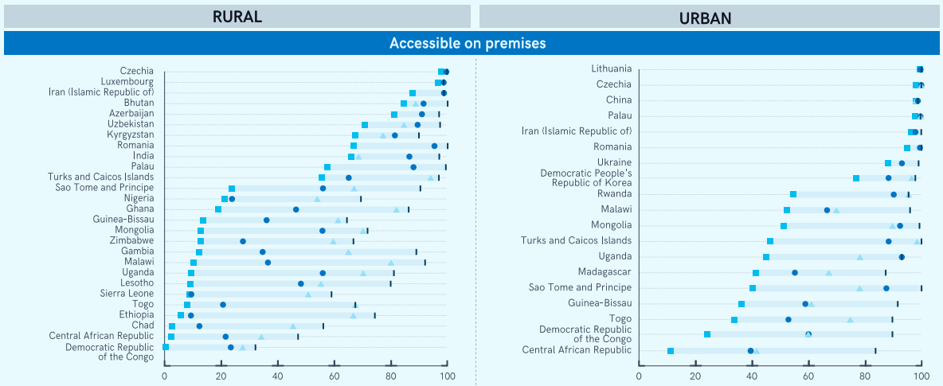
Accessible on premises
Notes:
More detailed analysis of limiting factors by country
Chart shows countries where limiting factor is accessible on premises (squares)
27 rural, 19 urban
Lots of challenges in sub-Saharan Africa, especially in rural areas.
Uganda: On premises far and away the limiting factor in both urban and rural settings. Second limiting factor in Uganda is quality (circle) in rural – availability when needed is relatively high, and close to the improved value.

Slide 35
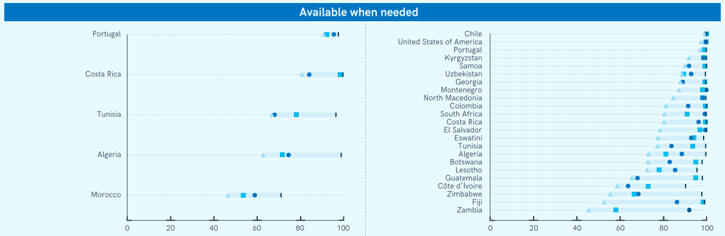
Available when needed
Notes:
Countries where available when needed is limiting factor (triangles)
5 rural, 23 urban
Not as common a limiting factor, but also some countries don’t have data on this one, and still get an SMDW number.
There can be really big gaps between improved and available when needed in some countries, for instance in rural Algeria.
But there are a lot more countries with issues here in urban settings, especially in LAC and middle-income countries. These tend to be countries with high prevalence of piped water, but where supplies are still intermittent. And the quality, and accessibility on premises, can be very different.
In many countries, like El Salvador, almost all water supplies are accessible on premises and free from contamination, so availability when needed is really driving the safely managed number.
On the other hand in Guatemala, and also Cote d’Ivoire, problems with water quality are almost as common as problems with availability.

Slide 36
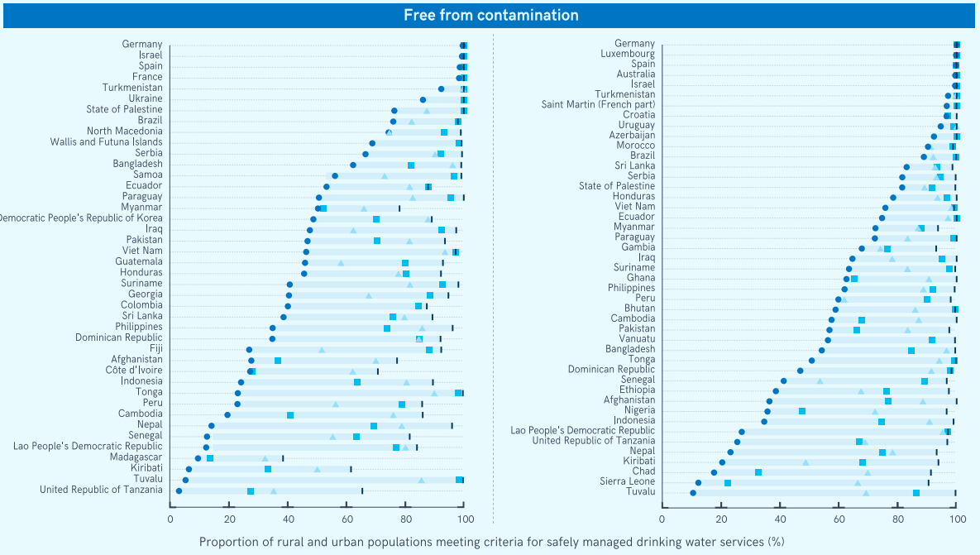
Notes:
Lastly free from contamination (circles)
42 rural, 45 urban
Most common limiting factor, in both urban and rural settings.
Lao PDR: Far and away, quality is limiting factor in both urban and rural areas.
Note also that improved is very high in many settings (mainly urban but also rural), but SMDW can be quite low, highlighting the difference between the MDG and SDG indicators.

Slide 37
Conclusions
Strengthening national systems for monitoring SDG targets
Data availability improving but large gaps remain
  Household survey data infrequent (3-5 years)
  Administrative/regulatory data coverage incomplete (esp rural, non-piped)
Data quality varies widely between and within countries
  Standardized definitions, representative samples, disaggregation of variables
Moving beyond project/programme monitoring to national monitoring
Accelerating progress towards SDG targets
Quality is important, but it’s not everything
On premises is a big challenge especially in rural areas and in sub-Saharan Africa
Availability is a challenge in middle-income countries, especially in urban areas

Slide 38
Thank you!
Notes:
Thank you!

Slide 39
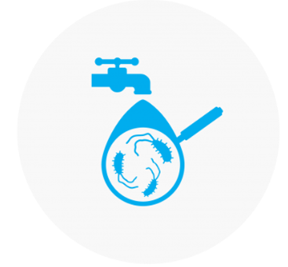
Key challenges
Advantages
Sampling: Household surveys have representative samples; building on those samples is easier.
Staff: No need for highly trained staff, using existing field staff for the household survey
Cost: Could be expensive to run independently but easier and much less costly to piggyback on a national household survey (logistics, salaries for the same team)
Quality: Built in measures (blank tests, supervision, lab technicians, reliable and standard testing materials – UNICEF Supply Division)
Data collection: E. Coli only plates are easier to read
Analysis: Household survey with wide range of variables at various disaggregation levels, e.g. socio-economic – inequalities wealth quintiles, subnational….
Risk factors for contamination: What happens between PoC and PoU (water treatment, storage)
Time to result (24 hours), difficult to feedback to households
Training requirement: 3-4 days, especially difficult for Training of Trainers
Cost: US$1500 for the equipment, US$2.5 per test
Incubation: electricity or wearing belts – difficult at night, could be perceived as security risk
Disposal: volume of consumables and disinfection of used plates
Planning : Procurement of water quality testing equipment needs to be planned well in advance (at least 3 months before the survey).
Frequency: Interval of household surveys is 3 to 5 years
Additional parameters that could and should be monitored to achieve a more comprehensive assessment of water quality. E. coli is insufficient
Source of contamination cannot be assessed.
Local contamination: Limited information.
→ UNICEF Supply Division Innovation Challenge on Rapid E. coli Detection
Notes:
HH surveys fill the data gap for WQ estimates but cannot replace or are not superior to routine surveillance and regulation of DWQ systems → better to have routine surveillance but in short term could be a good source to provide a dashboard and trigger discussions about routine systems, how WQ problems can be addressed.
WASH sector (ministries, national stakeholder representation) engagement is key to maximize ownership and use of data collected, through the very beginning of the process – national survey teams can play a role in planning to involve national stakeholders
Rapid water quality detection method or portable kit: UNICEF is seeking a solution for innovative and easy to use detection methods that can accurately determine faecal contamination as rapidly as possible.
Working with industry UNICEF has identified alternative products that can return a result within 10 hrs but faster tests are needed.
Integration of water testing in household surveys is a very cost-effective way of collecting nationally representative information on water quality. It is much more expensive to run a dedicated survey with dedicated teams.
The costs are around $60-$90k per survey but expected to reduce over time as new innovations lower the cost of supplies.
Nearly all test based on cultures
Difficult to persuade people to wear belts at night or in some countries wearing a belt could be perceived as security risk.
Share of data should be discussed early at the planning stage. It could be complicated for the measurer to explain the results. Besides, the sample is created for extracting information at aggregate levels, national. It is not really targeting to provide hh level results – frequency may be higher for that purpose for instance to catch false results better.

