Slide 1
Monitoring WASH services with a gender focus Session 11200, Room C1, Sunday Aug 20, 14:00-15:30
Start time | Description
14:00 | Introduction
14:05 | Highlights from JMP progress update on WASH in households 2000-2022: special focus on gender
14:30 | Q&A, discussion
14:45 | Consultation on proposed list of priority indicators (Zoom)
14:55 | Panel discussion
15:25 | Closing remarks

Slide 2
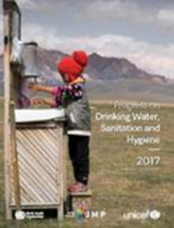
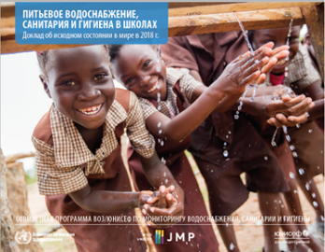
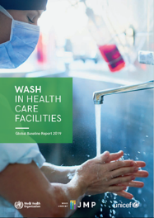
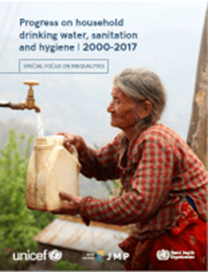
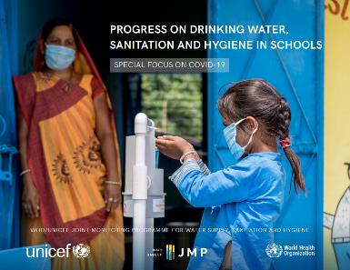
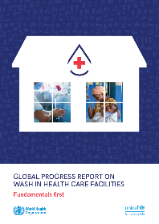
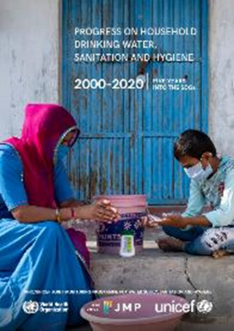
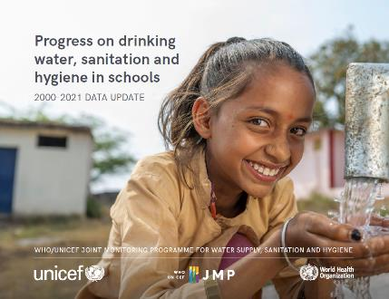
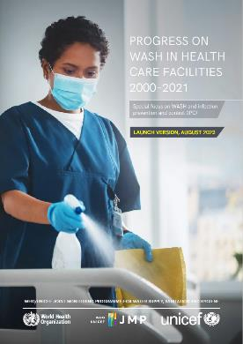
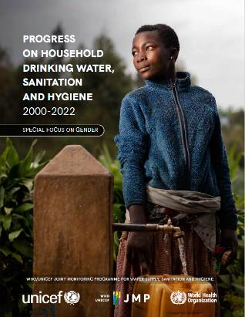
WHO/UNICEF JMP global monitoring of drinking water, sanitation and hygiene
WASH in Households in odd years
WASH in Schools and Health Care Facilities in even years
2017
2018
2019
2019
2020
2020
2021
2022
2022
2023
Stockholm World Water Week
Rick Johnston (johnstonr@who.int)
Tom Slaymaker (tslaymaker@unicef.org)
Ayca Donmez (adonmez@unicef.org)
washdata.org
Notes:
WHO/UNICEF joint programme since 1990
We previously reported on MDGs and now responsible for global monitoring of SDG targets related to WASH
JMP reporting previously focused on households and has now been expanded to cover schools and health care facilities
We now produce upda
tes for each setting every 2 years. Households in odd years. Schools and Health Care Facilities in even years.
We published updates for schools and health care facilities in 2022 and will be launching our 2023 household update on Thursday
At the end of each year we circulate draft estimates to country offices for a 2 month period of country consultation with national authorities
WHO and UNICEF regional and country offices play a critical role in making sure that the latest available national data are included in JMP estimates
The JMP team also works closely with regional and country offices to help governments address data gaps and strengthen national systems for monitoring SDG WASH targets (key part of our mandate)

Slide 3
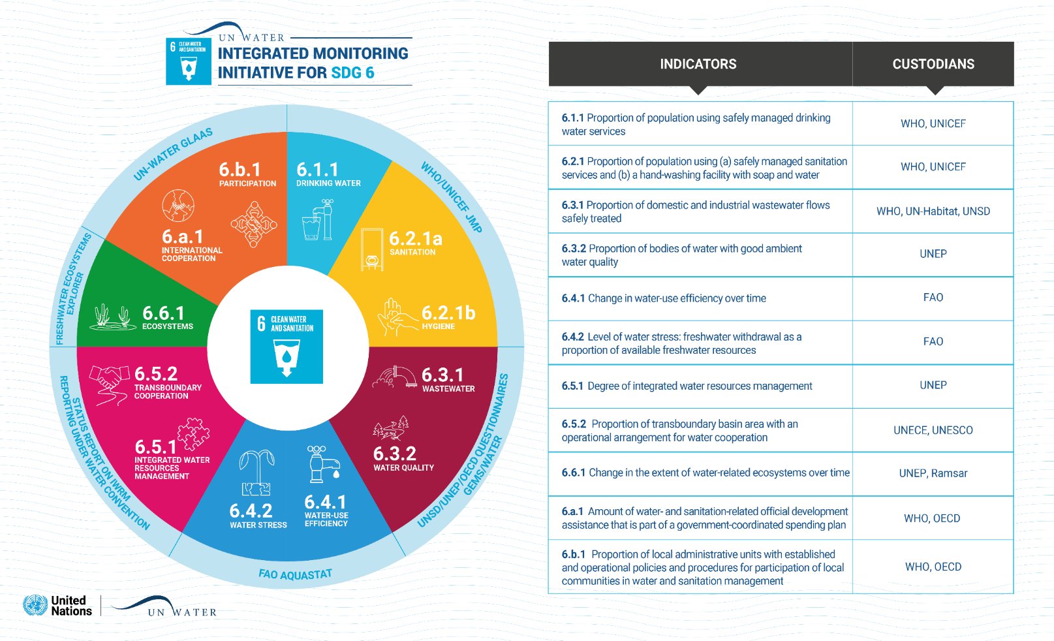
UN Water Integrated Monitoring Initiative for SDG 6
Notes:
SDG 6 includes 8 targets and 12 global indicators
WHO/UNICEF JMP serves as custodian of global data for targets 6.1 and 6.2
JMP works with agencies responsible for global monitoring of other targets under the UN Water IMI-SDG6
We also try to coordinate support for SDG 6 monitoring at regional and country level
We also collaborate with agencies responsible for reporting on other SDG goals for Poverty, Education, Health, Gender

Slide 4
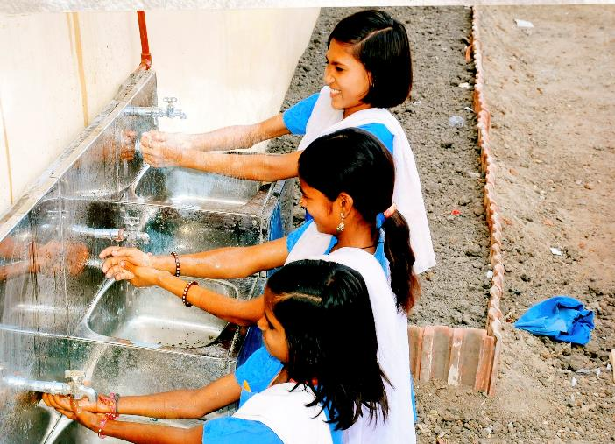
SDG 6 Integrated Monitoring Initiative
Gender contextualization
Phase 2 completed activities: consultation, method development, pilot testing
Phase 3 planned activities:
Identification of capacity building needs
Design of training modules and tools
Implementation, possible activities include
  Regional/global webinars covering entire contextualisation framework
  Regional/global webinars on contextualisation for specific SDG 6 indicators
  Country-specific support and technical assistance on stakeholder mapping, data mapping, analysis, etc
  In-person global workshop with pilot countries and other focus countries

Slide 5
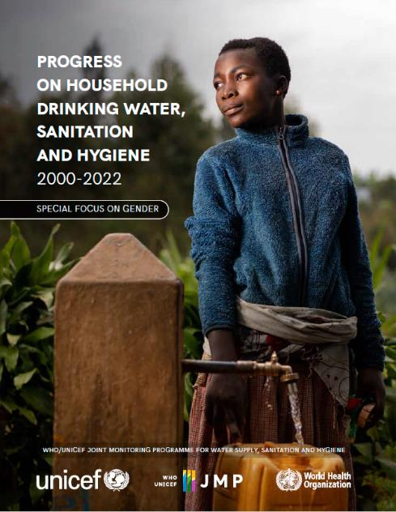
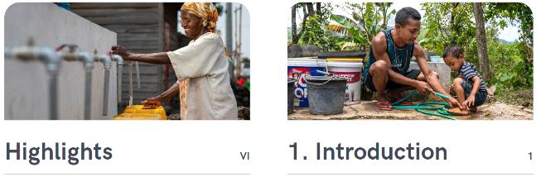
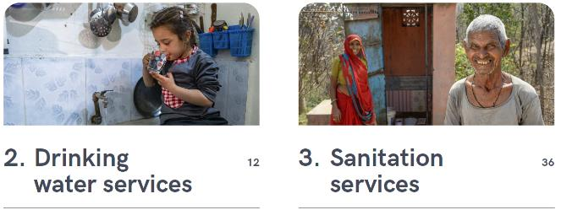
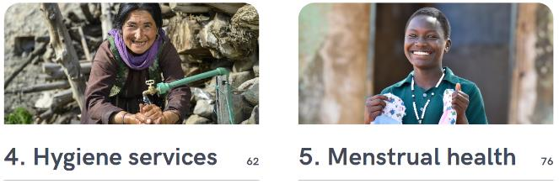
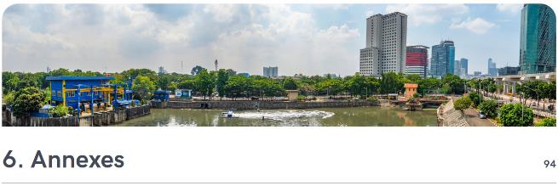
JMP 2023 progress update: special focus on gender
Notes:
This presentation will give highlights from the JMP 2023 progress update on WASH in households which has special focus on gender
The JMP produces internationally comparable estimates based on national data sources
The household database contains nearly 8000 national datasets of which 5340 were used for last report. About half from censuses and hh surveys and half from administrative data including regulators.
This chart shows how the database has grown with each JMP update
Nearly 4000 datasets on drinking water (3894) and sanitation (3831) but only 269 on hygiene (almost all hh surveys)
In 2021 the JMP established a new database on menstrual health which now includes 61 datasets (all hh surveys)

Slide 6
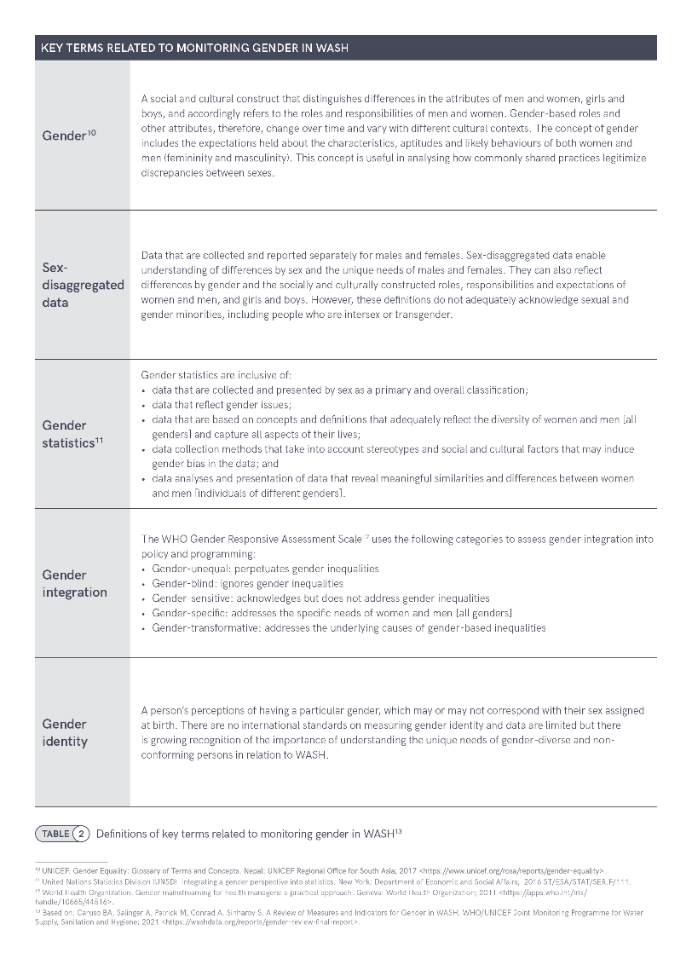
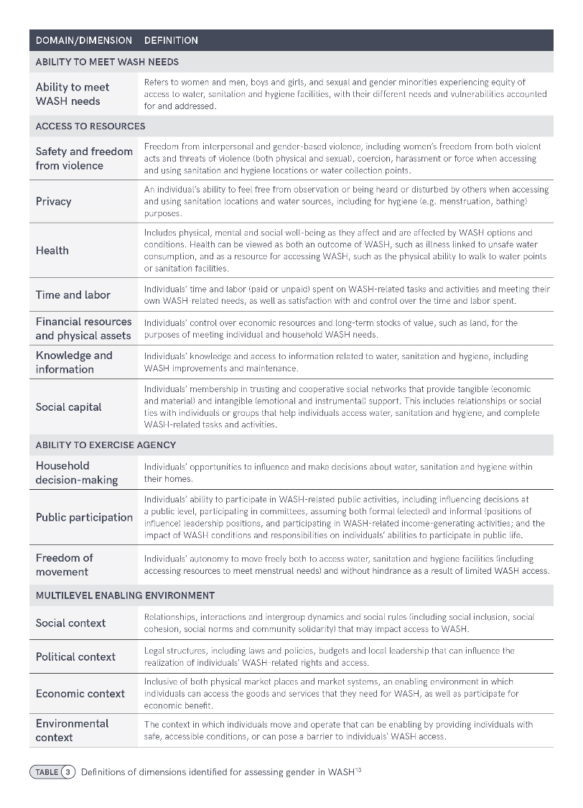
Notes:
15 dimensions of gender equality related to WASH among four interrelated domains (Bethany Caruso from Emory will describe these in a bit more detail)
Note ability to meet WASH needs, also Time & Labor, Safety & Freedom from Violence

Slide 7
Global monitoring of gender and WASH
SDG Framework
  Goal 6 ‘…for all’
  Targets 6.1, 6.2 ‘universal and equitable access…’, ‘…for all’
  Target 6.2 ‘…paying special attention to the needs of women and girls’
WASH activities and services are often highly gendered
  Few examples of sex-disaggregated data collected at scale
  Indicators can be gender-sensitive without being sex-disaggregated
Notes:
Nonetheless, some of the indicators used for national and global monitoring take account of the fact that the burden of inadequate WASH services is unevenly distributed between women and men, and can therefore be considered gender-sensitive. (Gender-sensitive: acknowledges but does not address gender inequalities )

Slide 8
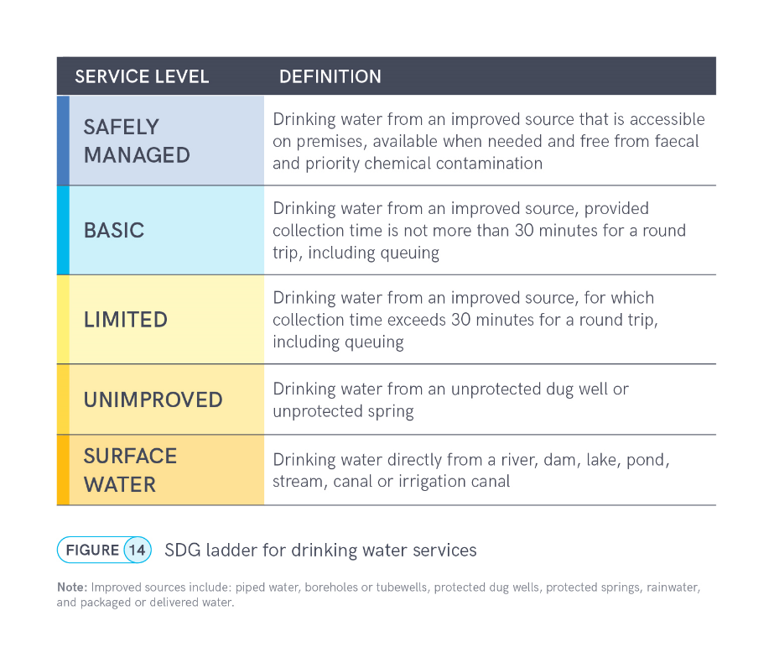
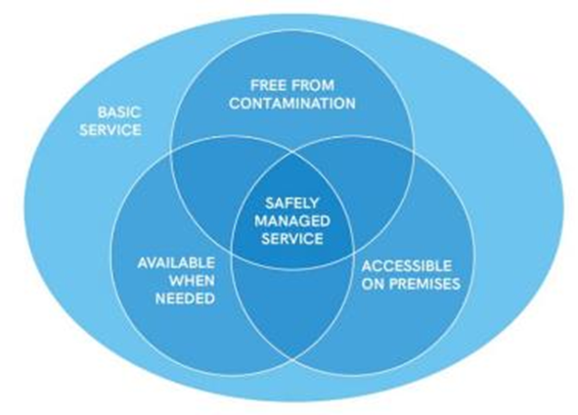
6.1.1 Drinking water
Notes:
The JMP uses ‘service ladders’ to benchmark and compare progress across countries, and these have been updated and expanded for SDG monitoring. The drinking water ladder defines five service levels, ranging from surface water to safely managed drinking water services, which is the global indicator for SDG target 6.1. The ladder builds on the improved/unimproved source type classification used for Millennium Development Goal (MDG) monitoring and introduces additional criteria related to the level of service provided. For SDG monitoring, households using improved sources are divided into three categories. If a round trip to collect water, including queuing, exceeds 30 minutes, it counts as a ‘limited service’, and if it takes no more than 30 minutes, it counts as a ‘basic service’.
But to meet the SDG standard for ‘safely managed services’, improved sources must be accessible on premises, available when needed, and free from contamination. Since households with safely managed services also meet the requirements for basic services, the two levels can also be grouped together as ‘at least basic service’, which is the indicator used for monitoring SDG target 1.4

Slide 9
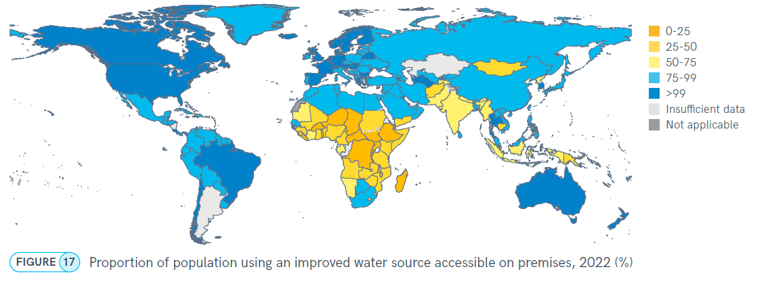
Water accessible on premises
1.8 billion people live in households without water accessible on premises
Notes:
Globally 1.8 billion people live in households where water is collected from sources located off premises.
And in 41 countries less than half of the population used an improved source accessible on premises.
Gender-relevant because in most cases women bear the primary responsibility for water carriage (more on that later). It’s in the domain of ability to meet basic needs.
People who need to collect water from off premises, especially women, face risks of harassment and violence. And of course it takes time and is physically dangerous – there are risks of injuries either from carrying large containers (20 kg or more), risk of slipping and having accidents, it’s dangerous.
Accessible on premises is part of the SDG framework, it is a component of safely managed drinking water services.

Slide 10
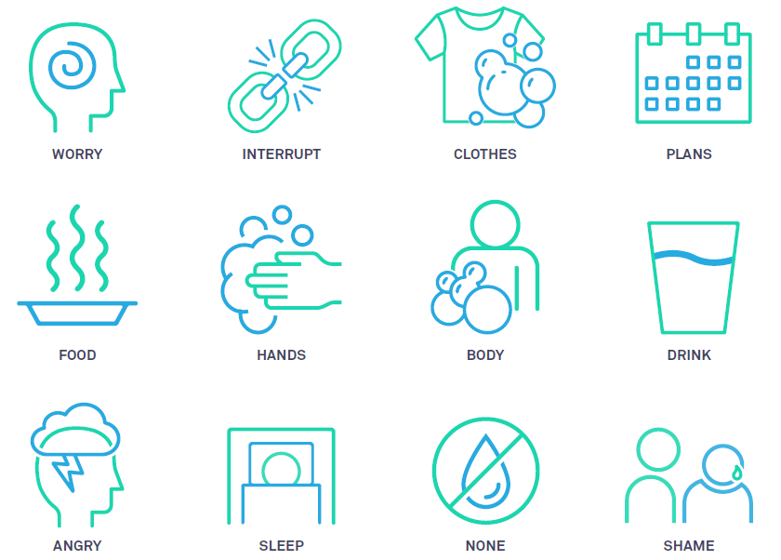
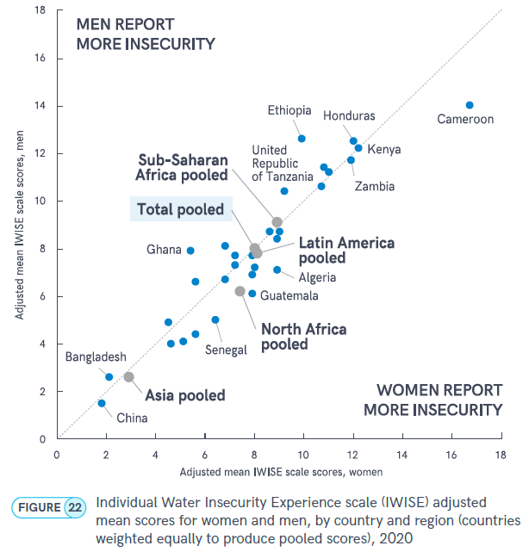
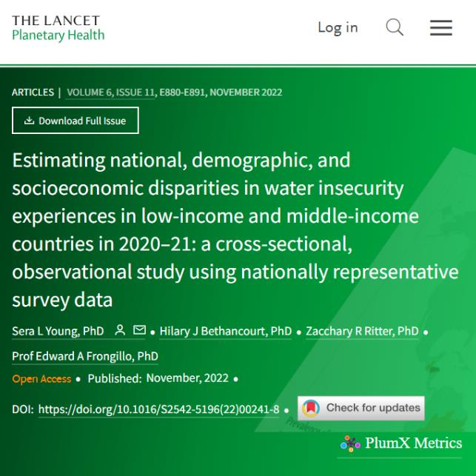
Notes:
“I will now ask you about your experiences with water. For each experience, we want to know in how many months this happened to you during the last 12 months. Even if it happened just once during a month, we’d like you to count that month.” The response options are 1) never, 2) in 1 or 2 months, 3) in some but not every month, or 4) in almost every month.
Worry 1) How often did you worry that you would not have enough water for all of your needs?
Interruption 2) Please think about where you get most of your water, such as a tap, well, borehole, bottled water, river, or stream. How often was this water source interrupted or limited in any way during the last 12 months?
Clothes 3) How often could your clothes NOT be washed because of problems with water?
Plans 4) How often did you have to change schedules or plans because of problems with water?
Food 5) Still thinking about the last 12 months, how often did you change what you ate because of problems with water?
Hands 6) How often were you NOT able to wash your hands after dirty activities because of problems with water?
Body 7) How often were you NOT able to wash your body because of problems with water?
Drink 8) How often did you NOT have as much water to drink as you would have liked?
Anger 9) Still thinking about the last 12 months, how often did you feel angry because of problems you were experiencing with water?
Sleep 10) How often did you go to sleep thirsty because there was no water to drink?
No Water 11) How often did you have NO useable or drinkable water whatsoever?
Shame 12) How often did you feel shame because of problems you were experiencing with water during the last 12 months?

Slide 11
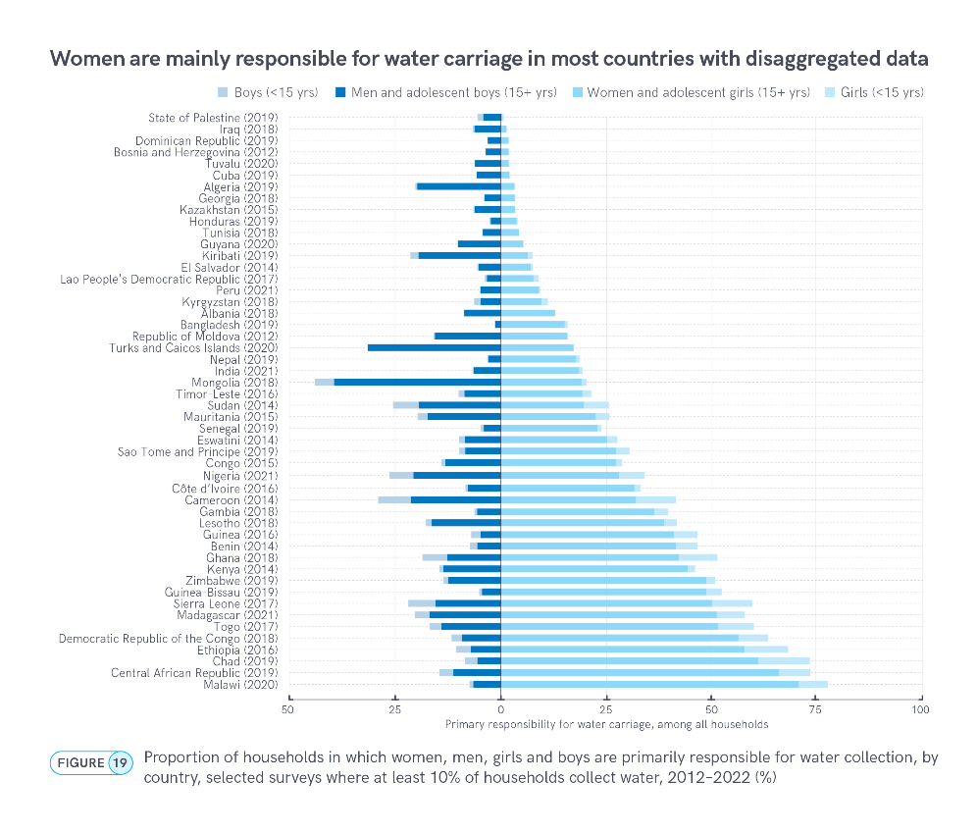
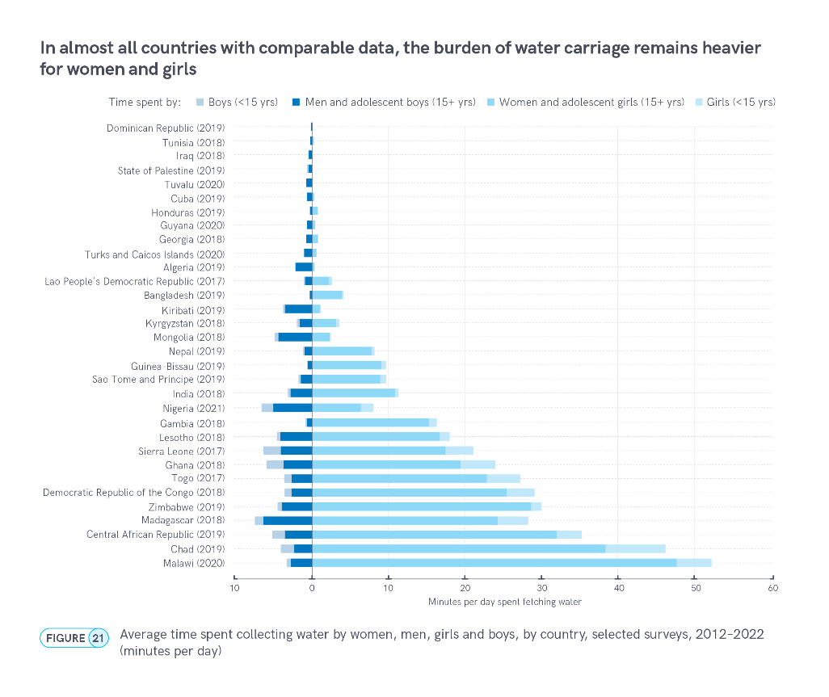
Water carriage responsibility and time spent
Notes:
Figure 19 shows that responsibility for collecting drinking water from sources located off premises is often a highly gendered activity. Analysis of harmonized data from 49 recent surveys shows that primary responsibility for fetching drinking water falls mainly to women (34 countries). In eight countries (Central African Republic, Chad, Democratic Republic of Congo, Ethiopia, Madagascar, Malawi and Togo), over half of households relied on women to collect water.
All 21 of the countries where at least a quarter of households relied on women are located in sub-Saharan Africa. In Bangladesh, Chad, Guinea-Bissau and Malawi, women are more than ten times as likely than men to be responsible for fetching water. The distribution of responsibility is most unequal in Malawi, where women and men are responsible for fetching water in 71% and 7% of households, respectively.
Figure 21 shows the average amount of time spent each day collecting water in countries with disaggregated data available for women, men, girls and boys. The average time spent per household per day on water collection ranges from 55 minutes in Malawi to less than one minute in Dominican Republic. In 20 out of 31 countries, women and girls spent more time collecting water than men and boys.
In countries where men and boys are primarily responsible for water collection, the burden of water carriage was relatively light: men and boys spent four minutes per day fetching water in Kiribati and Mongolia, two minutes per day in Algeria, and one minute or less per day in the remaining eight countries. In all 12 countries where household members spent at least 10 minutes per day collecting water, women were primarily responsible for water fetching; all but one of these countries are located in sub-Saharan Africa. In 11 countries, women and girls spend more than five times as much time collecting water per day as men and boys, and in five countries (Bangladesh, Chad, Gambia, Guinea-Bissau and Malawi), women and girls spent more than ten times as much time. The biggest gender disparity was observed in Malawi, where women and girls spent 52 minutes per day collecting water while men and boys spent three minutes. In Chad, girls spent five times as much time per day (eight minutes) collecting water than boys (1.7 minutes).

Slide 12
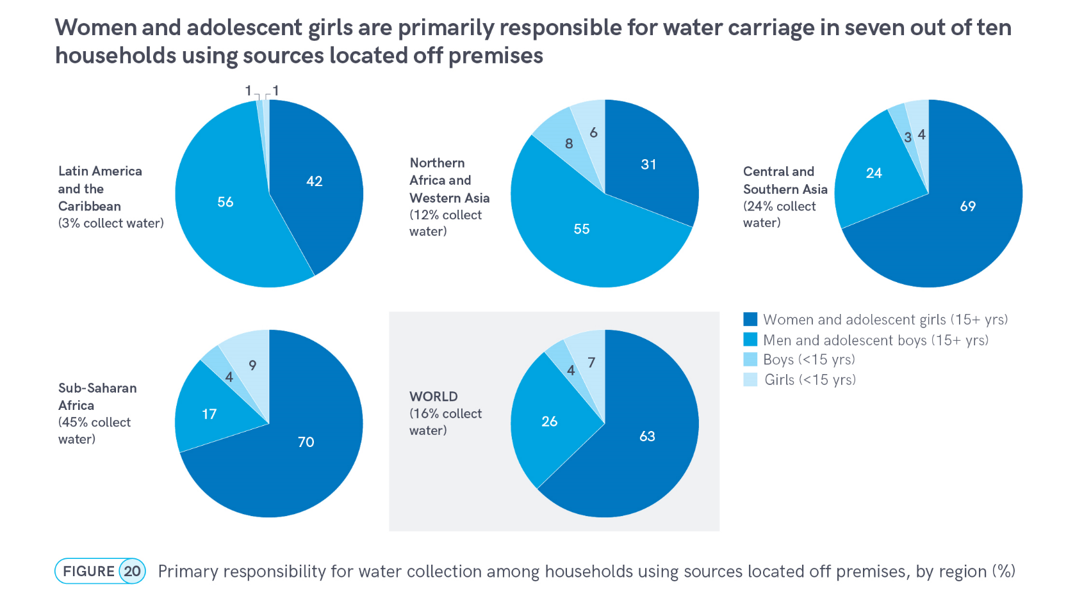
Notes:
The burden and responsibility for water carriage also varies between regions (Figure 20). Globally, 16% of the population (1.8 billion people) live in households where water is collected from sources located off premises (both improved and unimproved). In two out of three of these households (63%), women are primarily responsible for water carriage, compared with one in four households (26%), where men are responsible. Nearly half (45%) of the 1.2 billion people in sub-Saharan Africa and a quarter (24%) of the 2.1 billion people in Central and Southern Asia rely on water collection, compared with only 12% of the population in Northern Africa and Western Asia (554 million), and just 3% in Latin America and the Caribbean (660 million). Women are four times as likely as men to fetch water in sub-Saharan Africa and nearly three times as likely in Central and Southern Asia. However, in Northern Africa and Western Asia, and in Latin America and the Caribbean, men are more likely to be responsible. Globally, girls (7%) are more likely than boys (4%) to fetch water and this is true for all regions except Northern Africa and Western Asia.

Slide 13
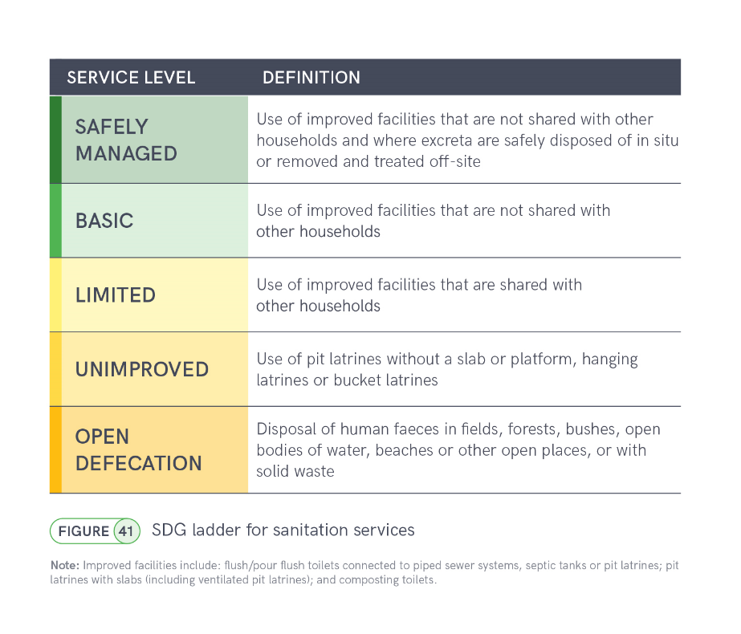
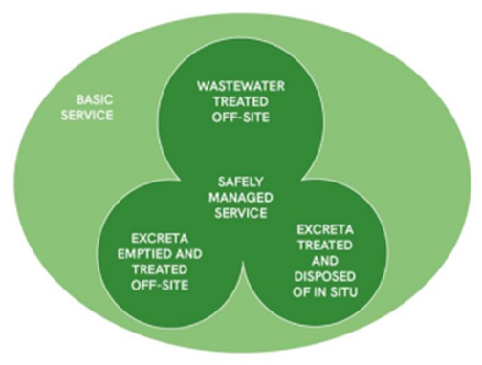
6.2.1a Sanitation
Notes:
The sanitation ladder ranges from open defecation at the bottom to safely managed sanitation at the top. Households using improved sanitation facilities that are shared with other households count as limited service and if they are not shared then they count as a basic sanitation service. But additional criteria are applied to meet the SDG standard for ‘safely managed services’, excreta must either be safely disposd of in-situ, or removed and treated offsite
Since households with safely managed drinking water and sanitation services also meet the requirements for basic services, the two levels can also be grouped together as ‘at least basic service’, which is then combined with basic hygiene for monitoring SDG target 1.4 ‘universal access to basic services.

Slide 14
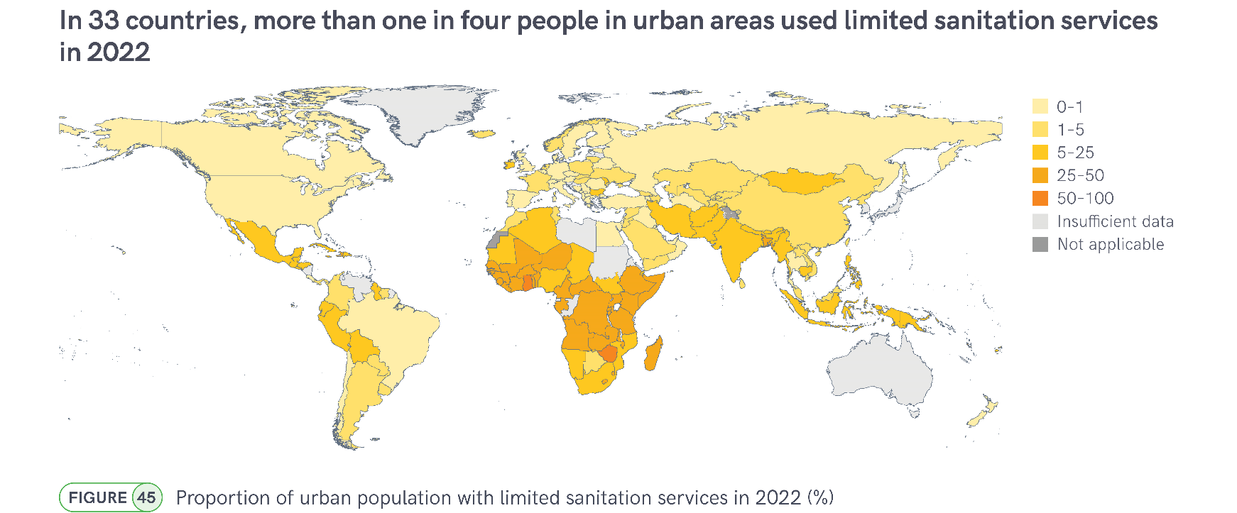
Limited sanitation services
Notes:
Shared sanitation facilities are an important interim solution when individual household facilities are not feasible, but they frequently do not meet the needs of women and girls due to concerns about accessibility when needed, cleanliness, privacy and personal safety.
In 2022, 570 million people used improved facilties that were shared with other households and count as a ‘limited’ service. Three out of five (335 million) lived in urban areas. Gender inequalities related to shared sanitation are likely to be greatest in the 33 countries where more than a quarter of the urban population used limited services in 2022, of which 30 were located in sub-Saharan Africa (Figure 45). In 2022, one in five people used limited services in sub-Saharan Africa (18%), compared with one in ten in Central and Southern Asia (11%), and one in twenty in Oceania (5%).
The Multiple Indicator Cluster Surveys (MICS) ask women and men separately how safe they feel walking alone in their neighborhood after dark. In 22 recent surveys among households that use shared sanitation facilities, men were much more likely than women to report feeling ‘very safe’ (Figure 47). For example, in Georgia, 85% of men but only 47% of women said that they felt very safe, while in Belarus, men (59%) were more than four times as likely to report feeling very safe than women (13%). Far fewer respondents reported feeling ‘very unsafe’, but this was much more common among women than men.

Slide 15
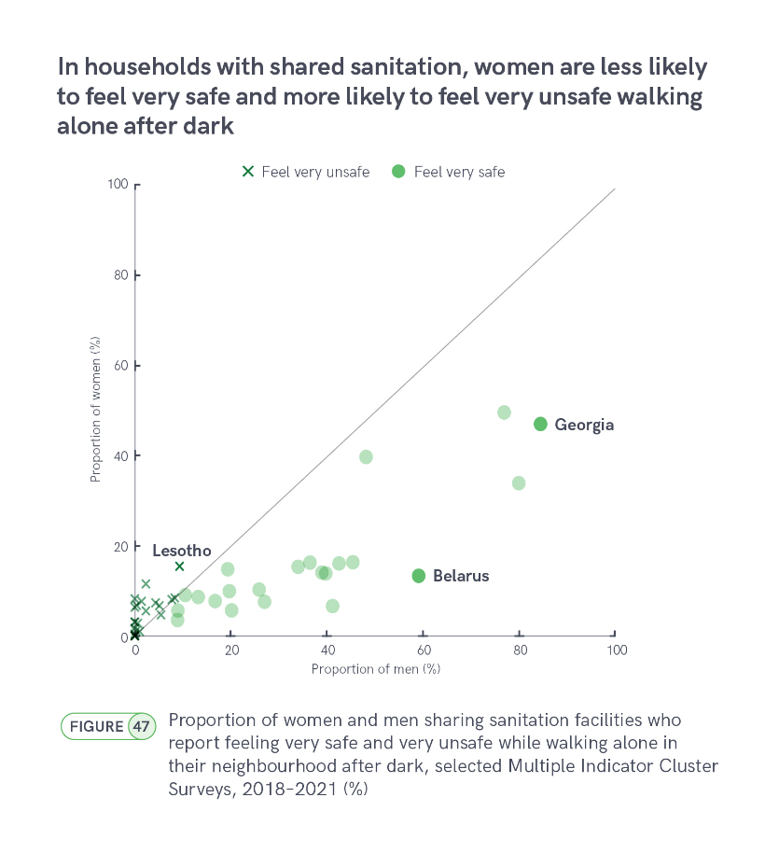
Perceived safety
How safe do you feel walking alone in your neighbourhood after dark?
Very safe
Safe
Unsafe
Very unsafe
Never walk alone after dark
Notes:
Shared sanitation facilities are an important interim solution when individual household facilties are not feasible, but they frequently do not meet the needs of women and girls due to concerns about accessibility when needed, cleanliness, privacy and personal safety.18 In 2022, 570 million people used improved facilties that were shared with other households and count as a ‘limited’ service. Three out of five (335 million) lived in urban areas. Gender inequalities related to shared sanitation are likely to be greatest in the 33 countries where more than a quarter of the urban population used limited services in 2022, of which 30 were located in sub-Saharan Africa (Figure 45). In 2022, one in five people used limited services in sub-Saharan Africa (18%), compared with one in ten in Central and Southern Asia (11%), and one in twenty in Oceania (5%).
The Multiple Indicator Cluster Surveys (MICS) ask women and men separately how safe they feel walking alone in their neighborhood after dark. In 22 recent surveys among households that use shared sanitation facilities, men were much more likely than women to report feeling ‘very safe’ (Figure 47). For example, in Georgia, 85% of men but only 47% of women said that they felt very safe, while in Belarus, men (59%) were more than four times as likely to report feeling very safe than women (13%). Far fewer respondents reported feeling ‘very unsafe’, but this was much more common among women than men.

Slide 16
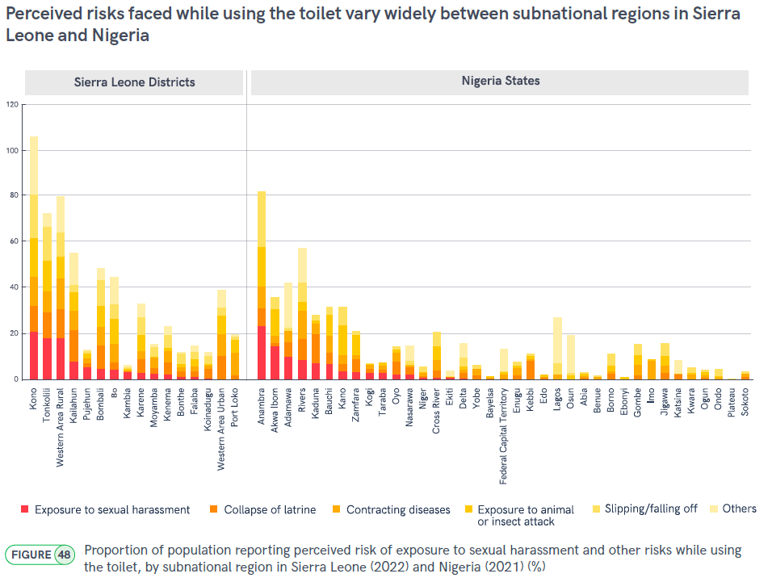

Slide 17
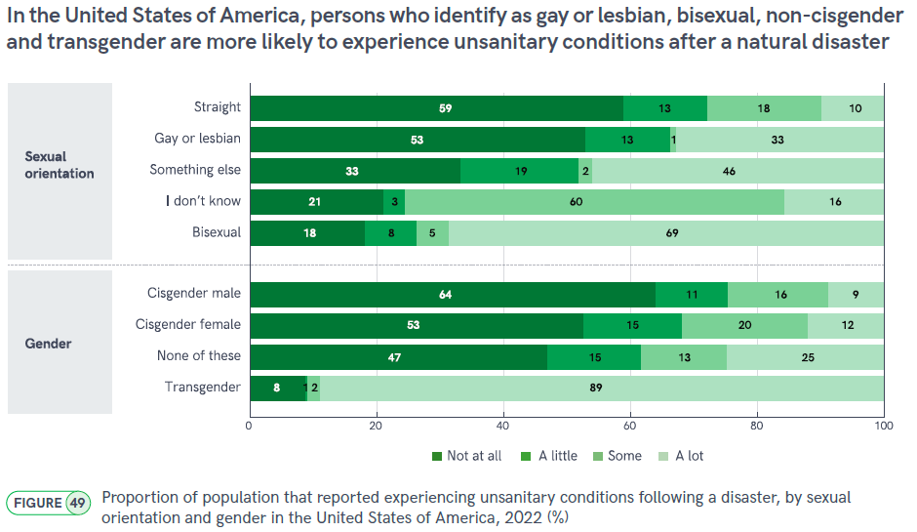

Slide 18
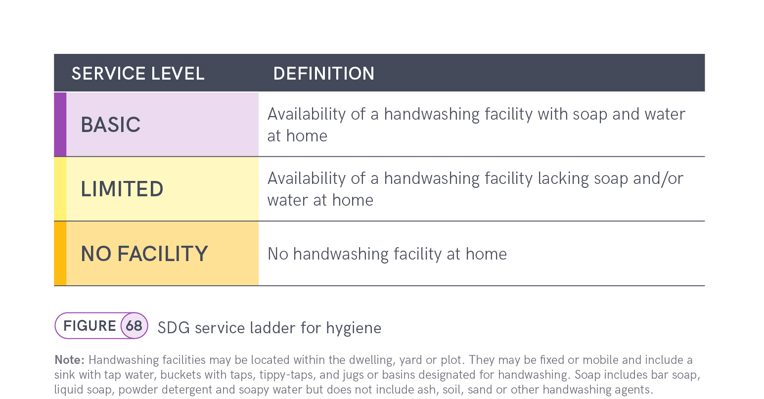
6.2.1b Hygiene
SDG 6.2.1: Proportion of population using … (b) a hand-washing facility with soap and water
Notes:
Hand hygiene is another SDG indicator because of its being critical to reducing transmission of infectious diseases and its being foundational to a resilient health system.
The hygiene ladder was added for SDG monitoring and only has 3 rungs ranging from ‘no facility’ to ‘basic’ which is the global indicator on hygiene for SDG target 6.2
Basic hygiene service means households have a handwashing facility with soap and water available at home.
If facility is available but either soap or water are missing it counts as limited service and at the bottom of the ladder we have no handwashing facility at all.
The JMP 2023 progress update highlights inequalities in service levels between and within countries.
But the burden of inadequate hygiene also varies widely across population subgroups.
It is widely recognized that inequalities in hygiene services impact women and men in different ways
partly due to differences in the specific needs of females and males, but also due to differences in gender norms, roles and responsibilities related to hygiene.
IN JMP 2023 progress report we tried to highlight some surveys and results help deep dive on these differences

Slide 19
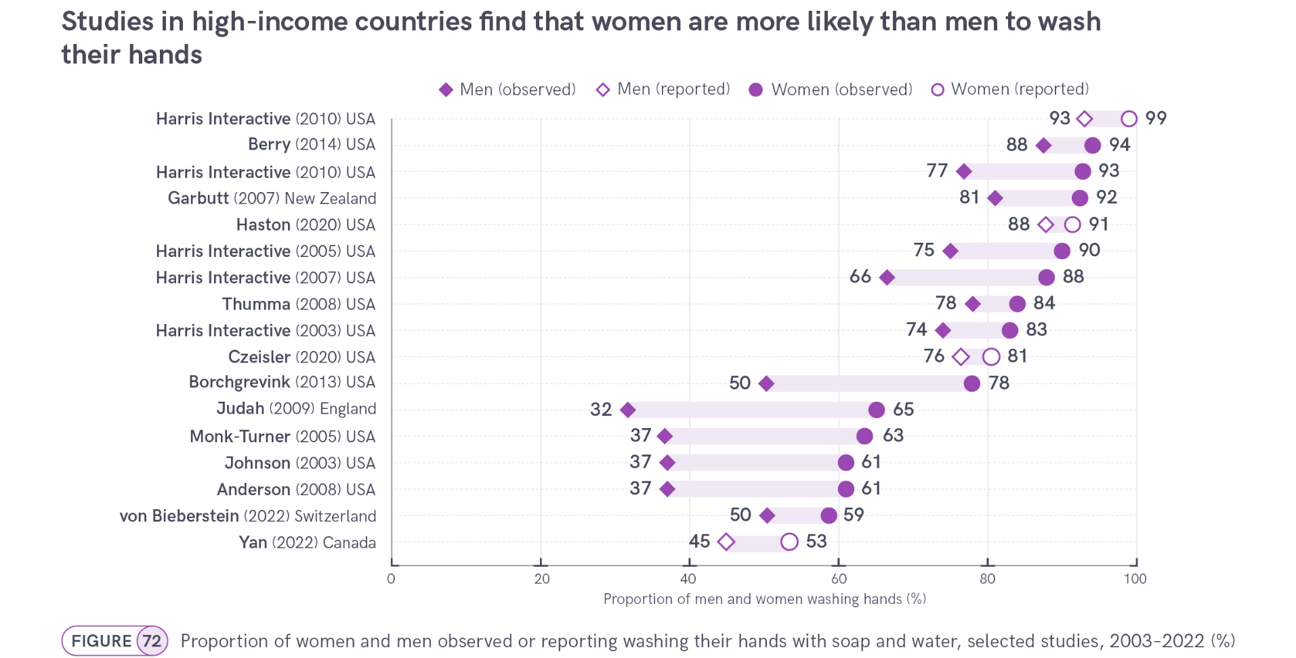
Gender and hygiene
Notes:
A small number of studies in high-income countries have either asked people about their reported handwashing practices, or observed actual handwashing behaviour in public settings, such as bathrooms in universities, transport hubs or museums.
These studies are often small scale, not nationally representative and not fully comparable due to methodological differences – there are also differences in time domain.
However, they consistently show that, while people do not always wash their hands after using public bathrooms, women are more likely to do so than men (Figure 72 - circles).
In one study of motorway rest stop bathrooms in England, women were more than twice as likely as men to be observed washing their hands with soap and water after using the toilet.
However, in most other studies, gender gaps were smaller, at around 10–25 % pts.
Women were also more likely to selfreport handwashing than men, but this gap was smaller.
In 2010, a Harris Interactive study found that 99% of women and 93% of men in the United States of America reported ‘always’ washing their hands after using public toilets, but structured observation in four major cities showed that only 93% of women and 77% of men actually did so.
In shopping malls in New Zealand found that males (81%) not only washed their hands less frequently than females (92%), but also washed their hands for a shorter period of time and were less likely to use soap (66% vs. 77%).
All references listed in our report

Slide 20
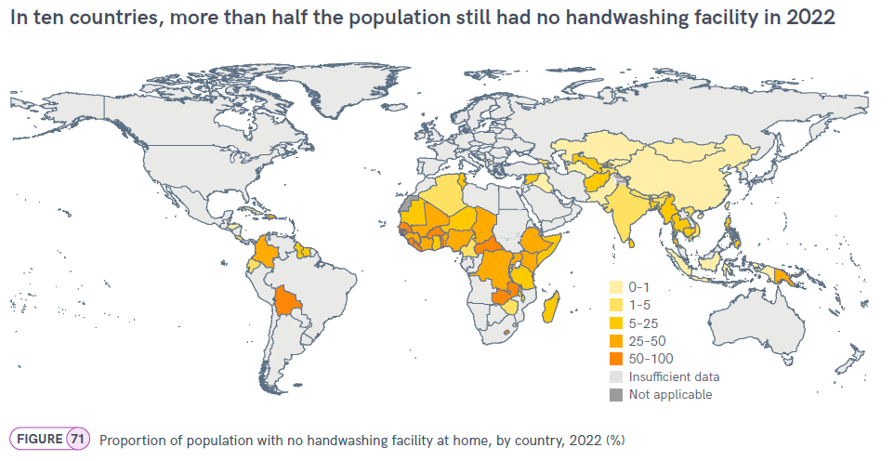
No handwashing facility
Notes:
National data on hand hygiene are typically collected at household rather than individual level, but some indicators take account of gender inequalities and can therefore be considered gender-sensitive.
Inadequate hand hygiene is likely to disproportionately impact women and girls because they remain primarily responsible for child care and domestic chores in many countries around the world.
Access to handwashing facilities is also important for maintaining personal hygiene, and women and girls, and other persons who menstruate, have specific additional hygiene needs related to menstrual health, which we will cover next.
If we look at 2022 estimates for population with no access to handwashing facility we can see that:
In 2022, 84 countries had estimates for basic hygiene services (access to handwashing facilities with soap and water available at home).
Among these were 25 countries where more than one in four people had no handwashing facility at all.
The most extreme cases in 2022 were ten countries where more than half the population still had no handwashing facility at home (Figure 71).
Over two thirds of the population had no facility in Guinea-Bissau (66%), Liberia (73%), Sierra Leone (70%) and Togo (75%).

Slide 21
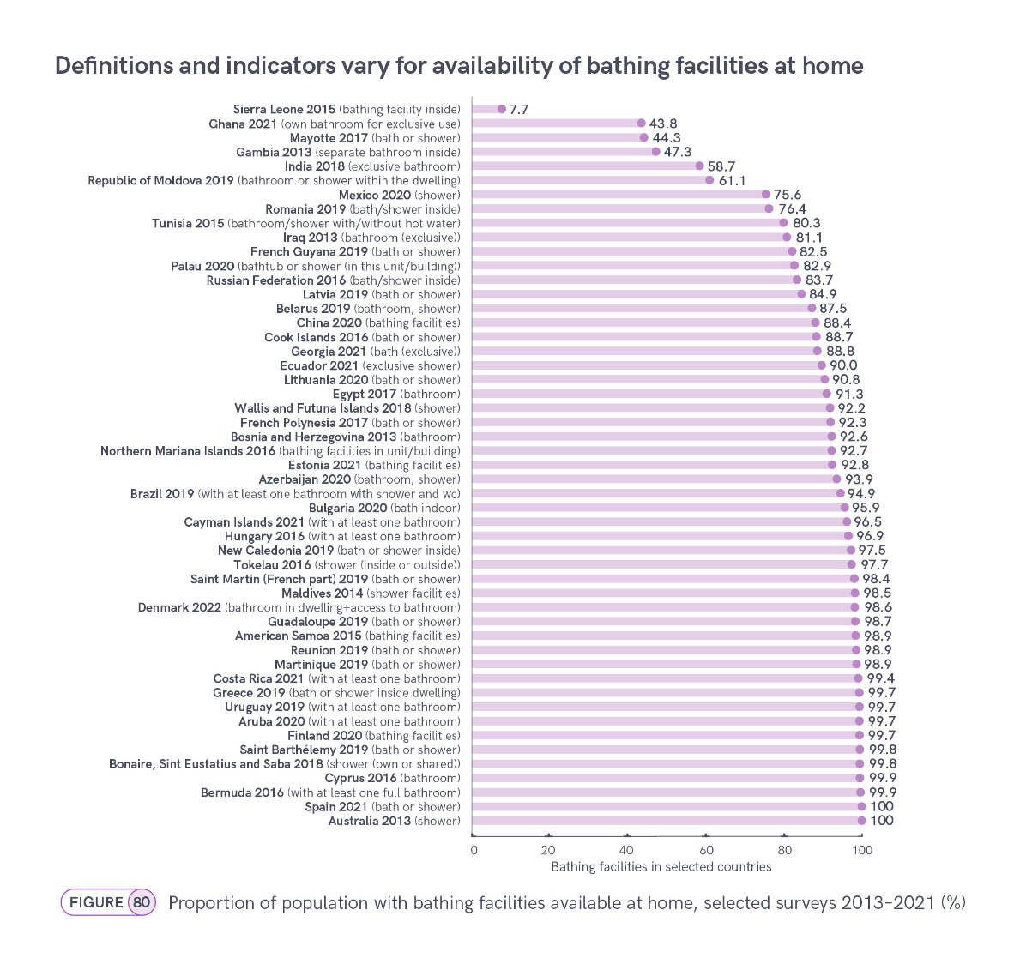
Presence of:
Bathing facilities → China, Finland
Bath or shower → Latvia, Mayotte, Reunion, Spain
Bathroom (at least one) → Bermuda, Cayman Islands,
Costa Rica, Hungary
Shower or WC → Brazil
Location of facilities:
Inside the dwelling → Denmark, Greece,
Republic of Moldova,
New Caledonia, Tokelau
Shared or not shared by other households:
Not shared→ Georgia, Ghana, India
Shared → Bonaire, Sint Eustatius and Saba
Notes:
Existing data suggest that the availability of a bath or shower within a dwelling, yard or plot varies across countries and could be a useful additional indicator of hygiene inequalities.
Access to bathing facilities has also been identified as an important dimension of gender related inequalities in the ability of women and girls to meet their hygiene needs,
which could be linked to maintaining personal hygiene for people who menstruate, and therefore have specific additional hygiene needs related to menstrual health
Data availability is a problem and for global monitoring the comparability is another layer of problem pulling down the data availability
A growing number of countries monitor the availability of bathing facilities but national indicator definitions vary, making crosscountry comparison difficult (Figure 80).
Many countries simply monitor the presence of ‘bathing facilities’ (China, Finland) or ‘bath or shower’ (Latvia, Mayotte, Reunion, Spain).
Others focus on the presence of (at least one) ‘bathroom’ (Bermuda, Cayman Islands, Costa Rica, Hungary) and sometimes also specify a shower or WC (Brazil).
Some countries distinguish facilities that are inside the dwelling (Denmark, Greece, Republic of Moldova, New Caledonia, Tokelau),
while others monitor whether they are for exclusive use of household members (Georgia, Ghana, India) or shared (Bonaire, Sint Eustatius and Saba).

Slide 22
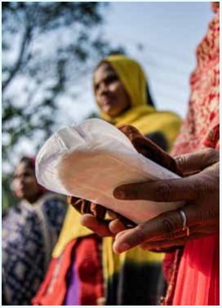
Menstrual health
Current data:
MICS6 (2017-2023)
  Use of menstrual materials such as sanitary pads, tampons or cloth (grouped), followed up by: were these reusable.
  Access to a private place to wash and change while at home
  Participation in activities during menstruation, such as school, work and social activities (grouped)
DHS8 (~2021+)
  Type of menstrual materials used (specific responses)
  Access to a private place to wash and change while at home
  Correct knowledge of the fertile period (sex-disaggregated)
Notes:
The JMP does not currently use a menstrual health service ladder because norms and standards for monitoring menstrual health are still evolving.
However, a growing number of national household surveys include new questions on menstrual health in questionnaires for adolescent girls and women age 15–49.
Actual publication date for DHS8 questionnaires: June 2020
DHS8 men questionnaire has questions on the knowledge of fertile period as well as women quest.

Slide 23
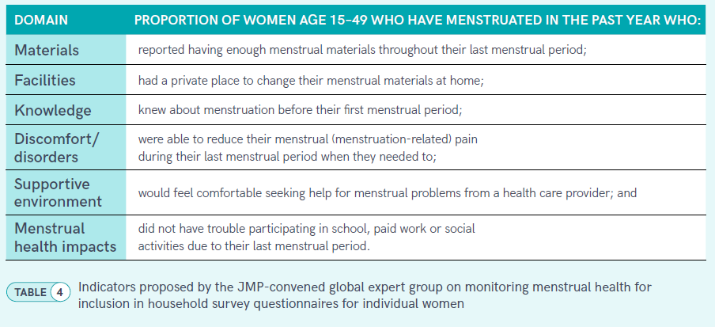
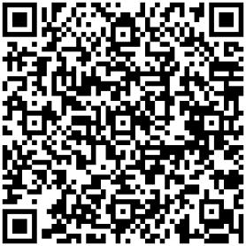
Future data on menstrual health
For more details: Proposed questions on menstrual health for inclusion in household survey questionnaires for individual women - zero draft December 2022
https://washdata.org/reports/proposed-questions-menstrual-health-household-surveys-dec-2022
Notes:
Menstrual health is a broad term that includes the various factors that influence the experience of those who menstruate, as defined by the Terminology Action Group of the Global Menstrual Collective in 2021.
This new definition reflects a wider range of domains that are critical to menstrual health (including discomfort and a supportive environment), in addition to materials and facilities that have been more commonly monitored to date.
Monitoring of menstrual health has often focused on what is provided to those who menstruate, rather than their experiences and needs
The new definition has informed ongoing development of menstrual health indicators, including a priority list for monitoring girls’ menstrual health and hygiene, and updated JMP indicators for household surveys
The proposed indicators aim to cover elements from previous household surveys (such as those included in this report), while also addressing emerging elements on unmet material needs, menstrual pain and social support.
They are based on questions used in previous surveys, including for other settings, such as the USAID 2021 survey of women in workplaces in Kenya and Nepal, which is one of the few surveys to include questions on discomfort, supportive environment and quantity of materials
Review and discussion by the JMP Expert Group on MH (November 2022): The term MH is recommended to broaden the focus beyond menstrual hygiene and limit stigma associated with the term hygiene and links to uncleanliness.
In 2020, the JMP and GLAAS partnered with Emory University to initiate a multi-year, multi-phase initiative to review opportunities for enhanced monitoring of gender in relation to SDG targets 6.1, 6.2, 6.a and 6.b and to identify a set of priority indicators for integration into national and global monitoring.
Phase 1 (2020-2021) of this process, the ‘review phase’, provided a conceptual framework of gender equality related to WASH. Currently Phase 2 of this process is being conducted, which will result in a list of priority indicators for enhanced monitoring of gender and WASH under SDG 6.1 and 6.2. In this session, we will hear more about this process and the list of those indicators.
Terminology Action Group of the Global Menstrual Collective in 2021: Hennegan J, Winkler IT, Bobel C, Keiser D, Hampton J, Larsson G, et al. Menstrual health: a definition for policy, practice, and research. Sexual and Reproductive Health Matters. 2021;29(1):31-8.

Slide 24
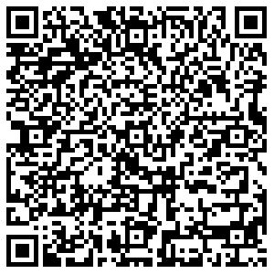
Future data on menstrual health
MICS7 (2023+): MICS7 Complementary Questionnaire Topics https://mics.unicef.org/tools
  Participation in activities during menstruation, such as school, work and social activities (individual activities)
  Worry that someone would see you while changing menstrual materials at home (privacy)
  Had enough menstrual materials to change them as often as you wanted to (sufficiency)
  Ability to reduce menstruation-related pain (discomfort)
  Feel comfortable seeking help from a health care provider about
  concerns (supportive environment)
  Awareness of menstruation before menarche (knowledge)
MICS7 MH Module

Slide 25
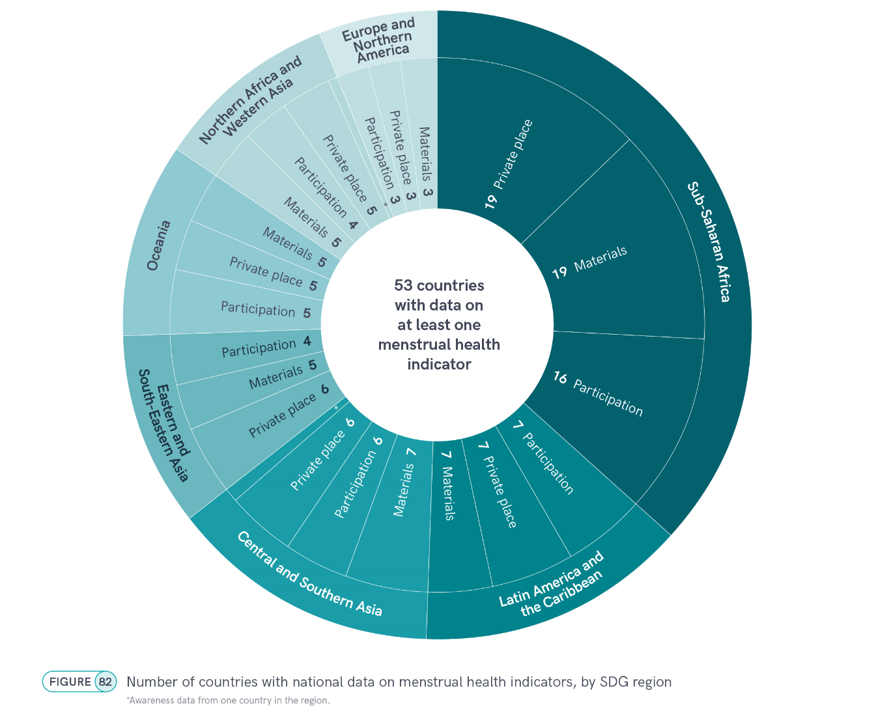
By 2022, nationally representative data on menstrual health were available for 53 countries, representing seven out of eight SDG regions
Notes:
By 2022, nationally representative data on menstrual health were available for 53 countries, representing seven out of eight SDG regions,
of which 44 countries had data for at least three of the four harmonized indicators

Slide 26
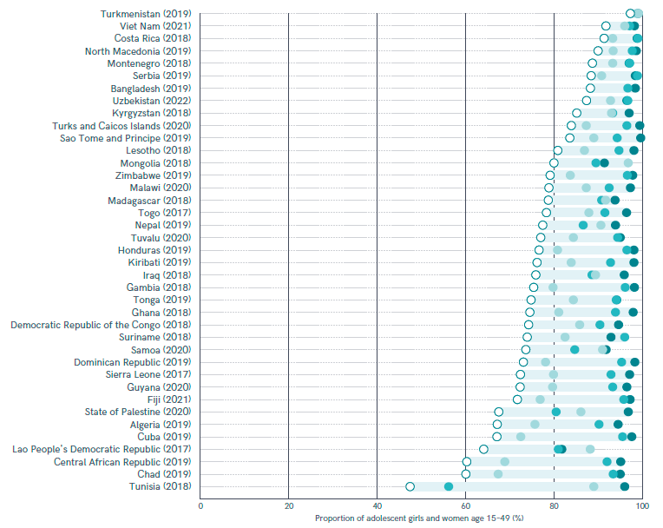





Materials, private place, participation
Selected MICS, 2016–2022 (%)
Proportion of adolescent girls and women age 15–49
In most of the countries, participation is the lowest of the three.
In some countries the proportion of adolescent girls and women meeting all three criteria was significantly lower still.
Madagascar:
94% used materials, 91% had a private place to wash and change, and 92% participated in activities during menstruation, but only 79% satisfied all three needs.
Notes:
Often participation is the lowest of the three. And having all three indicators is lower still.
Proportion of adolescent girls and women age 15–49 who used menstrual materials, had a private place to wash and change, and participated in work, school and social activities during their last period, selected MICS, 2016–2022 (%)

Slide 27
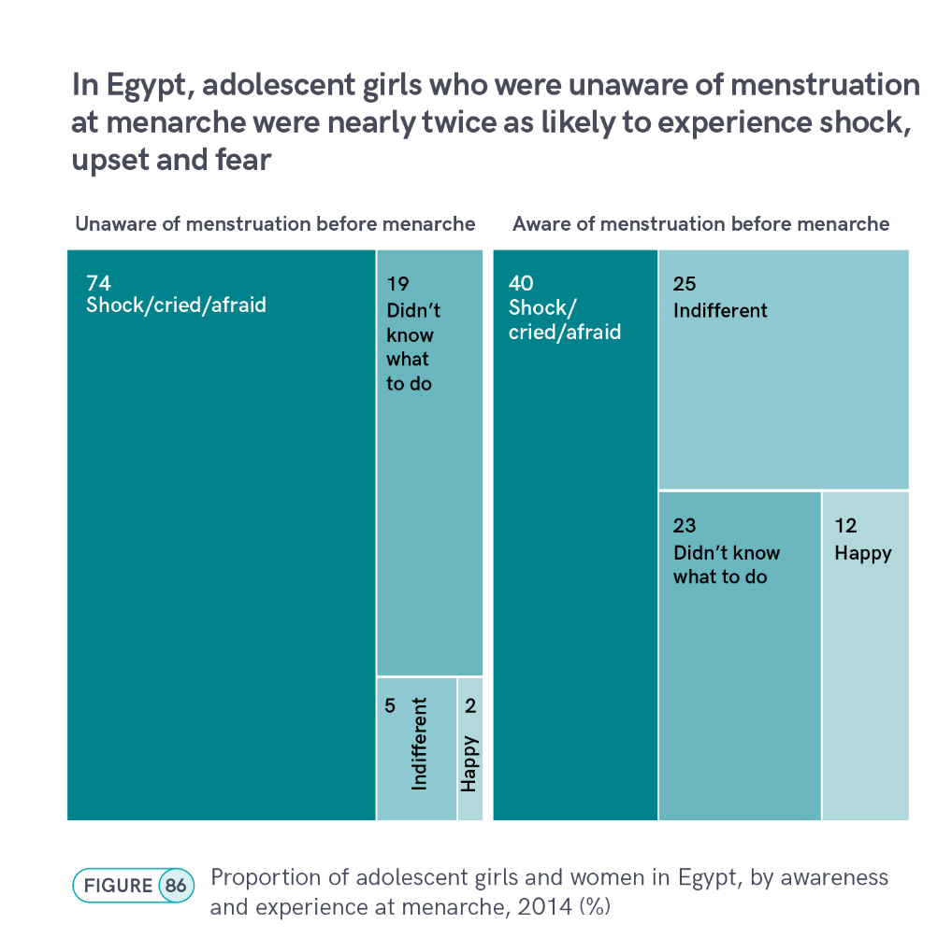
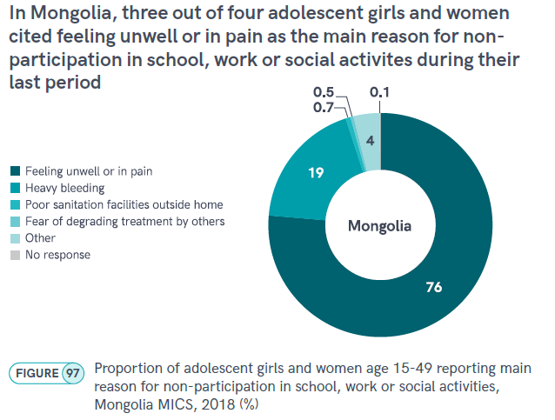
Notes:
The report has many examples of other MH indicators, often only available for a few countries.
Here are two examples from individual countries that already have data on some of the proposed new MH indicators.
Awareness of menstruation before menarche has been identified as a useful indicator of changing gender and social norms related to menstruation, but only a small number of countries have collected this information to date.
While Bangladesh and Egypt were the only countries with nationally representative data, subnational surveys were available for Magway region in Myanmar and for Soroti district in Uganda
Egypt included a question: ‘The first time you got your menstrual cycle, what was your reaction?’.
Those who were not aware of menstruation prior to having their first period were nearly twice as likely to experience shock, upset and fear as those who were already aware of menstruation at menarche (74% vs. 40%).
37% of girls who were already aware were either happy or indifferent, compared with just 7% of those who were unaware
Mongolia is one of the few countries which has collected information on the reasons for non-participation in school, work or social activities during menstruation.
In a 2018 MICS, three quarters of respondents reported feeling unwell or in pain and
a fifth reported heavy bleeding (Figure 97).
Less than 1% cited poor sanitation facilities outside the home or fear of degrading treatment by others,
but 4% cited ‘other’ (unspecified) reasons. In countries with data available

Slide 28
Q&A

Slide 29
Extra slides

Slide 30
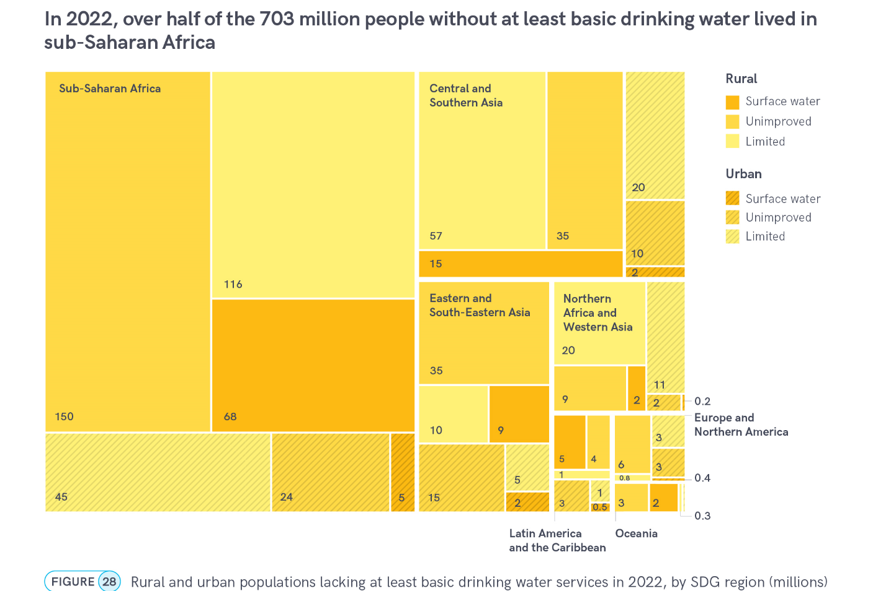
Notes:
There’s another SDG indicator related to accessibility of water: ‘basic drinking water services’ are defined as using water from an improved source, provided that collection time is not more than 30 minutes per trip. This indicator is part of SDG target 1.4, on universal access to basic services.
And still over 700 million people lack basic drinking water (at least basic drinking water). More than three quarters of them are in rural areas, and more than half of them live in sub-Saharan Africa.
The report also shows that there are large rich-poor gaps; in 10 countries there was more than a 60 % pt gap between the richest and the poorest quintiles, with respect to basic drinking water services.

Slide 31
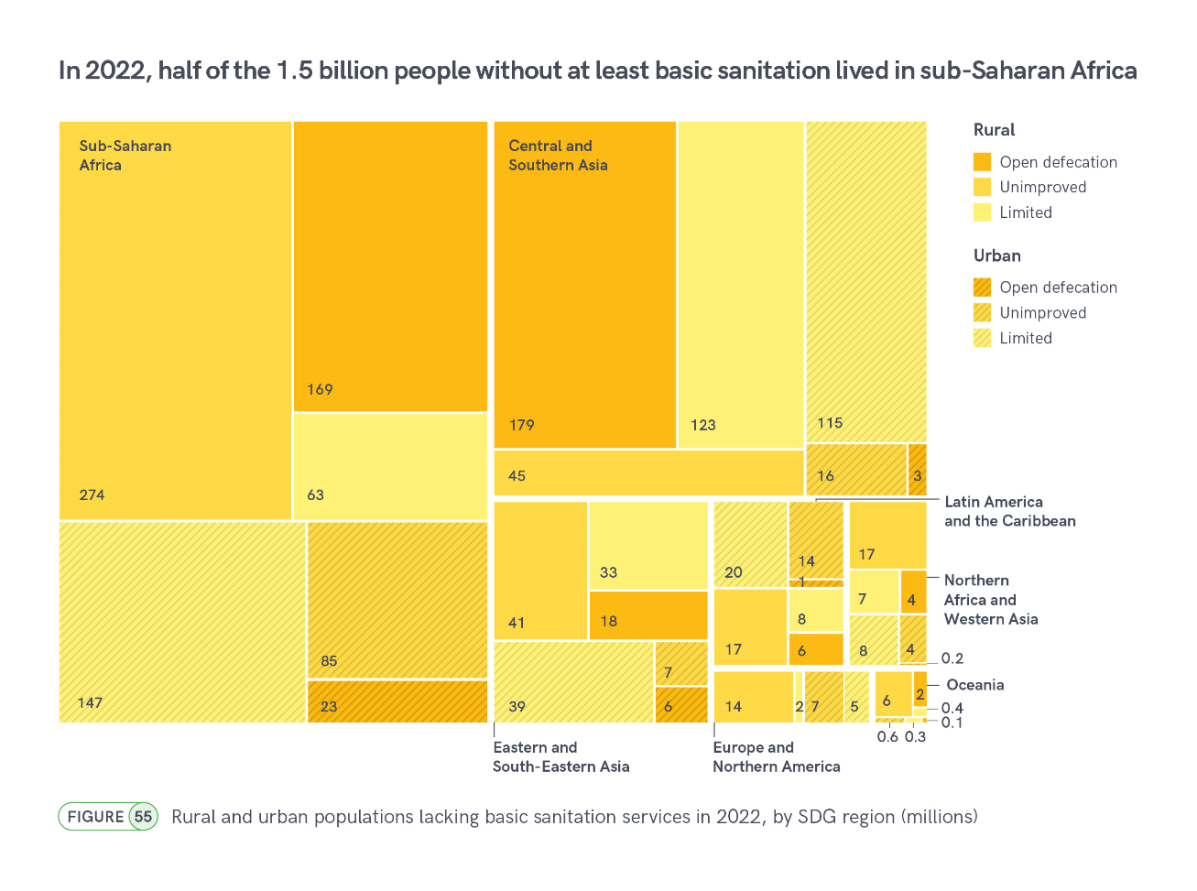

Slide 32
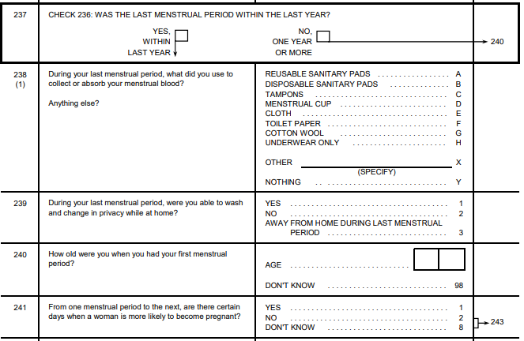
DHS8 – MH Questions

Slide 33
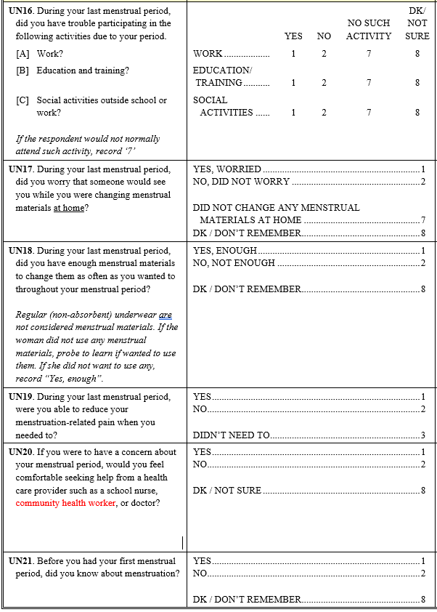

MICS7 MH Questions
MICS6 (2017-2023) → MICS7 (2023+) →

Slide 34

Notes:
This presentation will give highlights from the JMP 2023 progress update on WASH in households which has special focus on gender
The JMP produces internationally comparable estimates based on national data sources
The household database contains nearly 8000 national datasets of which 5340 were used for last report. About half from censuses and hh surveys and half from administrative data including regulators.
This chart shows how the database has grown with each JMP update
Nearly 4000 datasets on drinking water (3894) and sanitation (3831) but only 269 on hygiene (almost all hh surveys)
In 2021 the JMP established a new database on menstrual health which now includes 61 datasets (all hh surveys)

