Slide 1






Systemic Requirements for Monitoring and Managing Water Quality
2 May 2023
IRC All Systems Connect Symposium
The Hague, Netherlands

Slide 2
Session Outline
13:45 Introduction
13:50 PART 1: Presentations
      Progress on global monitoring on safely managed water (WHO/UNICEF JMP)
      Monitoring & surveillance under Jal Javeen Mission (Aga Khan Foundation)
      Role of fit-for-purpose labs for monitoring & management (REACH)
14:25 PART 2: Panel Response & Discussion
14:55 Reflection & Close

Slide 3

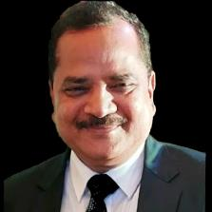

Speakers
Mr. Tom Slaymaker
Senior Statistics & Monitoring Specialist
UNICEF, JMP WASH
Dr. Asad Umar
Director WASH & Health
Aga Khan Foundation
Dr. Sital Uprety
Postdoctoral Fellow
Eawag
Notes:
Need photos

Slide 4
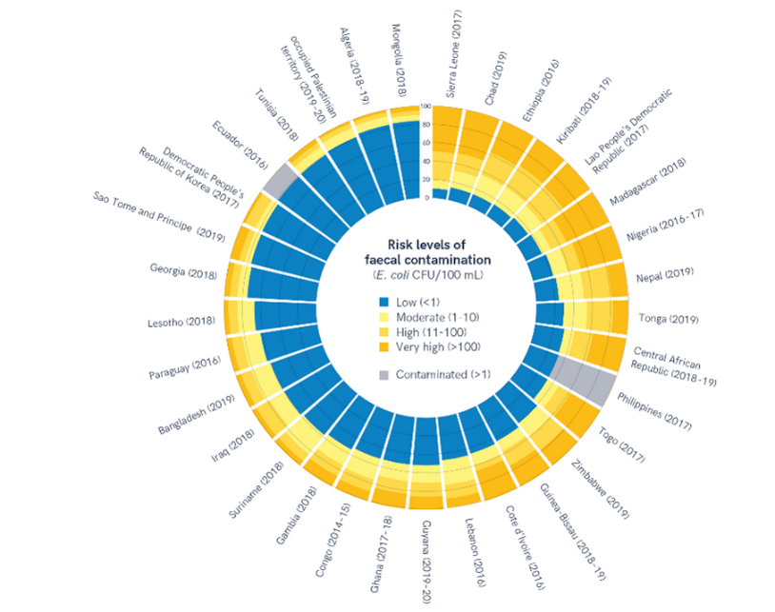
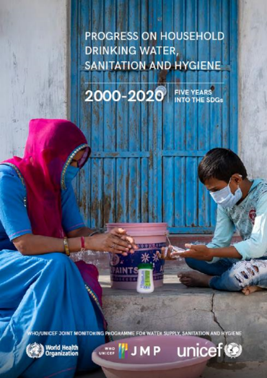
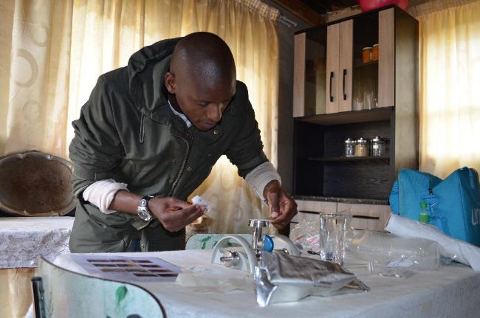
Progress on global monitoring of safely managed drinking water services
2 May 2023
W1.2 Systemic requirements for monitoring and managing water quality
Rick Johnston (johnstonr@who.int) Tom Slaymaker (tslaymaker@unicef.org)
washdata.org
Notes:
Joint programme
Global monitoring and support to national monitoring
2021 report 4500 national data sources (50% census and surveys, 50% admin)
3283 national sources for drinking water (2/3 census and surveys)
2023 update will be released in July

Slide 5
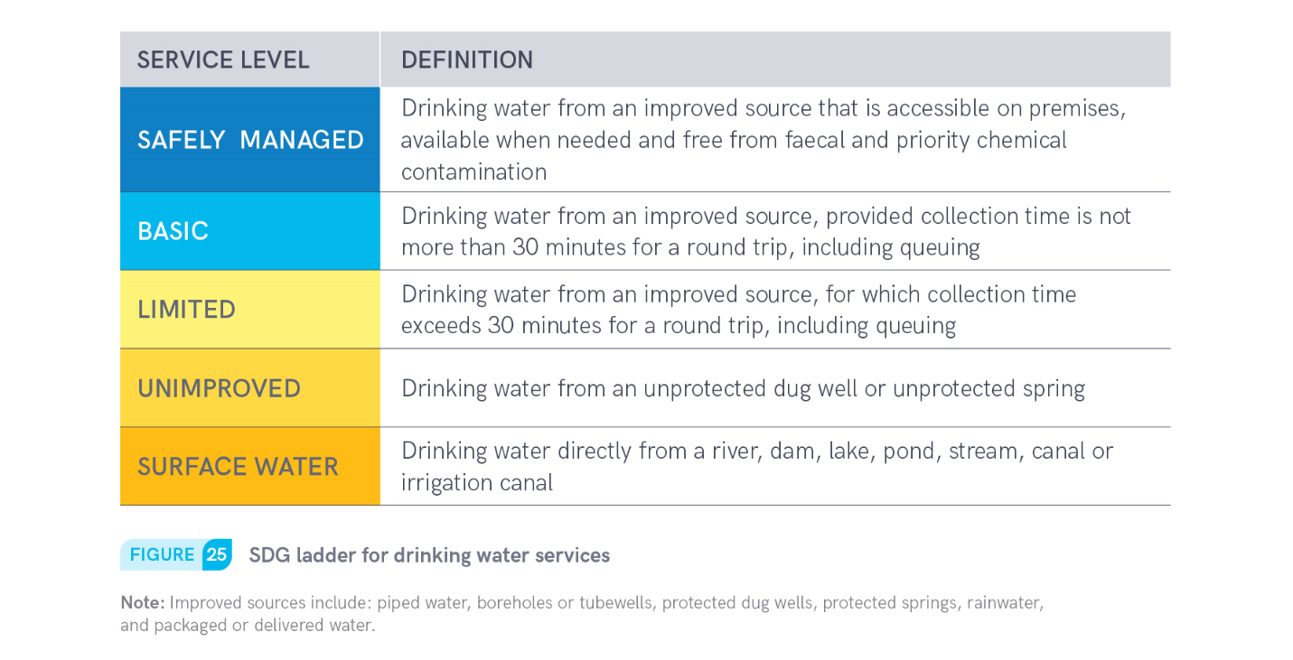
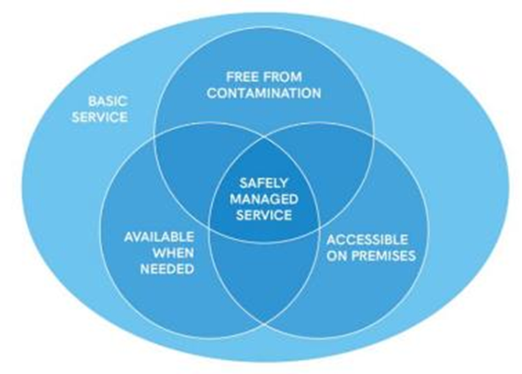
6.1.1 Drinking water

Slide 6
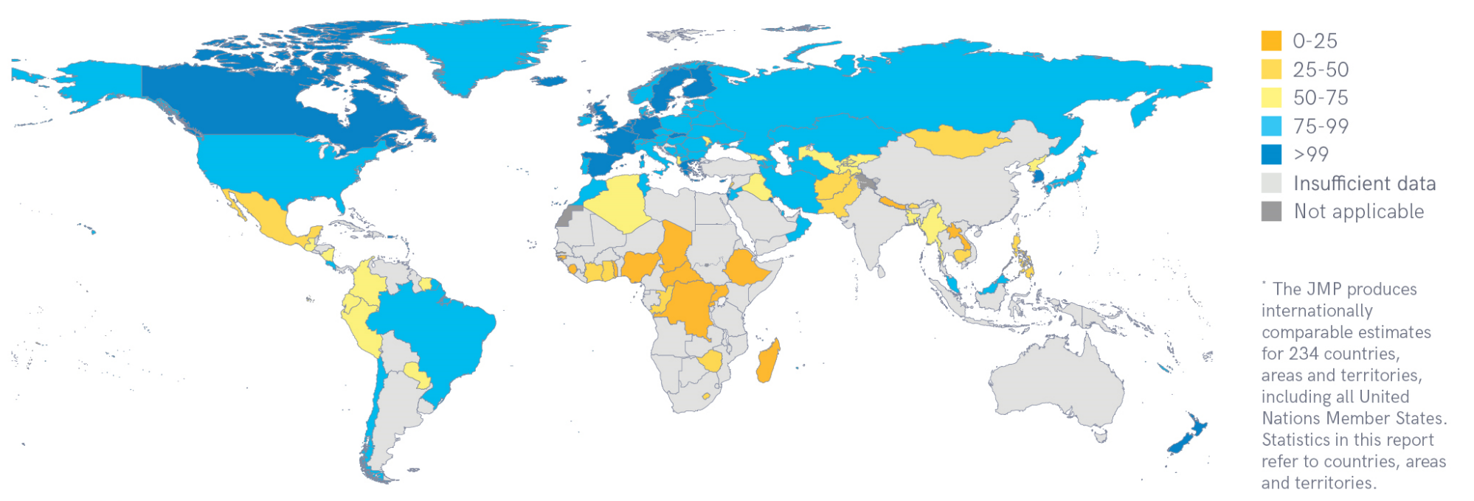
138 countries had estimates for safely managed services in 2020
Notes:
138 countries, areas and territories representing 45% of global population
Missing national estimates for large countries including India (only rural), China (only urban), Indonesia
Many LMICS still lack nationally representative data on drinking water service levels

Slide 7
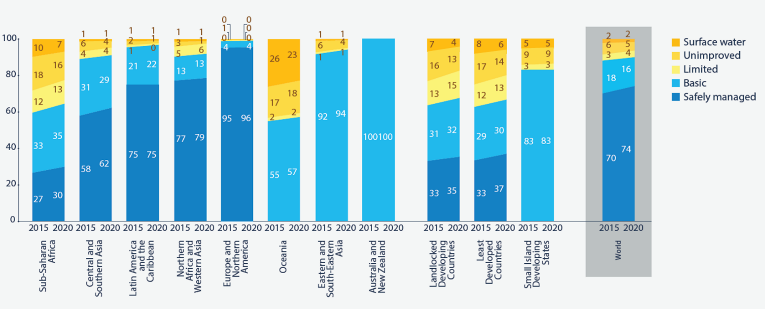
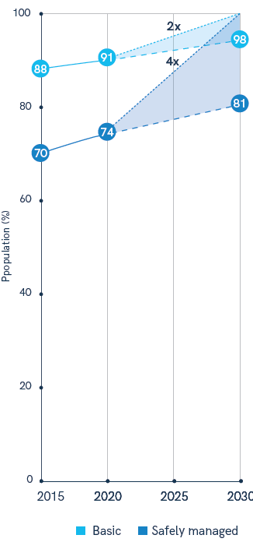
The world is off track to meet the SDG target
Notes:
Estimates for 5 out of 8 SDG regions (30%)
Insufficient national data to generate regional estimates for Oceania, ESEA and ANZ
On this basis estimated that 1 in 4 still lacked SMDW in 2020
Extrapolated current rates of progress and showed acceleration required to achieve universal access by 2030
Headline statistic at water conference ‘world is off track’ and ‘4x acceleration required’

Slide 8
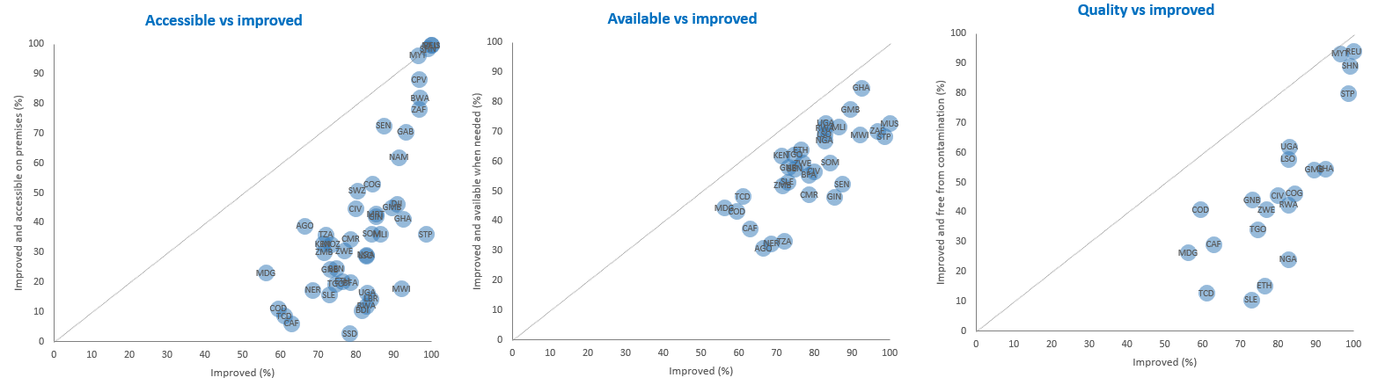
Improved is not always accessible, available, or free from contamination
https://washdata.org/how-we-work/country-and-regional-engagement/regional-analysis-2021
Notes:
To calculate safely managed drinking water services, the JMP takes the minimum value for accessibility, availability and quality in rural and urban areas and combines these to produce national estimates.
2021 report highlighted the challenge of meeting these new criteria and that the limiting factor varies between and within countries

Slide 9
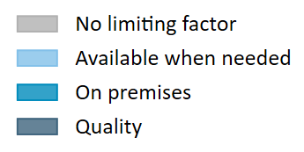
Limiting factors (2023 update)
Notes:
Analysis based on 2023 update (forthcoming)
142 estimates at national level, only 75 in rural areas and 96 in urban areas.
Can’t always combine the three elements at the household level, because they may come from different data sources – so we take the minimum of the three for rural, urban and national. The lowest of the three is therefore the ‘limiting factor’.
Chart shows number of estimates (left) and proportion of estimates (right) by limiting factor
Quality is limiting factor in about half of cases (49%).
Accessibility on premises is second most common (27%), and is particularly an issue in rural areas (36%).
Availability when needed is less common (13%), but especially in urban areas is an issue in certain countries (24%).

Slide 10
Accessible on premises
Notes:
More detailed analysis of limiting factors by country
Chart shows countries where limiting factor is accessible on premises (squares)
27 rural, 19 urban
Lots of challenges in sub-Saharan Africa, especially in rural areas.
Uganda: On premises far and away the limiting factor in both urban and rural settings. Second limiting factor in Uganda is quality (circle) in rural – availability when needed is relatively high, and close to the improved value.

Slide 11
Available when needed
Notes:
Countries where available when needed is limiting factor (triangles)
5 rural, 23 urban
Not as common a limiting factor, but also some countries don’t have data on this one, and still get an SMDW number.
There can be really big gaps between improved and available when needed in some countries, for instance in rural Algeria.
But there are a lot more countries with issues here in urban settings, especially in LAC and middle-income countries. These tend to be countries with high prevalence of piped water, but where supplies are still intermittent. And the quality, and accessibility on premises, can be very different.
In many countries, like El Salvador, almost all water supplies are accessible on premises and free from contamination, so availability when needed is really driving the safely managed number.
On the other hand in Guatemala, and also Cote d’Ivoire, problems with water quality are almost as common as problems with availability.

Slide 12
Free from contamination
Notes:
Lastly free from contamination (circles)
42 rural, 45 urban
Most common limiting factor, in both urban and rural settings.
Lao PDR: Far and away, quality is limiting factor in both urban and rural areas.
Note also that improved is very high in many settings (mainly urban but also rural), but SMDW can be quite low, highlighting the difference between the MDG and SDG indicators.

Slide 13
“Faecal and priority chemical contamination”
Data on faecal (E. coli or thermotolerant coliforms) from 172 countries/territories
  Data coming primarily from administrative sources and household surveys
  Point of collection/delivery, not point of use/consumption
Less data on arsenic (77 countries), fluoride (73 countries)
Minimum approach: few countries can integrate datasets at household level
  Take the minimum value, at the level of urban, rural, or total population
  64 countries with all three parameters: E. coli limiting factor in 75% (n=48)
  Arsenic (n=7): Andorra, Austria, Croatia, Greece, Hungary, Portugal, Slovakia
  Fluoride (n=9): Cyprus, Estonia, Finland, Italy, Lithuania, Malta, Moldova, Norway, UK
Other parameters
Notes:
So missing out on some arsenic and fluoride contamination. Example of Bangladesh – worst arsenic contamination in the world but higher levels of faecal contamination.
Arsenic is the limiting factor in 7 countries, most have very high compliance with E. coli
Andorra 99.76 90.64 100
Austria 98.6 92.9 100
Greece 98.03773 97.93 100
Croatia 70.5 66.31 100
Hungary 89.8 54.1 97.1
Portugal 97.2 97.17 98.86
Slovakia 97.38 96.8 99.86
Fluoride is the limiting factor in 9 countries, again where microbiological compliance is very high:
Cyprus 96.3 100 94
Estonia 98.5 100 77.03
Finland 99.8 99.9499 88.6
United Kingdom of Great Britain and Northern Ireland 99.83904 99.93136 99.67848
Italy 93.9 92.62 91.25
Lithuania 99 100 76
Republic of Moldova 84.9 100 83.5
Malta 100 100 98.23009
Norway 98.3 99.8 96.6
Other parameters are also important at the national and local levels, but don’t occur at the same scale as arsenic and fluoride, or have the same egregious health impacts, so they aren’t aggregated for global monitoring.

Slide 14

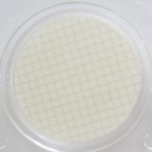
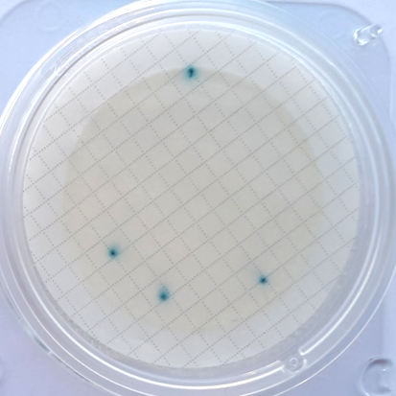
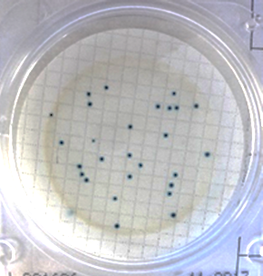
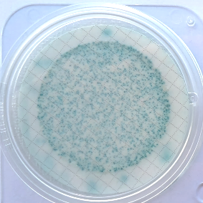
Water quality testing module for household surveys
Portable field kit
Water quality testing manual
Test water from glass and source (100 mL samples)
Nationally representative sample: 5 hh/cluster
Quantification of E. coli (risk levels)
Test takes ~5-10 mins followed by 24 hour incubation
Test by existing field team (often the measurer)
QA/QC: expert training, blank tests, field supervision
Data analysis: tabulation plan/syntax/report template
https://mics.unicef.org/tools?round=mics6
<1
1-10
11-100
>100

Slide 15
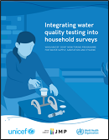
>50 countries supported to date
2023
2012-2015
2012-13
Ghana LSS
Congo MICS
Nepal MICS
2018
Ethiopia ESS
2020
(Pakistan MICS)
(Afghanistan ALCS)
(Belize MICS6 Pilot)
Ecuador ENEDMU
(Mongolia MICS)
Nigeria MICS
Paraguay MICS
Côte d’Ivoire MICS
Philippines APIS
Senegal EEAH
Sierra Leone MICS
Suriname MICS
Lao PDR SIS
Georgia MICS
Tunisia MICS
Iraq MICS
Kiribati MICS
Mongolia MICS
DRC MICS
Lesotho MICS
Madagascar MICS
Ghana MICS
Côte d’Ivoire DHS
2021
2022
Benin MICS
2019
Algeria MICS
Bangladesh MICS
CAR MICS
Chad MICS
Gambia MICS
Dominican Republic MICS
Guinea-Bissau MICS
Honduras MICS
Lebanon National
Indonesia SKAM-RT
Sao Tome and Principe MICS
Samoa MICS
State of Palestine MICS
Malawi MICS
Bangladesh MICS
2014-15
2016-17
Ecuador ENEMDU
Trinidad and Tobago MICS
Togo MICS
Tonga MICS
Turks and Caicos MICS
Tuvalu MICS
Viet Nam MICS
Eswatini MICS
Fiji MICS
Sri Lanka HIES
Zimbabwe MICS
Kosovo MICS
Mozambique DHS
Nigeria NORM
Tanzania NPS
DPRK MICS
Nepal MICS
Nigeria NORM
Guyana MICS
Afghanistan MICS
Argentina MICS
Azerbaijan MICS
Belize MICS
Burkina Faso
Ethiopia DHS
FSM MICS
Guatemala DHS
Laos SIS
Lebanon MICS
Nauru MICS
Nicaragua MICS
Somalia MICS
Sudan MICS
Tunisia MICS
Turkmenistan MICS
Uganda DHS
Vanuatu MICS
https://washdata.org/reports/integrating-water-quality-testing-household-surveys
15
Notes:
Slum surveys in Indonesia, Philippines?

Slide 16
Conclusion
Strengthening national systems for monitoring SDG targets
Data availability improving but large gaps remain
  Administrative/regulatory data coverage incomplete (esp rural, non-piped)
  Household survey data infrequent (3-5 years)
Data quality varies widely between and within countries
  Standardized definitions, representative samples, disaggregation of variables
Moving beyond project/programme monitoring to national monitoring
Accelerating progress towards SDG targets
Quality is important, but it’s not everything
On premises is a big challenge especially in rural areas and in sub-Saharan Africa
Availability is a challenge in middle-income countries, especially in urban areas

Slide 17
Water Quality Monitoring & Surveillance (WQMS) framework under Jal Jeevan Mission (JJM)- the Flagship Rural Water Supply Initiative in India
&
The promotion of water safety plan as risk mitigation tool to strengthen WQM&S approaches – An example from Indian state of Uttar Pradesh

Slide 18
Contents slide
Background and context
Water quality issues in India
Water Quality Monitoring & Surveillance (WQMS) Strategy and its Operationalization
Institutional Mechanism and Quality Control
Status of testing of drinking water samples in 2023-24 under Jal Jeevan Mission
AKF Response and arguments for promoting a WSP approach with JJM
  Water Safety Planning and Alignment with JJM in 5 districts of Uttar Pradesh
  Arguments for promoting WSP under JJM
Way Forward

Slide 19
Background and context
  Jal Jeevan Mission (JJM) aims to provide a Functional Household Tap Connection (FHTC) with assured water supply
    in adequate quantity (55 litres per capita per day) of prescribed quality (BIS) with adequate pressure on regular and long-term basis to every rural household in the country
  Water testing gained traction in monitoring the operation of water supply, safety of drinking water, investigation of disease outbreaks, and preventive measures.
  New drinking water quality monitoring and water quality surveillance framework was rolled out in October 2021 to streamline monitoring and surveillance—bringing together two distinct yet, closely related activities
    the drinking water quality is to be 'monitored' by the Public Health Engineering Department (PHED)/ Rural Water Supply (RWS) Department
    Surveillance of water quality to be led by the local community involving women using Field Test Kits (FTK)s
  To safeguard rural public health, nation-wide online Water Quality Management Information System (WQMIS) has been developed by using the reports generated from water quality testing through FTKs as well as laboratories

Slide 20
Water quality issues in India
Nearly 19 States in India, have geogenic contaminants such as Arsenic, Fluoride, Nitrate, Iron, Salinity issues .
Ministry of Health and Family Welfare (MOHFW) has identified 61 priority districts across five states that are affected by Japanese Encephalitis and Acute Encephalitis Syndrome (JE/ AES).
According to an assessment by the Central Ground Water Board (CGWB) in 2018, 52% blocks in the country have at least one of the geogenic contaminants, viz. Arsenic, Fluoride, Iron, Nitrate and Salinity.
Diarrhoea linked to bacteriological contamination is one of the leading causes of deaths in children in this age group globally and claims approximately 1.1 lakh lives in India every year

Slide 21
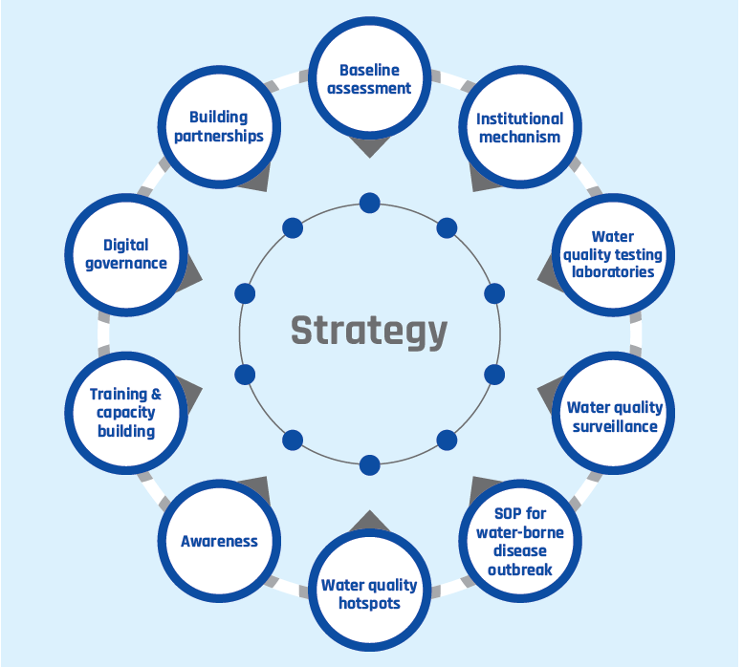
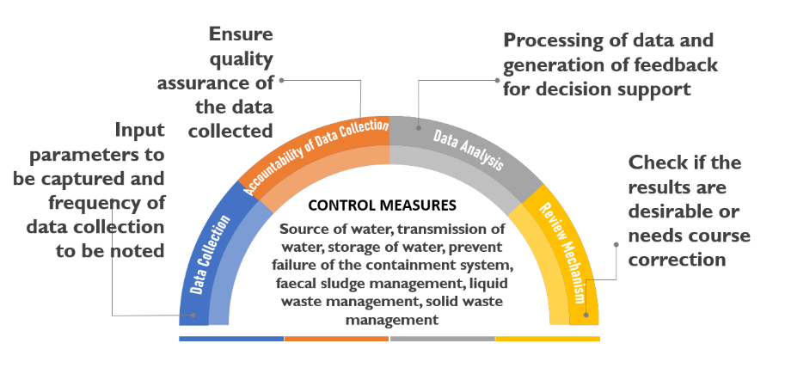
Water Quality Monitoring & Surveillance (WQMS) Strategy and its Operationalization

Slide 22
Institutional Mechanism and Quality Control
A robust institutional arrangement is in place, connecting the cadre of chemists, engineers and the existing four-tier framework under JJM, viz. VWSC, DWSM, SWSM, NJJM*
All the Water Quality Testing laboratories are being standardized, upgraded and mandated to be NABL accredited/ recognized-At least one NABL accredited laboratory in every district
100% testing of all drinking water sources to be undertaken and mandatory reports to be generated for wide dissemination
Testing of drinking water sources –
    Once in year for chemical and physical parameters and
    Twice in a year for bacteriological parameters (pre and post monsoon).
    Water quality testing using FTKs to be done at least once every month in schools and ECD Centers
Identification and training of women from local community to test quality of drinking water for chemical/ bacteriological contamination using FTKs/ H2S vials
    At least 2 women if village population < 1000
    At least 5 women if village population >= 1000
States are to test at least 5% of the total drinking water samples from all district level laboratories
*VWSC: Village Water Sanitation Committee, DWSM: District Water Sanitation Mission; SWSM: State Water Sanitation Mission; NJJM: National Jal Jeevan Mission

Slide 23
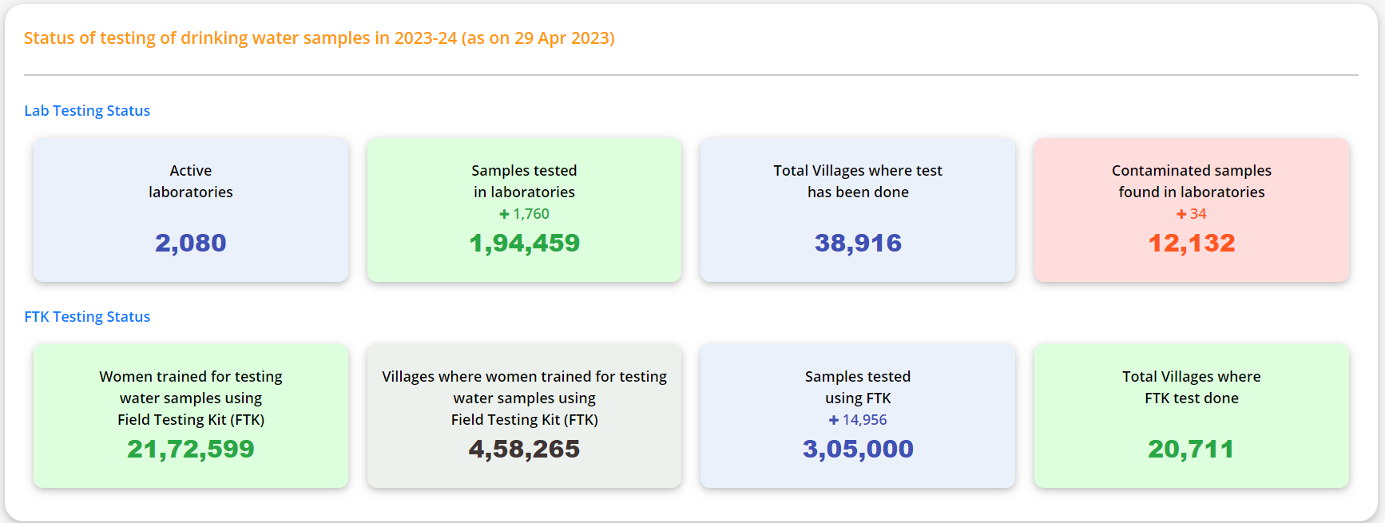
Status of testing of drinking water samples in 2023-24 (as on 29 Apr 2023)

Slide 24
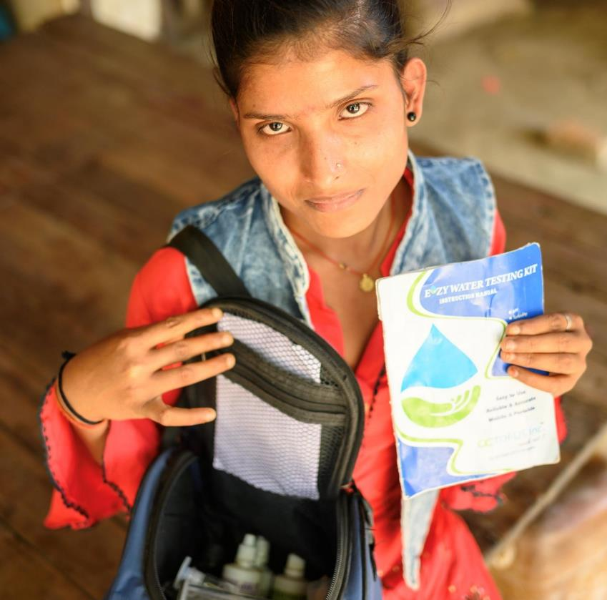
AKF Response and arguments for promoting Water Safety Planning approach as risk mitigation tool under Jal Jeevan Mission

Slide 25
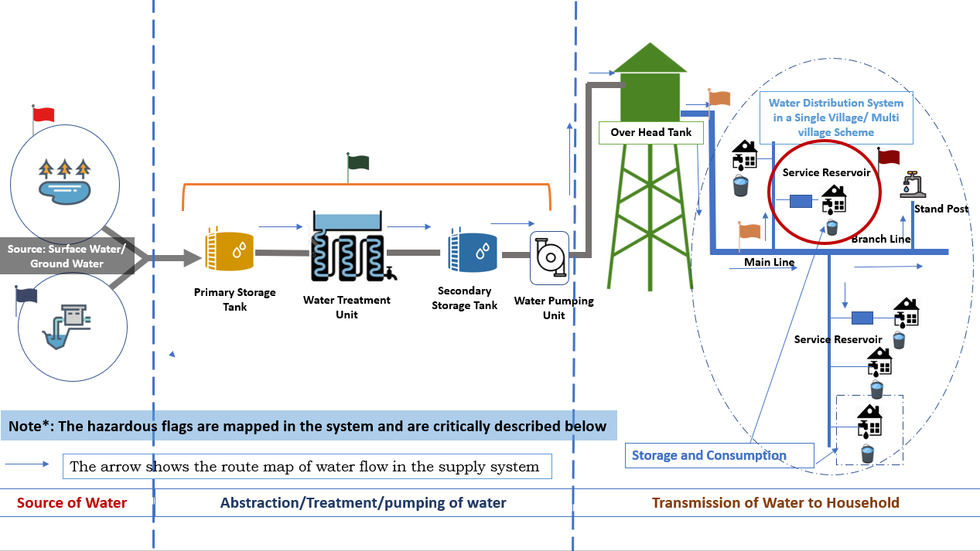
Water Safety Planning and Alignment with JJM in 5 districts of Uttar Pradesh
Water Safety Planning is a proactive risk mitigation and management system to
  Understanding the complete water supply system
  Identifying where & how problems could arise
  Putting barriers and management systems in place to stop possible source of contamination
On-ground demonstration through sanitary risk assessment in 2 blocks
Capacity building of Engineers, Water Utility managers & Implementation Support Agencies (ISAs) in 5 districts of UP
Knowledge support through development of process guide
Mapping the hazardous events & Risk Mitigation Approaches
Source -Catchment
Production of Water – Abstraction & Treatment
Distribution of Water – Storage for consumption
Risk Mitigation Approaches- WQ monitoring & Management, Retrofitting of Toilet- Single to Twin pits, System of containment and faecal sludge management; Management of solid &Liquid waste;

Slide 26
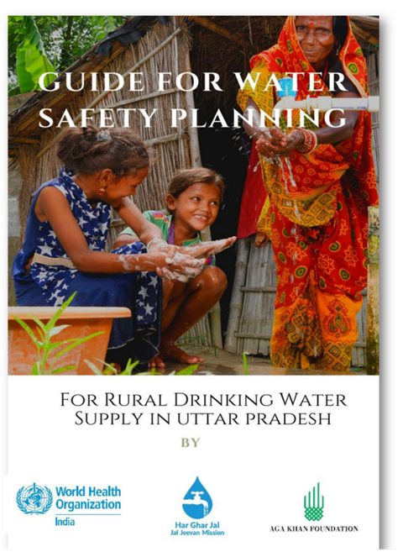
Arguments for promoting WSP under JJM
Argument 1: WSP helps to focus on health outcomes and bring about visible improvements:
Argument 2: WSP facilitates the continuous assessment of risks across the supply chain and take proactive measures to mitigate risks; this also makes O&M more systematic
Argument 3: WSP leads to cost savings or financial gains, as risks or problems are fixed before they become big
Argument 4: WSP promotes community ownership and management of O&M, establishes, and empowers community institutions
Argument 5: WSP promotes inclusion and brings about tangible changes in water quality and availability, for an otherwise marginalized and vulnerable people.

Slide 27
Way Forward
For both groundwater and surface water-based rural drinking water supply schemes, it is vital to monitor the bacteriological and chemical parameters to ascertain the safety of water quality.
The road ahead is thus to build capacities of local communities to be able to achieve service level benchmarking for rural drinking water supply at GP/ village level and monitor it regularly
The Water Quality Management Information System (WQMIS) is enabling digital governance with IoT based online service delivery monitoring.
As highlighted under risk mitigation approaches, it is critical to strengthen implementation of Swachh Bharat Mission Phase-II to ensure proper management of Fecal Sludge Management (FSM), GOBARDHAN, Grey water and solid waste management.
It is important to study the water quality patterns, document and analyze the same for effective
policy intervention

Slide 28
Resources and more info slide
https://ejalshakti.gov.in/jjmreport/Quality/WQMIS_Dashboard.aspx
https://jalshakti-ddws.gov.in/sites/default/files/WQMS-Framework.pdf
https://drive.google.com/file/d/1wNOSlczGZ xl_Ja4i3MBWfTzP6Q7XmvU/view?usp=share_link

Slide 29
The Role of Fit-for-Purpose Labs for Monitoring and Managing Rural Water Supplies
The REACH Labs Project: A 3-Country Study
Dr. Sital Uprety

Slide 30
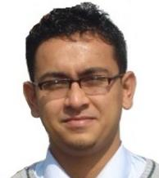
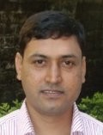
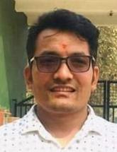
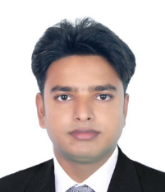
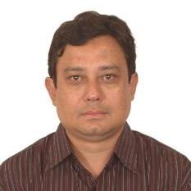
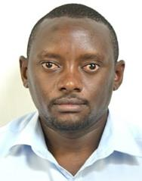

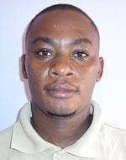






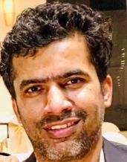
The REACH Labs Project
Helvetas
SafePani
FundiFix
Eawag
Univ of Oxford
Govt of Nepal

Slide 31
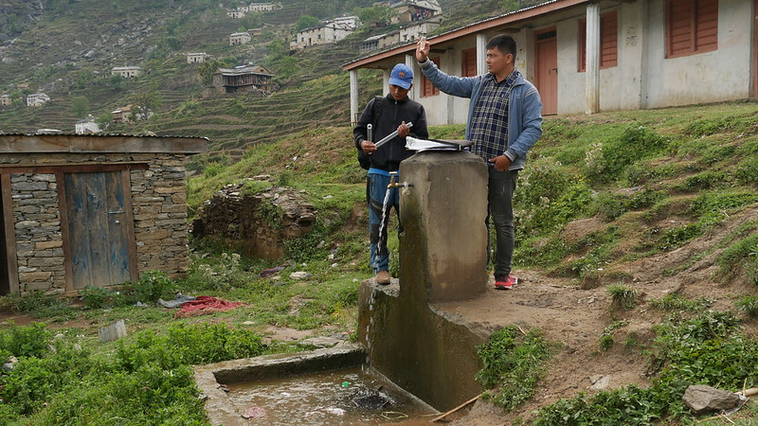
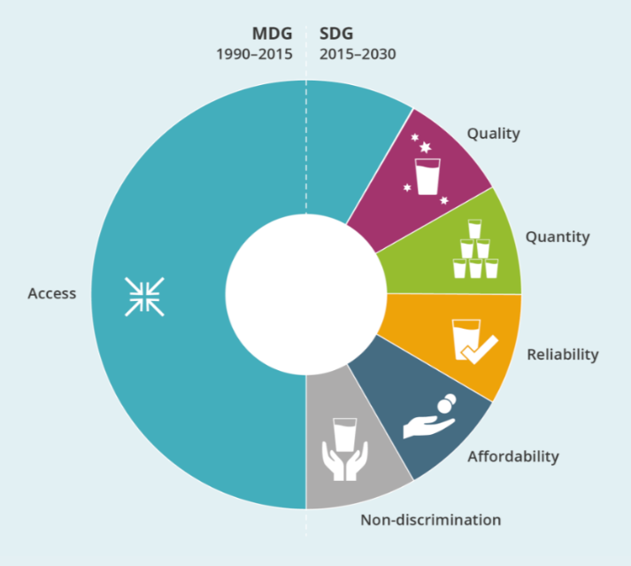
Insufficient
data
Unsafe water
Low motivation to identify risks
Low awareness & evidence of risks
Inadequate planning and management
Photo: Michael Vogel
Notes:
Problem statement: The challenge of fulfilling SDG 6, especially in rural zone with landscapes as shown. The system status quo is one of little to no data collection, which leads to delayed or no response by operators and users, ultimately leading to a low-level equilibrium of unsafe drinking water. Breaking this cycle is challenging because the system is self-reinforcing, ie, lack of data drives lack of response and vice versa.

Slide 32
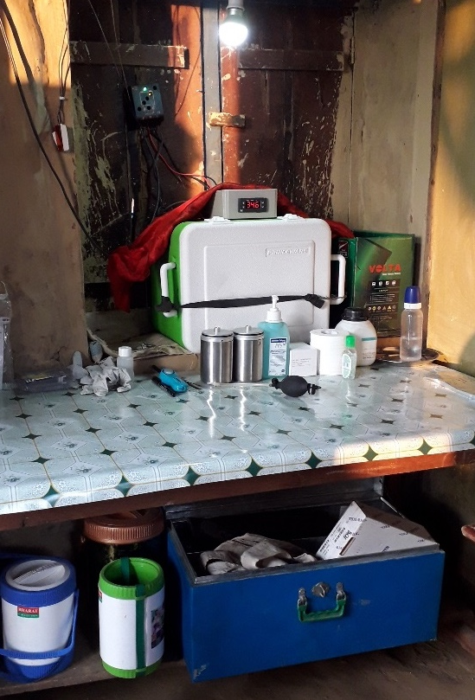
The REACH Labs Project
Partners:
Eawag (Switzerland), Univ. of Oxford (UK), Helvetas (Nepal), Univ. of Nairobi (Kenya), FundiFix (Kenya), SafePani (Bangladesh)
Objectives:
Identify enablers and barriers
Develop a digital lab assessment tool
Timeline: 2021 – 2023

Slide 33
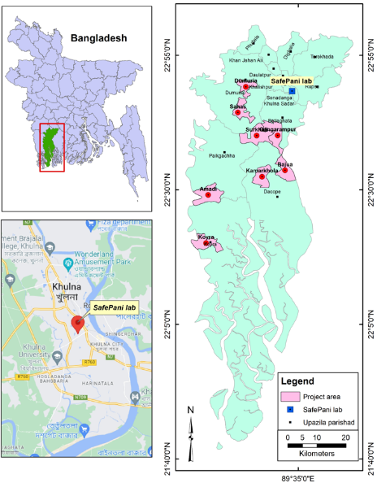
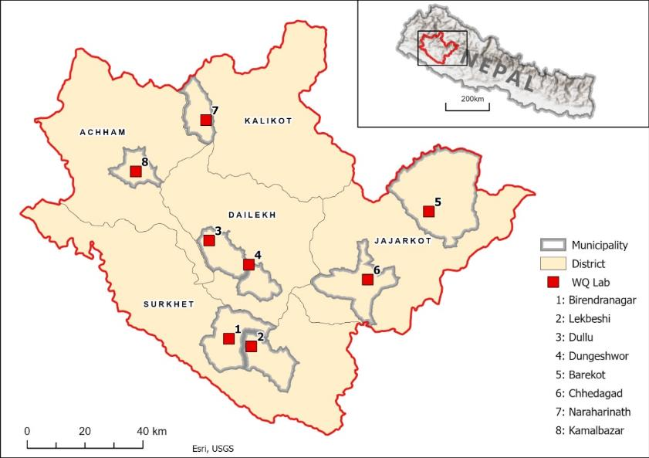



Study Sites
Khulna, Bangladesh
Surkhet, Nepal
Kitui, Kenya
SafePani here

Slide 34
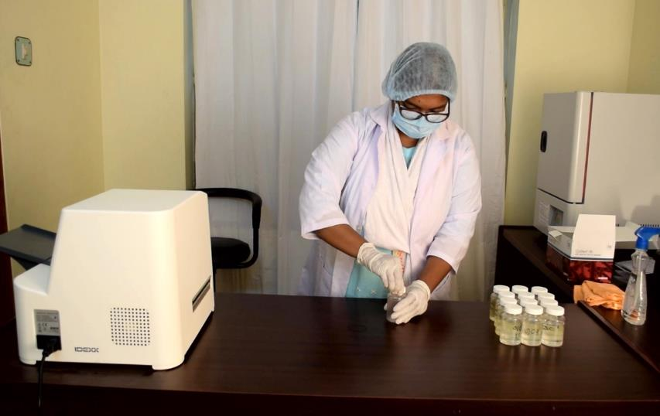
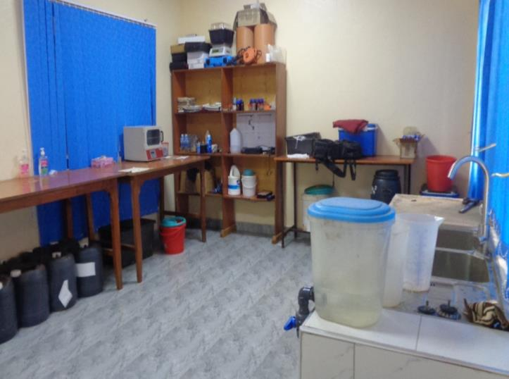
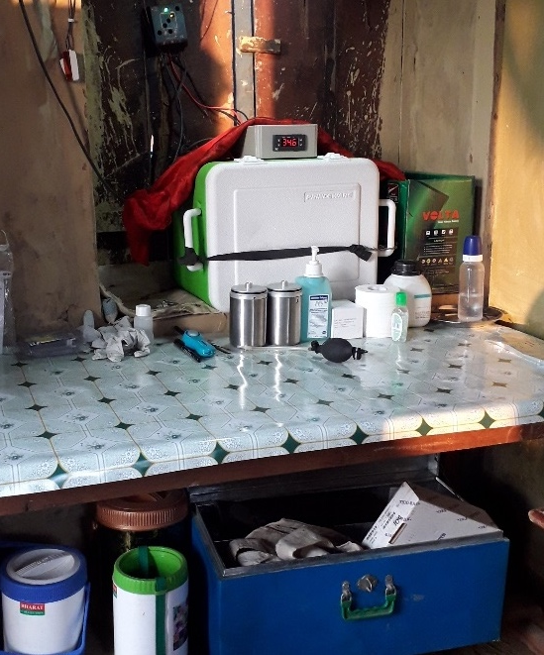
Rural labs tailored to local needs and capacities
SafePani here

Slide 35
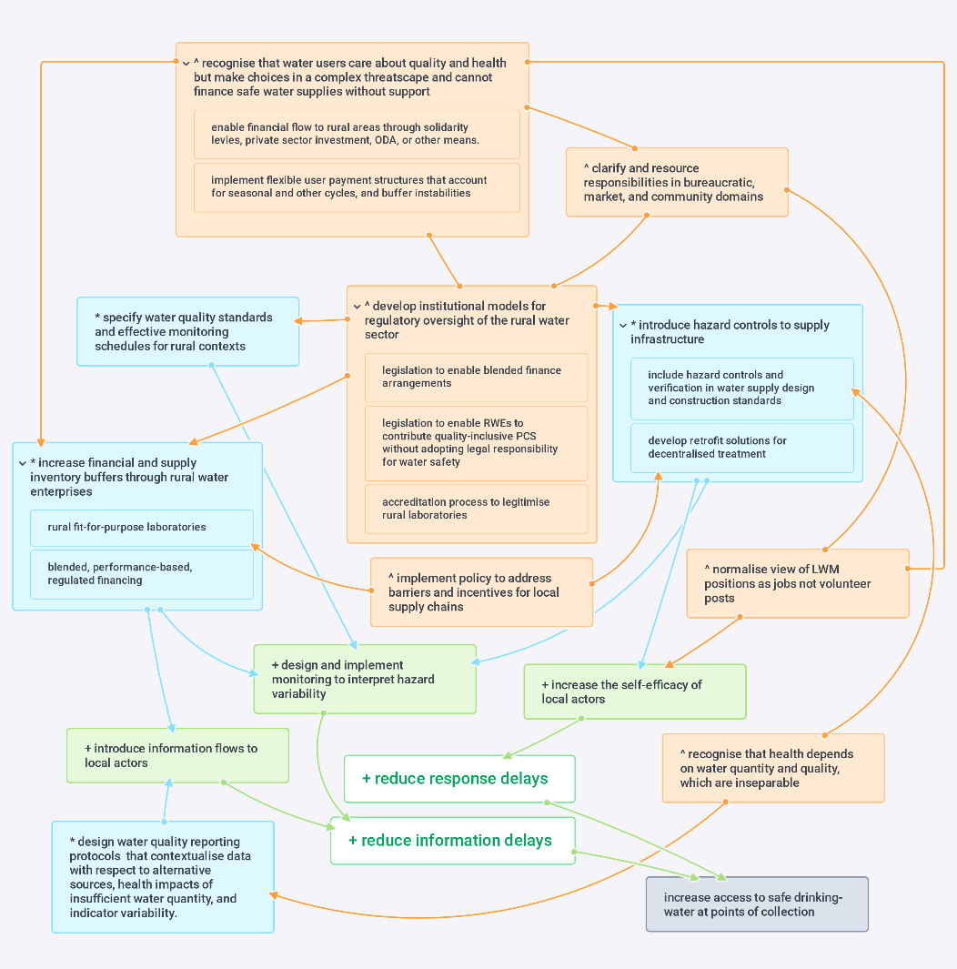
Rural laboratories are part of the system of safely managed water
LEVERAGE POINTS:
Stock and flow leverage
Feedback leverage
Institutional / structural leverage
Positional leverage
Nowicki, S. (2021) Data, Decisions, and Drinking-Water Safety: An interdisciplinary response to monitoring in rural Kenya. DPhil Thesis, University of Oxford. https://ora.ox.ac.uk/objects/uuid:952a1144-59e7-4cc7-8bb9-4273556c3892
Notes:
Here I will introduce this figure as the theoretical framework driving the research, mentioning Saskia’s work and highlighting the role of rural FFLs as part of a larger “ecosystem” at play. Then introduce the simplified graphic next to highlight the main leverage points to be covered in the talk…

Slide 36
Rural laboratories are part of the system of safely managed water
Rural water enterprises
Lack of capacity
in rural water managment
Rural water financing and regulation
Local supply chains
Information flows
Fragmented databases, measures are not comparable
Lack of regulatory integration, water quality perceived as expensive
Limited / inconsistent
availability of materials

Slide 37
Rural laboratories are part of the system of safely managed water
Rural water enterprises
Local FFP labs
Lack of capacity
in rural water managment
Rural water financing and regulation
Local supply chains
Information flows
Fragmented databases, measures are not comparable
Lack of regulatory integration, water quality perceived as expensive
Limited / inconsistent
availability of materials

Slide 38
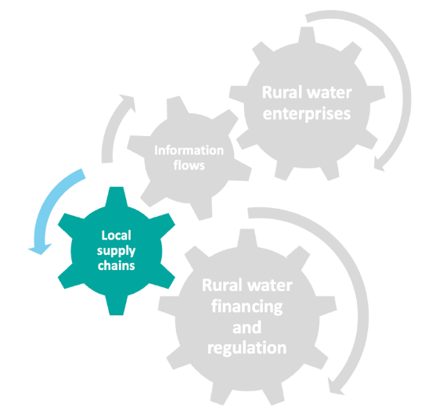
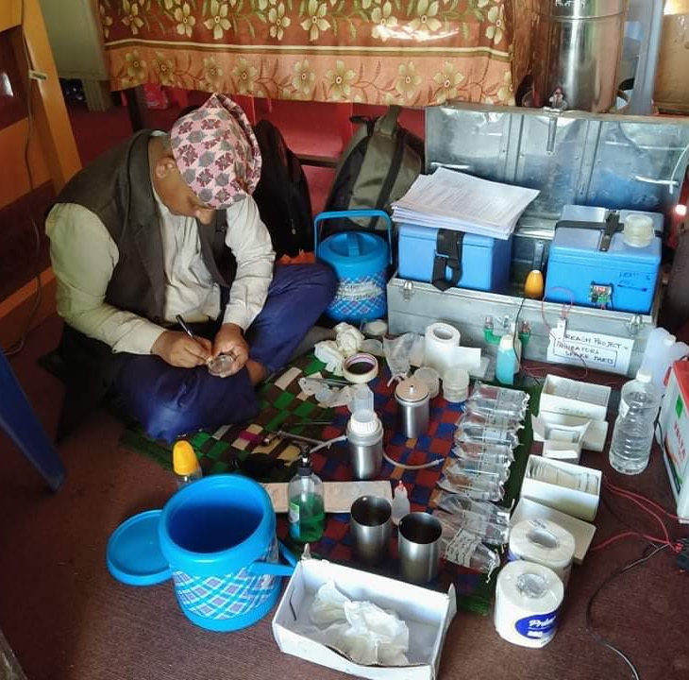
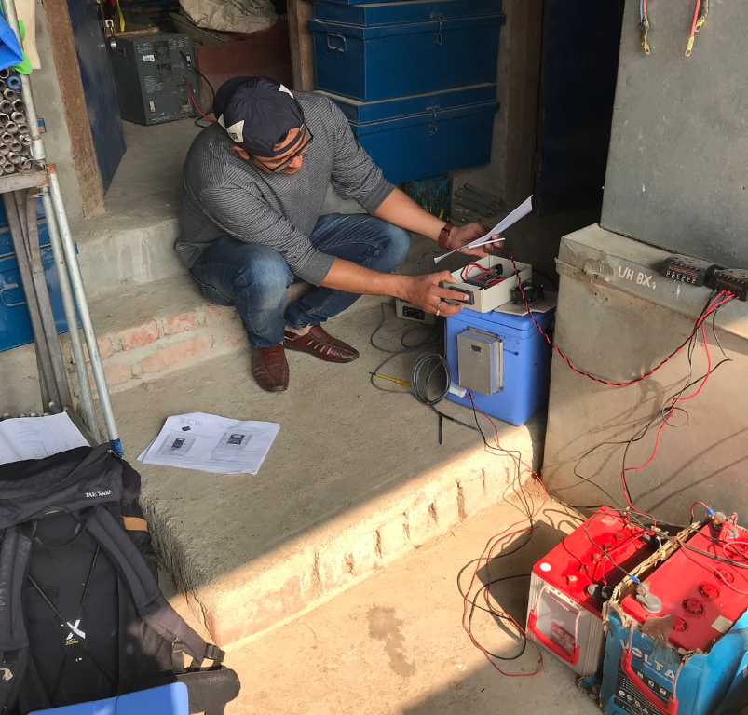
Rural labs stocked with adapted equipment, locally sourced materials

Slide 39
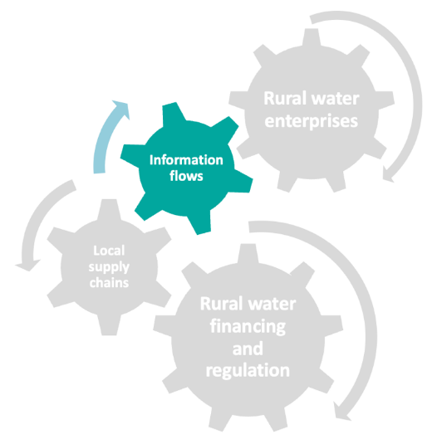
Rural labs feed into Nepal’s national WASH information system (NWASH)
Operational Monitoring
Local level
Compliance Monitoring
Provincial level
Water Quality Surveillance
Ministry level

Slide 40
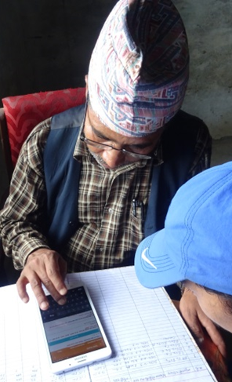

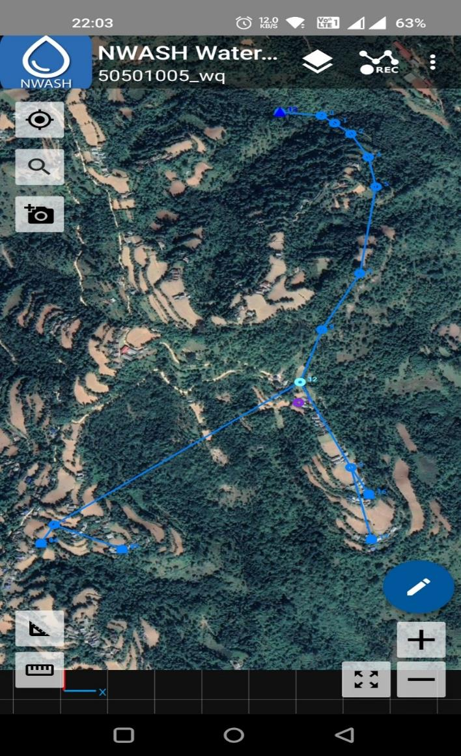
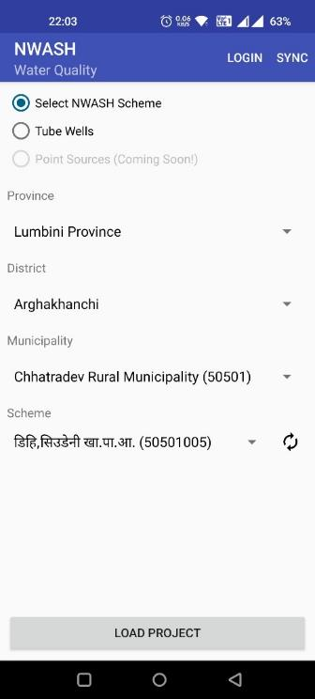
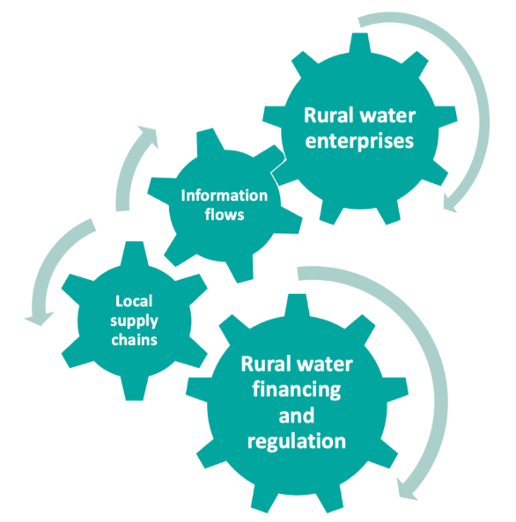
Photos: Rajit Ojha

Slide 41
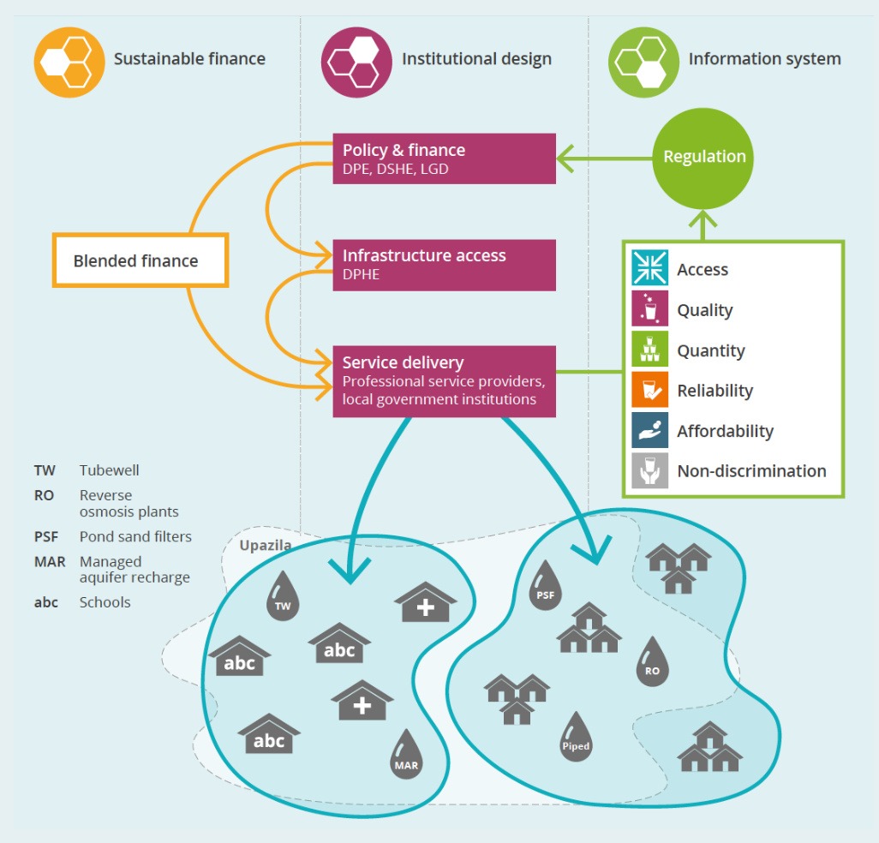
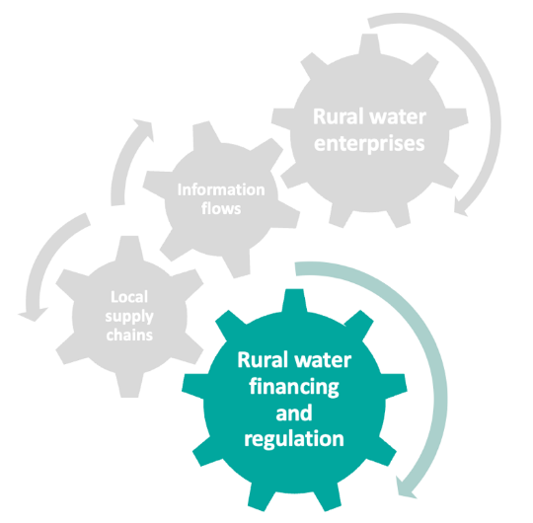
Subsidising water safety and monitoring through rural labs
Notes:
it is difficult to get funding on water safety to rural areas to help monitoring. The labs provide a mechanism.

Slide 42
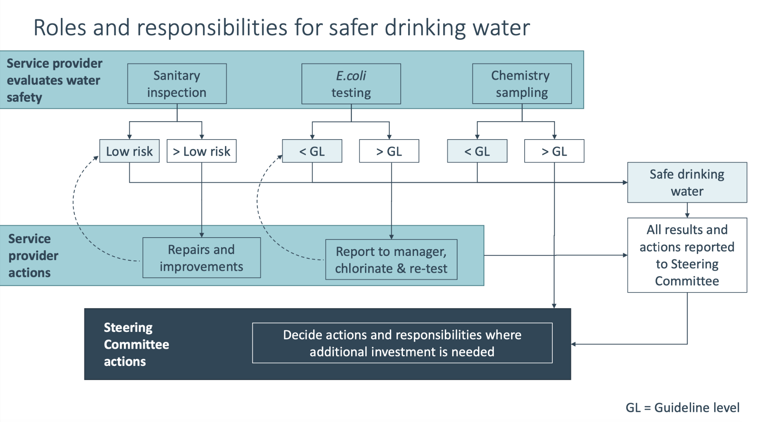

Slide 43


Rural labs embedded within local institutions to share costs & align activities

Slide 44








Thanks to our partners

Slide 45

Questions?

Slide 46
Session Outline
13:45 Introduction
13:50 PART 1: Presentations
      Progress on global monitoring on safely managed water (WHO/UNICEF JMP)
      Monitoring & surveillance under Jal Javeen Mission (Aga Khan Foundation)
      Role of fit-for-purpose labs for monitoring & management (REACH)
14:25 PART 2: Panel Response & Discussion
14:55 Reflection & Close

Slide 47




Panelists
Dr. Rachel Peletz
Excecutive Director
Aquaya Institute
Ms. Marieke Adank
Senior Programme Officer
IRC
Prof. Katrina Charles
Environmental Health Risks
University of Oxford
Mr. Monir Alam
WASH Specialist
UNICEF Bangladesh
Mr. Tom Slaymaker
Senior Statistics & Monitoring Specialist
UNICEF
Dr. Asad Umar
Director WASH & Health
Aga Khan Foundation
Notes:
Check titles

Slide 48

Panel
Discussion

Slide 49

Reflection & Close

