Slide 1

Progress on global monitoring of safely managed sanitation services
3 May 2023
W4.5 Data and monitoring: strengthening systems for achieving safely managed sanitation services
Rick Johnston (johnstonr@who.int) Tom Slaymaker (tslaymaker@unicef.org)
washdata.org

Slide 2

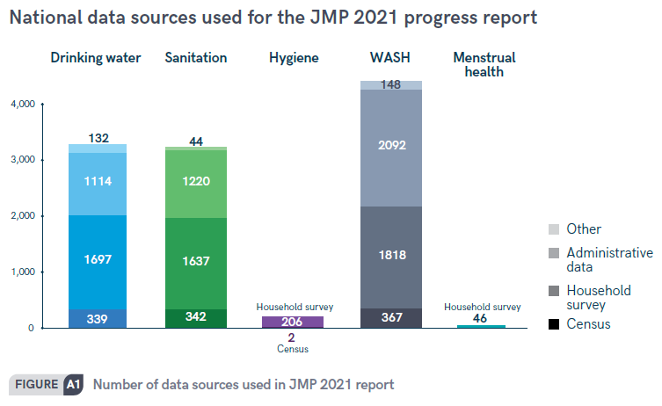
JMP 2021 progress report
https://washdata.org/report/jmp-2021-wash-households

Slide 3
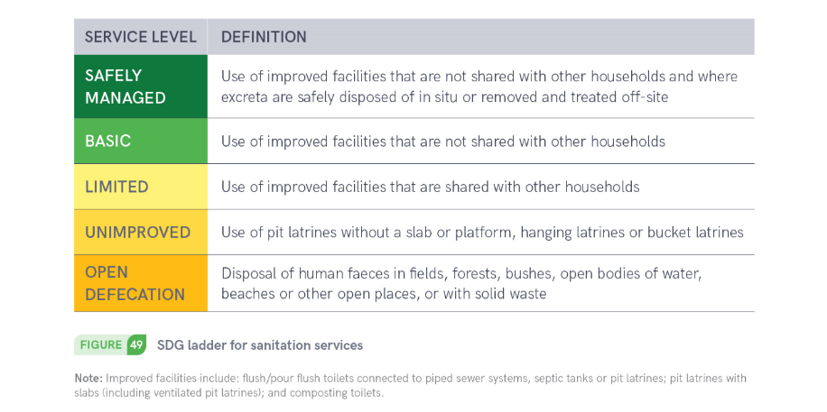
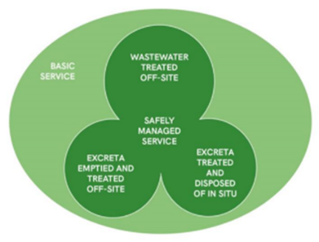
6.2.1a Sanitation

Slide 4
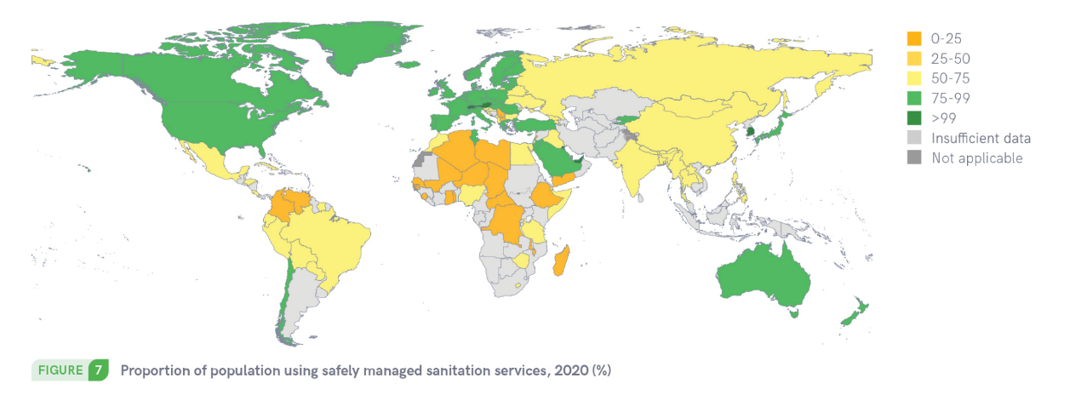
120 countries had estimates for safely managed services in 2020

Slide 5
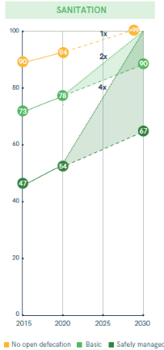
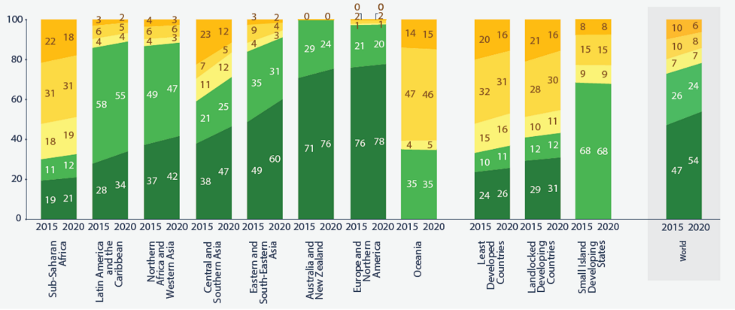
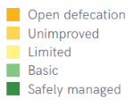
The world is off-track to meet the SDG target

Slide 6
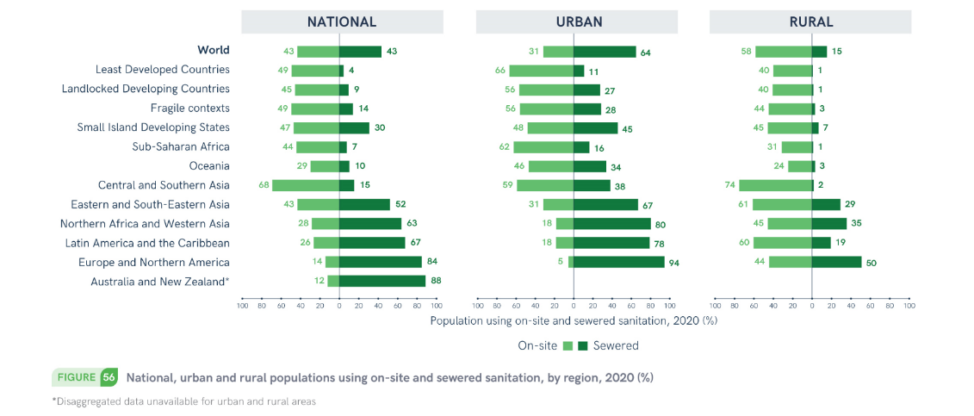
The distribution of on-site and sewered sanitation varies widely by region
Notes:
Onsite is growing faster than sewered, even in urban areas

Slide 7
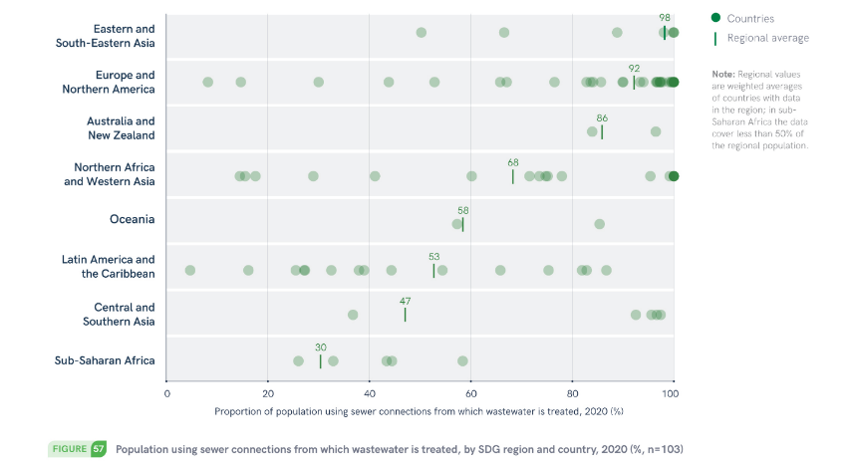
Many countries have data on treatment of wastewater from sewers
Notes:
In all regions, there are some countries where half or less of sewered wastewater is treated. Of course this doesn’t reflect the large non-sewered populations, especially in Asia and Africa, and especially in rural areas.

Slide 8

Safe management of onsite sanitation
CONTAINMENT
EMPTYING
TRANSPORT
TREATMENT
DISPOSAL / REUSE
https://www.fsmtoolbox.com/

Slide 9
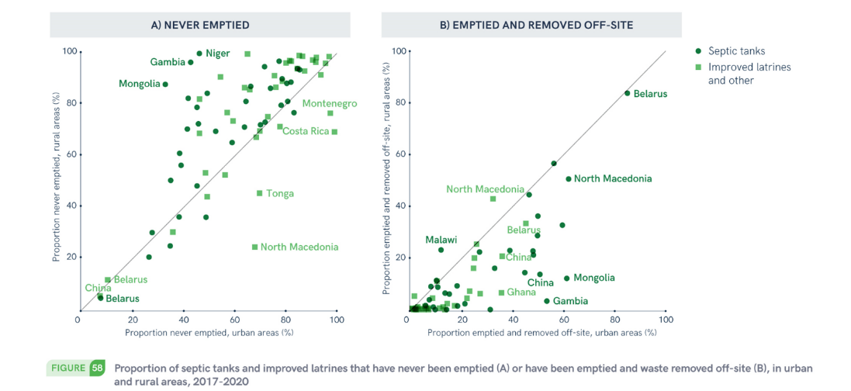
Few countries have data on safe management of on-site sanitation

Slide 10
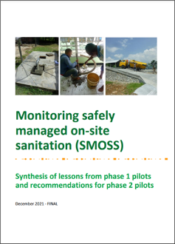
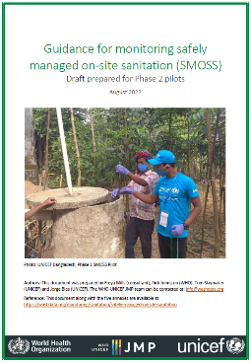
Monitoring Safely Managed On Site Sanitation (SMOSS) project
Phase 1 pilots (2020 – 2022)
Bangladesh
Ecuador
Indonesia
Kenya
Serbia
Zambia
Phase 2 guidance (2022+ )
Annex A (indicators)
Annex B (household questionnaire)
Annex C (sanitation inspection)
Annex D (service authority)
https://washdata.org/monitoring/sanitation/safely-managed-on-site-sanitation
Notes:
Phase 1 pilots x 6 recently completed (list them)
Country reports coming in and we have also produced a Synthesis report summarising key findings from Phase 1
One of the key findings is importance of containment, as well as downstream FSM, led to tools to better monitor containment including inspections
Phase 2 guidance
Core indicators for global monitoring, expanded indicators for national and sub-national
Multiple data sources covering different steps on sanitation chain (hh surveys, inspections, administrative data from service authorities)
Good progress on containment, emptying and disposal in-situ
Remaining challenges on collecting and aggregating data on emptying, transport and treatment off-site
Opportunities for integration into emerging WASHMIS and regulatory reporting systems

Slide 11
Understanding global vs national indicators
 | Global indicators | Examples of optional local indicators for national monitoring
Containment | Containment is not overflowing or discharging waste directly to the surface environment | Design standards: sealed cover, wall and base material or permeability, chambers, dimensions, outlet type Functionality: damage, blockage, leaks, sludge depth Groundwater risk: proximity to wells, depth of groundwater, soil characteristics density (volume/area requirements for infiltration)
Disposed in-situ | Contained, not emptied | Function: Years operation, size, sludge depth, Risks: Groundwater risk, flood risk
 | Contained, emptied, buried in-situ | Location: on/off premises, distance from house Safety: covered, how buried, buried in rainy season, groundwater risk, proximity to waterways / residents Reuse: contents used after less than 2 years storage
Emptying | If containment ever emptied | Emptying frequency: years, regular or scheduled Method: manual, mechanical (type of equipment) Safety to workers: PPE/protection, not entering pit Safety to user/public: no spillage, flushed to drain Accessibility: location of containment, presence of lid/manhole, street access
Transport | Excreta delivered to off-site treatment facility | Method of transport: manual (cart), motorized, Safety to workers: PPE/protection during transport Safety to user/public: no spillage, covered transport, vehicles not used for water supply
Treatment | Designed to provide treatment for both solid and liquid phase | Design standards: meets national standards for faecal sludge treatment facilities; treatment adequately level for the risk of exposure to the effluent Function: Systems function, not overloaded/ reasonable capacity, not damaged, leaking, overflowing or bypassed.
Notes:
Containment is defined as a permeable or impermeable container for storing excreta close to the toilet or latrine. Examples of containments include latrines pits, cesspools, septic tanks, and holding tanks

Slide 12
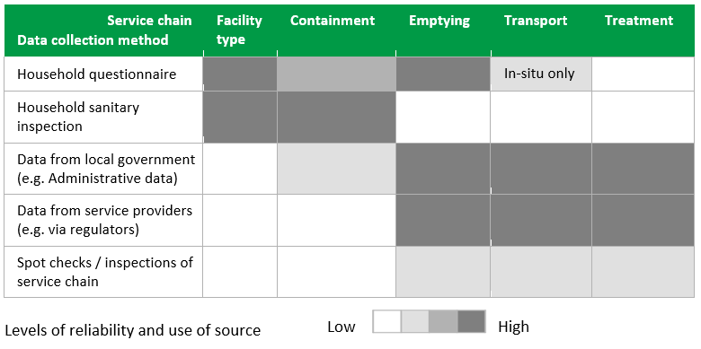
Drawing on multiple sources of data

Slide 13
SMOSS – example household survey questions
Does your septic tank or pit latrine have an outlet pipe for liquid effluent?
  If it has an outlet pipe for liquid effluent, where does this pipe discharge?
In the last year, have excreta from your (pit latrine or septic tank) been released to the surface environment due to any of the following events?
Has your (pit latrine or septic tank) ever been emptied?
  The last time it was emptied, where were the contents emptied to?

Slide 14
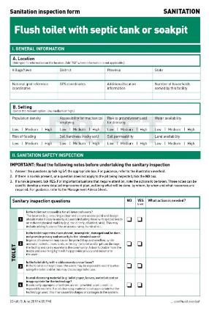
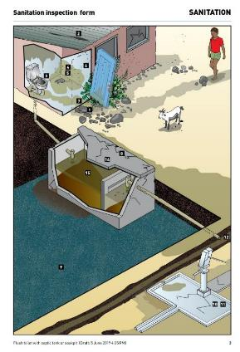
SMOSS – sanitation inspections
Sanitary inspection forms
New version under preparation
Digital format with mobile app (mWater)
https://www.who.int/teams/environment-climate-change-and-health/water-sanitation-and-health/sanitation-safety/sanitation-inspection-packages

Slide 15
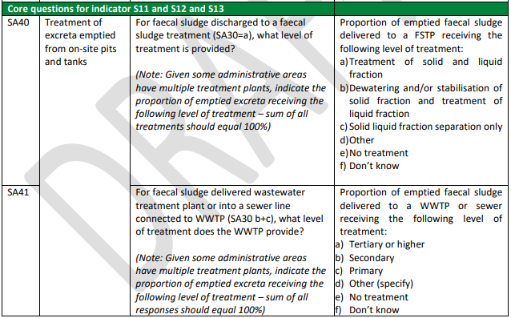
SMOSS – administrative data

Slide 16
Conclusions
Strengthening national systems for monitoring SDG targets
Harmonization of data between and within countries
  Indicators, definitions, methods
Many countries have data on WWT but few have data on SMOSS
  Containment is a big issue (sanitation inspections rare in LMICs)
  Few countries have nationwide data on treatment of faecal sludge
Moving from one off surveys/inspections towards routine data from service providers and regulators (urban and rural)
Integrating and analyzing data from multiple data sources

