Slide 1


Join at slido.com
#6358366
ⓘ Start presenting to display the joining instructions on this slide.

Slide 2

UNC Water and Health Conference
26 October 2022
JMP update on WASH in schools with a focus on pandemic preparedness and disabilities
Join at slido.com
#6358366
ⓘ Start presenting to display the joining instructions on this slide.

Slide 3
JMP update on WASH in schools with a focus on pandemic preparedness and disabilities
UNC Water and Health Conference, October 2022
08:30 Introductions and session overview
08:35 Progress on WASH in schools: 2000-2021 data update (JMP)
08:50 Focus on disability-inclusive WASH in schools (JMP, UNICEF)
09:10 Group discussion/Slido
09:20 Focus on pandemic preparedness in schools (JMP, MoE Cambodia, Global WinS Network)
09:40 Group discussion/Slido
09:50 Overview of the Global WinS Network
09:55 Closing remarks
Wednesday 26 October

Slide 4


Objectives of this side session
Understand the current status of WASH in schools and progress needed to meet the related SDG targets by 2030
Exchange practical lessons and ideas on how to further strengthen monitoring systems, including identifying key indicators for monitoring pandemic preparedness and disability inclusive WASH in schools.

Slide 5
JMP update on WASH in schools with a focus on pandemic preparedness and disabilities
UNC Water and Health Conference, October 2022
08:30 Introductions and session overview
08:35 Progress on WASH in schools: 2000-2021 data update (JMP)
08:50 Focus on disability-inclusive WASH in schools (JMP, UNICEF)
09:10 Group discussion/Slido
09:20 Focus on pandemic preparedness in schools (JMP, MoE Cambodia, Global WinS Network)
09:40 Group discussion/Slido
09:50 Overview of the Global WinS Network
09:55 Closing remarks
Wednesday 26 October

Slide 6
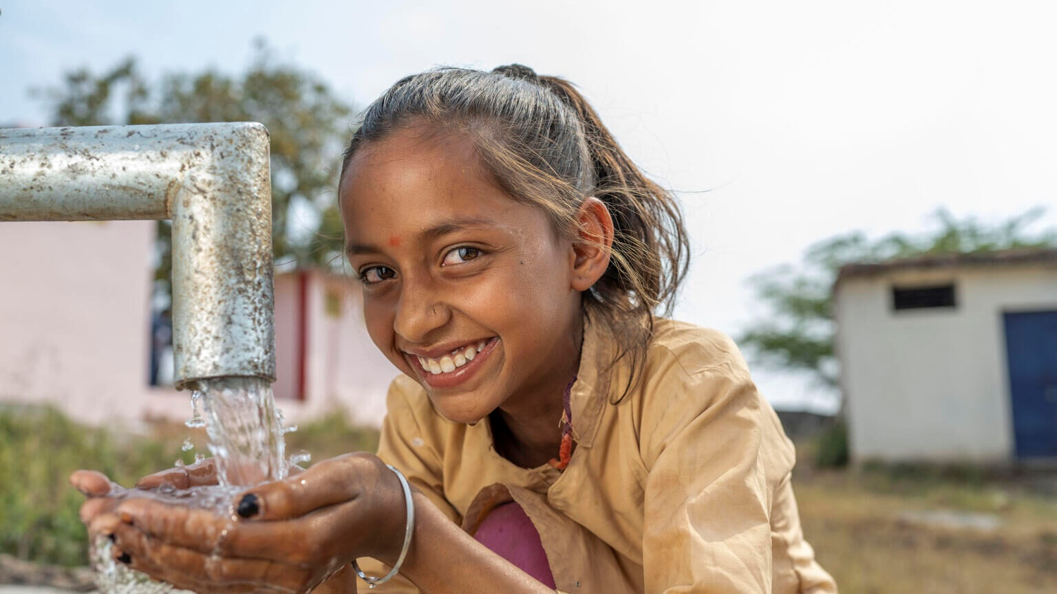
Progress on drinking water, sanitation and hygiene in schools: 2000-2021 data update
WHO/UNICEF Joint Monitoring Programme (JMP)
washdata.org
UNC Water and Health Conference
26 October 2022
7th WASH in Schools ILE, Manila
11 November 2019

Slide 7

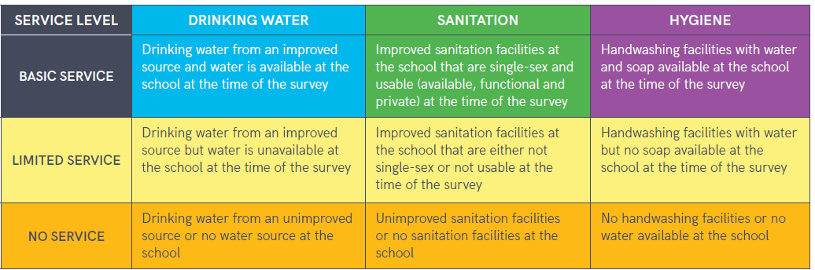
4.a Build and upgrade education facilities that are child, disability and gender sensitive and provide safe, nonviolent, inclusive and effective learning environments for all
4.a.1 Proportion of schools with: …(e) basic drinking water; (f) single-sex basic sanitation facilities; and (g) basic handwashing facilities (as per WASH indicator definitions)
Notes:
The JMP ladders focus on progress towards a basic level of drinking water, sanitation and hygiene service in schools which is the indicator used for SDG monitoring
Agreed upon by Expert Group representing multiple regions and organizations, including UNESCO-UIS.

Slide 8
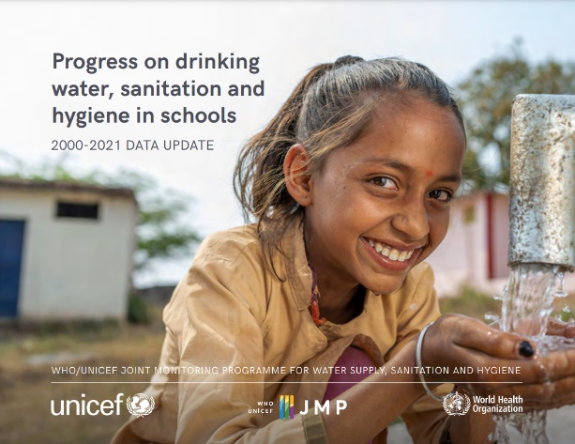

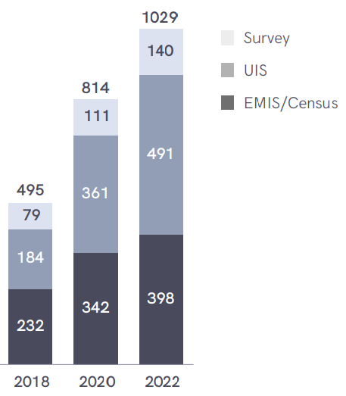
The JMP collects national data to track global, regional, & national progress toward the SDGs for WinS
The WHO/UNICEF JMP is responsible for tracking progress of WASH-related SDGs
The JMP has developed methods for global monitoring of WASH in schools to support SDG progress tracking
The JMP produces updated estimates on WASH in schools every 2 years
National data sources used in the JMP 2022 report
A total of 1,029 national data sources were used in the 2022 update (many from national systems – e.g. EMIS)
Notes:
A total of 1,029 national data sources were used for the 2022 update report
Average of 5.6 datasets per country (182 countries)
Data sources include EMIS, periodic censuses, UNESCO Institute for Statistics data, and surveys
Data were mapped to the indicator elements to standardize results between surveys and countries to the extent possible

Slide 9
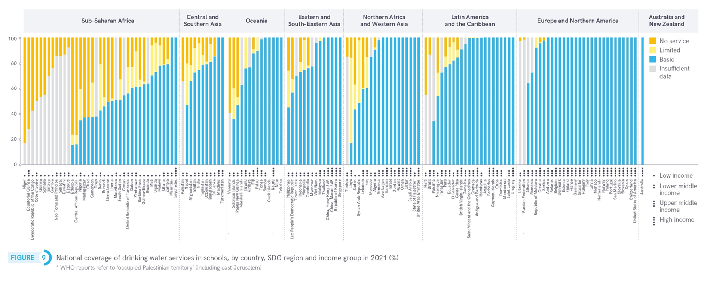
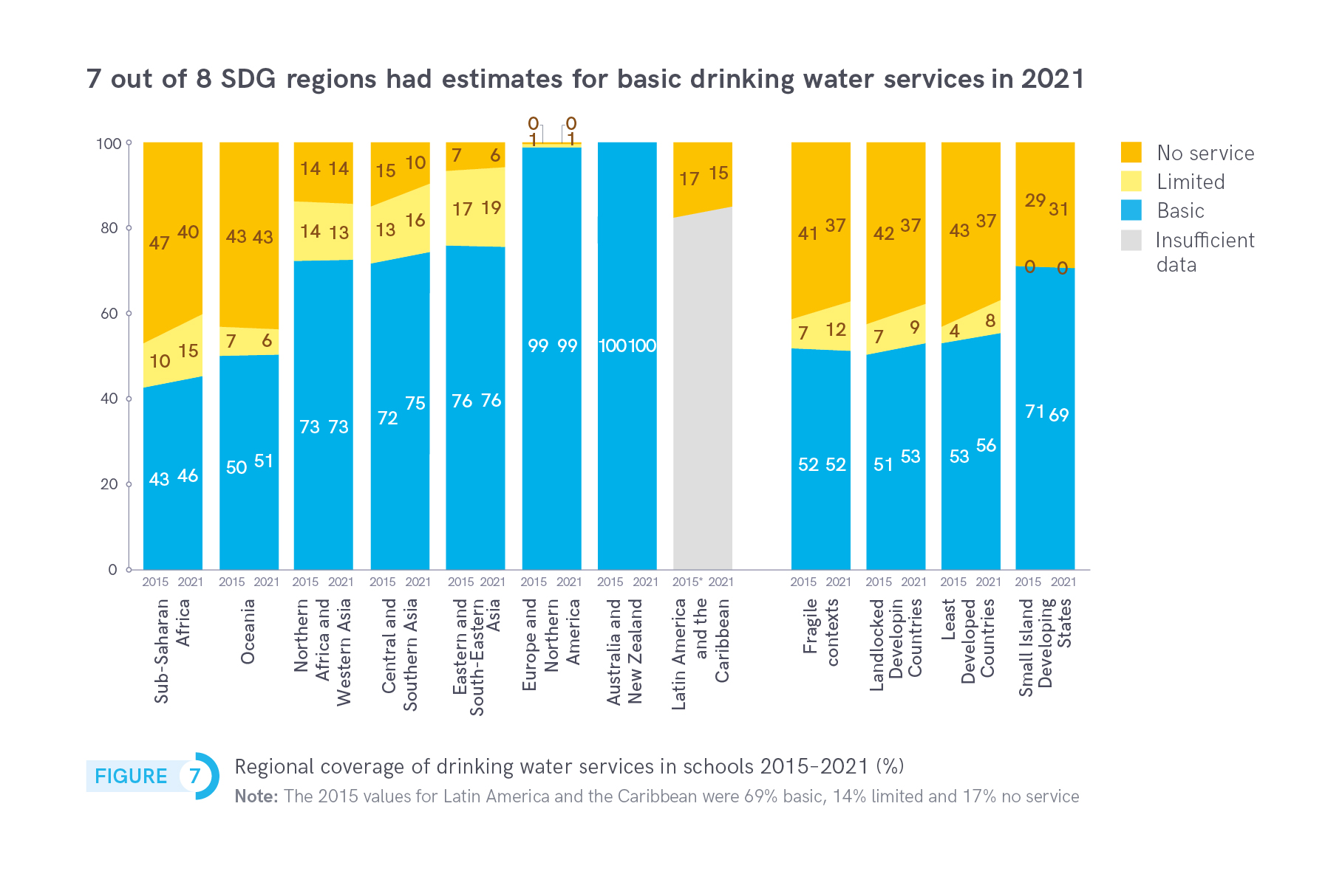
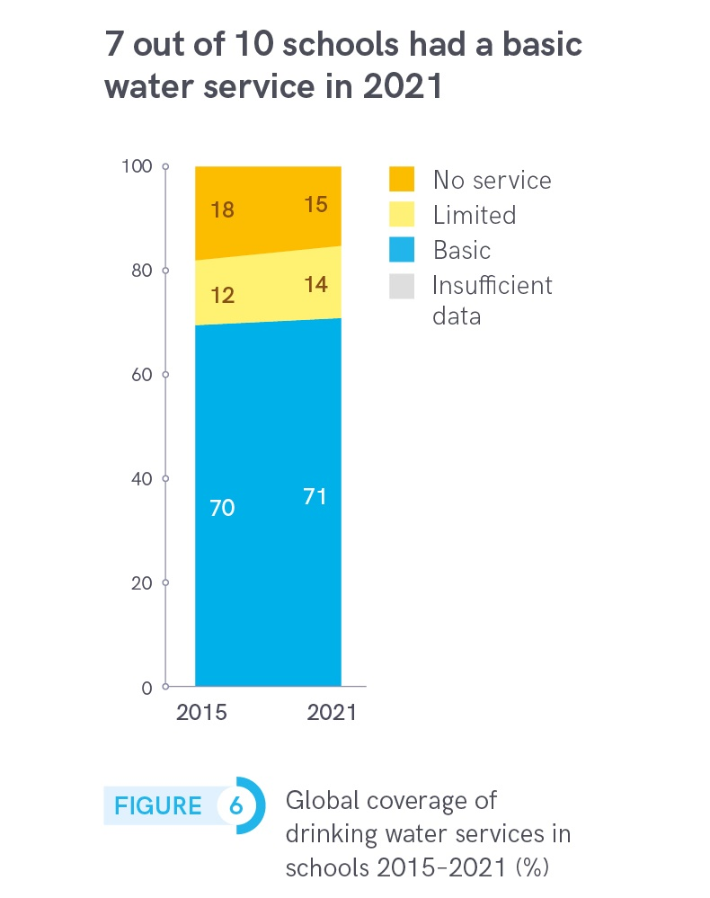
Drinking water service levels varied widely between countries and regions in 2021

Slide 10
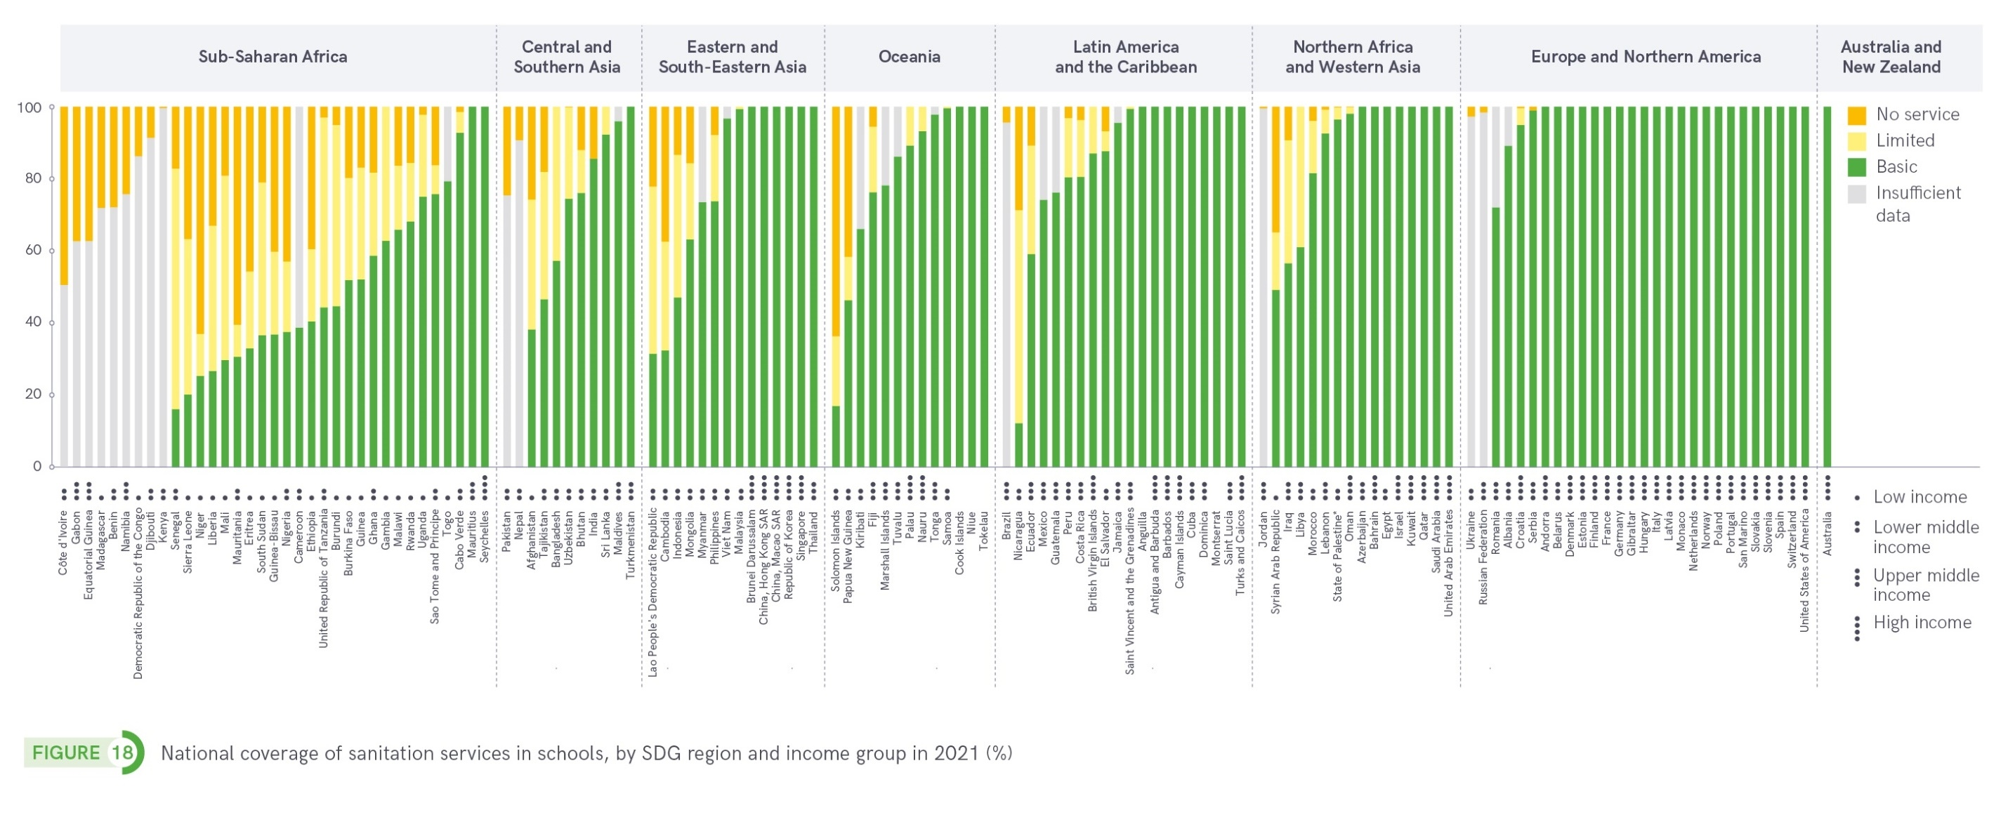
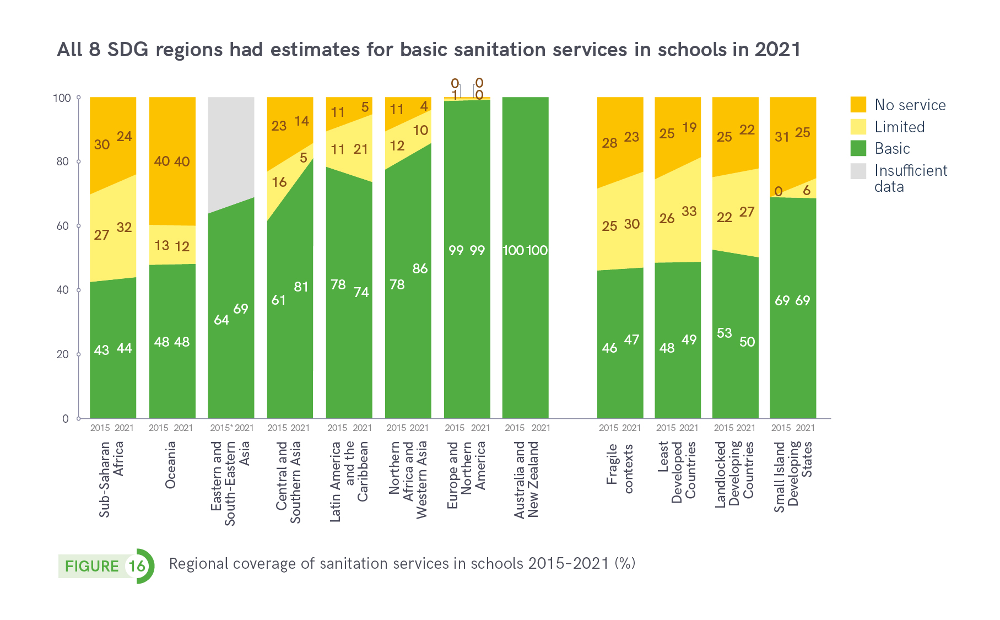
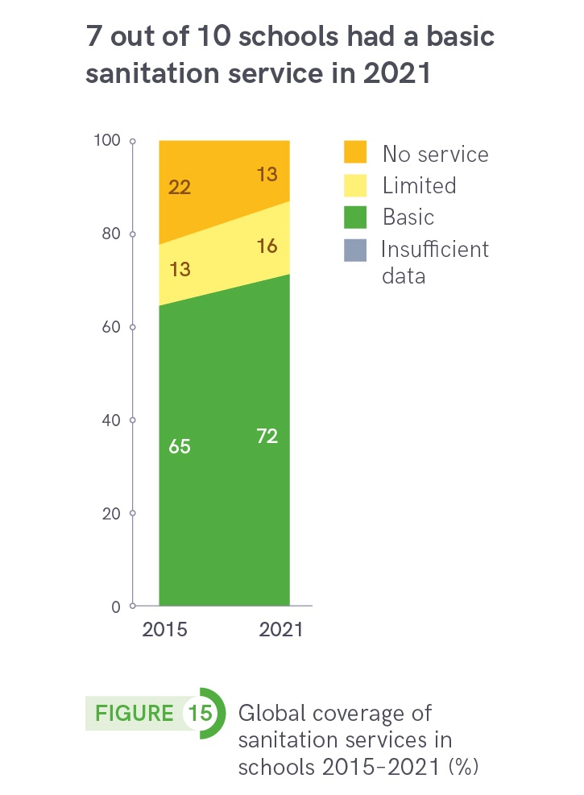
Sanitation service levels varied widely between countries and regions in 2021

Slide 11
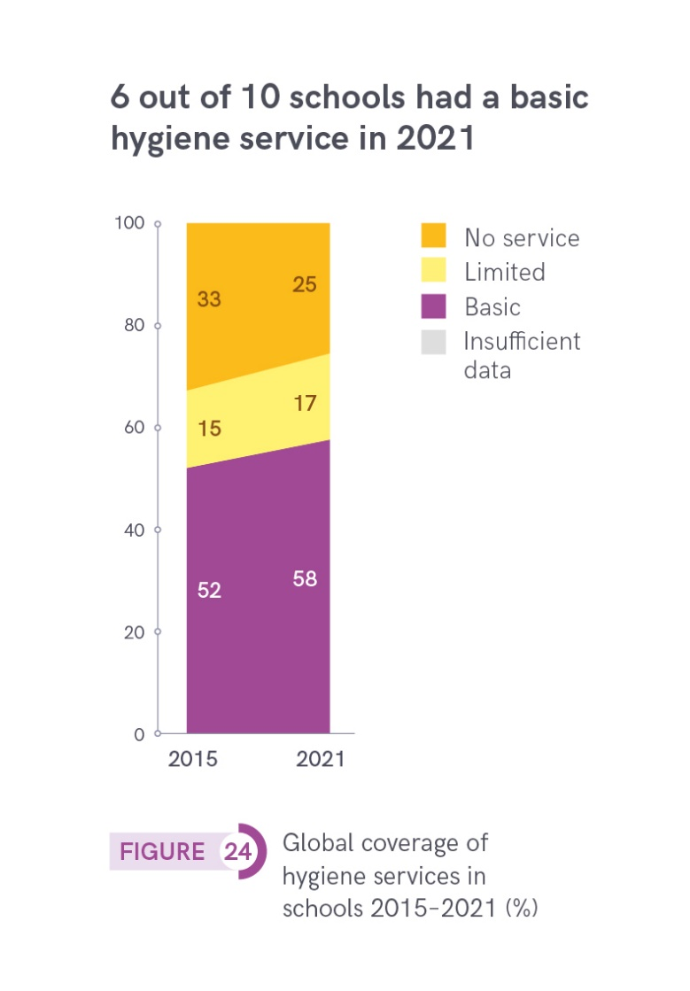
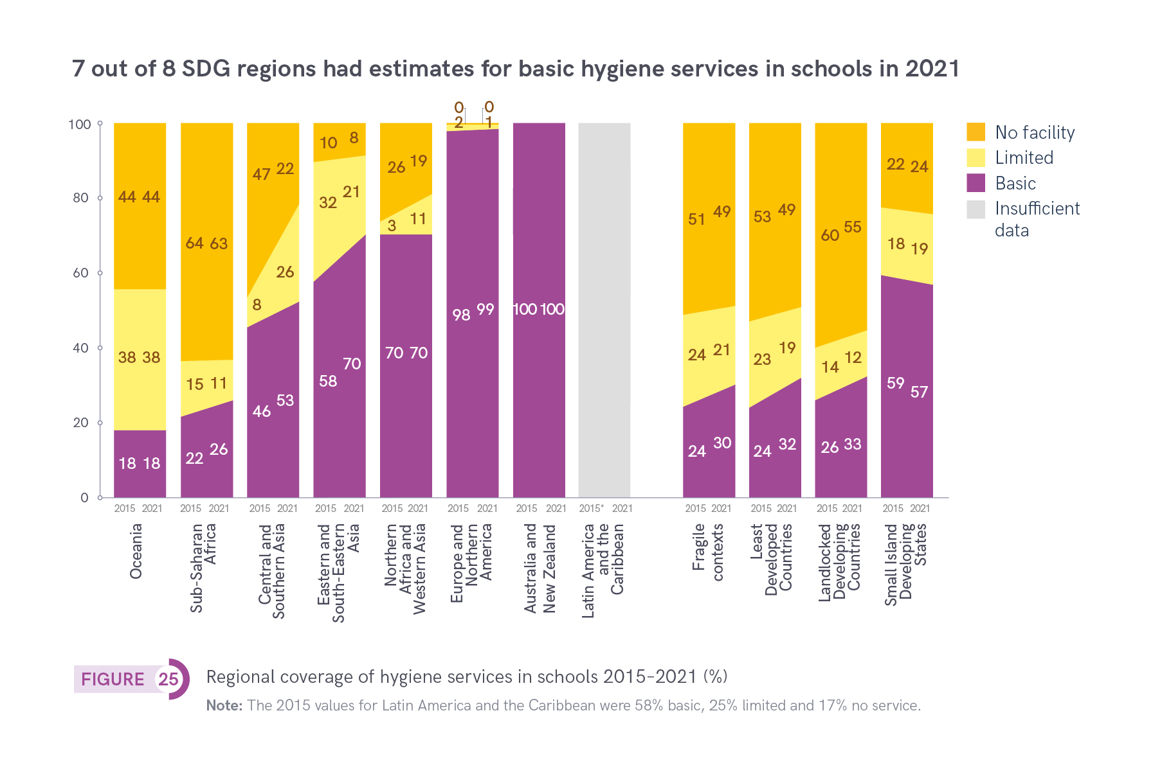
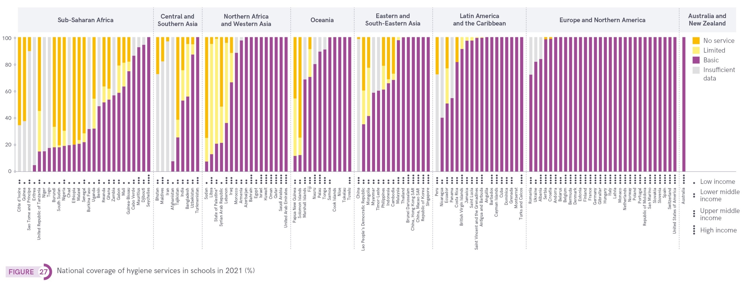
Hygiene service levels varied widely between countries and regions in 2021

Slide 12
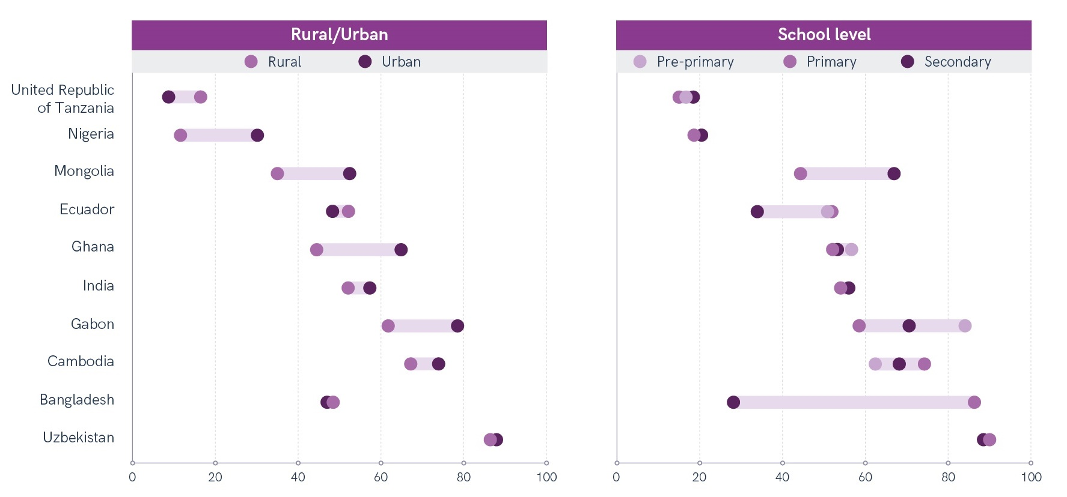
Disaggregated data reveal significant disparities between urban and rural and between school levels

Slide 13
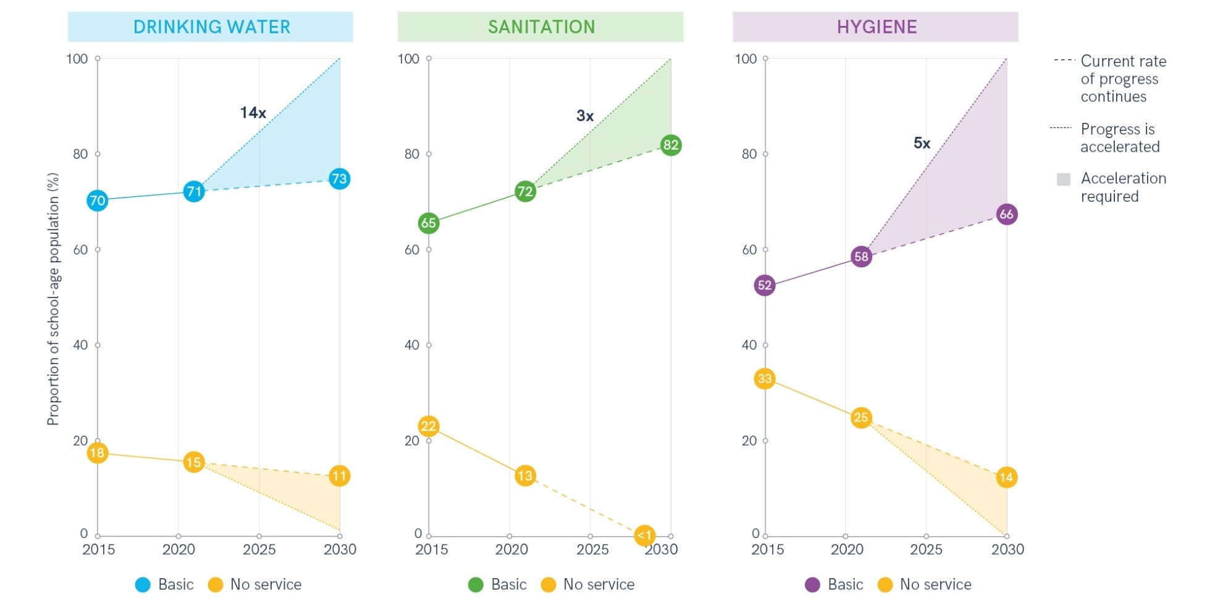
Achieving global SDG targets requires an acceleration in current rates of progress

Slide 14
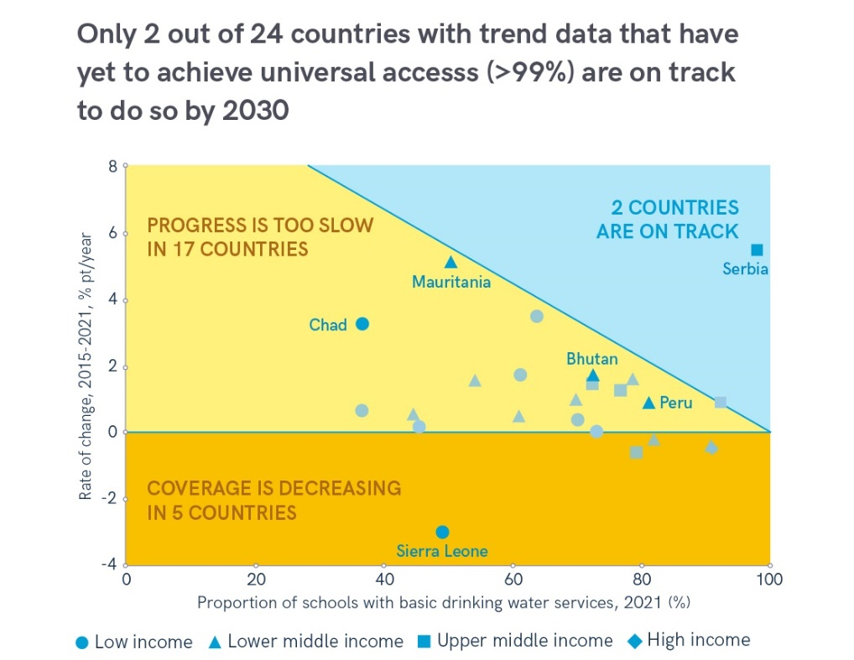
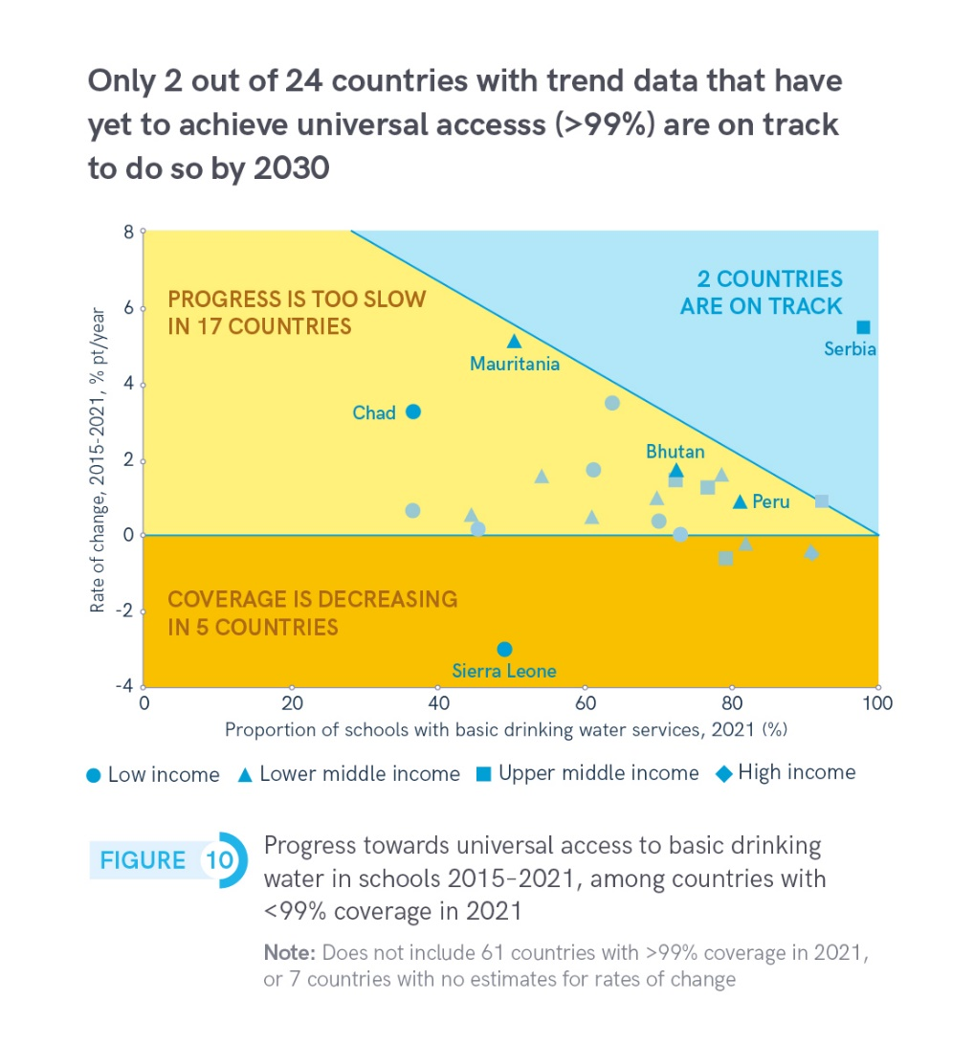
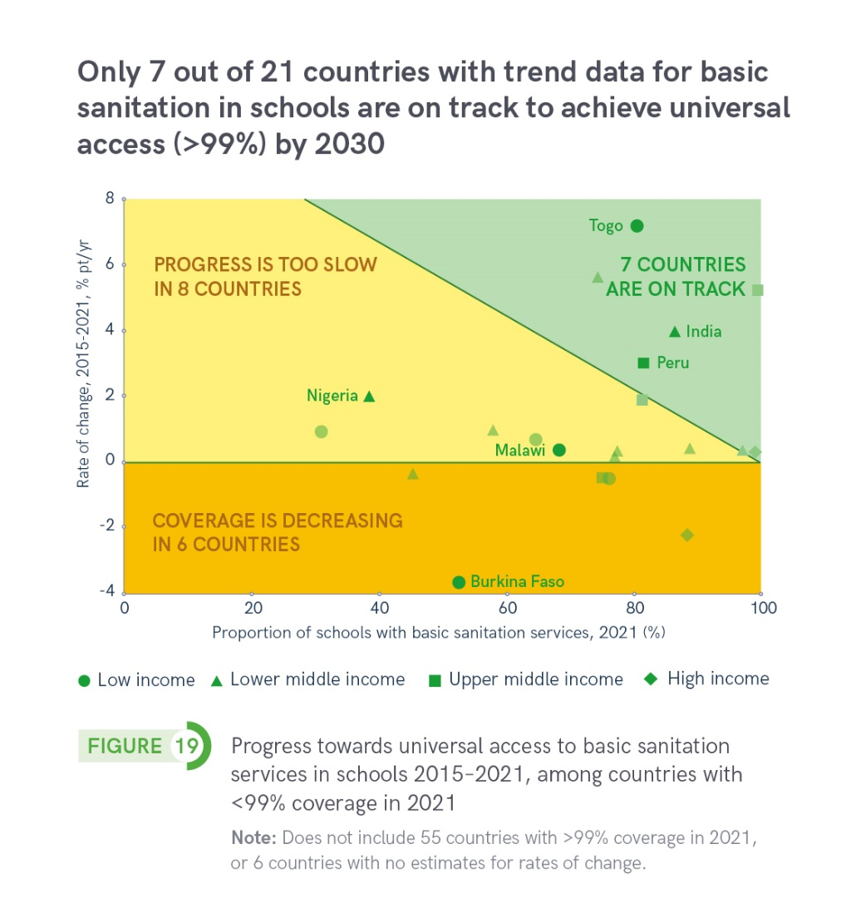
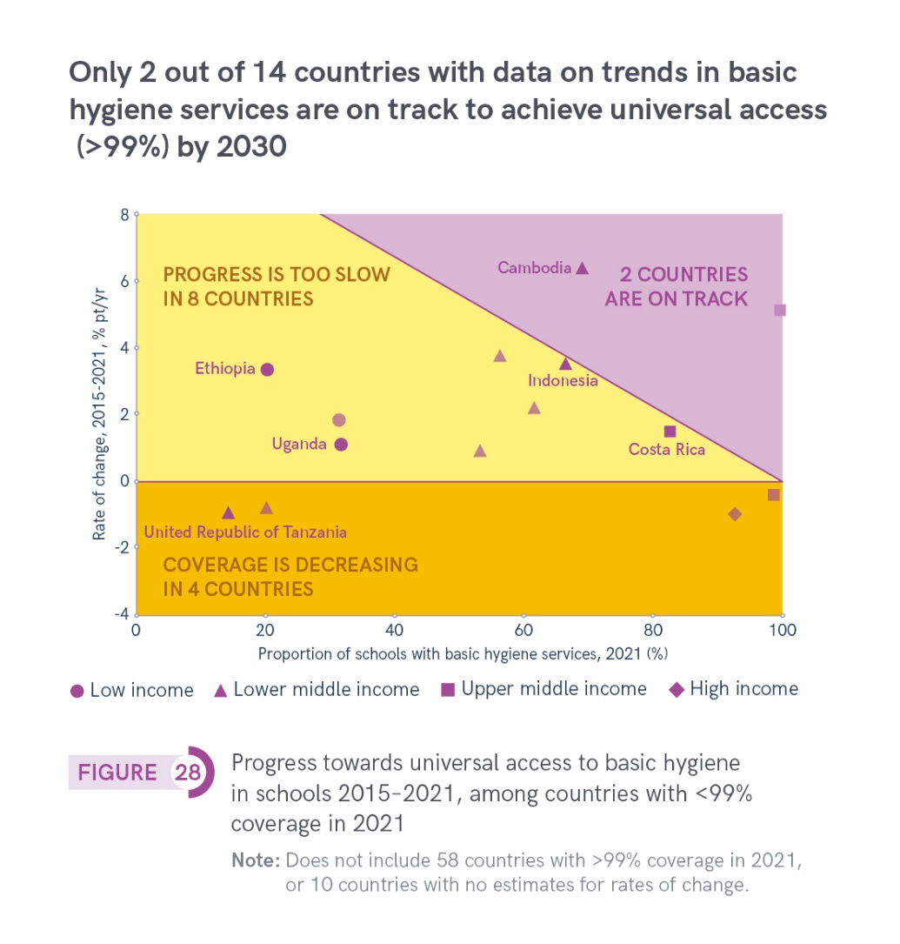
In many countries with trend data current rates of progress are not sufficient to achieve universal access to basic services by 2030

Slide 15
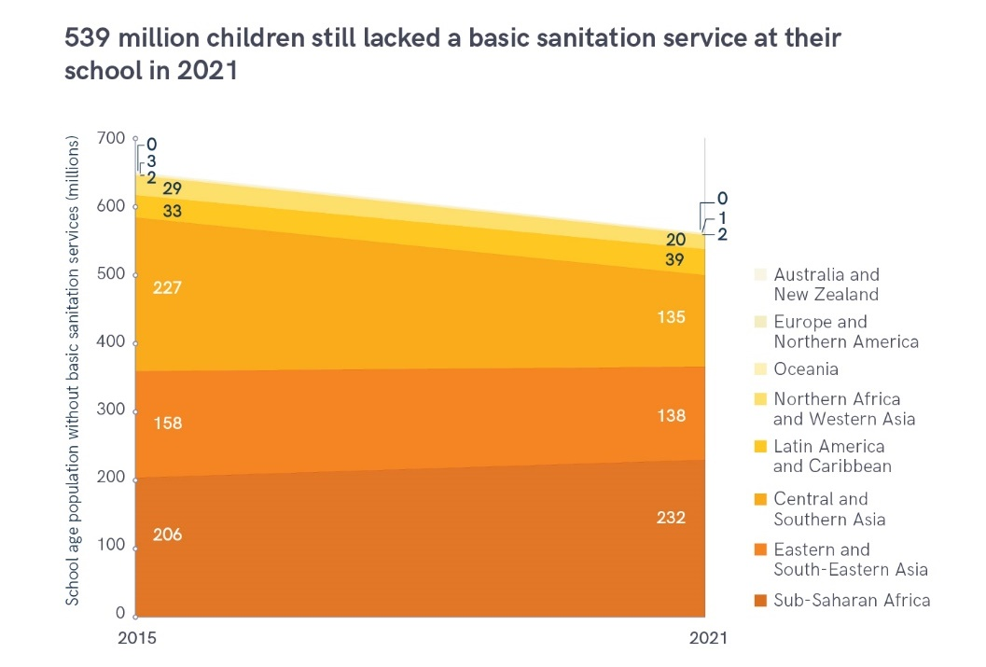
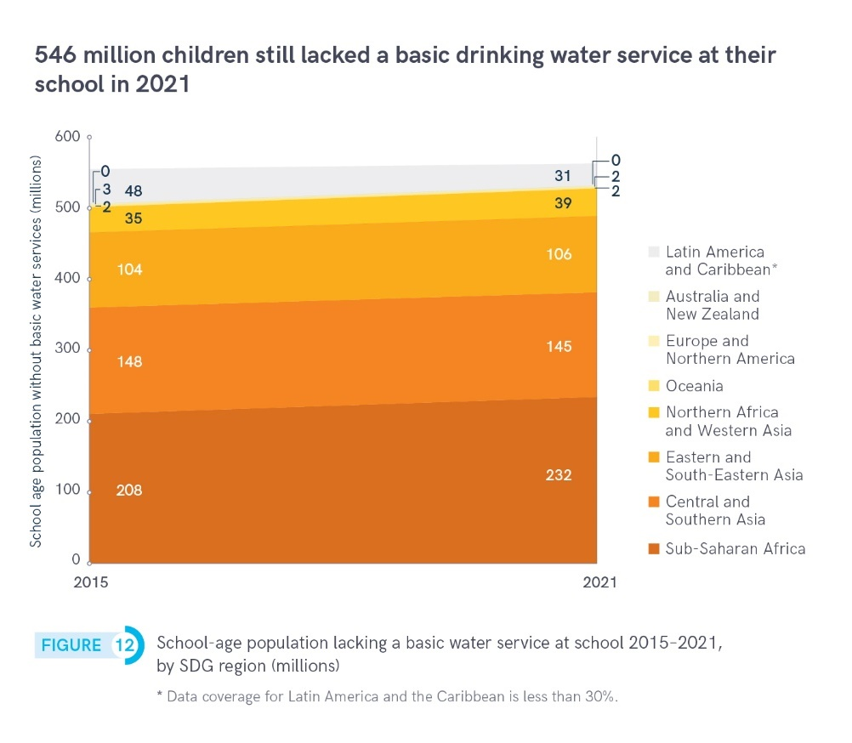
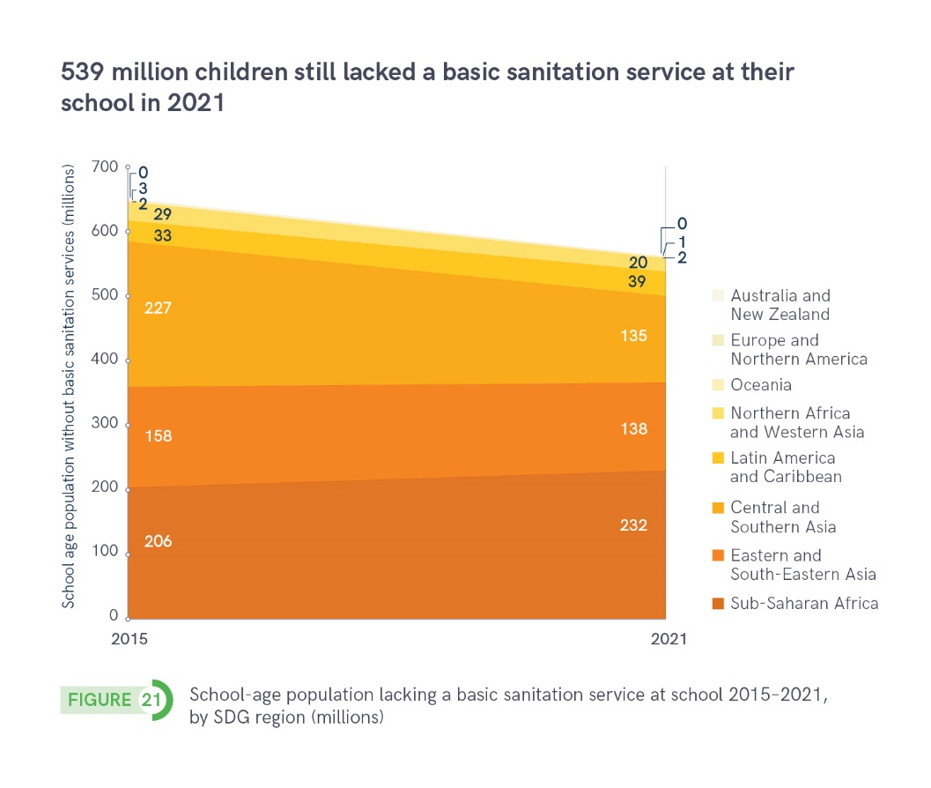
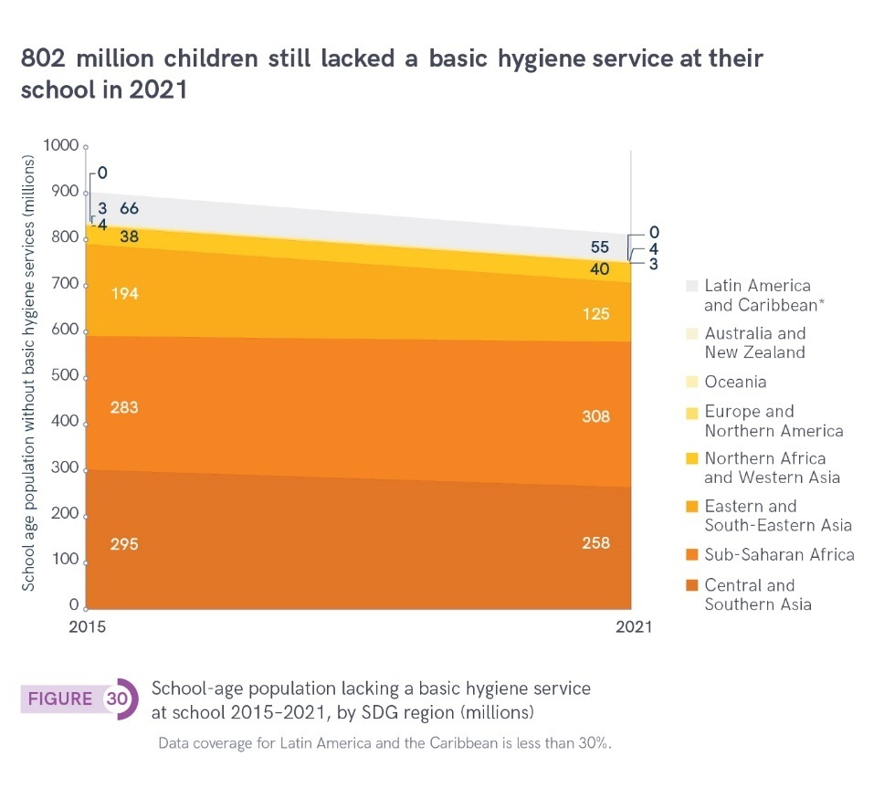
2 out of 3 children without basic WASH services at school lived in sub-Saharan Africa and Central and Southern Asia

Slide 16
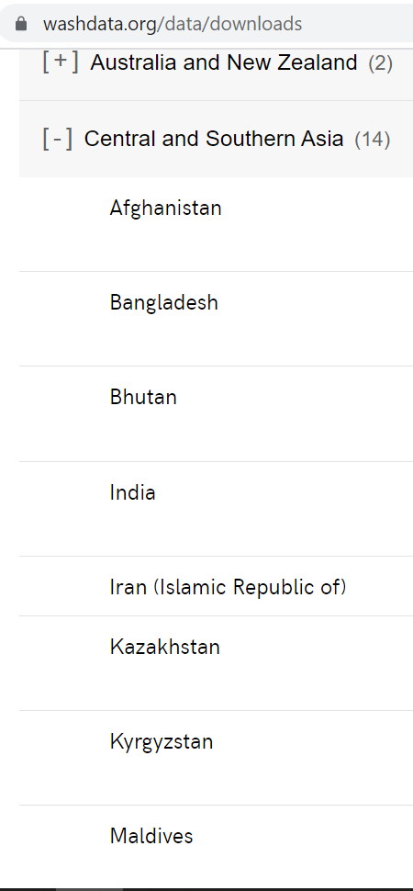
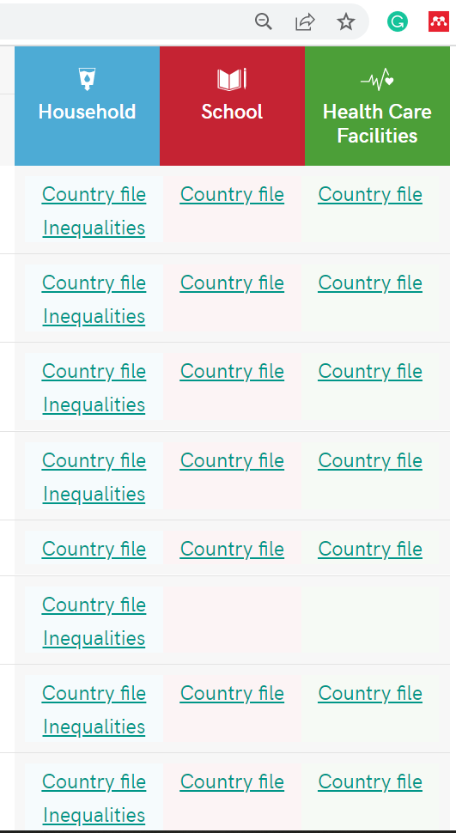
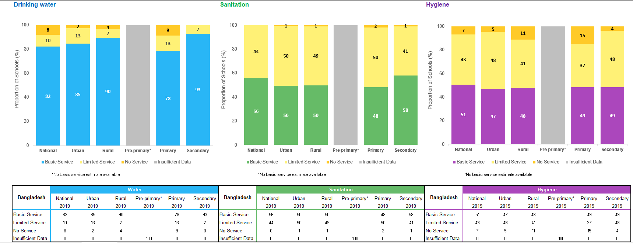
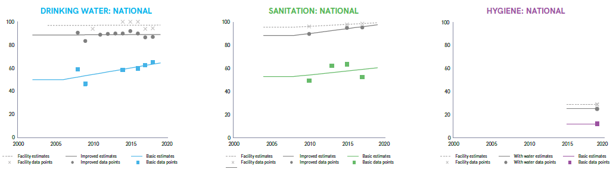
Download JMP country files to see data used for national estimates: washdata.org/data/downloads (now in multiple languages!)

Slide 17
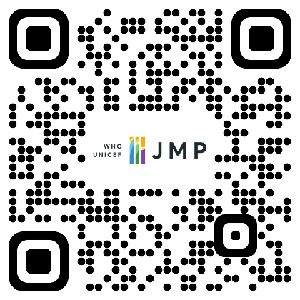

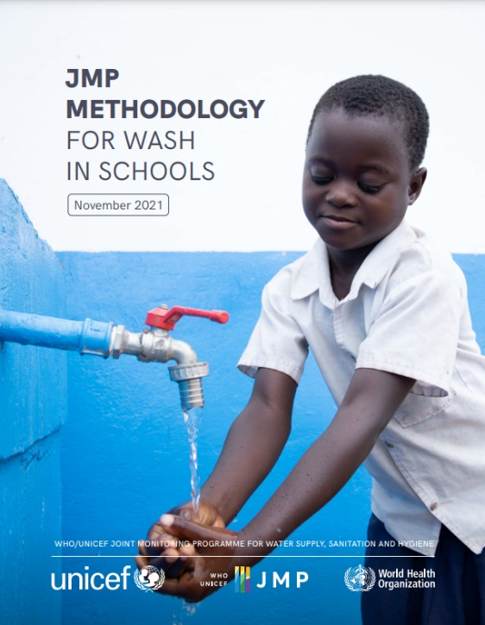
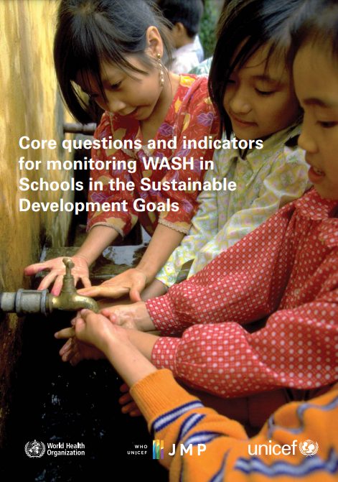
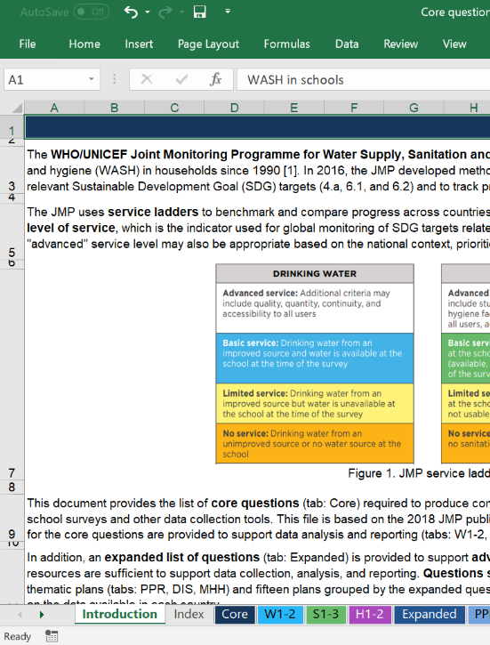
Resources
Can download all at washdata.org
https://washdata.org/sites/default/files/2022-07/jmp-2022-wins-data-update.pdf
https://washdata.org/sites/default/files/2022-09/jmp-2021-wins-methodology-final.pdf
https://washdata.org/sites/default/files/documents/reports/2018-08/SDGs-monitoring-wash-in-schools-2018-August-web2.pdf
https://washdata.org/monitoring/wash-schools/excel
Notes:
Add snapshots, side events, add to ILE page. QR code on screen?
Pretty URLs?
https://washdata.org/report/jmp-core-questions-monitoring-wash-schools-2018
https://washdata.org/report/unicef-2020-guidance-monitoring-mhh-v1

Slide 18
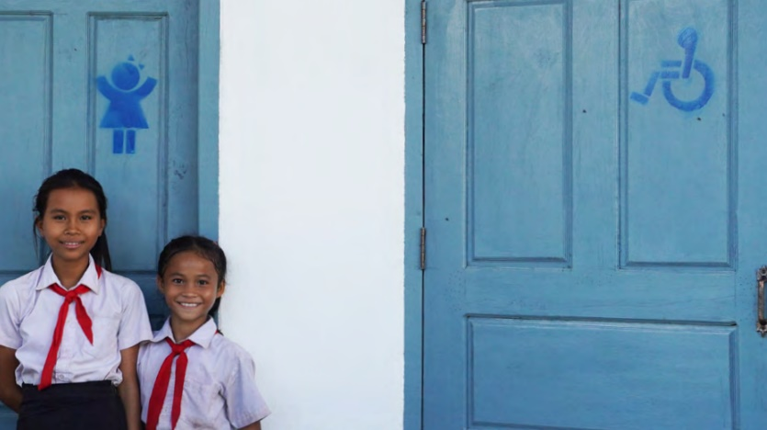
Thank you!
https://washdata.org/monitoring/schools
info@washdata.org

Slide 19
JMP update on WASH in schools with a focus on pandemic preparedness and disabilities
UNC Water and Health Conference, October 2022
08:30 Introductions and session overview
08:35 Progress on WASH in schools: 2000-2021 data update (JMP)
08:50 Focus on disability-inclusive WASH in schools (JMP, UNICEF)
09:10 Group discussion/Slido
09:20 Focus on pandemic preparedness in schools (JMP, MoE Cambodia, Global WinS Network)
09:40 Group discussion/Slido
09:50 Overview of the Global WinS Network
09:55 Closing remarks
Wednesday 26 October

Slide 20
JMP service ladders for WASH in schools
Drinking Water |  | Sanitation |  | Hygiene
Advanced service: Additional criteria may include quality, quantity, continuity, and accessibility to all users |  | Advanced service: Additional criteria may include student per toilet ratios, menstrual hygiene facilities, cleanliness, accessibility to all users, and excreta management systems |  | Advanced service: Additional criteria may include hygiene education, group handwashing, menstrual hygiene materials, and accessibility to all users
Basic service: Drinking water from an improved source and water is available at the school at the time of the survey |  | Basic service: Improved sanitation facilities at the school that are single-sex and usable (available, functional and private) at the time of the survey |  | Basic service: Handwashing facilities with water and soap available at the school at the time of the survey
Limited service: Drinking water from an improved source but water is unavailable at the school at the time of the survey |  | Limited service: Improved sanitation facilities at the school that are either not single-sex or not usable at the time of the survey |  | Limited service: Handwashing facilities with water but no soap available at the school at the time of the survey
No service: Drinking water from an unimproved source or no water source at the school |  | No service: Unimproved sanitation facilities or no sanitation facilities at the school |  | No service: No handwashing facilities available or no water available at the school

Slide 21
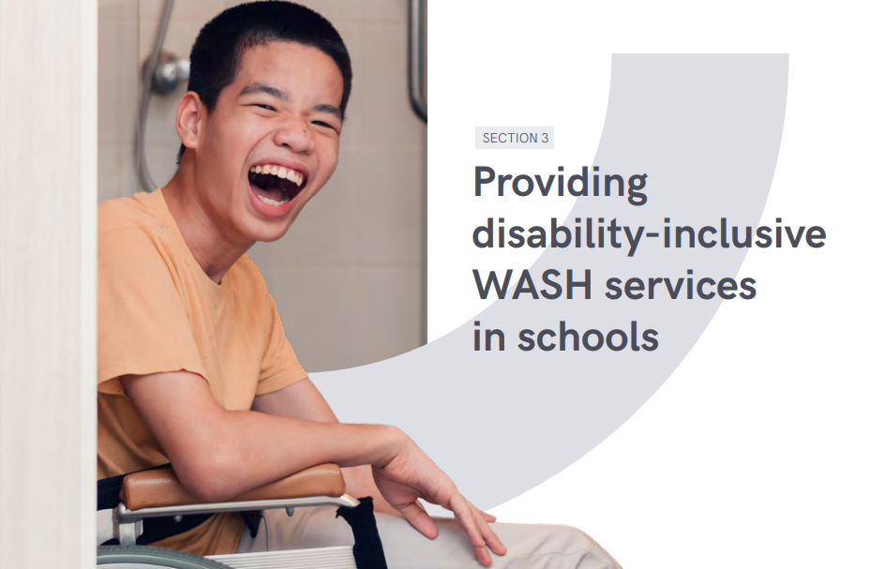

Slide 22

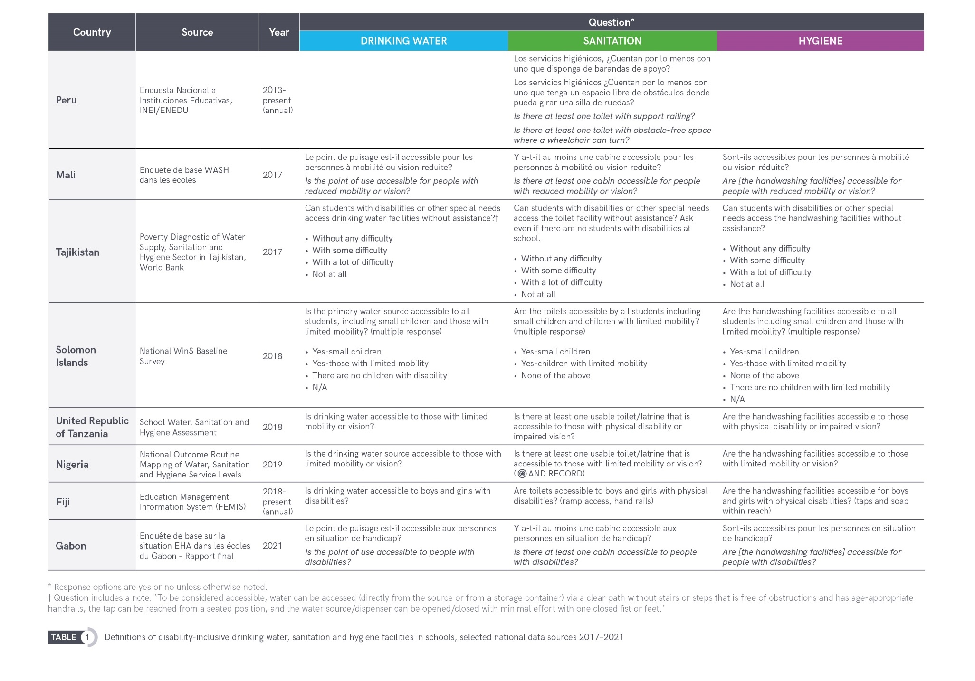
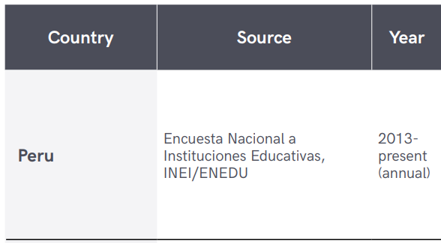
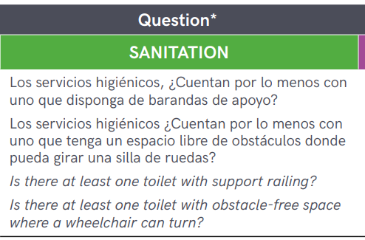
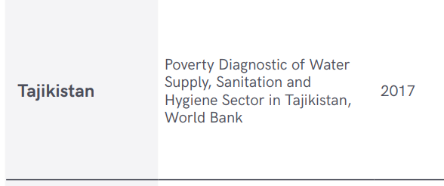
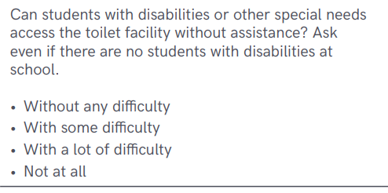
Disability-inclusive WASH services: developing definitions and indicators

Slide 23
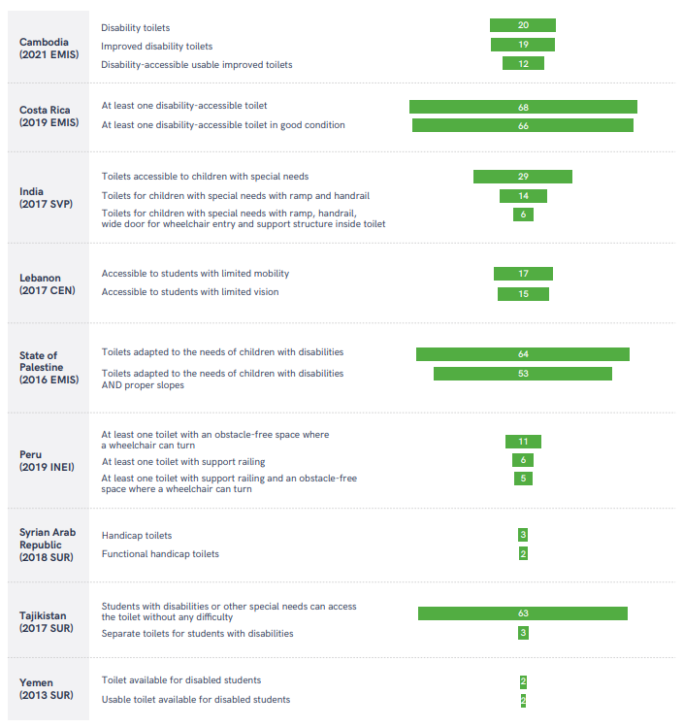
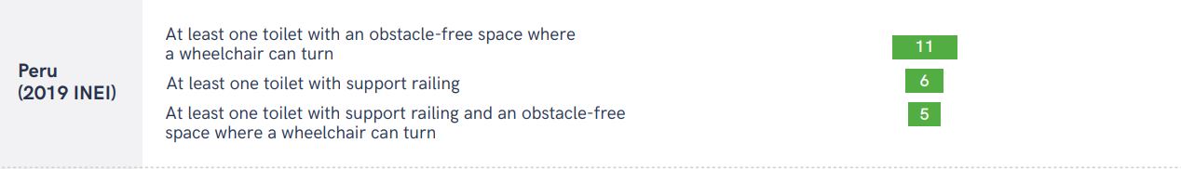
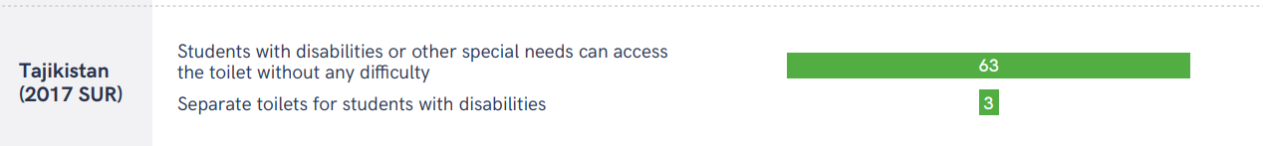
Coverage of disability-accessible toilets depends on the criteria used for classification

Slide 24
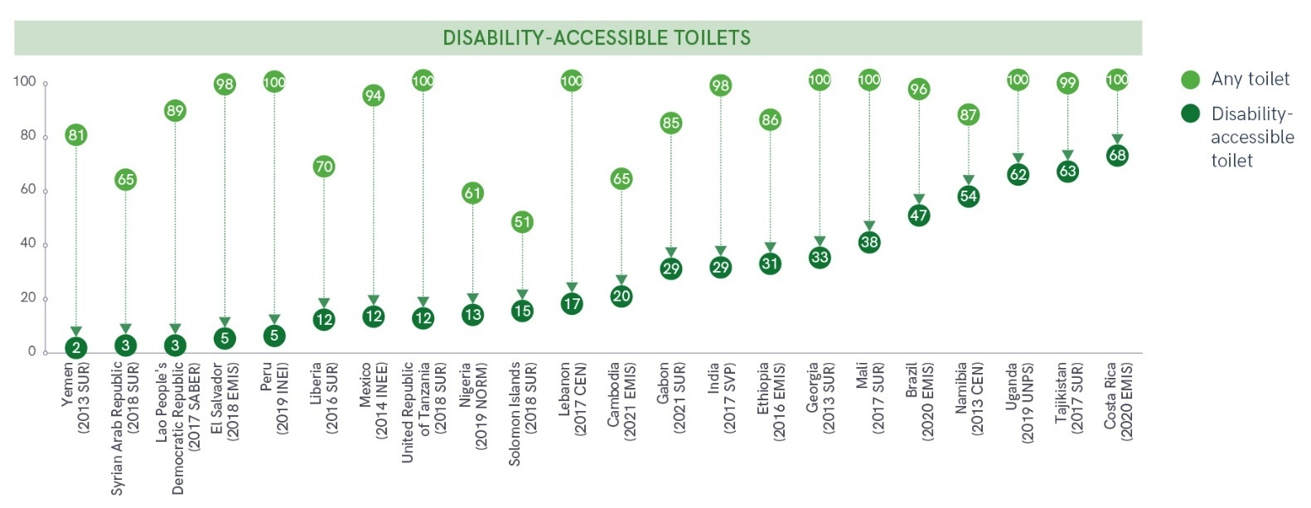
Far fewer schools had sanitation facilities that are disability accessible (multiple countries, 2013-2021)

Slide 25
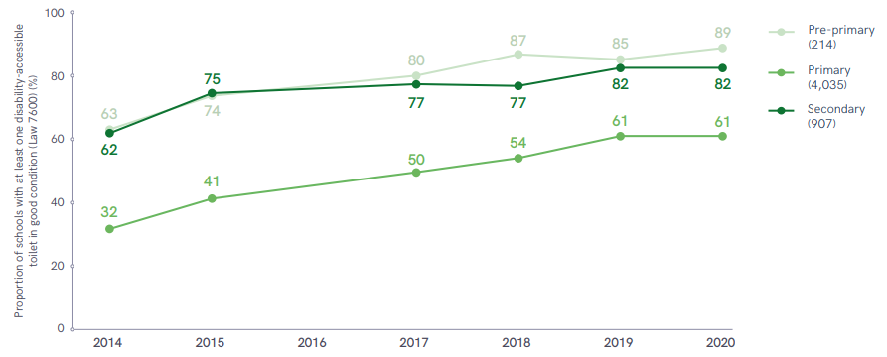
In Costa Rica, disability-accessible toilet coverage has increased at all school levels since 2014

Slide 26
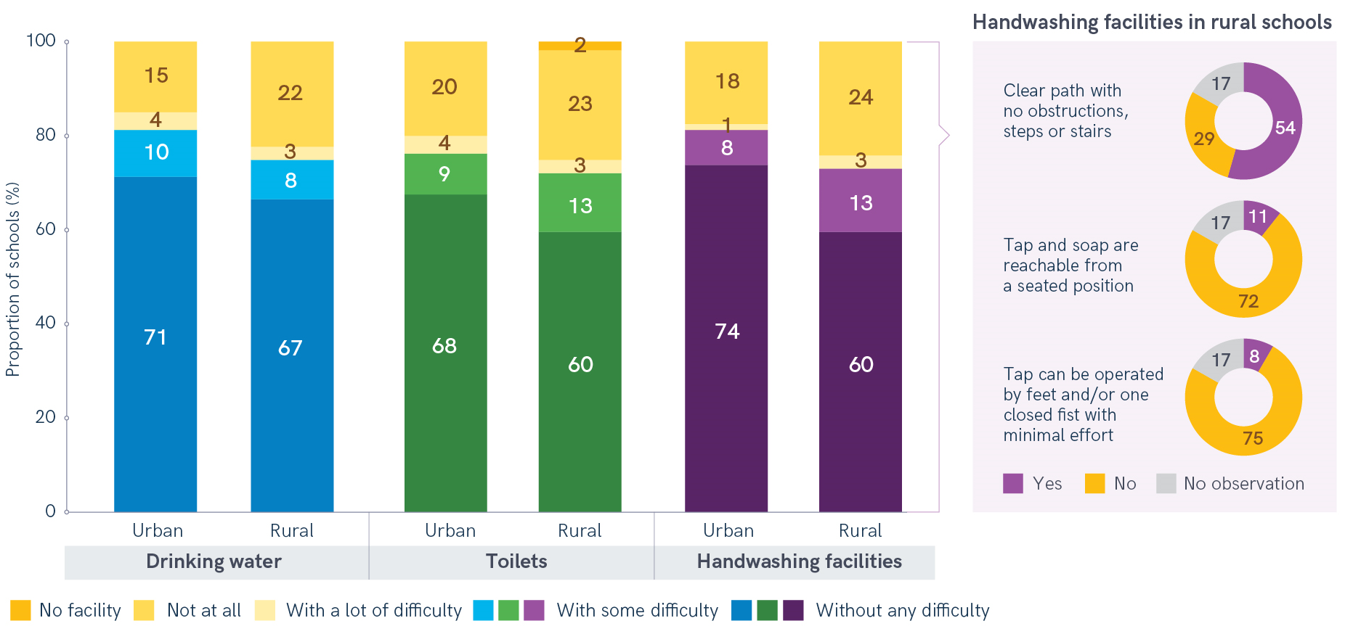
In a third of schools in rural Tajikistan, teachers reported that students with disabilities had difficulties accessing WASH services
Source: 2017 SUR

Slide 27
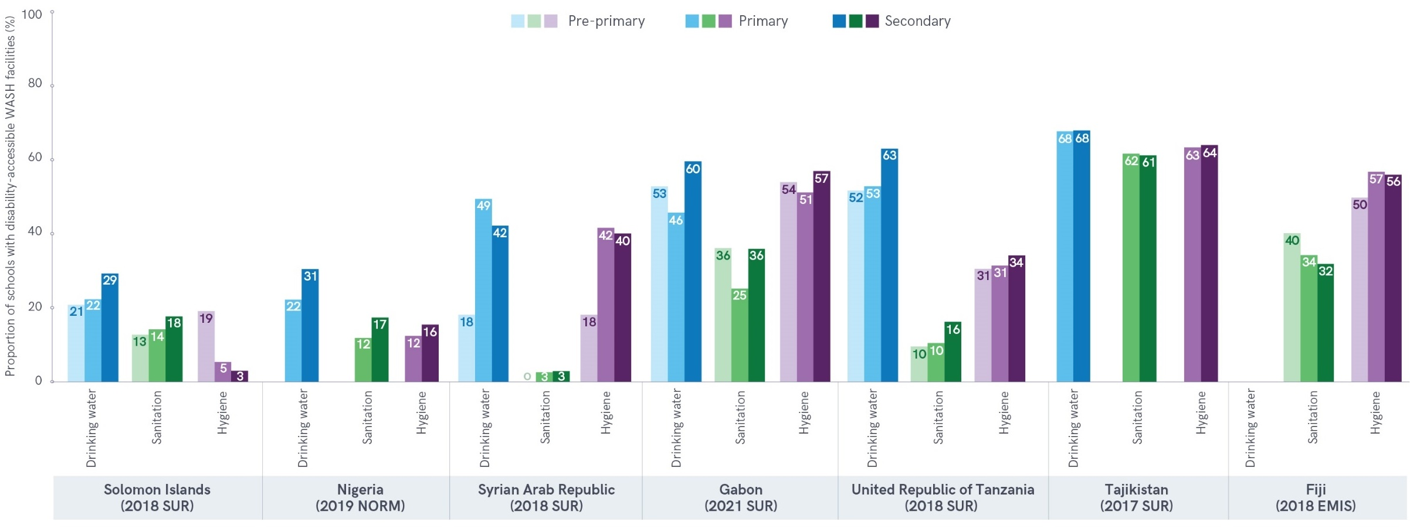
Coverage of disability-accessible drinking water, sanitation and hygiene often varies between school levels (multiple countries, 2017-2021)
Notes:
Coverage of disability-accessible drinking water, sanitation and hygiene often varies between school levels

Slide 28
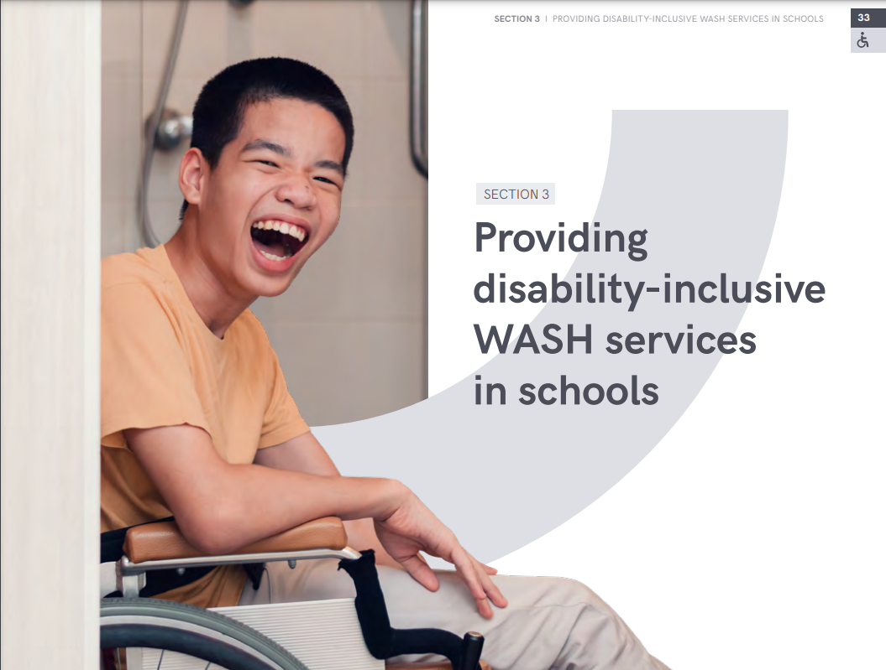
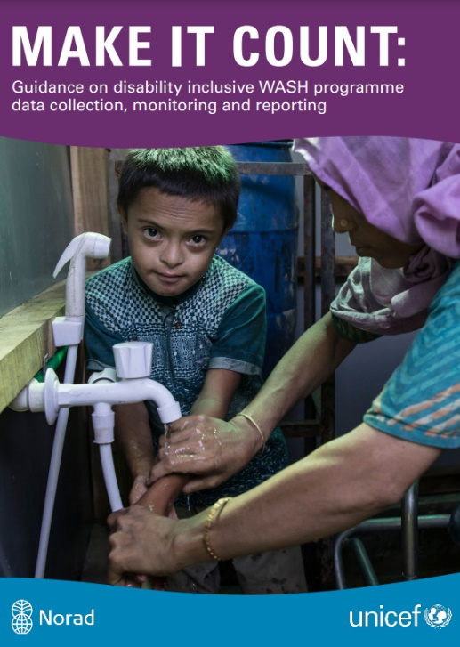
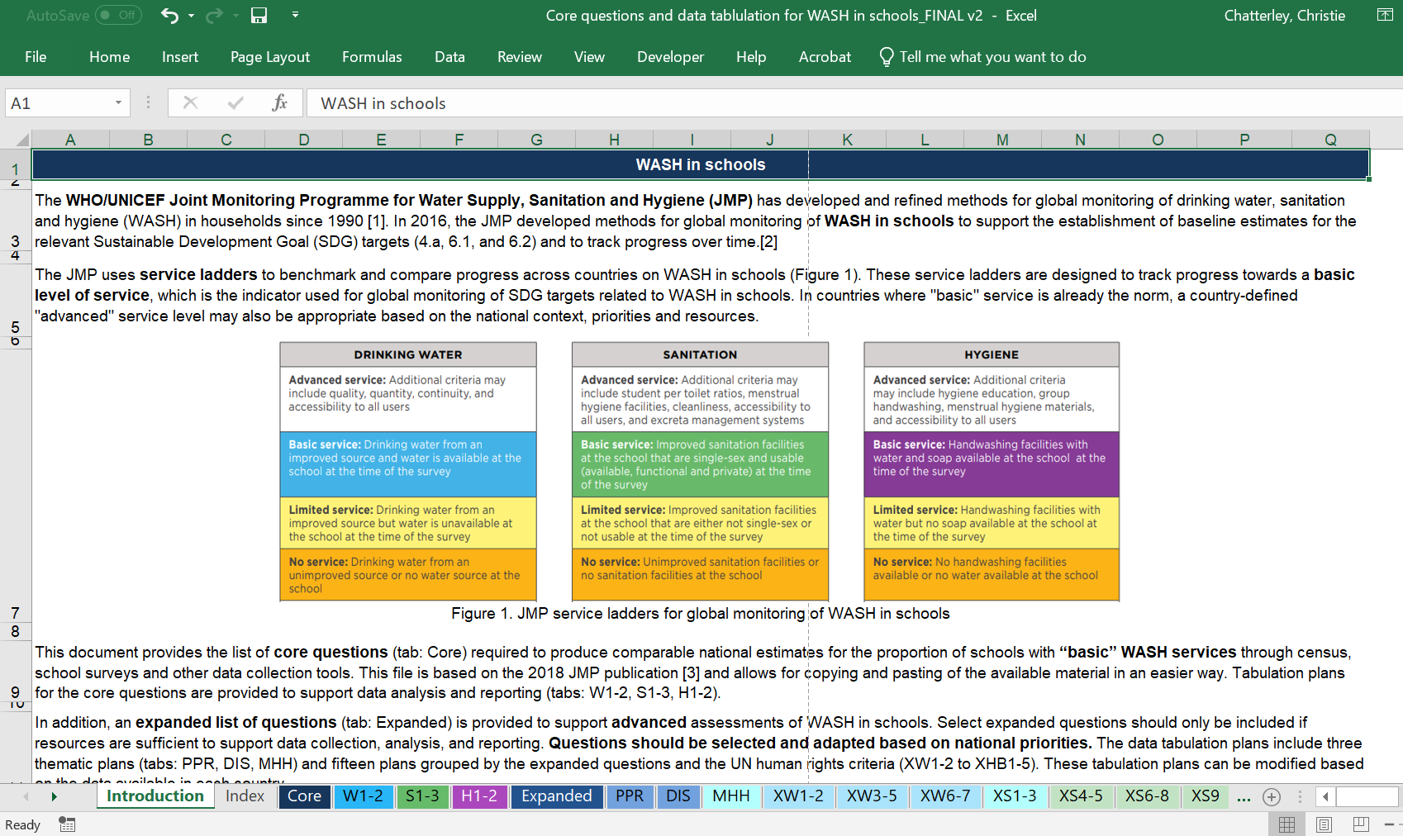
Thank you!
info@washdata.org
Resources. Can download all at washdata.org
https://washdata.org/sites/default/files/2022-08/jmp-2022-wins-data-update-disability-inclusive-WASH-services.pdf
https://www.unicef.org/media/114921/file/WASH%20Disability%20Toolkit.pdf
https://washdata.org/monitoring/wash-schools/excel
Notes:
Add snapshots, side events, add to ILE page. QR code on screen?
Pretty URLs?
https://washdata.org/report/jmp-core-questions-monitoring-wash-schools-2018
https://washdata.org/report/unicef-2020-guidance-monitoring-mhh-v1

Slide 29
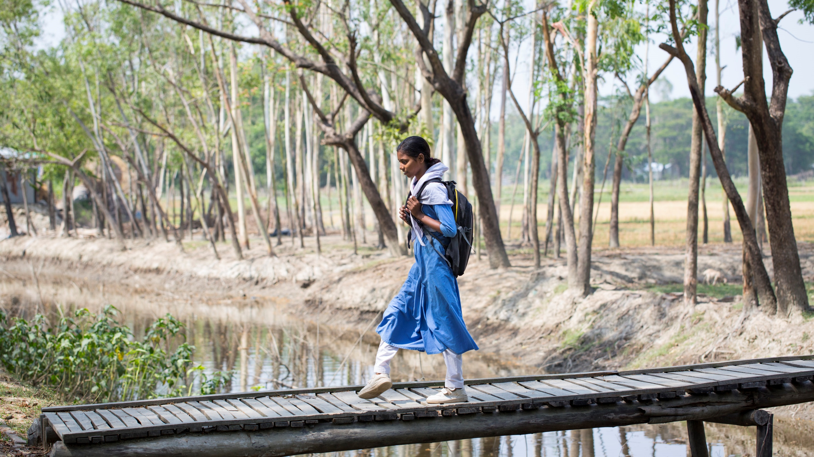

What is Disability Inclusive WASH in Schools?
© UNICEF/UN0358064/Mawa
JMP session on WASH in Schools
UNC Water and Health Conference
26 October 2022

Slide 30
What is Disability Inclusive WASH in Schools?
© UNICEF/UN0358064/Mawa
JMP session on WASH in Schools
UNC Water and Health Conference
26 October 2022

Slide 31

DI WinS Key Recommendations
Meaningful participation
Identification and addressing barriers
Empowerment & Capacity building
Data collection and monitoring
+ Capitalization and Lessons learnt
Notes:
Explain each recommendation, highlighting:
Meaningful participation and continuous consultation of: children with/without disabilities, parents-teachers organizations, school staff, neighboring communities, local organization of persons with disabilities
WASH and Education sectors working together
Consortium with organizations expert in inclusion/disability
Identification of Children and Adults (amongst school staff) with Disabilities + Identification of barriers to access WASH services and products (Sets of WGQs – for children and short set for adults)
Peer-to-peer education through Youth Clubs / Empowerment and capacity building
Safety and accessibility audit of WASH facilities (by the school)
Disability data collection, monitoring and reporting / Making sure that WASH services and products (e.g., facilities, IEC materials, hygiene kits, etc.) are accessible to everyone
MHM for women (school staff) and girls with/without disabilities
Capitalization: to inform and record what has been done (e.g., formalization of the designs, cost of disability inclusive WASH, good practices, etc.)

Slide 32
Accessibility of WASH in Schools
Accessibility affirms the right of persons with disabilities to enjoy “access, on an equal basis with others, to the physical environment, to transportation, to information and communications, including information and communications technologies and systems, and to other facilities and services open or provided to the public, both in urban and in rural areas.” (CRPD, Article 9)
WASH accessibility concerns the hardware
and software components.
Notes:
To enable persons with disabilities to access and use a facility with safety, comfort and dignity, the built environment not only must be physically accessible but the relevant personnel must be aware of accessibility-related issues and how to communicate and assist persons with disabilities.
WASH accessibility concerns the hardware and software components:
physical infrastructure; the related equipment; wayfinding and signposting systems; and safety and security measures; how hygiene promotion is delivered (written materials; hygiene kits, including for menstruation; sensitization sessions; training; training materials, etc.)
Accessibility is a precondition of inclusion: without accessibility, persons with disabilities cannot be included, and can lead to health issues, abuse (particularly for women and children with disabilities), and theft or damage of assistive devices.

Slide 33
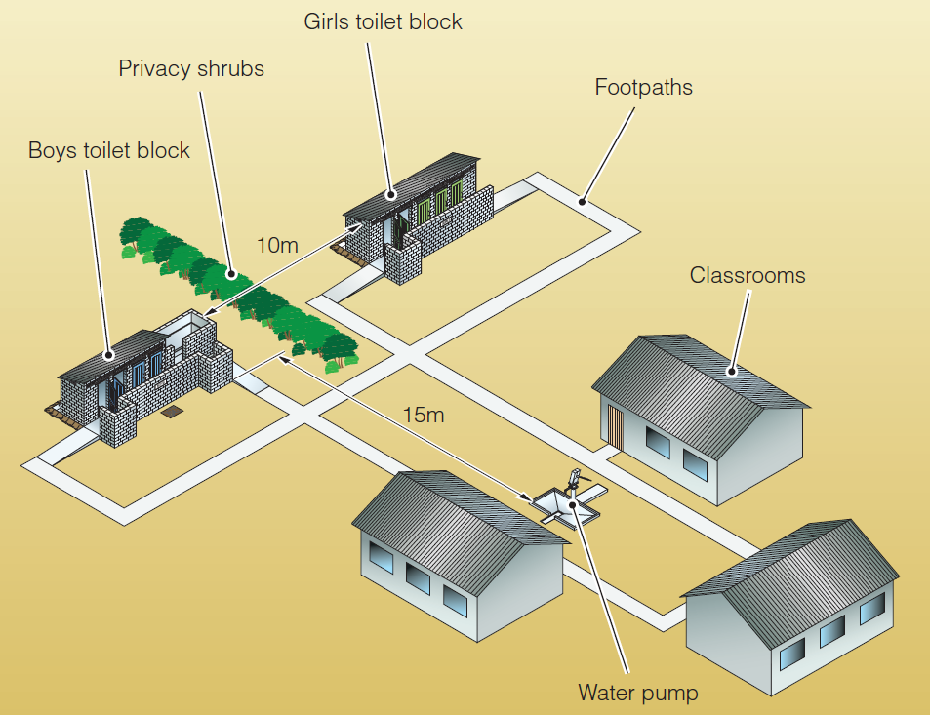
Accessibility continuum
Experience of everyone – including children, adults with disabilities – leaving their classroom, using pathways, to reach, enter, circulate in and use WASH services and facilities.
© WEDC, 2011
Unbroken chain of movement from the
classroom to the facility (RECU approach).
Notes:
Safety and accessibility audit / checklist (based mostly on observations)
Anyone must be able to Reach the WASH facility, while the design of the WASH infrastructure must ensure that they are able to Enter the facility, to Circulate around it, and to Use it freely and independently.

Slide 34
Universal design
“Design of products, environments, programmes and services to be usable by all people, to the greatest possible extent, without needing adaptation or specialised design.” (CRPD, Article 2)
Reasonable accommodation
“Necessary and appropriate modification and adjustments not imposing a disproportionate or undue burden, where needed in a particular case, to ensure to persons with disabilities the enjoyment or exercise on an equal basis with others of all human rights and fundamental freedoms.” (CRPD, Article 2)
Notes:
New facilities: universal design
Existing facilities: reasonable accommodation (unless many adjustments are required to make the facility accessible)
Universal design of IEC/BCC materials (hygiene messaging)
INCLUSIVE BUDGETING WHEN DESIGNING PROJECT
“Easy” for new facilities, if there are national standards and norms, with technical specifications (to access cost estimation of universal designs).
But, if there are existing facilities that need to be rehabilitated and upgraded to be full accessible: Cost?
The outcome of using universal design is that environments, buildings and products are inclusive of, usable by and accessible to everyone, to the greatest possible extent, including children, adults and older persons with and without disabilities, pregnant women, etc.
Reasonable accommodation seeks to ensure the right of persons with disabilities to use WASH facilities by removing barriers to accessing it equally with others. The concept of reasonable accommodation is not solely applicable to disability. Other personnel may require accommodation of their needs, such as people living with HIV/AIDS, pregnant women, people with family responsibilities, people who hold a particular religion or belief, etc.

Slide 35
Accessibility
Traditional Design
Reasonable Accommodation
Universal Design

Slide 36
Examples of disability inclusive WinS Indicators
Number (or proportion) of schools with accessible WASH (need to define toilets, handwashing, MHH)
Number (or proportion) of schools with functional water point that is available at or near the school that provides a sufficient quantity of water for the needs of school, is safe for drinking, and is accessible to children with disabilities
Number (or proportion) of schools with functional toilets and urinals for girls, boys and teachers that meets national standards, and are accessible to children with disabilities
Number (or proportion) of schools with functional and accessible handwashing facilities and soap (or ash) available for girls and boys in the school
Number (or proportion) of schools with accessible
information on handwashing for children with disabilities
Notes:
From “Make it count” UNICEF guidance
Quantitative indicators
+ Qualitative indicators: level of satisfaction of the users, participation of users at every stage of the project, etc.

Slide 37

Sources and tools for data collection
Washington Group Questions
  The short set on Functioning (WG-SS): six questions on functioning in core domains (for adults)
  The Child Functioning Module (CFM): While the WG-SS, WG-ES and WG-SS Enhanced are all useful for adult populations, questions were needed for the children. There are two CFM versions: one for children aged 2 - 4 and a second for children aged 5 - 17.
Notes:
WGQs: The questions ask if a person experiences any difficulty in six domains: vision, hearing, mobility, cognition (remembering), self-care and communication. Each domain is ranked on a scale from No difficulty to Cannot do at all.
WGQs: for identification of persons with disabilities, their disability and its severity + barriers
Safety and accessibility audit: to check through observation and practice (involving users, and especially children with disabilities), if the WASH facilities are accessible and safe, and which improvements/changes to be made.
School survey: evaluation of the WASH facilities, services and products (e.g., facilities, communication, messaging, etc.)
Programme monitoring:

Slide 38
Sources and tools for data collection
Washington Group Questions
  The short set on Functioning (WG-SS): six questions on functioning in core domains (for adults)
  The Child Functioning Module (CFM): While the WG-SS, WG-ES and WG-SS Enhanced are all useful for adult populations, questions were needed for the children. There are two CFM versions: one for children aged 2 - 4 and a second for children aged 5 - 17.
Safety and accessibility audit (checklists following R.E.C.U. approach)
KAP survey
School survey
Programme monitoring
Notes:
WGQs: The questions ask if a person experiences any difficulty in six domains: vision, hearing, mobility, cognition (remembering), self-care and communication. Each domain is ranked on a scale from No difficulty to Cannot do at all.
WGQs: for identification of persons with disabilities, their disability and its severity + barriers
Safety and accessibility audit: to check through observation and practice (involving users, and especially children with disabilities), if the WASH facilities are accessible and safe, and which improvements/changes to be made.
School survey: evaluation of the WASH facilities, services and products (e.g., facilities, communication, messaging, etc.)
Programme monitoring:

Slide 39


Good practices – Togo
Investing in inclusive WASH
Participatory assessment of girls, children and persons with disabilities toilet use
WinS standards (including specific needs of persons with disabilities) by Ministry of Education
Indicators to measure impact:
% of persons with physical disability gaining access to improved toilet
% of persons with visual disability gaining access to improved toilet
Notes:
Participatory assessment with pupils, students, parents-teachers organisations, technical partners and government

Slide 40


Good practices - India
School Sanitation and Hygiene Education (SHHE)
Formalization of strategy, norms and designs
Notes:
Guidance for implementation of DI WinS
Including technical drawings + DI WASH facilities cost (extremely useful for program design)

Slide 41

Thank you!
© UNICEF/UNI5298/Nesbitt
William Berbon
Disability-Inclusive WASH Consultant
wberbon@unicef.org

Slide 42
Questions?

Slide 43
JMP update on WASH in schools with a focus on pandemic preparedness and disabilities
UNC Water and Health Conference, October 2022
08:30 Introductions and session overview
08:35 Progress on WASH in schools: 2000-2021 data update (JMP)
08:50 Focus on disability-inclusive WASH in schools (JMP, UNICEF)
09:10 Group discussion/Slido
09:20 Focus on pandemic preparedness in schools (JMP, MoE Cambodia, Global WinS Network)
09:40 Group discussion/Slido
09:50 Overview of the Global WinS Network
09:55 Closing remarks
Wednesday 26 October

Slide 44

Discuss the following question with 4-5 people near you (feel free to stand up and move around!). Please have one person per group respond in slido.
Join at slido.com
#6358366
Based on the definitions of disability-inclusive WASH, what should be monitored to support action on disability-inclusive WASH in schools?
ⓘ Start presenting to display the poll results on this slide.

Slide 45
JMP update on WASH in schools with a focus on pandemic preparedness and disabilities
UNC Water and Health Conference, October 2022
08:30 Introductions and session overview
08:35 Progress on WASH in schools: 2000-2021 data update (JMP)
08:50 Focus on disability-inclusive WASH in schools (JMP, UNICEF)
09:10 Group discussion/Slido
09:20 Focus on pandemic preparedness in schools (JMP, MoE Cambodia, Global WinS Network)
09:40 Group discussion/Slido
09:50 Overview of the Global WinS Network
09:55 Closing remarks
Wednesday 26 October

Slide 46

Notes:
The COVID-19 pandemic triggered a lot of attention on the need for improvement while creating the opportunity to ‘build back better’ to ensure better preparedness for future pandemics (UN SDG report 2021).
When it comes to WASH, this transformative approach has reflections on strengthening all relevant settings, but especially schools if we consider the significant disruptions to education around the world during the pandemic.

Slide 47

JMP progress updates on WASH in schools and pandemics
2020 Update
  Focus on COVID-19
  Infection prevention and control (IPC) needs to extend beyond the provision of basic WASH services while including additional measures related to hygiene, cleaning, disinfection and waste management
2022 Update
  List some of those reflections by highlighting examples of emerging national data which go beyond the basic service indicators used for global monitoring
  Provide additional insights into specific challenges related to improving pandemic preparedness and response in schools

Slide 48

Universal access to basic WASH
Many schools already met some of the criteria for basic WASH services
but
far fewer schools meet for all three basic WASH services.
(multiple sources,
2017-2021)
Notes:
Data availability and the disruption around education monitoring systems have been crucial problems at the core of decision-making processes.
Furthermore, the available data suggested that while many schools already met some of the criteria for basic WASH services, far fewer schools met all of them.
Figure 33 from the report in this slide shows that among countries with school-level information on basic drinking water, sanitation and hygiene, the proportion of schools with access to all three services is often significantly lower.
In Guinea-Bissau, while three quarters of schools had basic hygiene services, two thirds had basic drinking water and more than a third had basic sanitation, only a quarter of schools had access to all three (WASH) in 2021.
In Nigeria, while a third of schools had basic water and basic sanitation and a tenth had basic hygiene, none of the schools surveyed had all three basic services in 2020.
Unless otherwise indicated, figures in this section are based on individual data sources. Short survey codes are provided for reference. For further information please refer to the relevant JMP country files for WASH in schools.

Slide 49

Inequalities in hygiene services
Ecuador (2020)
Subnational
inequalities
Condition and availability of water and soap at
group and individual handwashing facilities
Notes:
Rapid assessments of WASH in schools provided some relief in some countries but it remains to be seen whether new questions and indicators will be integrated into routine monitoring. While global data availability has been improving, many countries still have data gaps which makes it difficult to assess progress towards ‘safe and effective learning environments for all’ (SDG 4.a).
In Ecuador, disaggregated data highlight sub-national inequalities in coverage of basic hygiene services, and in the condition and availability of water and soap at group and individual handwashing facilities
In 2020, in response to COVID-19, Ecuador conducted a rapid nationwide assessment of the status of WASH in schools which enabled detailed analysis of the distribution of schools that didnot meet national WASH standards and required additional support to reopen.
Figure 38 shows that while 79% of schools had a basic drinking water service and 59% had a basic sanitation service, just 51% had a basic hygiene service. Within LAC, Nicaragua was the only country with lower coverage of basic sanitation (12%) and hygiene (40%) in schools.
The Ecuador assessment enabled further analysis of sub-national inequalities in hygiene. While there was little difference in coverage of basic hygiene services in rural (52%) and urban (49%) schools, there
were very large differences between sub-national provinces, ranging from 70% in Carchi to just 24% in Pastaza.
Further analysis of school-level data shows that coverage of group handwashing facilities was higher than coverage of individual handwashing facilities, but in both cases significantly fewer schools had facilities that were in good condition with water and soap available.
In 2020, 92% of secondary schools, 90% of preprimary and 83% of primary schools had a group handwashing facility but only 56%, 52% and 45% respectively were found to be in good condition.
While most of those in good condition had water available, fewer than a third of pre-primary and primary schools and a quarter of secondary schools had both water and soap at group handwashing facilities.
While a larger proportion of individual handwashing facilities were found to be in good condition, only a quarter of pre-primary and a fifth of secondary schools had individual handwashing
facilities meeting all criteria.

Slide 50

Hygiene progress over time
Cambodia
(EMIS 2020-21):
Availability of group handwashing facilities has increased in all 25 provinces since 2020.
Notes:
To monitor pandemic preparedness and response, countries also need to be able to track progress over time.
For example, Cambodia has integrated WASH questions into the Education Management Information System (EMIS) which is updated every 12 months. Improving hand hygiene in schools has been a key focus of the government’s pandemic response and EMIS data show a rapid increase in the availability of group handwashing facilities (Figure 34). Between 2020 and 2021, coverage of group handwashing facilities increased by 20 % pts with similar increases in both urban and rural and pre-primary and primary schools and an even bigger increase of 32 % pts in secondary schools.
Availability of group handwashing facilities has improved in all 25 provinces despite wide variations in coverage at the start of the pandemic.
By 2021, Kampong Chhnang, Stung Treng and Otdar Meanchey had all achieved 79% coverage, but from respective baselines of 66%, 53% and 35% in 2020. Preah Sihanouk increased coverage by nearly 50 % pts.
The Philippines uses a Three Star Approach for routine monitoring of WASH in schools which not only provides data on the availability of handwashing facilities but also whether they are present in key locations for promoting hand hygiene within the school. Between 2017 and 2020, the availability of handwashing facilities increased rapidly in both primary and secondary schools (Figure 35), but the availability of handwashing facilities in the toilets has increased more quickly than in the canteens.
Progress on both indicators has been faster in secondary schools (9,201) than in primary schools (39,018). By 2020, four out of five primary and secondary schools had handwashing facilities in the toilets, but only half
of primary schools had handwashing facilities in the canteen, compared with two thirds of secondary schools.

Slide 51

Hygiene progress over time
Philippines
(Three Star Approach 2017-20):
Availability of handwashing facilities in toilets and canteens has increased rapidly in both primary and secondary schools.

Slide 52

Handwashing behaviour
Iran (2016)
Children were found to be more likely to wash their hands after using the bathroom than before eating
Notes:
In addition to monitoring the availability and location of handwashing facilities, some countries also collect information on student handwashing behaviour at critical times.
For example, a nationwide survey of hygienic behaviours of children and adolescents in Iran asked teachers to record how frequently students wash their hands after using the bathroom and before eating.
Teachers reported that while 86% of students always washed their hands after using the bathroom, only 57% always washed their hands before eating.
Nearly a third ‘sometimes’ washed their hands before eating, and students were three times as likely to ‘never’ wash their hands before eating than after using the bathroom (Figure 36).

Slide 53

Handwashing promotion
Sudan (2020)
Only half of schools include hygiene within the core curriculum but
9 out of 10 schools include
health messages in morning assemblies.

Slide 54

Cleaning of toilets
In many countries with data available, more than a quarter of toilets were not clean, and the reported frequency of cleaning varied widely
Notes:
A growing number of countries also collect information on cleaning and waste management in schools.
While indicator definitions vary and are not always directly comparable, they nevertheless provide interesting insights.
For example, many countries collect information on the cleanliness of toilets, classifying facilities as ‘extremely clean’, ‘clean’, ‘somewhat clean’ and ‘not clean’ based on observations by teachers. Some countries also
collect information on the frequency at which toilets are cleaned. Categories include ‘more than once per day’, ‘once per day’, ‘two to four times per week’, ‘once per week’ and ‘not cleaned’ and the results are reported by school managers.
Among countries with data available it is possible to compare the proportion of schools with any toilet and ‘clean’ toilets and to calculate the proportion of schools in which toilets are cleaned ‘at least once per day’ and
‘at least once per week’.
In many countries, a significant proportion of school toilets were classified as ‘not clean’ (Figure 39).
A 2016 survey in Serbia found that all schools had toilets, 96% were cleaned at least once per day, and 90% were ‘clean’ at the time of the survey.
By contrast, a 2015 Knowledge, Attitudes and Practices (KAP) survey in the State of Palestine showed that while almost all schools had toilets that were cleaned at least once per day, just 42% were found to be ‘clean’. 2017 SABER surveys found that the ‘cleanliness gap’ between any toilet and clean toilets was much bigger in Afghanistan (44 % pts) than in the Lao People’s Democratic Republic (14 % pts).
The 2019 WASH NORM survey found an even bigger gap in Nigeria (48 % pts), and showed that a third (36%) of school toilets were cleaned once per week and only a fifth (22%) were cleaned once per
day, with just one in ten school toilets (12%) clean at the time of the survey.

Slide 55

Waste management
In countries with data on solid waste management, many schools lacked proper systems for safe management of solid waste - burn waste on the premises.
Notes:
Improving solid waste management has also been identified as a priority for pandemic preparedness and response. But in countries where school surveys and censuses have included questions, many schools lacked proper systems for safe management of solid waste (Figure 41). The 2020 school census in Uzbekistan showed that 92% of schools had solid waste collection services and 4% buried waste on premises, while 4% used unsafe disposal methods such as burning or openly dumping waste on the school premises. However, just 34% of schools in Gabon and 16% of schools in Sudan had solid waste collection services. The vast majority of schools in Guinea-Bissau (90%) reported burning waste on the premises and just 2% had solid waste collection services.
In Mali, more than a quarter of schools reported dumping waste on the premises (27%) and nearly one in ten (8%) had no system at all for managing solid waste.

Slide 56


Thank you!
info@washdata.org
Resources. Can download all at washdata.org
https://washdata.org/sites/default/files/2022-08/jmp-2022-wins-data-update-pandemic-preparedness.pdf
https://washdata.org/sites/default/files/documents/reports/2018-08/SDGs-monitoring-wash-in-schools-2018-August-web2.pdf
https://washdata.org/monitoring/wash-schools/excel
https://www.winsnetwork.org/resources/wash-schools-focus-country-examples-ppr-through-lens-enabling-environment-matrix
Notes:
Add snapshots, side events, add to ILE page. QR code on screen?
Pretty URLs?
https://washdata.org/report/jmp-core-questions-monitoring-wash-schools-2018
https://washdata.org/report/unicef-2020-guidance-monitoring-mhh-v1

Slide 57


WinS in Focus: New publication highlighting country examples of Pandemic Preparedness and Response (PPR) through the lens of the Enabling Environment (EE) Matrix
Featured countries and EE Matrix areas are:
Ecuador and Indonesia in Policy and Planning
Indonesia and Timor Leste in Budget and Expenditure
Kenya in Monitoring and Evaluation
India in Implementation Arrangements
South Africa, Malawi, and the Philippines in Capacity Development.
Many examples from Africa, Asia and the Pacific!
Underlines the positive momentum created for COVID-19 PPR in schools by governments, development partners and private sector

Slide 58
Questions?

Slide 59
JMP update on WASH in schools with a focus on pandemic preparedness and disabilities
UNC Water and Health Conference, October 2022
08:30 Introductions and session overview
08:35 Progress on WASH in schools: 2000-2021 data update (JMP)
08:50 Focus on disability-inclusive WASH in schools (JMP, UNICEF)
09:10 Group discussion/Slido
09:20 Focus on pandemic preparedness in schools (JMP, MoE Cambodia, Global WinS Network)
09:40 Group discussion/Slido
09:50 Overview of the Global WinS Network
09:55 Closing remarks
Wednesday 26 October

Slide 60
Discuss the following question with 4-5 people near you (feel free to stand up and move around!). Please have one person per group respond in slido.
Based on lessons from COVID-19 and consideration of other communicable illnesses, what should we monitor at schools to better prepare for future pandemics? i.e., what are the key indicators?
Join at slido.com
#6358366
ⓘ Start presenting to display the poll results on this slide.

Slide 61
Thank you!
https://washdata.org/monitoring/schools
info@washdata.org

