Slide 2
Visualizing WinS data through dashboards to track progress, recognize achievements, and identify gaps
Ubo Pakes & Marvin Marquez
GIZ – Regional Fit for School Program

Slide 3
What gets measured gets done
Monitoring clarifies responsibility
Monitoring puts pressure on the duty bearers
Entices stakeholders to act
There is no clear answer, but … … M&E gives directions

Slide 4
6 function of monitoring
Monitoring builds capacity
Monitoring recognizes performance
Monitoring creates demands for WinS
Monitoring informs planning and resource allocation
Monitoring creates transparency and accountability
Monitoring guides data driven decision making

Slide 5
6 function of monitoring
Monitoring builds capacity
Monitoring recognizes performance
Monitoring creates demands for WinS
Monitoring informs planning and resource allocation
Monitoring creates transparency and accountability
Monitoring guides data driven decision making

Slide 6
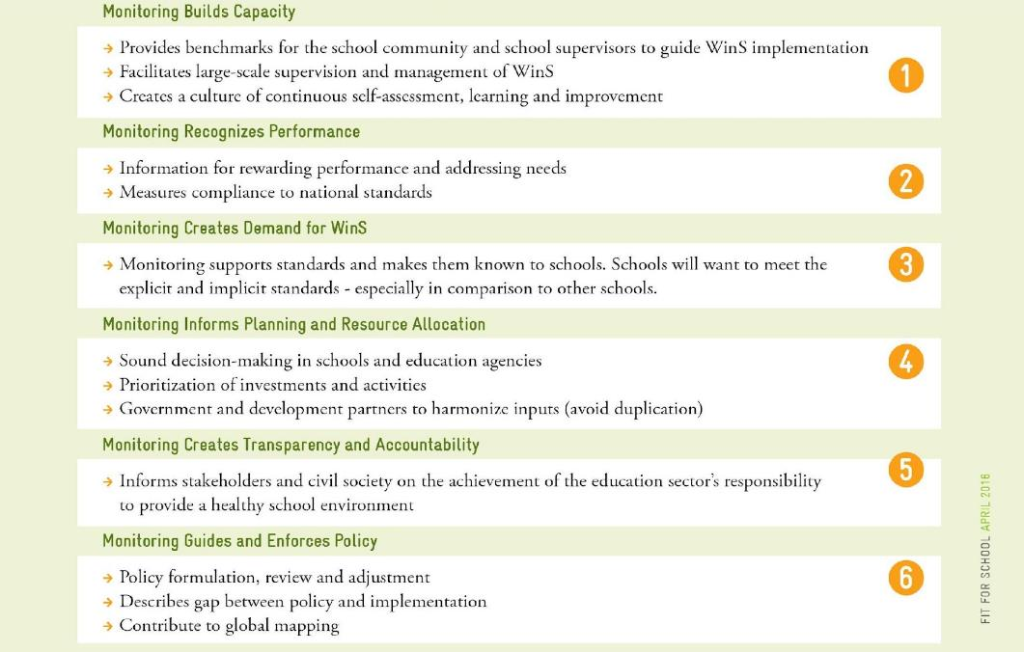
Six functions of WinS monitoring

Slide 7
Monitoring recognizes performance
CAMBODIA
Report cards
PHILIPPINES
Feedback loops
Seal of excellence

Slide 8
Monitoring recognizes performance
Philippines
Feedback loops
Seal of Excellence
Cambodia
Report cards
Resource allocation
LGU facilities GAP Dashboard

Slide 9
Country Example: Cambodia – report cards

Slide 10
Cambodia: Three Star Approach
Three Star Approach (TSA) levels are calculated for 4 categories:
Drinking water
Latrines and urinals
Handwashing facilities
Environment and safety

Slide 11
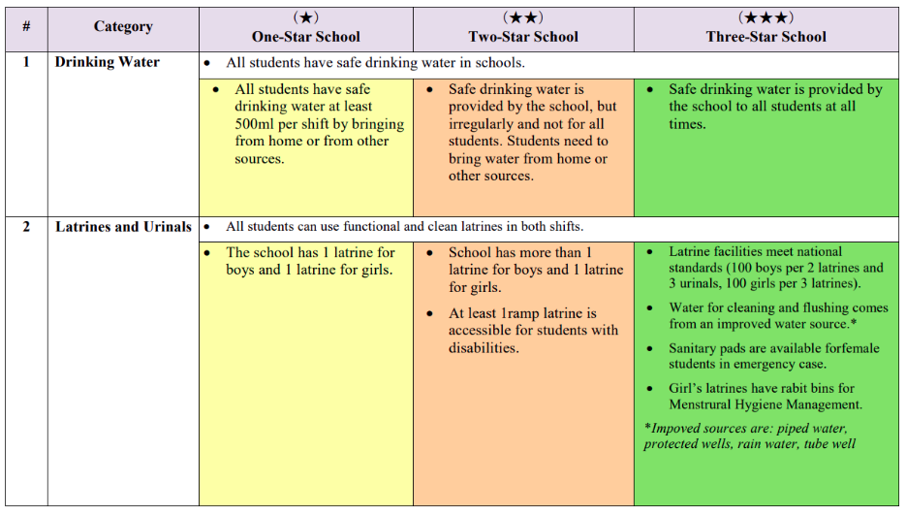
Example TSA definitions

Slide 12
Cambodia TSA WinS Monitoring
MOE has defined minimum requirement standards for schools
Schools fill in a monitoring form as appendix to the EMIS
Annual data collection (now 4 years)
9036 schools
Aggregated data available in Excel

Slide 13
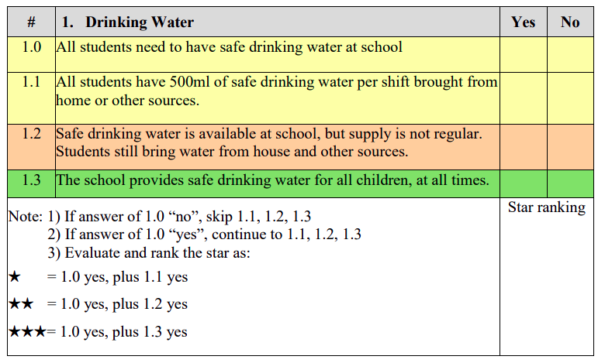
Example TSA entry form

Slide 14
School improvement
Achievement per indicator and
steps needed to take to reach the next level

Slide 15
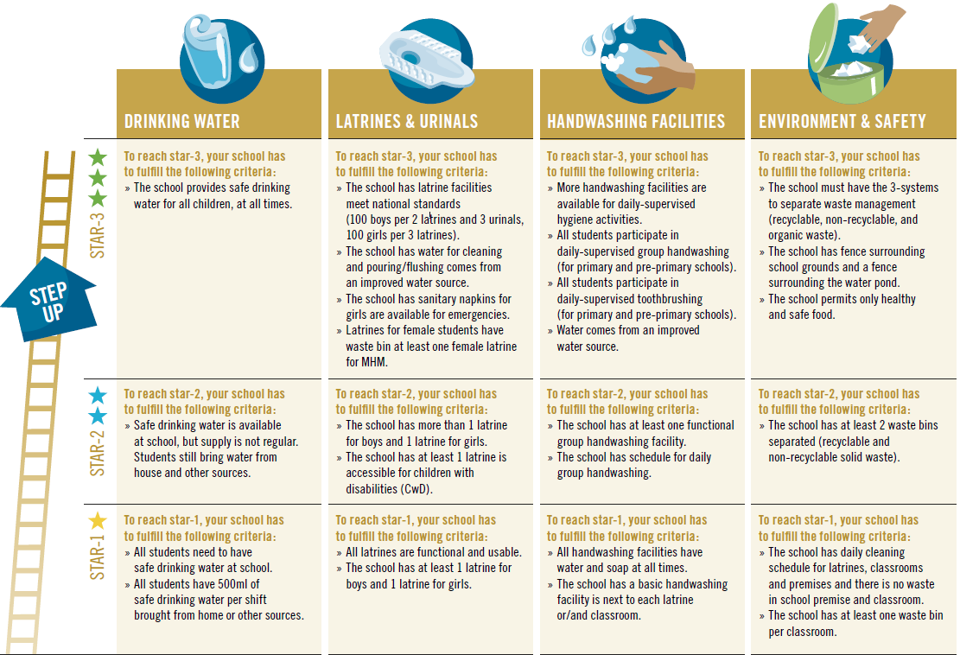

Slide 16
School recognition
Awarding options:
0 STAR – report card but no certificate
1 STAR – report card and certificate issued by the district
2 STARS – report card and certificate issued by the province
3 STARS – report card and certificate issued by the ministry

Slide 18
Country Example: Philippines – recognition

Slide 19
Philippines: Three Star Approach
WinS-OMS based on voluntary self assessment
Annual data collection, now 5 years
More than 48,000 schools, 94% participation rate
Schools enter data in an Excel sheet
School data are aggregated into a national data base

Slide 20
Country examples: Philippines
WINS-OMS based on voluntary self assessment
Annual data collection, now 5 years
More than 48,000 schools, 94% participation rate
Schools enter data in an Excel sheet

Slide 21
How monitoring is done at School Level?

Slide 22
Philippines: Recognition models
Data entry process provides immediate feedback for schools
National data base is used to provide dashboard for management on national and subnational level

Slide 23
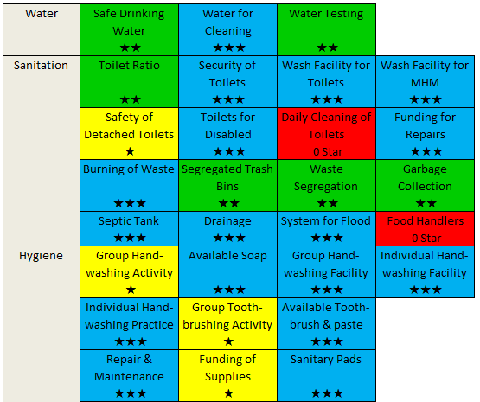
Example data entry feedback

Slide 24
And for (sub) national offices
WinS Monitoring Dashboard
A tool for online data visualization and sharing of data.
Easy access to visualization of common/important WinS indicators.
Contents:
Participation Rate
Thematic areas (water, sanitation, hygiene, deworming & health education)
Three-Star Rating
Specific WinS indicators

Slide 25
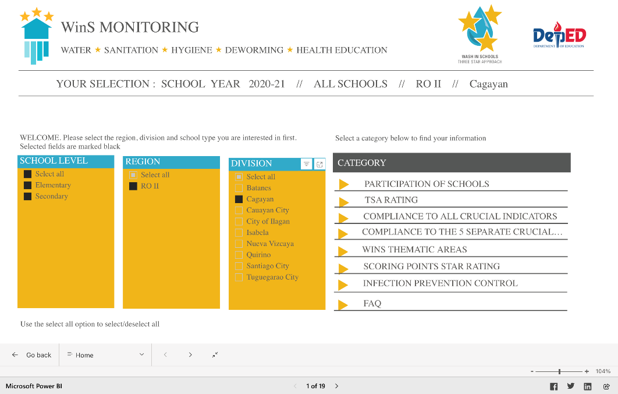

Slide 26
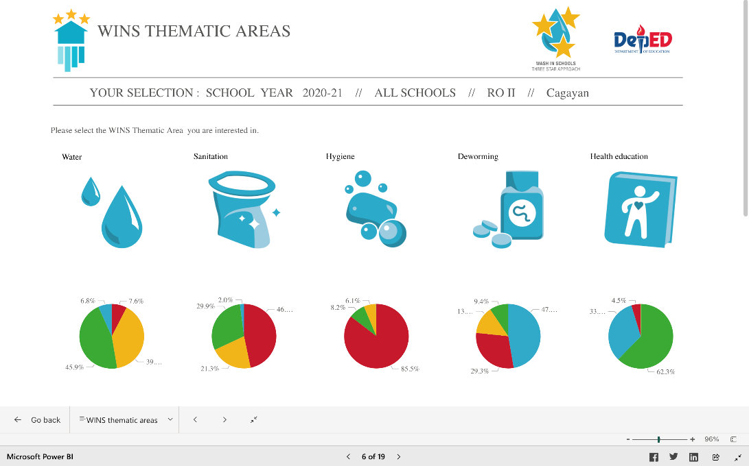

Slide 28
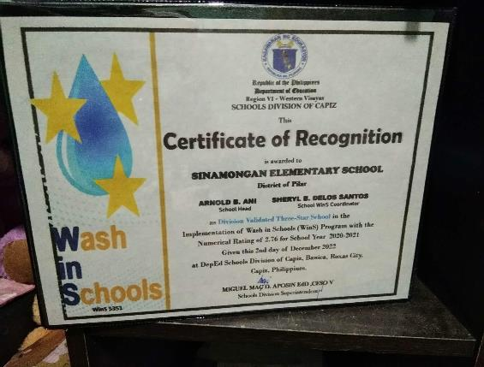
Recognition: Seal of Excellence
Awarded by DEPED to schools that maintained three star ratings (or the National WinS standards for 3 consecutive years).
Schools with improvement from last year as well as those who reached three stars at the time of monitoring are given an award at the subnational level.

Slide 29
Lessons learned
Keep it simple!
Use tools that are easy to use and understand
Keep a visually consistent language
Feedback and recognition work!
Need close cooperation between content and IT specialists at MOE, but content should be in the lead
Be flexible, the world changes, and so should your M&E system

Slide 30
6 function of monitoring
Monitoring builds capacity
Monitoring recognizes performance
Monitoring creates demands for WinS
Monitoring informs planning and resource allocation
Monitoring creates transparency and accountability
Monitoring guides data driven decision making

Slide 31
Resource Allocation
Many schools do not meet national WinS standards
Municipalities can support schools
Dashboard that shows the school needs
Supports School Districts and School Directors with Fund Raising
Combined with:
A MOOC;
Implementing guidelines;
O&M app for calculation operational costs;

Slide 32
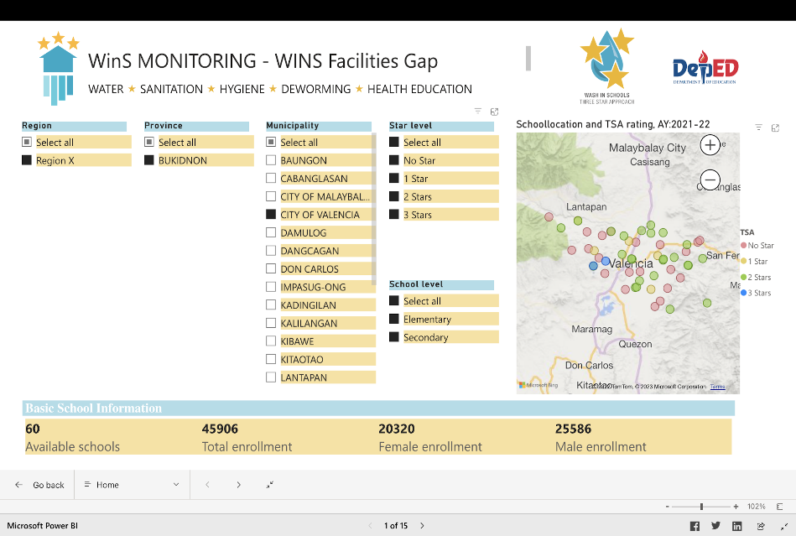
WINS Facilities Gap

Slide 33
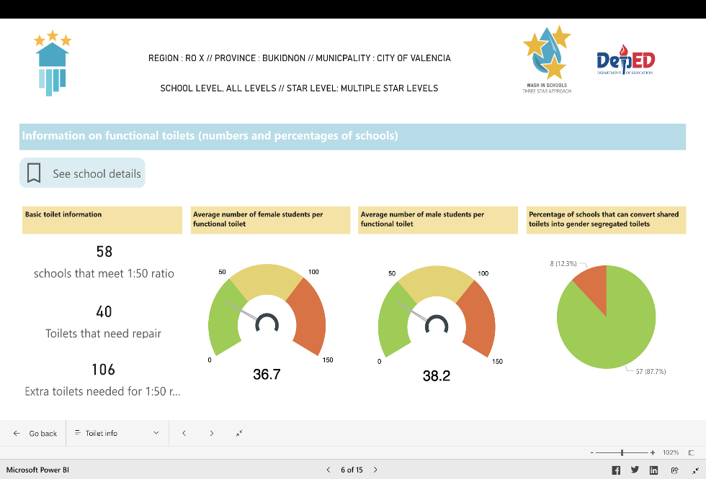
WinS Facilities GAP

Slide 34
Mobile data collection

Slide 35
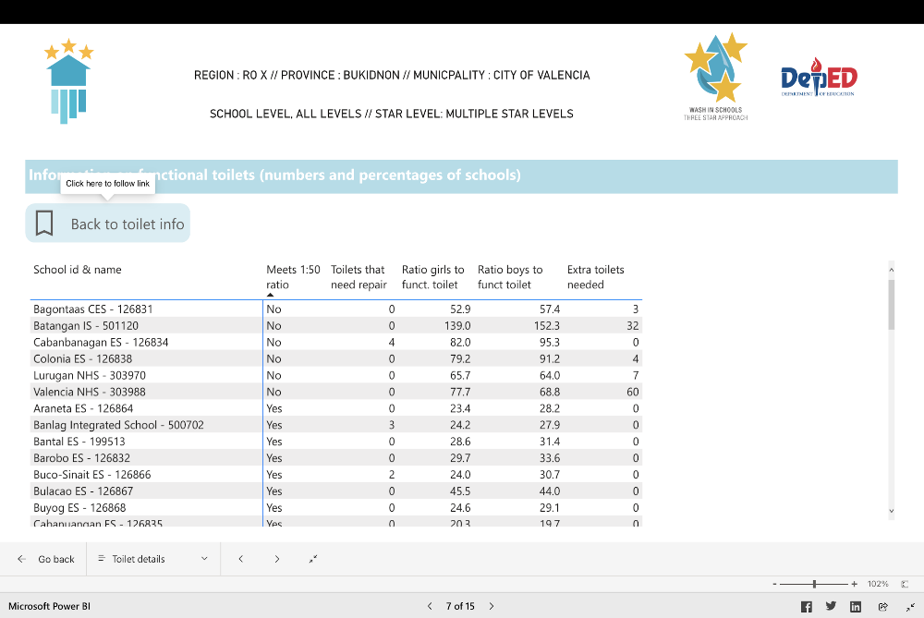

Slide 36
Digital data collection for WINS
Android based data collection
KoBo toolbox
Digital data collection
Online/offline workflow + Digital database
Easy to learn and relative low investment
GPS + media
Checks and balances
JMP has basic questionnaire

Slide 37
Thank you!
For more information please contact:
Marvin Marquez
GIZ – Fit for School
marvin.marquez@giz.de
Ubo Pakes
WASH Consultant
ubo@gis-tm.com

