Slide 1
Please change your name on Zoom to include your country delegation
Welcome to day 1 of the JMP side session on monitoring basic and inclusive WinS at the 2022 ILE
Please introduce yourself in the chatbox

Slide 2
Monitoring basic and inclusive WinS: global guidance and cross-country sharing
9th ILE on WinS, 2022
09:00 Introductions and session overview
09:10 Global recommendations and resources – WHO/UNICEF JMP
09:35 Cross-country discussion on day 2 preparation – breakout groups (3-4 countries)
09:50 Wrap-up
09:00 Session overview
09:10 Cross-country sharing on data collection, reporting, and usage – breakout groups (3-4 countries)
10:20 Groups share 3 key take-aways with plenary
10:50 Wrap-up
Tuesday 13 September (times are GMT+7 / Bangkok time)
Tuesday 20 September (times are GMT+7 / Bangkok time)

Slide 3
“What we measure is what we pay attention to… and how we judge success” “If you can’t measure it, you can’t improve it.”
Quotes from Julie Hennegan (Burnet Institute) and Peter Drucker (Business Management expert)

Slide 4
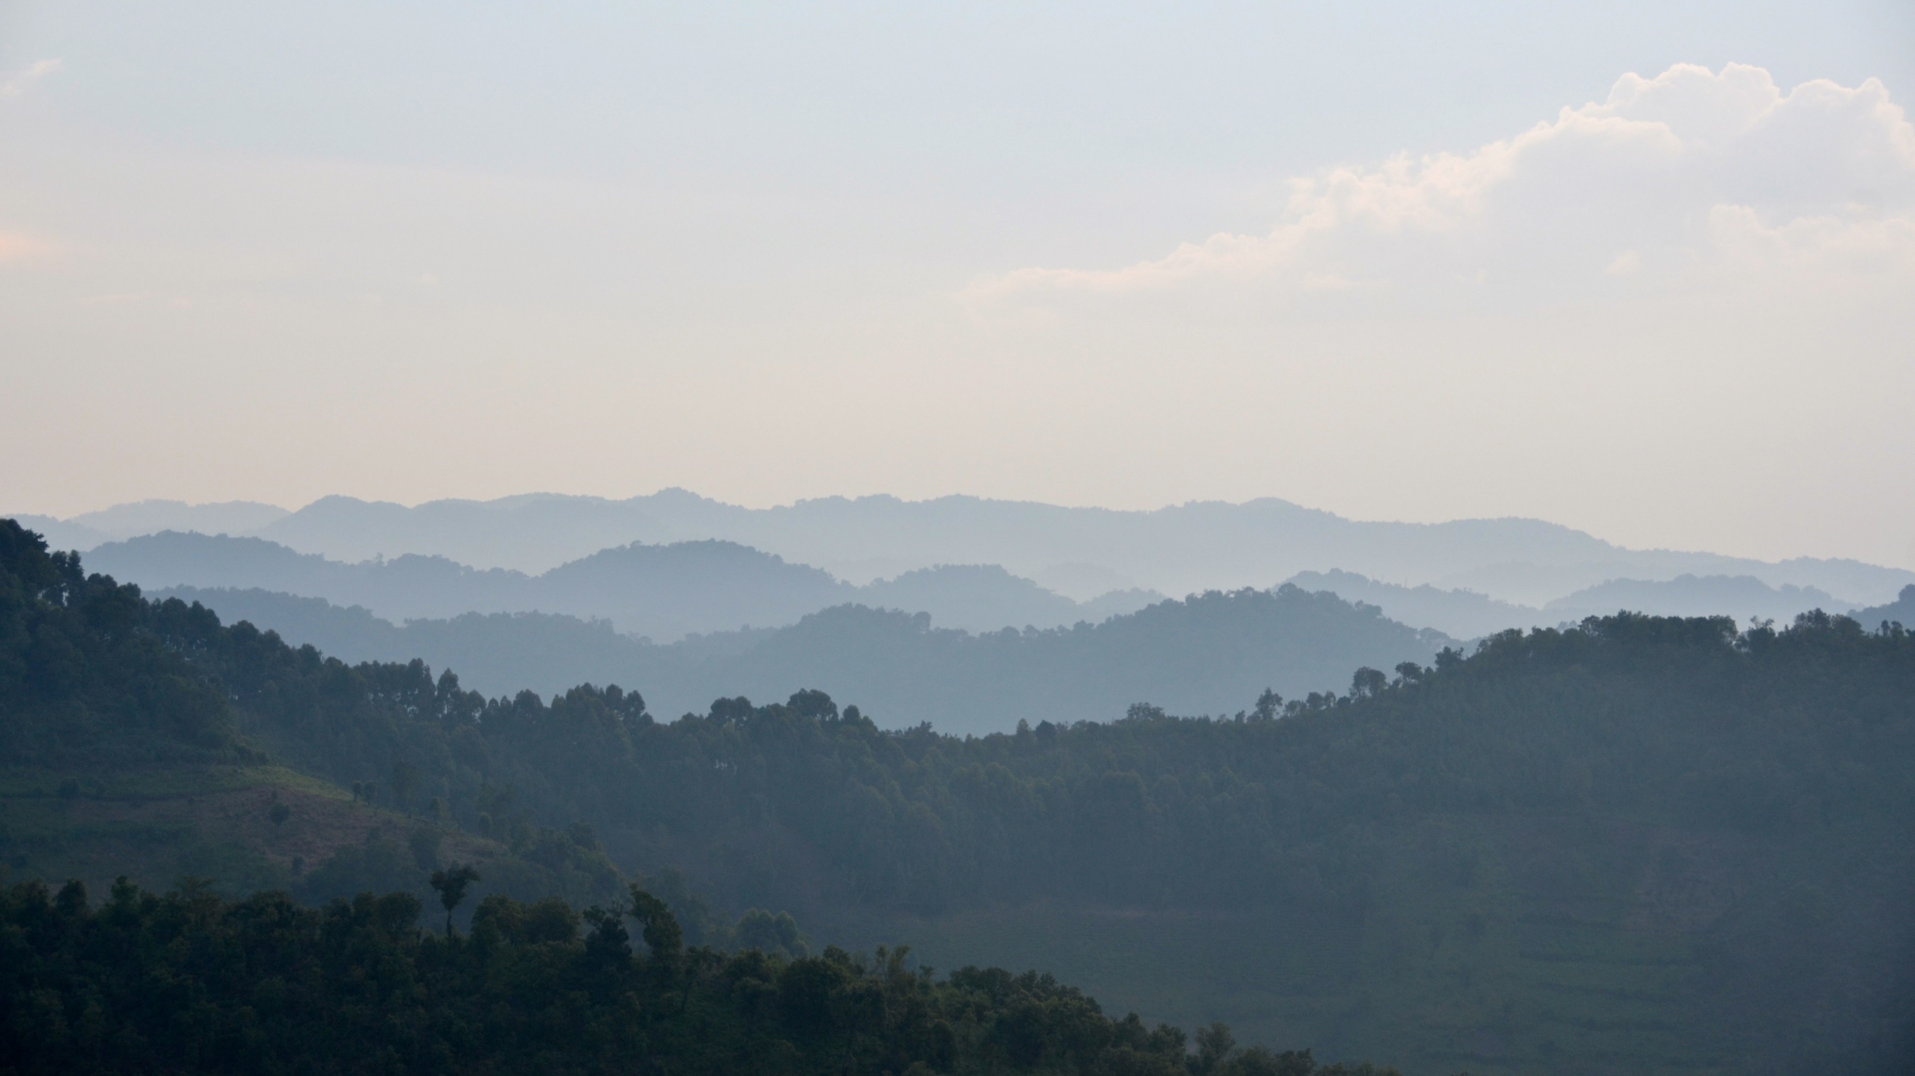
Objectives of this side session
Understand the recommended core (and expanded) questions to monitor the SDGs for WinS
Learn how other countries in the region are collecting, analysing, reporting, and using data on basic and inclusive WinS
Get ideas and inspiration for how to improve WinS monitoring in your country

Slide 5
4.a Build and upgrade education facilities that are child, disability and gender sensitive and provide safe, nonviolent, inclusive and effective learning environments for all
4.a.1 Proportion of schools with: …(e) basic drinking water; (f) single-sex basic sanitation facilities; and (g) basic handwashing facilities (as per WASH indicator definitions)
Notes:
SDG4 has a target on effective learning environments which includes basic drinking water, sanitation and hygiene in schools
This target calls for close collaboration between WASH and Education sectors

Slide 6
4.a Build and upgrade education facilities that are child, disability and gender sensitive and provide safe, nonviolent, inclusive and effective learning environments for all
4.a.1 Proportion of schools with: …(e) basic drinking water; (f) single-sex basic sanitation facilities; and (g) basic handwashing facilities (as per WASH indicator definitions)
Notes:
The JMP ladders focus on progress towards a basic level of drinking water, sanitation and hygiene service in schools which is the indicator used for SDG monitoring
Agreed upon by Expert Group representing multiple regions and organizations, including UNESCO-UIS.

Slide 7
The JMP collects national data to track global, regional, & national progress toward the SDGs for WinS
The WHO/UNICEF JMP is responsible for tracking progress of WASH-related SDGs
The JMP has developed methods for global monitoring of WASH in schools to support SDG progress tracking
The JMP produces updated estimates on WASH in schools every 2 years
A total of 1,029 national data sources were used in the 2022 update (many from EMIS)
National data sources used in the JMP 2022 report
Notes:
A total of 1,029 national data sources were used for the 2022 update report
Average of 5.6 datasets per country (182 countries)
Data sources include EMIS, periodic censuses, UNESCO Institute for Statistics data, and surveys
Data were mapped to the indicator elements to standardize results between surveys and countries to the extent possible

Slide 8
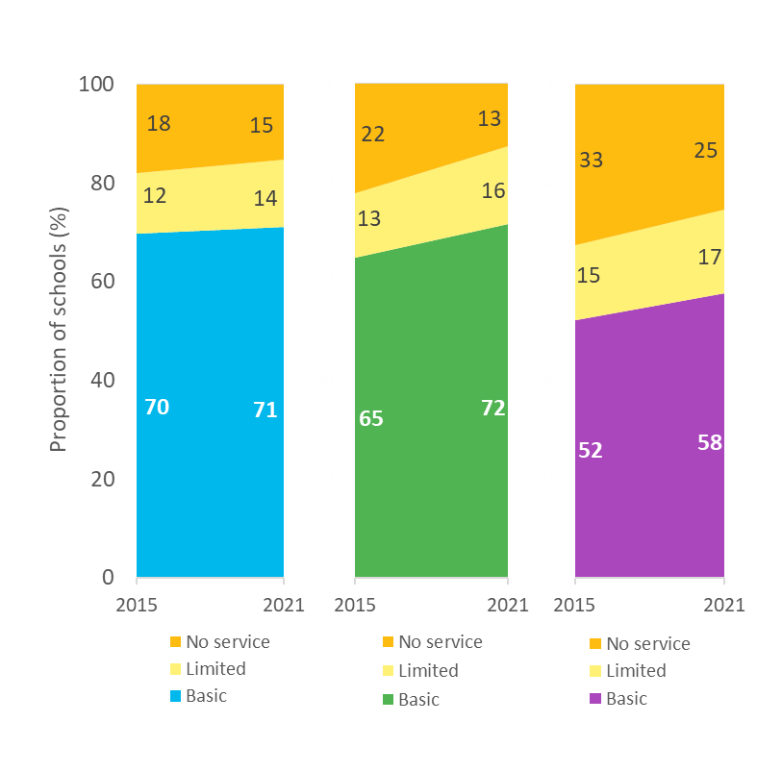
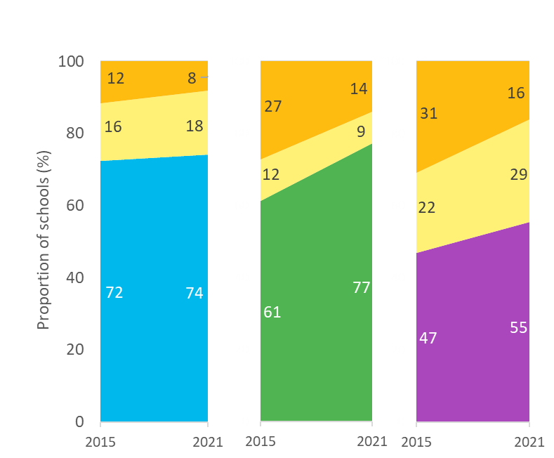
Global
WASH in schools coverage from 2015 to 2021
ILE Countries

Slide 9
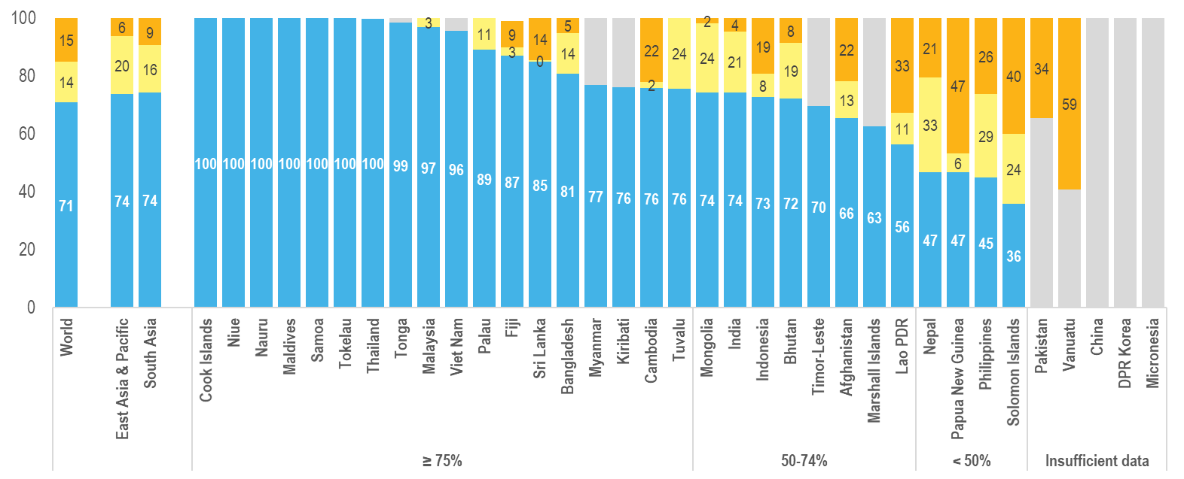
Basic drinking water in schools (2021)
Estimates for 30 countries in the EAP and SA regions
Notes:
30 countries in EAP and SA had sufficient data to estimate coverage of basic services in 2021 (up from 22 in the previous update). <50% of schools in four of the 30 countries. 8 are below the global average.

Slide 10
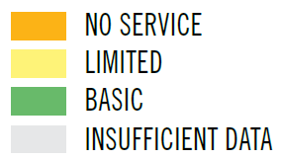
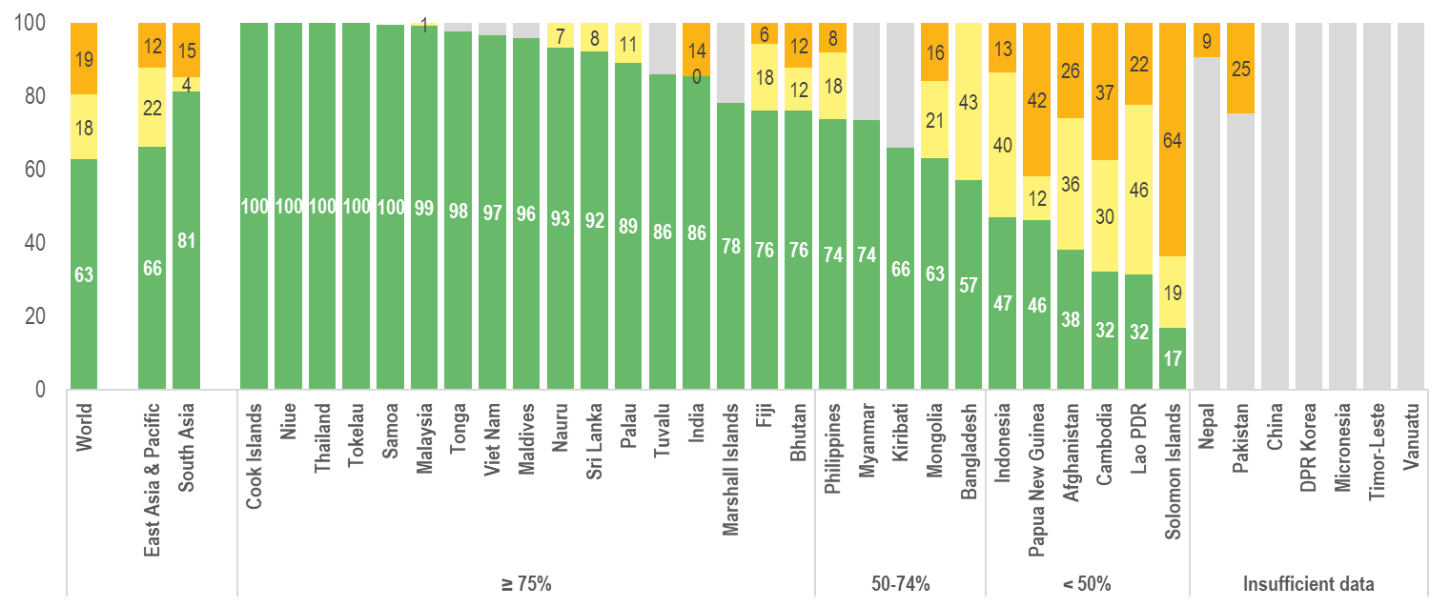
Basic sanitation in schools (2021)
Estimates for 28 countries in the EAP and SA regions
Notes:
28 countries in EAP and SA had sufficient data to estimate coverage of basic services in 2021 (up from 21 in 2019). Coverage is less than 50% in 6 of the 28. 7 are below the global average.

Slide 11
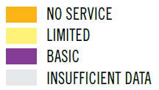
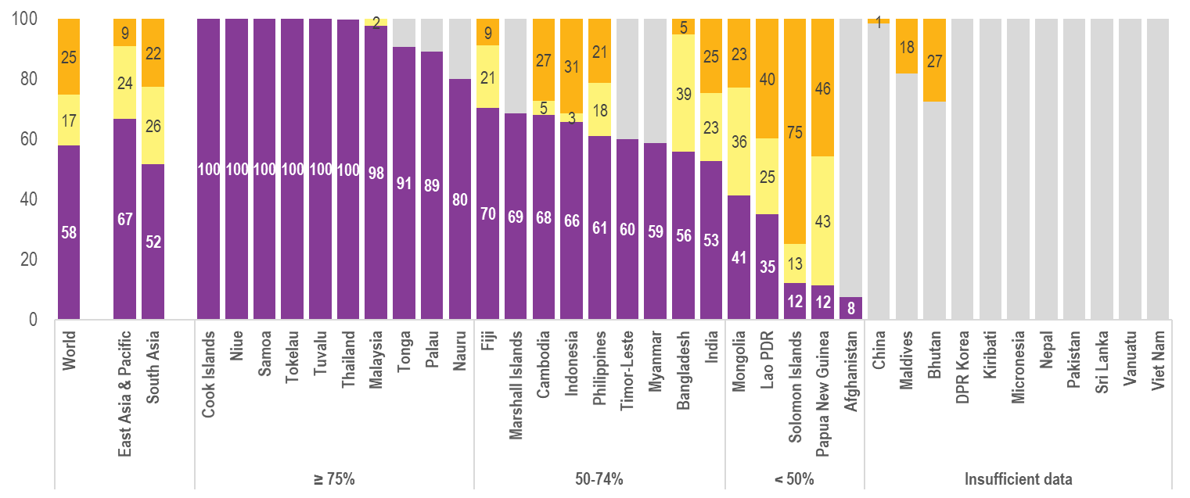
Basic hygiene in schools (2021)
Estimates for 24 countries in the EAP and SA regions
Notes:
24 countries in EAP and SA had sufficient data to estimate coverage of basic hygiene services in 2021 (up from 18 for 2019). 5 of which are <50% and 7 are below the global average.

Slide 12
Examples of monitoring disability inclusive WASH
(2022 Report)
Notes:
And, the provision of disability-accessible infrastructure in schools goes far beyond WASH services

Slide 13
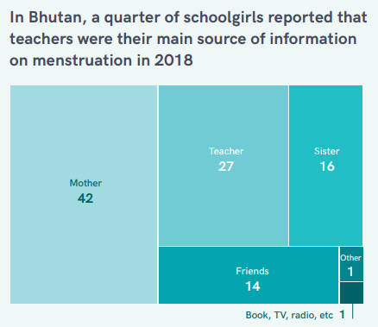
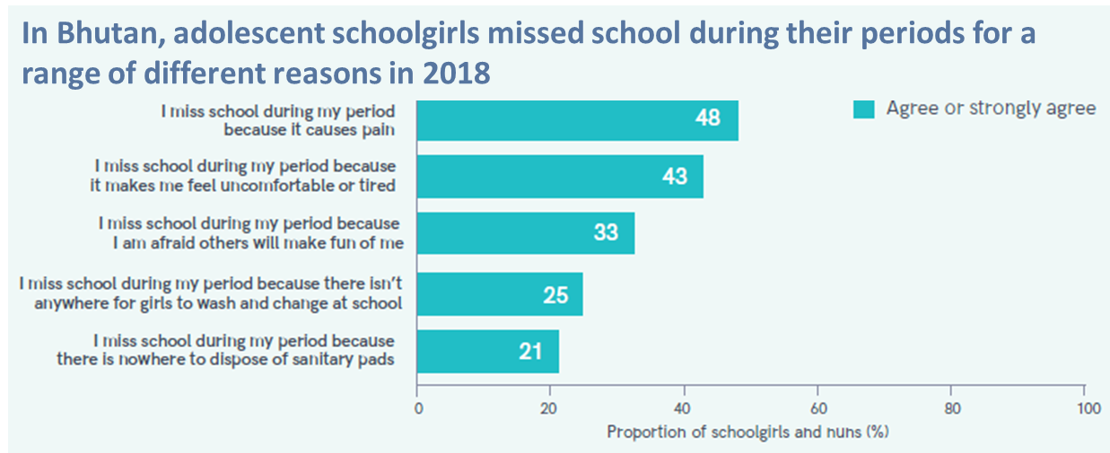
In India, Nearly 2 out of 3 schools provided MHM education, and more than 1 in 3 had a functional incinerator for disposal of sanitary waste in 2017
Examples of monitoring school services for MHH
(2020 Report)
Notes:
And, the provision of disability-accessible infrastructure in schools goes far beyond WASH services

Slide 14
What percentage of schools in your country have basic drinking water, sanitation and hygiene services?
How many schools in your country have disability-accessible toilets?
How many schools in your country have services to support menstrual health and hygiene (MHH)?
→ If you have answers to some of all of these questions, we want to learn how you collect, analyse and report these data!
→ If you don’t have answers, we want to learn about your challenges and share ideas across countries!

Slide 15
Monitoring basic and inclusive WinS: global guidance and cross-country sharing
9th ILE on WinS, 2022
09:00 Introductions and session overview
09:10 Global recommendations and resources – WHO/UNICEF JMP
09:35 Cross-country discussion on day 2 preparation – breakout groups (3-4 countries)
09:50 Wrap-up
09:00 Session overview
09:10 Cross-country sharing on data collection, reporting, and usage – breakout groups (3-4 countries)
10:20 Groups share 3 key take-aways with plenary
10:50 Wrap-up
Tuesday 13 September (times are GMT+7 / Bangkok time)
Tuesday 20 September (times are GMT+7 / Bangkok time)

Slide 16
Global recommendations & resources for monitoring basic and inclusive WinS
9th WinS ILE, virtual 13 September 2022
WHO/UNICEF Joint Monitoring Programme
info@washdata.org

Slide 17
Global recommendations and resources for…
Data collection
Data analysis

Slide 18
Global recommendations and resources for…
Data collection
Data analysis

Slide 19
Elements of basic WASH services in schools
Drinking Water |  | Sanitation |  | Hygiene
Basic service: Drinking water from an improved source and water is available at the school at the time of the survey |  | Basic service: Improved sanitation facilities at the school that are single-sex and usable (available, functional and private) at the time of the survey |  | Basic service: Handwashing facilities with water and soap available at the school at the time of the survey
Limited service: Drinking water from an improved source but water is unavailable at the school at the time of the survey |  | Limited service: Improved sanitation facilities at the school that are either not single-sex or not usable at the time of the survey |  | Limited service: Handwashing facilities with water but no soap available at the school at the time of the survey
No service: Drinking water from an unimproved source or no water source at the school |  | No service: Unimproved sanitation facilities or no sanitation facilities at the school |  | No service: No handwashing facilities available or no water available at the school
Notes:
The new JMP ladders focus on progress towards a basic level of drinking water, sanitation and hygiene service in schools which is the indicator used for SDG monitoring
Agreed upon by Expert Group representing multiple regions and organizations, including UNESCO-UIS.

Slide 20
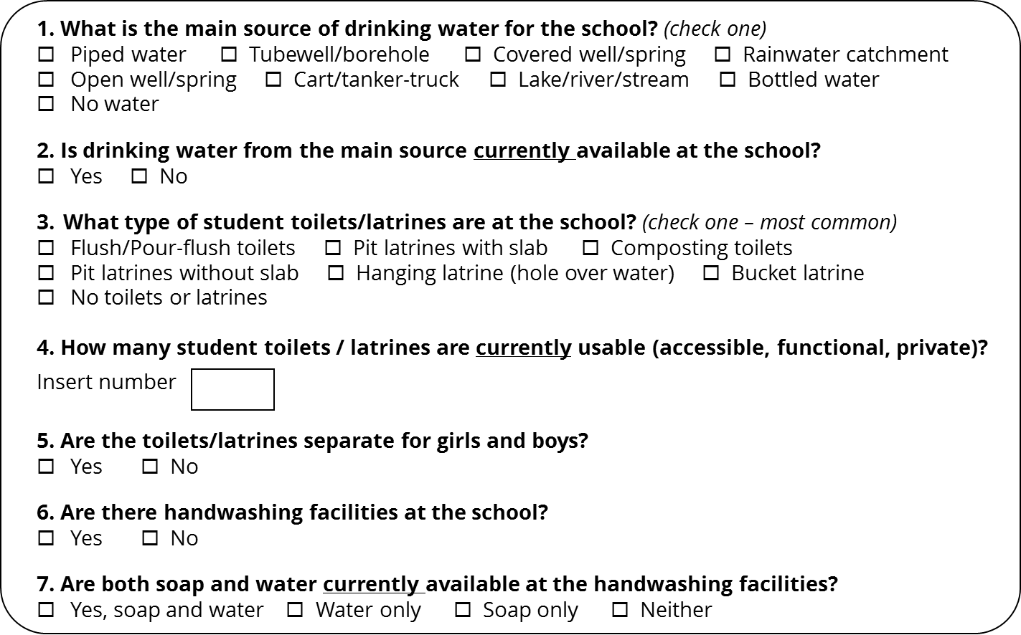
7 core questions to monitor basic service
Should be modified, if needed, based on country context
Example for inclusion in EMIS questionnaires
Notes:
Improve monitoring by moving beyond simply the presence of infrastructure
Supports global monitoring of the SDGs – comparing apples to apples across countries

Slide 21
JMP service ladders for WASH in schools
Drinking Water |  | Sanitation |  | Hygiene
Advanced service: Additional criteria may include quality, quantity, continuity, and accessibility to all users |  | Advanced service: Additional criteria may include student per toilet ratios, menstrual hygiene facilities, cleanliness, accessibility to all users, and excreta management systems |  | Advanced service: Additional criteria may include hygiene education, group handwashing, menstrual hygiene materials, and accessibility to all users
Basic service: Drinking water from an improved source and water is available at the school at the time of the survey |  | Basic service: Improved sanitation facilities at the school that are single-sex and usable (available, functional and private) at the time of the survey |  | Basic service: Handwashing facilities with water and soap available at the school at the time of the survey
Limited service: Drinking water from an improved source but water is unavailable at the school at the time of the survey |  | Limited service: Improved sanitation facilities at the school that are either not single-sex or not usable at the time of the survey |  | Limited service: Handwashing facilities with water but no soap available at the school at the time of the survey
No service: Drinking water from an unimproved source or no water source at the school |  | No service: Unimproved sanitation facilities or no sanitation facilities at the school |  | No service: No handwashing facilities available or no water available at the school
Notes:
It is recognised that this basic minimum level of service is not sufficient for full realization of the human rights to education, safe water and sanitation and that additional rungs may be needed in future to monitor advanced service levels
The JMP 2018 global report on WASH in schools includes a section on emerging data for enhanced monitoring of advanced service levels.
The following provides just a few examples following the normative criteria of the human rights to safe water and sanitation i.e. accessibility, availability, quality and acceptability

Slide 22
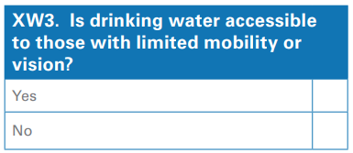
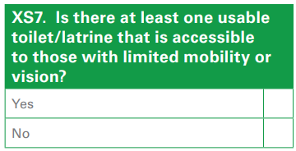
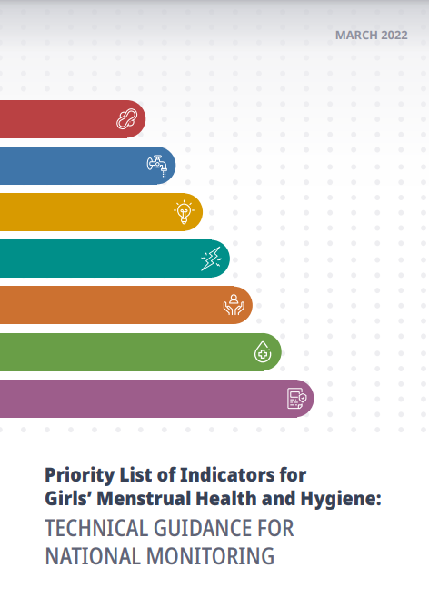
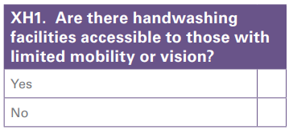
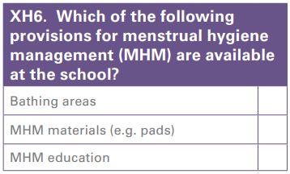
Examples of expanded questions to monitor inclusive WinS
Disability Inclusive WinS
MHH in schools
+ the Global MHH Monitoring Group recommended school-level questions (learn more at the side session on 19 Sept)
https://washdata.org/sites/default/files/documents/reports/2018-08/SDGs-monitoring-wash-in-schools-2018-August-web2.pdf

Slide 23
Excel-based tool to support data collection and analysis
Please download the Excel file here: https://washdata.org/monitoring/wash-schools/excel
Let’s open and explore the file together…
Notes:
Switch over to Excel file and walk through it.

Slide 24
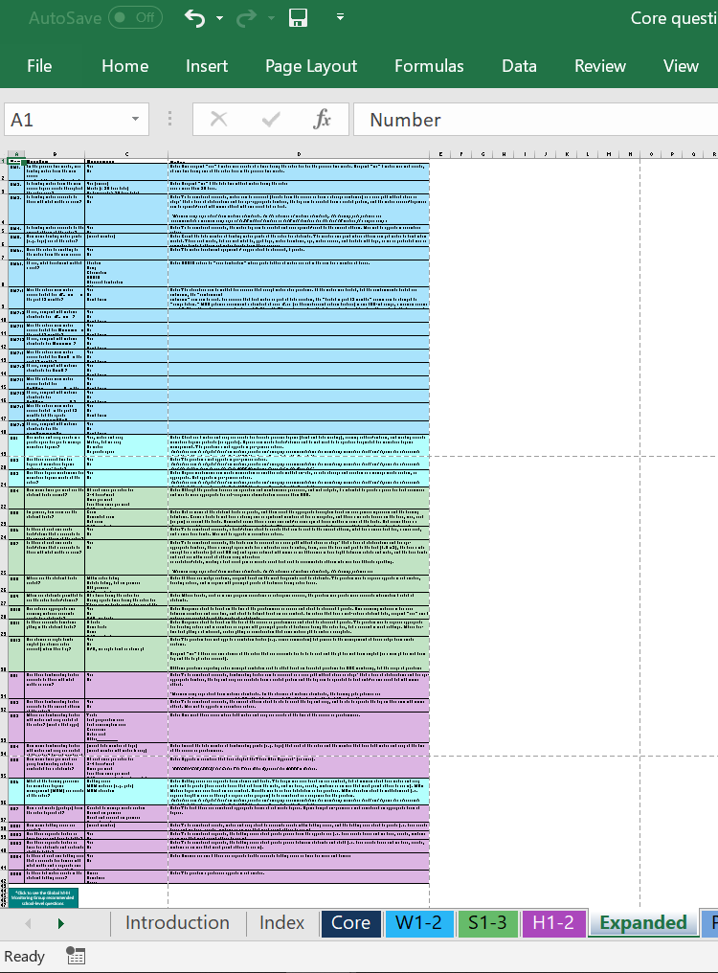
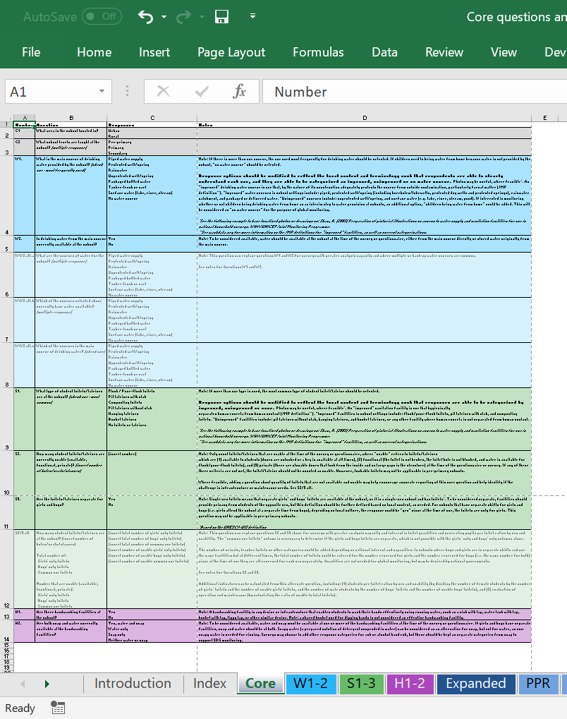
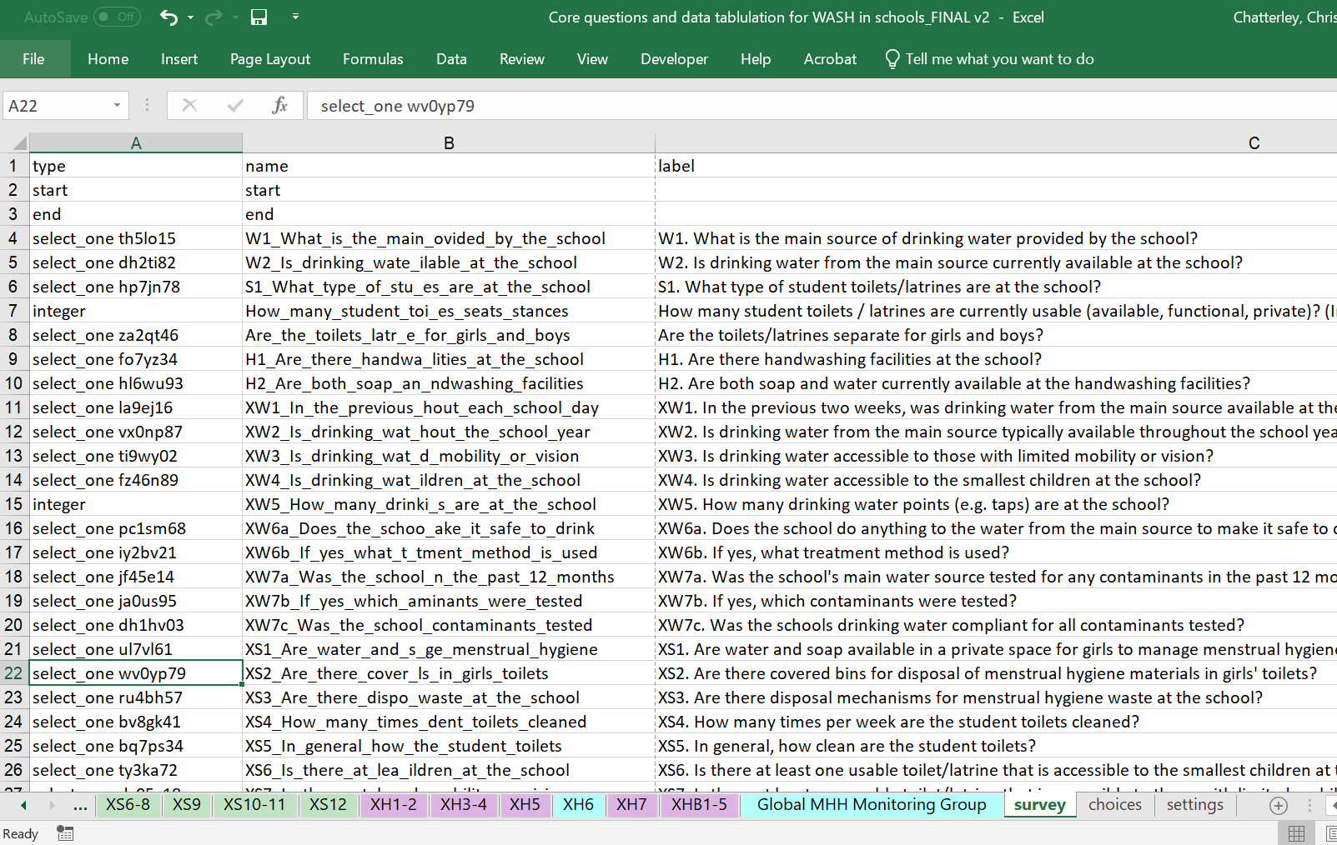
Excel-based tool to support WinS monitoring – data collection
Expanded Questions
Core Questions
KoBo Toolbox formatted Questions
Download here: https://washdata.org/monitoring/wash-schools/excel

Slide 25
Questions can be copied and pasted into EMIS questionnaires and modified as needed
 | Question | Responses | Notes
C1 | What area is the school located in? | Urban Rural
C2 | What school levels are taught at the school? (multiple response) | Pre-primary Primary Secondary
W1. | What is the main source of drinking water provided by the school? (check one - most frequently used) | Piped water supply Protected well/spring Rainwater Unprotected well/spring Packaged bottled water Tanker-truck or cart Surface water (lake, river, stream) No water source | Note: If there is more than one source, the one used most frequently for drinking water should be selected. If children need to bring water from home because water is not provided by the school, “no water source” should be selected. Response options should be modified to reflect the local context and terminology such that respondents are able to clearly understand each one, and they are able to be categorized as improved, unimproved or no water source. Photos may be useful, where feasible*. An “improved” drinking water source is one that, by the nature of its construction adequately protects the source from outside contamination, particularly faecal matter (JMP definition**). “Improved” water sources in school settings include: piped, protected well/spring (including boreholes/tubewells, protected dug wells and protected springs), rainwater catchment, and packaged or delivered water. “Unimproved” sources include: unprotected well/spring, and surface water (e.g. lake, river, stream, pond). If interested in monitoring whether or not children bring drinking water from home as an interim step to water provision at schools, an additional option, “children bring water from home” could be added. This will be considered as “no water source” for the purpose of global monitoring. *See the following example to base localized photos or drawings on: Shaw, R. (2005) Preparation of pictorial illustrations on access to water supply and sanitation facilities for use in national household surveys. WHO/UNICEF Joint Monitoring Programme. **See washdata.org for more information on the JMP definitions for "improved" facilities, as well as current categorizations.
W2. | Is drinking water from the main source currently available at the school? | Yes No | Note: To be considered available, water should be available at the school at the time of the survey or questionnaire, either from the main source directly or stored water originally from the main source.

Slide 26
The last three tabs can be modified as needed, saved as a separate Excel file, and uploaded to KoBo Toolbox (https://xlsform.org/en/)

Slide 27
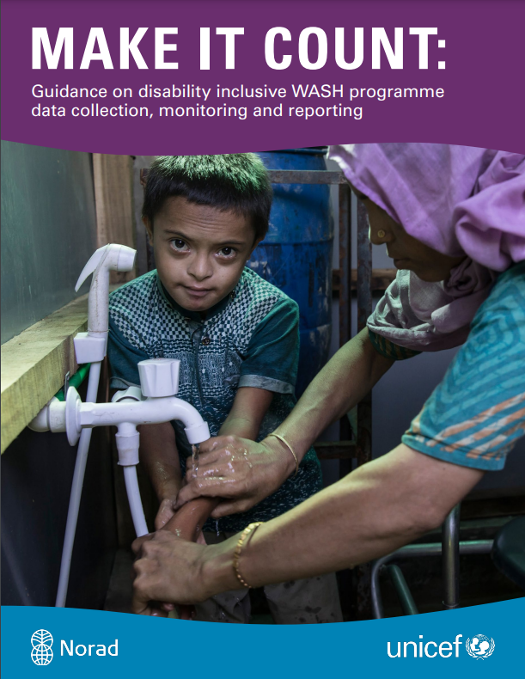
Resources for data collection
All these resources can be found here:
All elements of WASH in schools
Disabilities
MHH
https://washdata.org/monitoring/wash-schools/excel
https://www.unicef.org/media/114921/file/WASH%20Disability%20Toolkit.pdf
https://washdata.org/sites/default/files/2020-11/UNICEF-2020-guidance-monitoring-MHH-v1.pdf
https://www.publichealth.columbia.edu/sites/default/files/priority_list_of_indicators_for_girls_menstrual_health_and_hygiene-_technical_guidance_for_national_monitoring.pdf
https://washdata.org/sites/default/files/documents/reports/2018-08/SDGs-monitoring-wash-in-schools-2018-August-web2.pdf
Notes:
Add snapshots, side events, add to ILE page. QR code on screen?

Slide 28
Global recommendations and resources for…
Data collection
Data analysis

Slide 29
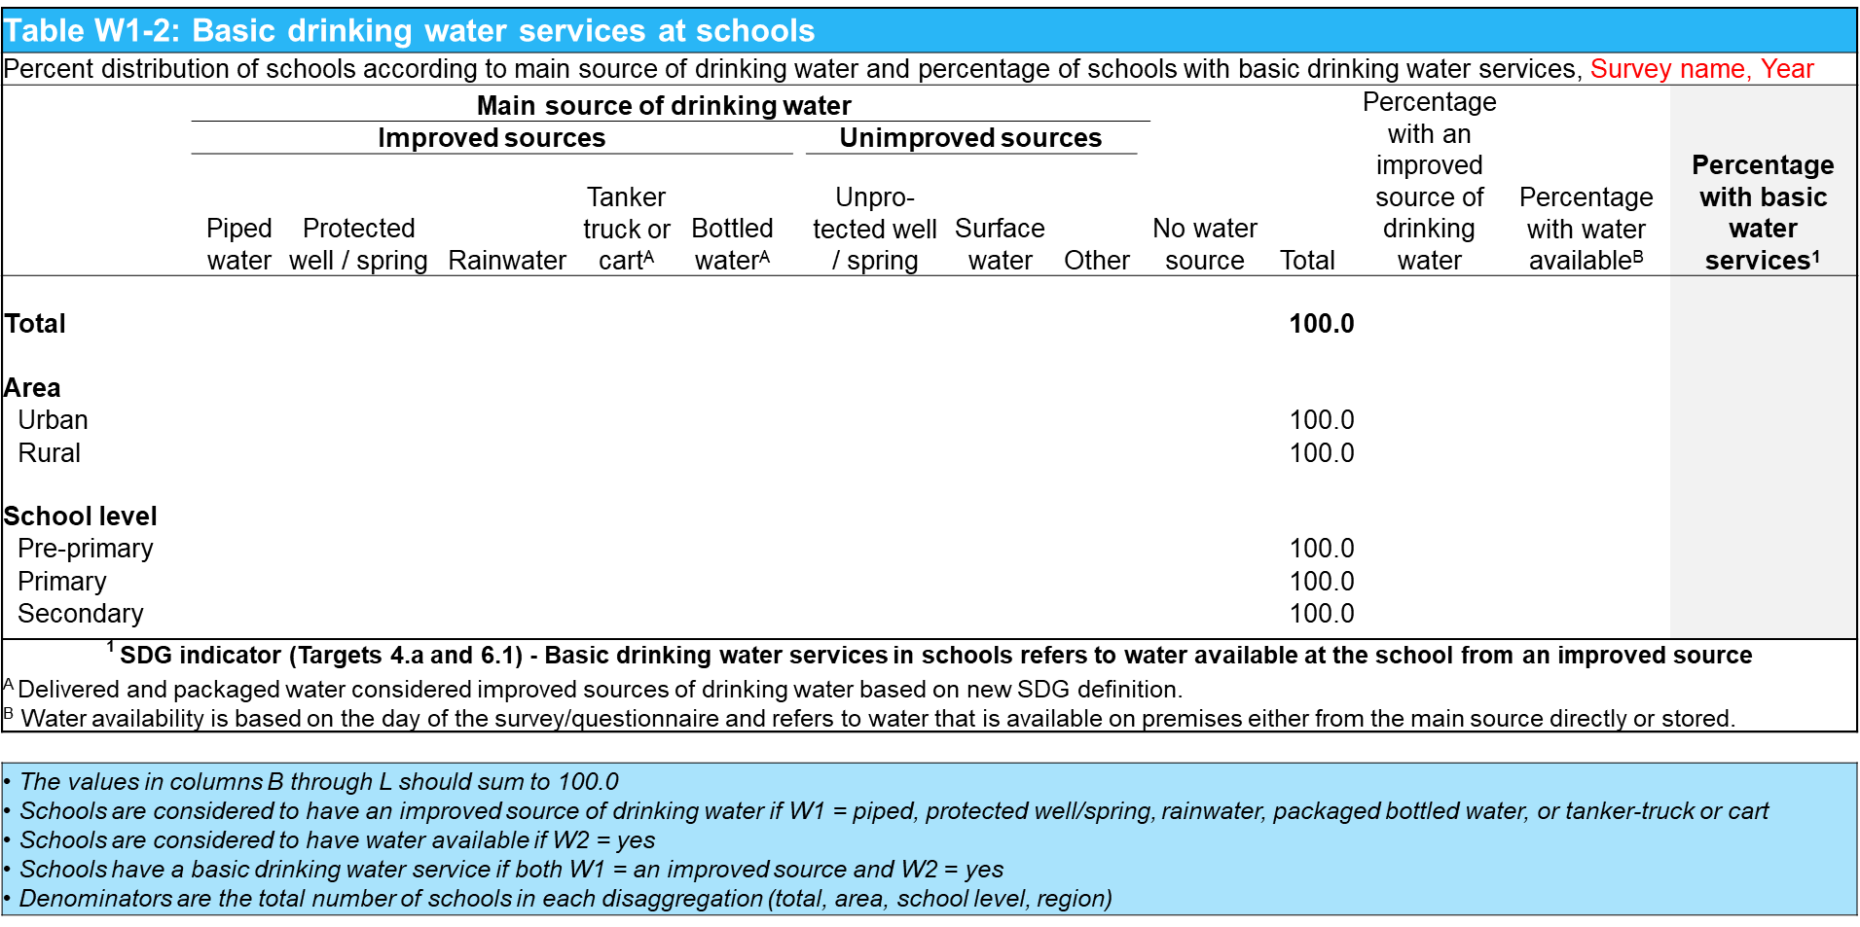
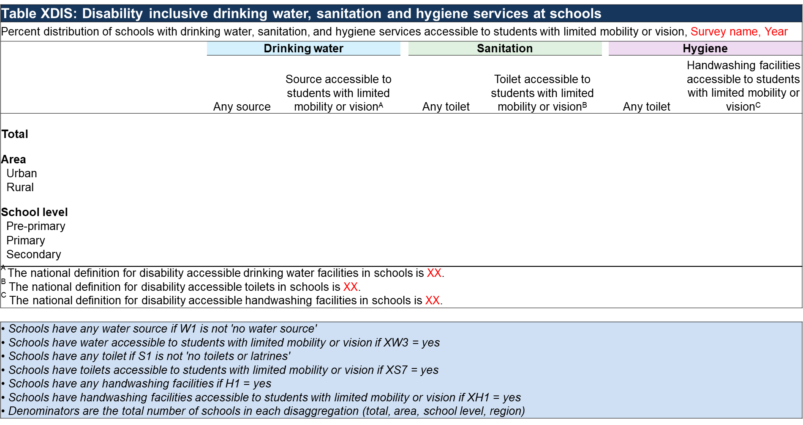
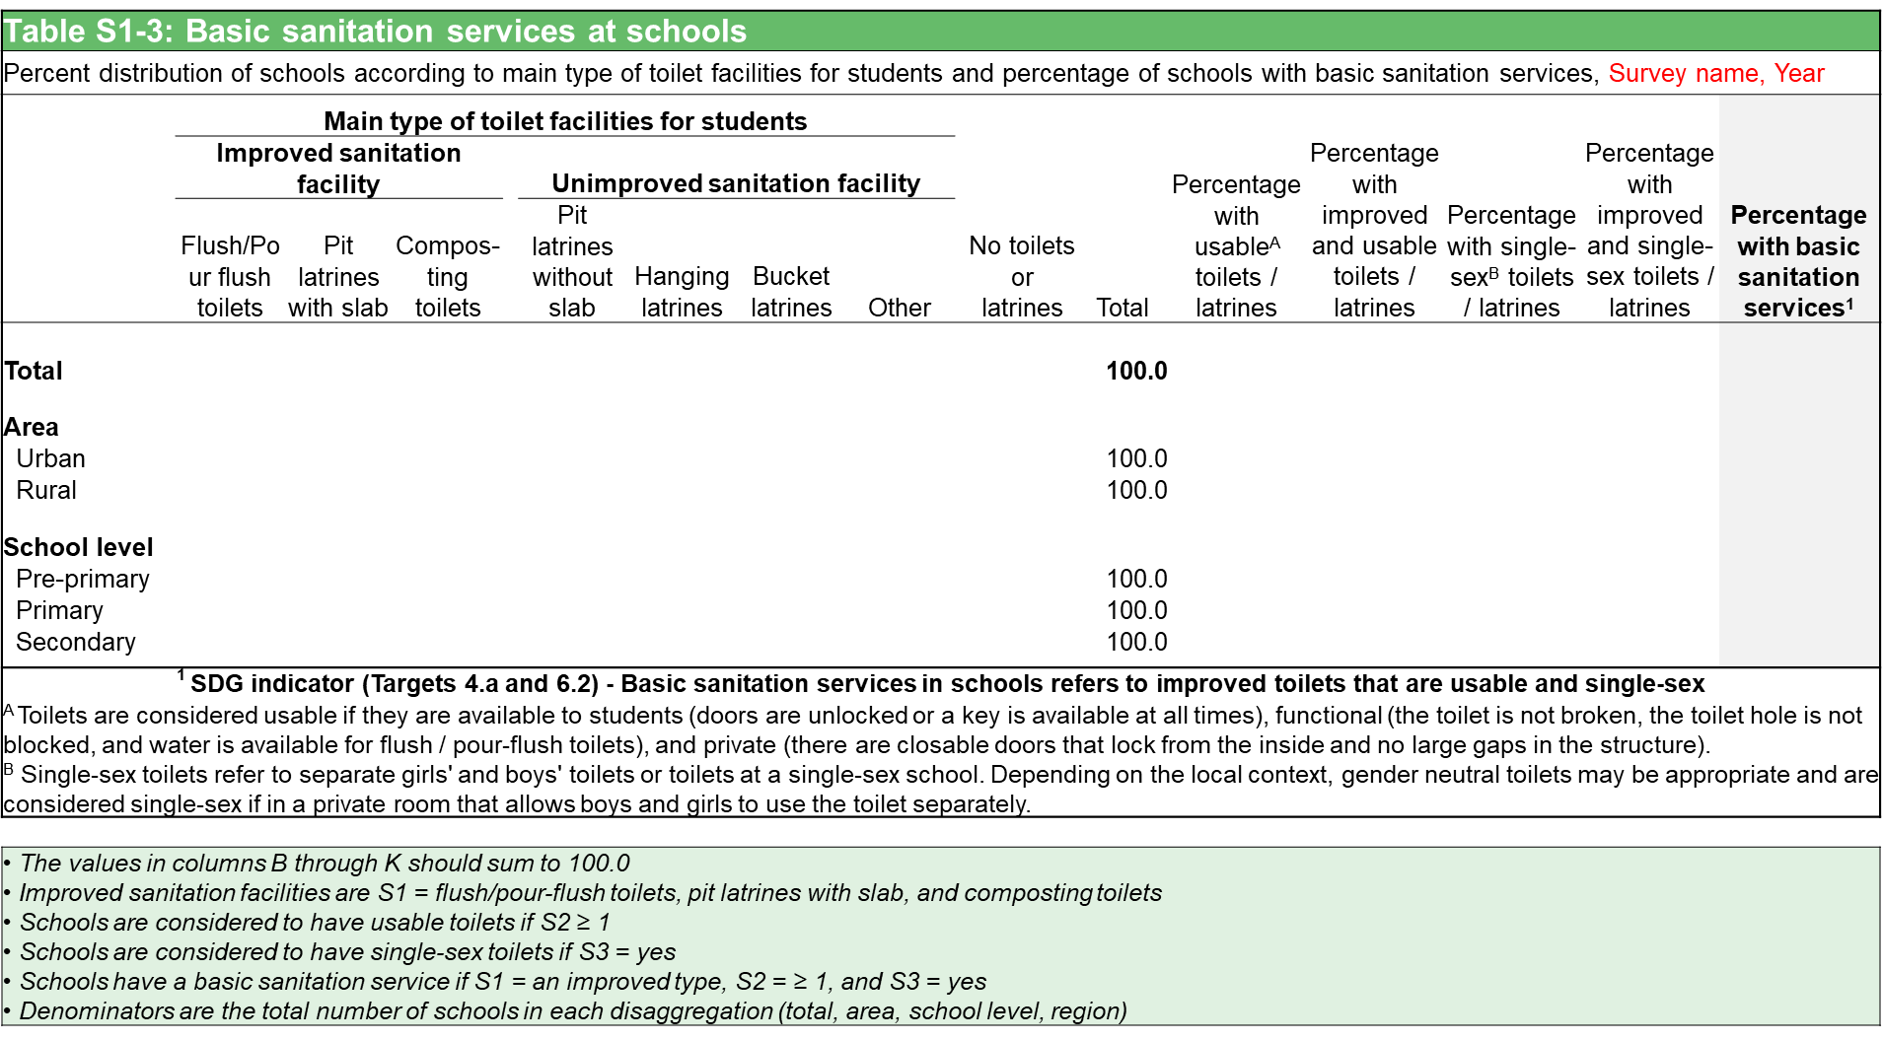
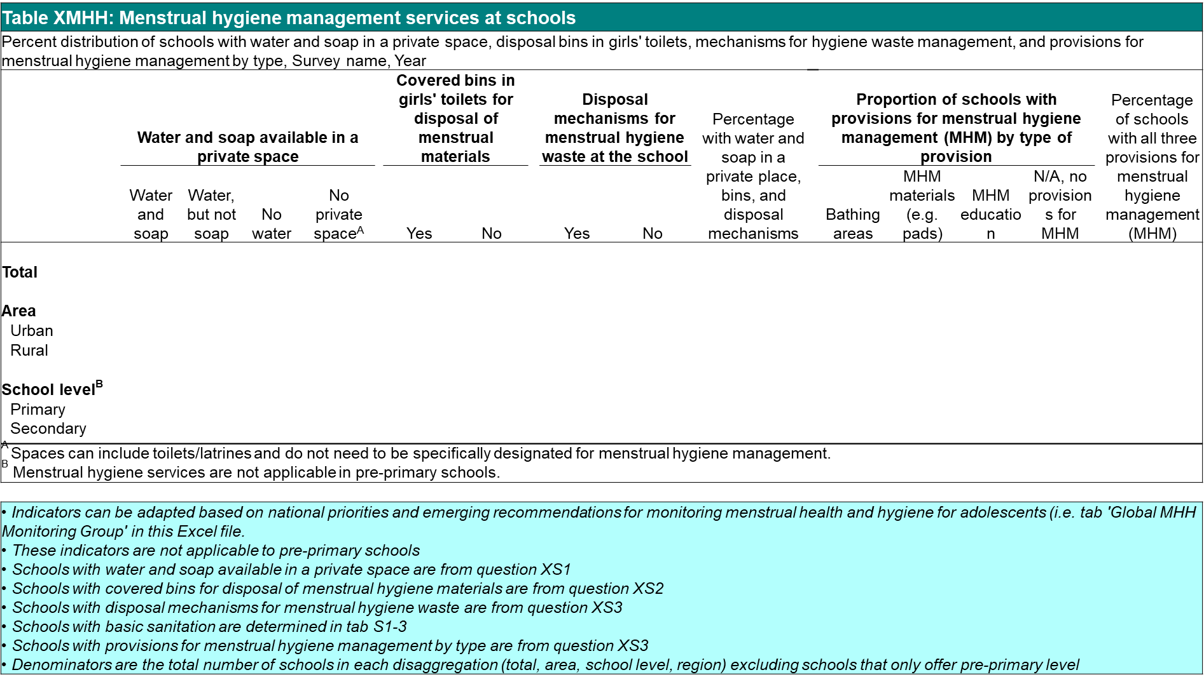
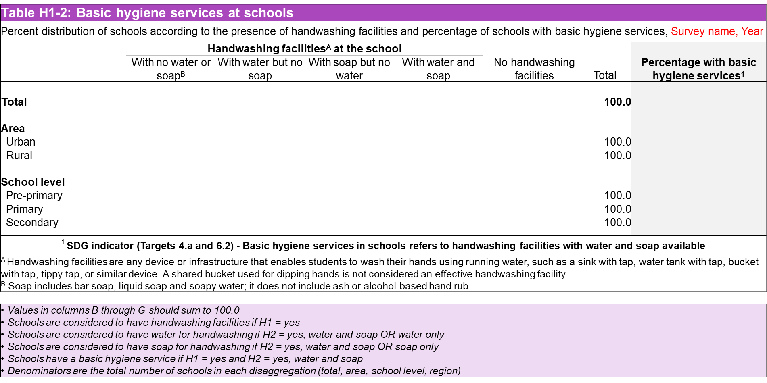
Excel-based tool to support WinS monitoring – data analysis
Thematic tabulations – Disabilities & MHH
Basic WinS tabulation
Additional expanded tabulations
Data analysis guidance provided in the box below each table

Slide 30
Table W1-2: Basic drinking water services at schools
Percent distribution of schools according to main source of drinking water and percentage of schools with basic drinking water services, Survey name, Year
 | Main source of drinking water |  |  |  |  |  |  |  |  |  | No water source | Total | Percentage with an improved source of drinking water | Percentage with water available^{B} | Percentage with basic water services¹
 | Improved sources |  |  |  |  |  | Unimproved sources
 | Piped water | Protected well / spring | Rainwater | Tanker truck or cart^{A} | Bottled water^{A} |  | Unpro-tected well / spring | Surface water | Other
Total |  |  |  |  |  |  |  |  |  |  |  | 100.0
Area
Urban |  |  |  |  |  |  |  |  |  |  |  | 100.0
Rural |  |  |  |  |  |  |  |  |  |  |  | 100.0
School level
Pre-primary |  |  |  |  |  |  |  |  |  |  |  | 100.0
Primary |  |  |  |  |  |  |  |  |  |  |  | 100.0
Secondary |  |  |  |  |  |  |  |  |  |  |  | 100.0
¹ SDG indicator (Targets 4.a and 6.1) - Basic drinking water services in schools refers to water available at the school from an improved source
^{A} Delivered and packaged water considered improved sources of drinking water based on new SDG definition. ^{B} Water availability is based on the day of the survey/questionnaire and refers to water that is available on premises either from the main source directly or stored.
• The values in columns B through L should sum to 100.0 • Schools are considered to have an improved source of drinking water if W1 = piped, protected well/spring, rainwater, packaged bottled water, or tanker-truck or cart • Schools are considered to have water available if W2 = yes • Schools have a basic drinking water service if both W1 = an improved source and W2 = yes • Denominators are the total number of schools in each disaggregation (total, area, school level, region)

Slide 31
Table XMHH: Menstrual hygiene management services at schools
Percent distribution of schools with water and soap in a private space, disposal bins in girls' toilets, mechanisms for hygiene waste management, and provisions for menstrual hygiene management by type, Survey name, Year
 | Water and soap available in a private space |  |  |  |  | Covered bins in girls' toilets for disposal of menstrual materials |  |  | Disposal mechanisms for menstrual hygiene waste at the school |  |  | Percentage with water and soap in a private place, bins, and disposal mechanisms |  | Proportion of schools with provisions for menstrual hygiene management (MHM) by type of provision |  |  |  |  | Percentage of schools with all three provisions for menstrual hygiene management (MHM)
 | Water and soap | Water, but not soap | No water | No private space^{A} |  | Yes | No |  | Yes | No |  |  |  | Bathing areas | MHM materials (e.g. pads) | MHM education | N/A, no provisions for MHM
Total
Area
Urban
Rural
School level^{B}
Primary
Secondary
^{A} Spaces can include toilets/latrines and do not need to be specifically designated for menstrual hygiene management. ^{B} Menstrual hygiene services are not applicable in pre-primary schools.
• Indicators can be adapted based on national priorities and emerging recommendations for monitoring menstrual health and hygiene for adolescents (i.e. tab 'Global MHH Monitoring Group' in this Excel file. • These indicators are not applicable to pre-primary schools • Schools with water and soap available in a private space are from question XS1 • Schools with covered bins for disposal of menstrual hygiene materials are from question XS2 • Schools with disposal mechanisms for menstrual hygiene waste are from question XS3 • Schools with basic sanitation are determined in tab S1-3 • Schools with provisions for menstrual hygiene management by type are from question XS3 • Denominators are the total number of schools in each disaggregation (total, area, school level, region) excluding schools that only offer pre-primary level

Slide 32
Table XMHH: Menstrual hygiene management services at schools
Percent distribution of schools with water and soap in a private space, disposal bins in girls' toilets, mechanisms for hygiene waste management, and provisions for menstrual hygiene management by type, Survey name, Year
 | Water and soap available in a private space |  |  |  |  | Covered bins in girls' toilets for disposal of menstrual materials |  |  | Disposal mechanisms for menstrual hygiene waste at the school |  |  | Percentage with water and soap in a private place, bins, and disposal mechanisms |  | Proportion of schools with provisions for menstrual hygiene management (MHM) by type of provision |  |  |  |  | Percentage of schools with all three provisions for menstrual hygiene management (MHM)
 | Water and soap | Water, but not soap | No water | No private space^{A} |  | Yes | No |  | Yes | No |  |  |  | Bathing areas | MHM materials (e.g. pads) | MHM education | N/A, no provisions for MHM
Total
Area
Urban
Rural
School level^{B}
Primary
Secondary
^{A} Spaces can include toilets/latrines and do not need to be specifically designated for menstrual hygiene management. ^{B} Menstrual hygiene services are not applicable in pre-primary schools.
• Indicators can be adapted based on national priorities and emerging recommendations for monitoring menstrual health and hygiene for adolescents (i.e. tab 'Global MHH Monitoring Group' in this Excel file. • These indicators are not applicable to pre-primary schools • Schools with water and soap available in a private space are from question XS1 • Schools with covered bins for disposal of menstrual hygiene materials are from question XS2 • Schools with disposal mechanisms for menstrual hygiene waste are from question XS3 • Schools with basic sanitation are determined in tab S1-3 • Schools with provisions for menstrual hygiene management by type are from question XS3 • Denominators are the total number of schools in each disaggregation (total, area, school level, region) excluding schools that only offer pre-primary level
XS1 | Are water and soap available in a private space for girls to manage menstrual hygiene? | Yes, water and soap Water, but no soap No water No private space
XS2 | Are there covered bins for disposal of menstrual hygiene materials in girls’ toilets? | Yes No
XS3 | Are there disposal mechanisms for menstrual hygiene waste at the school? | Yes No
XH6 | Which of the following provisions for menstrual hygiene management (MHM) are available at the school? | Bathing areas MHM materials (e.g. pads) MHM education
Questions from the ‘Expanded’ tab needed to complete this table

Slide 33
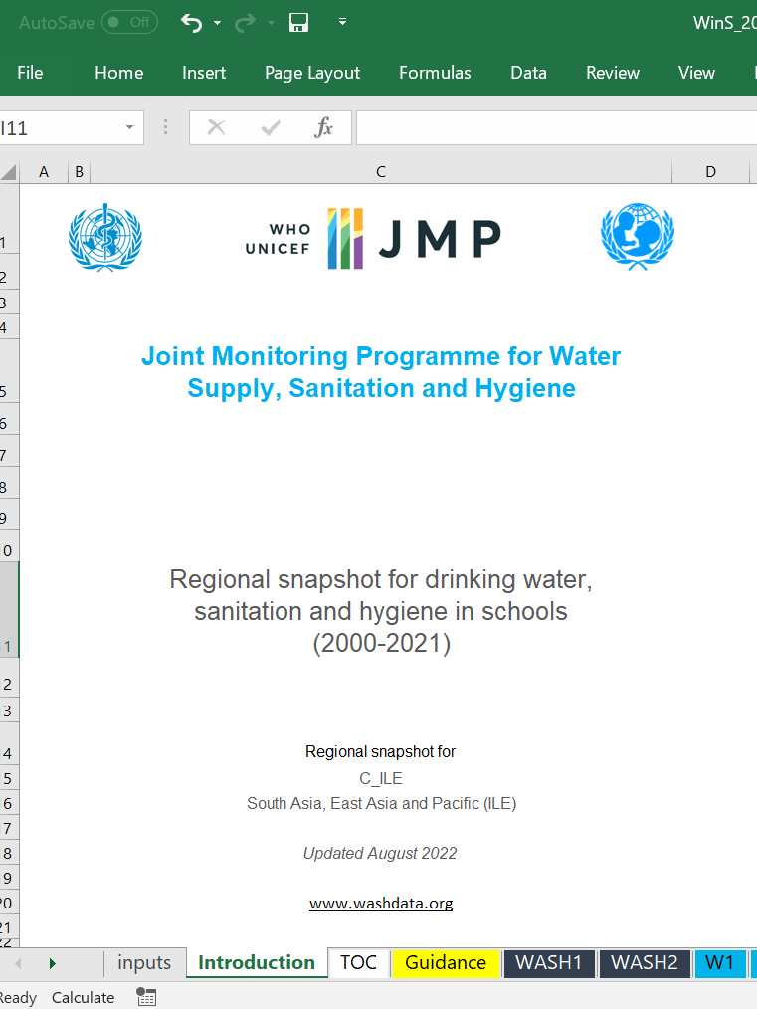
Resources for data analysis
All these resources can be found here:
All elements of WASH in schools
Disabilities
MHH
https://washdata.org/monitoring/wash-schools/excel
https://www.unicef.org/media/114921/file/WASH%20Disability%20Toolkit.pdf
https://washdata.org/sites/default/files/2020-11/UNICEF-2020-guidance-monitoring-MHH-v1.pdf
https://www.publichealth.columbia.edu/sites/default/files/priority_list_of_indicators_for_girls_menstrual_health_and_hygiene-_technical_guidance_for_national_monitoring.pdf
Customizable regional snapshot for countries participating in the ILE
https://washdata.org/sites/default/files/2022-07/jmp-2022-wins-data-update.pdf
Notes:
Add snapshots, side events, add to ILE page. QR code on screen?

Slide 34
Checklist for national monitoring of the SDGs for WinS
Core questions are included in a national system (e.g. EMIS)
Some advanced questions are included (if appropriate)
Core (and advanced) data are analysed, including disaggregation
Core (and advanced) data are reported to local, national & global levels
Notes:
Not just in the questionnaire but analyzed and reported, including local and global levels

Slide 35
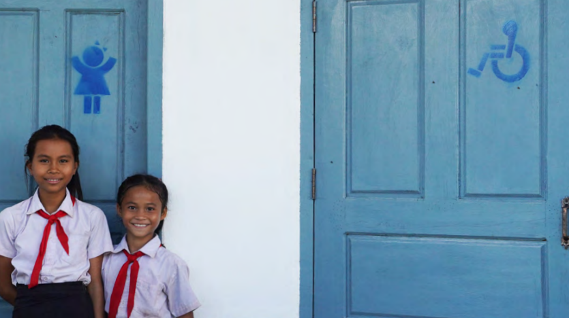
Thank you!
info@washdata.org
Slides and resources can be downloaded here:

Slide 36
Monitoring basic and inclusive WinS: global guidance and cross-country sharing
9th ILE on WinS, 2022
09:00 Introductions and session overview
09:10 Global recommendations and resources – WHO/UNICEF JMP
09:35 Cross-country discussion on day 2 preparation – breakout groups (3-4 countries)
09:50 Wrap-up
09:00 Session overview
09:10 Cross-country sharing on data collection, reporting, and usage – breakout groups (3-4 countries)
10:20 Groups share 3 key take-aways with plenary
10:50 Wrap-up
Tuesday 13 September (times are GMT+7 / Bangkok time)
Tuesday 20 September (times are GMT+7 / Bangkok time)

Slide 37
Preparation for Day 2
Review the Excel resource: https://washdata.org/monitoring/wash-schools/excel
Gather information and examples for how your country collects, analyses, and reports WinS data
Prepare a brief presentation (4 minutes MAX) to share with your group, using the PowerPoint template: https://washdata.org/monitoring/wash-schools/wins-ile/template
Please note: the JMP would like to share your presentation slides on the JMP website ILE page if you agree

Slide 38
Download the presentation template
https://washdata.org/monitoring/wash-schools/wins-ile/template
Or click the last link on the webpage accessed through this QR code:

Slide 39
Cross-country sharing – day 2 preparation
As a group, review the PowerPoint template:
Are there questions or concerns?
Where / How will you find the information needed to complete the template?
Does everyone in the group have a clear idea of what to present next week?

Slide 40
Move to breakout groups
Group A | Group B | Group C | Group D | Group E | Group F

Slide 41
Monitoring basic and inclusive WinS: global guidance and cross-country sharing
9th ILE on WinS, 2022
09:00 Introductions and session overview
09:10 Global recommendations and resources – WHO/UNICEF JMP
09:35 Cross-country discussion on day 2 preparation – breakout groups (3-4 countries)
09:50 Wrap-up
09:00 Session overview
09:10 Cross-country sharing on data collection, reporting, and usage – breakout groups (3-4 countries)
10:20 Groups share 3 key take-aways with plenary
10:50 Wrap-up
Tuesday 13 September (times are GMT+7 / Bangkok time)
Tuesday 20 September (times are GMT+7 / Bangkok time)

Slide 42
Preparation for Day 2 – Re-cap
Review the Excel resource: https://washdata.org/monitoring/wash-schools/excel
Gather information and examples for how your country collects, analyses, and reports WinS data
Prepare a brief presentation (4 minutes MAX) to share with your group, using the PowerPoint template: https://washdata.org/monitoring/wash-schools/wins-ile/template
Please note: the JMP would like to share your presentation slides on the JMP website ILE page if you agree

Slide 43
Thank you!
info@washdata.org
Slides and resources can be downloaded here:

Slide 44
Please change your name on Zoom to include your country delegation
Welcome to day 2 of the JMP side session on monitoring basic and inclusive WinS at the 2022 ILE
Please re-introduce yourself in the chatbox

Slide 45
Monitoring basic and inclusive WinS: global guidance and cross-country sharing
9th ILE on WinS, 2022
09:00 Introductions and session overview
09:10 Global recommendations and resources – WHO/UNICEF JMP
09:35 Cross-country discussion on day 2 preparation – breakout groups (3-4 countries)
09:50 Wrap-up
09:00 Session overview
09:10 Cross-country sharing on data collection, reporting, and usage – breakout groups (3-4 countries)
10:20 Groups share 3 key take-aways with plenary
10:50 Wrap-up
Tuesday 13 September (times are GMT+7 / Bangkok time)
Tuesday 20 September (times are GMT+7 / Bangkok time)

Slide 46
Monitoring basic and inclusive WinS: global guidance and cross-country sharing
9th ILE on WinS, 2022
09:00 Introductions and session overview
09:10 Global recommendations and resources – WHO/UNICEF JMP
09:35 Cross-country discussion on day 2 preparation – breakout groups (3-4 countries)
09:50 Wrap-up
09:00 Session overview
09:10 Cross-country sharing on data collection, reporting, and usage – breakout groups
10:20 Groups share 3 key take-aways with plenary
10:50 Wrap-up
Tuesday 13 September (times are GMT+7 / Bangkok time)
Tuesday 20 September (times are GMT+7 / Bangkok time)

Slide 47
Cross-country sharing (70 minutes)
Each country presents their PowerPoint slides using the template (4 min each)
What national WinS data are available in your country?
How does your country collect WinS data?
How does your country analyse WinS data?
How does your country report and use WinS data?
What is an example of a WinS monitoring success in your country?
What is an example of a WinS monitoring challenge in your country?
Share ideas across countries for how to improve WinS monitoring based on the presentations shared (15 min focusing on each country)
Agree on 3 key take-away messages to share with the plenary (15 min)

Slide 48
Move to breakout groups
Group A | Group B | Group C | Group D | Group E | Group F

Slide 49
Monitoring basic and inclusive WinS: global guidance and cross-country sharing
9th ILE on WinS, 2022
09:00 Introductions and session overview
09:10 Global recommendations and resources – WHO/UNICEF JMP
09:35 Cross-country discussion on day 2 preparation – breakout groups (3-4 countries)
09:50 Wrap-up
09:00 Session overview
09:10 Cross-country sharing on data collection, reporting, and usage – breakout groups (3-4 countries)
10:20 Groups share 3 key take-aways with plenary
10:50 Wrap-up
Tuesday 13 September (times are GMT+7 / Bangkok time)
Tuesday 20 September (times are GMT+7 / Bangkok time)

Slide 50
Monitoring basic and inclusive WinS: global guidance and cross-country sharing
9th ILE on WinS, 2022
09:00 Introductions and session overview
09:10 Global recommendations and resources – WHO/UNICEF JMP
09:35 Cross-country discussion on day 2 preparation – breakout groups (3-4 countries)
09:50 Wrap-up
09:00 Session overview
09:10 Cross-country sharing on data collection, reporting, and usage – breakout groups (3-4 countries)
10:20 Groups share 3 key take-aways with plenary
10:50 Wrap-up
Tuesday 13 September (times are GMT+7 / Bangkok time)
Tuesday 20 September (times are GMT+7 / Bangkok time)

Slide 51
Wrap up
Thank you to all country delegations for sharing their examples, successes and challenges!
Please tell us in the chatbox what other tools or support might be helpful going forward.

Slide 52
Thank you!
info@washdata.org
Slides and resources can be downloaded here:

